Slide 1

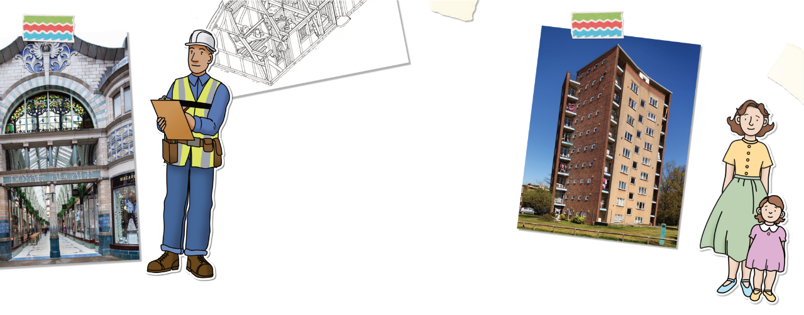


Street Spotters

Slide 2
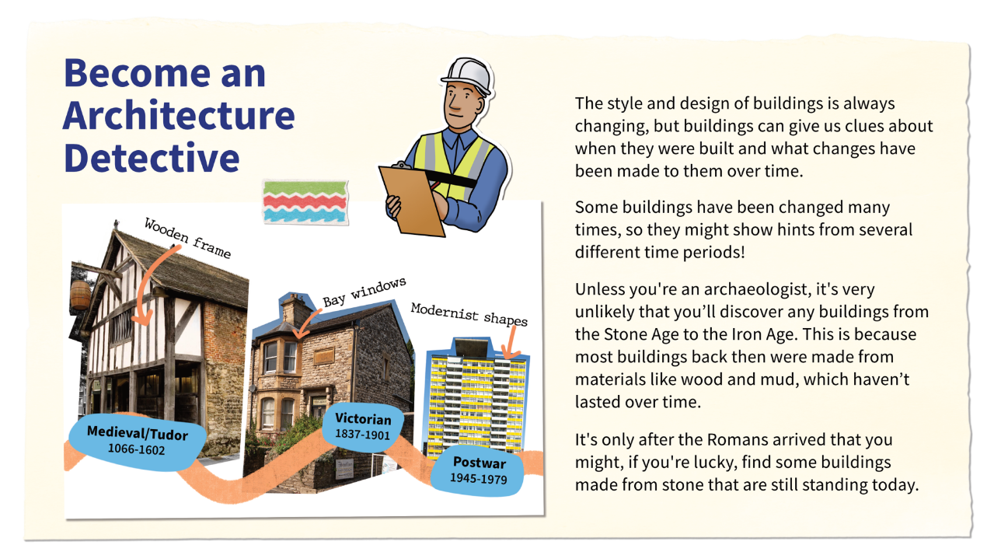
Become an architecture detective

Slide 3
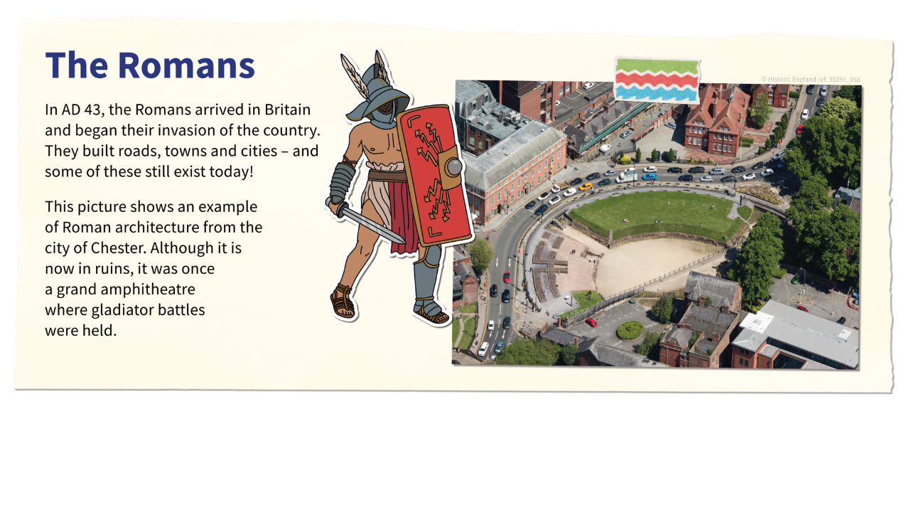
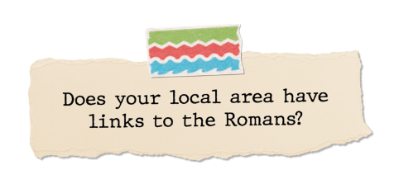


The Romans

Slide 4

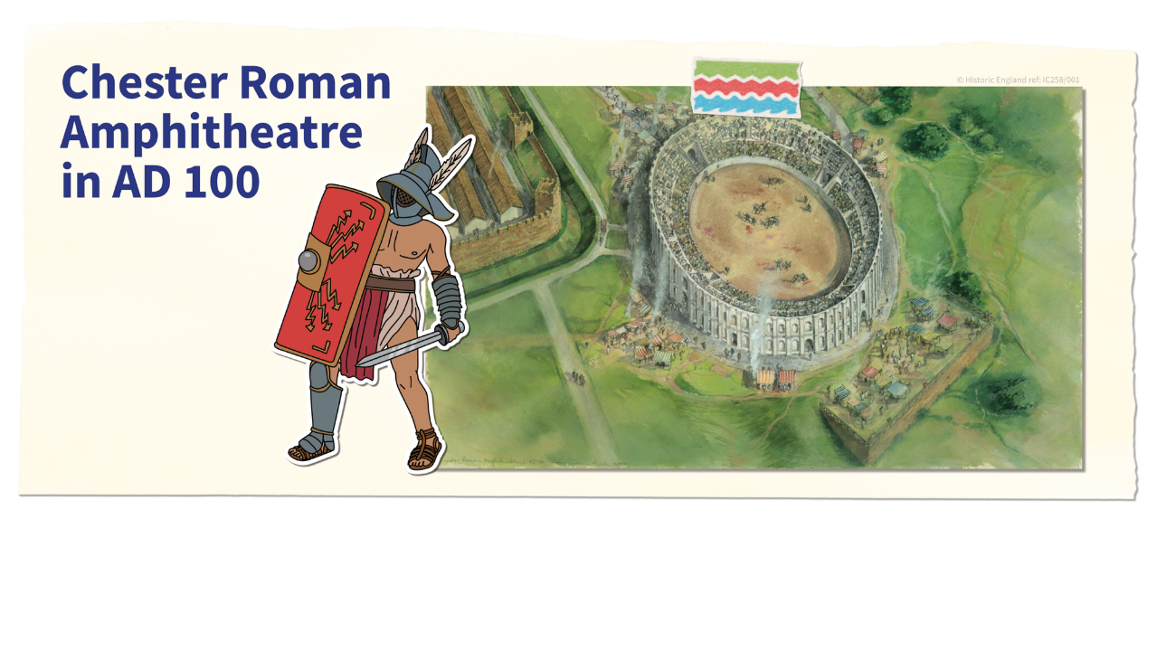

Chester Roman Amphitheatre

Slide 5
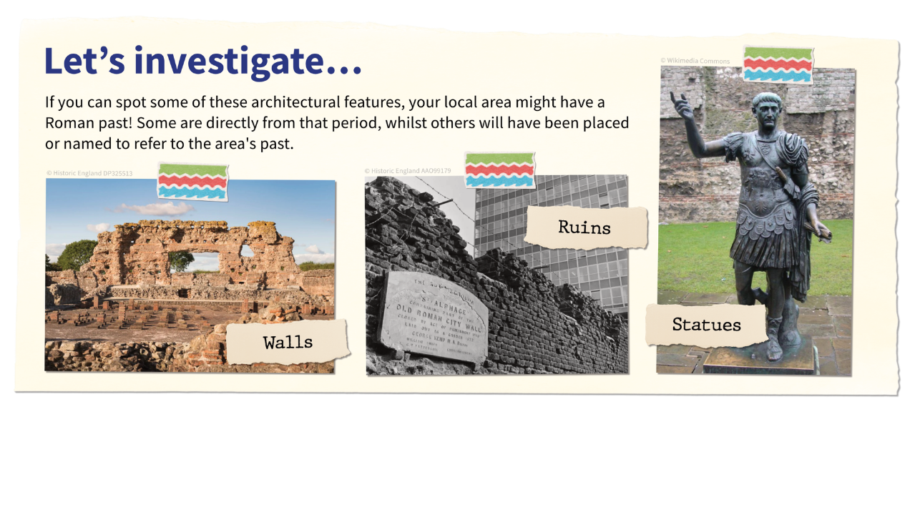
Let’s investiage the Romans

Slide 6
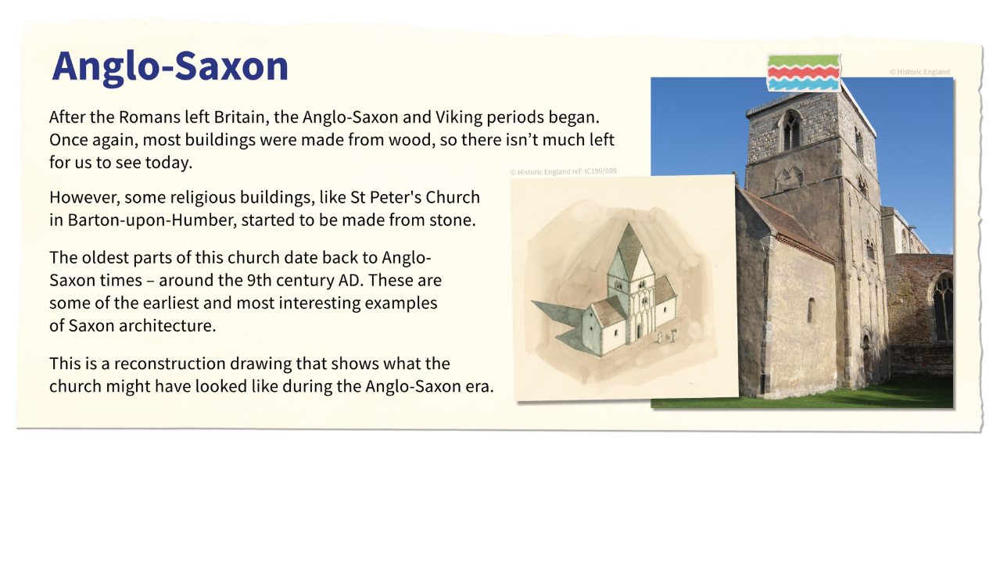


Anglo-Saxon

Slide 7
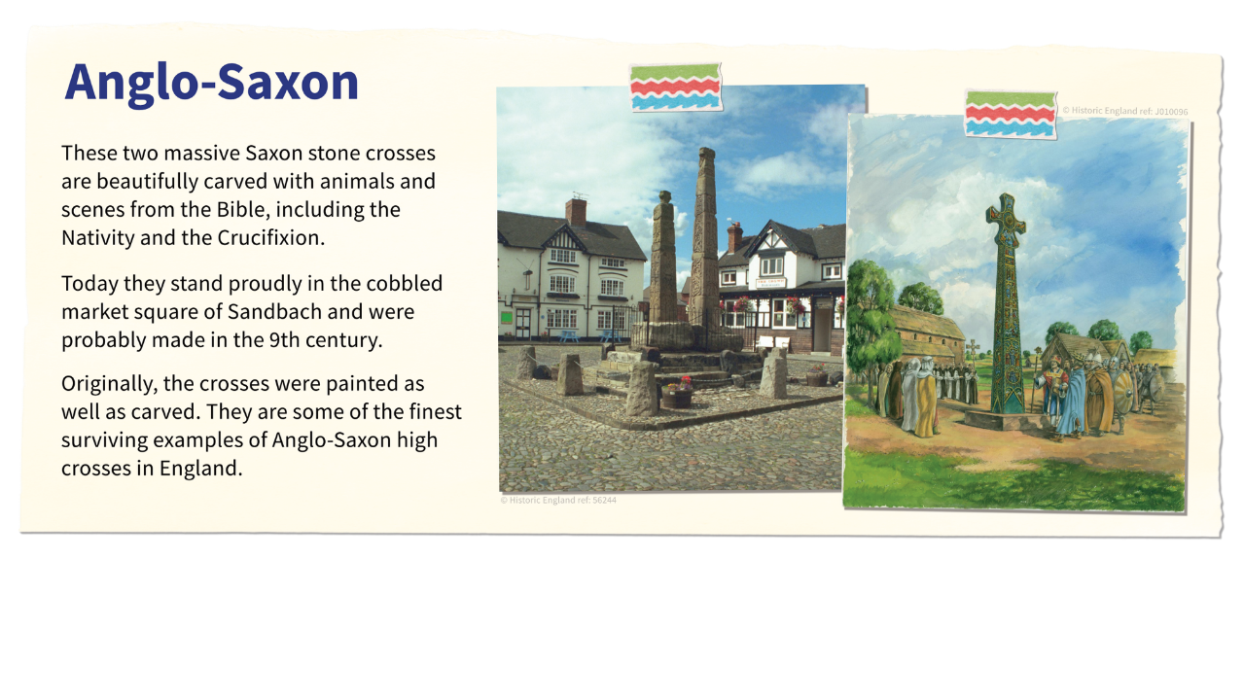
Anglo-Saxon crosses

Slide 8
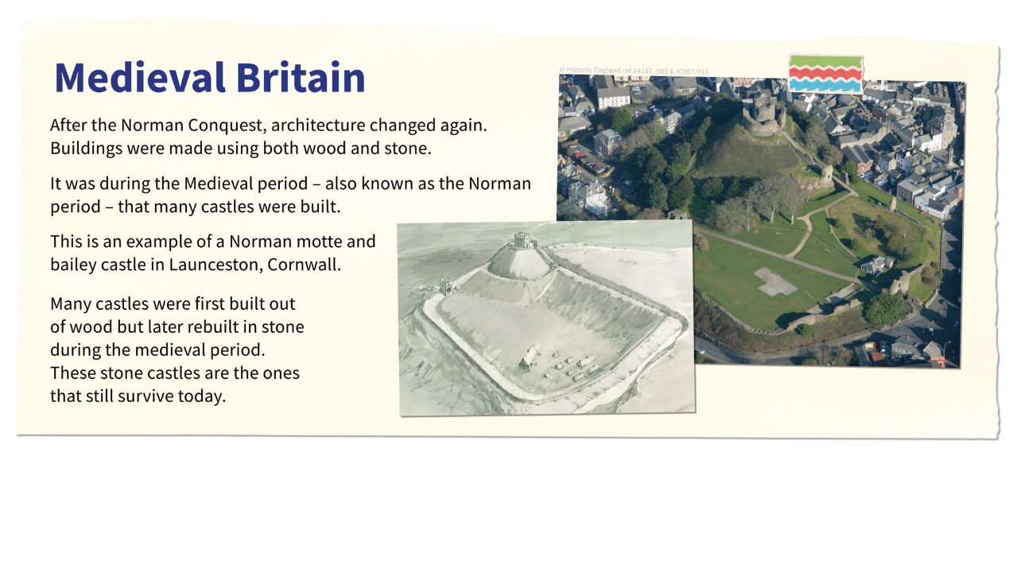
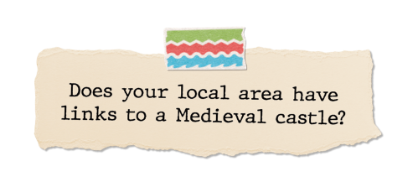


Medieval Britain - Castles

Slide 9
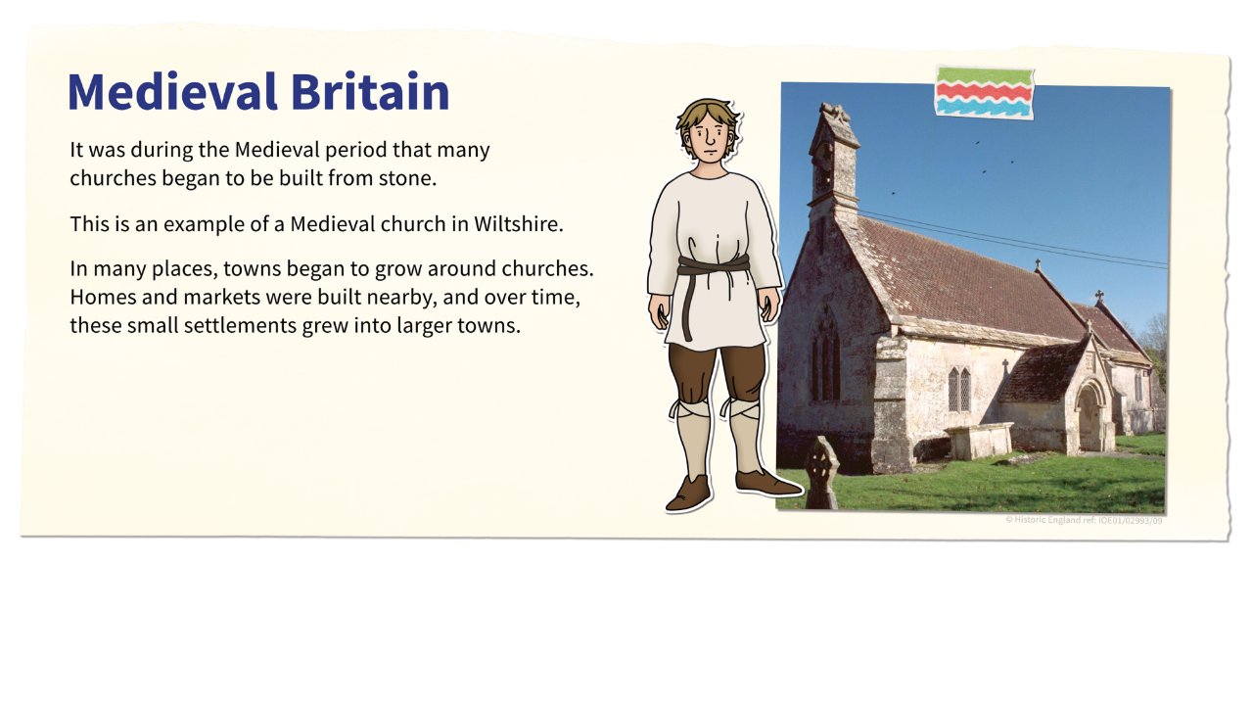

Medieval Britain - Churches

Slide 10
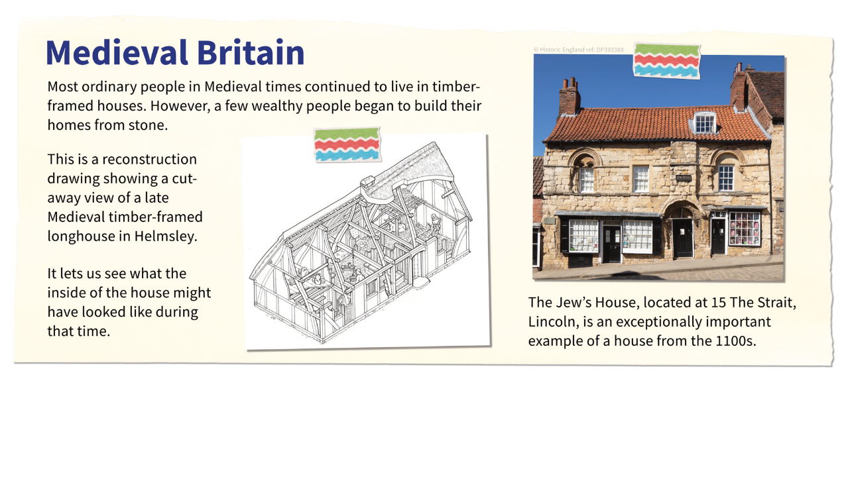
Medieval Britain - Houses

Slide 11
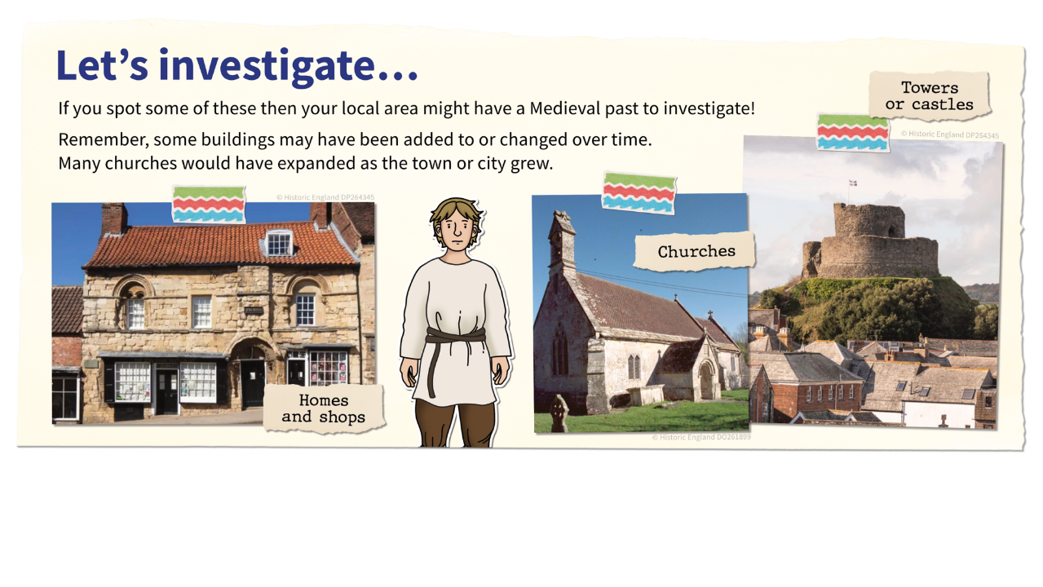
Let’s investigate Medieval buildings

Slide 12
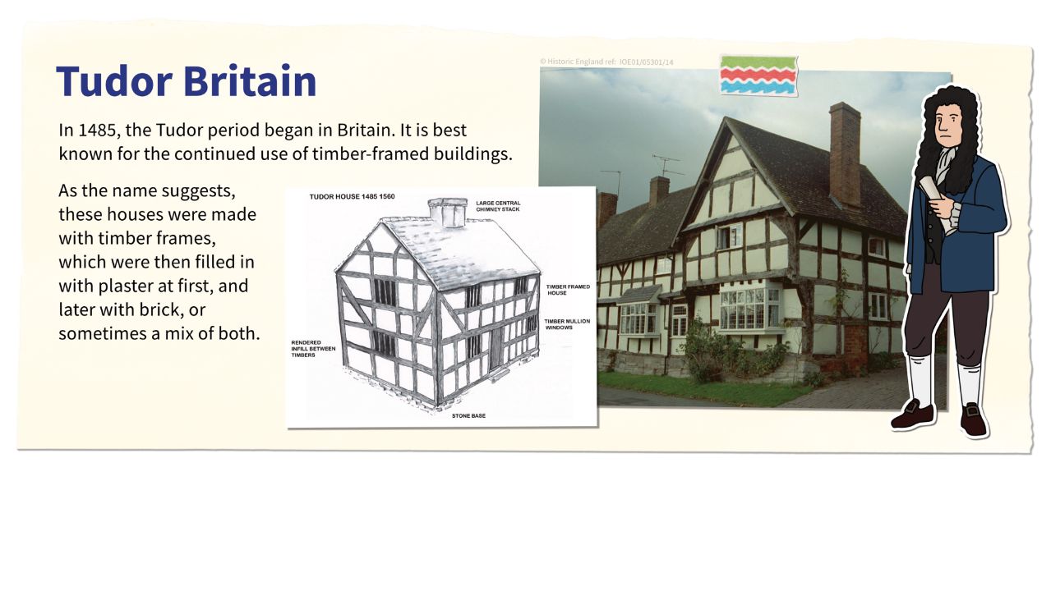


Tudor Britain – part 1

Slide 13
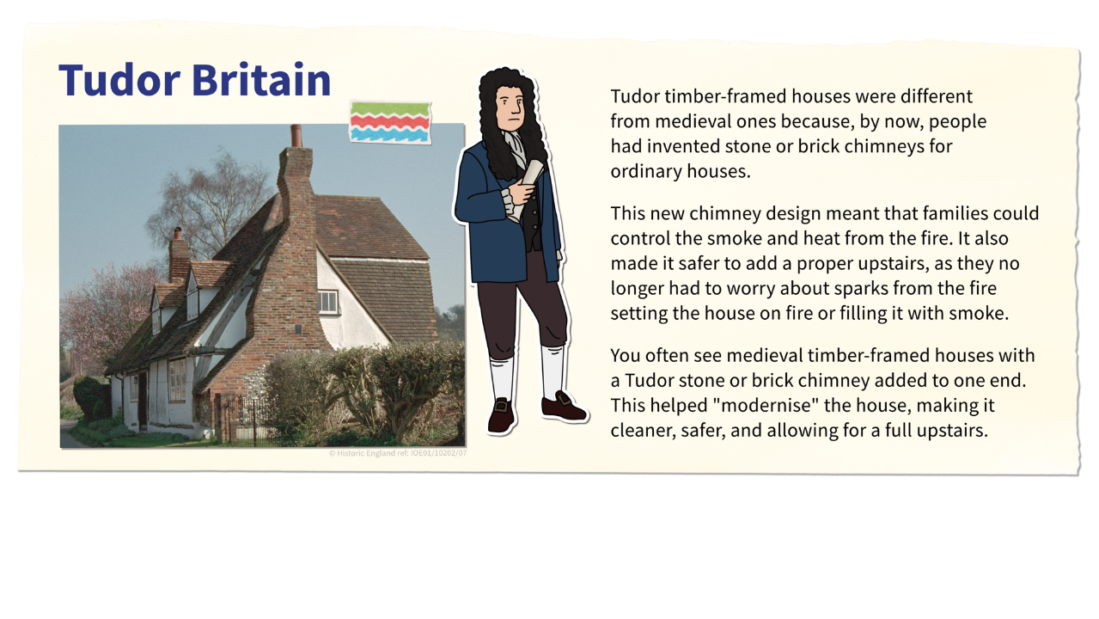
Tudor Chimneys

Slide 14
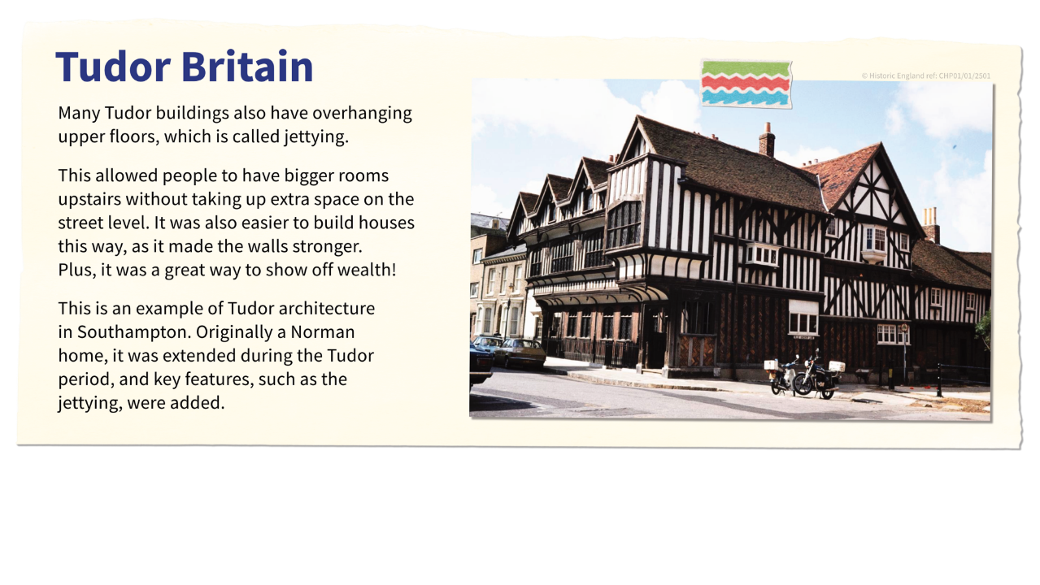

Tudor Jettying

Slide 15
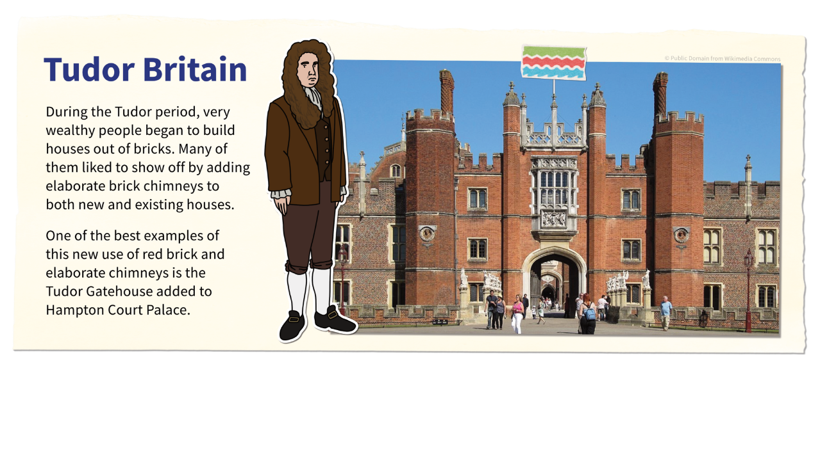
Tudor Brick

Slide 16
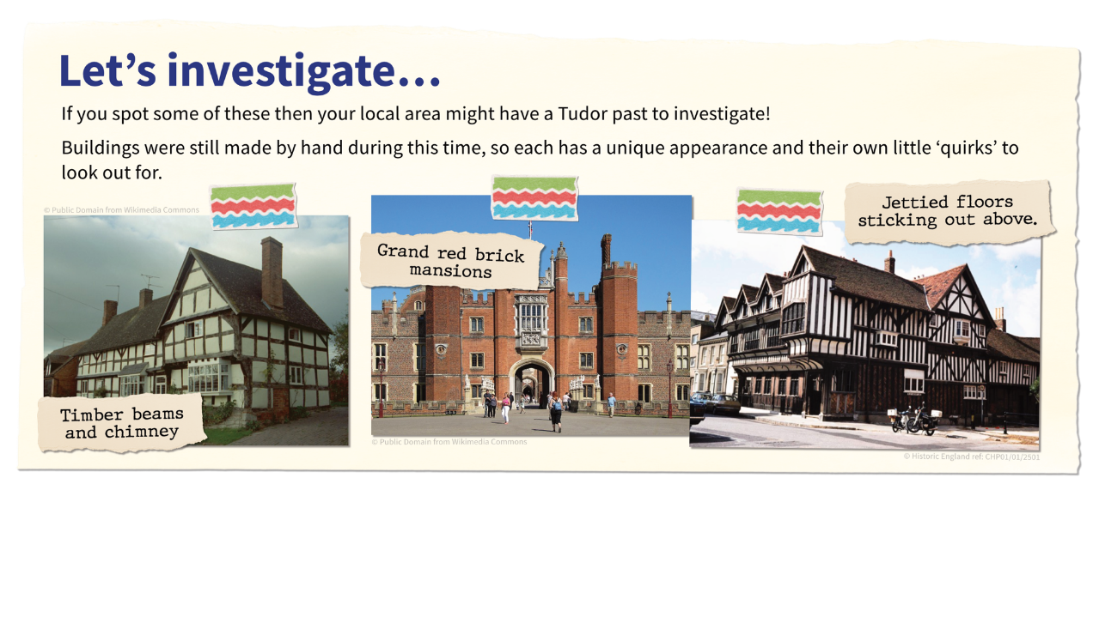
Let’s investigate Tudor buildings

Slide 17
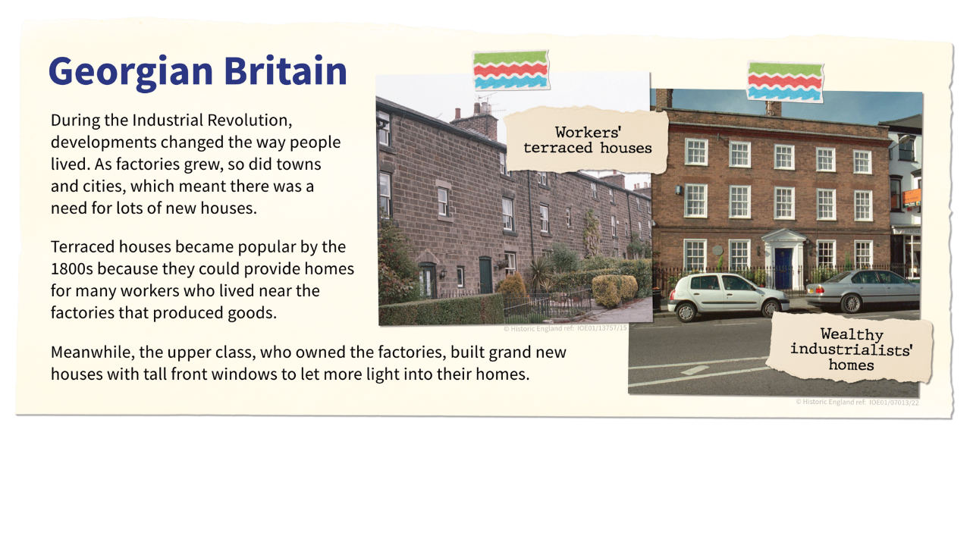


Georgian Britain

Slide 18
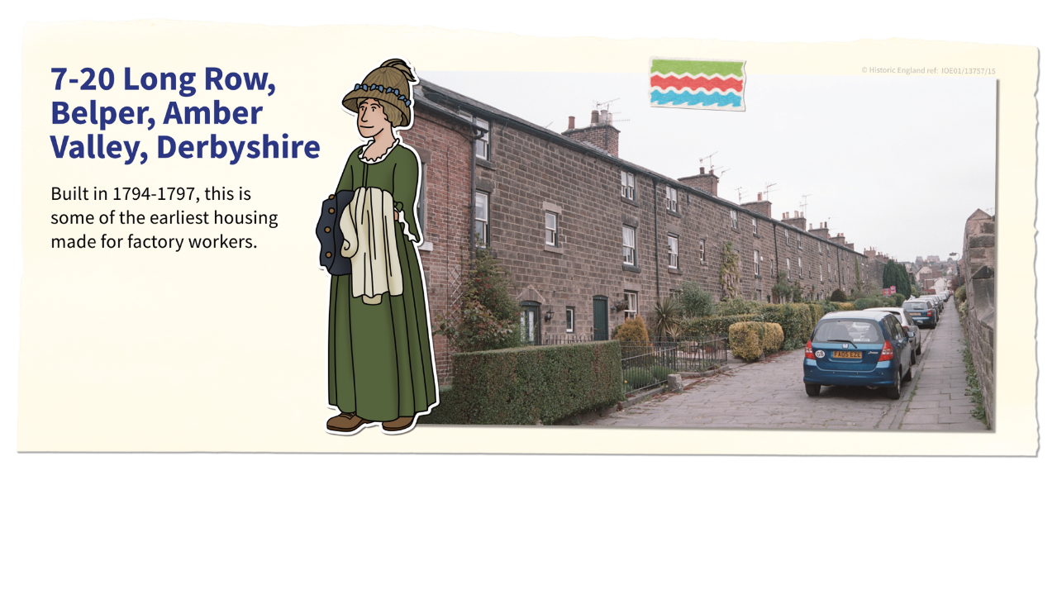
Georgian Workers’ Housing​

Slide 19
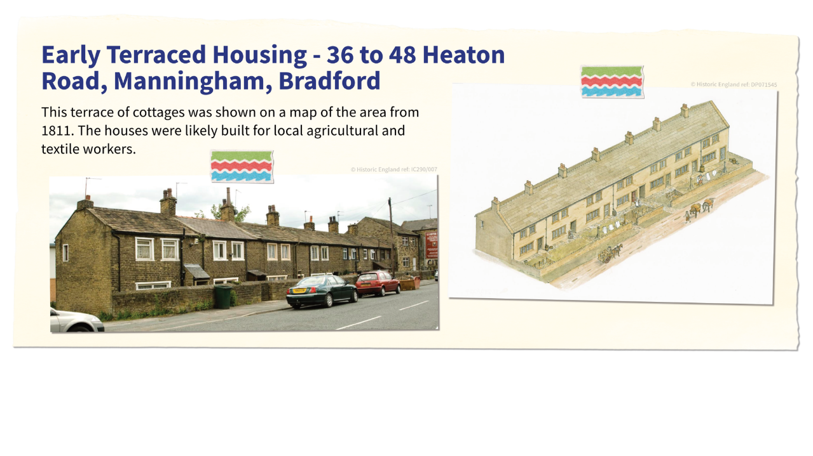
Early Terraced Housing

Slide 20
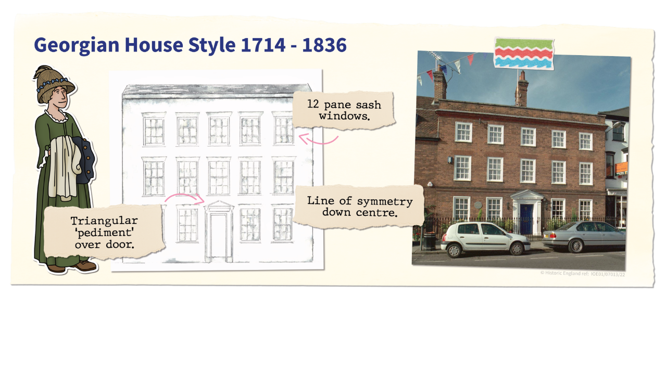
Georgian House Style 1714 - 1836

Slide 21
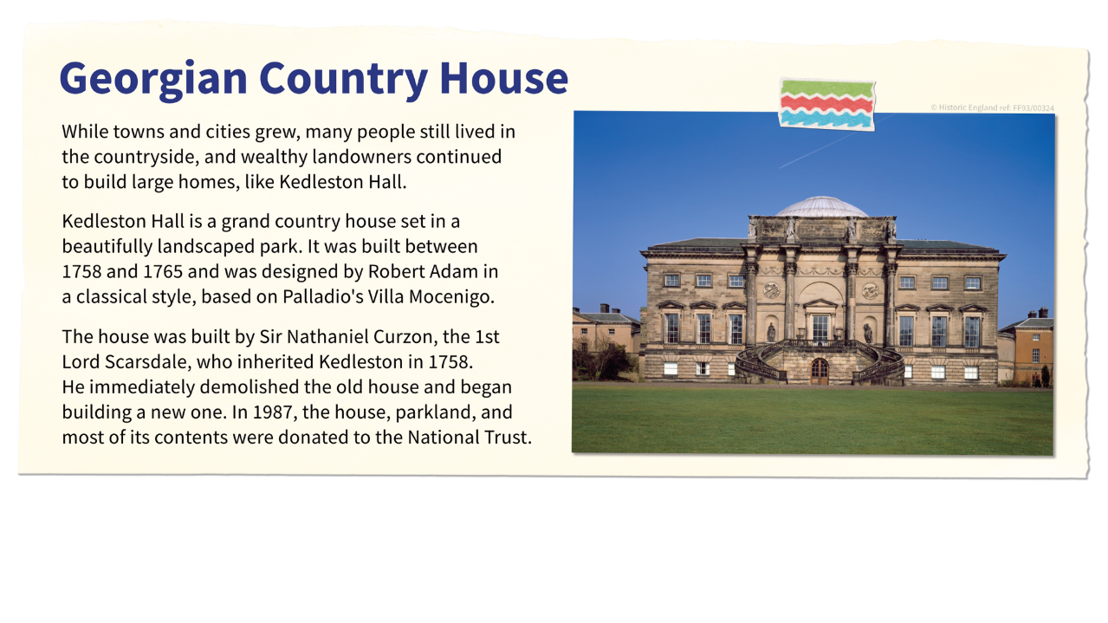
Georgian Country Houses

Slide 22
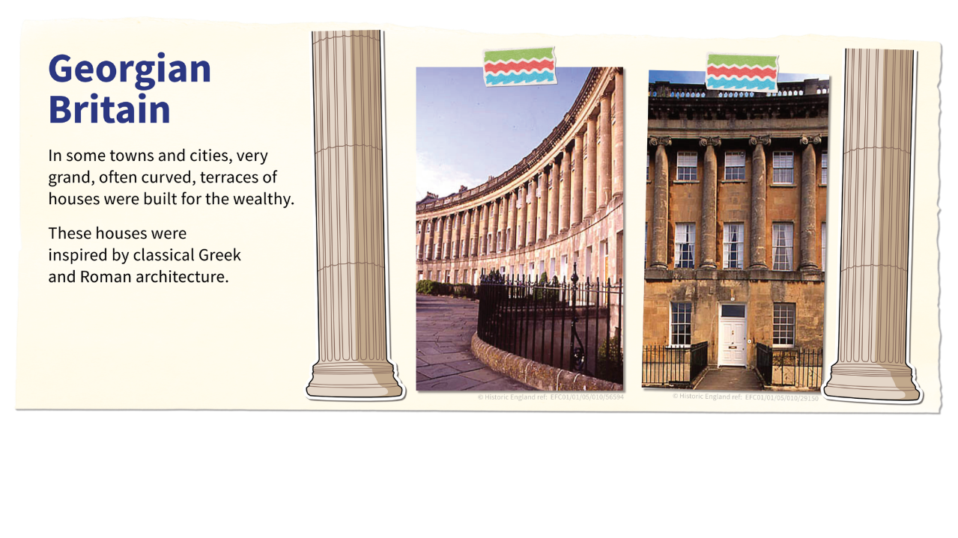
Georgian curved terraces

Slide 23
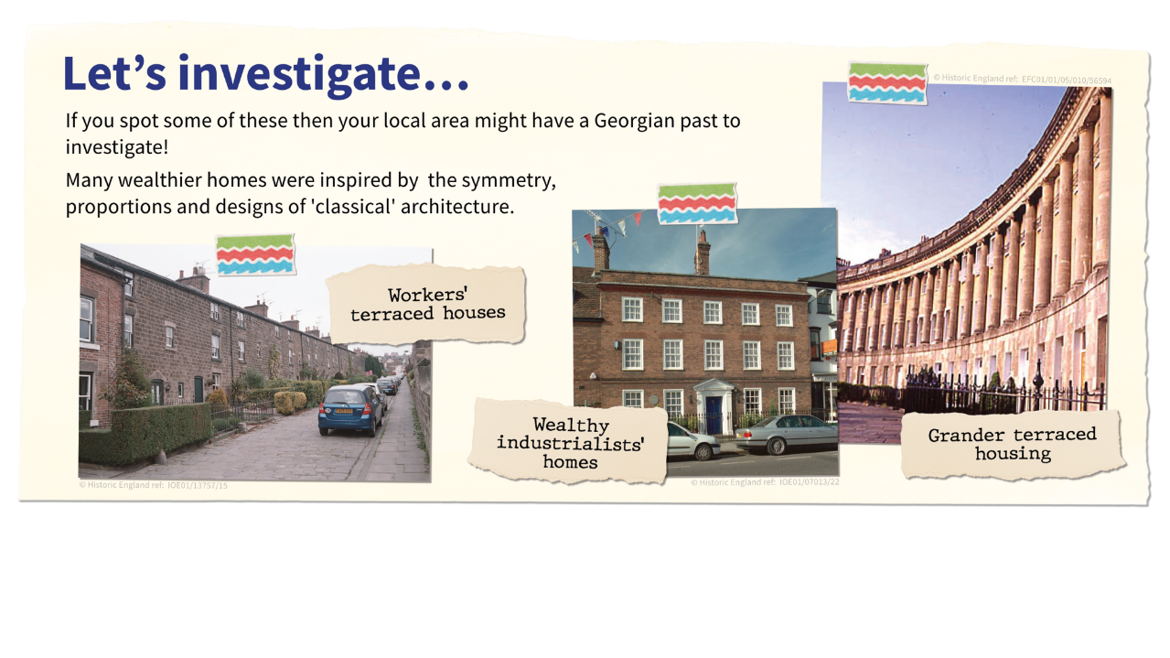
Let’s investigate Georgian houses

Slide 24
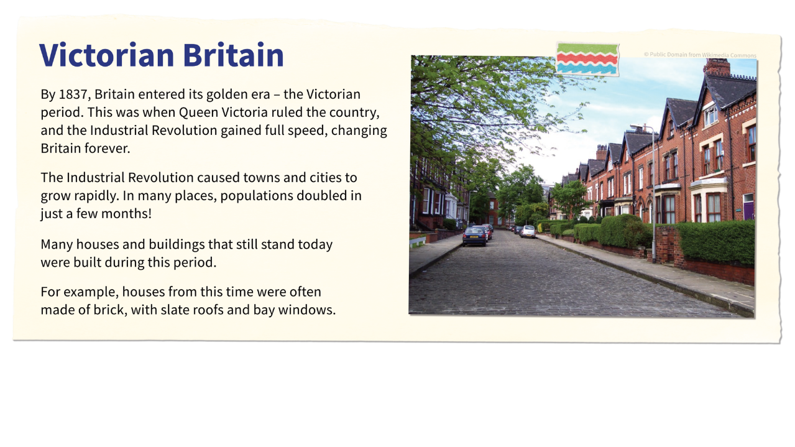
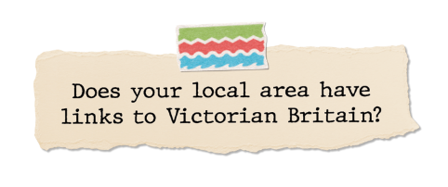


Victorian Britain

Slide 25
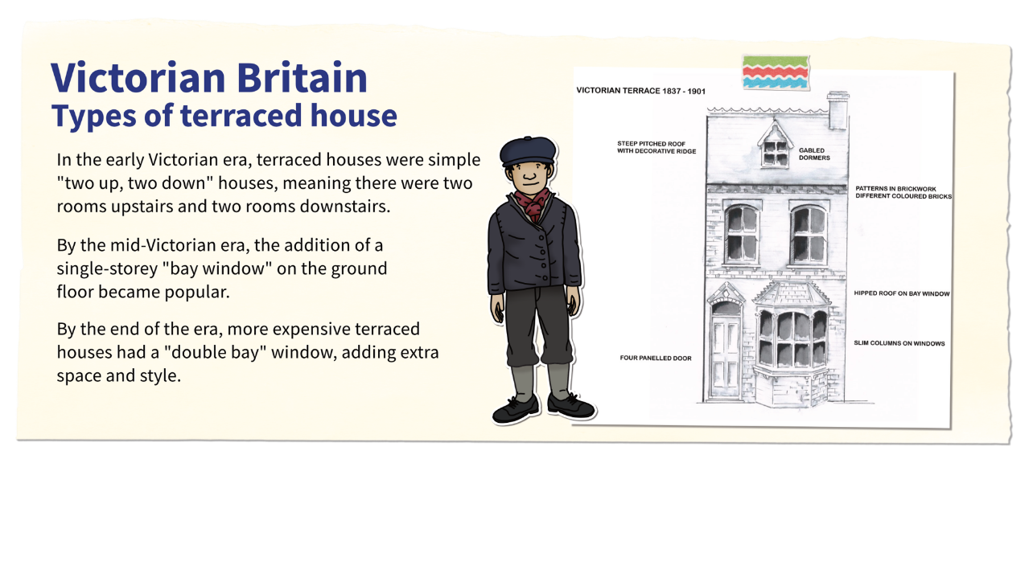
Types of Victorian Terraced House

Slide 26
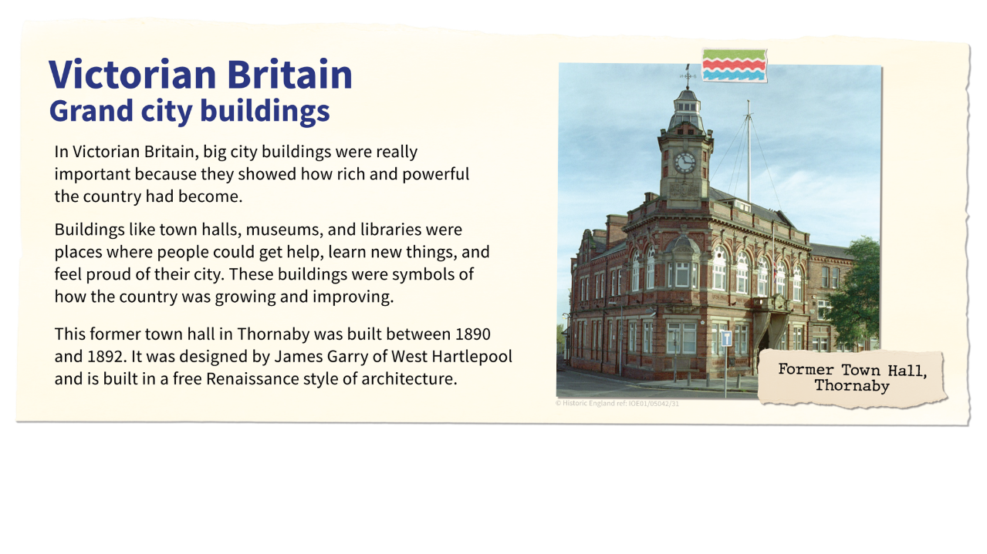
Victorian Grand city buildings

Slide 27
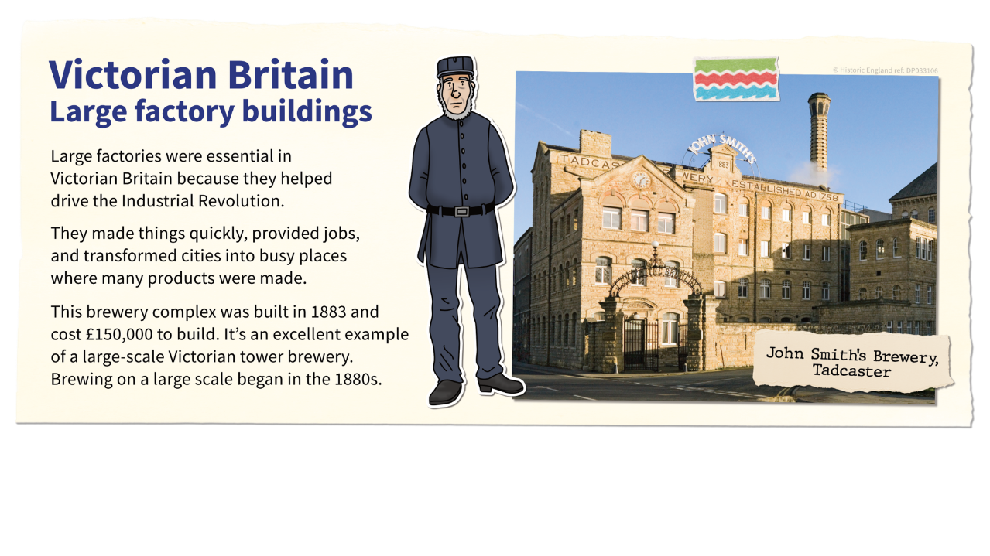
Victorian Large factory buildings

Slide 28
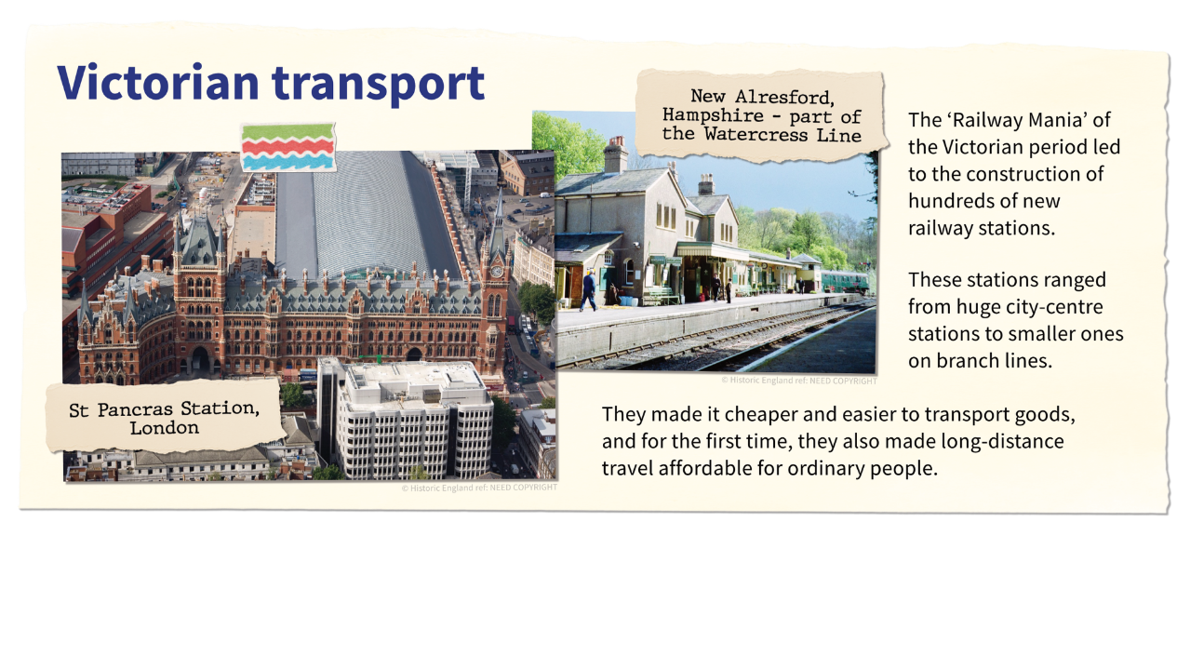
Victorian Transport

Slide 29
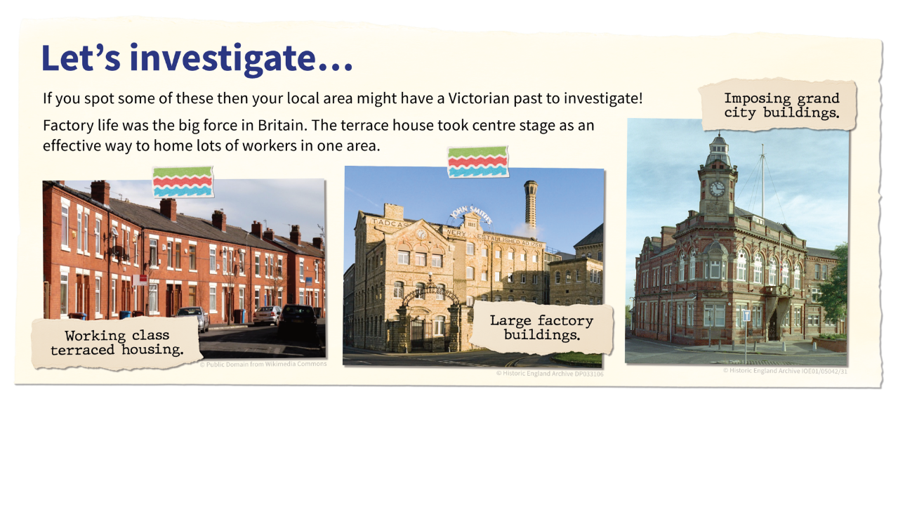
Let’s investigate Victorian buildings

Slide 30
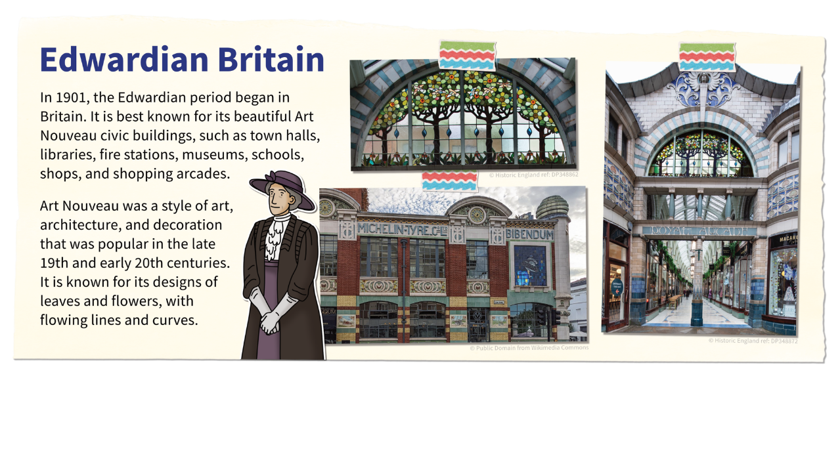


Edwardian Britain

Slide 31
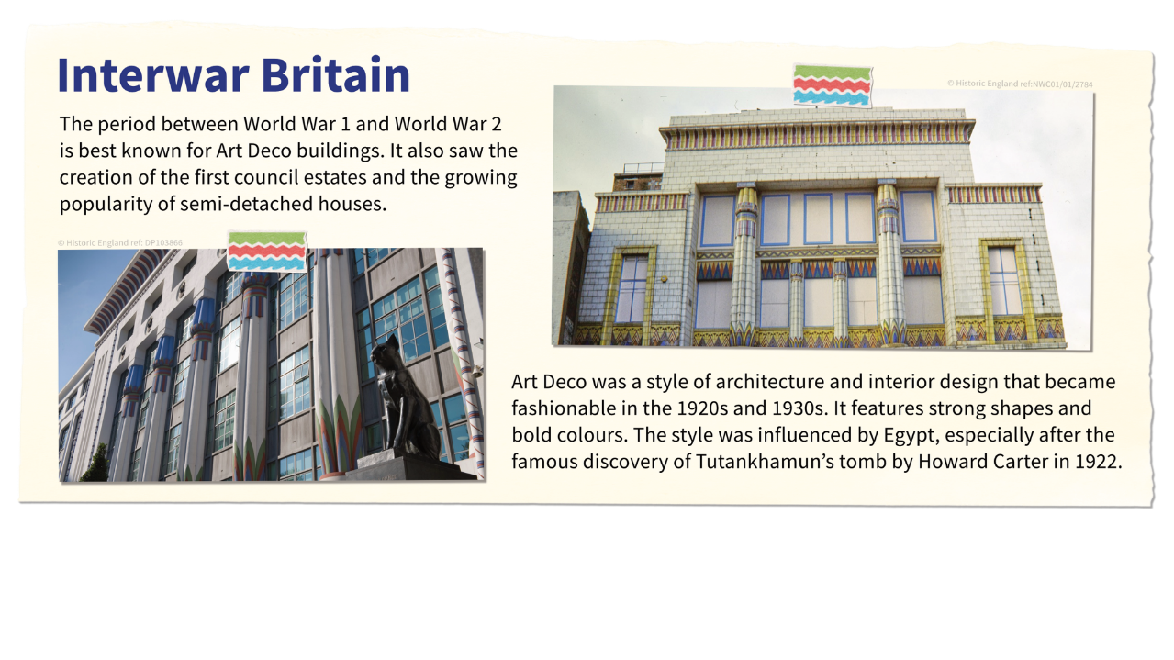


Interwar Britain – Art Deco

Slide 32
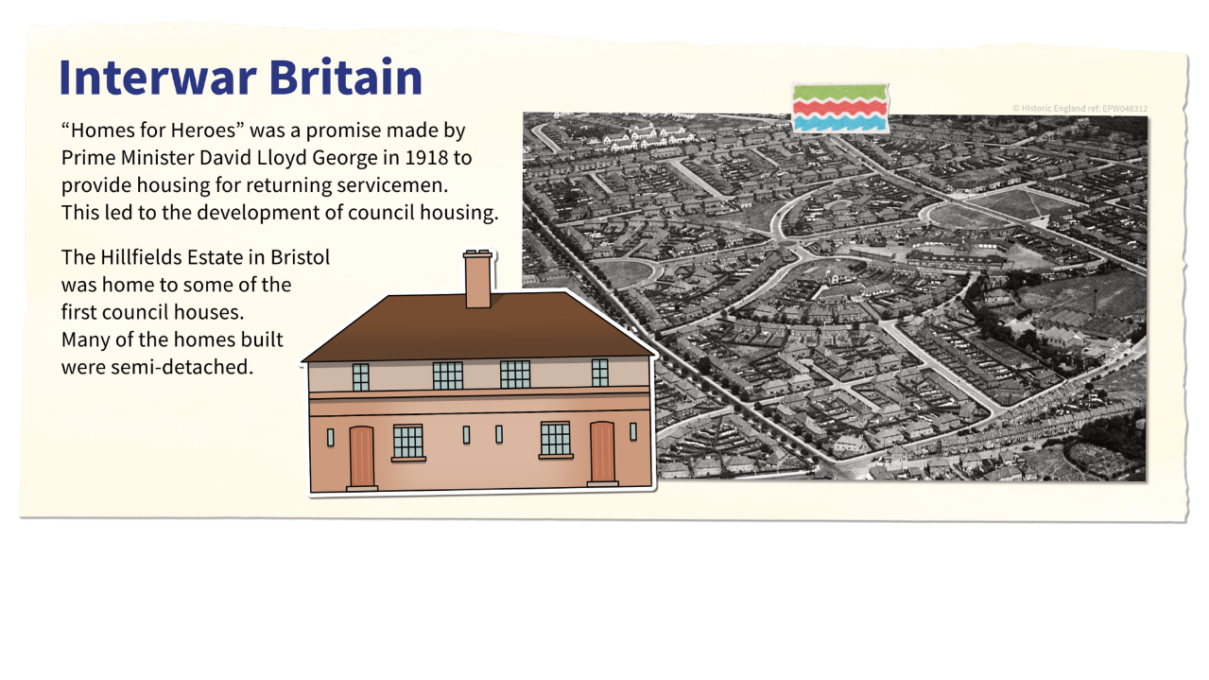
Interwar Britain – Semis

Slide 33
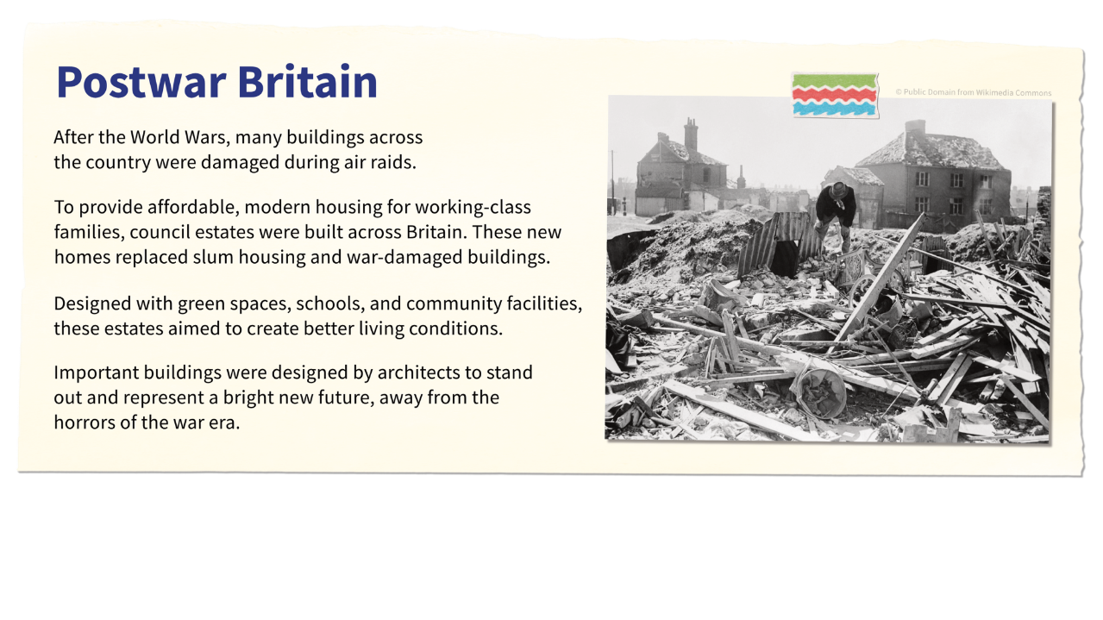
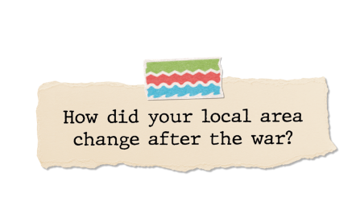
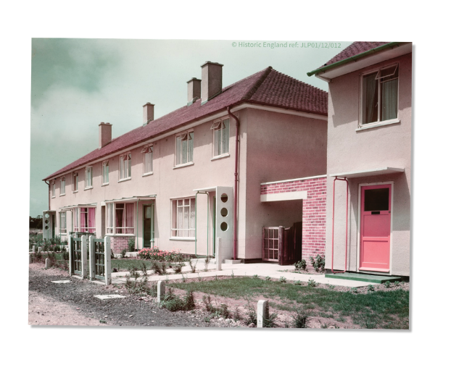

Postwar Britain
​

Slide 34
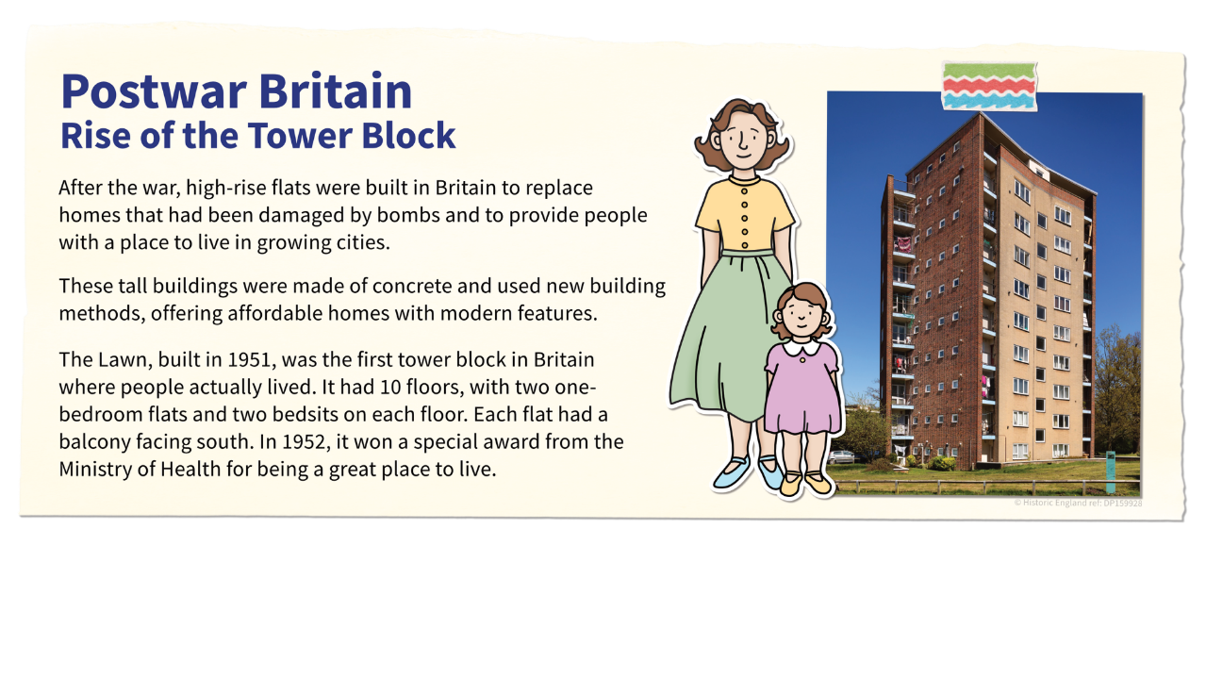
Postwar Tower Blocks

Slide 35
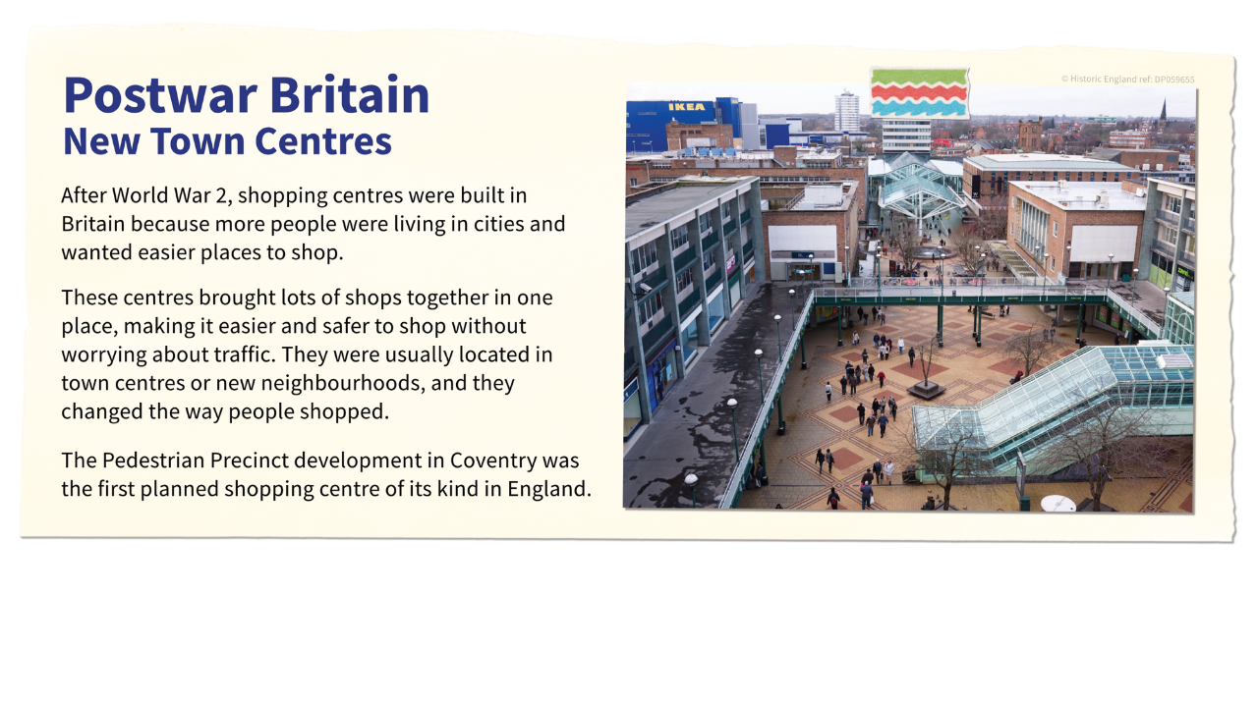
Postwar New Town Centres

Slide 36
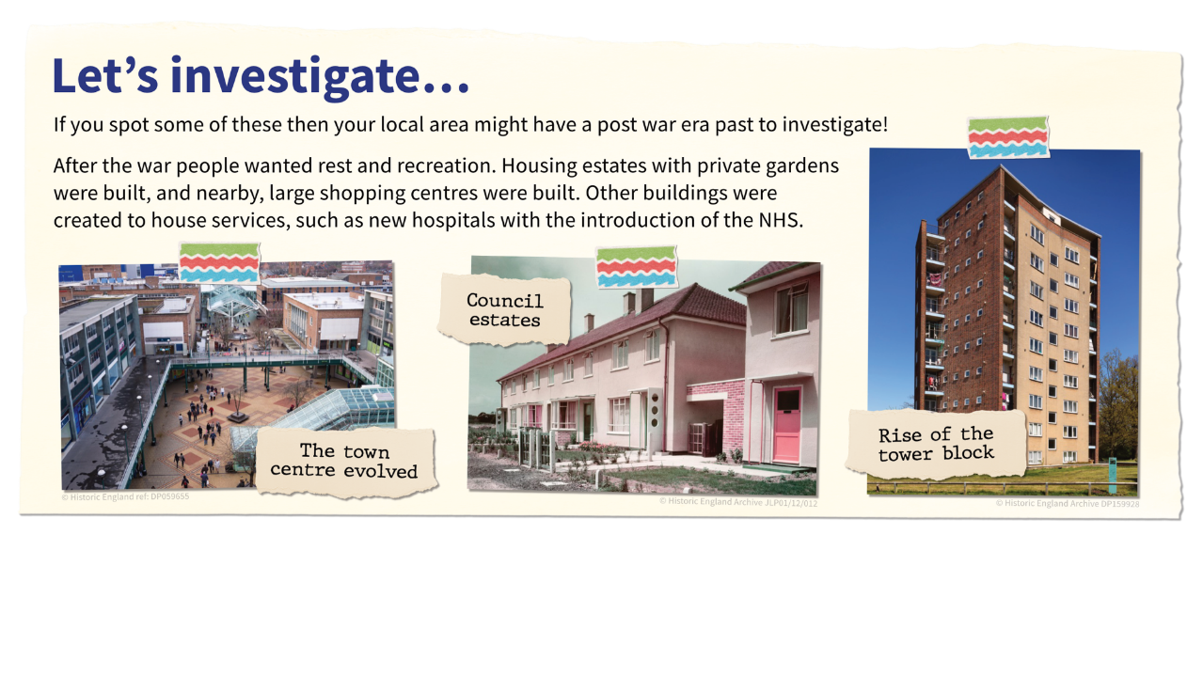
Let’s investigate Postwar buildings

Slide 37
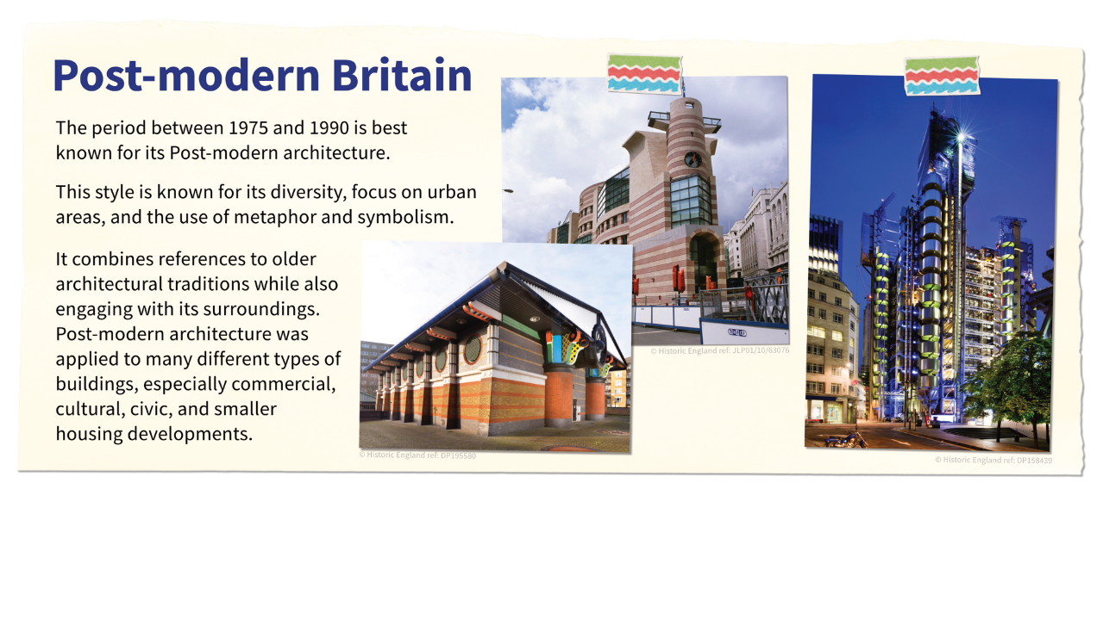


Post-modern Britain

Slide 38
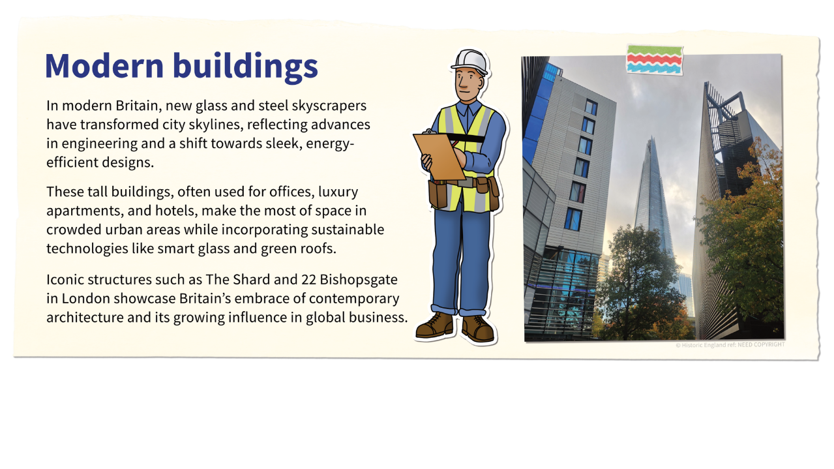

Modern (contemporary) buildings

Slide 39
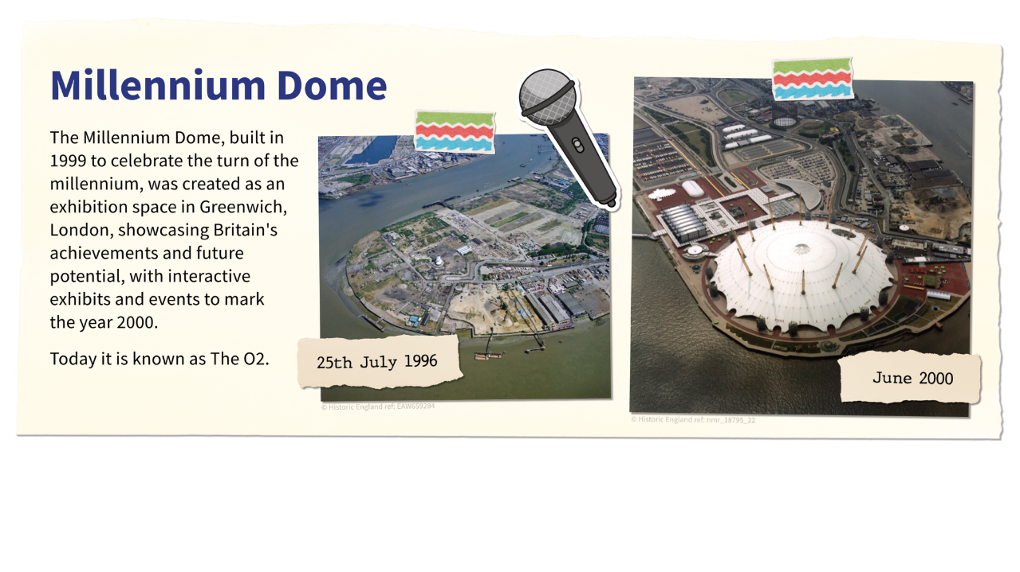
Millennium Dome

Slide 40
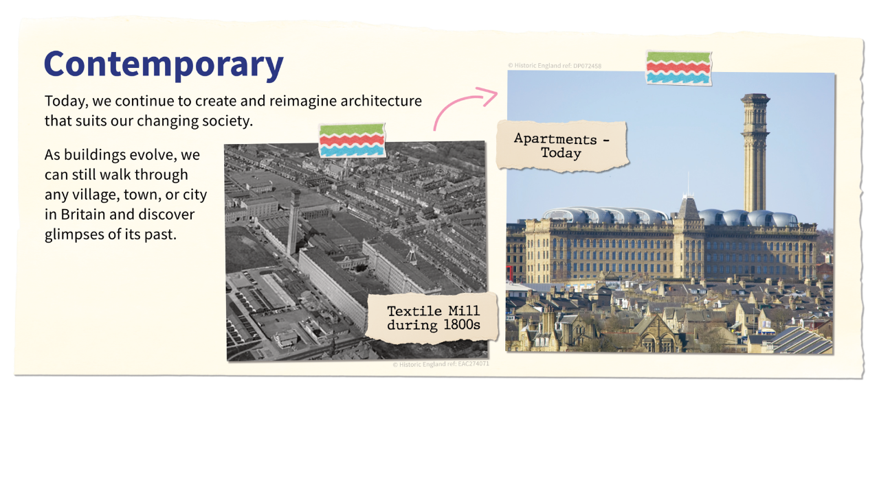

Contemporary re-use of older buildings

