Slide 1
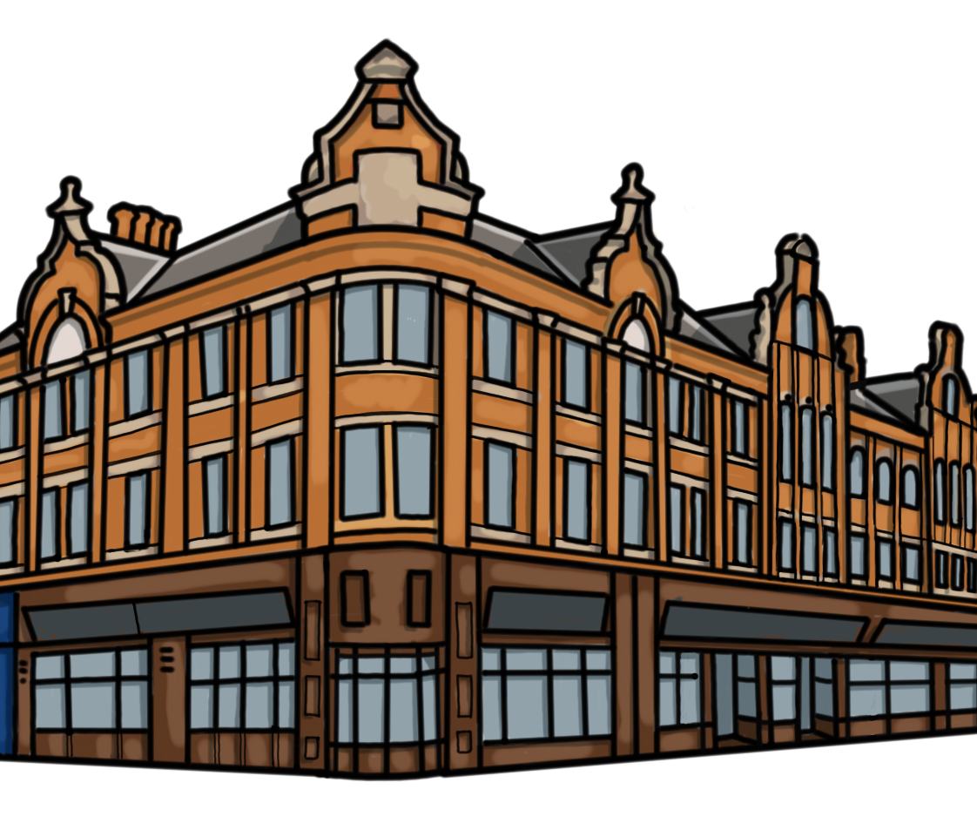
What can Barrow’s buildings tell us about the story of our town?
Additional Activities PPT

Slide 2
What can Barrow’s buildings tell us about the story of our town?
Key Stage 2
To develop pupils’ knowledge of significant places, people, events and themes in Barrow’s history.
To support pupils in using the built historic environment as historical evidence to find out about an area in the past
To build pupils’ sense of place and pride in their local area.

Slide 3
How to use this PPT (1)
This PowerPoint is part of the learning resource: What can Barrow’s buildings tell us about the story of our town? Teachers should use this PPT, after they have taken pupils on the history trail of the same name.
In the first part of this PPT, teachers will find a recap of the information about each site, followed by suggested activities which will allow pupils to explore each site on the trail in greater depth. There are suggested in class activities and suggested enrichment activities, which can be carried out by pupils with their families.
Introductory PPT
Heritage trail route map and script for teachers
Heritage trail worksheet for pupils
Recap and Reflect PPT
Colour and cut activity sheets PDF

Slide 4
How to use this PPT (2)
At the end of this PPT are a number of additional activities which will allow pupils to gain an overview of the sites as a whole and the themes explored in the trail. They will also develop pupils’ disciplinary skills, such as causation, chronological understanding and similarity and difference
The activity suggestions in this PPT are a starting point only. Teachers are encouraged to use the website links provided, as well as their own research and planning, to further develop these ideas into teaching activities.
Introductory PPT
Heritage trail route map and script for teachers
Heritage trail worksheet for pupils
Recap and Reflect PPT
Colour and cut activity sheets PDF

Slide 5
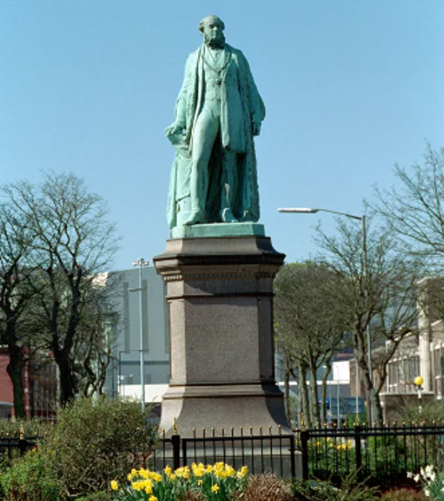
James Ramsden Statue
James Ramsden moved to Barrow in 1846 to become Superintendent of the newly built Furness Railway. When James arrived, Barrow was a small village with a basic dock, made up of wooden piers, from which iron ore, mined from local mines, was shipped to other parts of the country and the world.
James Ramsden realised that rather than just transporting the iron ore from Barrow to other places, he could make lots of money by smelting it and turning it into iron and steel himself. In 1866 James opened an iron and steel works. By the 1870s it was one of the largest in the world!
James was involved in many other developments in Barrow:
  he helped pay for bigger and better docks
  he started Barrow Iron Ship Building company in 1871, which is now BAE!
  he designed a town plan and paid for lots of the public buildings in Barrow
James Ramsden was made Mayor of Barrow in 1867.
Notes:
https://historicengland.org.uk/images-books/photos/item/IOE01/02860/31 Need permission

Slide 6


Suggested in-class activity:
How did Barrow change in the 1800s?
Look at the map of Barrow by 1849 shown here. This map shows Barrow at around the time James Ramsden first arrived.
Can you spot:
The railway lines which transported iron ore from the mines to the dock at Barrow?
The piers which made up the dock and from which iron ore was transported to other parts of England and the world?
Iron ore yards where the iron was stored?
Look

Slide 7

Suggested in-class activity:
How did Barrow change in the 1800s?
Compare the 1849 map with the map on the following slide. This map shows Barrow in 1873.
Can you spot:
The railway lines?
The new docks?
Barrow Iron Shipbuilding Company? (Ramsden’s Haematite Iron and Steel works is not on this map. It was located northeast of what became Devonshire Dock)
Other factories and businesses?
Houses for workers?
Places for use by the people of Barrow?
Look
How is Barrow similar and different in 1849 compared with 1873?

Slide 8
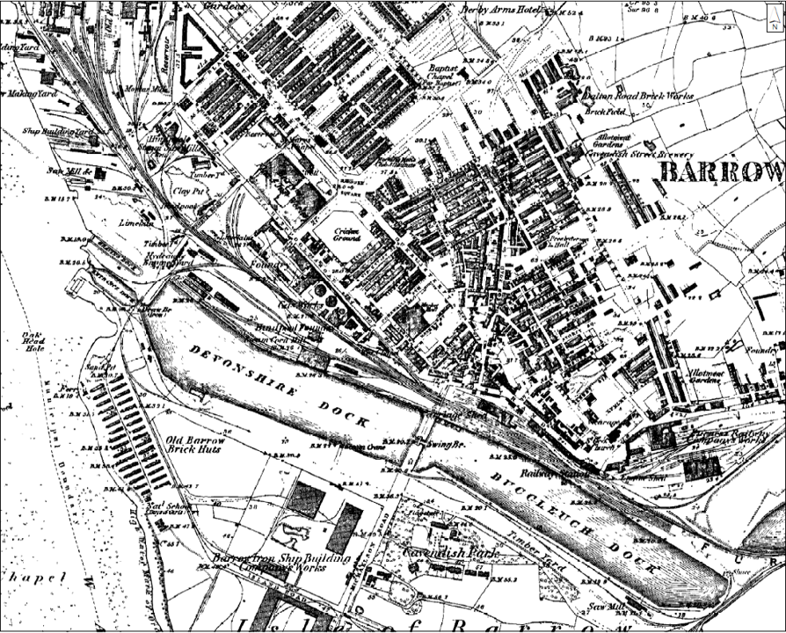
Barrow in 1873

Slide 9

Suggested enrichment activity: Investigate Barrow’s Statues
Are there any other statues of significant people in Barrow?
Can you find out where they are and go to visit them with your family?
Why have statues been put up to remember these people?
Investigate

Slide 10
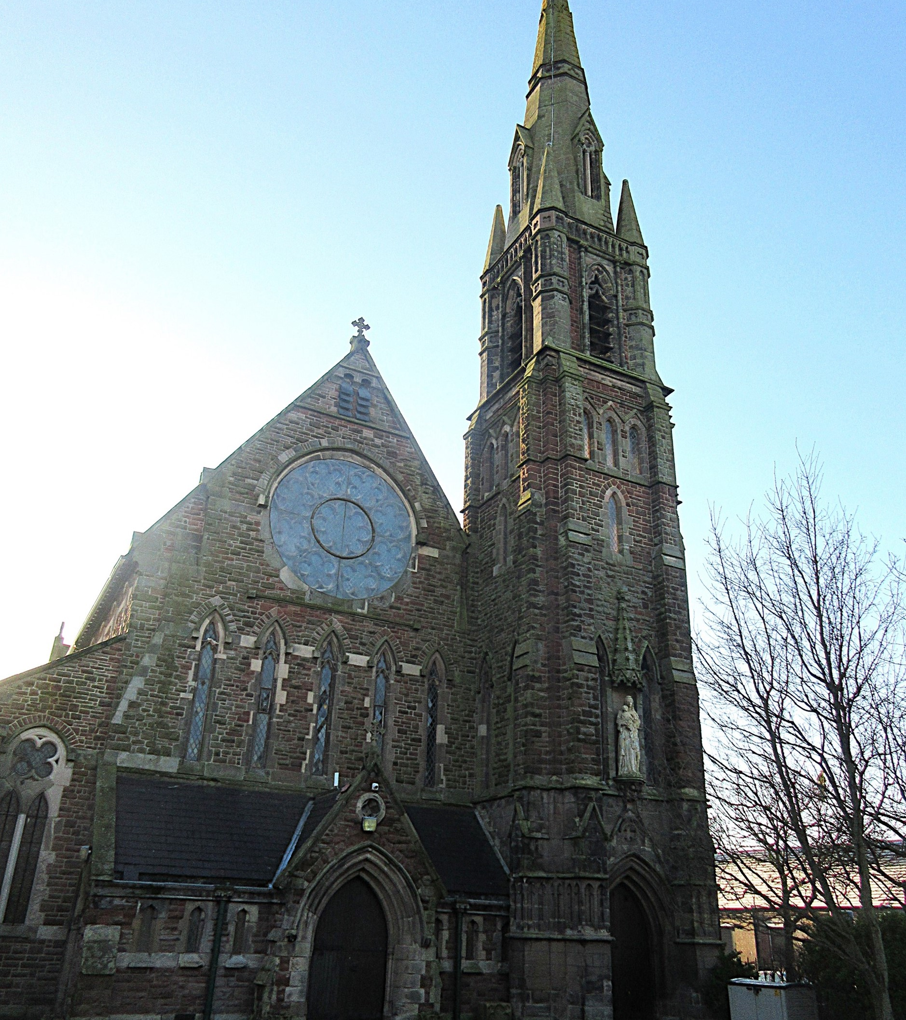
St Mary’s Catholic Church
St Mary’s Catholic Church
St Mary’s Church was built for Barrow’s quickly growing population, which increased from the 1850s.
In 1850 large deposits of a type of iron ore called haematite were found in Furness. This iron ore could be more easily mined and was better quality. This discovery, as well as the increased demand for iron ore created by James Ramsden’s iron and steel works and his ship building company, meant more and more people moved to Barrow for work.
Many of the people moving to Barrow were Catholic people from Ireland. By 1863 there were said to be at least 500 Catholic people in Barrow. St Marys Church was built in 1867 so that they had somewhere to worship and pray. It was the first Catholic Church in the Borough of Furness.
The church was designed in a style we call Gothic Revival. This style is inspired by Medieval buildings.
Notes:
Image courtesy of Susan Benson

Slide 11
Suggested in-class activity: Exploring migration into Barrow
People having moved to Barrow, from other parts of the country and the world, for centuries.
Find out more about these groups:
Cistercian monks in the Middle Ages
People from Ireland, Cornwall and Scotland in the 1800s
Can you find out about other individuals or groups of people who have moved to Barrow?
Why did they come to Barrow?
How did they help Barrow to grow and develop?

Slide 12
Suggested enrichment activity: Investigate Gothic Architecture in Barrow
Can you find out more about Gothic Architecture?
What are the key features?
Can you find any more buildings on the trail, and elsewhere in Barrow, that you think might have been inspired by Gothic Architecture?
Design your own building inspired by Gothic Architecture!
Investigate

Slide 13
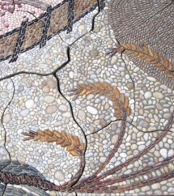
Pride of Barrow Mosaic
Pride of Barrow Mosaic
This mosaic gives us lots of clues about Barrow in the past and how and why it grew.
Three ears of wheat: These tell us about a time, before, the iron and steel works and shipyards, when Barrow was a tiny village surrounded by farmland.
Red, iron ore-coloured pebbles: These pebbles represent the importance of iron ore in the growth of Barrow. Some of the pebbles in the mosaic come from places like South America, China & Japan, representing Barrow’s links with other parts of the world. Some come from the Roose quarry, reminding us of the importance of local resources.
Railway wheels and railway lines: One of the first developments in Barrow was the building of the Furness Railway in 1846. The railway allowed the local mining industry to grow because iron could be more easily transported to and then out from Barrow’s port.
Notes:
Images from http://pebblemosaic.blogspot.com/ Need permission

Slide 14
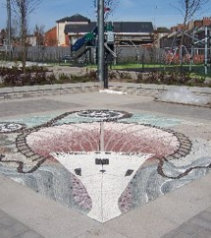
Pride of Barrow Mosaic (2)
Pride of Barrow Mosaic
A ship: This represents Barrow’s importance as a ship building town. Having opened Haematite Iron and Steel company in 1866, James Ramsden realised that he could make even more money by using the iron and steel he had made at his works to build iron and steel ships. From the 1870s Barrow was one of the world’s leading ship building towns!
Ropes: As Barrow started to grow and develop, many other businesses opened in the town. One of the major employers of women and girls was Barrow Flax and Jute company, opened in 1874, by James Ramsden. Jute and Flax were imported from Calcutta on boats which were built by Barrow Shipbuilding Company.
Notes:
Images from http://pebblemosaic.blogspot.com/ Need permission

Slide 15

Suggested in-class activity: Mosaic Design
Design your own mosaic to show what you think makes Barrow special.
You could use counters, stickers or just draw the shapes yourself!
Design

Slide 16

Suggested enrichment activity: Urban Park
The Pride of Barrow Mosaic is in Urban Park.
Visit Urban Park again with your family. See if you can find a second mosaic, made using the designs of local young people.
What do all the pictures in the mosaic have in common?
Find out more about the children’s mosaic, including some games you can play using it, at this website.

Slide 17
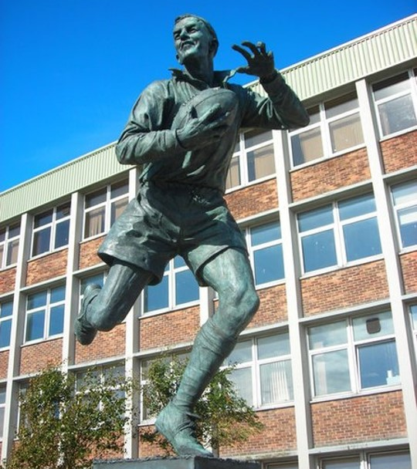
Willie Horne Statue
Willie Horne Statue
Willie Horne is a local significant individual and a hero for many Barrow people! Willie captained Barrow’s rugby league team in the 1940s and 50s, as well as leading Lancashire and England to many victories. He is known as one of the greatest rugby league players of all time.
Willie was born in Barrow in 1922. He signed for Barrow in 1943 and played as a stand-off at Craven Park stadium. He captained England in 1952, when they achieved a victory against Australia in the Ashes, and in 1955, he played an important role in Barrow winning the Challenge Cup Final at Wembley.
In 1995 Barrow Borough Council voted unanimously to make Willie Horne a Freeman of the Borough. He was the first sportsman to receive such an honour.
Notes:
Wiki commons By Rosalind Mitchell, CC BY-SA 2.0, https://commons.wikimedia.org/w/index.php?curid=13013983

Slide 18

Suggested in-class activity: Significant individuals
What makes someone significant?
Who would be your local significant individual and why?
Could you design a statue or plaque for them?
Consider

Slide 19

What makes a person significant?
Questions to ask about a person.
Did they:
make big changes in their lifetime?
make a lot of people’s lives better or worse?
change the way people think about something?
have a lasting impact on their locality, the country or the world?
set a really good/bad example to people about how to live and behave?
Notes:
For this activity we’re using Ian ‘Dawson’s Model’ for significance criteria.

Slide 20








How can we find out about local significant people?
?
Ask people who might know about them
Use books and the internet to research them
Find buildings and places connected to them
Who’s local to me?

Slide 21
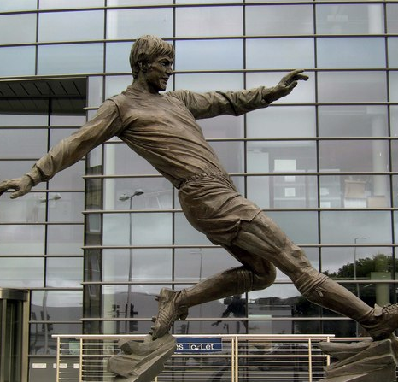
Suggested enrichment activity: Emlyn Hughes
Another local sporting hero is Emlyn Hughes.
Find out where the Emlyn Hughes statue is in Barrow. Visit the statue with your family and read the plaque.
What can you find out about him?
Why is he a significant individual for Barrow?
Is anything else in Barrow named after Emlyn Hughes?
Emlyn Hughes Statue, Barrow
Notes:
By Colin Kinnear, CC BY-SA 2.0, https://commons.wikimedia.org/w/index.php?curid=9908106

Slide 22
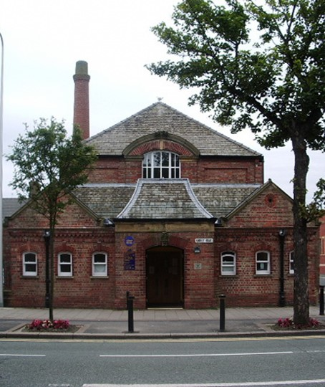
Ramsden Hall
Ramsden Hall
Ramsden Hall was built in 1872 and paid for by James Ramsden, as a gift to the people of Barrow.
In 1867 Barrow became a municipal borough. It got its first mayor, James Ramsden, and for the first time there was a borough council to help look after the town.
As Barrow continued to grow, the council realised that the thousands of workers, who had come to Barrow to live and work, needed facilities like schools, a hospital, churches and a park for getting fresh air and exercise.
Ramsden Hall was a public bath house. This was somewhere people could go to wash themselves and their clothes, if they didn’t have running water or a bathroom in their homes.
The public baths were only in use for about 5 years and then a suite of Turkish baths were opened, further up Abbey Road. and these were more popular.
Notes:
By Alexander P Kapp, CC BY-SA 2.0, https://commons.wikimedia.org/w/index.php?curid=8898786

Slide 23

Suggested in-class activity: Barrow in World War Two
Ramsden Hall narrowly escaped being bombed in World War Two. Buildings on the other side of the road such as Abbey Road Baptist Church, Christ Church and the Waverley Hotel were destroyed.
Why do you think Barrow might have been a target for bombs?
Research
Use these resources to find out more about the impact of WW2 on Barrow:
The Dock Museum, Second World War
Barrow Blitz Timeline
Cumbria Archive Service, Cumbria at War
Free Teachers Pet, Barrow Local History Pack
Use this Barrow bomb map to find other local bomb sites

Slide 24
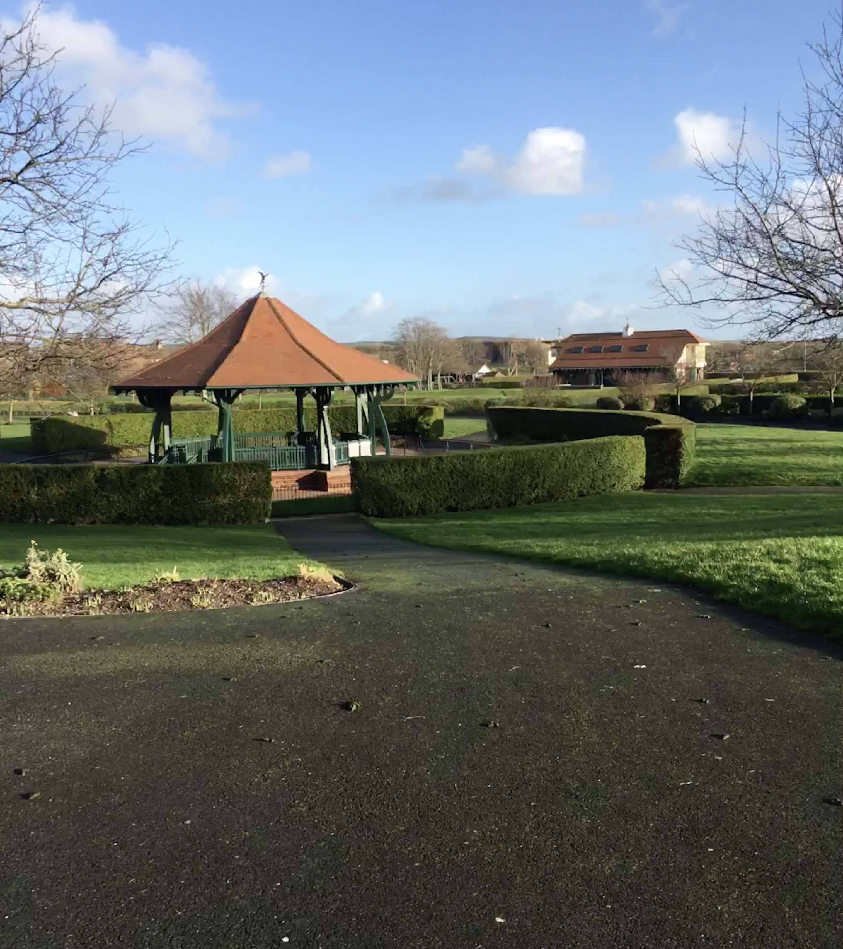
Suggested enrichment activity: Barrow Park
Like Ramsden Hall, Barrow Park was opened to provide a service for Barrow’s growing population.
This was Barrow’s first public park and was opened in the early 1900s to provide somewhere for working people to get fresh air and exercise when they weren’t working.
Take a trip to Barrow Park with your family.
Can you spot any parts of the park that you think might have been there a long time?
Which bits of the park are more modern?
Barrow Park
Notes:
By Stevvvv4444 - Own work, CC BY-SA 4.0, https://commons.wikimedia.org/w/index.php?curid=74786533

Slide 25
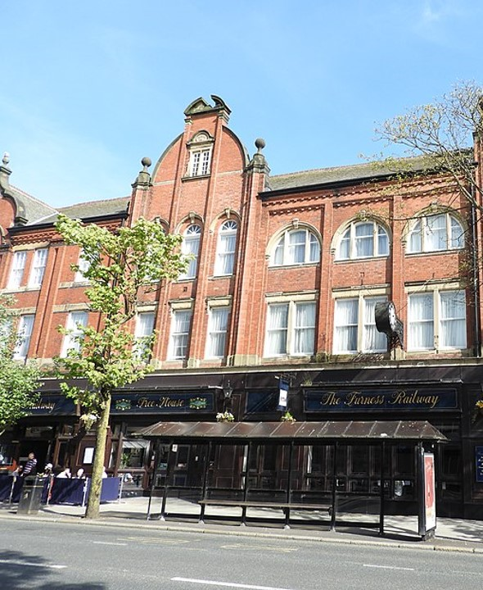
Furness Railway Hotel and Pub / Old Coop Dept Store
Furness Railway Hotel and Pub / Old Coop Dept Store
This building was built in 1889 as a Coop (Cooperative) Department store.
The Cooperative movement started in Rochdale in 1844. At this time, food was often too expensive for ordinary, working people and shop keepers sometimes cheated their customers – watering down milk for example or adding saw dust to flour! A group of Rochdale men, who became known as the Rochdale Pioneers, decided to work together (cooperate) with other members of the community, to set up their own shop. Their shop sold good quality food at fair prices.
People in other parts of the country heard about the Rochdale Cooperative and decided to set up their own shops too. In 1863 the individual co-op societies joined together and formed The Co-operative Wholesale Society (CWS). The Cooperative movement spread all over Britain and the world!
Notes:
By Reading Tom from Reading, UK - The Furness Railway, CC BY 2.0, https://commons.wikimedia.org/w/index.php?curid=104002307

Slide 26
Furness Railway Hotel and Pub / Old Coop Dept Store (2)
Furness Railway Hotel and Pub / Old Coop Dept Store
This building is now a hotel and pub named after the Furness Railway.
One reason for this is that the coop building was originally bought from the Furness Railway Company. The company was owned by lots of the rich and influential people of Barrow, including James Ramsden. They opened many of the businesses in the town in the 1800s and they paid for several of the important buildings.
The name of the pub also reflects the importance of the coming of the railway to Barrow.
Notes:
https://commons.wikimedia.org/w/index.php?curid=104002307

Slide 27


Suggested in-class activity: Transport in Barrow
Think about the following transport methods that have played a role in Barrow’s past and present. How have they helped the people and businesses of Barrow:
Furness Railway
Barrow harbour and docks
Trams and buses
Bicycles! (Cumbria and Barrow)
Can you think of others?
Think
Follow the links to find out more!

Slide 28
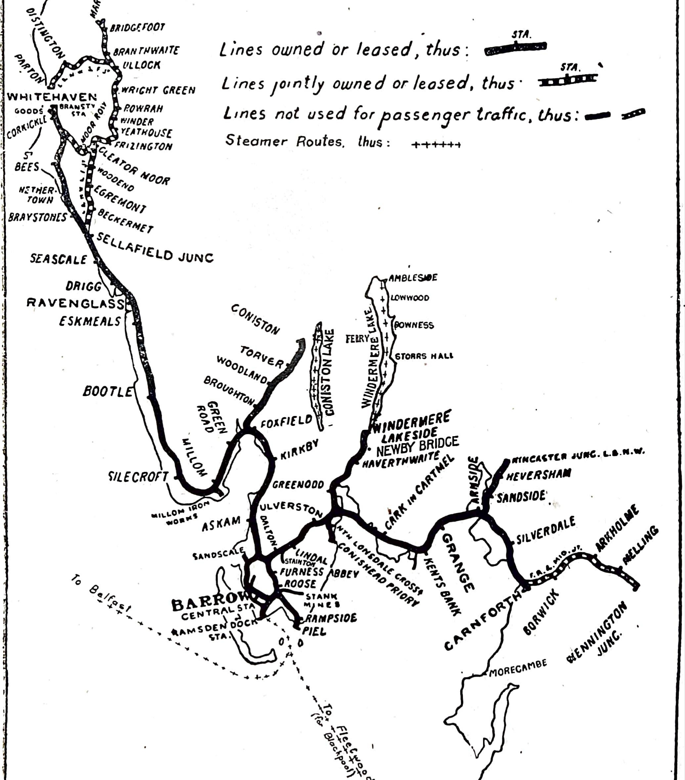
Suggested enrichment activity: The Furness Railway
Find out more about the history of the Furness Railway by visiting The Furness Railway’s page on the Wetherspoon’s website.
If you’d like to know even more about railways in Cumbria, you could visit Ravenglass Railway Museum
1920 map of the lines of the Furness Railway.
Notes:
By The Railway Year Book for 1920. The Railway Publishing Company Limited, London., Public Domain, https://commons.wikimedia.org/w/index.php?curid=143285602

Slide 29
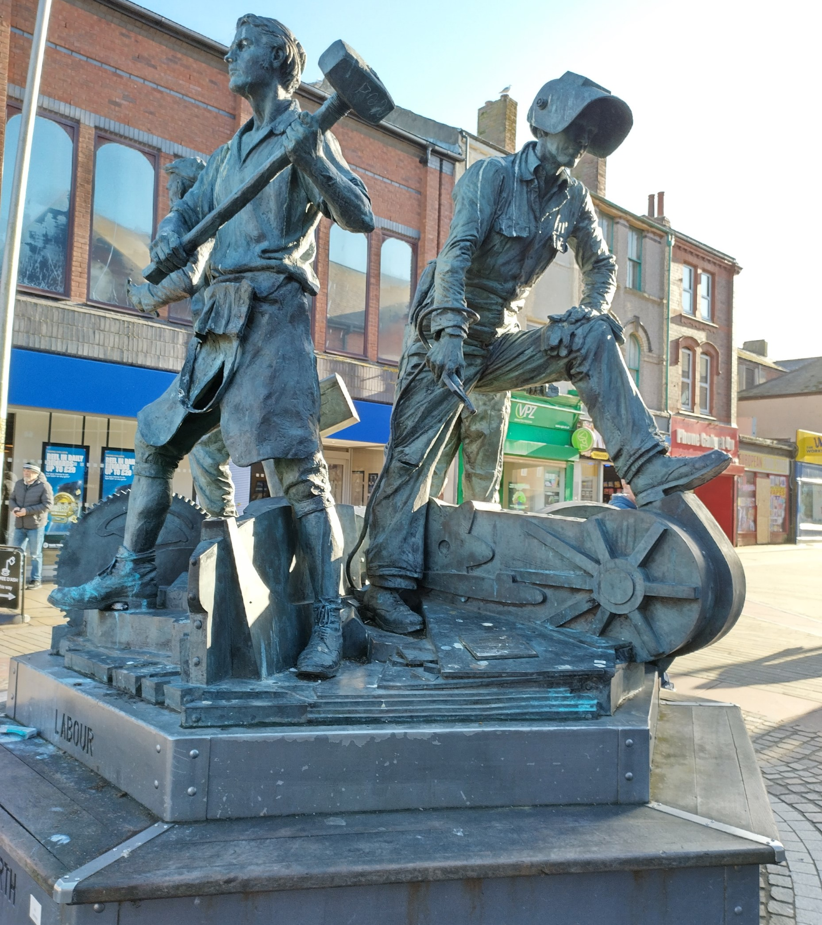
Spirit of Barrow Statue
Spirit of Barrow Statue
This sculpture was unveiled in 2005. It shows four shipyard builders through different time periods.
Ship building has played a very important role in the growth and development of Barrow. The first ship building company, Barrow Iron Ship Building Company, was opened in 1871 by James Ramsden. The company used steel produced at Ramsden’s iron and steel business, to make war, trade and passenger ships. The company was very successful and in their first 10 years, the yard produced more than 100 ships!
Notes:
Susan Benson

Slide 30
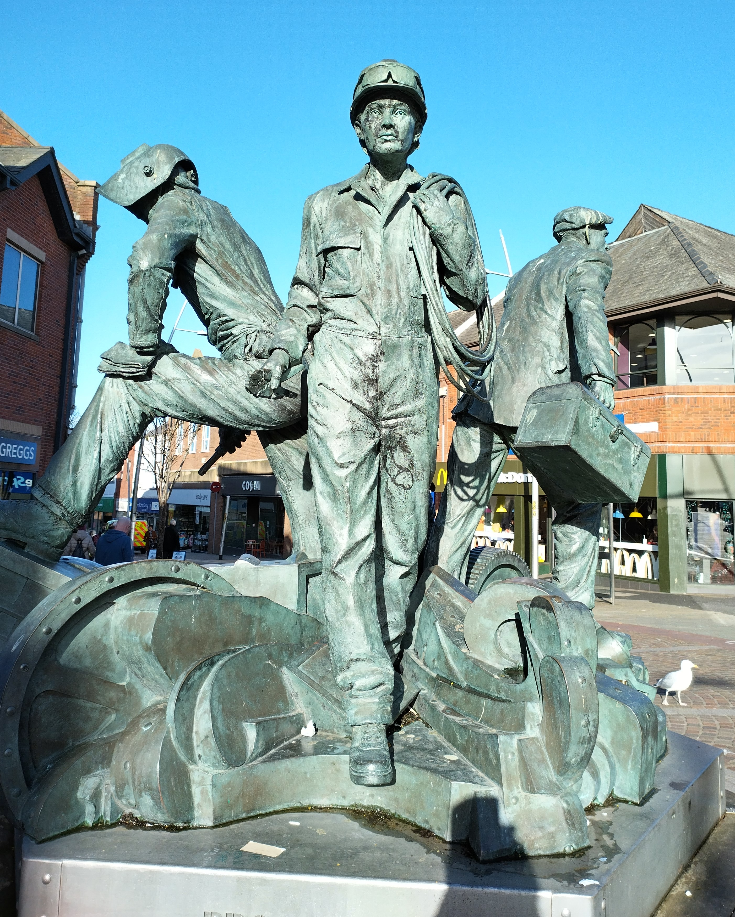
Spirit of Barrow Statue (2)
Spirit of Barrow Statue
When James Ramsden died, the steel manufacturing company Vickers & Sons bought the Company. Vickers became a world-renowned producer of impressive ships and naval vessels. Barrow became famous for naval building, producing ships and submarines which were used in World War 1 and 2.
Today the shipyard is part of a company called BAE Systems. They still make submarines for the Royal Navy.
Notes:
Susan Benson

Slide 31
Suggested in-class activity: The significance of shipbuilding in Barrow
Find out more about the importance of shipbuilding to the development of Barrow.
The BAE Systems website provides lots of information and resources (search for Barrow)
Research
You might also like to find out about:
The importance of Vickers Shipbuilding Company during the World Wars.
What it was like to work at Vickers, using this oral testimony on the Barrow in Furness Civic Society website.
Vickers Town – where and what was it? This short film is a good place to start.

Slide 32

Suggested enrichment activity
Visit the Dock Museum with your family to find out more about the history and importance of ship building in Barrow.

Slide 33
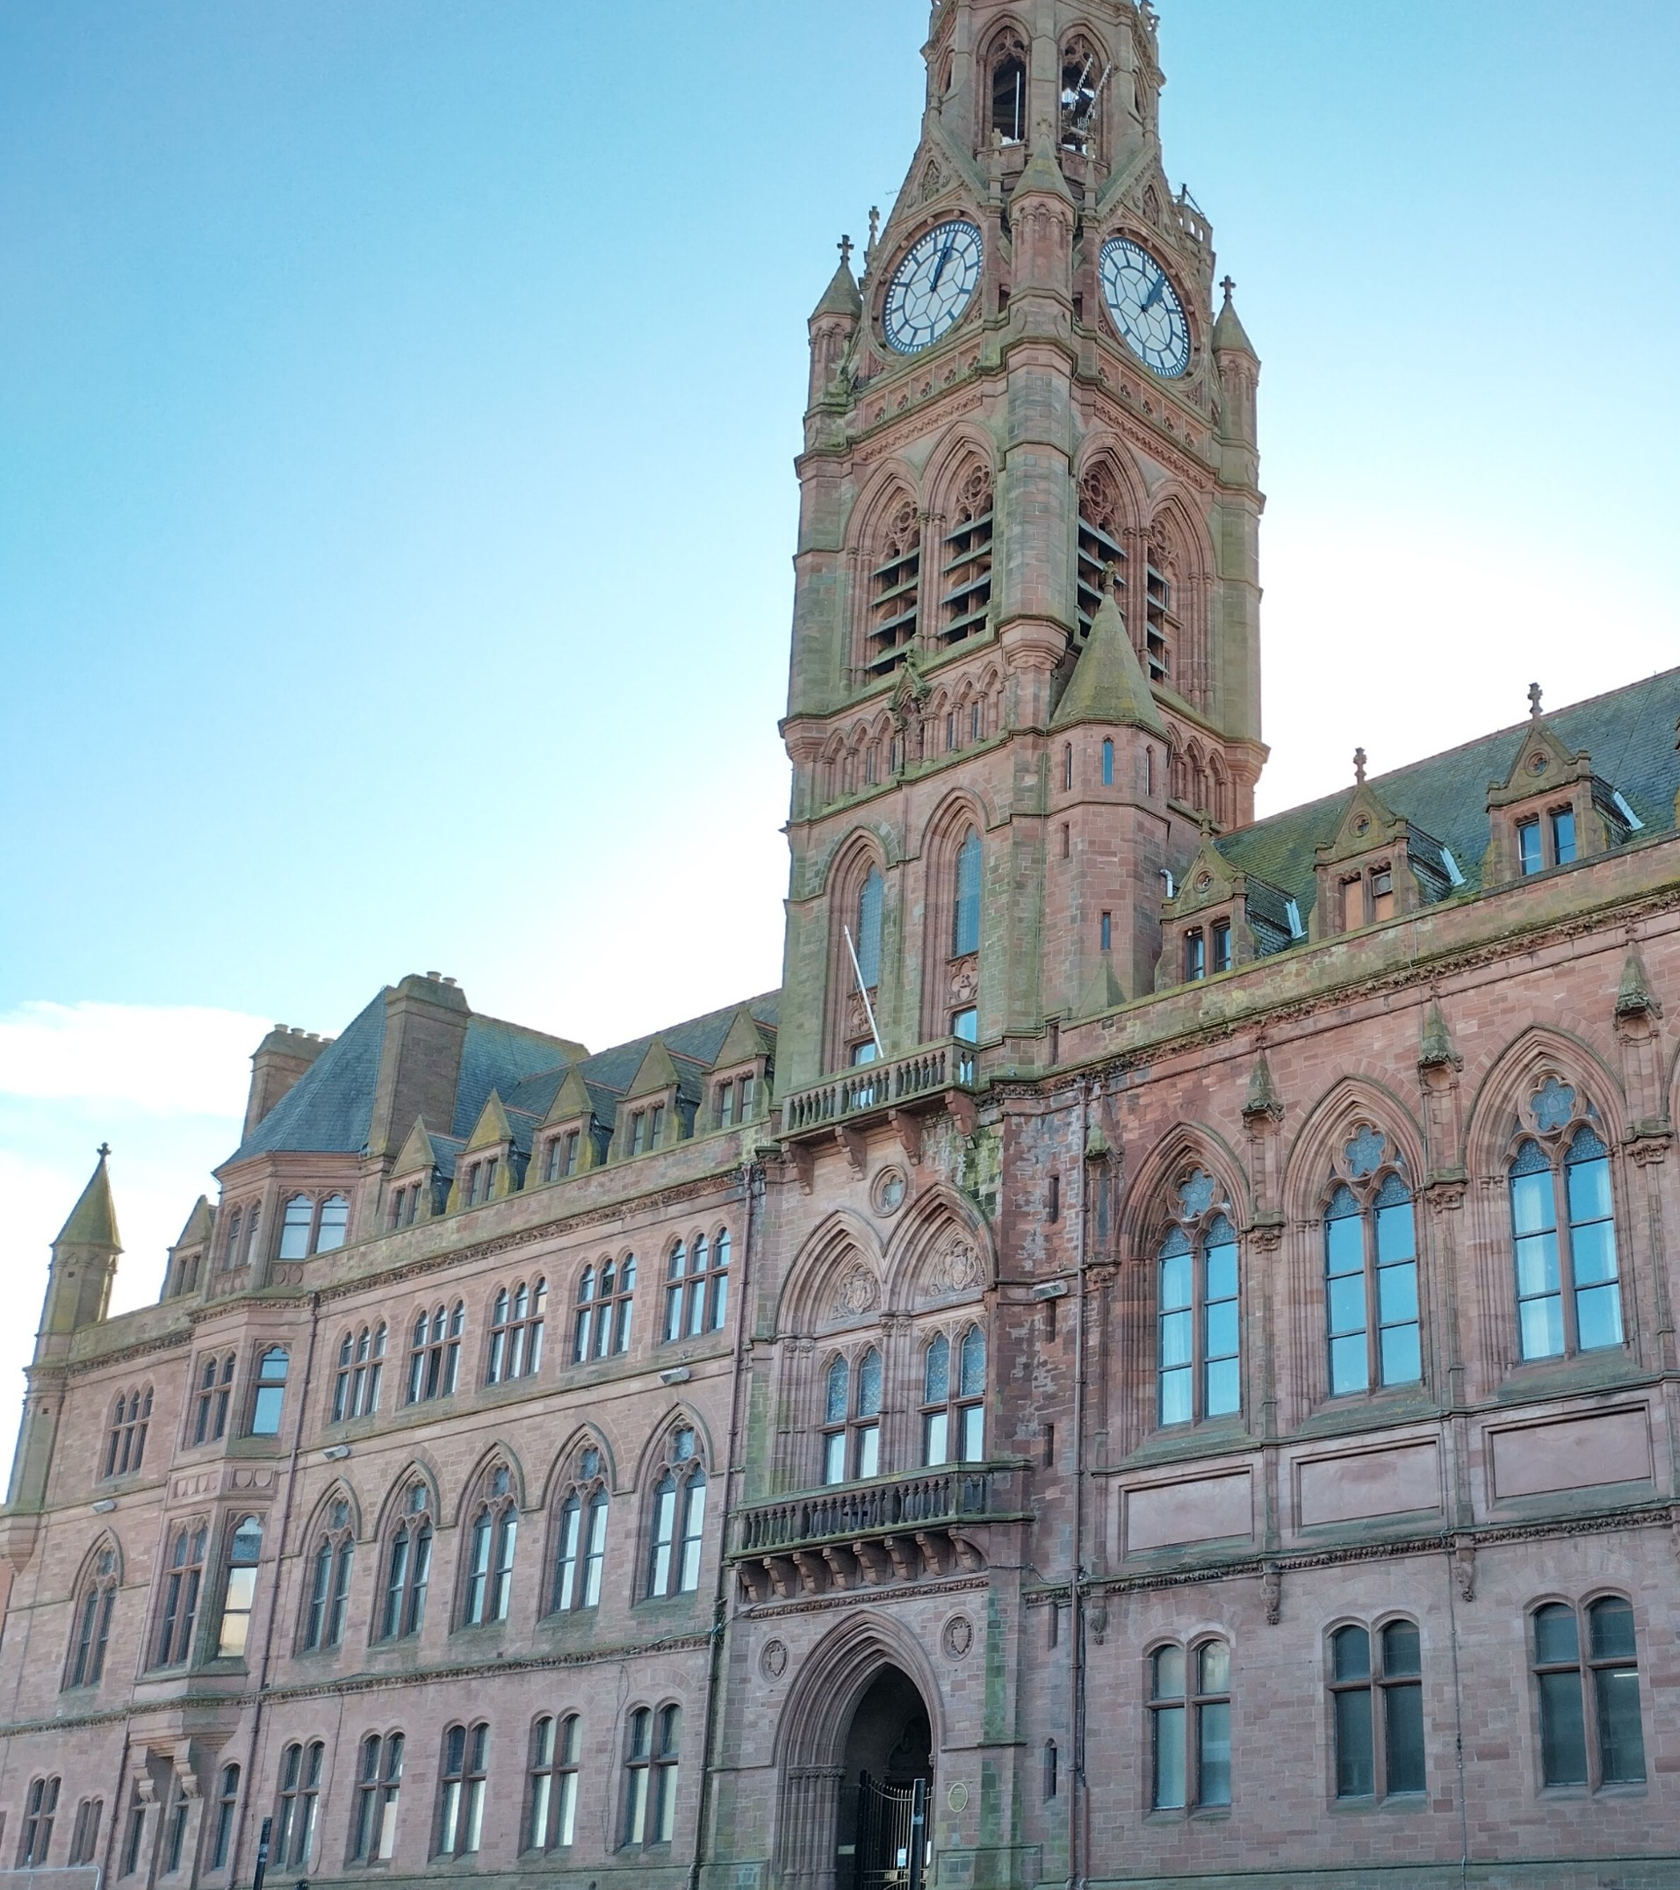
Barrow Town Hall
Barrow Town Hall
When James Ramsden became mayor of the new Municipal Borough of Barrow, he and other important people in the town, decided they wanted to build an impressive town hall. It would be a symbol of Barrow’s industrial growth, wealth and prosperity
A competition was held for its design and the winner was the architect William Henry Lynn. The town hall was built between 1882–6, using local sandstone from Hawcoat Quarry.
Like St Mary’s Church, Barrow town hall is designed in the gothic revival style. The impressive clock tower is 50m high and can be seen for miles around. During building, in 1885, cracks appeared at the base of the tower, so it had to be dismantled. It was rebuilt but this delayed the completion of the town hall. It wasn’t finished until 1886, but the date stone still says 1885.
Notes:
Susan Benson

Slide 34
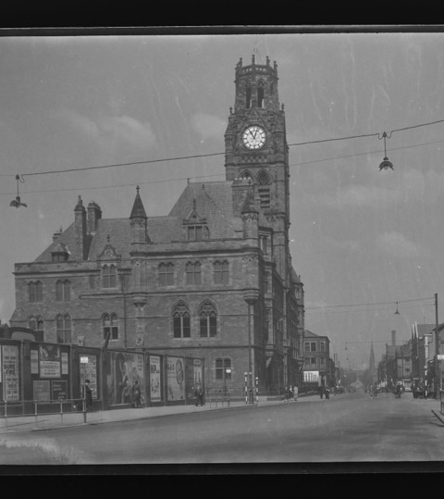
Suggested in-class activity: Change and continuity
Search the Sankey Photo Archive to find photos of the town hall in the past.
Compare photos of the town hall and the surrounding area in the past with how it looks now (visit again, find photos, or use a “street-view” tool on the internet).
What has changed and what has stayed the same?
Barrow Town Hall, 1935
Notes:
Sankey Photo Archive A579A, BDB 86/1/3393 Sankey Family Photographic Archive © Cumbria Archives https://www.sankeyphotoarchive.uk/collection/view/?id=1651

Slide 35
Suggested enrichment activity: Inside the town hall
Visit the town hall with your family and see if you can go inside (you may even be able to have a guided tour).
Look out for:
The WW1 and WW2 war memorials
Queens Hall, the largest room in the town hall, with its impressive clustered columns
A portrait of the Duke of Devonshire
A bust of Queen Victoria
Look

Slide 36
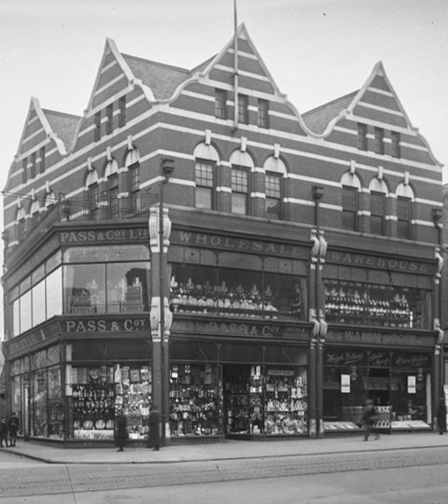
Site of Pass & Co Department Store, Duke Street
Site of Pass & Co Department Store, Duke Street
Before Barrow’s growth Duke Street was an unmade road linking the villages of Barrow and Hindpool. Over time shops, banks and businesses set up here. By the late 1800s Duke Street was Barrow’s main shopping street.
Notes:
Image: 7963, BDB 86/1/2477 Sankey Family Photographic Archive © Cumbria Archives https://www.sankeyphotoarchive.uk/collection/view/?id=4362
Pass and Co 1920s

Slide 37
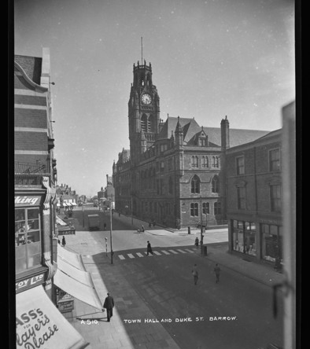
Site of Pass & Co Department Store, Duke Street (2)
Site of Pass & Co Department Store, Duke Street
Pass and Co was one of the first shops on Duke Street. Over time it grew to be a large department store. Its motto was that it sold “anything from a pin to a piano”.
One of the most popular areas of the shop was its record department. The store sold 78 records. If you wanted to listen to a song, you asked the person behind the counter to put it on a record player. You then went into a little booth and listened to it through headphones. If the store didn’t have the record you wanted, you could place an order and collect it a few days later.
Duke St with Pass & Co bottom left
Notes:
Image: A510A, BDB 86/1/3310 Sankey Family Photographic Archive © Cumbria Archives https://www.sankeyphotoarchive.uk/collection/view/?id=1568

Slide 38
Suggested in-class activity: Duke Street in the Past
Find out more about Pass and Co, and other shops that used to be on Duke Street using this short film.
Design
Could you design and illustrate one or more plans of the street, showing the shops at a particular time in the past?

Slide 39



Suggested enrichment activity: Listening to music
Record player
Ask a parent, grandparent or another adult how they used to buy and listen to music in the past.
Listen
Cassette tape
Notes:
Image by freepik

Slide 40
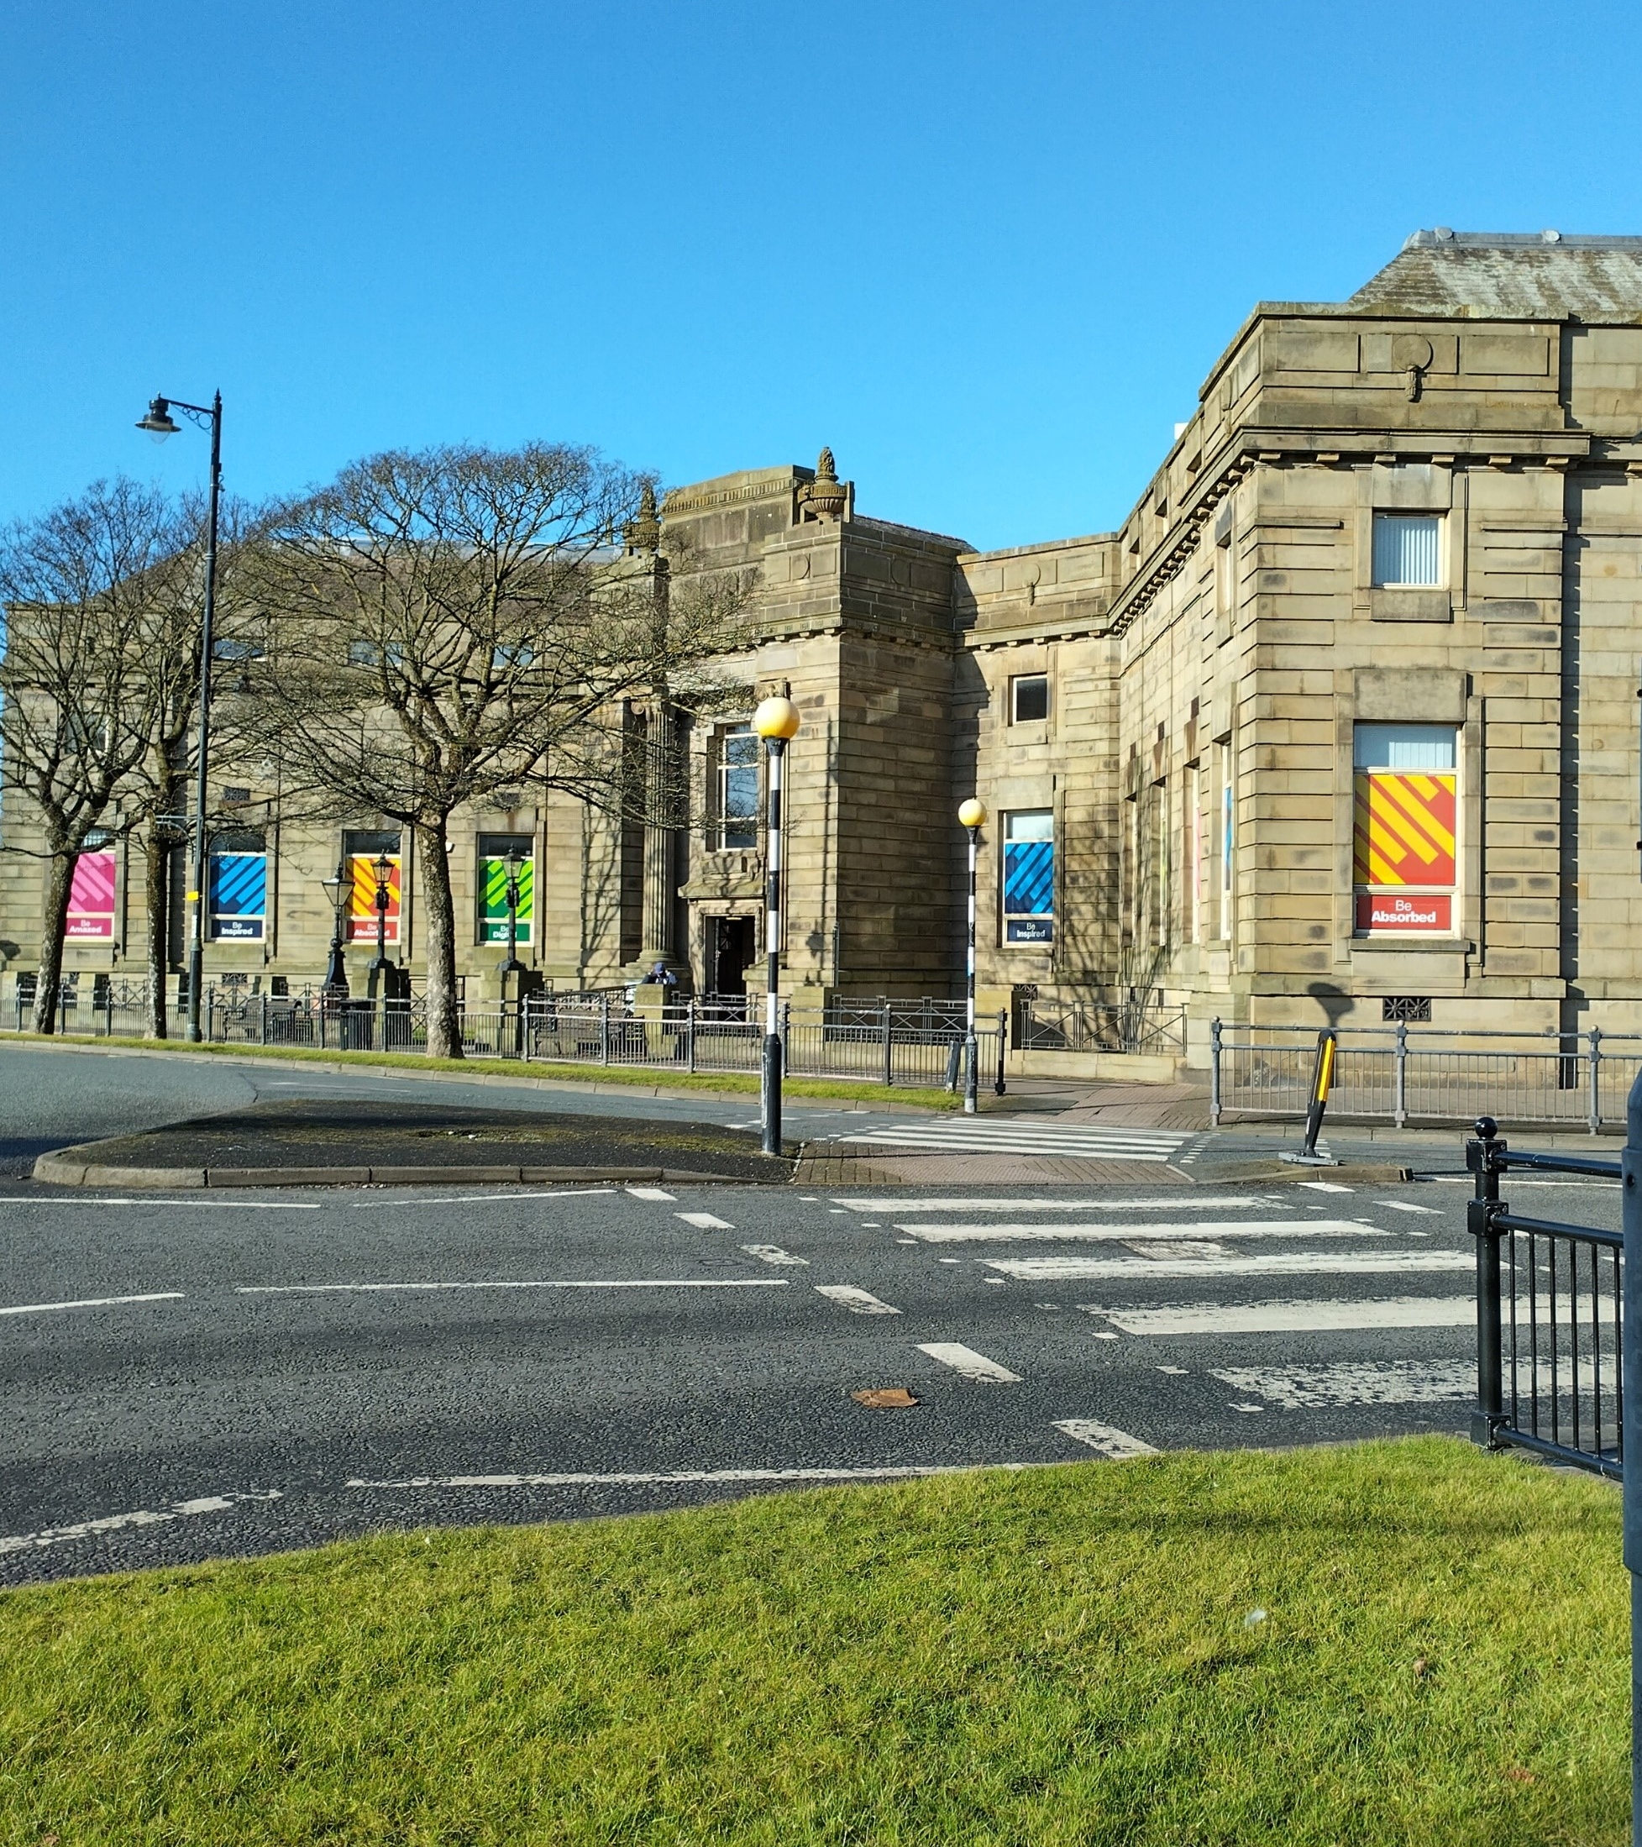
Barrow Library
Barrow Library
The first Barrow library opened in 1882. In 1913 the council received a grant from the Carnegie Corporation to build of a new library on Ramsden Square.
When it was first opened, the library included a children’s library, a reading room and a lecture theatre on the top floor. In the 1930s the lecture theatre became a museum with artefacts linking to Barrow’s history. The museum moved out of the library when the Dock Museum opened in the 1990s.
Notes:
Susan Benson

Slide 41
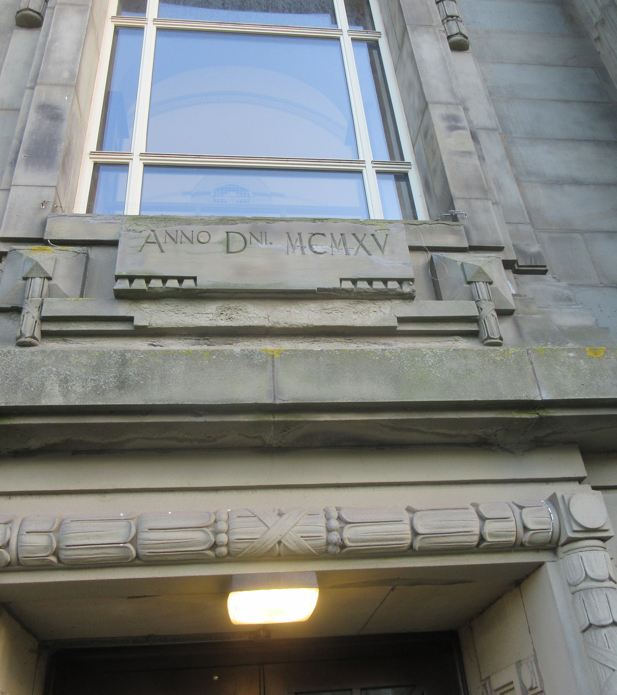
Barrow Library (2)
Barrow Library
The council planned that the library would be ready by 1915, but it took longer than expected and, in 1916, the building work had to stop because of the war. The library was officially opened in 1922. The date stone reflects the planned opening date, reading ANNO DNI and the Roman numerals MCMXV which represent the year 1915AD.
Notes:
Image: Susan Benson

Slide 42
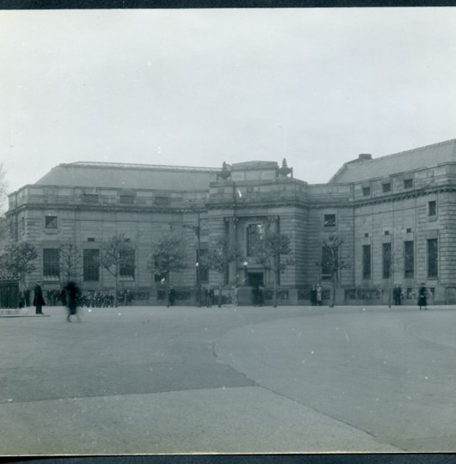
Suggested in-class activity: why is Barrow Library Important?
Watch this short film to find out more about the history of Barrow library.
Can you design an information poster, explaining why it is such an important building for the people of Barrow?
Barrow Library 1940
Notes:
A482AX, BDB 86/1/3280 Sankey Family Photographic Archive © Cumbria Archives https://www.sankeyphotoarchive.uk/collection/view/?id=1538

Slide 43
Suggested enrichment activity: Barrow Local Studies Centre and Archive
Visit the library with your family.
Explore what services are available there.
Research
Locate the Local Studies Centre and Archive in the library.
Can you find any books on, photos of, or information about any of the buildings on this trail?

Slide 44
Overview Activities
On the following slides are some additional activities which will allow pupils to gain an overview of the sites as a whole, and the themes explored in the trail.
They will also develop pupils’ disciplinary understanding providing an opportunity to consider concepts such as change and continuity, causation, similarity and difference and chronology.

Slide 45
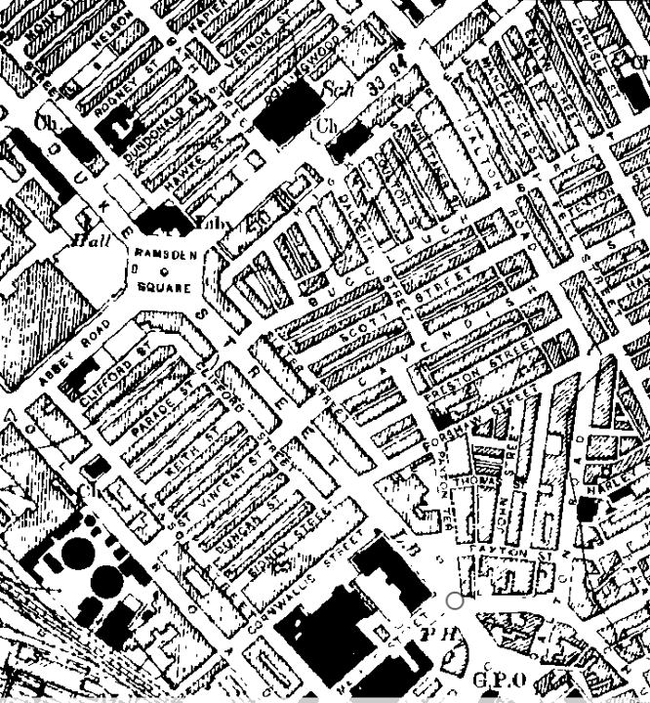
Map Skills: Exploring change and continuity over time
Find and mark the places on the trail on a map. You could:
  use an ordinance survey map or print out a map from the internet then draw a circle around each site or place a sticker.
  You could use Digimaps, Google My Maps or another online mapping tool to make a digital map.
Now use the National Maps Scotland website to compare a modern map of Barrow with old maps of the area.
  Can you find the sites from the trail on the old maps?
  What has changed and what has stayed the same?
Map of Barrow in 1931
Notes:
Image: Historic OS Mapping: Copyright and database right
Crown Copyright and Landmark Information Group Ltd
(All rights reserved)

Slide 46
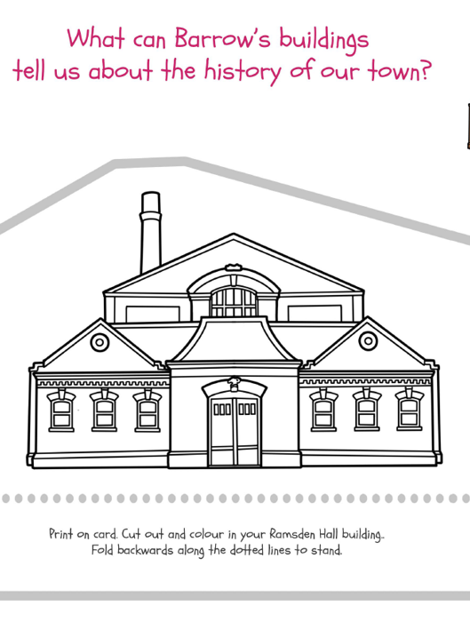
Chronological Understanding (1)
Download the Colour and cut activity sheets PDF
Cut out and build the models of each site on the trail.
Cut out the name and date cards on the next slide (blue), then match the models to their name cards.
Can you place the sites in chronological order from oldest to most modern?
Cut out of Ramsden Hall

Slide 47
Timeline cards
Buildings and sites on the trail: Name and date cards
Significant local events cards
1872: James Ramsden statue
1867: St Mary’s Catholic Church
1850: Haematite iron ore discovered
1844: Furness Railway opens
2007: Pride of Barrow Mosaic
2004: Willie Horne Statue
1867: James Ramsden becomes first Mayor of Barrow
1864: James Ramsden opens Haematite Iron and Steel Works
1872: Ramsden Hall
1889: Barrow Cooperative Department Store
1998: Coop building became Furness Railway pub
1874: Barrow Jute works opened.
1850: Population of Barrow is 650 people
1871: Population of Barrow is 18,000
1871: James Ramsden opens Barrow Iron Shipbuilding Works (becomes Vickers,1896)
1882: Barrow Town Hall
2005: Spirit of Barrow sculpture
1922: Barrow Library and Archive
1904: Pass and Co Department Store

Slide 48
Chronological Understanding (2)
Print out the timeline on the next slide (A3 may work best)
Place the site “name and date” cards (blue), from the previous activity, in the correct place on the timeline.
Cut out the “significant local events” cards from the previous slide (green) and add those to the timeline too.
Investigate
How many years ago were different sites built / erected?
Can you tell the story of Barrow using the places and events on the timeline?

Slide 49
A timeline of Barrow
1800
1900
2000
1850
1950
2050

Slide 50
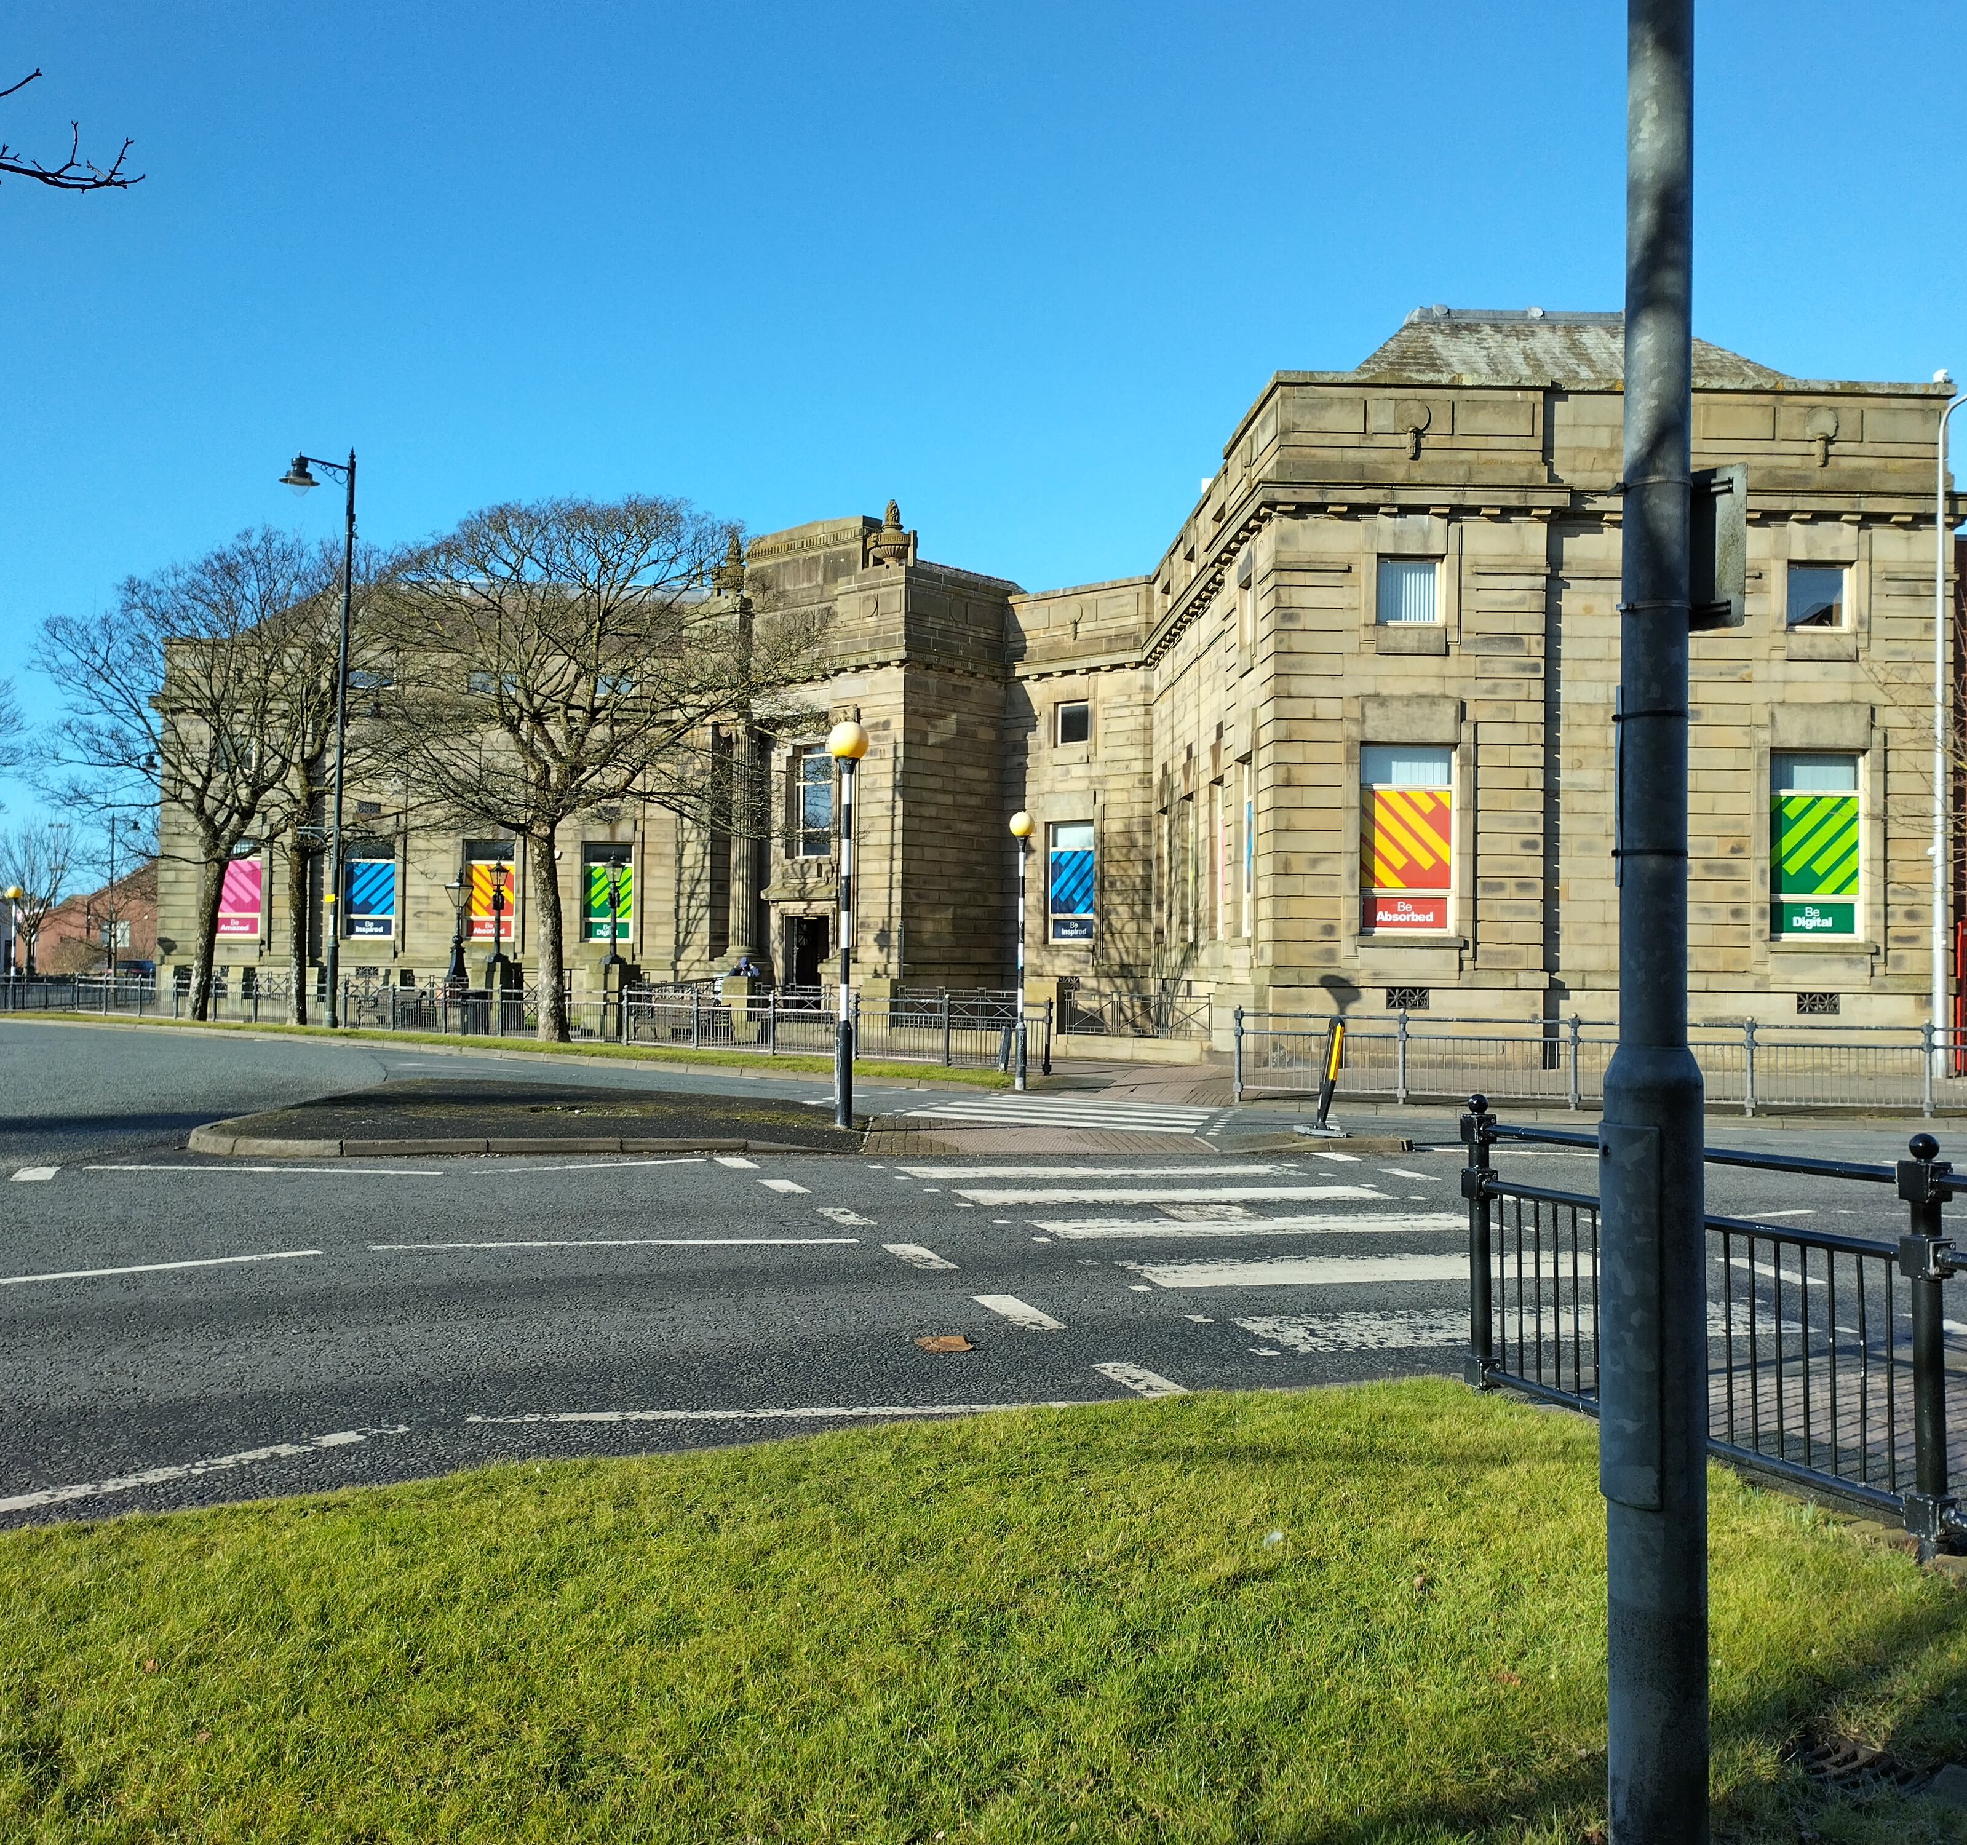
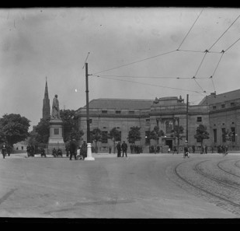
Similarity and Difference
Ramsden Square 2025
Search for old photos of Abbey Road and Duke Street on the Sankey Photo Archive.
Can you find any of the buildings from the trail in the photos?
Use Google street view or, if you can, go out in person. Try to view the streets from a similar angle to the photograph.
Investigate
What has changed and what has stayed the same?
Ramsden Square 1924
Notes:
Image 1: Susan Benson
Image 2: A83, BDB 86/1/3044 Sankey Family Photographic Archive © Cumbria Archives https://www.sankeyphotoarchive.uk/collection/view/?id=1300

Slide 51


Understanding Causation
Several factors caused Barrow to grow and develop from the 1840s onwards.
Complete the table on the next slide. For each factor below, can you explain how and why it caused Barrow to grow?
Explain
  There were large quantities of iron ore in Furness
  The Furness Railway was built
  James Ramsden opened his Haematite Iron and Steel Works
  Barrow Docks were built
  James Ramsden opened his Shipbuilding Works
  More and more people moved to Barrow
Justify
Which do you think is the most important factor and why?

Slide 52
Why did Barrow grow and develop from the 1840s?
Factor | How it helped Barrow to grow and develop
There were large quantities of iron ore in Furness
The Furness Railway was built
James Ramsden opened his Haematite Iron and Steel Works
Barrow Docks were built
James Ramsden opened his Shipbuilding Works
More and more people moved to Barrow

Slide 53
Exploring Listed Buildings
Many of the buildings and sites on the trail are listed buildings. This means that they have been recognised as nationally important because of their architecture and/or their history.
Historic England is the organisation that looks after listed buildings and encourages people to care for the historic environment. They have a database of all listed buildings in England on their website. It is called the National Heritage List for England. Use the map search to explore listed buildings in and around Barrow:
Find Duke Street and then Abbey Road.
Which of the buildings and sites on our trail are listed?
What can you find out about them from their list entries?
Are there any other listed buildings nearby?
Type in your home or school’s postcode
  Are there any listed buildings near you?
Investigate
Find out more about Listed Buildings in Barrow, in the free Teachers Pet Barrow Local History Pack

Slide 54
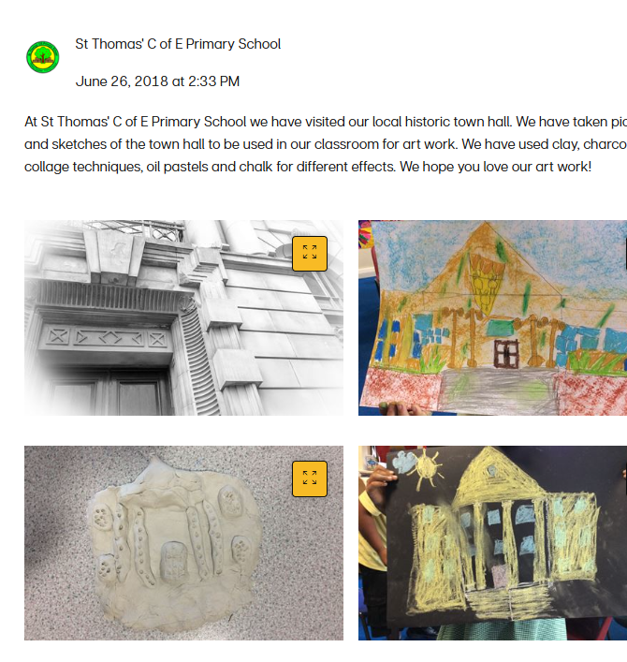
The Missing Pieces Project
Historic England’s Missing Pieces Project invites people to upload their photos, artwork, stories and memories to the list entries for listed buildings.
Follow this step-by-step guide and upload some of your work to the list entries for listed buildings in Barrow, as part of the Missing Pieces Project.

