Slide 1
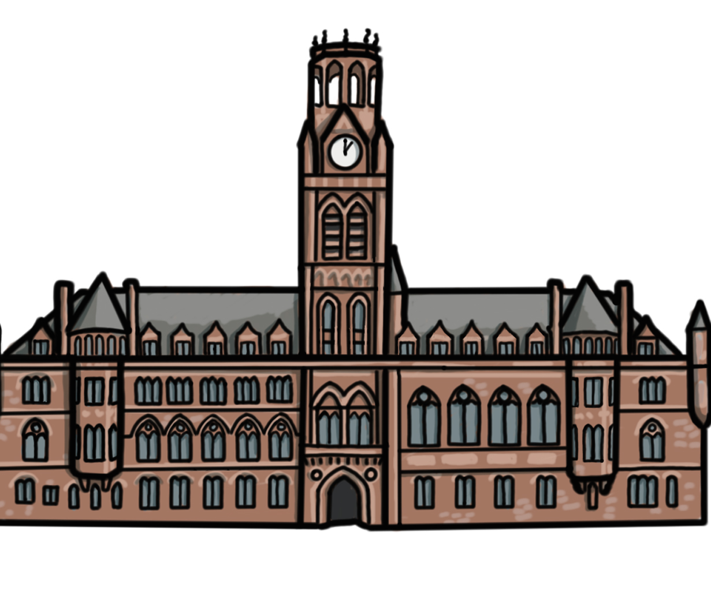
What can Barrow’s buildings tell us about the story of our town?
What can Barrow’s buildings tell us about the story of our town?
Introductory PPT

Slide 2
What can Barrow’s buildings tell us about the story of our town?
Key Stage 2
To develop pupils’ knowledge of significant places, people, events and themes in Barrow’s history.
To support pupils in using the built historic environment as historical evidence to find out about an area in the past
To build pupils’ sense of place and belonging in the community in which they live

Slide 3
Resource Overview and Contents (for teachers)
At the centre of this resource is a local history and heritage trail. The trail starts and ends at Barrow Library and Archive and explores ten key sites which help to tell the story of Barrow. By understanding Barrow’s story, we hope pupils will gain a sense of place, an understanding of how and why Barrow grew, and an appreciation of what makes Barrow a significant place.
The trail resource is made up of:
Trail route map and trail script for teachers, including questions to ask pupils and directions from one site to the next.
Trail worksheet for pupils, including a simplified trail, a drawing of each site and “spot it” activities en route.

Slide 4
Resource Overview and Contents (for teachers) (2)
In addition to the trail, there are a number of supporting resources to be used in the classroom:
Introductory PPT to introduce pupils to the sites on the trail and the trail’s purpose and value
Online StoryMap allowing teachers and pupils to preview or revisit the stops on the trail. Or to explore the trail virtually, if unable to walk it in person
Recap and Reflect PPT allowing pupils to revisit learning from the trail and draw conclusions
Additional Activities PPT including “in-class activities”, to support pupils in exploring each trail site in greater depth, and / or to develop pupils’ disciplinary skills and “enrichment activities” that pupils could do with a parent or carer outside of school

Slide 5
How to use this PPT
This PowerPoint is part of the learning resource: What can Barrow’s buildings tell us about the story of our town? We encourage teachers to use this PPT in class, before taking pupils on the history trail of the same name.
The purpose of this PPT is to introduce pupils to the sites on the trail and to help them to understand the trail’s purpose and value.
Teachers can use all, or some of the slides, and can edit them to meet the needs of pupils.
Heritage trail route map and script for teachers
Heritage trail worksheet for pupils
Recap and Reflect PPT
Additional Activities PPT
Colour and cut activity sheets PDF

Slide 6
What can Barrow’s buildings tell us about the story of our town?
In this lesson we will:
Think about what we know about Barrow, and how we feel about the town.
Find out about a history trail exploring 10 important sites in Barrow town centre.

Slide 7


What does Barrow mean to me? 1
Complete the mind map on the worksheet provided on the next slide.
What words, phrases, places and people come to mind when you think of Barrow?
How would you describe Barrow?
How do you feel about Barrow?
Consider

Slide 8
What does Barrow mean to me?

Slide 9

What does Barrow mean to me?
Compare your mind map with others in your class
  Do you all have the same people and places on your mind map?
  Have you used the same words to describe Barrow?
  Do you all have the same feelings about Barrow?
Group Discussion

Slide 10

What does Barrow mean to me? (2)
Is Barrow where you were born?
Is Barrow where your parents were born?
Is Barrow where your grandparents were born?
Hands up
Wherever we were born, Barrow is where we live now.
It is important that we find out about the places and people that tell the story of our town in the past, so that we can appreciate what makes Barrow special.

Slide 11
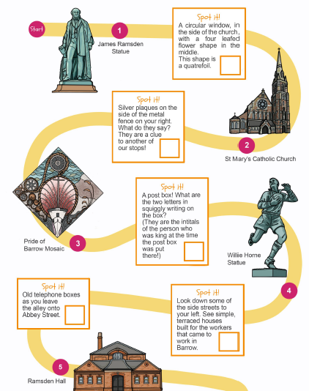

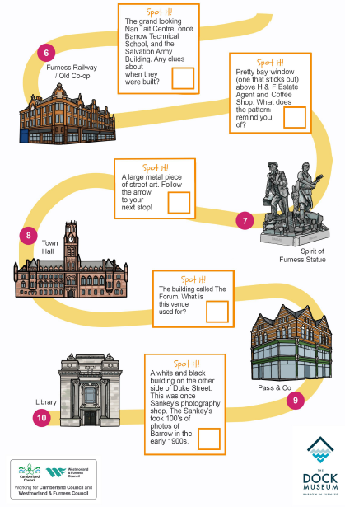
What places and people tell the story of Barrow?
Trail Worksheet
We are going to go on a trail around the centre of Barrow.
We are going to visit 10 buildings and sites which tell us about people and events that help us to understand the story of Barrow and what makes the town special.

Slide 12


Where will we visit?
The map on the next slide shows the route of our trail and the sites we will explore.
Have you visited the centre of Barrow before?
What have you done there?
Where have you visited?
Can you find any of those places on a map?
Think

Slide 13
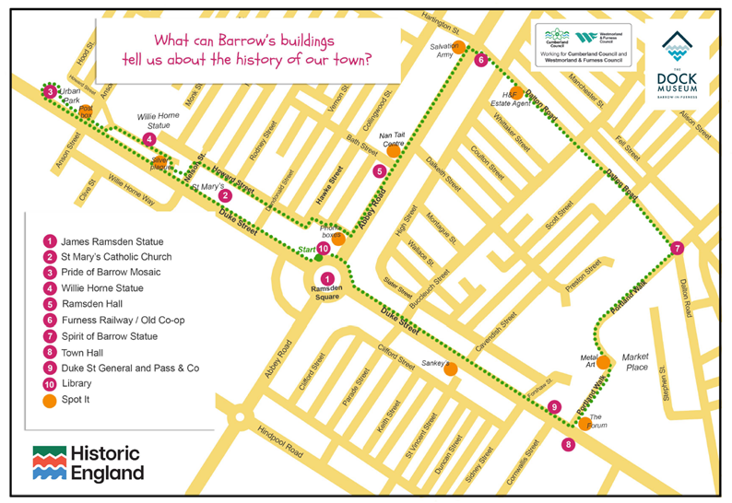
Trail Route Map

Slide 14

What will we see?
The following slides tell you which building and sites we will be exploring on our trail
For each site:
Have you seen it / been there before?
Do you know what it is?
Do you know anything about it?
Look

Slide 15
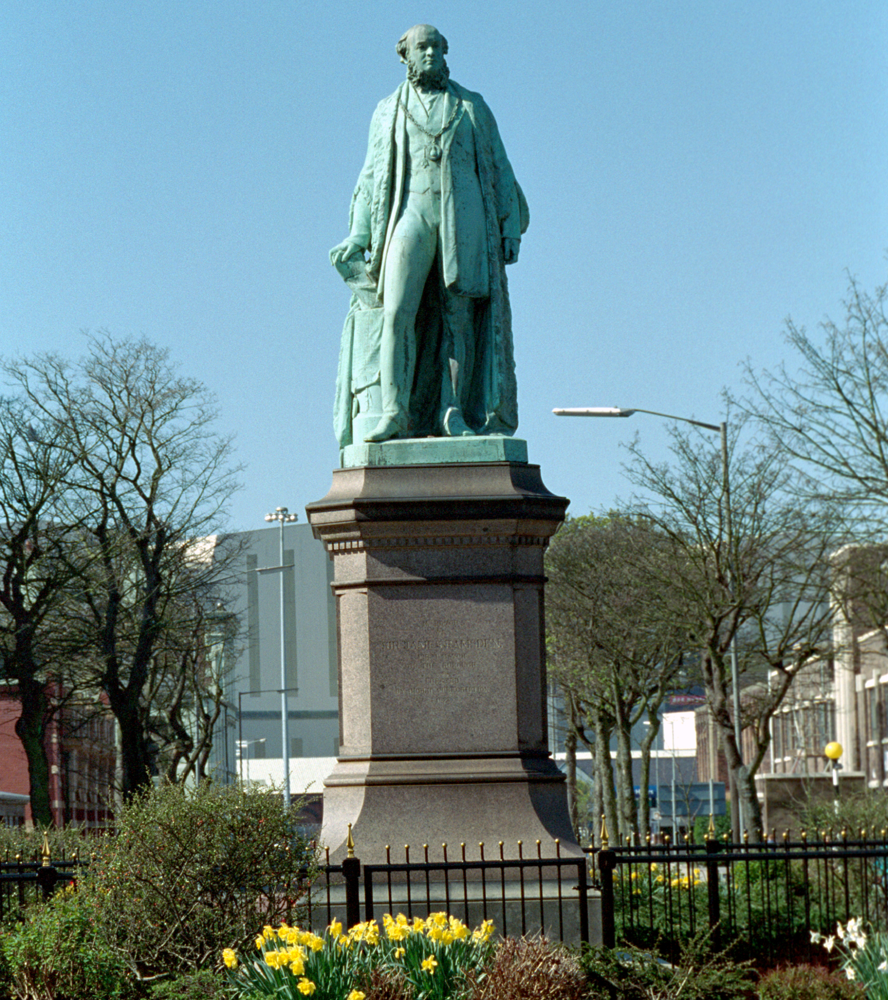
STOP 1: James Ramsden Statue
Notes:
© Mr CJ Wright. Source: Historic England Archive Ref:IOE01/02860/31 - https://historicengland.org.uk/images-books/photos/item/IOE01/02860/31

Slide 16
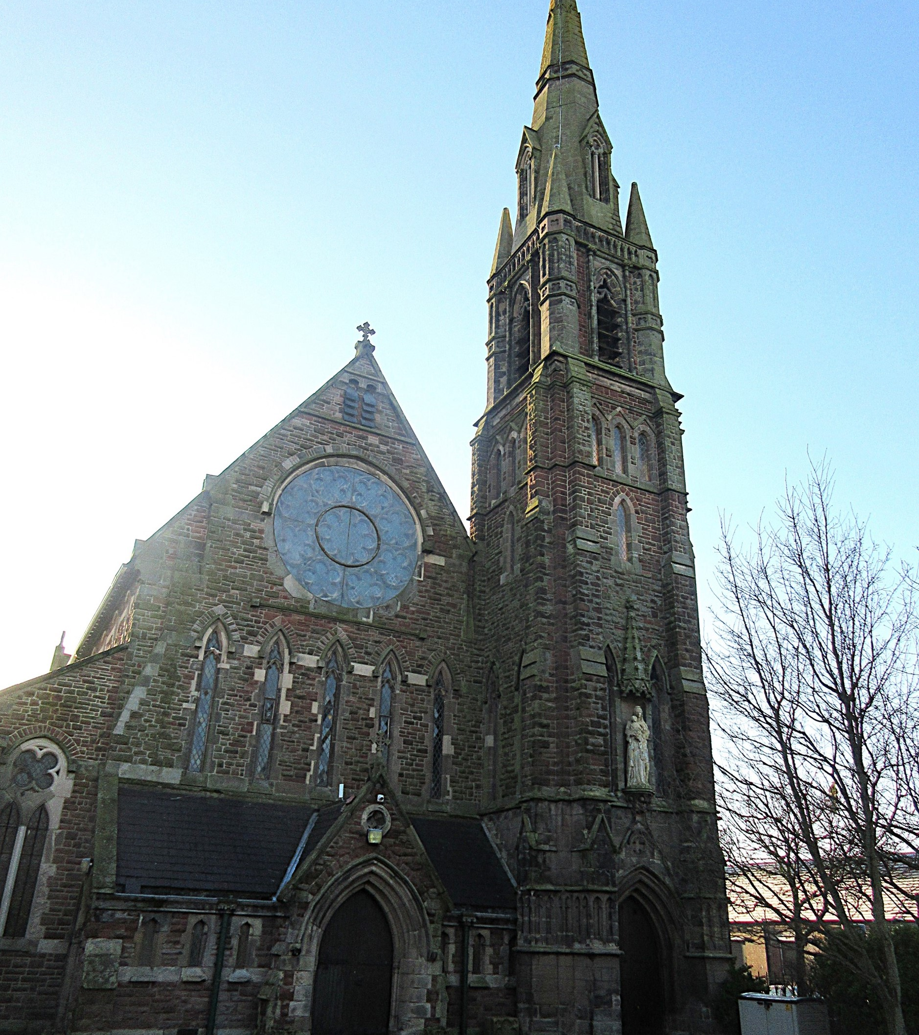
STOP 2: St Mary’s Catholic Church
Notes:
Image courtesy of Susan Benson

Slide 17
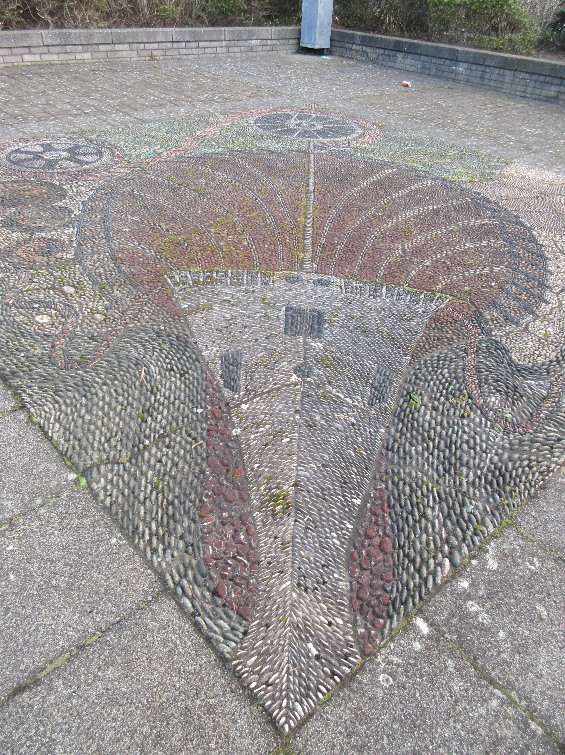
STOP 3: Pride of Barrow Pebble Mosaic
Notes:
Image: Susan Benson

Slide 18
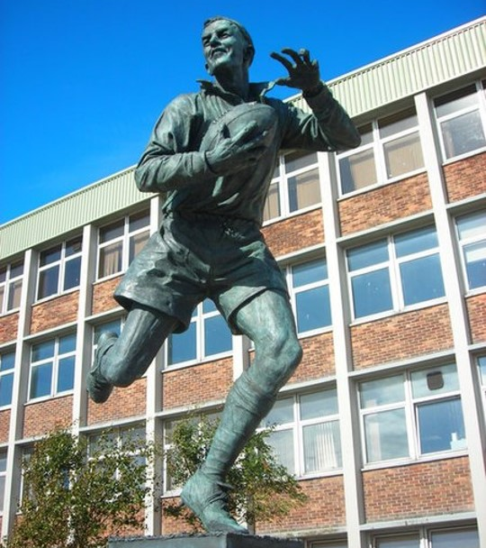
STOP 4: Willie Horne Statue
Notes:
Wiki commons By Rosalind Mitchell, CC BY-SA 2.0, https://commons.wikimedia.org/w/index.php?curid=13013983

Slide 19
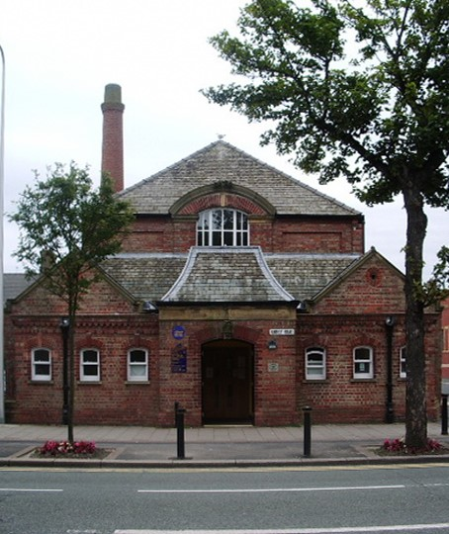
STOP 5: Ramsden Hall
Notes:
By Alexander P Kapp, CC BY-SA 2.0, https://commons.wikimedia.org/w/index.php?curid=8898786

Slide 20
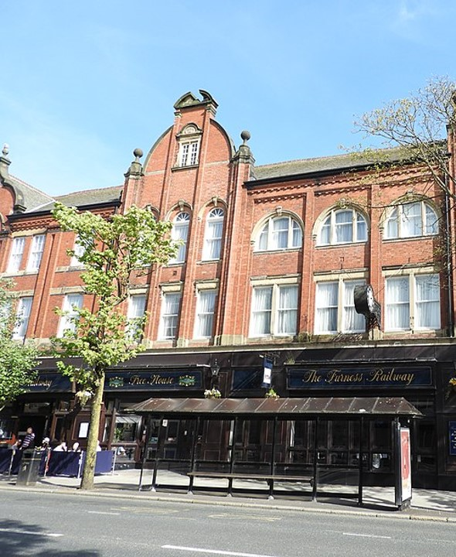
STOP 6: Furness Railway Hotel and Pub
Notes:
By Reading Tom from Reading, UK - The Furness Railway, CC BY 2.0, https://commons.wikimedia.org/w/index.php?curid=104002307

Slide 21
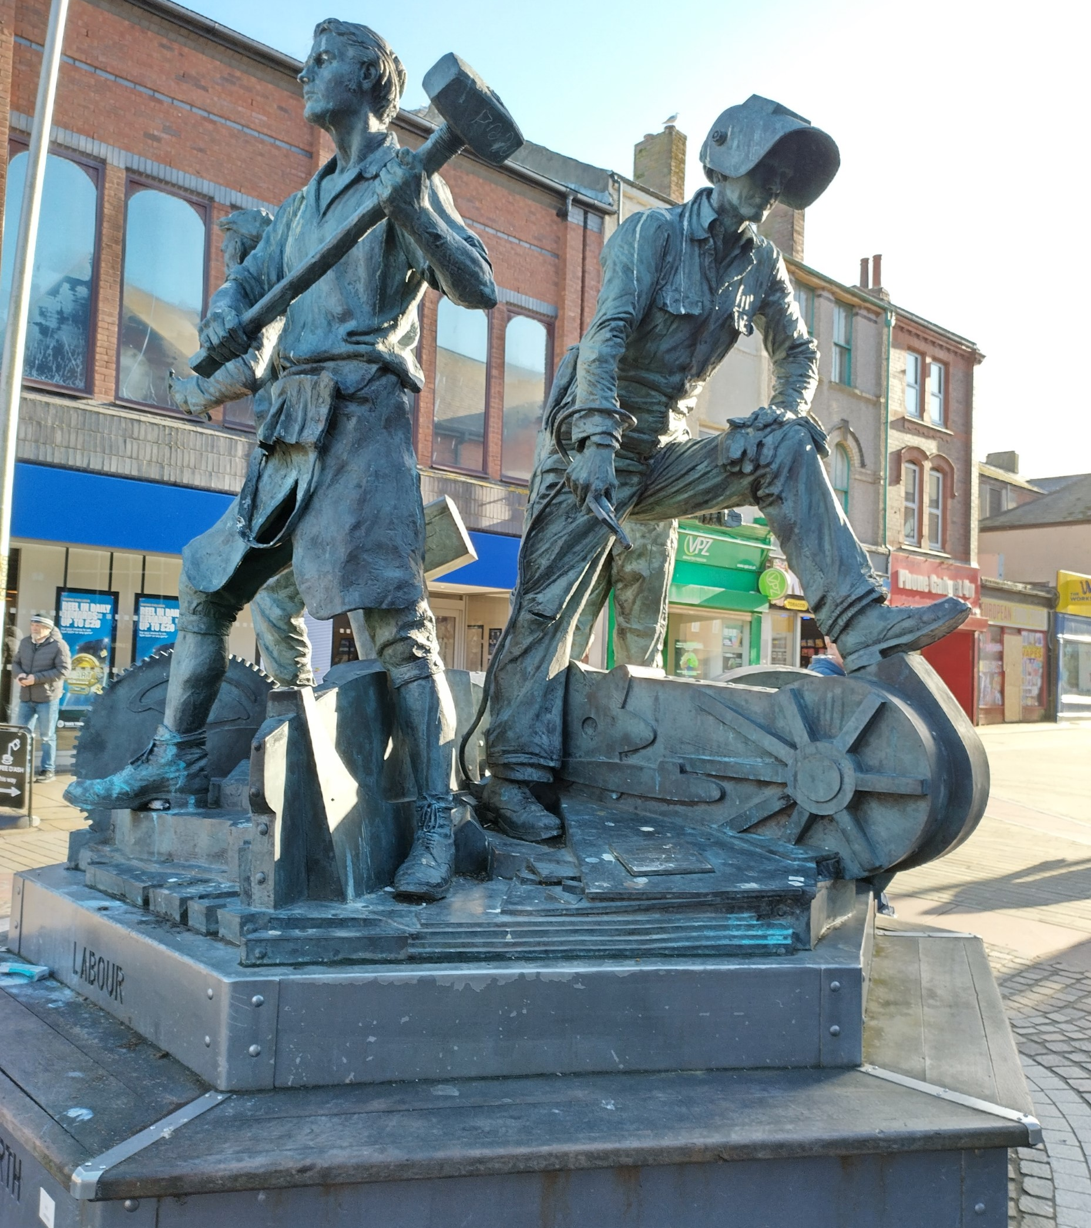
STOP 7: Spirit of Barrow Statue
Notes:
Susan Benson

Slide 22
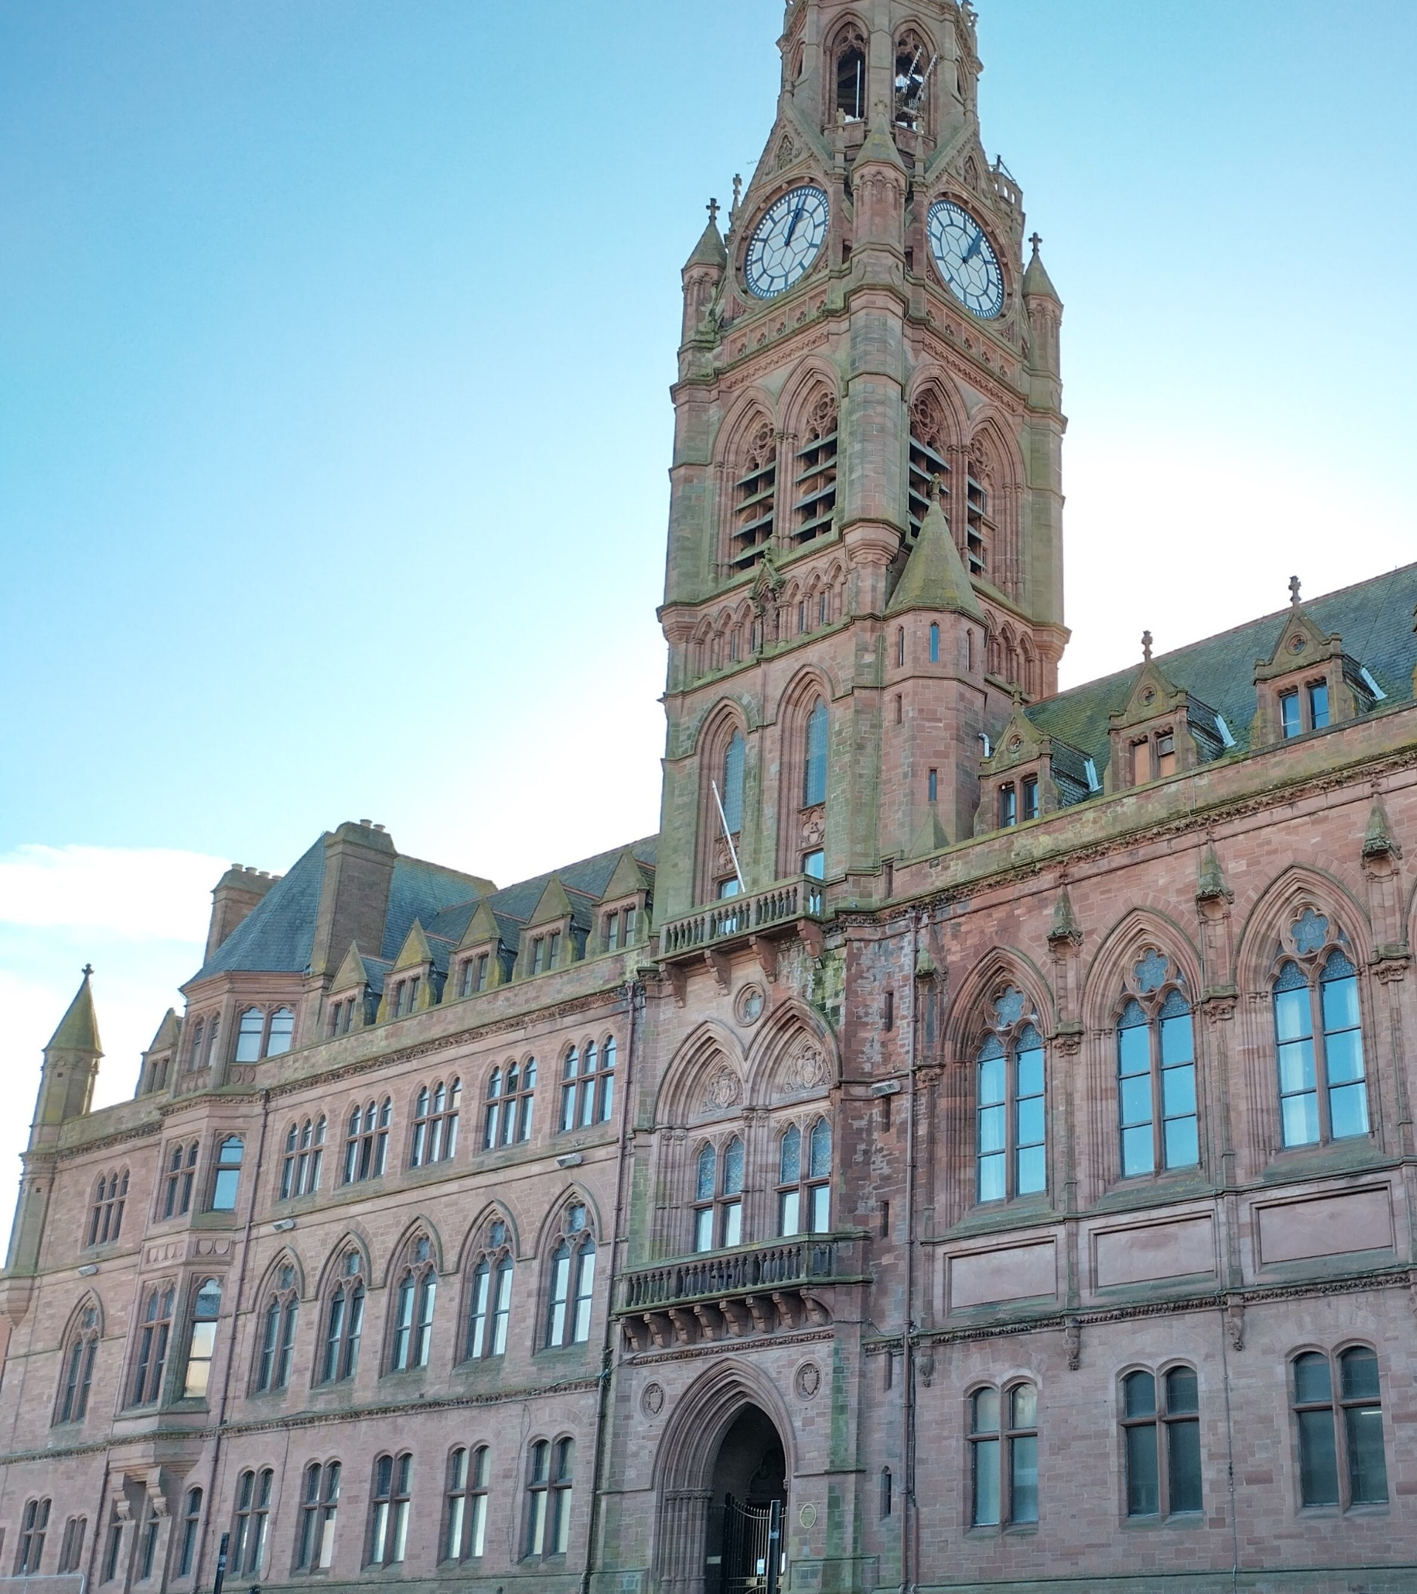
STOP 8:Barrow Town Hall (2)
Notes:
Susan Benson

Slide 23
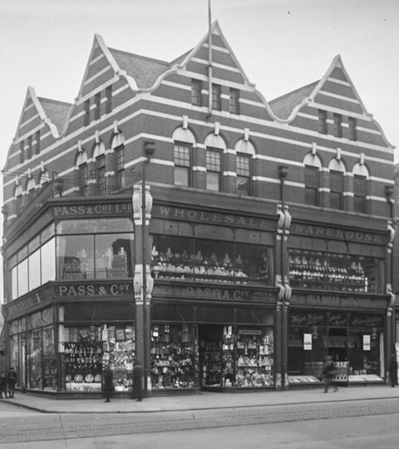
STOP 9: The site of Pass & Co Department Store on Duke Street
Notes:
7963, BDB 86/1/2477 Sankey Family Photographic Archive © Cumbria Archives - https://www.sankeyphotoarchive.uk/collection/view/?id=4362 Pass and Co 1920s

Slide 24
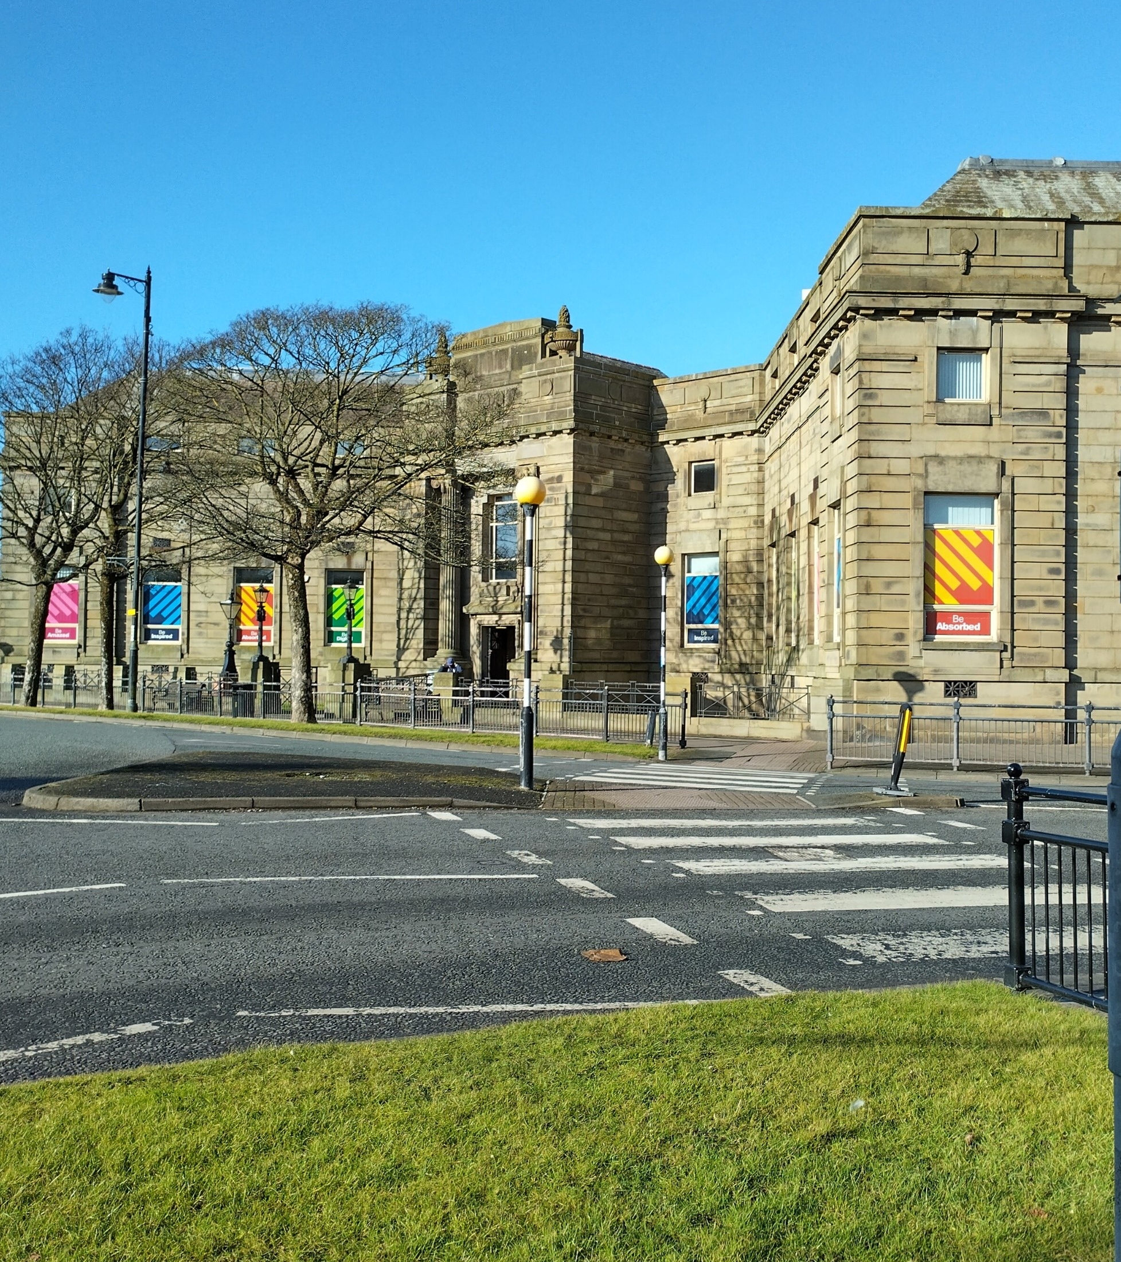
STOP 10: Barrow Library and Archive
Notes:
Susan Benson

Slide 25
What can Barrow’s buildings tell us about the story of our town? History Trail
As you take part in the history trail, you will visit each of the sites from the previous slides. Your teacher will tell you more about each site and will ask you some questions!
You will be given a copy of the worksheet opposite. Each of the 10 sites are marked on the worksheet and there are also some things to SPOT as you walk from one site to the next. If you see them, tick them off on your sheet!
Consider
What does each site tell you about what makes Barrow special?

Slide 26
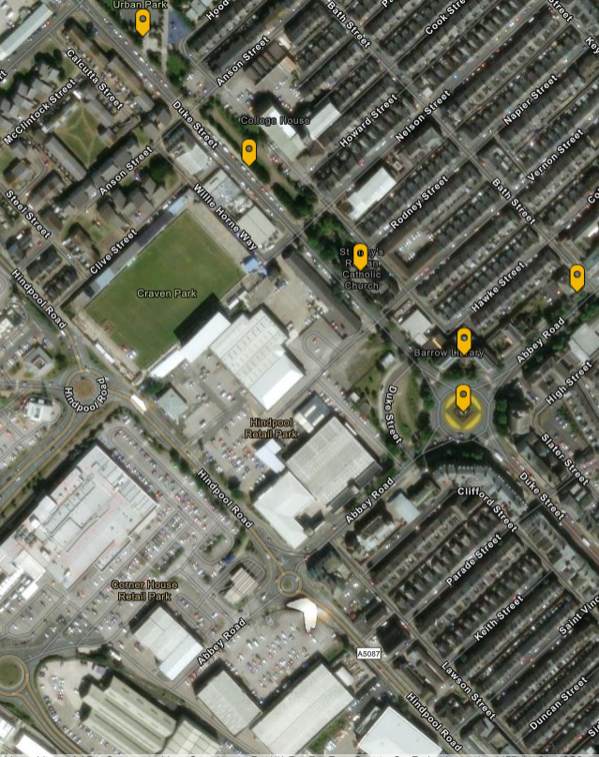
What can Barrow’s buildings tell us about the story of our town? StoryMap
If you can’t walk the trail in person, you could explore the sites using the StoryMap: What can Barrow’s buildings tell us about the story of our town?
Consider
What does each site tell you about what makes Barrow special?
What can Barrow’s buildings tell us about the story of our town StoryMap
Notes:
https://storymaps.arcgis.com/stories/a0c835ad08a343f0b6f306d845b153f1

