Slide 1

What can a timeline tell us about the stories of different people in Bradford?
Key Stage 2: History
Learning Aims and Outcomes
Pupils will analyse an historical narrative for evidence of the development of a place over time
Pupils will highlight information on the timeline as evidence of the development of Bradford over time, including settlement patterns of different groups of migrants
Pupils will considered and then reconsider whether statements about Bradford are true or false
Pupils will plot information on to graphs, present hem to peers and discuss relationship between different graphs
This activity relates to the Teaching Activity: Stories in Stone - How & why has Bradford changed over time?
Notes:
What can buildings tell us about the history of Bradford?
Learning Objective
To analyse an historical narrative for evidence of the development of a place over time including different settlement patterns.
Learning Outcomes
Pupils will analyse an historical narrative for evidence of the development of a place over time
Pupils will highlight information on the timeline as evidence of the development of Bradford over time, including settlement patterns of different groups of migrants
Pupils will considered and then reconsider whether statements about Bradford are true or false
Pupils will plot information on to graphs, present hem to peers and discuss relationship between different graphs

Slide 2
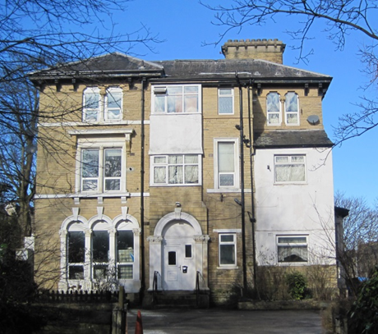
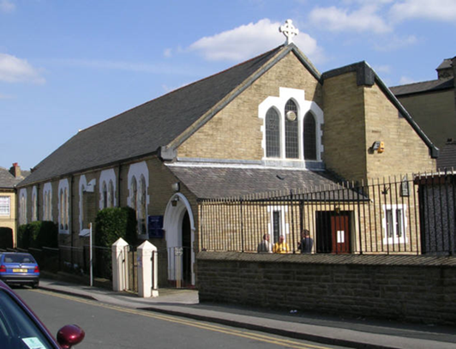
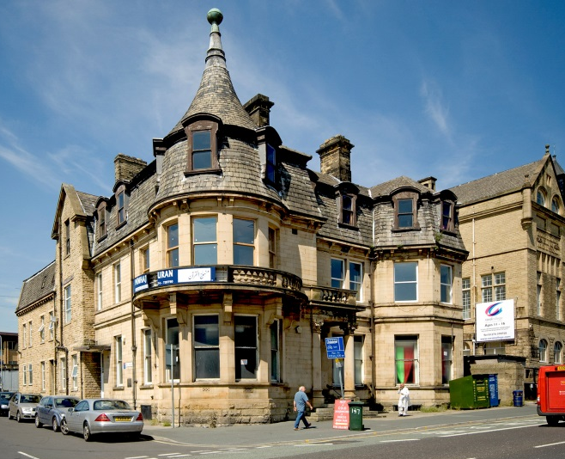
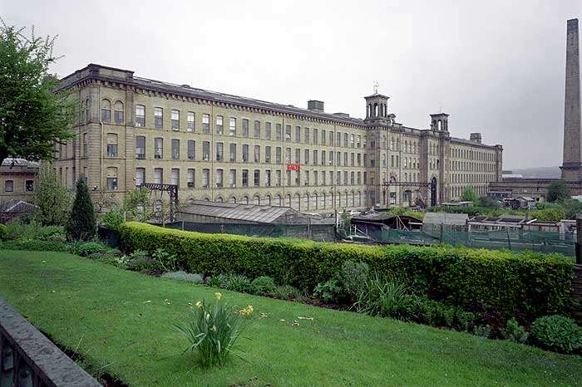
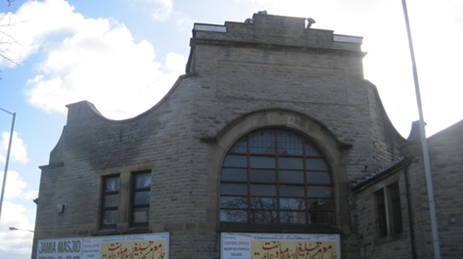
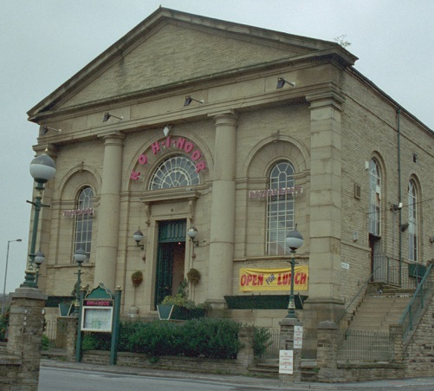
What can buildings tell us about the history of Bradford?
Notes:
Starter Activity
Display the image of a local building that is known to have changed its use over time
e.g. The school building itself if it once had a former use, a former cinema that is now a bingo hall, a former factory that is now a place of worship etc.
Explain its history and ask pairs to briefly discuss what this might reveal about the history of the locality e.g. that people go to the cinema less now, that a once important industry has declined, that a particular religion has become important. Lead discussion, taking comments from pairs.

Slide 3
Bradford
True or false?
Bradford was once a small market town
Making cutlery (knives, forks and spoons) was once a large Bradford industry
There were once German butchers in Bradford
Migrants have been coming to Bradford for over 200 years.
Irish migrants who came to work in the mills were treated very well.
Manningham was one of the richer areas of the city in the 19th century.
Textiles (making cloth and clothes) was once a large Bradford industry.
Living conditions for textile workers in Bradford was generally very good in the 19th century.
In the late 1940s migrants settled in Bradford from Central and Eastern Europe
Notes:
Initial stimulus activity or starter
Display the statements above about Bradford.
Ask pairs to discuss which ones they think are true or false, take comments from selected pairs and hold a class vote about each one in turn. Place T for true by a statement if the majority think the statement is true or F for false if they think it is not. Keep a record of the opinion for each statement.

Slide 4
Things to highlight in the timeline
The population of Bradford from 1776
Irish people in Bradford
German people in Bradford
Jewish people in Bradford
South Asian people in Bradford
East European people in Bradford (from Poland Hungary, Latvia, Ukraine, Serbia etc.)
Caribbean people in Bradford
Notes:
Activity One
Give out copies of the migratory timeline https://historicengland.org.uk/content/docs/education/explorer/bradford-timeline-doc/
of Bradford to different groups or pairs.
Allocate different groups or pairs to highlight dates and details relating to different points on slide two. These are;
The population of Bradford from 1776
Irish people in Bradford
German people in Bradford
Jewish people in Bradford
South Asian people in Bradford
East European people in Bradford (from Poland Hungary, Latvia, Ukraine, Serbia etc)
Caribbean people in Bradford
(Some tasks will take longer than others and some groups or pairs may need to be given more than one item on the list to check the timeline for.)
Which groups are more challenging to research from the timeline?

Slide 5
Population
1776
1800
1850
1900
1950
2000
TODAY
Notes:
Activity Two
Ask the pairs or groups highlighting details of the population growth of the city from the timeline to plot a graph using their data onto a version of the graph on this slide.

Slide 6
Highly visible (Everybody must have noticed them)
Quite visible (most people would have noticed them)
Not very visible (people didn't really notice them)
Invisible (there was little evidence of them left)
1776
1800
1850
1900
1950
2000
TODAY
Notes:
Explain to the remaining groups dealing with different migrants groups that they will plot a graph for their group according to how "visible" these people were (defined according to how much Bradford people were aware of this particular group and what they were doing in the city at particular times). Use the graph on Slide Six.

Slide 7
Bradford
True or false?
Bradford was once a small market town
Making cutlery (knives, forks and spoons) was once a large Bradford industry
There were once German butchers in Bradford
Migrants have been coming to Bradford for over 200 years.
Irish migrants who came to work in the mills were treated very well.
Manningham was one of the richer areas of the city in the 19th century.
Textiles (making cloth and clothes) was once a large Bradford industry.
Living conditions for textile workers in Bradford was generally very good in the 19th century.
In the late 1940s migrants settled in Bradford from Central and Eastern Europe
Notes:
Activity Three
Ask selected pairs or groups to display their graphs and explain any pattern on them.
Lead discussion about any relationships between graphs that pupils might have noticed.
Plenary
Display the statements about Bradford discussed for being true or false in the starter activity (repeated in Slide Seven with answers). Review each statement in turn discussing whether knowledge and counted in the timeline changes any views on the statement being true or false.

