Slide 1
Can we be room detectives?
Can we be room detectives?
Notes:
Image: Source: Historic England Archive Ref: BL08258 Date: 1887 - https://historicengland.org.uk/images-books/photos/item/BL08258

Slide 2
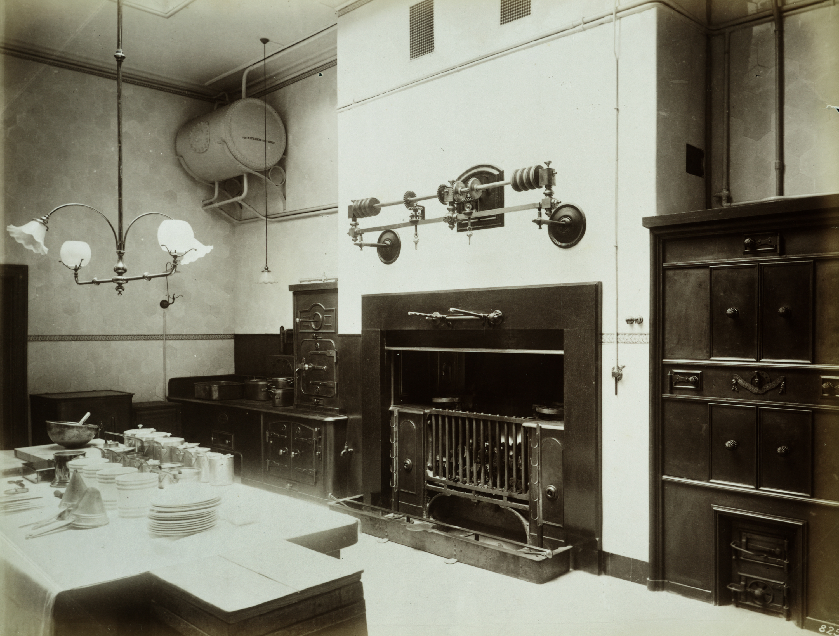
Can YOU be a room detective?
Look carefully at the old photograph on the next slide - it was taken in 1887!
What FURNITURE can you see?
What OBJECTS can you see?
What ROOM do you think it is?
Investigate

Slide 3
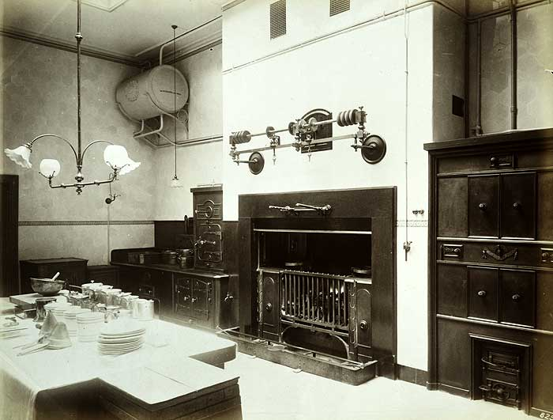
Room Detective
Look carefully at the old photo.
What clues can you see?
Investigate
Notes:
Image: Source: Historic England Archive Ref: BL08258 Date: 1887 - https://historicengland.org.uk/images-books/photos/item/BL08258
You can print out the next slide if you’d like pupils to do this pairs or small groups, rather than all together on a whiteboard,

Slide 4
Room Detective – Print out
Notes:
Image: Source: Historic England Archive Ref: BL08258 Date: 1887 - https://historicengland.org.uk/images-books/photos/item/BL08258

Slide 5
Room Detective – Furniture 1
Can you match the right word to the right number?
Cupboard
Cooker
Table
Fireplace
3
1
2
Investigate
4
Notes:
Image: Source: Historic England Archive Ref: BL08258 Date: 1887 - https://historicengland.org.uk/images-books/photos/item/BL08258

Slide 6
Room Detective – Furniture 2
Can you match the right word to the right number?
Furniture | Number
Cupboard
Cooker
Table
Fireplace
3
1
2
4
Notes:
Image: Source: Historic England Archive Ref: BL08258 Date: 1887 - https://historicengland.org.uk/images-books/photos/item/BL08258

Slide 7
Room Detective – Furniture 3
ANSWERS
Cupboard
Cooker
Table
Fireplace
3
1
4
2
Investigate
Notes:
Image: Source: Historic England Archive Ref: BL08258 Date: 1887 - https://historicengland.org.uk/images-books/photos/item/BL08258

Slide 8
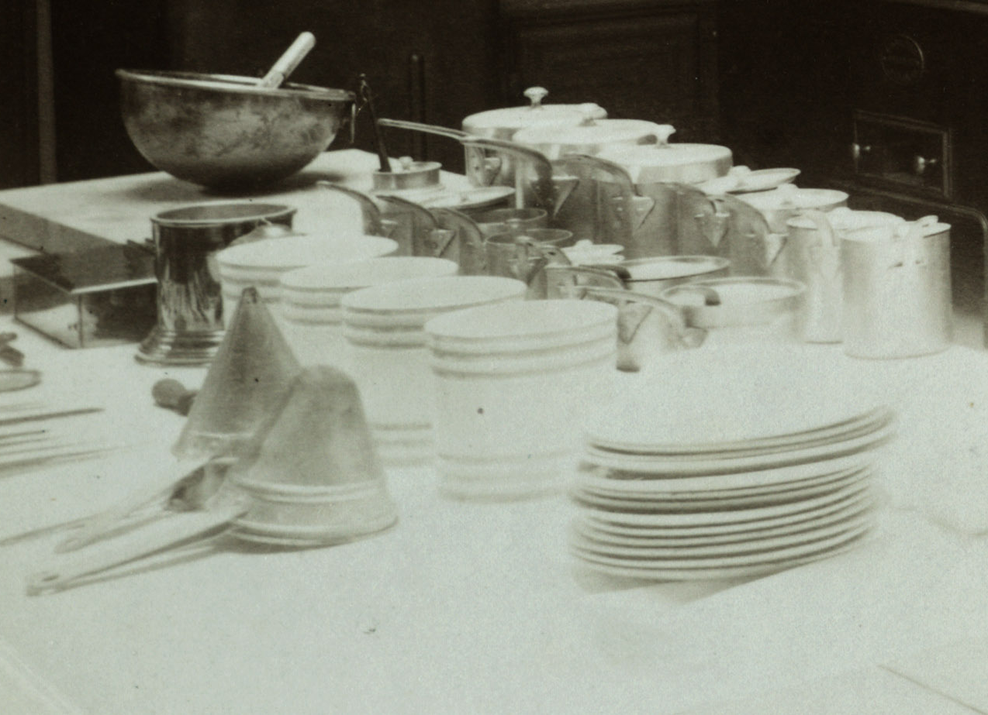
Room Detective – Objects 1
Can you match the right word to the right number?
Sieves
Plates
Mixing Bowl
1
2
3
Investigate
Notes:
Image: Source: Historic England Archive Ref: BL08258 Date: 1887 - https://historicengland.org.uk/images-books/photos/item/BL08258

Slide 9
Room Detective – Objects 2
Can you match the right word to the right number?
1
Furniture | Number
Sieves
Plates
Mixing bowl
2
3
Notes:
Image: Source: Historic England Archive Ref: BL08258 Date: 1887 - https://historicengland.org.uk/images-books/photos/item/BL08258

Slide 10
Room Detective – Objects 3
ANSWERS
Sieves
Plates
Mixing Bowl
2
3
1
Investigate
Notes:
Image: Source: Historic England Archive Ref: BL08258 Date: 1887 - https://historicengland.org.uk/images-books/photos/item/BL08258

Slide 11
Room Detective – did you work out what room this is?
It's a Victorian
KITCHEN!
Click here to reveal the answer!
Investigate
Notes:
Image: Source: Historic England Archive Ref: BL08258 Date: 1887 - https://historicengland.org.uk/images-books/photos/item/BL08258

Slide 12
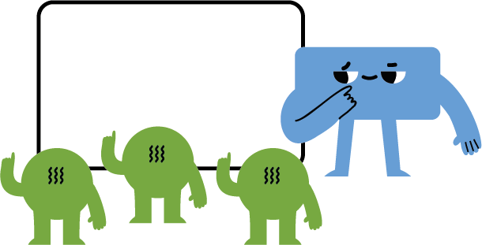
Extension/Further Work
As a class write a list of 10 OBJECTS and/or pieces of FURNITURE you would find in your KITCHEN today…
What was it like to live in the past?
How are KITCHENS today different from those in the past?
Class discussion

Slide 13
Kitchen Objects / Furniture – Print out
Write your list of 10 kitchen items
Modern Kitchen | Victorian Kitchen | Modern Kitchen | Victorian Kitchen
1. |  | 6.
2. |  | 7.
3. |  | 8.
4. |  | 9.
5. |  | 10.
Then write ‘YES’ or ‘NO’ in the other column if you think you would find the item in a Victorian Kitchen

Slide 14
Kitchen Objects / Furniture
Your list might look something like this, but which of them would you also find in a Victorian kitchen?
Modern Kitchen | Victorian Kitchen | Modern Kitchen | Victorian Kitchen
1. Stove/cooker | YES | 6. Knife, fork, spoon etc | YES
2. Fridge | NO | 7. Saucepan | YES
3. Sink | YES | 8. Plate, bowl, cup etc | YES
4. Table | YES | 9. Kettle (electric) | NO
5. Dishwasher | NO | 10. Mircowave | NO
Click on the ? To reveal the answer

Slide 15
So, what did the Victorians do?
They used wood or coal powered stoves (cookers) to cook their food.
They kept their food cold in a larder – a cold room on the north side of the house.
They washed their dishes by hand.
They used metal kettles that sat on top of a stove.

Slide 16
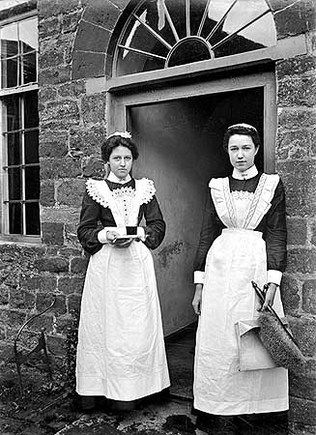
Or if they were rich…
They had servants!
Notes:
Source: Historic England Archive Ref: BB98/06062 Date: 1896 – 1920 - https://historicengland.org.uk/images-books/photos/item/BB98/06062
Find more teaching resources at: HistoricEngland.org.uk/Education

