Slide 1
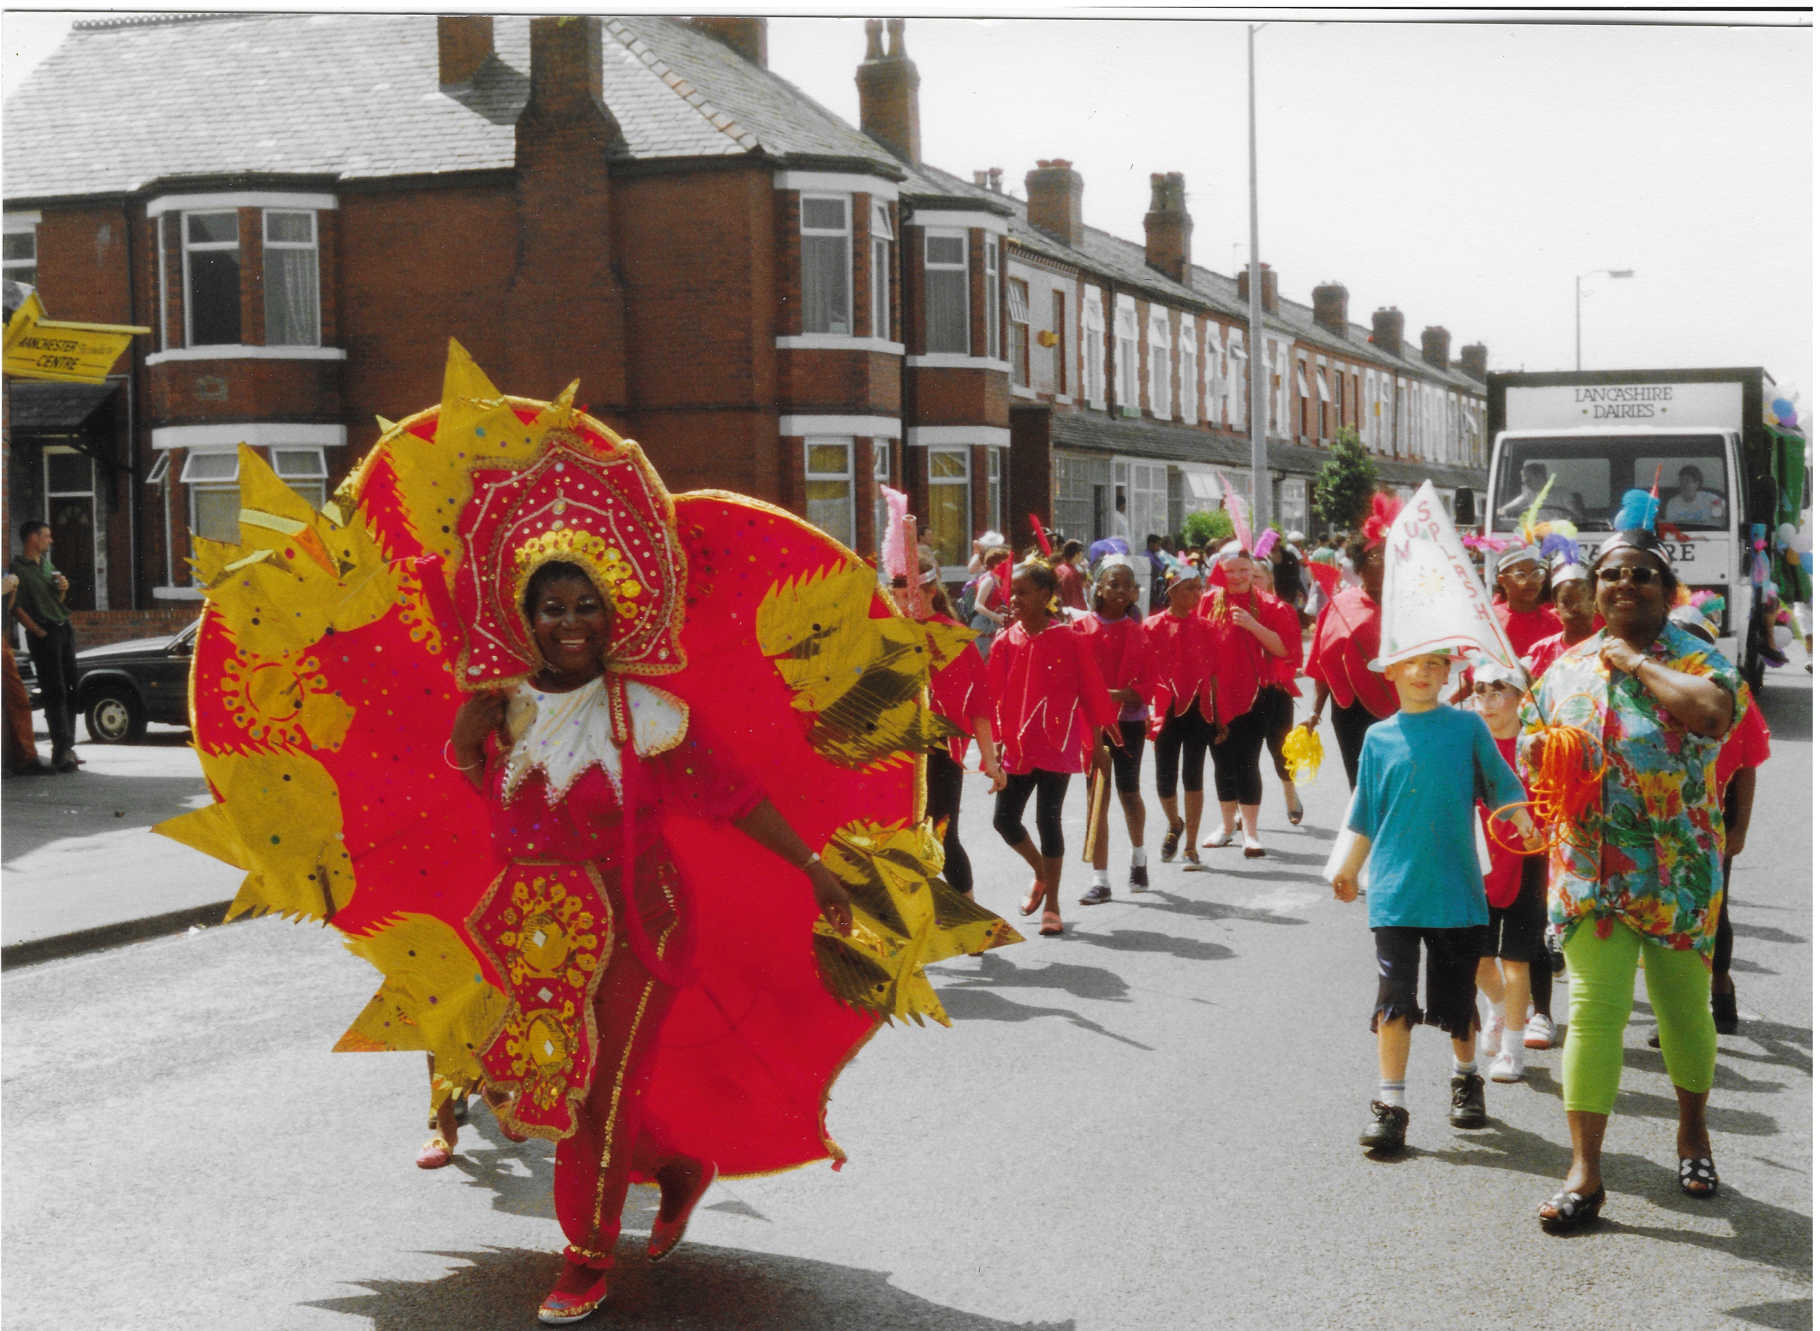
Carnival in Manchester
What can primary evidence tell us about the significance of carnival to the Manchester community in the 1970s?

Slide 2
Lesson 1: What can newspapers tell us about the significance of carnival to the Manchester Community in the 1970’s?
Key Stage 3
Develop historical enquiry skills by using historical evidence to find out about a topic in the past.
Explore diverse and inclusive histories that students will be less familiar with / are less often studied in the classroom.
Analyse local source material, including newspapers
The following PPT was produced by Michelle O’Neill, Head of History at Wellacre Academy in Trafford, Manchester and Jessica White, former PhD student at Manchester University and now lecturer in Black British History at the University of Liverpool. It focuses on the use of newspapers as evidence to explore the significance of carnival to the Manchester community in the 1970s. For more information, see Overview and Scheme of Work.

Slide 3
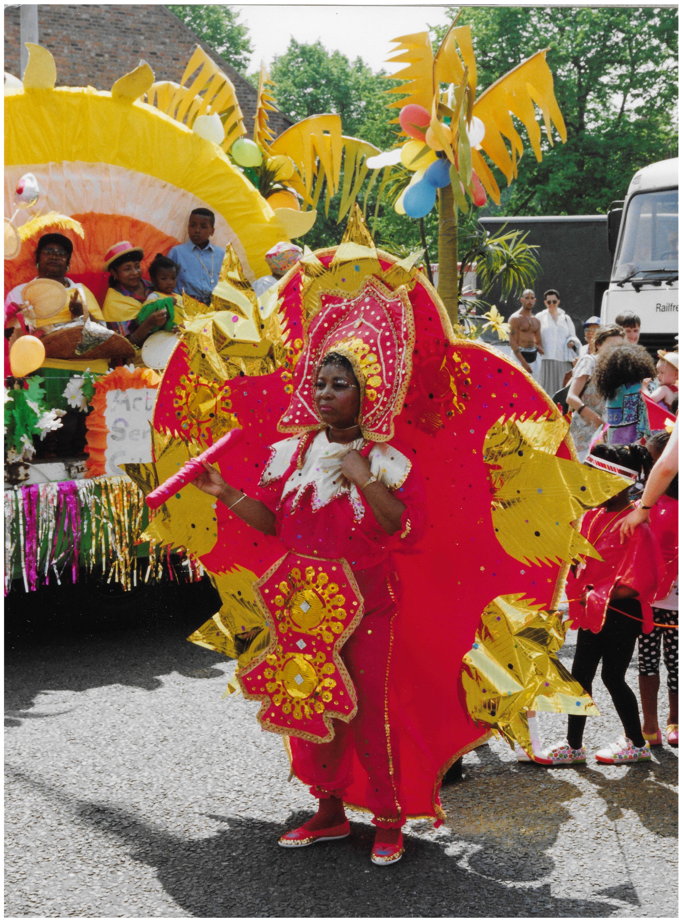

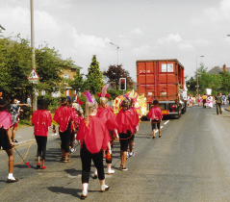
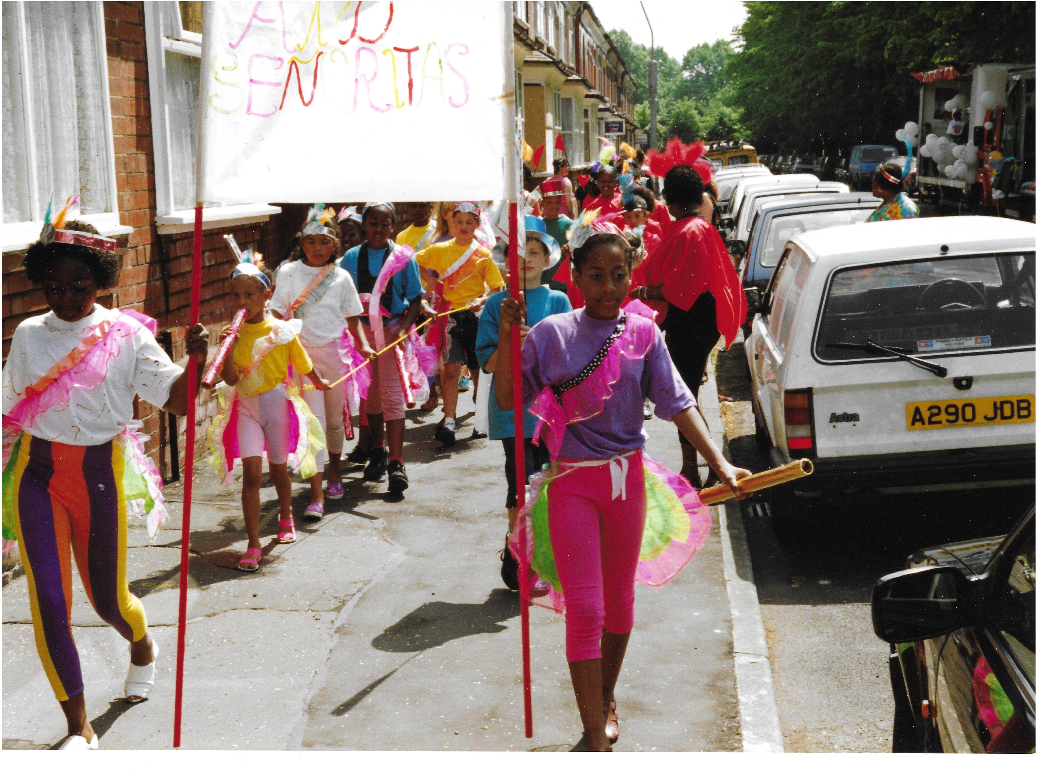
What is going on in these images? 1
Pairs
In pairs, focus on one of these images. Complete the activity as shown on slides 4 – 7 then compare your findings with the class ….
Notes:
Images taken from the personal collection of Lois Gyves

Slide 4


What is going on in these images? 2
What can you infer?
What questions do you want to ask?
What can you see?
Notes:
Images taken from the personal collection of Lois Gyves

Slide 5
What is going on in these images? 3
What can you infer?
What questions do you want to ask?
What can you see?
Notes:
Images taken from the personal collection of Lois Gyves

Slide 6

What is going on in these images? 4
What can you infer?
What questions do you want to ask?
What can you see?
Notes:
Images taken from the personal collection of Lois Gyves

Slide 7
What is going on in these images? 5
What can you infer?
What questions do you want to ask?
What can you see?
Notes:
Images taken from the personal collection of Lois Gyves

Slide 8


What is going on in these images?
These images show scenes from the Manchester Caribbean Carnival in 1992.
They were taken by Lois Gyves who attended the carnival. They are part of a personal collection.
Speak
What have you learnt from the images about the
Manchester Caribbean Carnival?
What do you still want to know?

Slide 9
Carnival – the basics!
The first Caribbean carnivals took place in the slavery era when, in 1784, French colonials introduced Mardi Gras masquerade balls into Trinidad.
When slavery was abolished in 1834, freed Africans were brought onto the streets and this colonial Mardi Gras was transformed into an African-Caribbean Carnival.
The masquerade element of carnival, also called ‘playing mas’, was, and still is, a key component of the British Caribbean carnival, as was traditional Trinidadian music, such as Soca and Calypso.
Caribbean carnivals are now held all over the world. The Notting Hill Carnival, held annually over August Bank Holiday in London, is one of the biggest in the world!
Notes:
This information came from https://drive.google.com/file/d/1b1Pp2iKLb7iPjFq8RswrsdHvAkxm6PCX/view

Slide 10
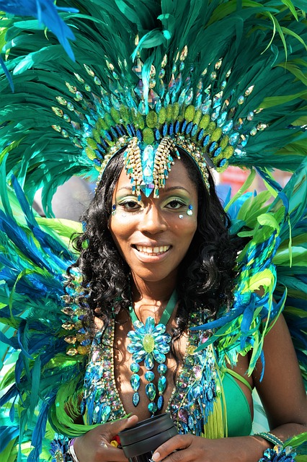
The Notting Hill Carnival
Notting Hill Carnival was the first Caribbean carnival in Britain. The earliest carnival there began in 1959.
Watch one or both of these videos:
https://youtu.be/jDmDb-fF4OI
https://www.youtube.com/watch?v=Wg8L47fZn90
What is the significance of carnival to the people in the videos?
Notes:
Image – Pixaby – There are lots more Notting Hill Carnival is Me films here: https://nhcarnival.org/experience/nhc-is-me

Slide 11
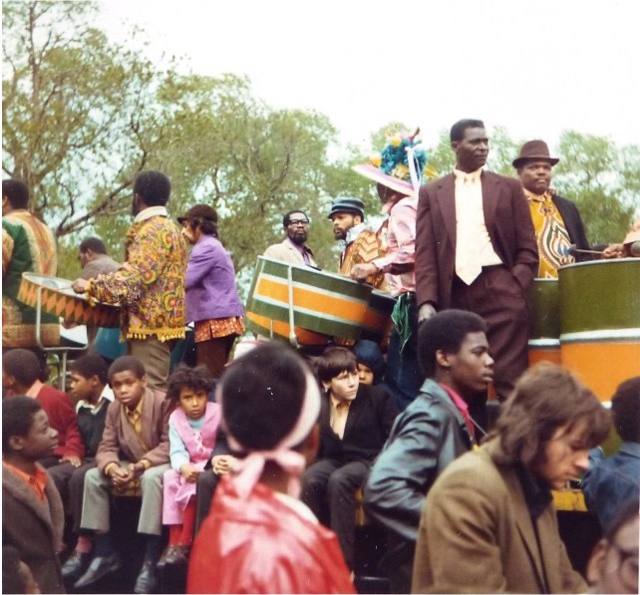
Manchester Caribbean Carnival – History 1
Moss Side is an area of Manchester with a long African and Caribbean history. It was popular with African seamen during and after both world wars. Following Windrush, during the 1950s and ‘60s, a new wave of settlers arriving from the Caribbean contributed to the district’s multicultural feel.
There’s some disagreement as to exactly when the carnival started – some say it was the summer of 1970, others say 1971. It is believed that a group of locals from St. Kits & Nevis and Trinidadian origin decided to throw an impromptu procession through the streets, just like they used to back home.
Notes:
Alexandra Park Carnival, Whalley Range, Manchester By Tom Jolliffe, CC BY-SA 2.0, https://commons.wikimedia.org/w/index.php?curid=14442419

Slide 12
Manchester Caribbean Carnival – History 2
Every year since, traditional mas bands, dance troupes and floats have formed a parade which snakes through neighbouring Hulme and Moss Side itself on the Saturday of carnival weekend. The procession ends up in the park for a party of community events, music and food.
Notes:
Alexandra Park Carnival, Whalley Range, Manchester By Tom Jolliffe, CC BY-SA 2.0, https://commons.wikimedia.org/w/index.php?curid=14442419

Slide 13
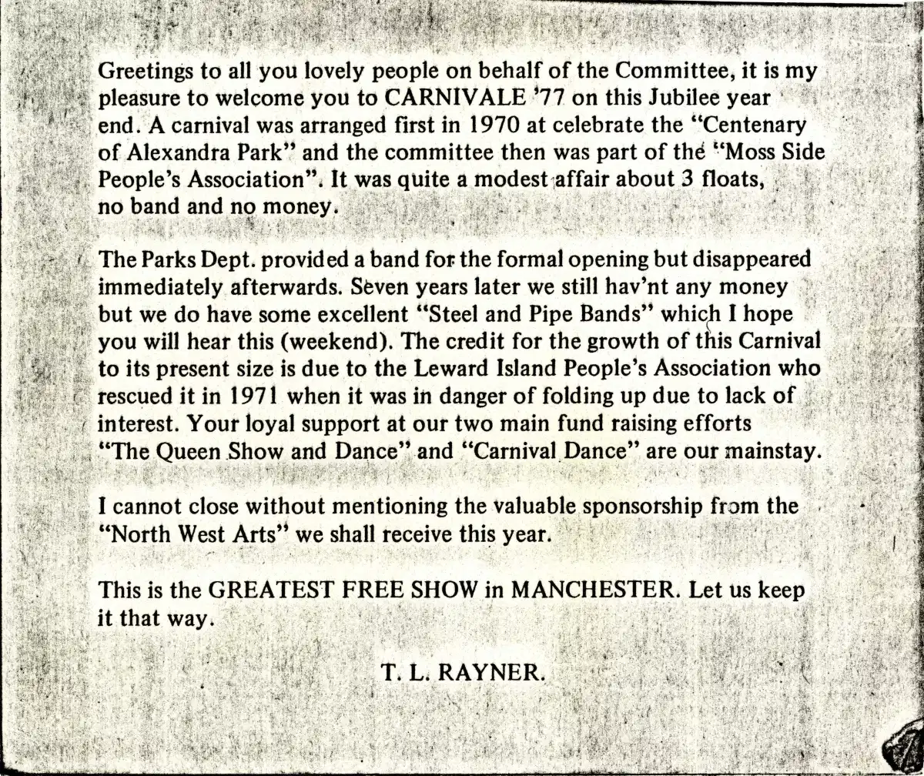
Manchester Caribbean Carnival – History 3
This document is from the personal collection of Locita Brandy, carnival organiser. It is a speech made by T.L. Rayner (carnival committee member) on the opening of the 1977 Caribbean Carnival in Manchester.
What can we learn about the carnival in the 1970’s from this document?
Notes:
Rayner, T. L, ‘Carnival 1977 Address’, Manchester, 1977. Ahmed Iqbal Ullah Race Relations Centre – GB3228.09/2/16.

Slide 14

Key Question
What can newspaper articles tell us about the significance of carnival to the Manchester community in the 1970’s?

Slide 15
Manchester Caribbean Carnival – Newspapers 1
Read the newspaper article on the next slide - Happy festival helps race relations.
Use the article to identify ten facts about the history of the Manchester Caribbean Carnival.
What does the article tell us about the significance of the carnival to the Manchester community by 1972?

Slide 16
The Guardian
Happy festival helps race relations The Guardian; May 30, 1972, pg. 24
The Alexandra Park Festival in Manchester’s Moss Side, which took place yesterday like dozens of other Bank Holiday events throughout the country, is now assuming a new importance as a focal point of improving race relations in the community.
The festival was started three years ago to celebrate the centenary of the park, which lies to the South of the Moss Side area, where one third of the 30,000 community are West Indians.
This year the Leeward Islands Association, which represents the West Indians, combined with the organisers to put on a festival which had more of the flavour of the West Indian carnival than the mere staid British procession.
As gaily-coloured steel bands and West Indian dancers joined the more traditional lorry-borne floats. Mr Moses Leader, the chairman of the association, said he was hoping that the festival would now be expanded to provide an even greater opportunity for the two races to work together and understand each other.
Moss Side, a decaying area of Victorian terraces, which is rapidly being torn apart by the bulldozers under the corporation’s slum clearance programme, houses one out of three West Indians in the Greater Manchester area. Although its former residents are now being scattered to the suburbs, Mr Leader said that the festival could provide an ideal basis for them all to meet again once a year.
The committee has been working for nearly a year to organise the festival, which included processions, a carnival queen, dances and football matches, and has financed it through jumble sales, a charity shop,and donations. “It is ideal as a link between black and white by which both can understand the other and learn mutual respect, which leads to good race relations,” Mr Leader said.
Mr John Rayner, a dispatch manager who is the festival chairman, said: “I think this festival is unique in Manchester. Race relations in Moss Side are already excellent, and this sort of thing should make them even better”.
Notes:
PRINT this slide and hand out to students

Slide 17
The Guardian Help Sheet
Happy festival helps race relations The Guardian; May 30, 1972, pg. 24
The Alexandra Park Festival in Manchester’s Moss Side, which took place yesterday like dozens of other Bank Holiday events throughout the country, is now assuming a new importance as a focal point of improving race relations in the community.
The festival was started three years ago to celebrate the centenary of the park, which lies to the South of the Moss Side area, where one third of the 30,000 community are West Indians.
This year the Leeward Islands Association, which represents the West Indians, combined with the organisers to put on a festival which had more of the flavour of the West Indian carnival than the mere staid British procession.
As gaily-coloured steel bands and West Indian dancers joined the more traditional lorry-borne floats. Mr Moses Leader, the chairman of the association, said he was hoping that the festival would now be expanded to provide an even greater opportunity for the two races to work together and understand each other.
Moss Side, a decaying area of Victorian terraces, which is rapidly being torn apart by the bulldozers under the corporation’s slum clearance programme, houses one out of three West Indians in the Greater Manchester area. Although its former residents are now being scattered to the suburbs, Mr Leader said that the festival could provide an ideal basis for them all to meet again once a year.
The committee has been working for nearly a year to organise the festival, which included processions, a carnival queen, dances and football matches, and has financed it through jumble sales, a charity shop,and donations. “It is ideal as a link between black and white by which both can understand the other and learn mutual respect, which leads to good race relations,” Mr Leader said.
Mr John Rayner, a dispatch manager who is the festival chairman, said: “I think this festival is unique in Manchester. Race relations in Moss Side are already excellent, and this sort of thing should make them even better”.
Notes:
Could be used as help sheet - with some key points highlighted

Slide 18
Manchester Caribbean Carnival – Newspapers 2
Read the article below - “We are all for Manchester.”
What does the article suggest about Carnival in the 1970’s?
We are all for Manchester!, Manchester Evening News, 1976
Mancunians accused us of anti-Manchester bias when we put a picture (of the Carnival Queen) on page 15 of last week’s issue: ‘Are we not good enough for your front page? An irate reader asks. And he continued: “And journalistically speaking I think it would have made good sense if that picture appeared on the front page because it is such a beautiful shot and, moreover, Manchester deserves better treatment. No argument about that so here once again folks is the heart-warming sight of 21-year-old Irma Brandy, newly crowned Manchester Carnival Queen, getting a well-deserved hug and kiss from Mother Brandy. “Well done my little girl” she seems to be saying. And we share that view too.
Notes:
Please note. The original article, along with the image to which it refers, can be viewed at https://uomhistory.com/2020/10/05/the-beginnings-of-manchesters-caribbean-carnival/. Look out for the title of the article “We are all for Manchester”, underneath an image of two women hugging!
PRINT this slide and hand out to students

Slide 19
Reflection - How useful are newspaper articles for telling us about the significance of Carnival?
Title | Useful because… (What is this type of evidence useful for telling us about the significance of Carnival? What makes this type of evidence reliable?) | Not so useful because… (What is this type of evidence less useful for telling us about the significance of Carnival?What makes this type of evidence less reliable?) | More useful if… (What other evidence would you like to see to tell you more about the significance of Carnival?)
Newspapers

Slide 20

More resources
MORE RESOURSCES AT
HistoricEngland.org.uk/Education
contact@historicengland.org.uk

