Slide 1
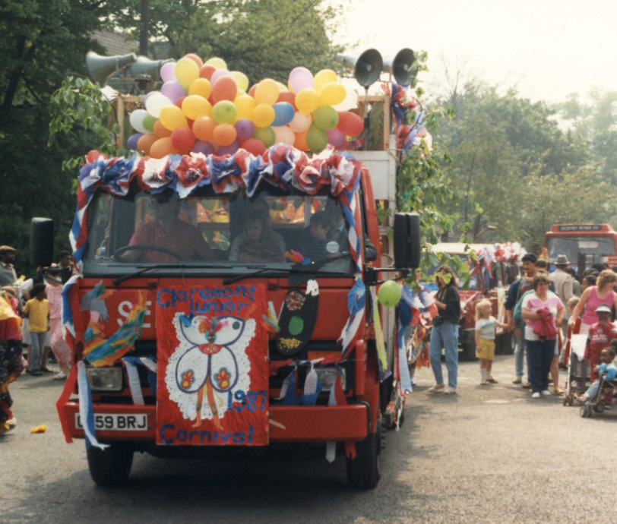
Carnival in Manchester: Lesson 2
What can primary evidence tell us about the significance of carnival to the Manchester community in the 1970s?

Slide 2
Lesson 2: What can photographs tell us about the significance of carnival to the Manchester Community in the 1970’s?
Key Stage 3
Develop historical enquiry skills by using historical evidence to find out about a topic in the past.
Explore diverse and inclusive histories that students will be less familiar with / are less often studied in the classroom.
Analyse local source material, including newspapers
The following PPT was produced by Michelle O’Neill, Head of History at Wellacre Academy in Trafford, Manchester and Jessica White, former PhD student at Manchester University and now lecturer in Black British History at the University of Liverpool. It focuses on the use of newspapers as evidence to explore the significance of carnival to the Manchester community in the 1970s. For more information, see Overview and Scheme of Work.

Slide 3


Carnival – the basics!
The first Caribbean carnivals took place in the slavery era when, in 1784, French colonials introduced Mardi Gras masquerade balls into Trinidad.
When slavery was abolished in 1834, freed Africans were brought onto the streets and this colonial Mardi Gras was transformed into an African-Caribbean Carnival.
The masquerade element of carnival, also called ‘playing mas’, was, and still is, a key component of the British Caribbean carnival, as was traditional Trinidadian music, such as Soca and Calypso.
Caribbean carnivals are now held all over the world. The Notting Hill Carnival, held annually over August Bank Holiday in London, is one of the biggest in the world!
Notes:
This information came from https://drive.google.com/file/d/1b1Pp2iKLb7iPjFq8RswrsdHvAkxm6PCX/view

Slide 4
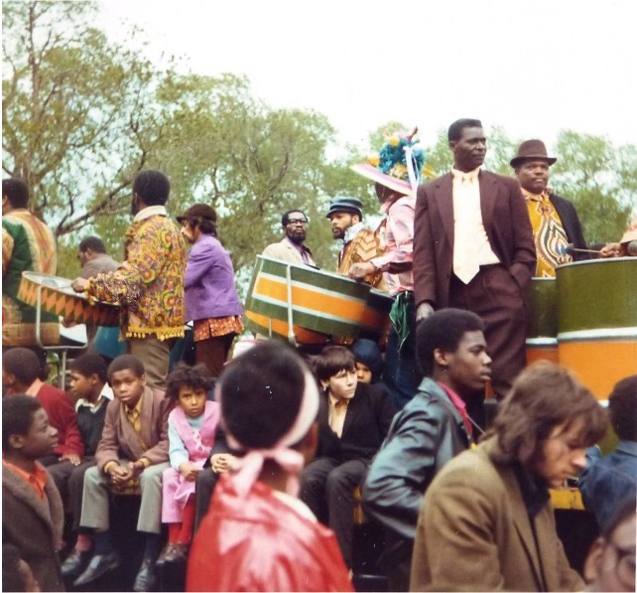
Manchester Caribbean Carnival – History 1
Moss Side is an area of Manchester with a long African and Caribbean history. It was popular with African seamen during and after both world wars. Following Windrush, during the 1950s and ‘60s, a new wave of settlers arriving from the Caribbean contributed to the district’s multicultural feel.
There’s some disagreement as to exactly when the carnival started – some say it was the summer of 1970, others say 1971. It is believed that a group of locals from St. Kits & Nevis and Trinidadian origin decided to throw an impromptu procession through the streets, just like they used to back home.
Notes:
Alexandra Park Carnival, Whalley Range, Manchester By Tom Jolliffe, CC BY-SA 2.0, https://commons.wikimedia.org/w/index.php?curid=14442419

Slide 5
Manchester Caribbean Carnival – History 2
Every year since, traditional mas bands, dance troupes and floats have formed a parade which snakes through neighbouring Hulme and Moss Side itself on the Saturday of carnival weekend. The procession ends up in the park for a party of community events, music and food.
Notes:
Alexandra Park Carnival, Whalley Range, Manchester By Tom Jolliffe, CC BY-SA 2.0, https://commons.wikimedia.org/w/index.php?curid=14442419

Slide 6

How useful were newspaper articles for telling us about the significance of carnival to the Manchester community in the 1970s?
Less useful for / because...
Useful for / because…
What other evidence might help you find out more?...
Notes:
Image: Pixaby

Slide 7

Key Question
What can photographs tell us about the significance of carnival to the Manchester community in the 1970’s?

Slide 8
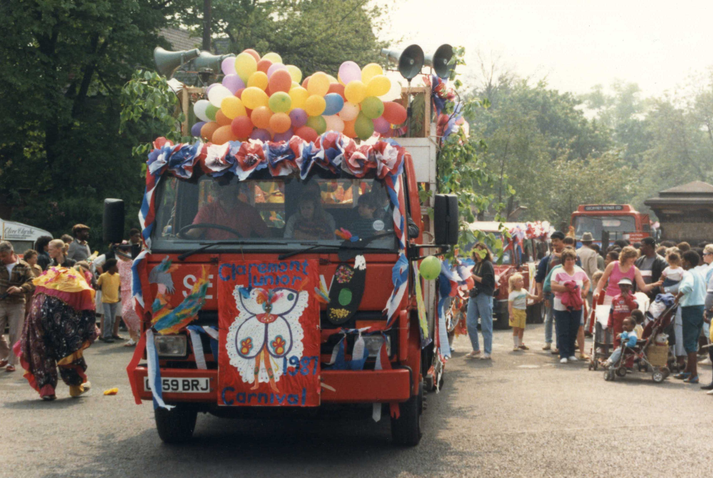
Photograph 1
Describe what you see in this picture.
Try to comment on at least five things you notice.
Notes:
Claremont Junior School float, 1987. Courtesy Locita Brandy

Slide 9
Photograph 1 a
Describe what you can infer from this photograph (what does it reveal to you about carnival)?
I think this because….
Notes:
Claremont Junior School float, 1987. Courtesy Locita Brandy

Slide 10
Photograph 1. Example
In the photograph I see a carnival float decorated with balloons and loud speakers on top. I see a person in a colourful costume and people of different races watching from the side, including children.
This makes me think that the Manchester Caribbean Carnival is a celebratory event, with music. It is multicultural and multigenerational, bringing all sorts of people from different backgrounds together.

Slide 11
Task
Write an analysis of Photographs 2, 3 and 4. Focus on what you see in the photographs, and what you can infer from the photographs…
In the photograph I see…
This photograph makes me think...

Slide 12
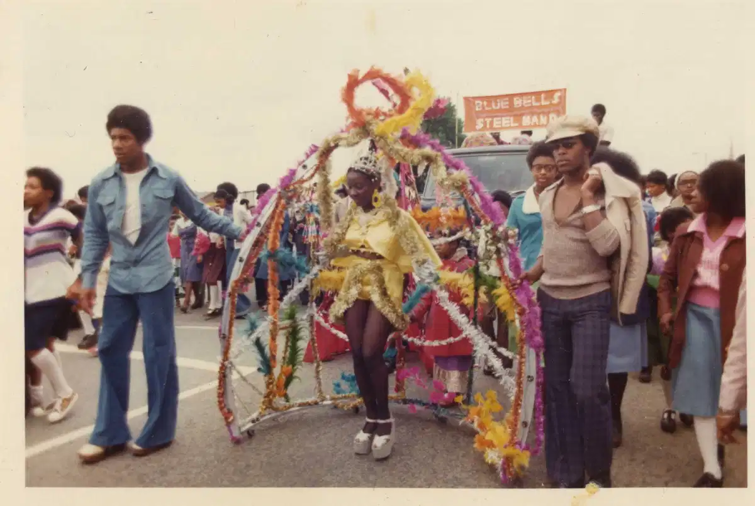
TASK: Photograph 2
In the photograph I see…
This photograph makes me think...
Notes:
Irma Brandy (daughter of Locita Brandy) as Carnival Queen, 1976
PRINT this slide and hand out to students

Slide 13
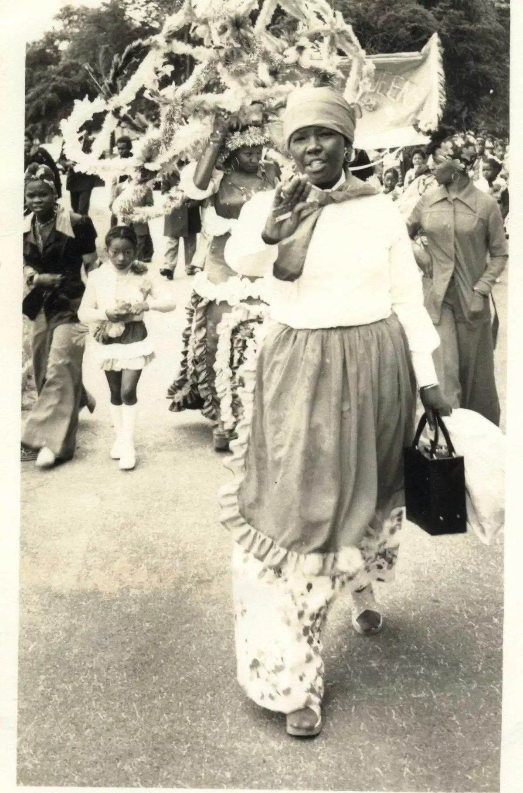
TASK: Photograph 3
In the photograph I see…
This photograph makes me think...
Notes:
Carnival organiser Mrs Brandy leads out the parade, 1974. Courtesy Locita Brandy
PRINT this slide and hand out to students

Slide 14
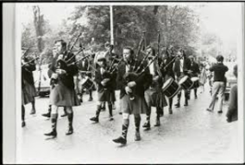
TASK: Photograph 4
In the photograph I see…
This photograph makes me think...
Notes:
Scottish bagpipe band perform at the first carnival procession in Alexandra Park (Manchester Central Library Archives, 1970)
PRINT this slide and hand out to students

Slide 15
Purpose
Most of the photographs we have looked at are from the personal collection of Locita Brandy, who organised the first carnival and continued in the role for many years. She donated these photographs (and other documents about carnival) to an archive for historians and other interested people to access.
REFLECT
Why do people take and keep personal photographs? Explore several reasons.
Why do you think Ms Brandy donated her carnival photographs and documents to an archive?

Slide 16
Reflection - How useful are photographs for telling us about the significance of Carnival?
Title | Useful because… (What is this type of evidence useful for telling us about the significance of Carnival? What makes this type of evidence reliable?) | Not so useful because… (What is this type of evidence less useful for telling us about the significance of Carnival? What makes this type of evidence less reliable?) | More useful if… (What other evidence would you like to see to tell you more about the significance of Carnival?)
Photographs

Slide 17

More resources
MORE RESOURSCES AT
HistoricEngland.org.uk/Education
contact@historicengland.org.uk

