Slide 1
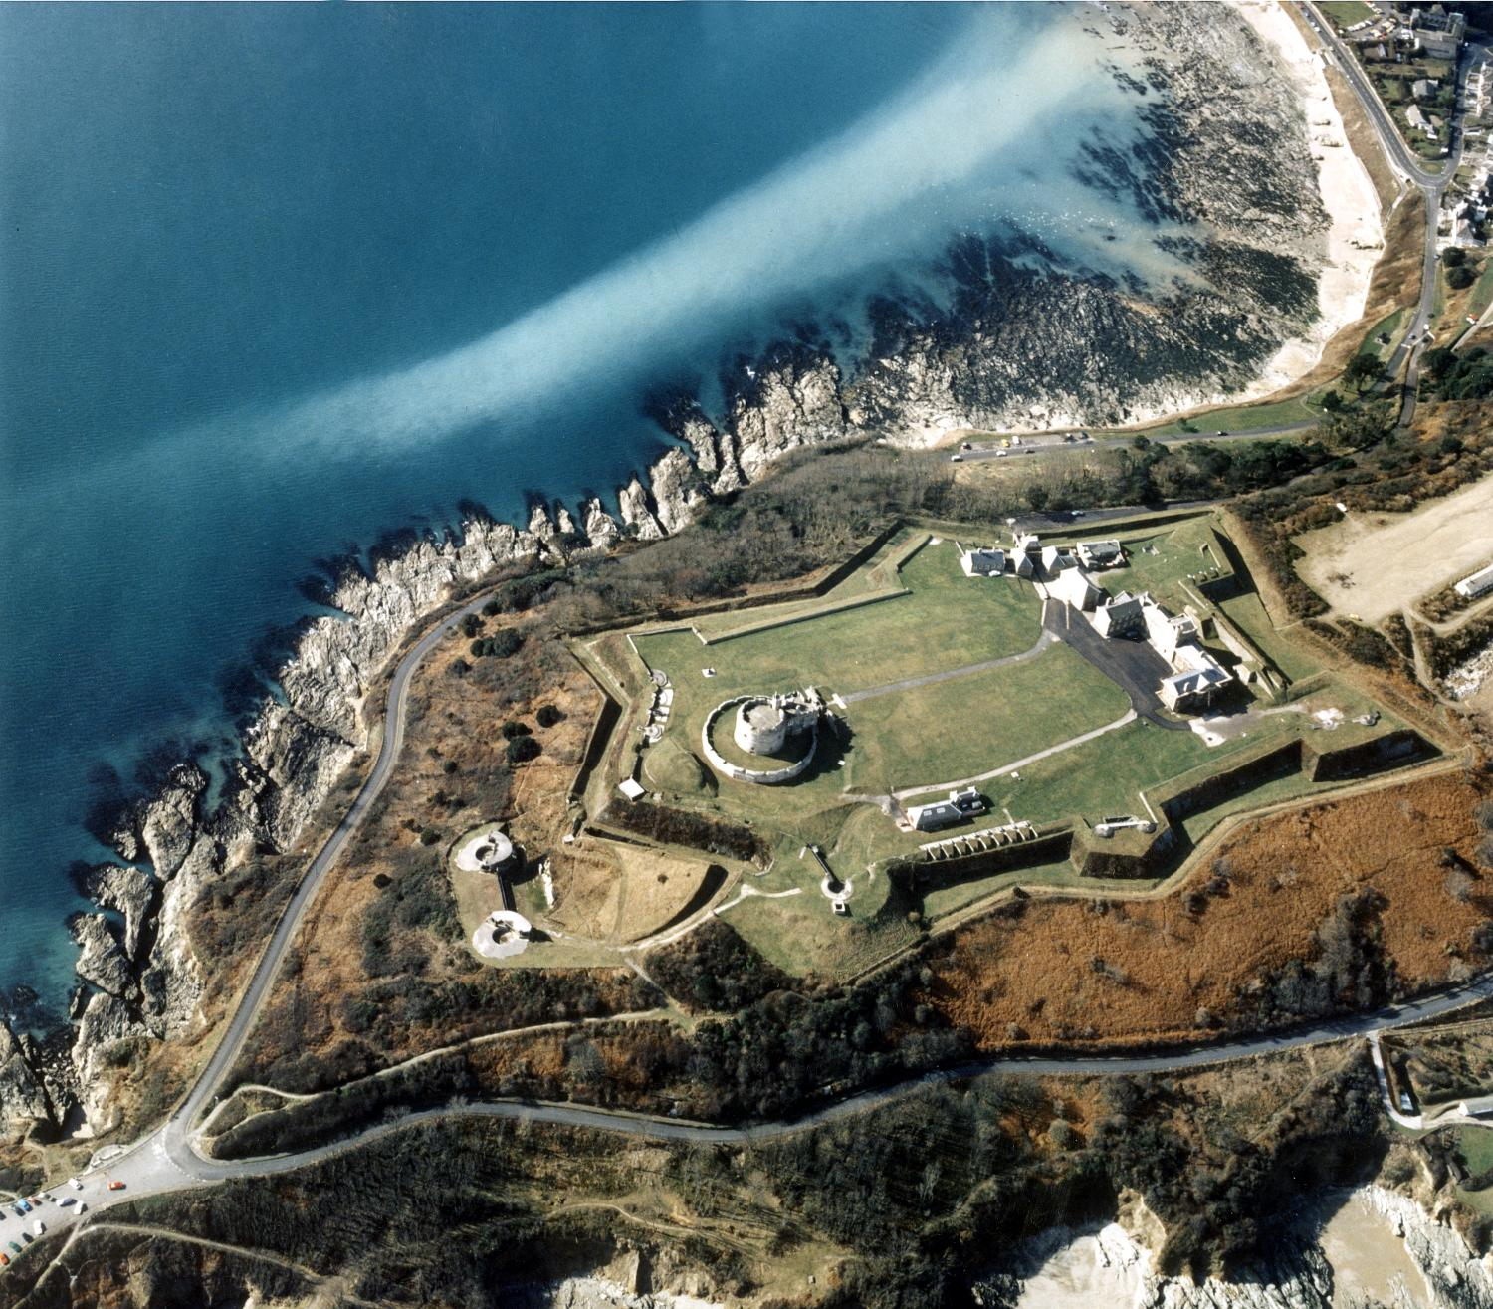
Can we prove how real the threat of invasion was in 1538-47?
Can we prove how real the threat of invasion was in 1538-47?
Notes:
Pendennis - © Crown copyright. Historic England Archive ref: nmr 10700/56a

Slide 2
Can we prove how real the threat of invasion was in 1538-47? 1
Key Stage 5: History
Learning Aims and Outcomes
Students will use evidence to help their understanding of how Henry VIII perceived the threat of invasion from France and Spain between 1538-47 and gain a better understanding of Henry VIII’s foreign policy and it’s impact on England
Students will be able to demonstrate skills in searching for, assessing and using relevant evidence
Notes:
Relates to: OCR - Unit Y307: Tudor Foreign Policy 1485–1603
Relates to: AQA - 1C The Tudors: England, 1485–1603 - How did relations with foreign powers change
This PowerPoint relates to the Teaching Activity: How real was the threat of invasion 1538-47?

Slide 3


Background
In 1538 The Truce of Nice saw the declaration of a 10 year truce between Francis I of France and Charles V (Holy Roman Emperor)…
In 1536 The Italian War between Francis I of France and Charles V of Spain begins…
The Pope issued a decree that Henry was no longer King of England. He called upon Catholics to attack him.

Slide 4
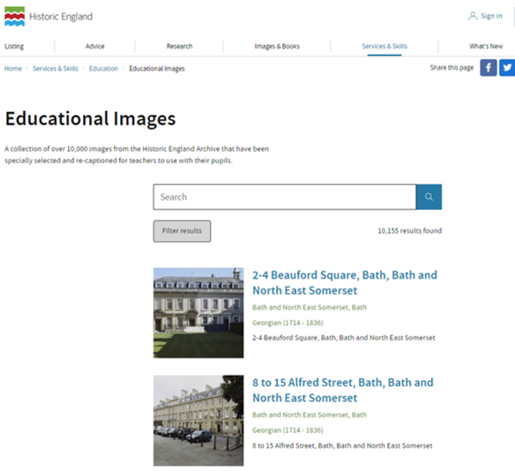

TASK 1
Search the Educational Images database using the terms…
Henry viii, castle and applying a ‘filter’ to select Tudor (1485-1602) from the drop-down list of Periods.
Look
Notes:
https://historicengland.org.uk/services-skills/education/educational-images?searchType=Educational%20Images&search=Henry%20viii,%20castle&page=&filterOption=filterValue&facetValues=facet_ddl_period:Tudor%2520%25281485%2520-%25201602%2529:fperiod%7C&pageId=32278

Slide 5
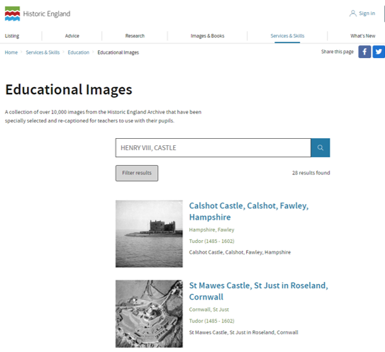

TASK 2
Go through all the results and create a list of all the castles built during the reign of Henry VIII.
Write

Slide 6
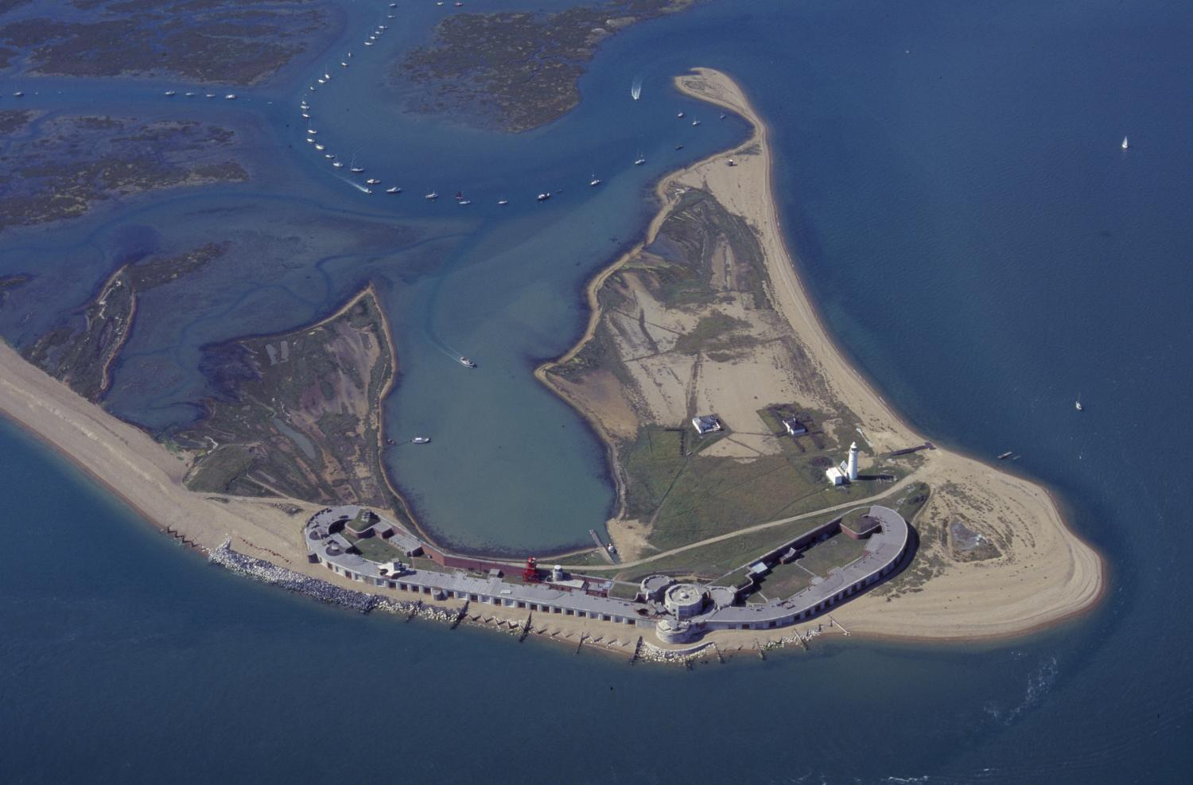
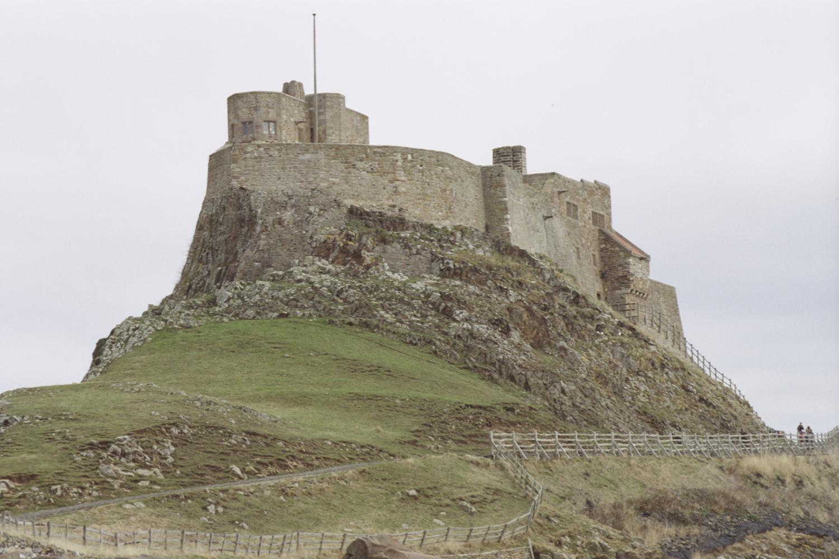
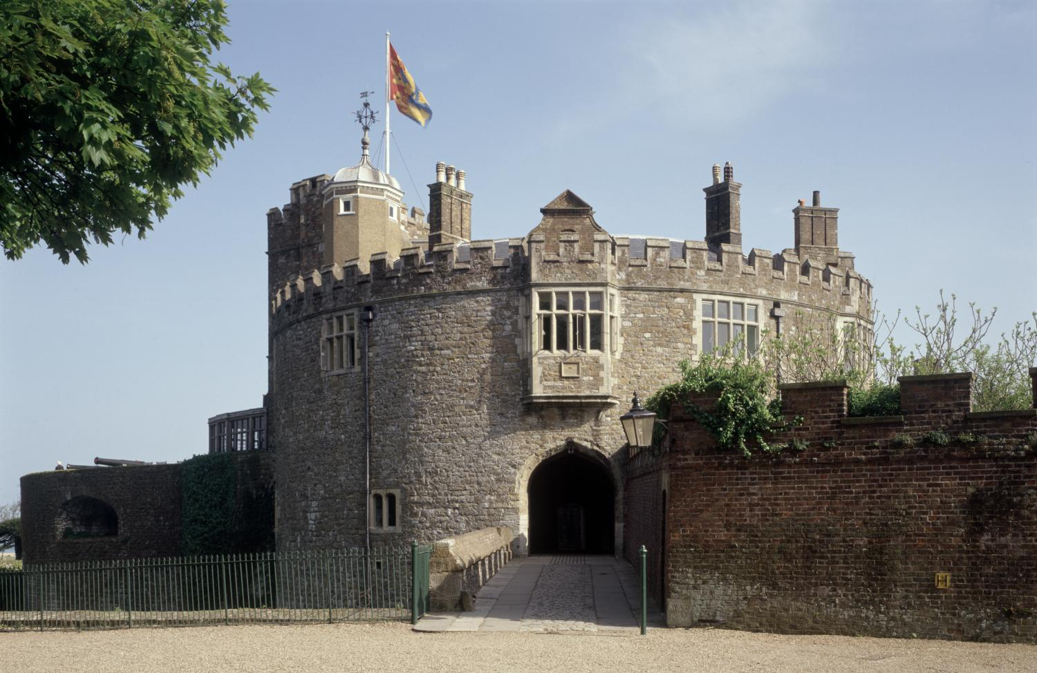
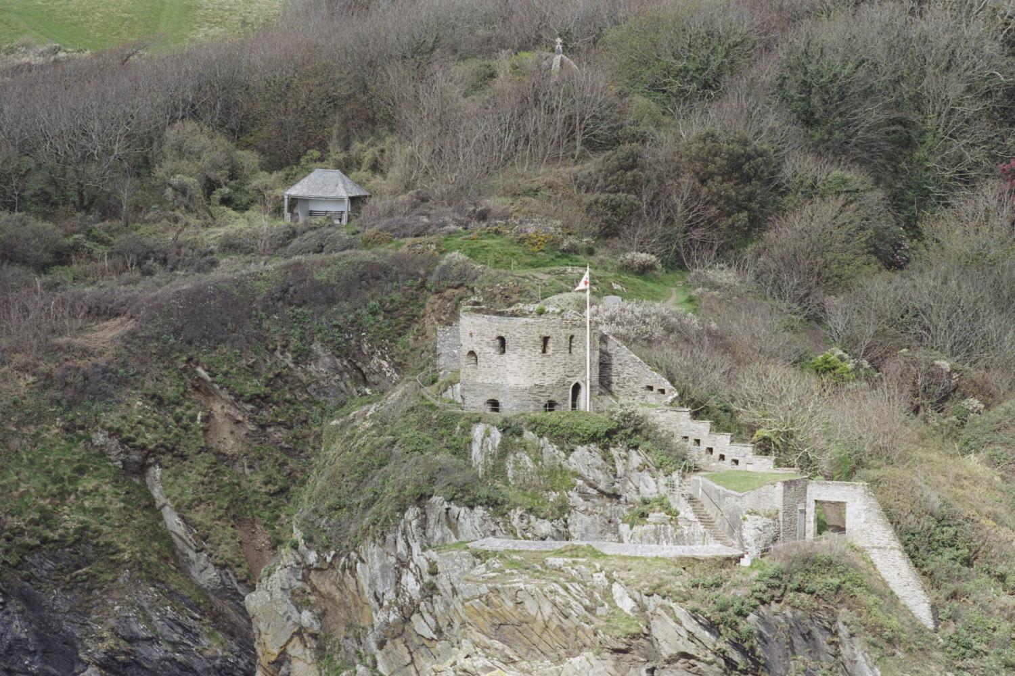
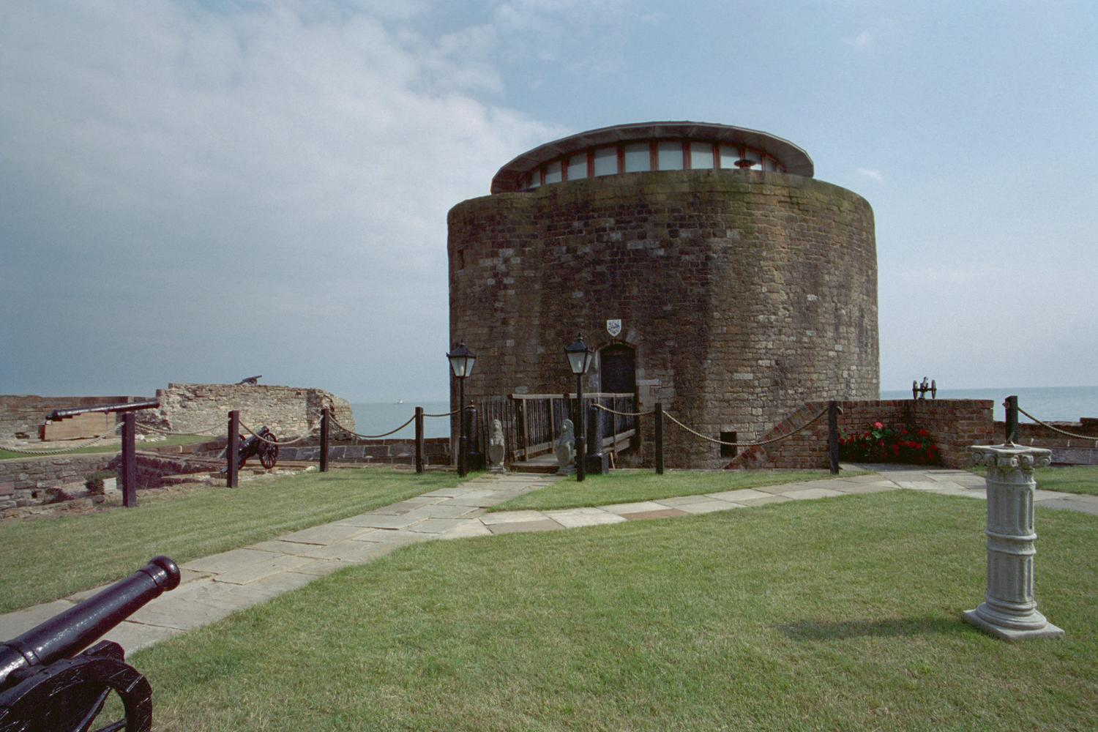
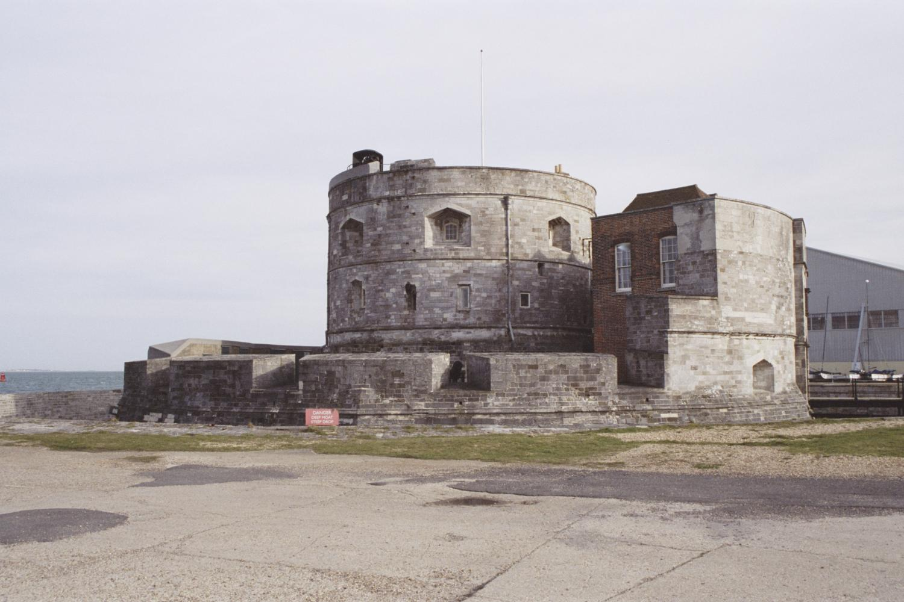
These are the castles built during the reign of Henry VIII 1
Use your research to label them
Notes:
Hurst - © Crown copyright. Historic England Archive ref: nmr 15700/29
Lindisfarne - © Mr John Murdoch. Source: Historic England Archive Ref: IOE01/15205/02
Walmer - © Copyright Historic England Archive Photo Library ref: k980415
St Catherine - © Mr Roger Norman. Source: Historic England Archive ref: IOE01/13919/04
Sandgate - © Mr Brian Collins. Source: Historic England Archive ref: IOE01/07295/02
Calshot – © Mr Alec Howard. Source: Historic England Archive ref: IOE01/12957/12

Slide 7
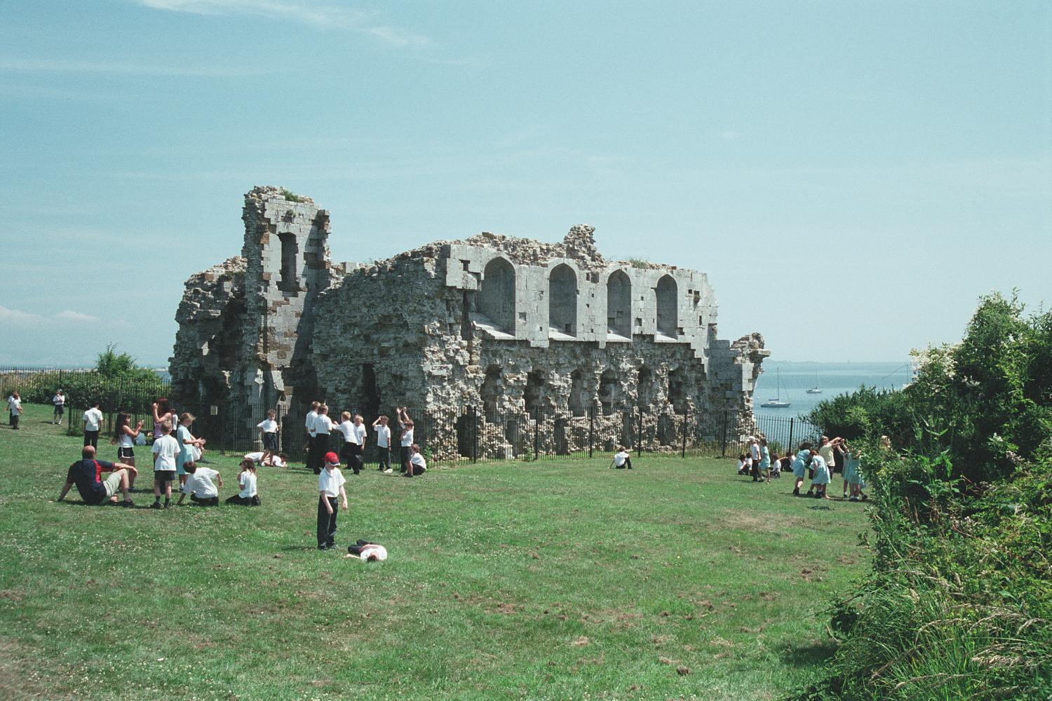
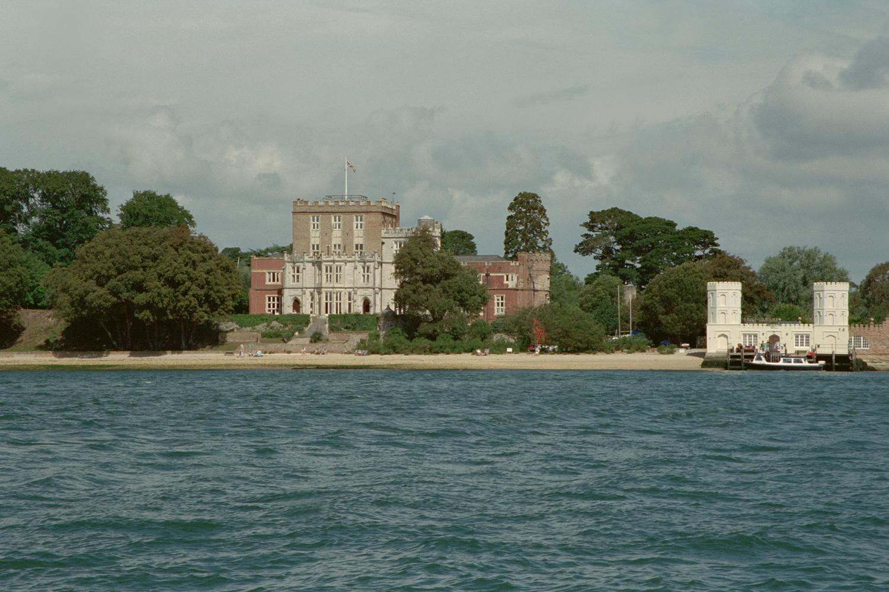

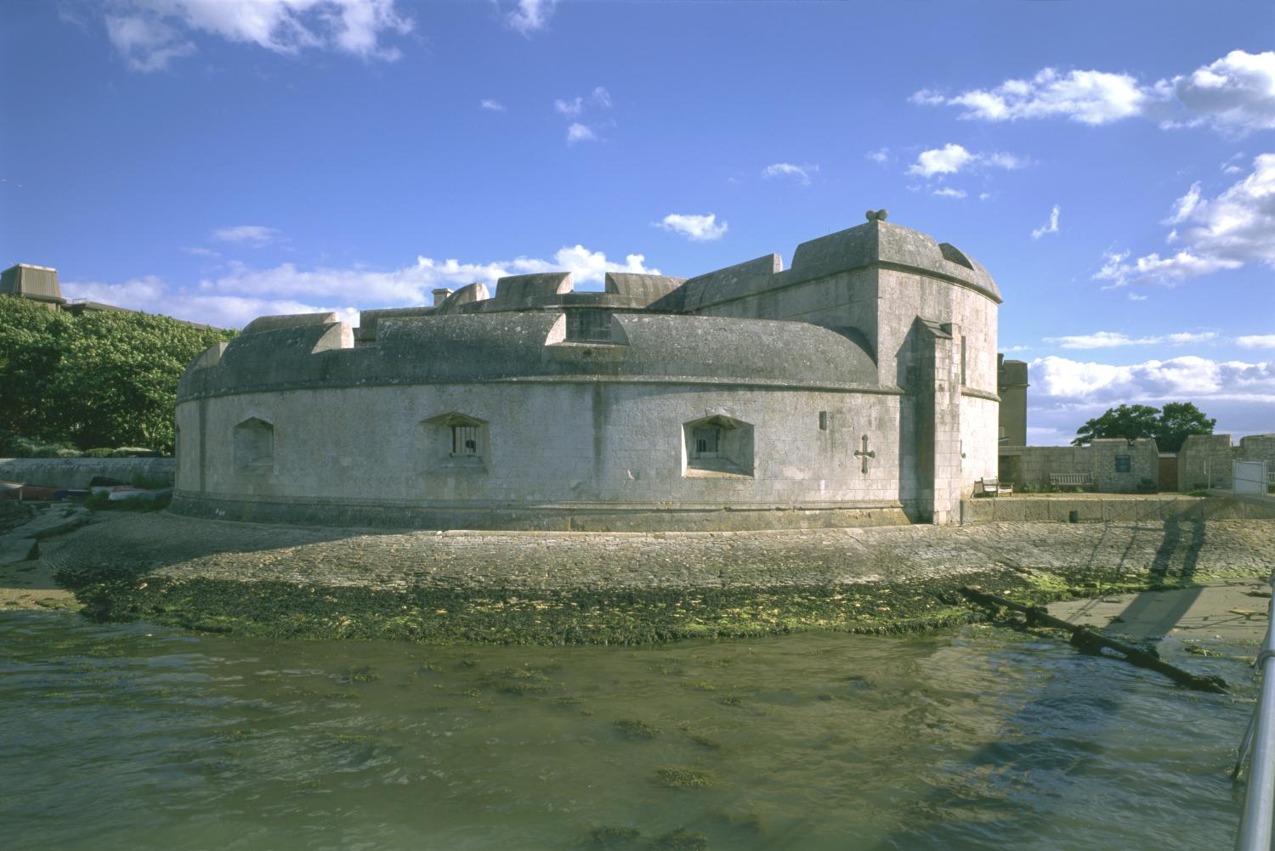
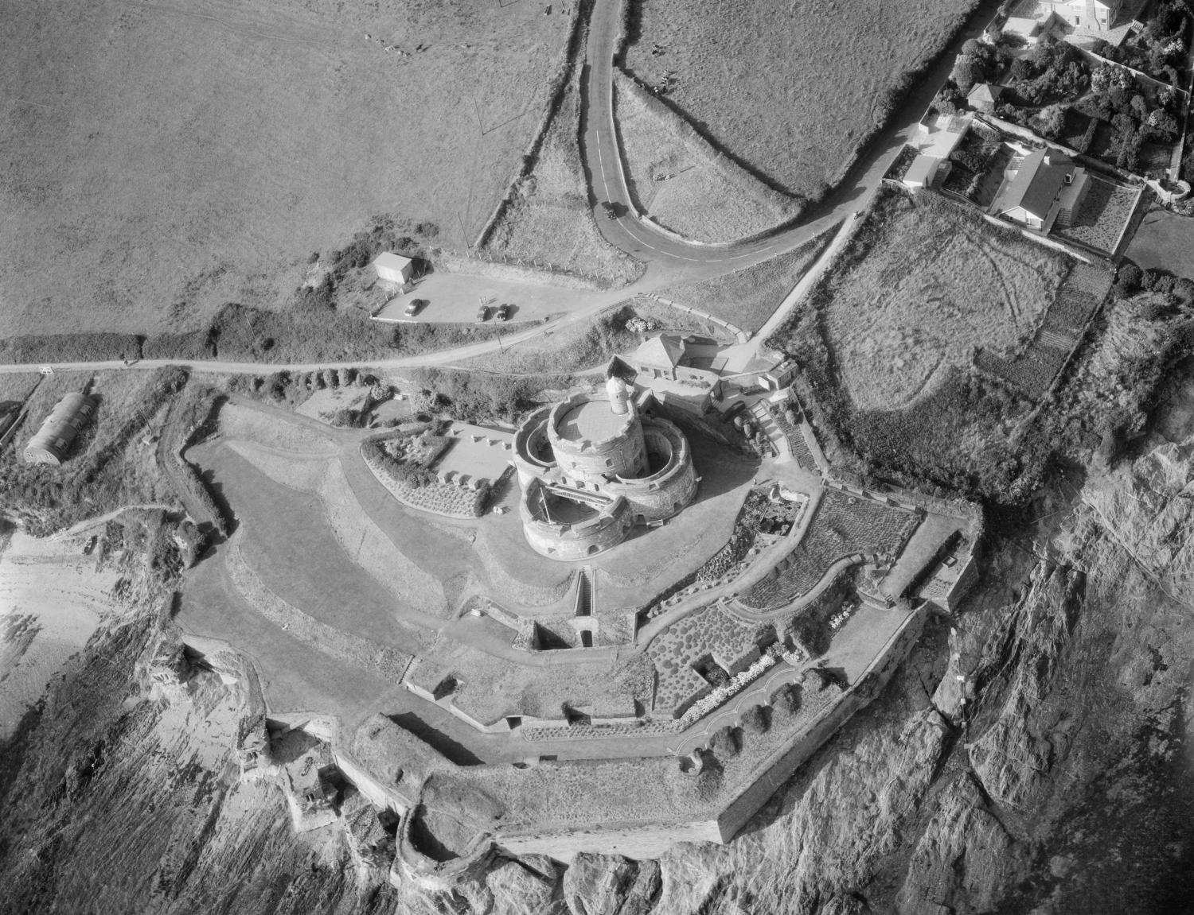

These are the castles built during the reign of Henry VIII 2
Use your research to label them
Notes:
Sandsfoot – © Mr Stuart Morris. Source: Historic England Archive ref: IOE01/10949/09
Brownsea – © Mr JE Leeson. Source: Historic England Archive ref: IOE01/07282/21
Yarmouth - © Dr Barry Senior ARPS. Source Historic England Archive ref: 393277
Portland - © Copyright Historic England Archive Photo Library ref: k981924
St Mawes - © Historic England Archive ref: HAW 9401/45
West Cowes - © Tim Belcher. Source Historic England Archive ref: 419053

Slide 8
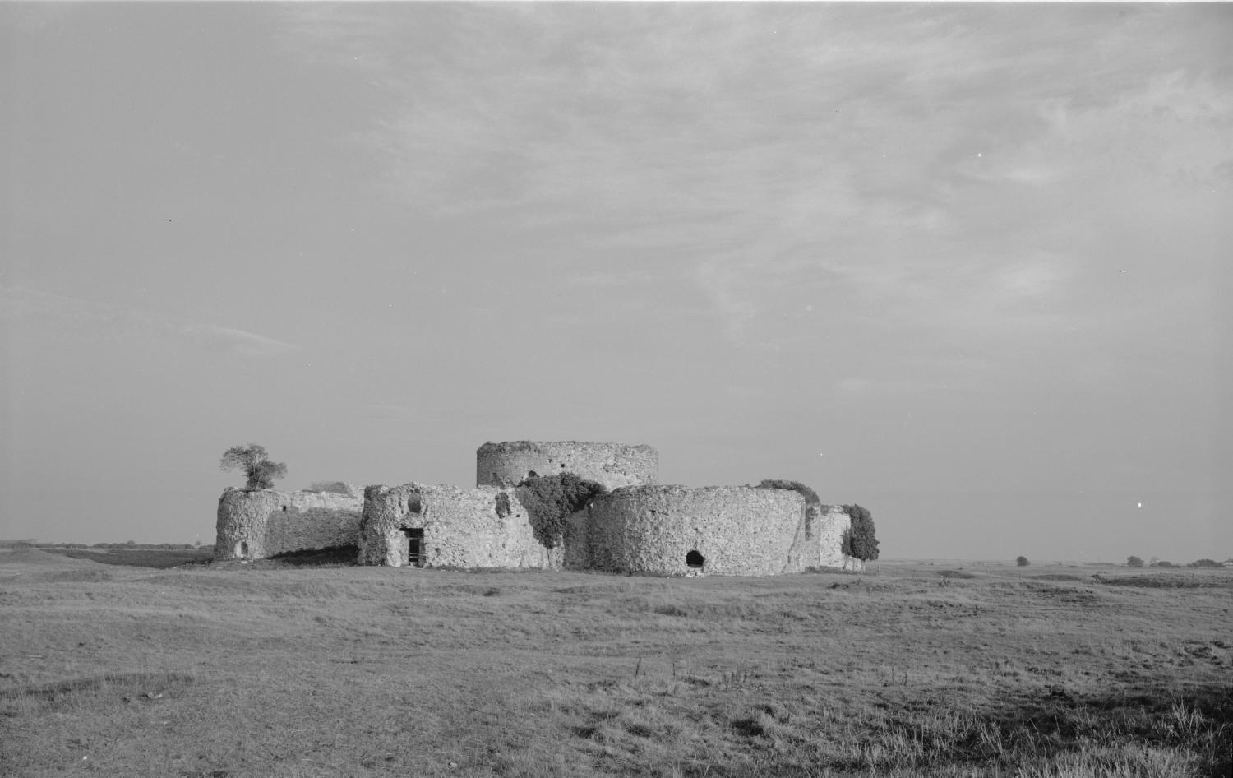
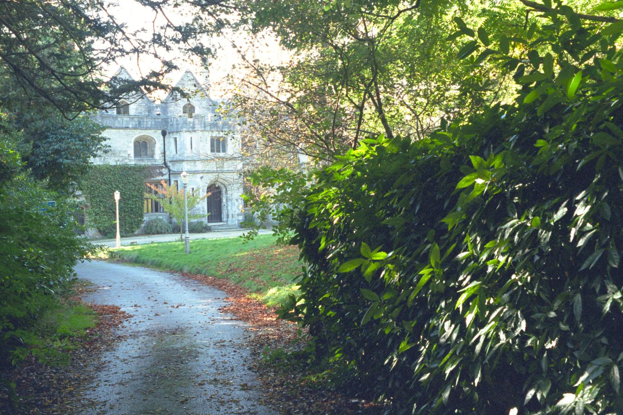
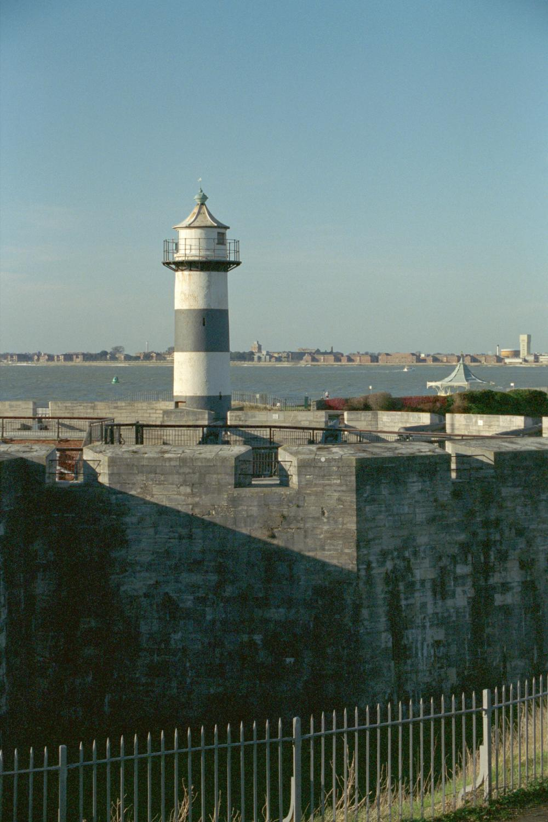
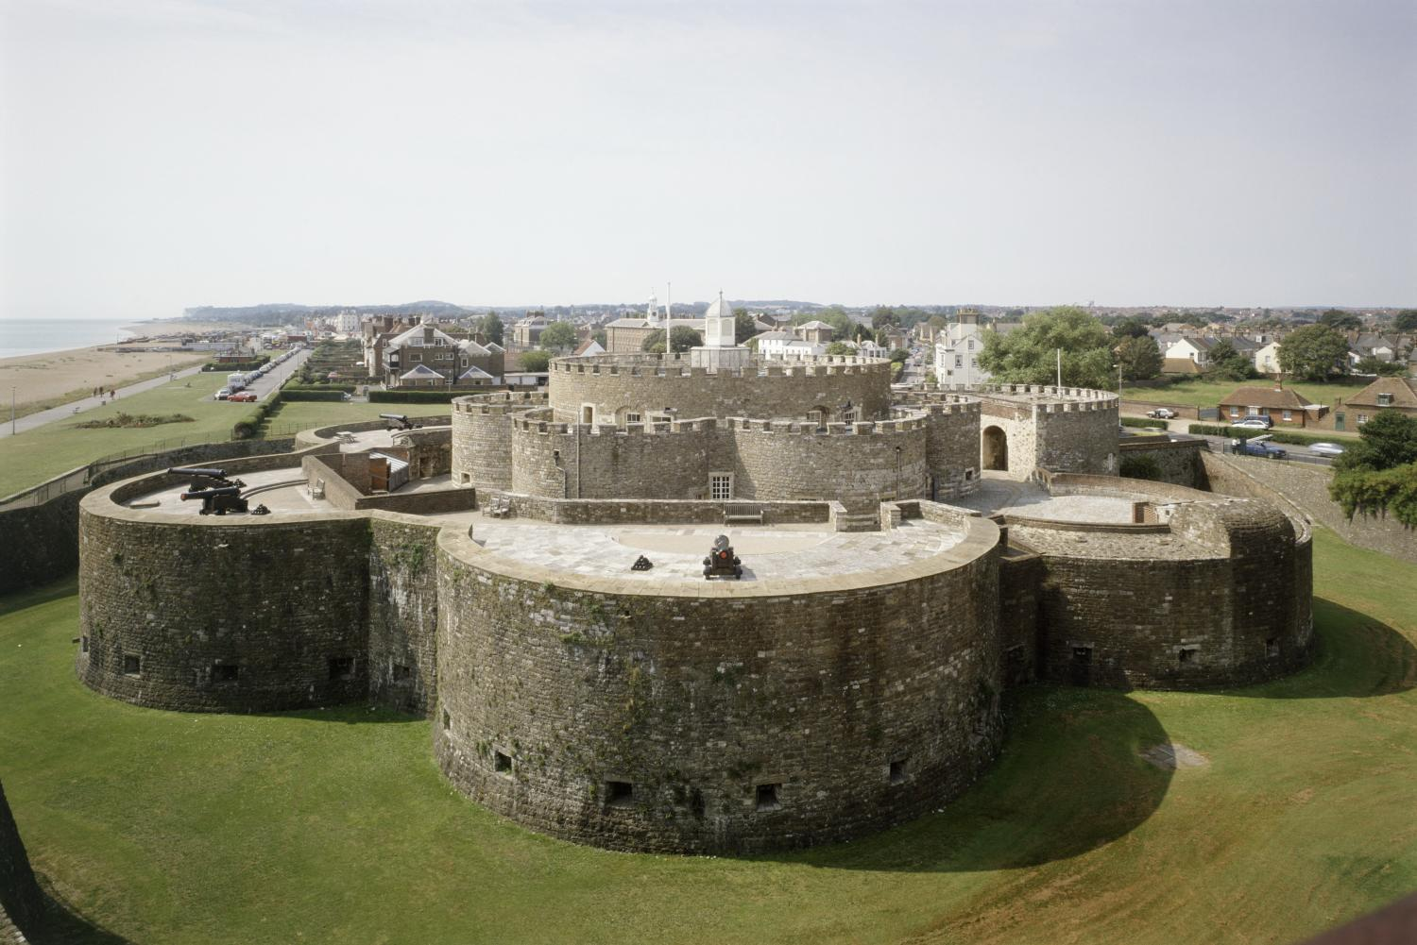
These are the castles built during the reign of Henry VIII 3
Use your research to label them
Notes:
Camber – © Historic England Archive ref: AA98/04491
Netley – © Mr W.G.P. Davies LRPS. Source Historic England Archive ref: IOE01/02002/16
Southsea – © Mr Mark Bardell. Source: Historic England Archive ref: IOE01/02052/31
Deal - © Copyright Historic England Archive Photo Library ref: k970992
Pendennis - © Crown copyright. Historic England Archive ref: nmr 10700/56a

Slide 9
TASK 2:
ANSWERS…

Slide 10
These are the castles built during the reign of Henry VIII 4
Hurst
Lindisfarne
Walmer
St Catherine
Sandgate
Calshot
Notes:
Hurst - © Crown copyright. Historic England Archive ref: nmr 15700/29
Lindisfarne - © Mr John Murdoch. Source: Historic England Archive Ref: IOE01/15205/02
Walmer - © Copyright Historic England Archive Photo Library ref: k980415
St Catherine - © Mr Roger Norman. Source: Historic England Archive ref: IOE01/13919/04
Sandgate - © Mr Brian Collins. Source: Historic England Archive ref: IOE01/07295/02
Calshot – © Mr Alec Howard. Source: Historic England Archive ref: IOE01/12957/12

Slide 11
These are the castles built during the reign of Henry VIII 5
Sandfoot
Brownsea
Yarmouth
Portland
St Mawes
West Cowes
Notes:
Sandsfoot – © Mr Stuart Morris. Source: Historic England Archive ref: IOE01/10949/09
Brownsea – © Mr JE Leeson. Source: Historic England Archive ref: IOE01/07282/21
Yarmouth - © Dr Barry Senior ARPS. Source Historic England Archive ref: 393277
Portland - © Copyright Historic England Archive Photo Library ref: k981924
St Mawes - © Historic England Archive ref: HAW 9401/45
West Cowes - © Tim Belcher. Source Historic England Archive ref: 419053

Slide 12
These are the castles built during the reign of Henry VIII 6
Camber
Netley
Deal
Pendennis
Southsea
Notes:
Camber – © Historic England Archive ref: AA98/04491
Netley – © Mr W.G.P. Davies LRPS. Source Historic England Archive ref: IOE01/02002/16
Southsea – © Mr Mark Bardell. Source: Historic England Archive ref: IOE01/02052/31
Deal - © Copyright Historic England Archive Photo Library ref: k970992
Pendennis - © Crown copyright. Historic England Archive ref: nmr 10700/56a

Slide 13

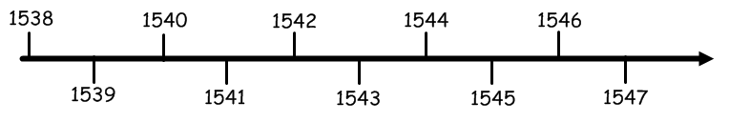
Task 3: Timeline
Go through the results and place the castles in chronological order on the timeline
Consider

Slide 14
TASK 3:
ANSWERS…

Slide 15
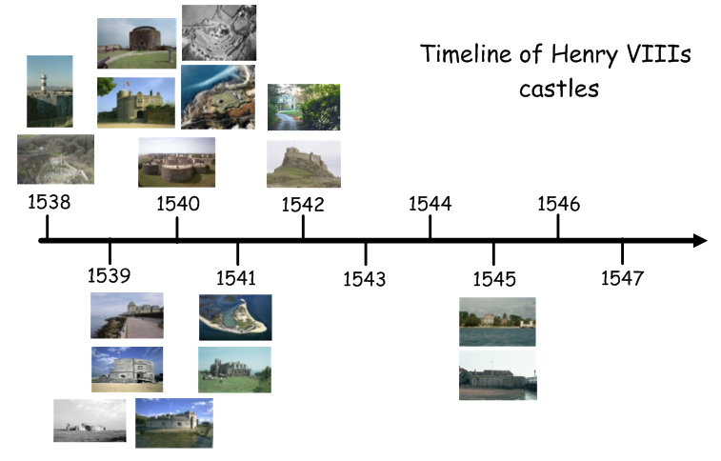
Task 3: Timeline of Henry VIII’s castles

Slide 16
Task 3: Timeline of Henry VIII’s castles 2
Sandgate
St Mawes
Southsea
Walmer
Pendennis
Netley
St Catherine
Deal
Lindisfarne
West Cowes
Hurst
Brownsea
Calshot
Sandsfoot
Yarmouth
Camber
Portland

Slide 17

Use your castle timeline to help you answer these questions
You may also wish to use the Timeline of Henry’s Reign provided on following slides and your own research
How does the building of the castles relate to Henry's foreign policy?
What is the significance of Yarmouth and Brownsea castles?
How did the building of so many castles affect Henry's domestic policies?

Slide 18
Timeline of Henry VIIIs Foreign Policy 1534-47
1534
May - Anglo-Scottish peace treaty signed
February - 9th Earl of Kildare Lord-Deputy of Ireland sent to the Tower (Lord-Deputy was the King's representative and head of the Irish executive during the Kingdom of Ireland
July - Failed Irish rebellion under Thomas Fitzgerald, Lord Offaly (Kildare’s son)
July-October - Sir William Skeffington made Lord-Deputy and sent to Ireland
December - 9th Earl of Kildare dies in the Tower, ‘of grief’ at his sons failed rebellion
1535
March - Lord Offaly (now 10th Earl of Kildare) defeated at Maynooth Castle
October - 10th Earl of Kildare surrenders to Skeffington and is sent to the Tower
1536
Royal approval was given for a bill uniting England and Wales (later referred to as the Act of Union)
Italian War between Francis I of France and Charles V of Spain begins
1537
February - Execution of 10th Earl of Kildare (and 5 of his uncles) at Tyburn in London
1538
May - Marriage of James V of Scotland and Mary of Guise
June - Francis I (France) and Charles V (Spain & Holy Roman Empire) sign the Treaty of Nice, agreeing peace between them and ending the Italian War
Cardinal Reginald Pole, the Pope’s representative in England is sent to raise support from France and Spain for a ‘crusade’ against Henry VIII
December - Pope Paul III excommunicates Henry VIII
1541
Dublin parliament passes an act declaring Henry VIII King of Ireland
1542
Crown of Ireland Act is passed stating that King Henry VIII of England and his successors would also be Kings of Ireland
November - English defeat the Scottish at the Battle of Solway Moss
December - Mary (Queen of Scots) born to Mary of Guise and James
December - Death of James V (6 days after the birth of Mary)
Notes:
This timeline is intended for use by teachers/students with the Teaching Activity: How real was the threat of invasion 1539 – 47? It is not a complete history of Henry VIIIs foreign policy.

Slide 19
Timeline of Henry VIIIs Foreign Policy 1534-47 2
1543
July - Anglo-Scottish ‘Treaty of Greenwich’ signed. This created a peace between England and Scotland and also arranged that Henry’s son Edward (VI) would marry James’s daughter Mary (Queen of Scots)
December - Scottish parliament rejects the Treaty of Greenwich. This led to 8 years of Anglo-Scottish battles, known as the Rough Wooing
December - Henry and Charles V signed a treaty pledging to invade France in person by 20th June 1544. Each was to provide an army of no less than 35,000 infantry and 7,000 cavalry
1544
Henry sends an army of some 40,000 men to Calais under the command of Thomas Howard, Duke of Norfolk, and Charles Brandon, Duke of Suffolk
July - Henry himself travels to Calais to join his army and begins a siege of the town of Boulogne
September - The English capture of Boulogne
September - Charles V makes peace with French and signs the Treaty of Crépy, without informing Henry first
1545
February - English defeated by Scottish at the Battle of Ancrum Moor
May - The French assembled a large fleet in the estuary of the Seine with the intent to land troops on English soil. In addition to the fleet, 50,000 troops were assembled at Havre de Grâce (modern-day Le Havre)
July - The French fleet set sail for England and entered the Solent unopposed with 128 ships on 16 July. The English had around 80 ships with which to oppose the French, including the flagship Mary Rose. The Mary Rose went into battle against the French on 19th July and was sunk whilst leading an attack on these French ships
1546
June - Treaty of Camp was signed between England and France to reach a peace settlement
1547
January – 28th of January Henry VIII dies at the Palace of Whitehall
February – 20th of February Henry’s son Edward is crowned Edward VI at the age of 9
Notes:
This timeline is intended for use by teachers/students with the Teaching Activity: How real was the threat of invasion 1539 – 47? It is not a complete history of Henry VIIIs foreign policy.

Slide 20

More resources
MORE RESOURSCES AT
HistoricEngland.org.uk/Education

