Slide 1
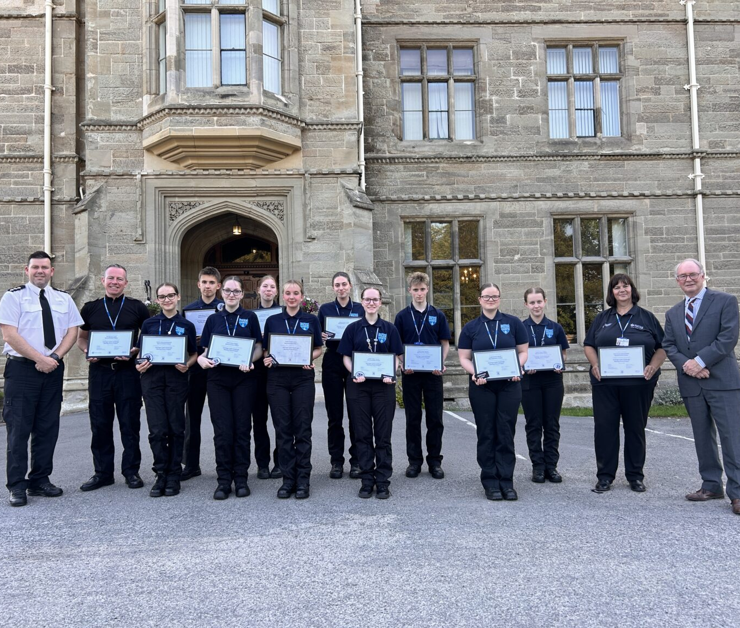
Add Your Missing Pieces!
How To
Notes:
With permission from the Office of Police Crime Commissioners for Warwickshire
All other photos © Historic England

Slide 2
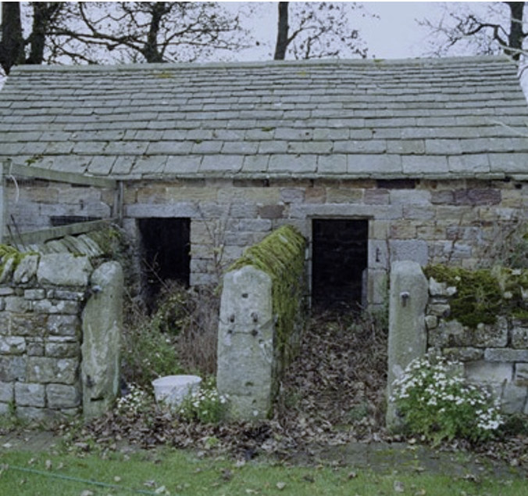
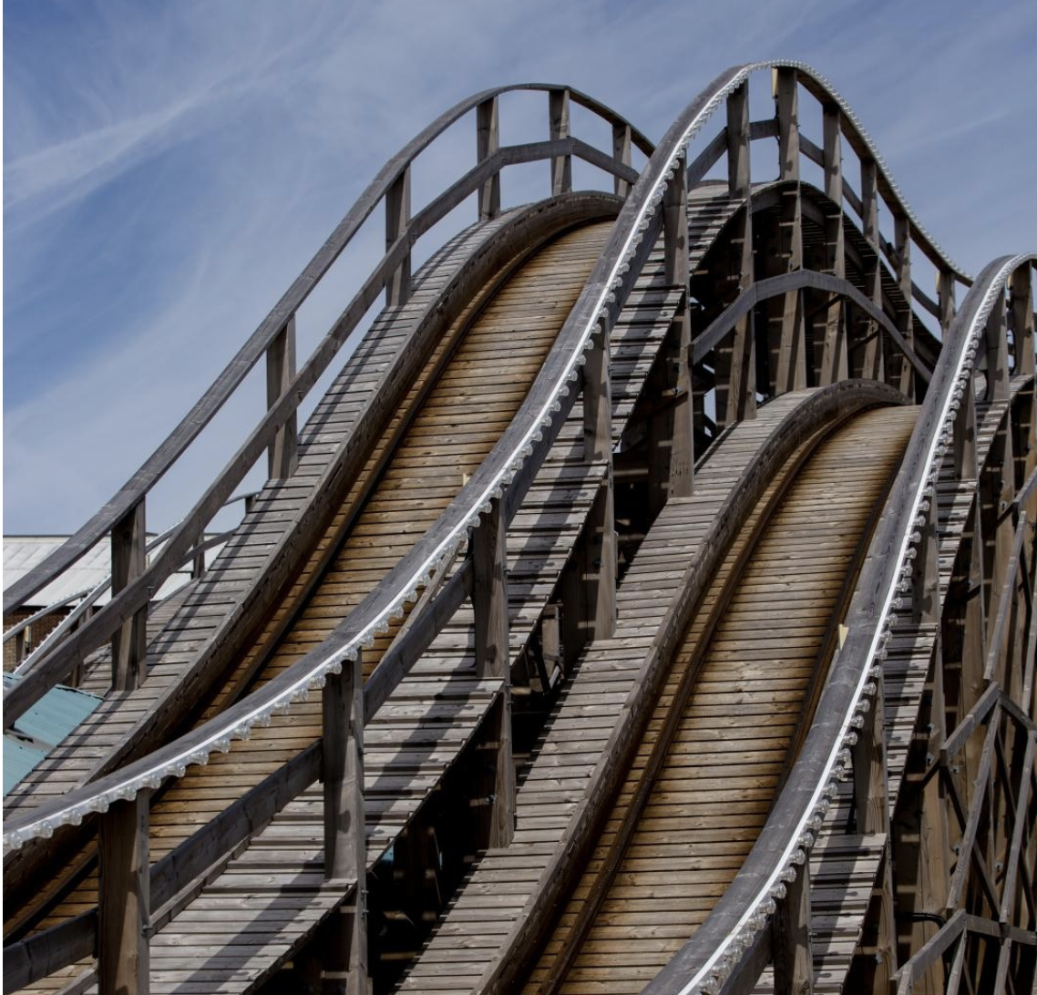
What is the Missing Pieces Project?
Pigsty from early 1800s
The Missing Pieces Project invites the public to share photos and stories about England’s historic places included on the National Heritage List for England.
Your missing pieces will help complete the story of these amazing places.
Scenic Railway (Rollercoaster) built in 1920
Notes:
Image 1 – Pigsty from early 1800s, Rothley, Northumberland.
Image 2 – Scenic Railway (Rollercoaster) built in 1920 at Dreamland, Margate, Kent. It is the oldest surviving roller coaster in Britain and the second oldest in Europe.

Slide 3

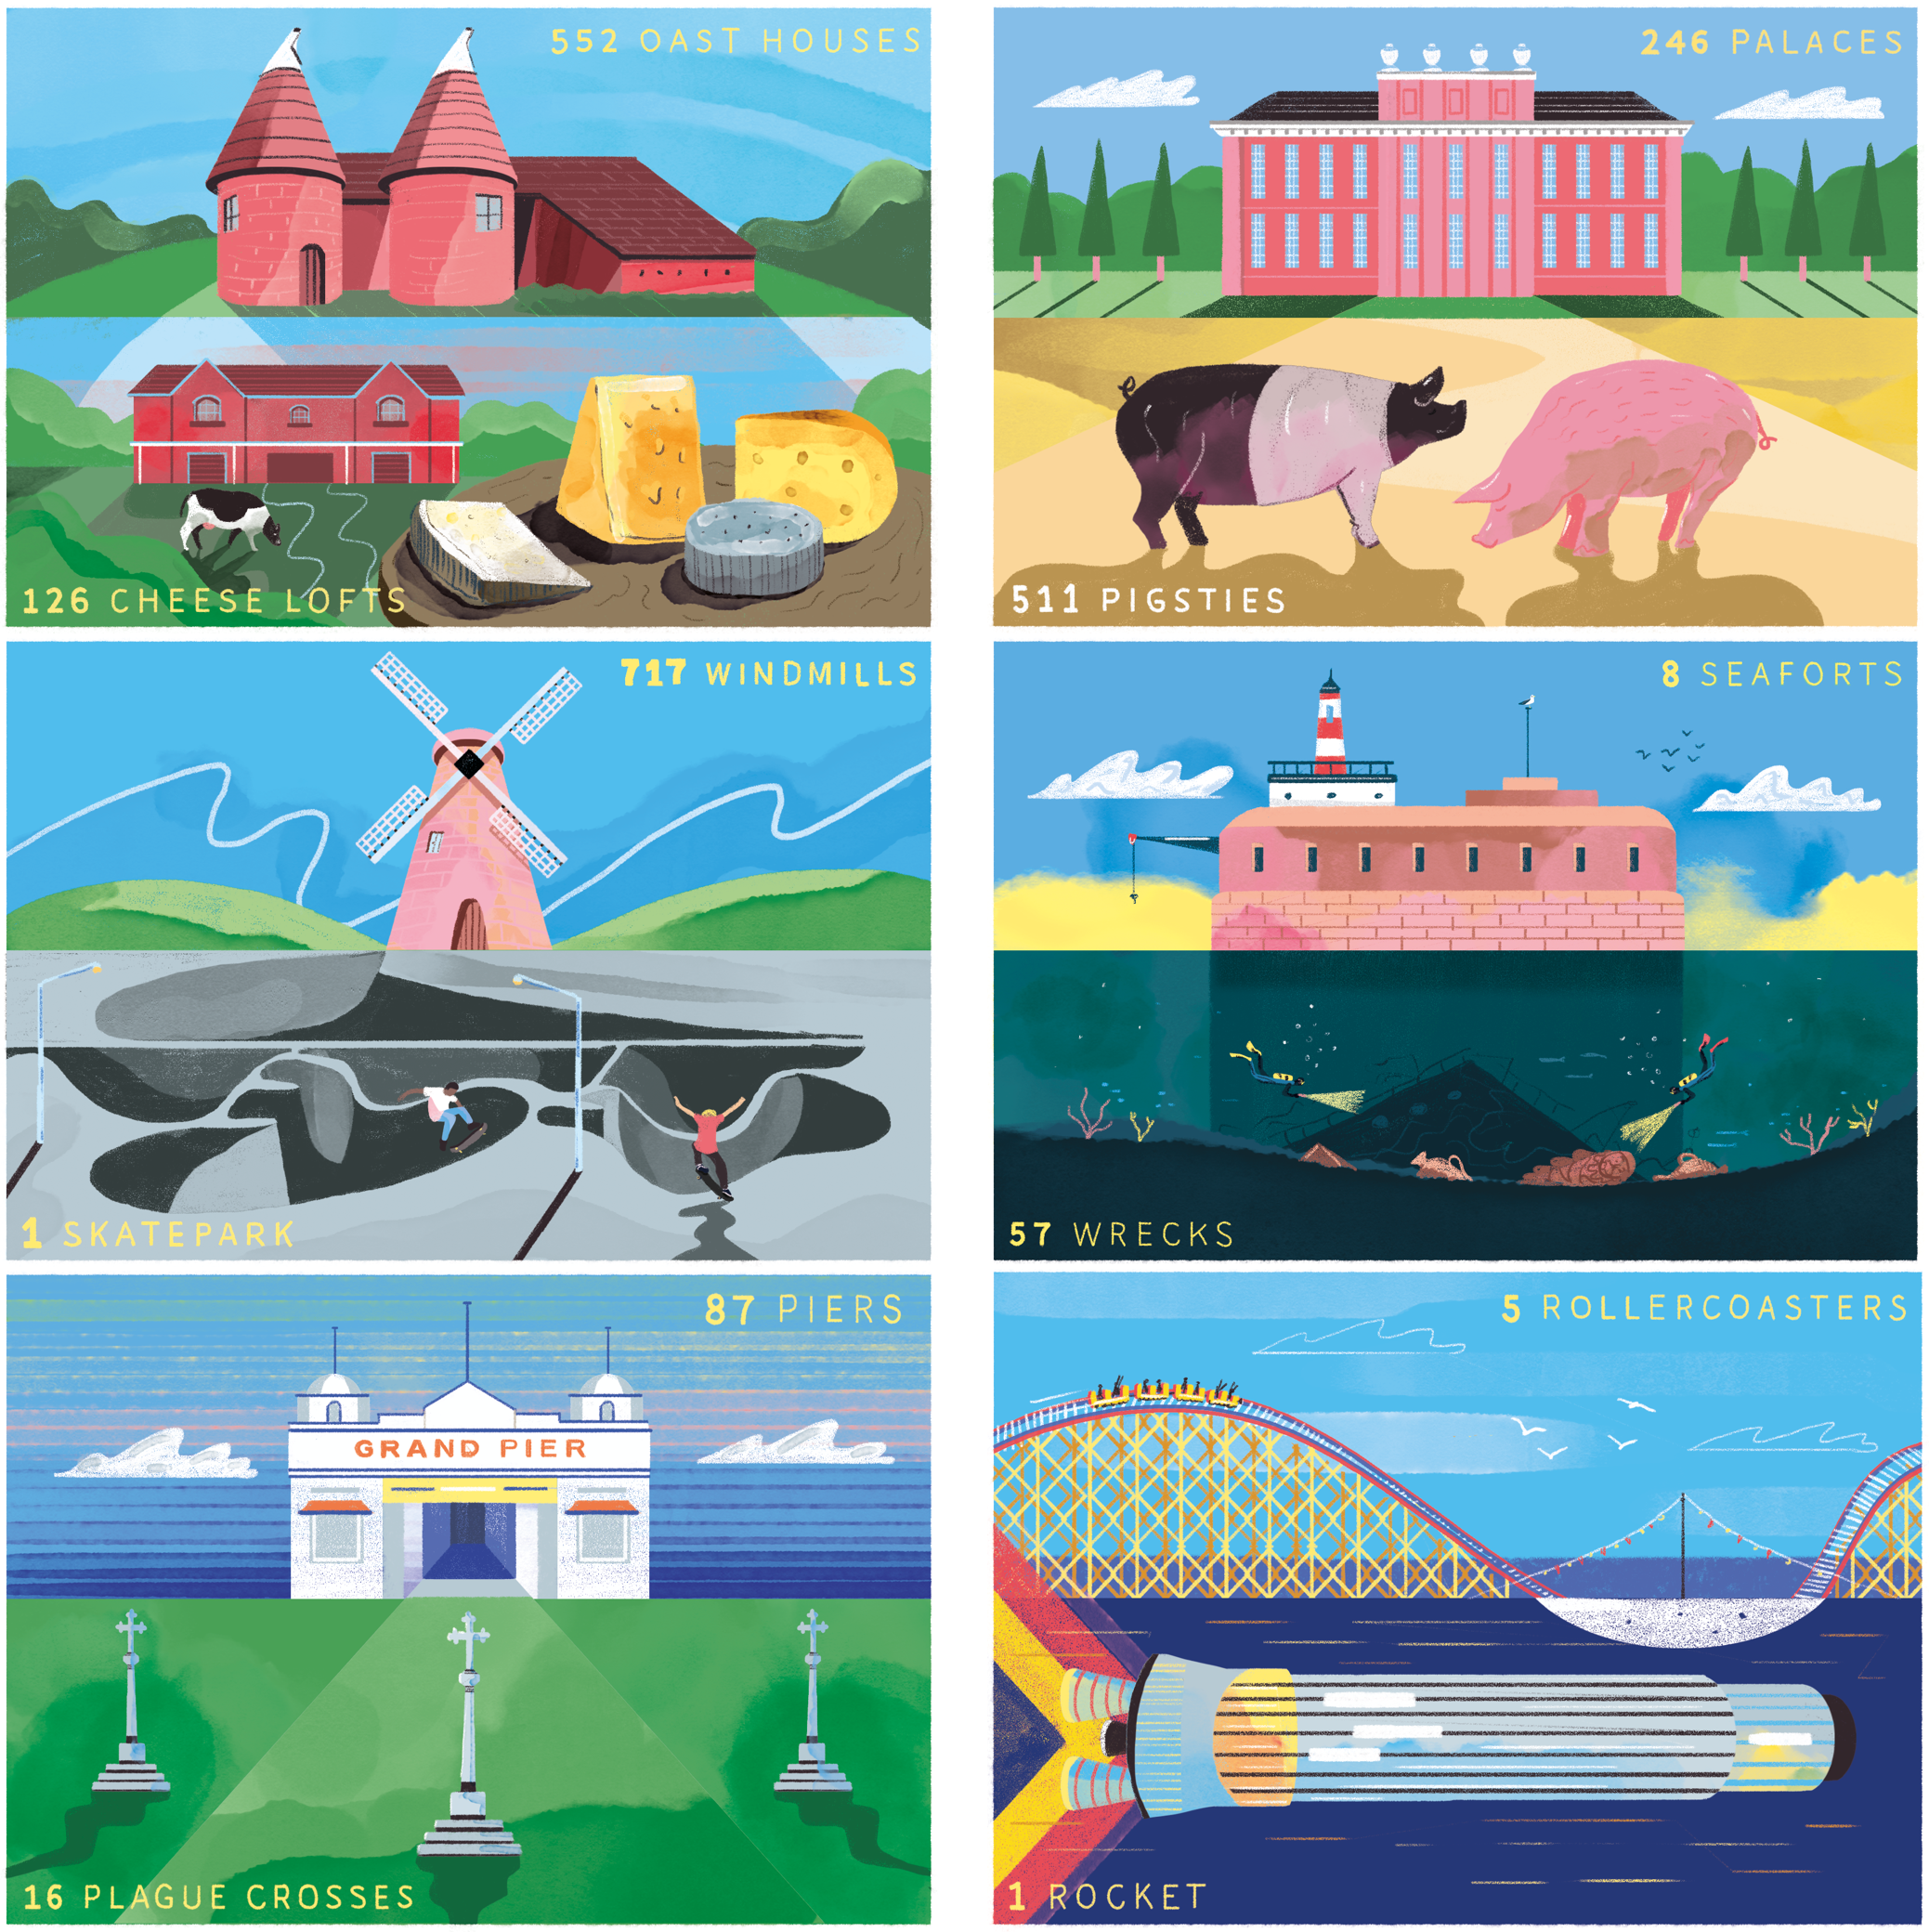



The National Heritage List for England contains almost 400,000 historic places, including:
castles
churches
factories
bridges
windmills
fairground rides
even pigsties!
Many of these places do not have any up‑to‑date photos and that’s where you can help!

Slide 4
Your Mission
Help Historic England record important historic places by:
visiting historic sites and buildings
taking photographs
researching their story
uploading your photos and information
Your contribution will become part of the national historic record/National Heritage List for England

Slide 5


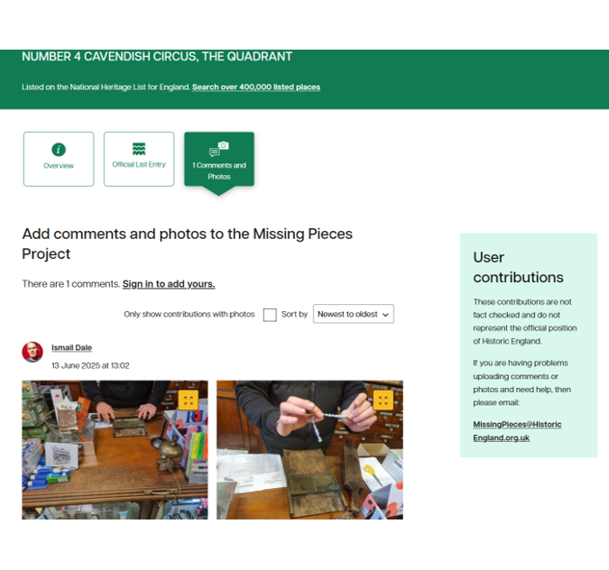
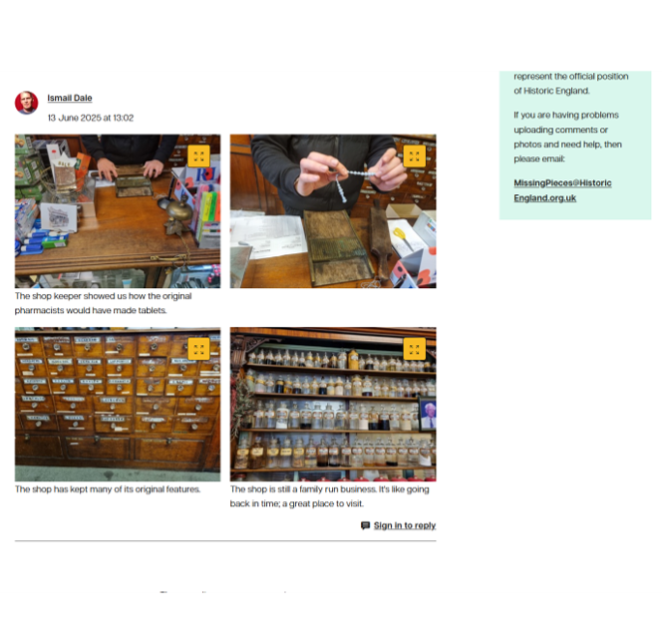
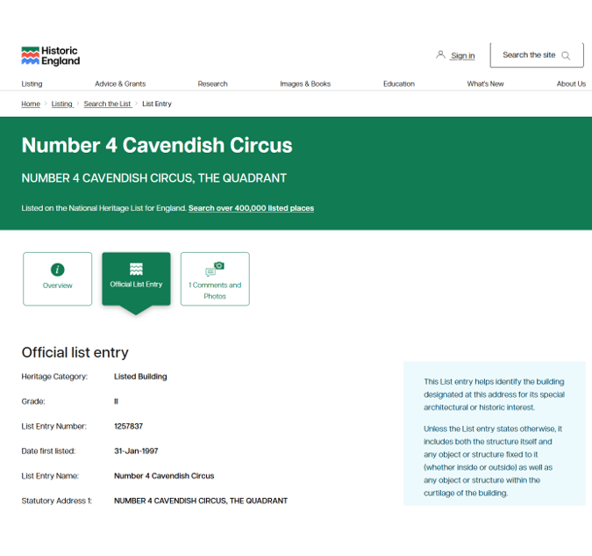
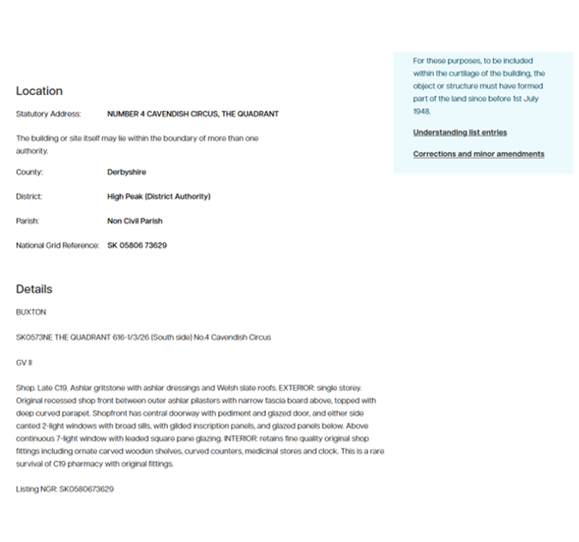
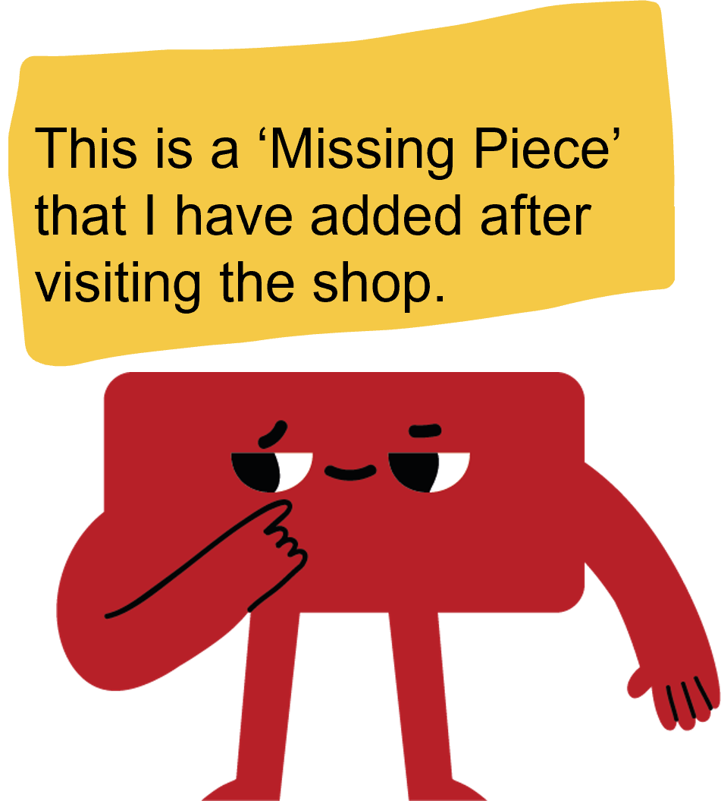
Help us find the missing pieces!
Across England, thousands of historic places have stories to tell - but their official descriptions can be hard to understand. So, we need YOU to help us improve them by adding photos and extra information!
You can help

Slide 6



Adding the missing pieces!
Every snapshot and story you add to the Missing Pieces Project becomes an important part of the story of England.
The more pieces we gather, the more we can protect these special places today — and for all the young people who will see them in the future.

Slide 7
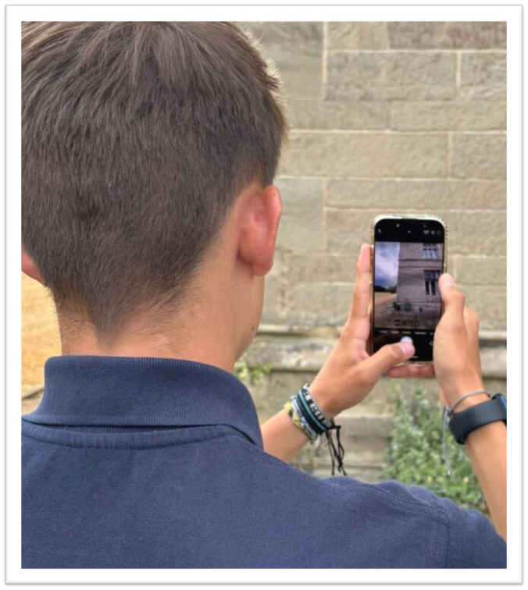
Get started in 3 easy steps
Step 1
Register: Create an account on the Historic England website
(If you are under 13, a responsible adult will need to upload on your behalf)
Search: Find a Listed Site or Building using the Map Search tool, enter your postcode or address to find historic places near you
Add Photos/Video and Information: Visit the building or site and upload your contribution
Photographs/video
short historical information
anything interesting you discovered
Step 2
Step 3
A young person photographing a building with a phone camera
Notes:
With permission from the Office of Police Crime Commissioners for Warwickshire

Slide 8
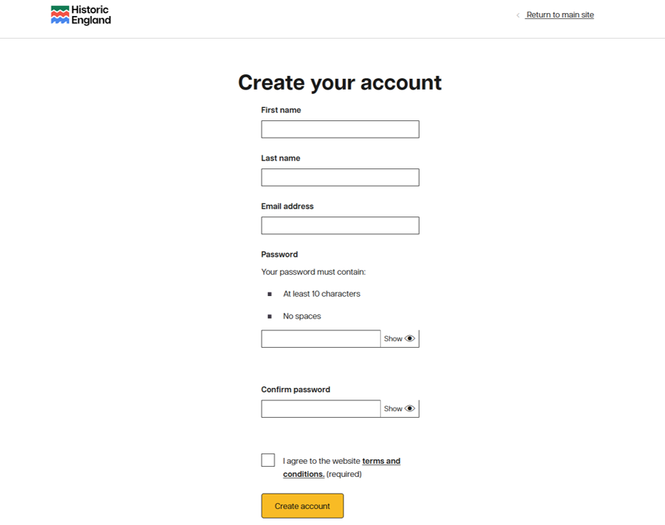
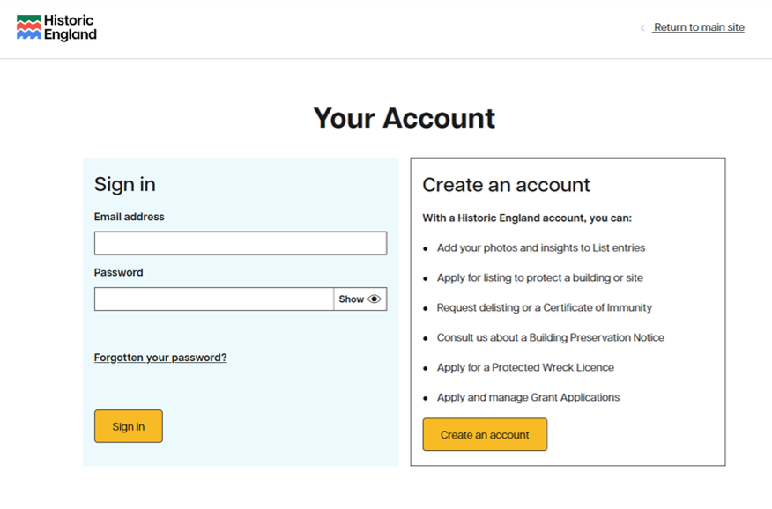
Step 1: Register (https://account.historicengland.org.uk/)
Step 1
All you need to register is your name, an email address and a password.
(If you are under 13, a responsible adult will need to register on your behalf)
Notes:
Go to https://account.historicengland.org.uk/ and select Create an account to register for the Missing Pieces project.

Slide 9
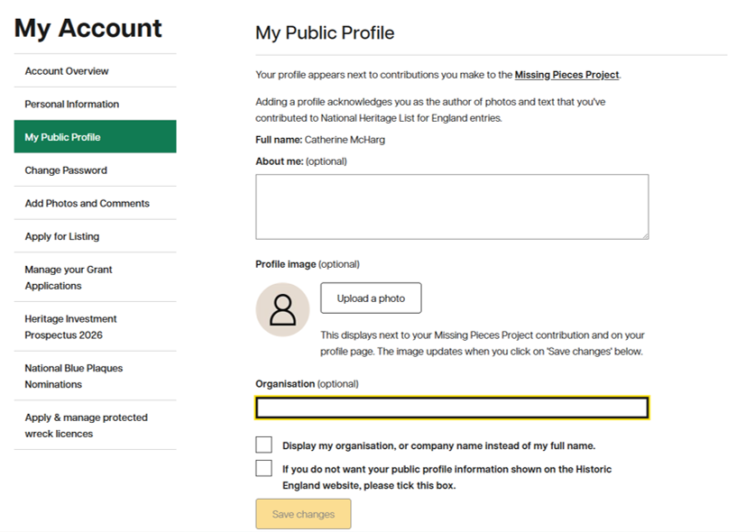
Step 1: Registering for a young person/group
Step 1
Click on ‘My Public Profile’
If you’ve signed up on behalf of a young person or group, you can easily control what name appears next to any contributions.
Just sign in and go to “My Public Profile.”
The Full Name will always stay as yours.
However, you can enter a different name in the “Organisation” field (for example, a group or club name).
Tick the box to display this instead.
Adding a photo is optional. If you want, you can upload a logo or badge that the young person/people will recognise.
You can also use the “About me” section to add a short description of your organisation.
?????? ??????
Add a suitable name
Notes:
Go to https://account.historicengland.org.uk/ and select Create an account to register for the Missing Pieces project.

Slide 10
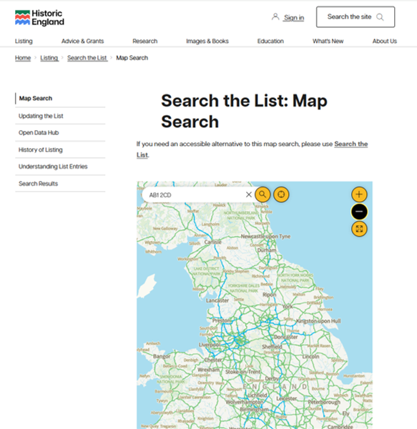
Step 2: Search
Step 2
Go to https://historicengland.org.uk/listing/the-list/map-search
Enter your postcode to find listed places near you.
To find the site with a search engine, search for ‘Historic England search the list’
Notes:
Put in the postcode, hit search. Everything ‘listed’ will show up as a BLUE MARKER – zoom in or out to find the nearest ones to your school.
Then click on any/all of them to see what they are.

Slide 11
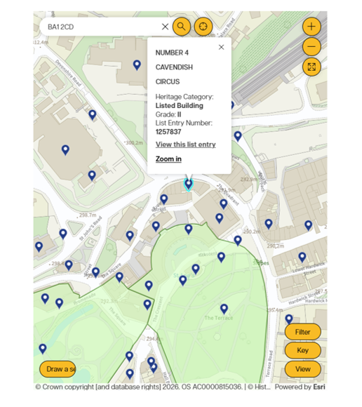
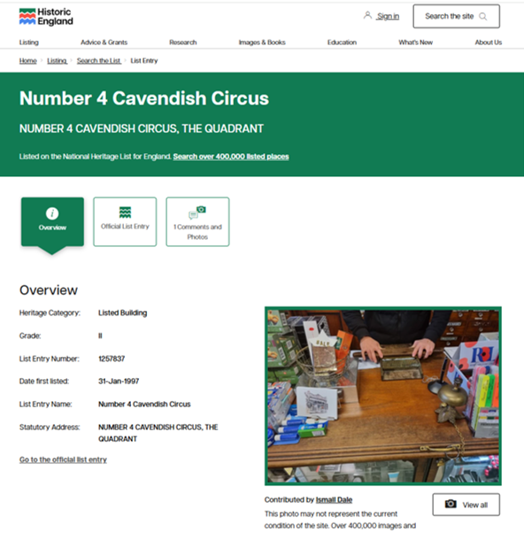
Step 2: Search – Explore your results
Step 2
Click ‘View this list entry’ to find out more
Notes:
Click on any/all of them where it says ‘View this list entry’ to find out more – using right-click, to open in a new tab is helpful if you’ve got lots you want to look at.

Slide 12


Step 3: What photos should you take?
Step 3
Try to include:
a photo of the whole building
photos from different angles
close-ups of interesting details & architectural features (windows, carvings, materials)
signs of change or repairs
Take photos from public land such as the pavement.
Avoid including:
people’s faces
car number plates
Remember: You can only add 4 images!
Notes:
Remember: You can only add 4 images! – Encourage young people to take lots on their visit – then select the ‘best’ 4 to add. This could be a whole group discussion/decision as part of an activity.

Slide 13



Step 3: Can’t decide on 4 – make a video!
Step 3
Try to include:
a photo of the whole building
photos from different angles
close-ups of interesting details & architectural features (windows, carvings, materials)
signs of change or repairs
Take photos from public land such as the pavement.
Avoid including:
people’s faces
car number plates
Create a video and upload it to YouTube – then you can add a link to it!
Remember: You can only add 4 images!
Notes:
Remember: You can only add 4 images! – Encourage young people to take lots on their visit – then select the ‘best’ 4 to add. This could be a whole group discussion/decision as part of an activity.

Slide 14

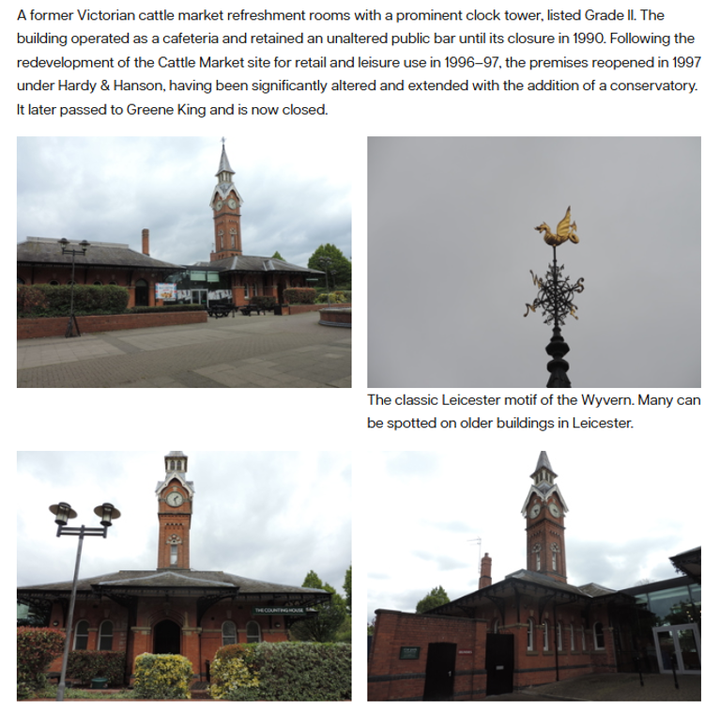



Step 3: Think about what you want to post
Research
Step 3
Research your site, you could write a short summary of its history and/or importance.
Explain:
when it was built
what it was used for
why it matters today
Remember: you can only upload 3000 characters, so keep your writing clear and concise.
Write
Add a web link: Include a useful website URL so readers can find more information.
Notes:
As well as the whole building why not pick out some features that are mentioned in the ‘Details Section’ – although the architectural terms can look a little complicated, a quick search for images using a term is really helpful!

Slide 15
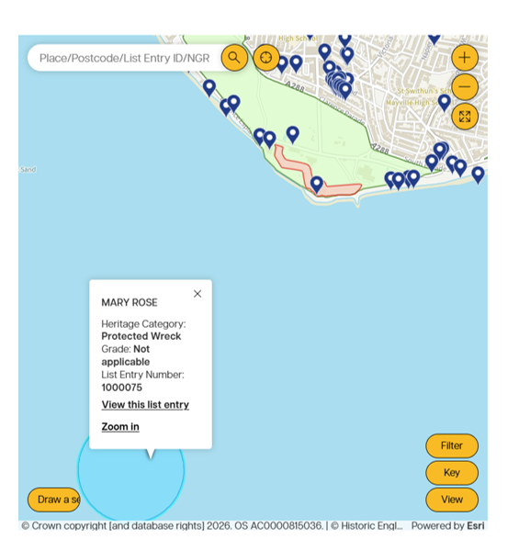
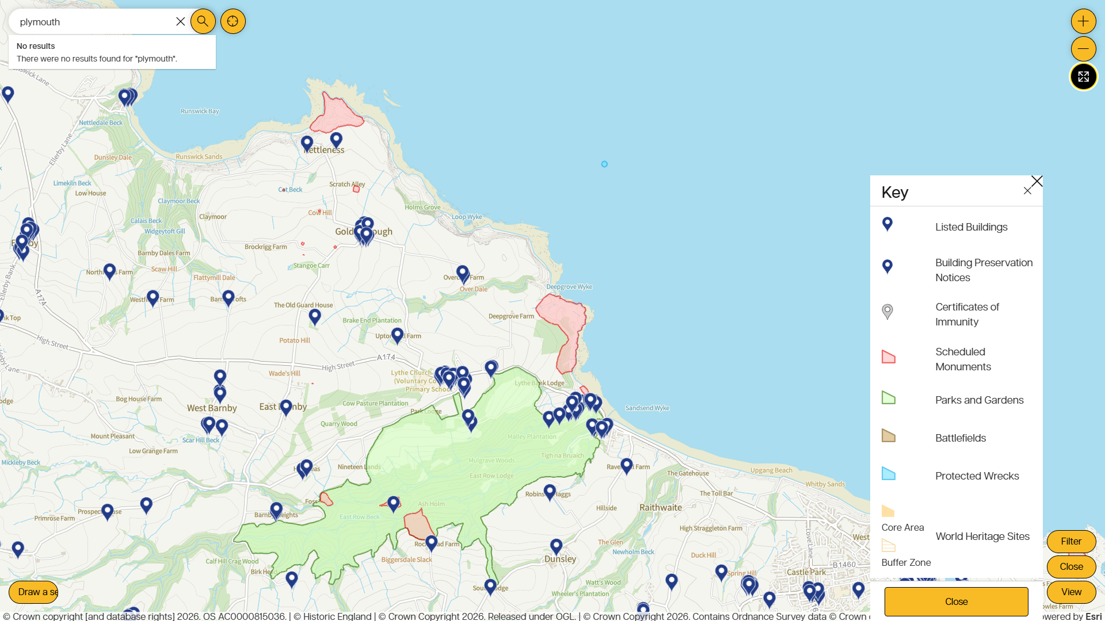






Step 3: It’s not just buildings – explore the map
Step 3
Use the key on the map to discover what other protected places are nearby – these need photos and information adding too!

Slide 16
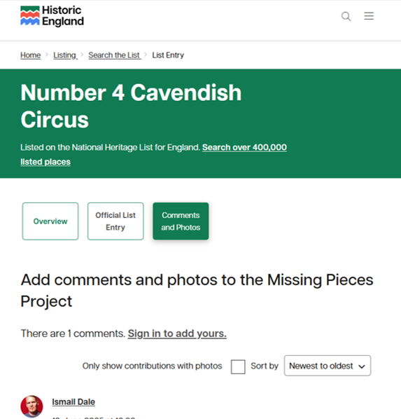

Step 3: When you’re ready add photos and comments
Step 3
Click on ‘Comments and Photos’ to add to the list entry
Click on ‘Sign in to add yours’
Remember: It doesn’t matter if there’s already a comment or photo, you can still add yours!

Slide 17
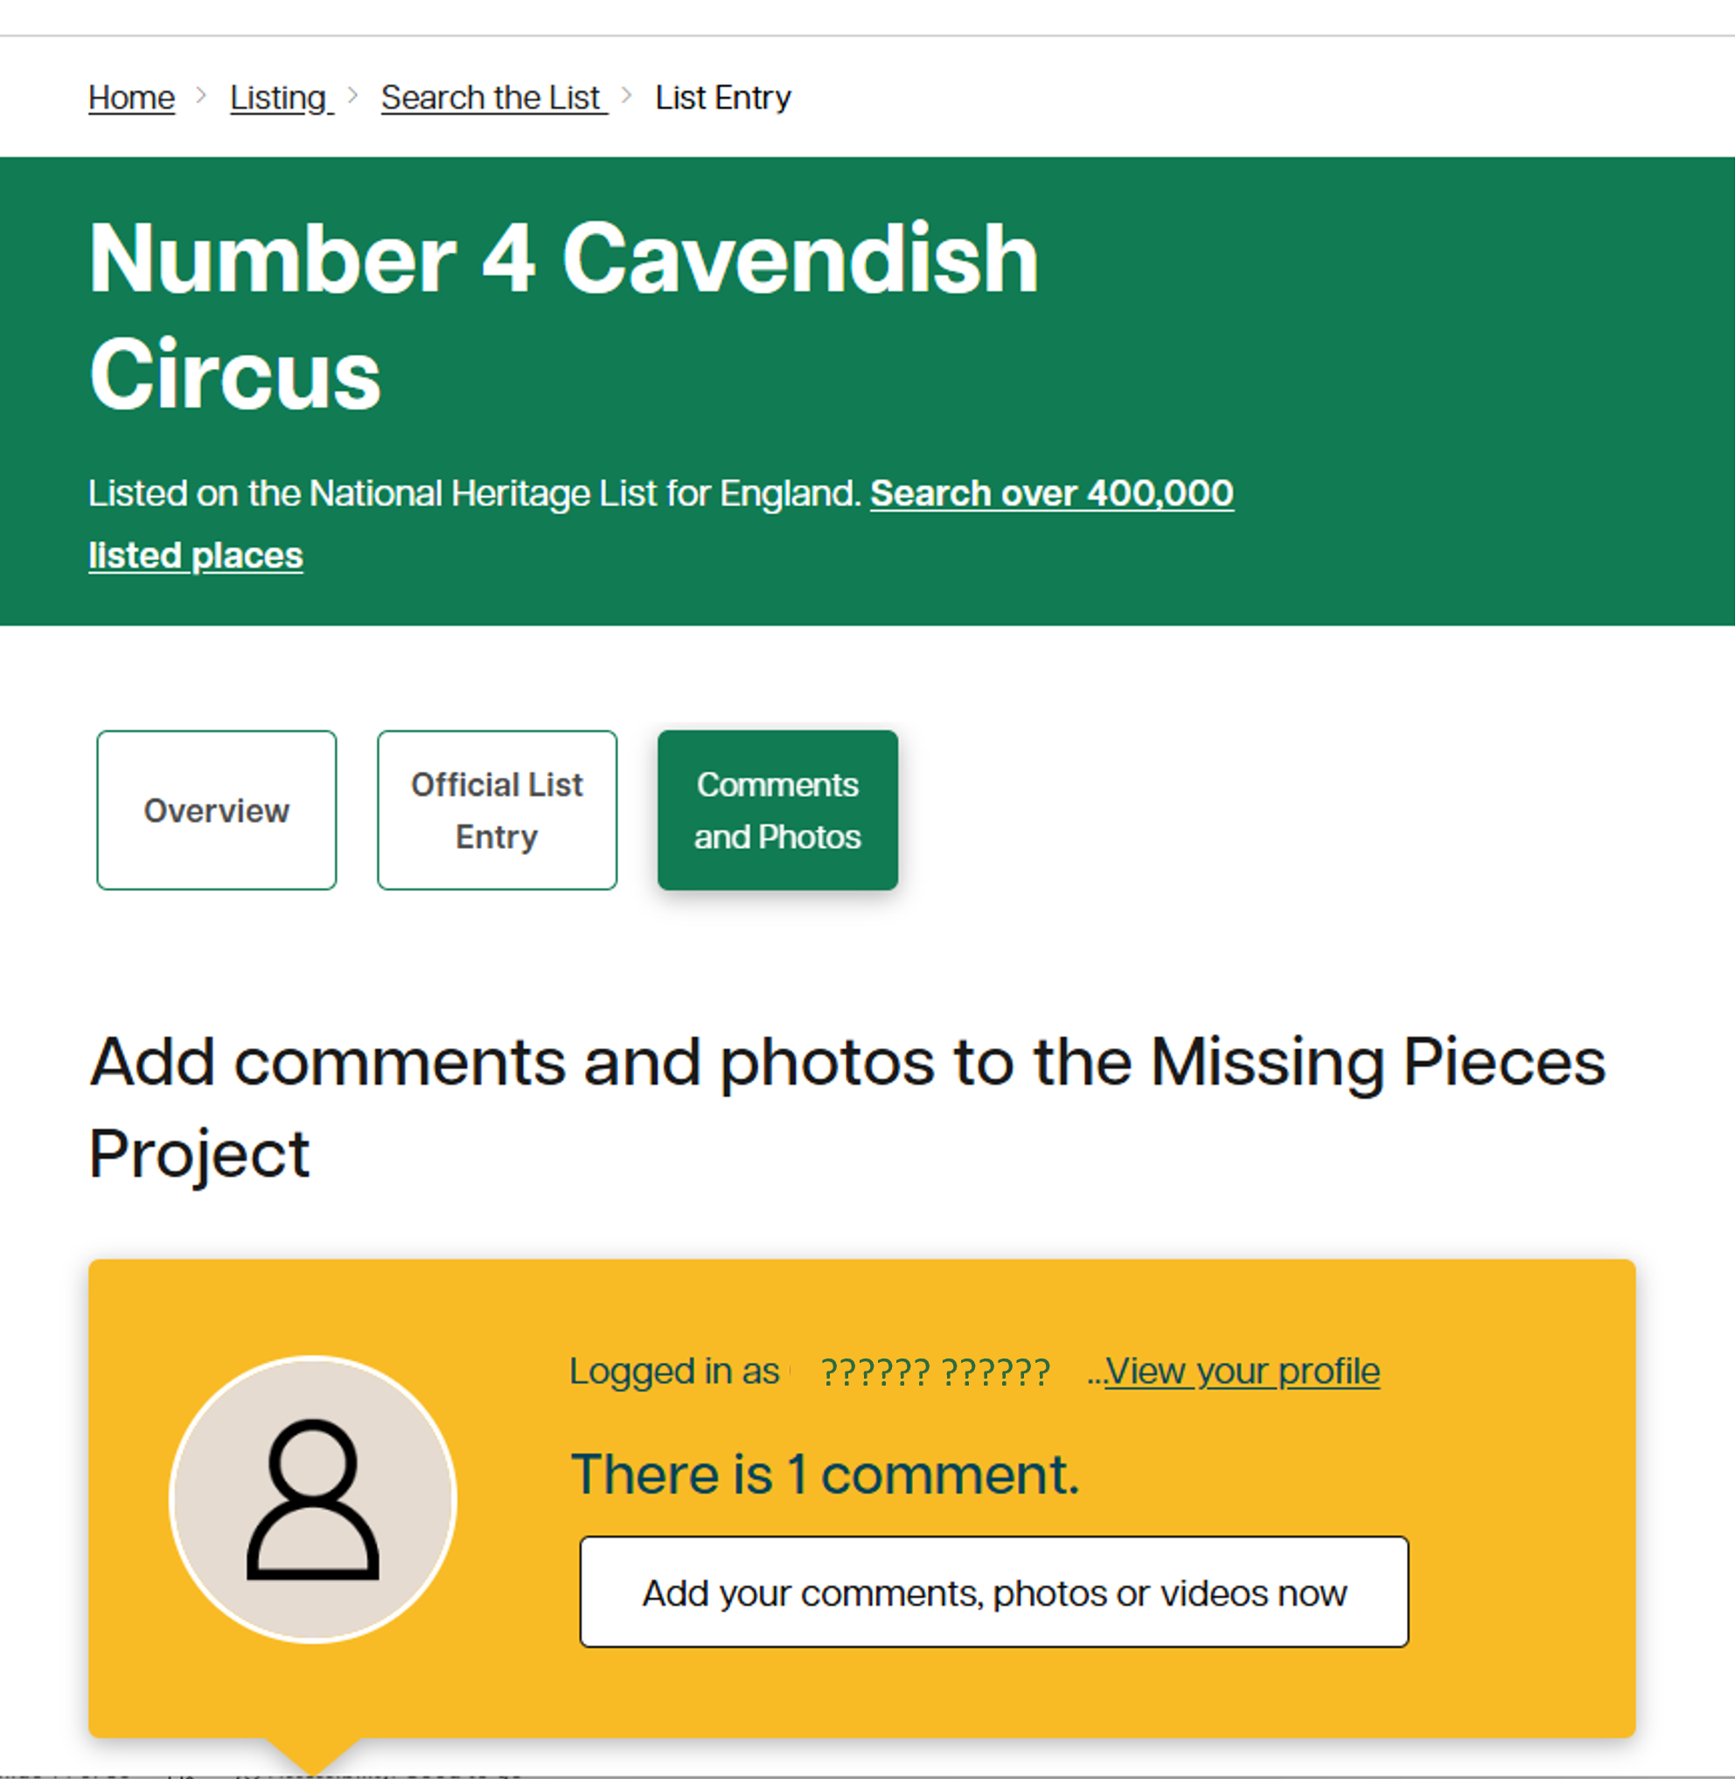
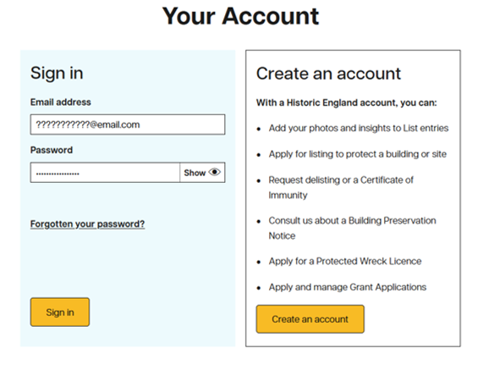
Step 3: Add photos and comments - login
Step 3
Enter your details or create an account if you missed Step 1
Click on ‘Add your comments…..’

Slide 18
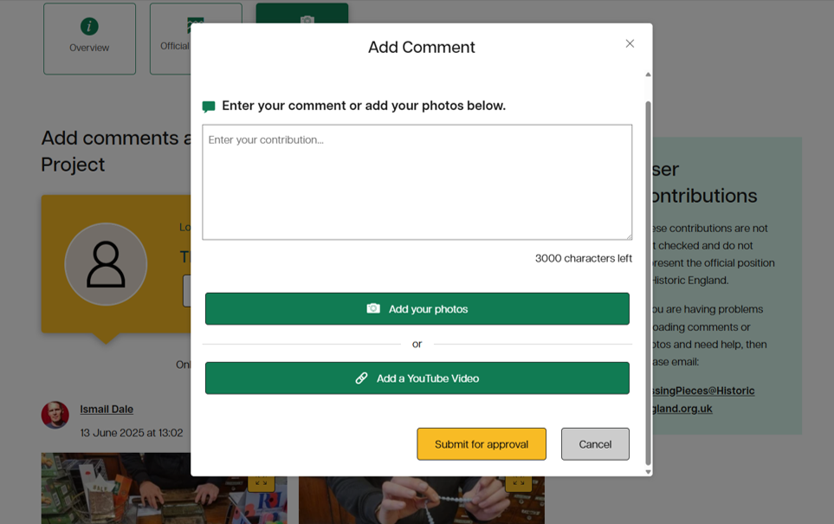
Step 3: Add photos and comments - uploading
Step 3
Add your text - you may want to write it first and then paste it in.
Add your photos or video link, then ‘Submit for approval’.

Slide 19
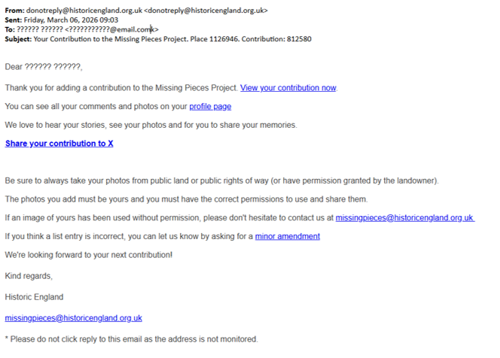
Step 3: Add photos and comments - confirmation
Step 3
You’ll be sent an email confirmation and then your Missing Pieces will appear online!
🎉

Slide 20

You are helping to protect England’s heritage
By contributing to the Missing Pieces Project, you are helping to:
record historic places
add new knowledge
show how places change over time
protect heritage for future generations
Every photograph and story you share adds another missing piece of the puzzle.
Notes:
Please click this link to find other resources that you might find useful: https://historicengland.org.uk/education/schools-resources/teaching-activities/street-spotters-guide/

Slide 21
Summary Notes
You must be over 13 years old to register to the Missing Pieces Project, so an adult must upload information on behalf of younger members of your group
Once you have registered you will receive an email. You can then login and go to ‘My Public Profile’ and add an ‘Organisation’, which will then show instead of your name next to any contributions
e.g. Instead of Contribution by : ‘Jenny Walker’ – change to ‘Thames Valley Volunteer Police Cadets’ or ‘1st Herne Bay Explorers’ etc
You can only upload 3000 characters of text per listed site or building, so it’s best to copy and paste text from Word and do a ‘word count’ – to check the number of characters.
You can only add 4 photos or 1 video per submission.

Slide 22
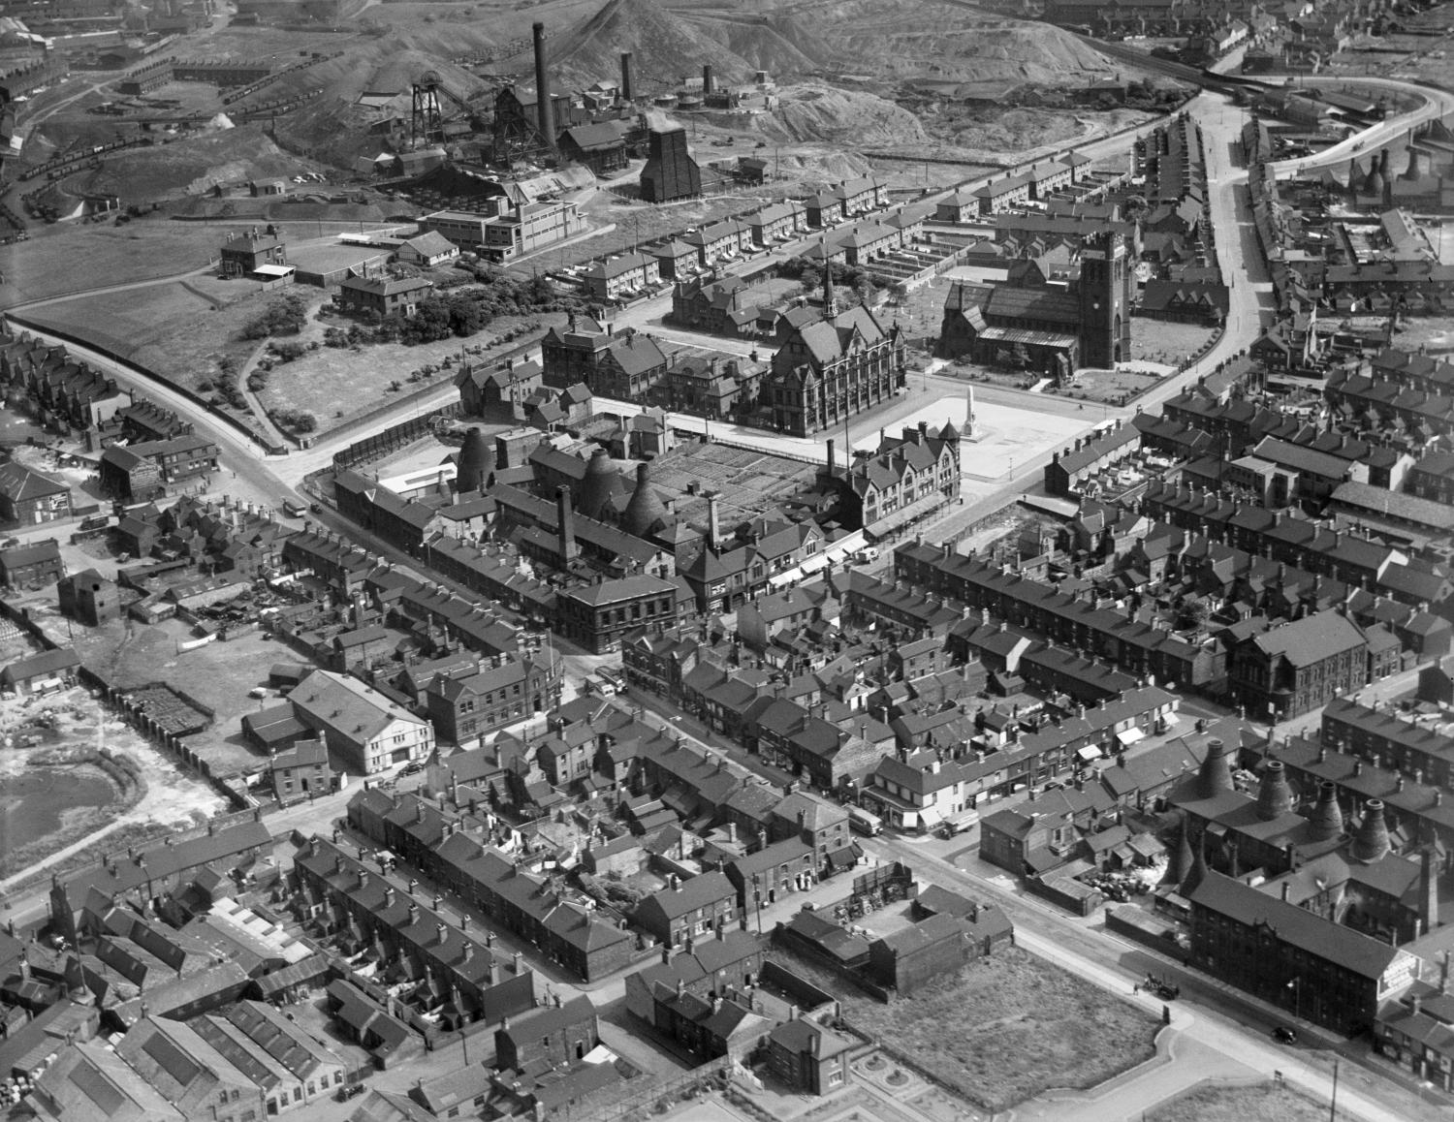
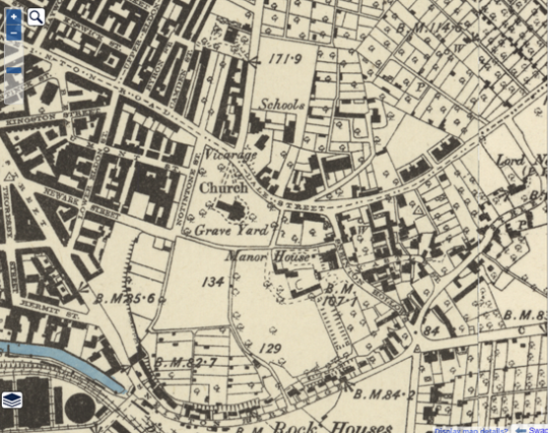
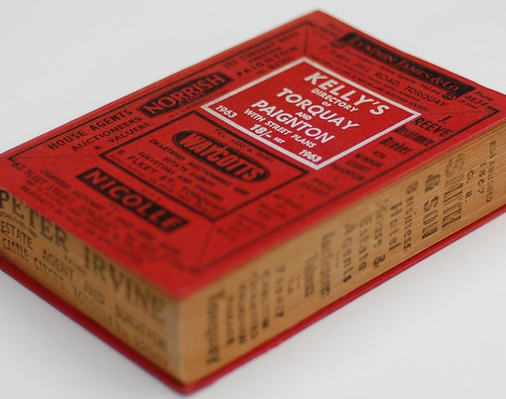
Further activities
Find an aerial photo
Find an old map
Find people
Use the Aerial Photo Explorer to find a historic photo of your site, then add a link to it in your Missing Pieces contribution.
Use the How To Guide & get started.
Use old maps to help research your site and see how the area has changed over time, then add a link to it in your Missing Pieces contribution.
Use the How To Guide & get started.
The census isn’t the only way to find from the past you can use Historical Directories. These were a published book, listing details about people, businesses, and institutions in a specific area at a particular time.
Use the How To Guide & get started.

