Slide 1
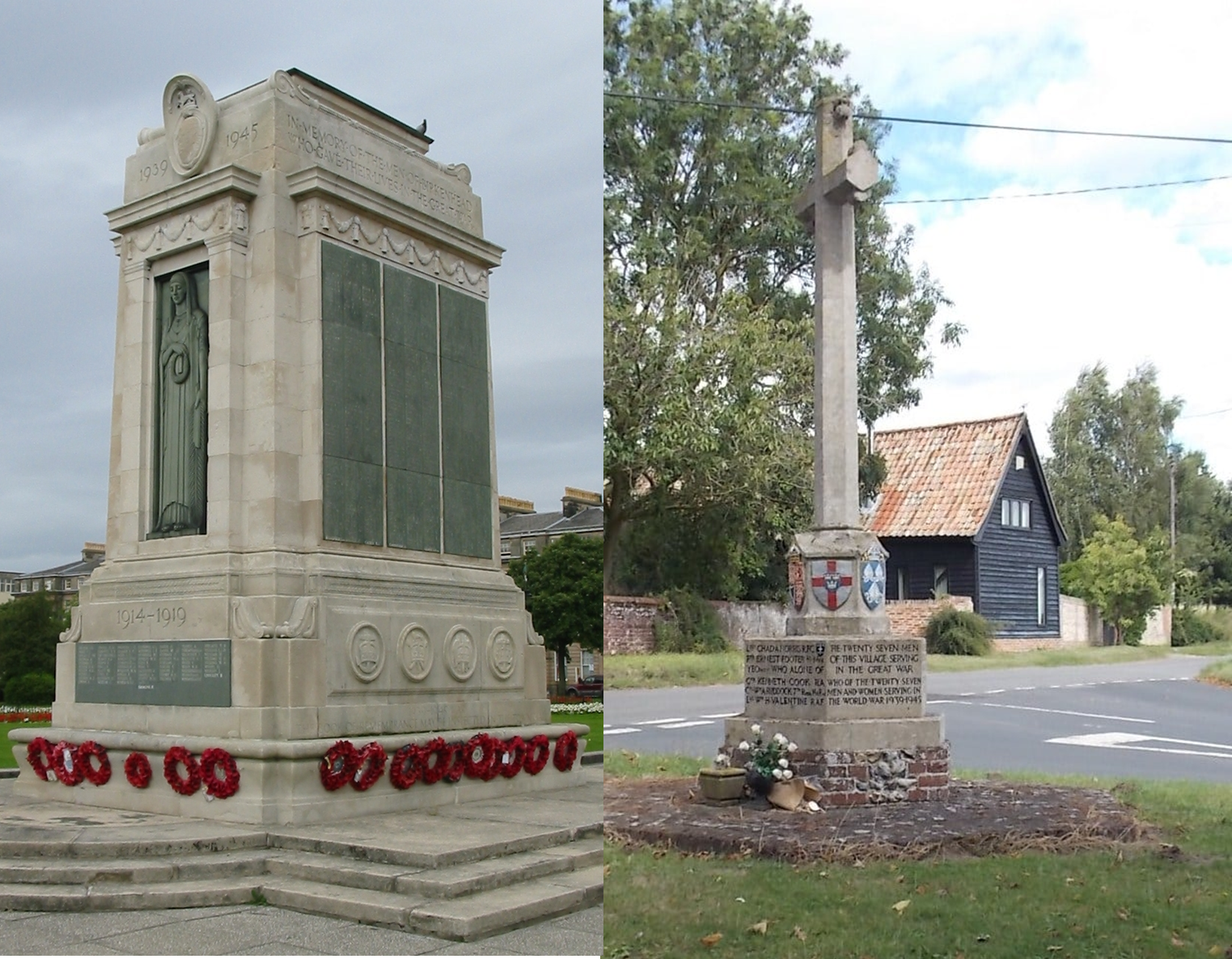
How to find your local war memorial
How to…..
Find your local war memorial
Notes:
Image 1: Birkenhead Cenotaph, The Wirral By Man vyi - Self-photographed, Public Domain, https://commons.wikimedia.org/w/index.php?curid=5064822
Image 2: Blo Norton Village War Memorial, Norfolk https://historicengland.org.uk/listing/the-list/list-entry/1453319?section=comments-and-photos

Slide 2
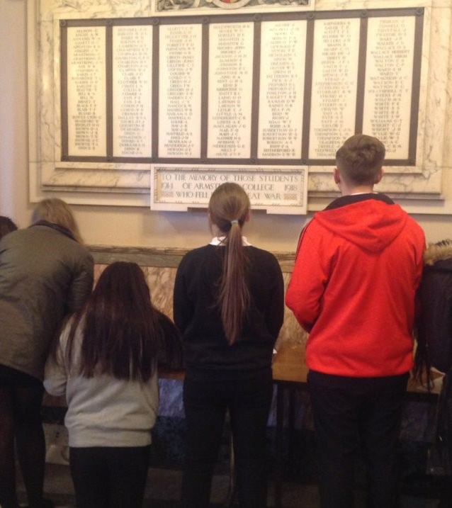
How to find your local war memorial
This guide will:
Provide information about different types of war memorial
Showcase websites that help you to locate your nearest war memorial
Suggest ideas for additional activities and next steps
This is the first guide in the series: How to investigate your local war memorial
Notes:
Image: ©Historic England

Slide 3
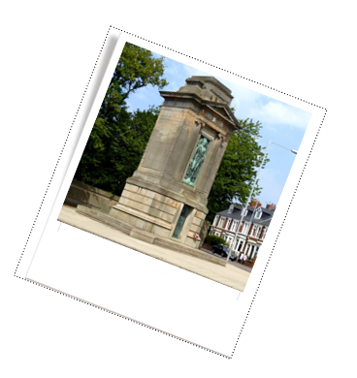
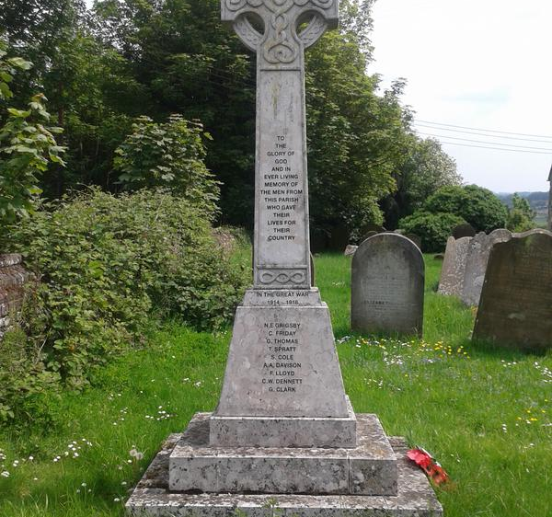
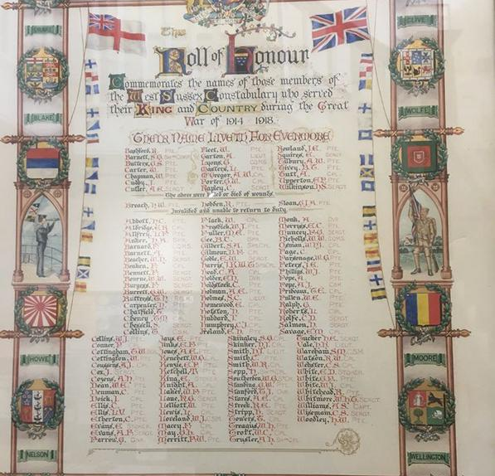
Types of War Memorial
Free standing war memorials
Plaques, rolls of honour, books of remembrance.
Memorial gardens and sites of remembrance
Gateshead Cenotaph
Stockbury WW1 and WW2 Memorial Cross
West Sussex Constabulary WW1 Roll Of Honour
West Sussex Constabulary WW1 Roll Of Honour
Notes:
War memorials of many kinds can be found in cities, towns, and villages across the UK. The best-known example of a free-standing war memorial is probably the Cenotaph in Whitehall, London but Cenotaphs, as well as many other types of free-standing memorial, exist across the country. Many were originally built to remember those who died in WWI and were later updated with plaques after WWII. Some memorials are dedicated solely to one war.
Other memorial types include plaques, rolls of honour, and books of remembrance, often linked to specific organisations, trades, or communities—You may even have one for your school remembering former pupils who served. These too may commemorate one or both World Wars.
Finally memorial gardens, parks, and sites of remembrance offer space to reflect and remember those who fought and died. These may also feature free-standing memorials and plaques .
It is important to note that not all memorials list names, but for the purposes of this guide and for suggested future steps, we will focus on those that do.
Image 1: Gateshead Cenotapa by Oliver Dixon, CC BY-SA 2.0, https://commons.wikimedia.org/w/index.php?curid=141661331
Image 2: Stockbury WW1 and WW2 Memorial Cross © John Weeks (WMR-16552)
Image 3: West Sussex Constabulary WW1 Roll Of Honour© Police Remembrance Trust (WMR-16803)

Slide 4
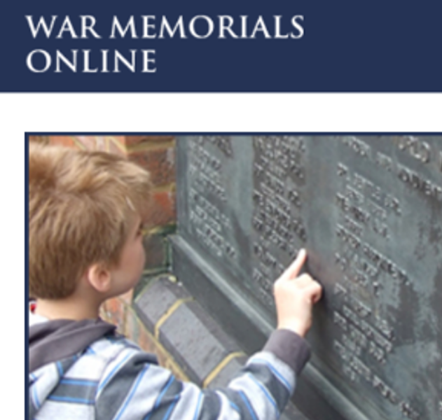
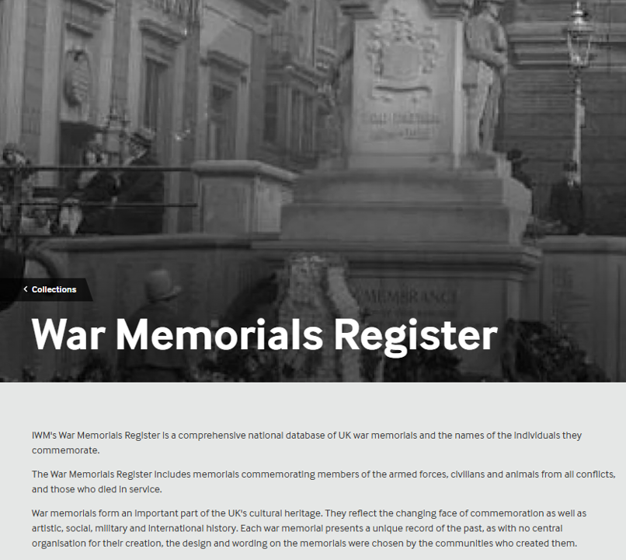
Finding your local war memorial
Most are listed on:
The War Memorials Trust’s War Memorials Online website
The Imperial War Museum’s War Memorials Register
You may also find local lists of war memorials online
Notes:
There are 2 main websites to help you find your local memorial.
The first is The War Memorials Trust’s War Memorials Online website
And the second is The Imperial War Museum’s War Memorials Register
Image 1: Screenshot War Memorials Online https://www.warmemorialsonline.org.uk/
Image 2: Screenshot War Memorials Register https://www.iwm.org.uk/memorials
Both are databases of war memorials across the Uk. Neither list all memorials but they both have a pretty large number and a good geographical spread.
It is also worth doing an internet search for a local database of memorials as these often contain even more detail than we’ll find here.

Slide 5
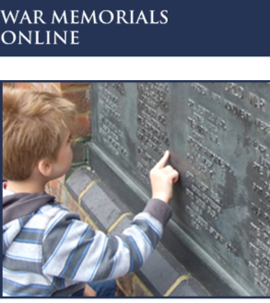
War Memorials Online
War Memorials Online is a website that was set up to help The War Memorials Trust to build a complete record of all war memorials in the UK.
Members of the public are invited to submit updates about memorials already listed on the website, or to add information about ones they know about that are not already listed.
The website holds records of around 80,000 war memorials across the UK
Notes:
The War Memorials Online website was set up to help the War Memorials Trust to build a comprehensive record of all war memorials in the UK including key information about them such as their location, type, condition and what information they carry.
The website is partially populated by information held by War Memorials Trust themselves but members of the public are also invited to submit information about additional memorials as well as updates about memorials already online.
There are thought to be around 100,000 memorials across the UK and this website holds records of around 80,000 of them.
Image: Screenshot War Memorials Online https://www.warmemorialsonline.org.uk/

Slide 6
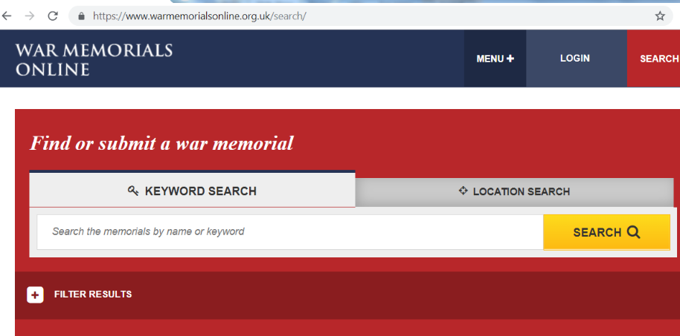

Carry out a location search on War Memorials Online
Notes:
War memorials online allows you to search the database. You can search by name or keyword or location, which is useful for finding local memorials to you.
Simply click on the location tab on the home page of the website
Image: Screenshot War Memorials Online https://www.warmemorialsonline.org.uk/

Slide 7
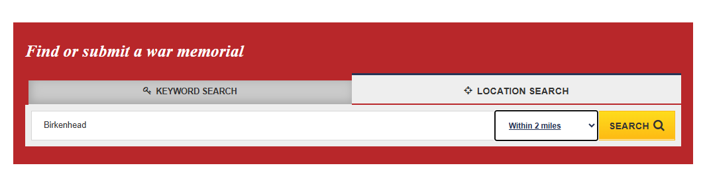

Type in place or postcode and select distance from that place by using the drop-down box. Press search.
Notes:
From here type in your postcode or the name of your city, town or village. You can also select a radius within which the search will be made.
Once you’ve done that click on search
Image: Screenshot War Memorials Online https://www.warmemorialsonline.org.uk/

Slide 8
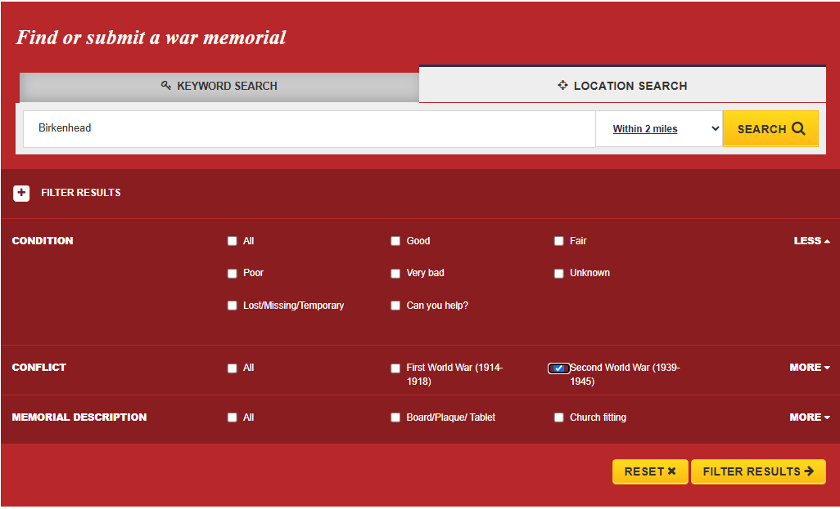
Filter results to focus on a specific type of memorial, or a particular war, if required.
Notes:
You have the option to filter your results This is helpful if you want to focus on a specific type of memorial, or a particular war.
Image: Screenshot War Memorials Online https://www.warmemorialsonline.org.uk/

Slide 9
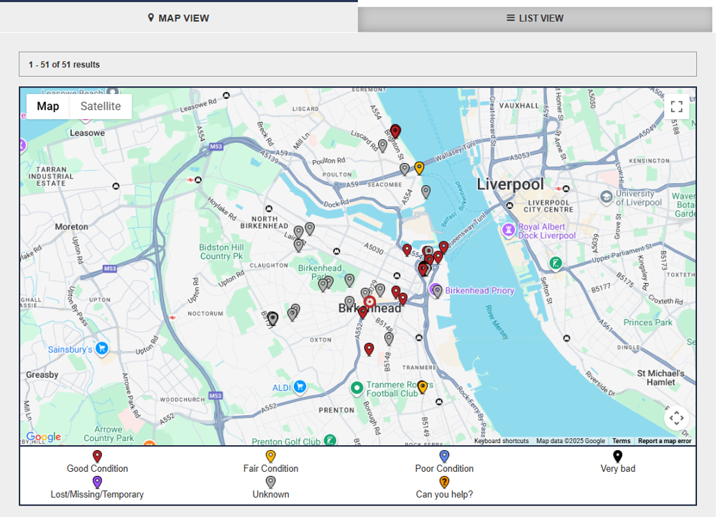
View results as a map
Different coloured pins represent the condition that each memorial is in.
Click on a pin to find out more
Notes:
Access your results in a couple of different ways.
1) Map view.
Each pin on the map represents a different memorial. Click on any one to find out more. You will notice that the pins are different colours. From the key below the map, we can see that the different colours refer to the condition that the memorial is in. This information is provided by members of the public and allows the War Memorials Trust to know which memorials need care and attention.
Towards the end of this guide you can find out about how you can help by carrying out a Condition Survey of your local memorial and submitting the information to the War Memorials Online website.
Image: Screenshot War Memorials Online https://www.warmemorialsonline.org.uk/

Slide 10
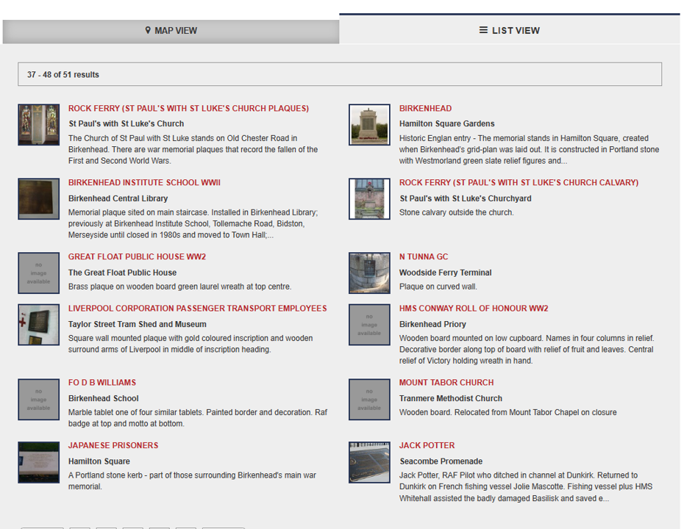
View results as a list
Click on a title to find out more
Notes:
2) List View
If you are looking for a memorial with names on it, for example, or you want to explore a memorial that you know there is a picture of, the thumbnail images are quite useful here
Image: Screenshot War Memorials Online https://www.warmemorialsonline.org.uk/

Slide 11
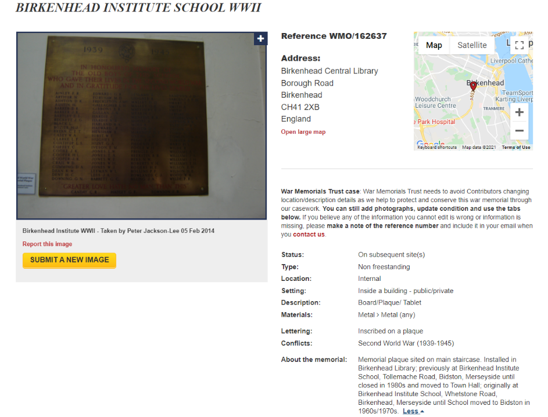
Birkenhead Institute School, WW2 Memorial
Current Location
Images
Memorial plaque sited on main staircase. Installed in Birkenhead Library; previously at Birkenhead, Merseyside until closed in 1980s and moved to Town Hall; originally at Birkenhead Institute School, Whetstone Road, Birkenhead, Merseyside until School moved to Bidston in 1960s/1970s. Institute School, Tollemache Road, Bidston.
Information about the history of the memorial – who, when, where, why etc
Notes:
It is important to remember that as the website relies heavily on information submitted by the public, the number and quality of the photos and the amount of information varies and the submission may be incomplete.
In this case for example we can see from the photo that there are names listed on the memorial, but we can’t make out what they are.
Image: Screenshot War Memorials Online https://www.warmemorialsonline.org.uk/

Slide 12
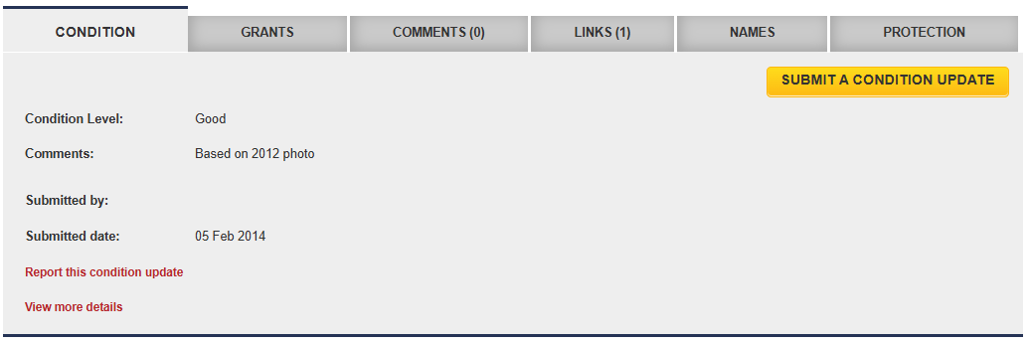
Scroll down to find out more
Many free-standing war memorials are listed on the National Heritage List for England as nationally important structures. Click on the PROTECTION tab to see if the memorial is listed. If so, click on the link to view the list entry.
Details of the condition of the memorial and the surrounding area
Notes:
“Condition” tab: find out more about how well looked after your memorial is and submit a condition update if you were carrying out a Condition Survey.
“Protection” tab: Many free-standing war memorials are listed on the National Heritage List for England as nationally important structures. If your memorial is listed, you can click on the link under the “protection” tab to view the list entry. This may contain extra info about the memorial and its history.
Image: Screenshot War Memorials Online https://www.warmemorialsonline.org.uk/

Slide 13
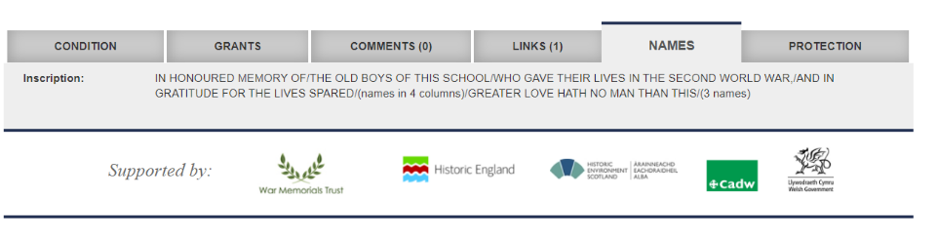
Scroll down to find out more 1
Details of the names written on the memorial. In this instance the names haven’t been transcribed so……
Notes:
“Names” tab: Information about the inscription on the memorial and sometimes a transcribed list of names. Unfortunately, in this instance, that hasn’t been done so we have a number of options if we want to find the listed names….
Image: Screenshot War Memorials Online https://www.warmemorialsonline.org.uk/

Slide 14
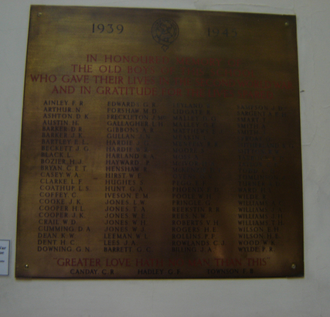
What if there are names on the memorial but they aren’t clear on War Memorials Online?
Visit the memorial and take your own photos or write a list of the names.
You could then add them to the War Memorials Online database.
See if your memorial is featured elsewhere online, for example on a local database of memorials.
Try the Imperial War Museum’s War Memorial’s Register
Often there is a direct link to the IWM database from War Memorials Online, under the LINKS tab…..
Birkenhead Institute School Memorial
Notes:
Visit the memorial and take your own photos or write a list of the names. You could then add the information to the “Names” tab on the War Memorials Online website.
Image: Screenshot War Memorials Online https://www.warmemorialsonline.org.uk/
2) See if you can find information about and / or photos of the memorial elsewhere online, for example on a local database of memorials
3) See if the names are transcribed, or the image is clearer on the Imperial War Museum’s War Memorial’s Register
Often there is a direct link to the IWM database from War Memorials Online…..

Slide 15
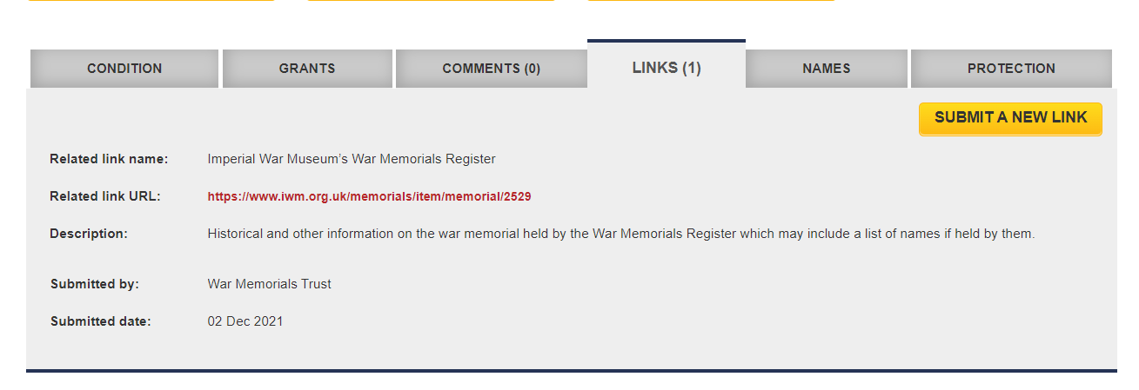
Links to the Imperial War Museum War Memorial’s Register
Notes:
“Links” tab: Useful links to other websites which provide more information and / or photos of the memorial. This often includes links to the war memorial entry on the War Memorials Register
Image: Screenshot War Memorials Online https://www.warmemorialsonline.org.uk/

Slide 16
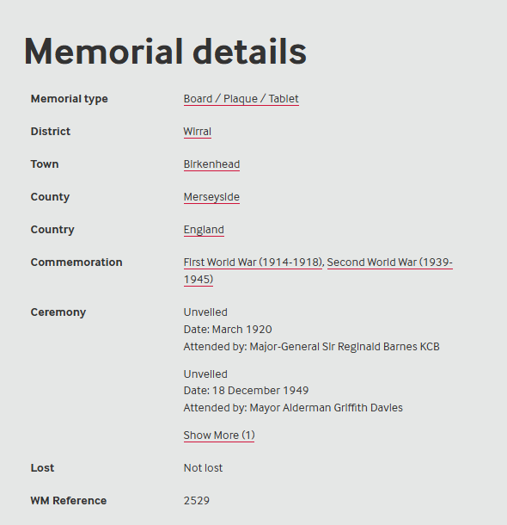
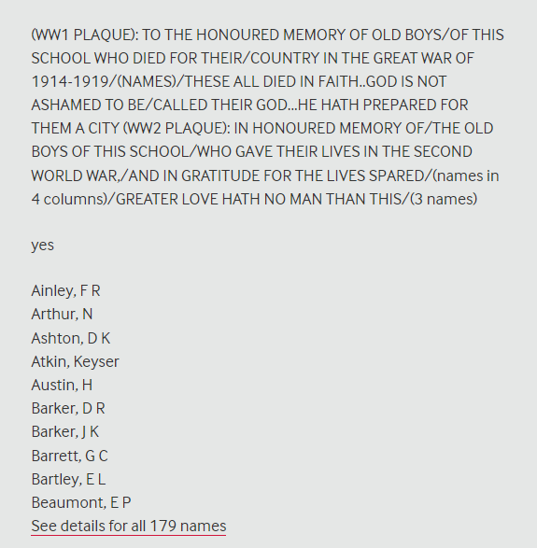
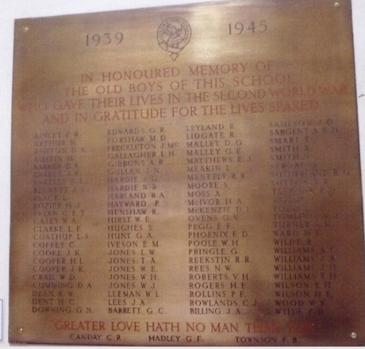

Imperial War Museum’s War Memorials Register
Additional info about the memorial
A clearer photo
A transcribed list of all names listed on the memorial
Notes:
Birkenhead Institute school on the IWM’s War Memorials Register
Here we may find:
Additional info about the memorial
Additional / clearer photos.
A transcribed list of all names listed on the memorial
It’s important to point out here that whilst in this instance the IWM’s War Memorial Register seems to provide much more information and a better photograph, this isn’t always the case
Always check both websites for information
Image 1: © (WMR-2529)
Image 2 and 3: Screenshot War Memorials Register website https://www.iwm.org.uk/memorials

Slide 17
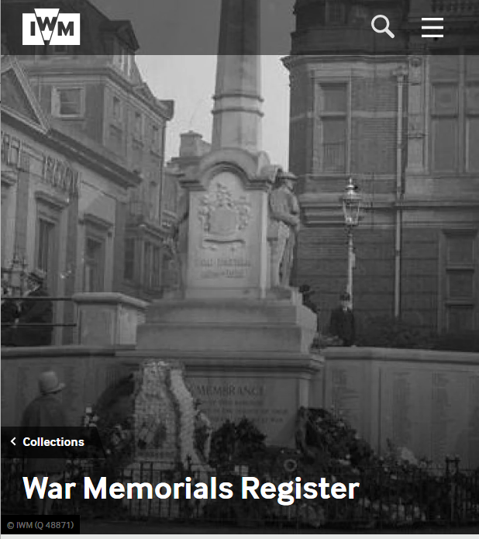
War Memorials Register
The War Memorials Register is a national database maintained by the Imperial War Museum.
It includes details of memorials commemorating members of the armed forces, civilians and animals from all conflicts, and those who died in service.
Notes:
Even if there isn’t a link from War Memorials Online to the War Memorials Register, it is worth doing a search on the register to see if you can find your memorial there too, as you may find more useful information.
Image: Screenshot War Memorials Register website https://www.iwm.org.uk/memorials

Slide 18
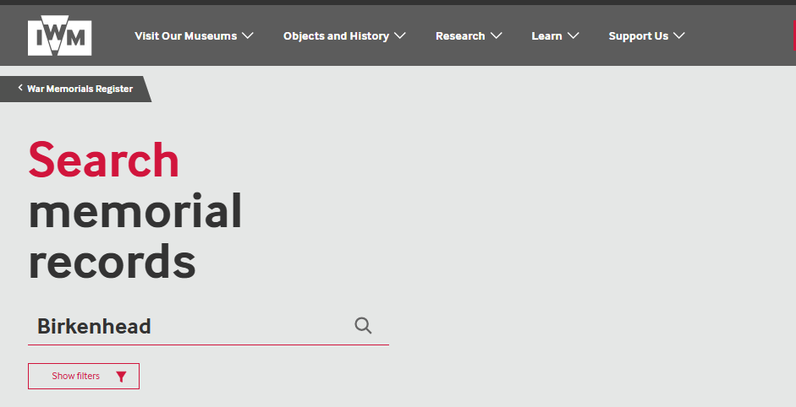
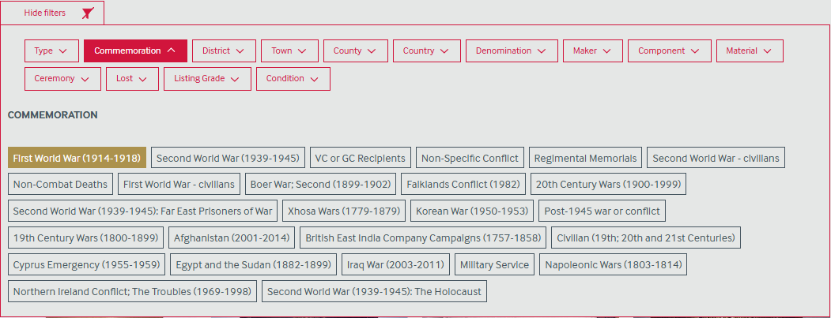
Searching the Imperial War Museum’s War Memorials Register
Filter the results if required:
Notes:
Like War Memorials Online you can search by name of place or, if you know it, the name of memorial and you can filter the results. You can’t search by postcode on this website.
Image 1 and 2: Screenshot War Memorials Register website https://www.iwm.org.uk/memorials

Slide 19
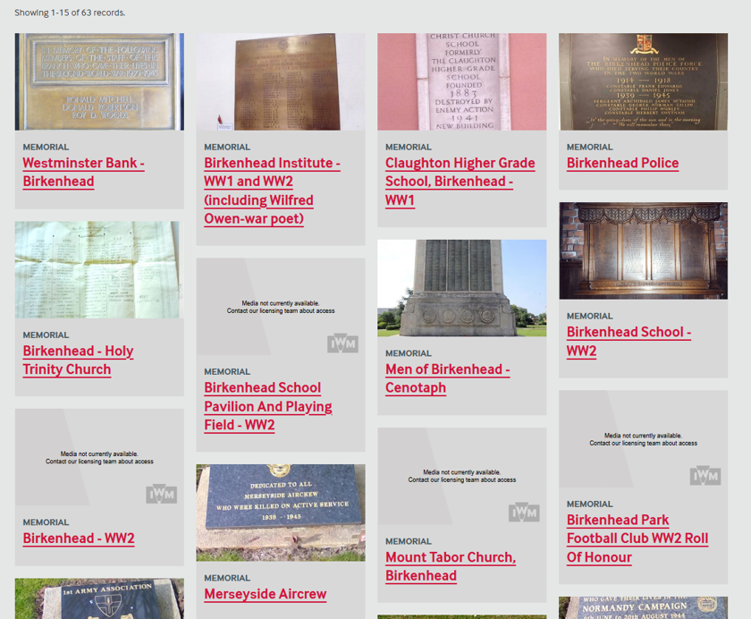
Results
Arranged in a grid rather than on a map
Notes:
We can see that the results are arranged in a grid format.
No option to view as a map
Click on the memorial you are focusing on and / or explore others
Image: Screenshot War Memorials Register website https://www.iwm.org.uk/memorials

Slide 20
Summary
Websites like The War Memorials Trust’s War Memorials Online website and the Imperial War Museum’s War Memorials Register help you to locate and learn about local memorials.
Once you have found a local war memorial the “Next Steps” on the following slides will help you to explore your local memorial, and the names listed on it, in more depth.

Slide 21
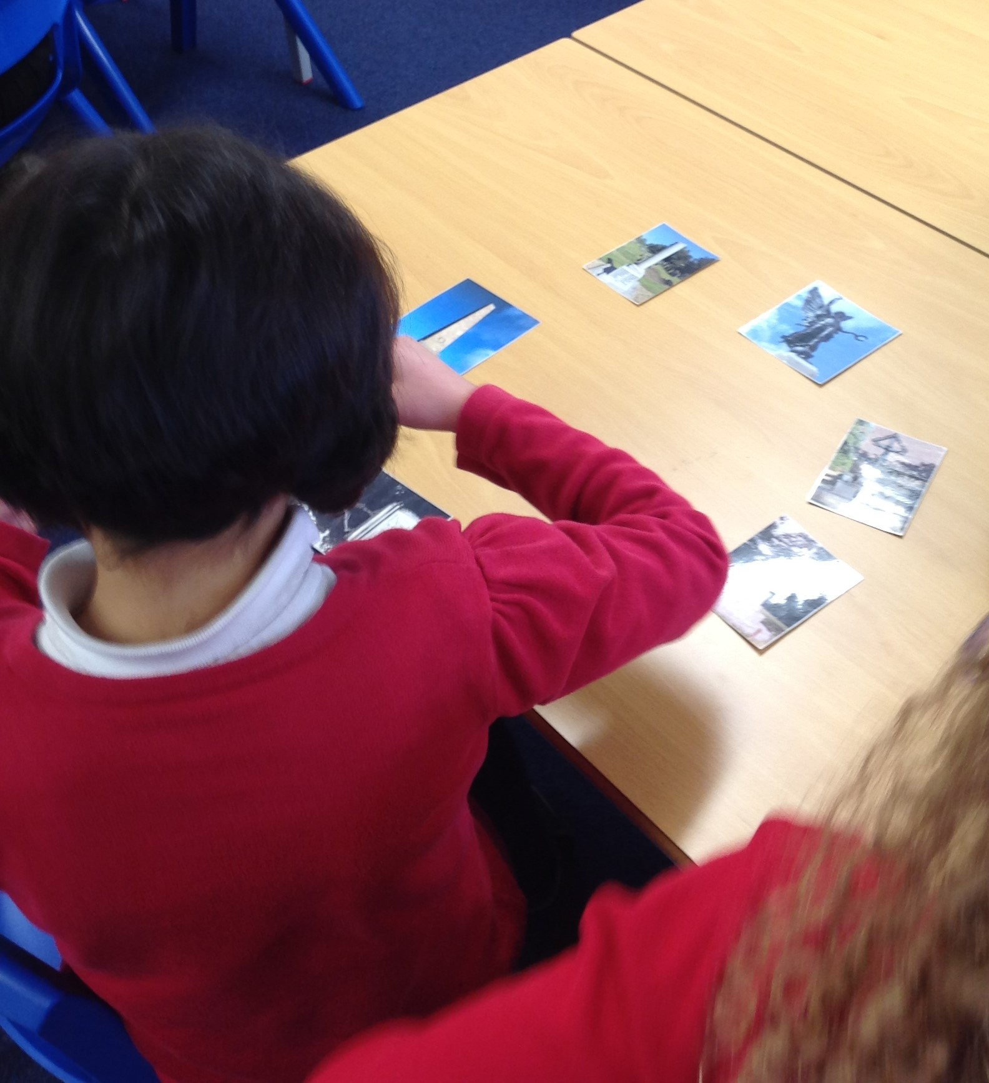
Next Steps: Find out more about the different types of war memorials in your area
Use War Memorials Online to find out about other war memorials in your area.
Explore different types of memorials, and their features, using the learning resources on The War Memorial’s Trust learning website, Learn About War Memorials
The War Memorials Trust is a UK charity dedicated to the preservation and conservation of war memorials.
Young people exploring the features of different types of war memorial
Notes:
Image: © Historic England

Slide 22
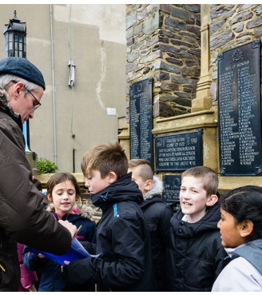
Next Steps: Carry out a Condition Survey
War Memorial Condition Surveys help the War Memorials Trust to know about the condition of memorials across the UK and to find out which memorials need attention.
Carrying out a Condition Survey with young people helps them to understand the lasting impact of war on their community.
Find out more about Condition Surveys, including an e-learning guide, on the Historic England website
Learn how Moorhouse Primary School in Rochdale carried out a Condition Survey of their local memorial, in this short film.
Children doing a Condition Survey of a war memorial
Notes:
Image: © Historic England

Slide 23
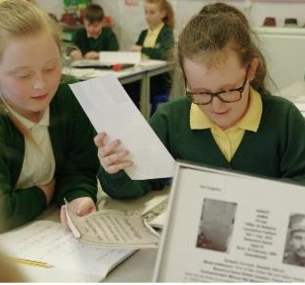
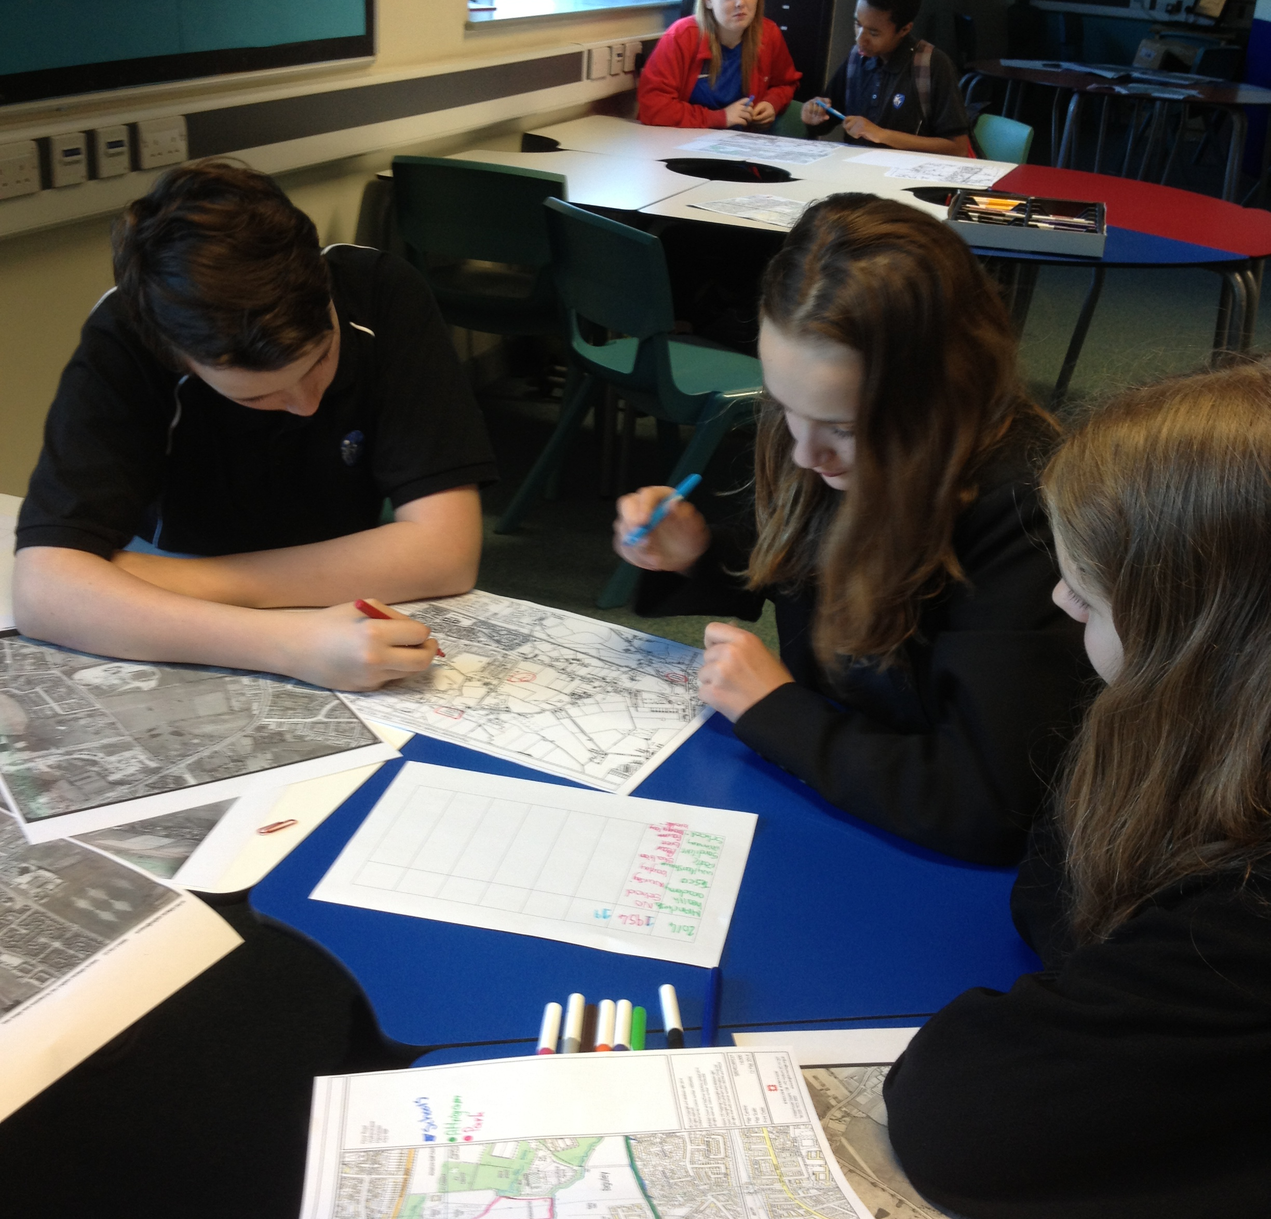
Next steps: Research your local service person
Pupil research
Use the following guides on our ‘How to investigate your local war memorial’ page to find out more about the people listed on your local war memorial:
How to research a local serviceperson using the Commonwealth War Graves Commission website
How to find out more about your local serviceperson
Pupil research
Notes:
You could use the Historic England how to guides listed here to support you in researching the life of a service person listed on your local memorial
Images: © Historic England

Slide 24
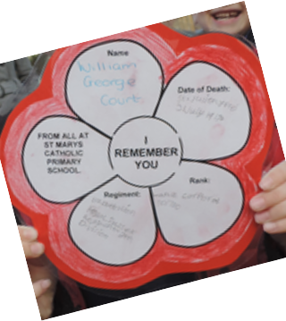
Next Steps: Remember the people listed on your memorial
Commemorate the people listed on your memorial by holding a remembrance service.
“I Remember You” project
Notes:
Image: © Historic England

Slide 25

Find more resources on the Historic England Website
www.historicengland.org.uk/education

