Slide 1
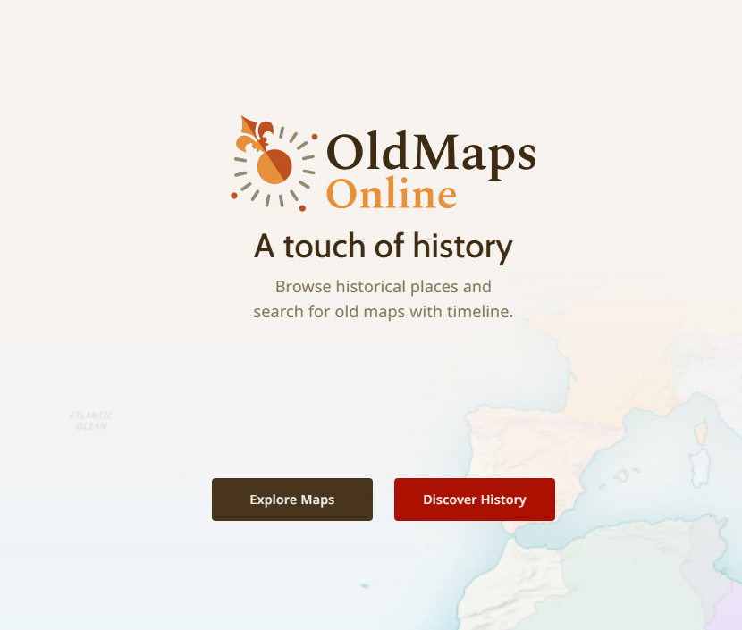
How to find and use old maps on the Old Maps Online website
How to find and use old maps on the Old Maps Online website
https://www.oldmapsonline.org

Slide 2
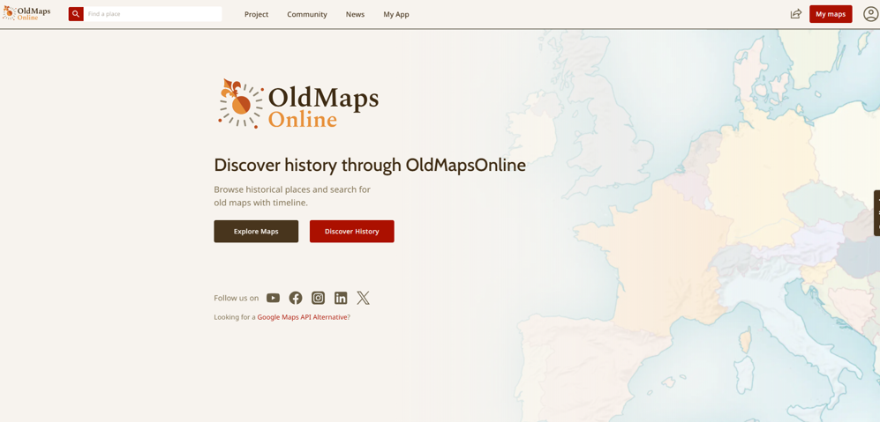

Using Old Maps Online
https://www.oldmapsonline.org
This free version has some limitations but is still a great resource. Start by going to Explore Maps

Slide 3
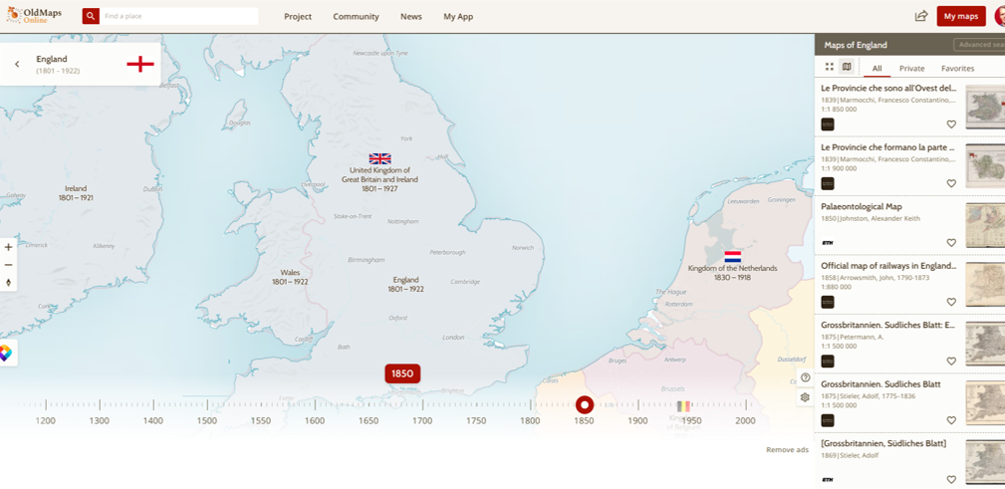
Use ‘Find a place’ or zoom in to find your local area
Start typing the name of a place and a drop-down list appears. Select the one you want.
You can also select a year by using the slider at the bottom of the page
(NB: In the free version, on occasions, the slider is not available)

Slide 4
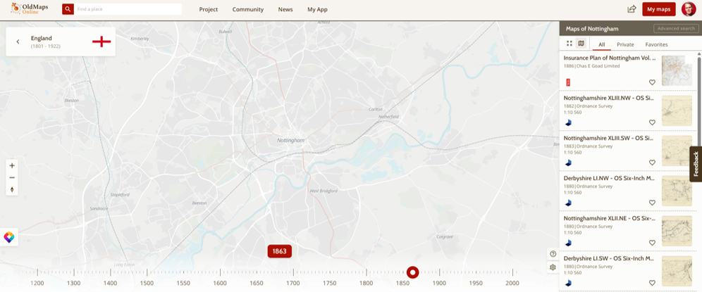
Choose one of the maps from the right-hand side 1

Slide 5
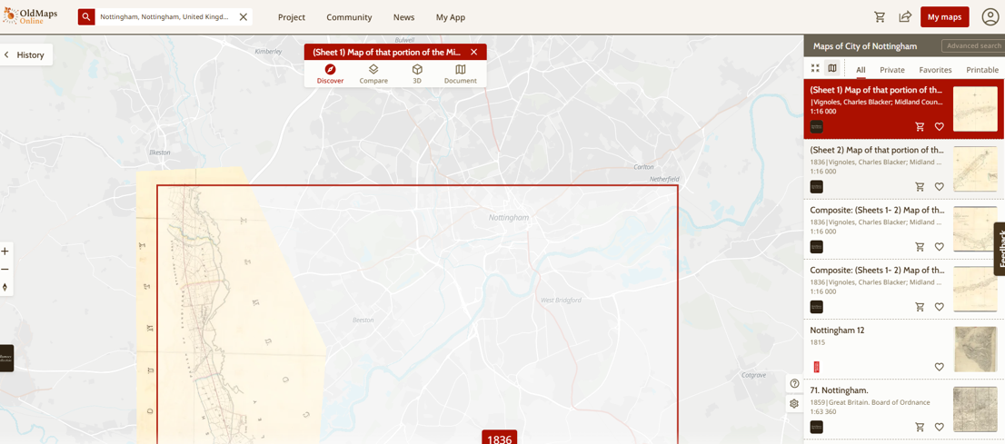
Choose one of the maps from the right-hand side 2
Hover over a map, a red lined area will appear on the map showing the area represented on each map

Slide 6
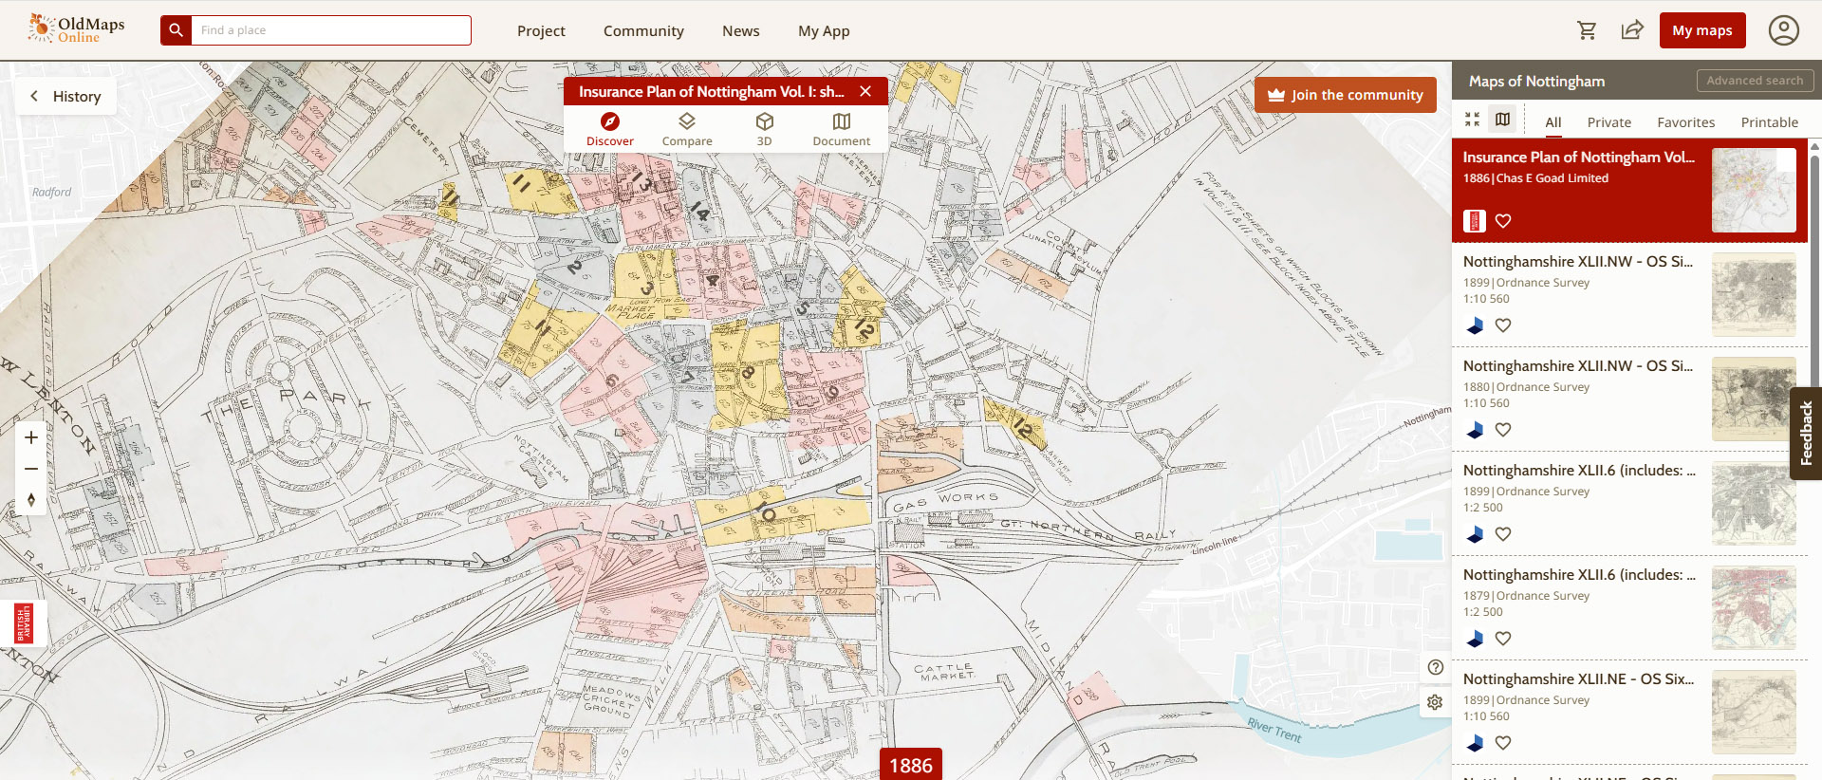
Compare the modern and historical maps 1
Once you’ve selected a map click on the ‘Compare’ symbol

Slide 7
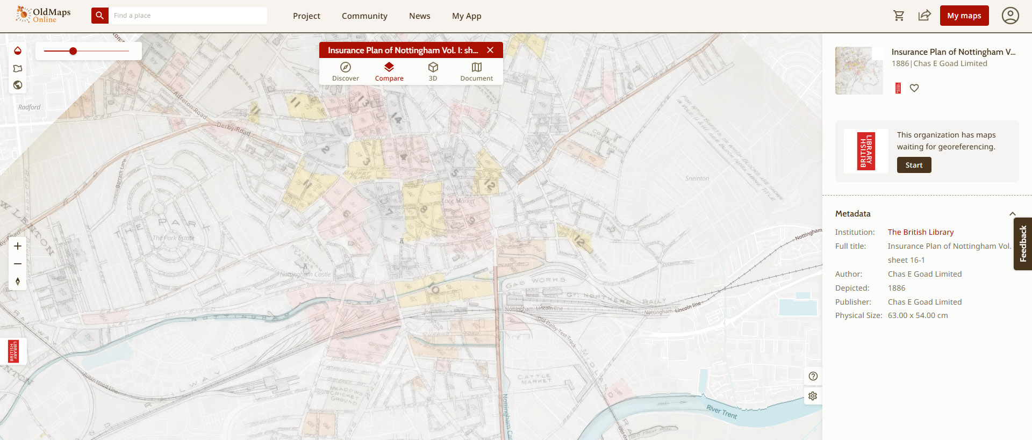
Compare the modern and historical maps 2
Use the slider to change the transparency of the map, to help you see the changes between them

Slide 8
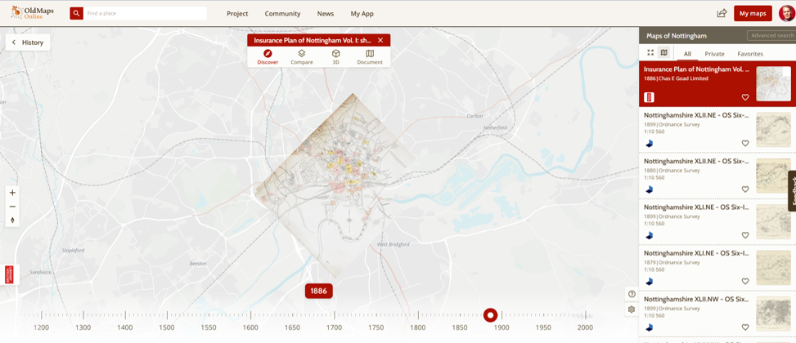
Click back on ‘Discover’
Now click on the ‘History’ tab

Slide 9
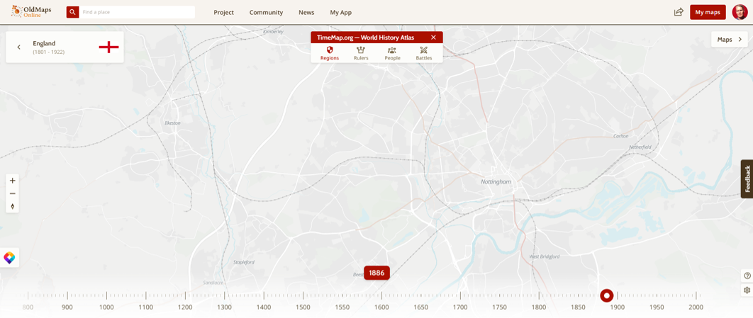
You can then explore Regions, Rulers, People & Battles
Select ‘People’ to find significant people in your area. You can also adjust the year.

Slide 10
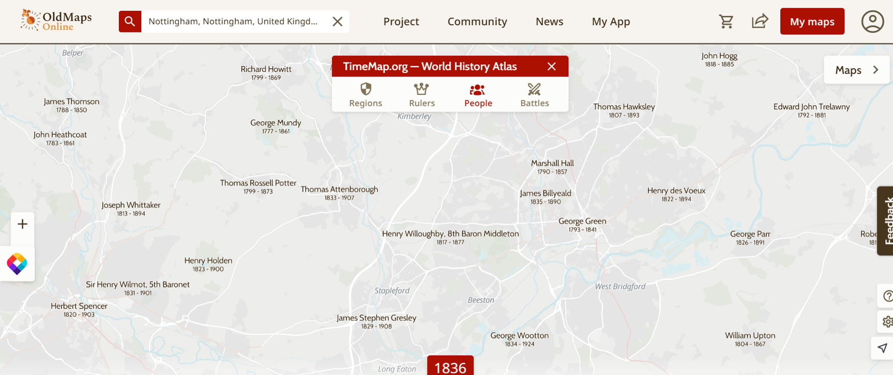
Clicking on a person takes you to Wikipedia information

Slide 11
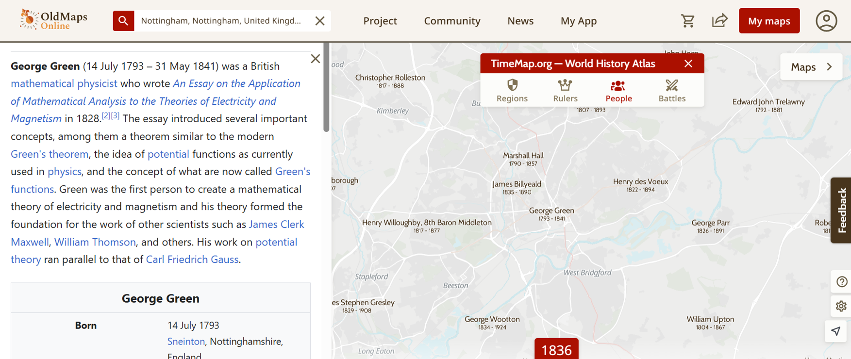
The Wikipedia information opens in a pop-up box

Slide 12
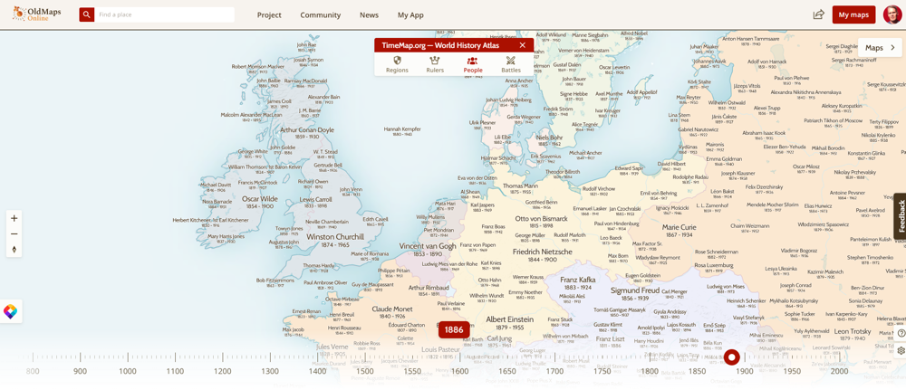
Experiment with different years and regions.
To return to maps, click the tab on the right-hand side

Slide 13


Have fun exploring your area
What has changed? What is still the same?
Change
over time
Similarities &
differences

Slide 14
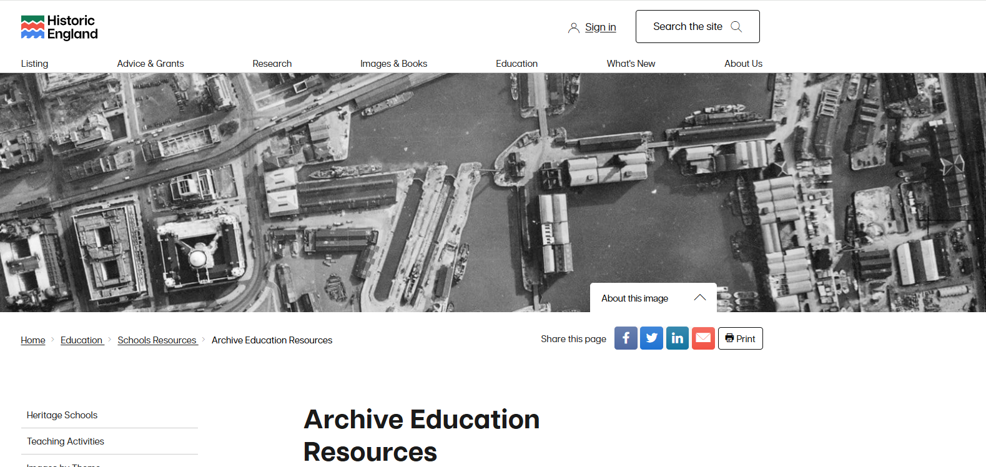
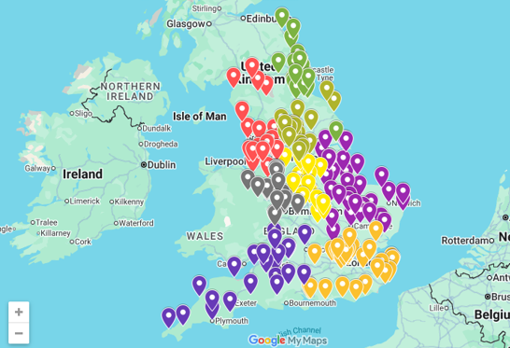
Find out more about Historic England’s old map and aerial photo collections in our Archive Resource Packs

