Slide 1
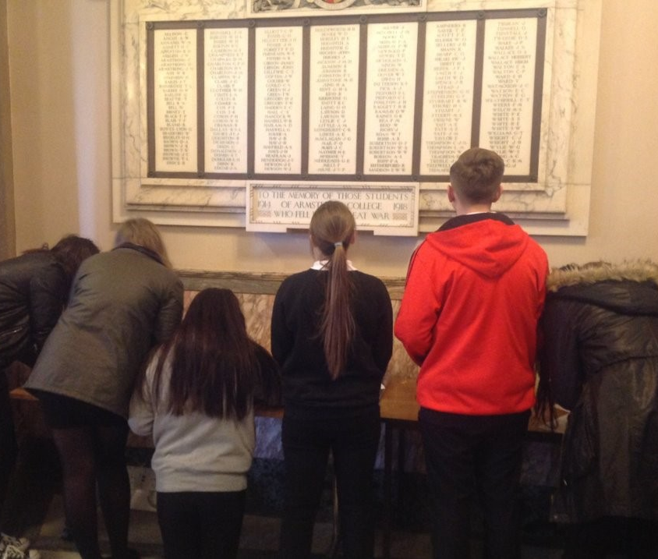
Use the Commonwealth War Graves Commission website to research a serviceperson remembered on a local memorial.
How to…..
Use the Commonwealth War Graves Commission website to research a serviceperson remembered on a local memorial.
Notes:
Image: ©Historic England

Slide 2
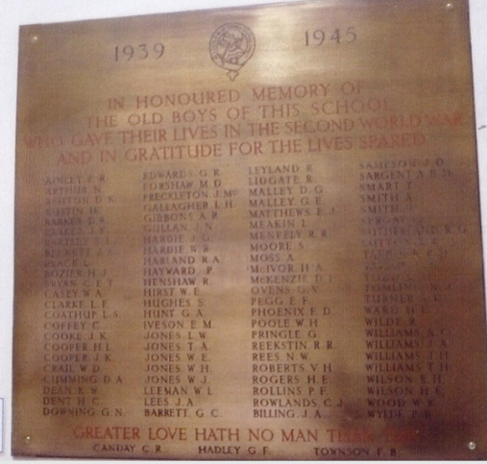
How to use the Commonwealth War Graves Commission website to research a serviceperson remembered on a local memorial.
This guide will:
Provide information about the Commonwealth War Graves Commission (CWGC).
Provide hints and tips for identifying a serviceperson on a war memorial.
Show you how to use the CWGC's website to find out more about your serviceperson.
This guide follows on from the guide How to find a local war memorial and is the second in the series:
How to investigate your local war memorial
Notes:
Image: © IWM (WMR-2529)

Slide 3

The Commonwealth War Graves Commission (CWGC)
The Commonwealth War Graves Commission’s mission is to ensure those who died in service, or as a result of conflict, are commemorated so that they, and the human cost of war, are remembered for ever.
They look after war memorials across Europe and the World.
They hold an online database of service people and civilians who died as a result of warfare.
Notes:
CWGC are an organisation who are responsible for looking after war graves, cememteries and memorials across Europe and the World That are linked to WW1 and 2 as well as other conflicts past and present.
They predominantly care for graves cemeteries and memorials remembering those from the Commonwealth who died but they also sometimes look after the graves of people from other nations who died in conflicts where Commonwealth forces have been involved.
They are responsible for memorials of service people but also civilians for example those who died in the Blitz during WW2..
And most pertinent here they hold an online database providing details of the service people and civilians who died in the first and second world wars. This means that we can search the database for the names of people listed on local war memorials to try to find out more about them.
Image: By Commonwealth War Graves Commission - Extracted from https://www.cwgc.org/media/noantj4i/report-of-the-special-committee-to-review-historical-inequalities-in-commemoration.pdf, Public Domain, https://en.wikipedia.org/w/index.php?curid=76106974

Slide 4
Case study: Using CWGC to find out about a serviceperson listed on Birkenhead Institute School, World War 2 Memorial
Birkenhead Institute School, World War 2 Memorial is currently located at Birkenhead Library.
Originally located at Birkenhead Institute School, Whetstone Road, Birkenhead.
In honoured memory of the old boys of this school who gave their lives in the Second World War and in gratitude for the lives spared.
Birkenhead Institute School, WW2 Memorial
Notes:
During this how to guide we will use Birkenhead Institute School WW2 memorial as an example to illustrate how you can find out more about a serviceperson listed on a war memorial using the CWWC website.
Image © IWM (WMR-2529)
Image: © (WMR-2529)

Slide 5

Identifying a soldier to find out more about
Try unusual surnames.
Try names with two initials / full name or rank given.
What can we find out about W A Casey?
Notes:
Not all soldiers listed on war memorials are easily identifiable on the CWGC website. You may need to search more than one name
Image: © IWM (WMR-2529)

Slide 6

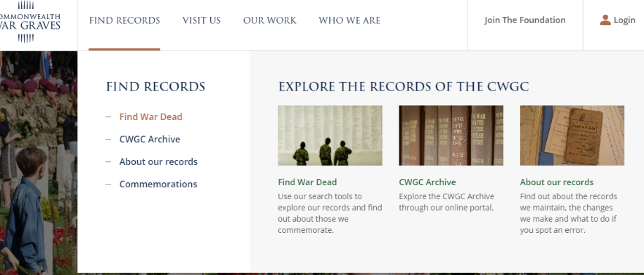

Finding a local serviceperson on the CWGC website
Go to: https://www.cwgc.org/
Notes:
From the CWGC home page, select Find Records and then Find War Dead
Image: Screenshot CWGC website https://www.cwgc.org/

Slide 7
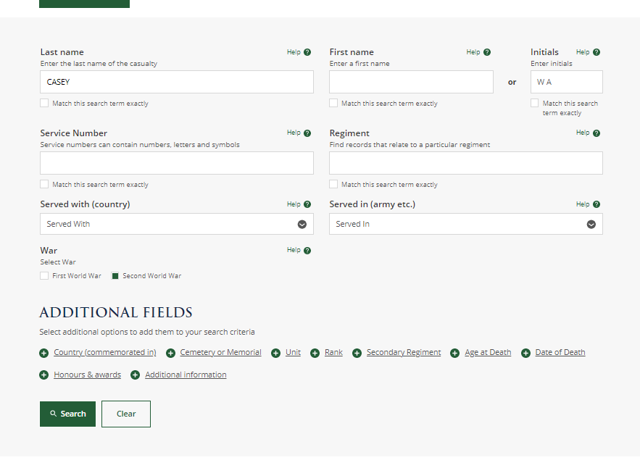
Type in a name, select FWW or SWW and click “Search”
Notes:
Complete as many details as known.
Click on search
Image: Screenshot CWGC website https://www.cwgc.org/

Slide 8
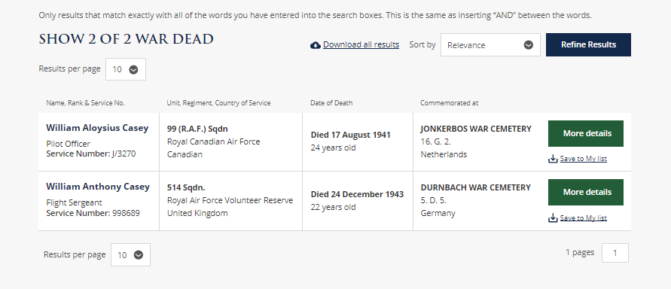
Click on a green box to find out more about those listed
If you get no results or too many results you may need to search again!
Notes:
If you get too many results or none at all you would need to select a different serviceperson
Click on “more details” to find out more about the people who may be your serviceperson
Image: Screenshot CWGC website https://www.cwgc.org/

Slide 9
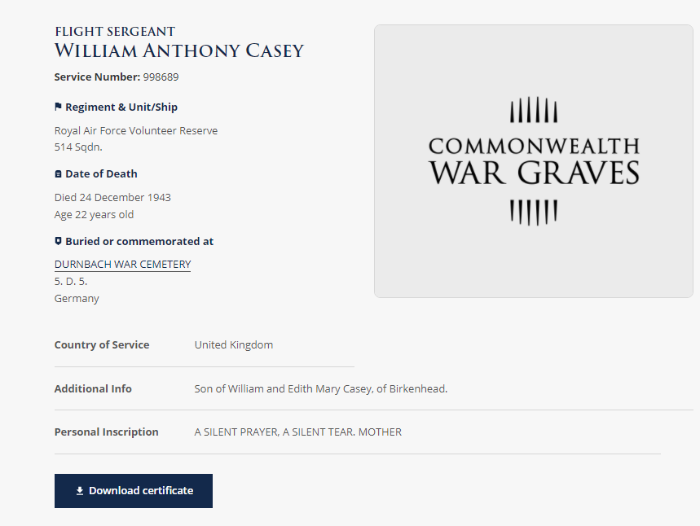
Serviceperson’s Details on CWGC
Since William’s parents are from Birkenhead, we can be pretty certain this is the WA Casey listed on Birkenhead Institute School memorial
First look at the “Additional Info”
If you find no “additional information” helping you to confirm that this is your local serviceperson, you may need to search again!
Notes:
Factfile about William Anthony Casey
View first the additional information section. If no additional information available, perhaps because the body was never formally identified, you will need to choose another name from the memorial and start again. There is no way of confirming that the person listed here is the same person listed on the memorial.
Image: Screenshot CWGC website https://www.cwgc.org/

Slide 10
We already know so much more than we did!
Service Number
Full name and rank
Who he served with
Age and date of death
Where he is buried and what plot
Family details.
Notes:
Image: Screenshot CWGC website https://www.cwgc.org/

Slide 11
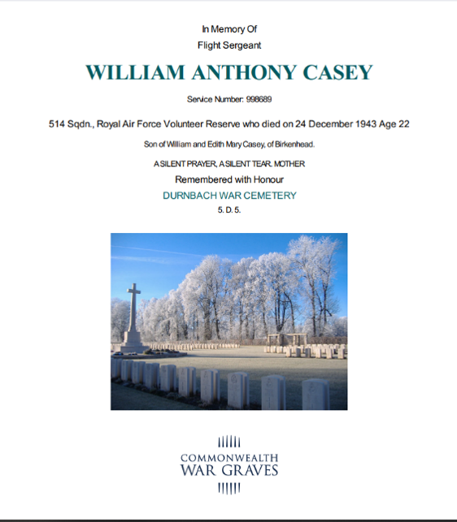
Download a commemorative certificate
Notes:
An opportunity to recognise, remember and humanise a local person who has been a name on a memorial but might not have been thought about as an actual person in a very long time.
Image: Commemorative Certificate courtesy of CWGC

Slide 12
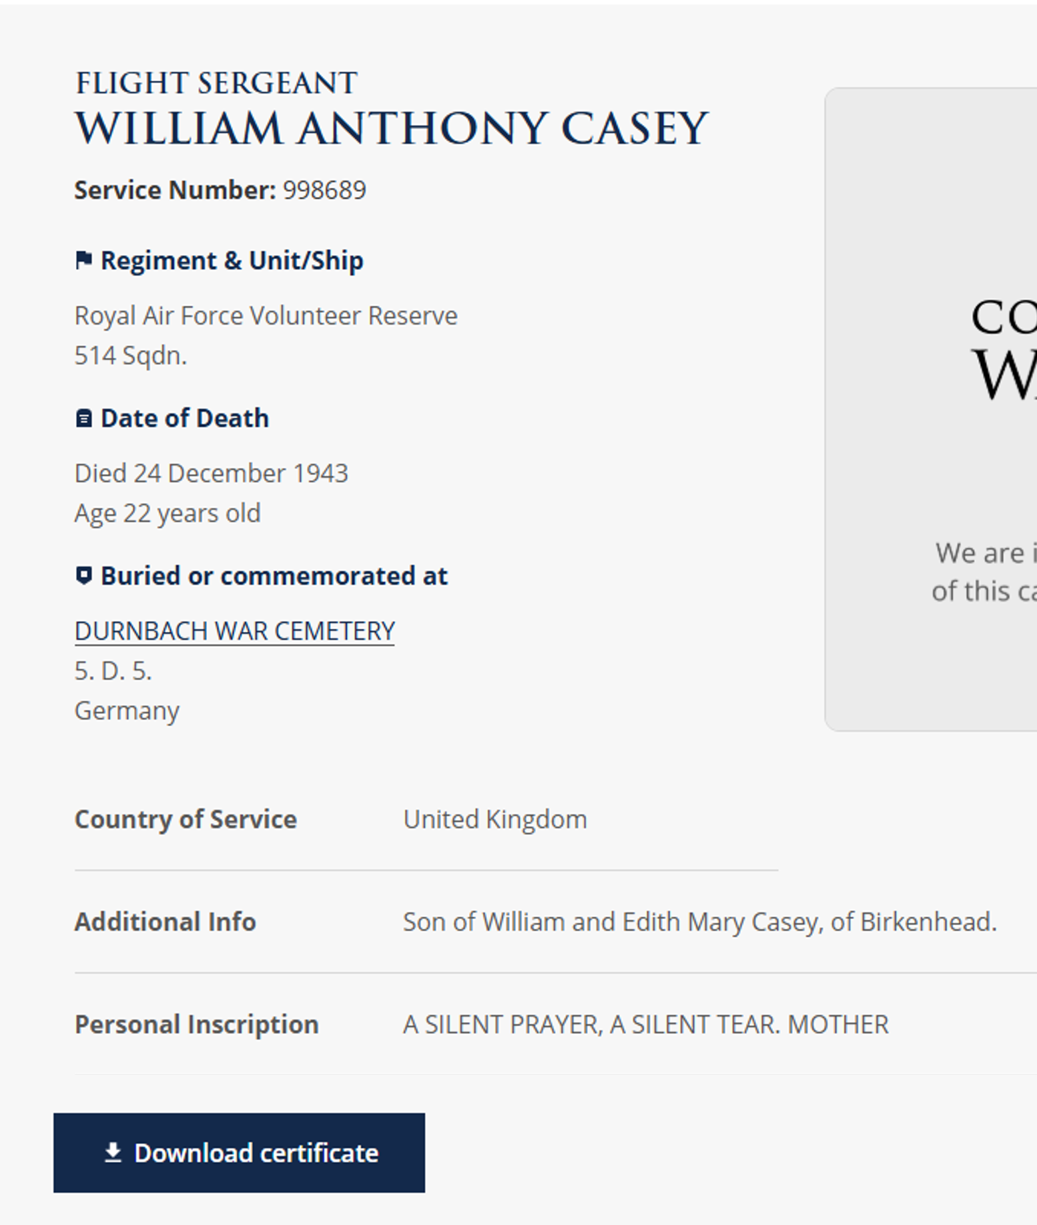
Find out more about the cemetery or memorial where your serviceperson is remembered
Click on cemetery / memorial to find out more
Notes:
Note: If your serviceperson’s body was never found, they may have their name inscribed on a memorial rather than a gravestone.
Image: Screenshot CWGC website https://www.cwgc.org/

Slide 13
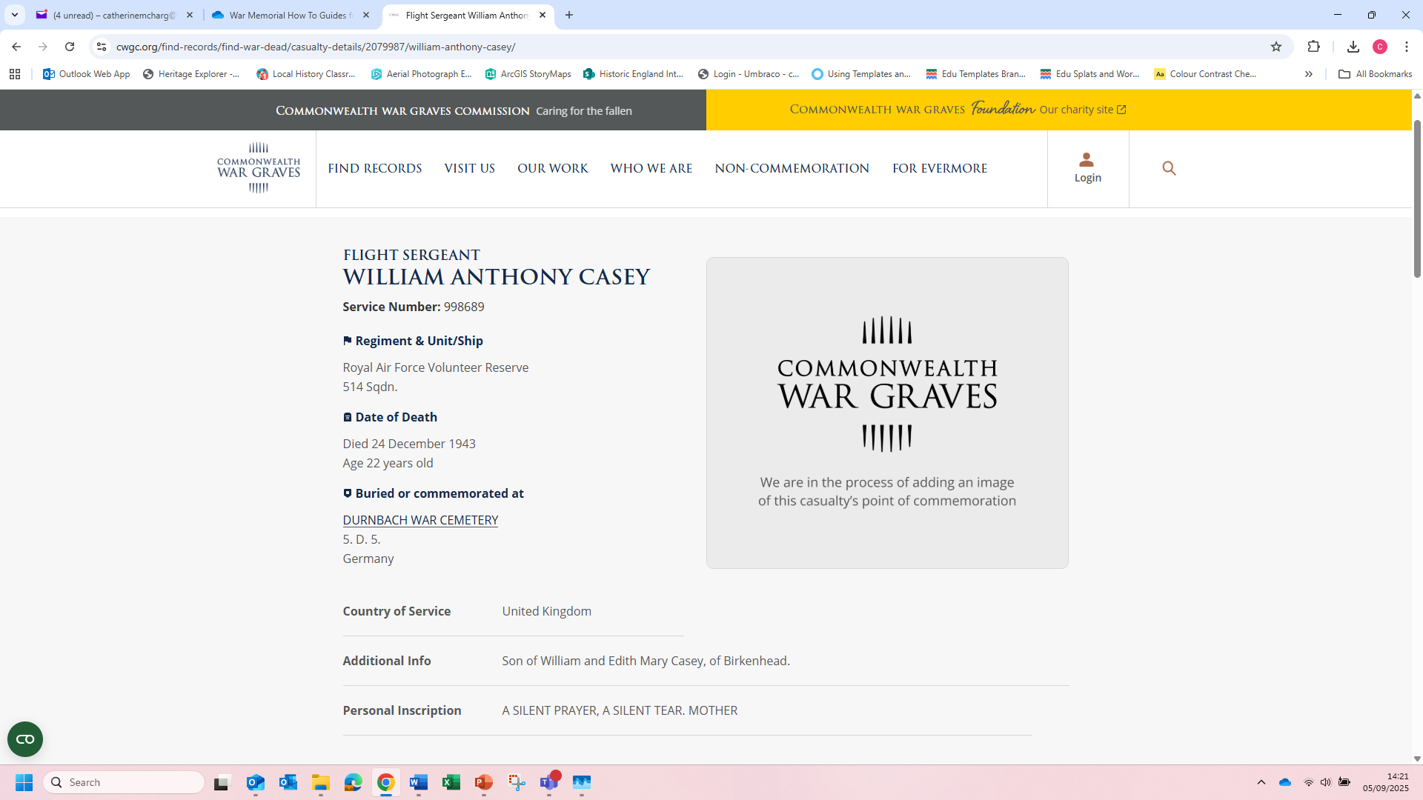
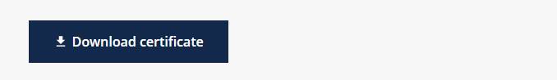

Slide 14
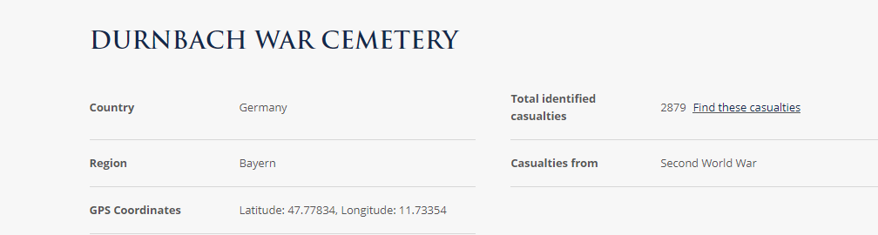
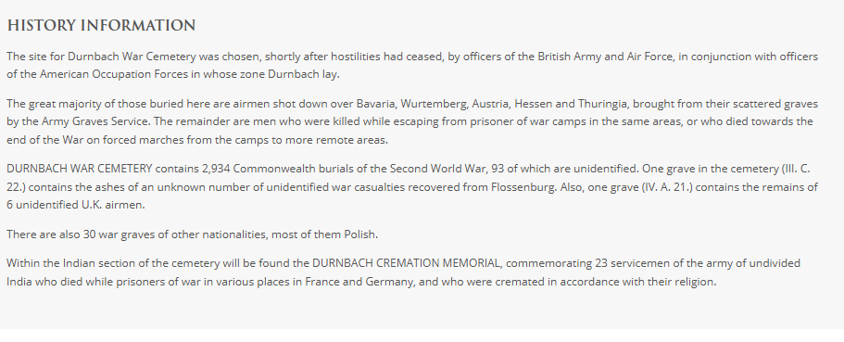
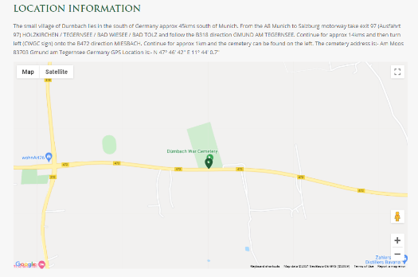
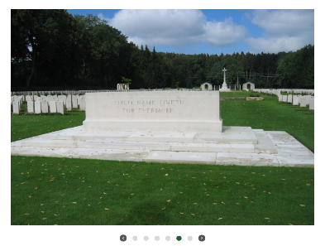
Durnbach War Cemetery
Notes:
Information provided:
- facts and figures about the cemetery including its location and the total number of casualties commemorated.
- photos of the cemetery
- map of the location of the cemetery. This might give you a clue as to where your serviceperson died.
Note, however, this isn’t always the case as bodies were sometimes moved and buried or reburied during or after the war
- History Information: provides information about the people buried or remembered at that site for example The great majority of those buried at Durnbach are airmen shot down over different parts of Germany and brought here from their scattered graves by the Army Graves Service.
You may also find that people remembered at a site are linked to a particular battle, period in the war or branch of armed forces.
Images: Screenshots CWGC website https://www.cwgc.org/

Slide 15
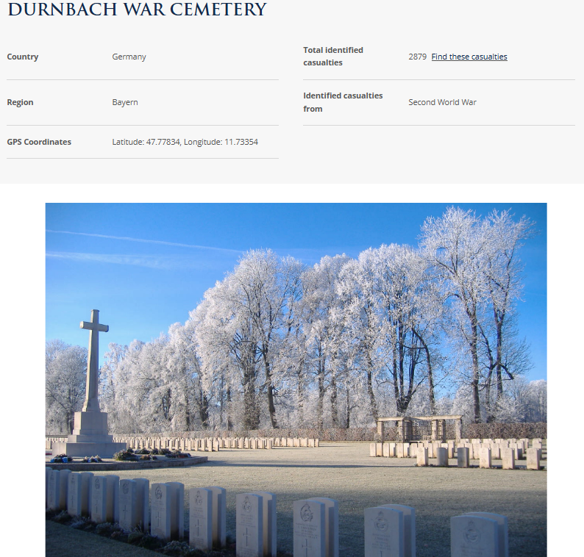

Download a cemetery plan
Notes:
For larger cemeteries, download a cemetery plan. Note. Not always available
Image: Screenshot CWGC website https://www.cwgc.org/

Slide 16
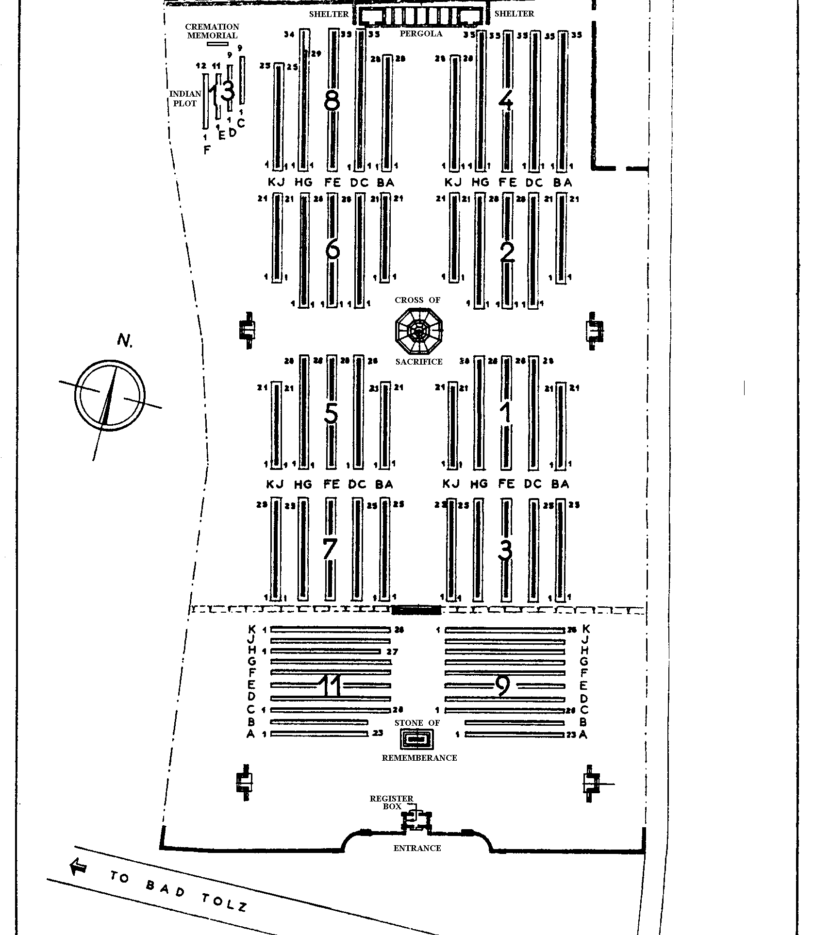
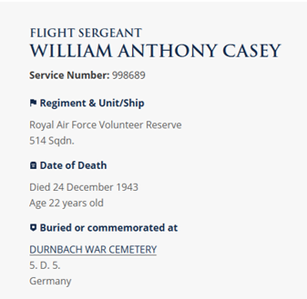
Locate exactly where your serviceperson is buried
Find the plot number from the information listed about your serviceperson. This indicates where in the cemetery they are buried.
Locate the plot on the plan
Durnbach Cemetery Plan
Notes:
Use the plot information from your serviceperson details to locate approximately where your serviceperson is buried if you were to be able to visit the cemetery and pay your respects
Image: Plan of Durnbach Cemetery courtesy of CWGC website https://www.cwgc.org/

Slide 17
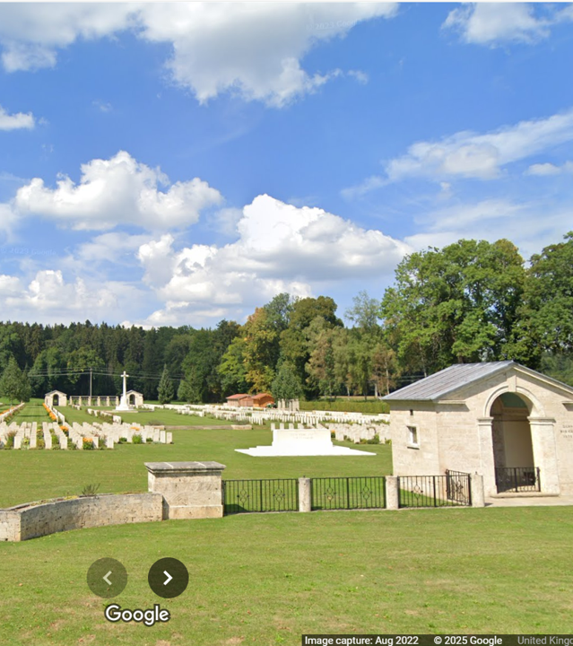
Explore the cemetery online
Use online maps and Streetview functions to explore the site in more detail.
Durnbach Cemetery
Notes:
Image 2: Screenshot Google Street View. Image Capture: Aug 2022 © 2025 Google

Slide 18
Use the cemetery / memorial to identify other casualties
Notes:
Explore other casualties remembered at the site.
Return to the details about Durnbach Cemetery and click on find these casualties
Image: Screenshot CWGC website https://www.cwgc.org/

Slide 19
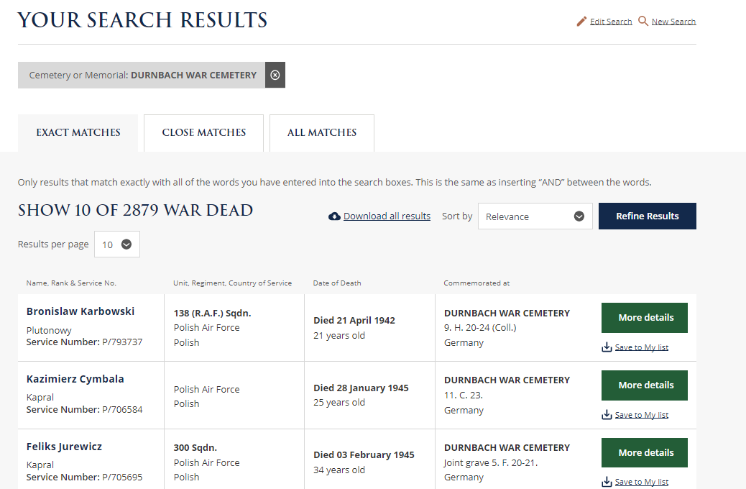
Who else is remembered at this cemetery / memorial?
Notes:
View list of names from CWGC’s database. These are all people remembered at the cemetery you are exploring
Scroll through, sort or refine the data online.
Or download a spreadsheet of the data…..
Image: Screenshot CWGC website https://www.cwgc.org/

Slide 20
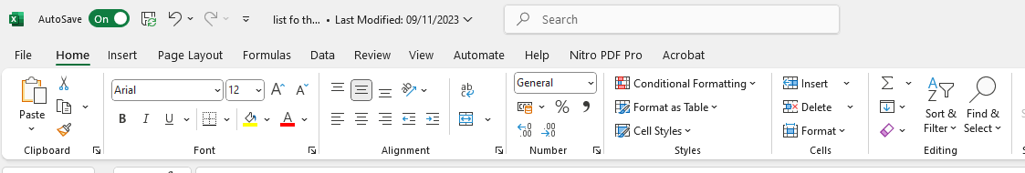
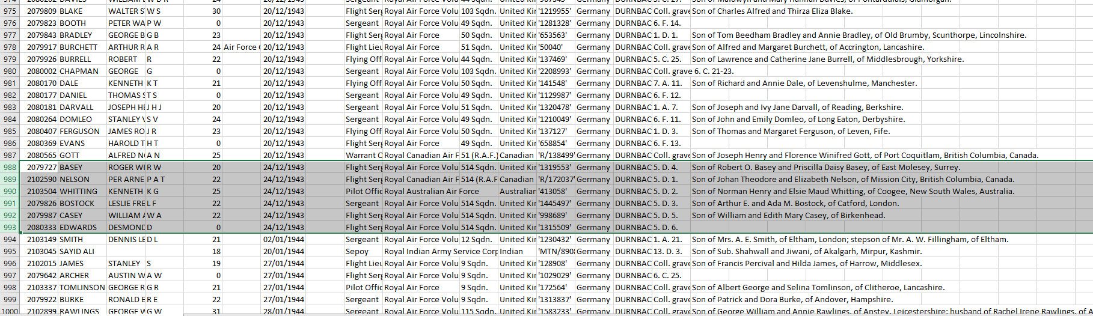
Exploring the data
What part of the armed forces did people serve in?
Where are people from?
Did anyone else die on the same day?
Is anyone else from your area?
Five other men from the same squadron as Casey died on 24/12/1940
Notes:
Using the sort and filter buttons you might
Sort the data to see what branches of the armed forces people are from. Create bar graphs or present the data in multiple ways.
Sort the data to explore where people come from who are remembered at the site.
Use the filter function, type in the name of your town or village and see if anyone else remembered here is from your local area
Sort the data by “date of death”. See if anyone else died on the same day as your serviceperson and explore any links (e.g. same battalion, squadron etc)
WA Casey is not the only person from 514 Squadron of the RAFVR who died on 24th Dec 1934. This suggests that he died, along with others flying in the same plane. This is something else we might research further.

Slide 21
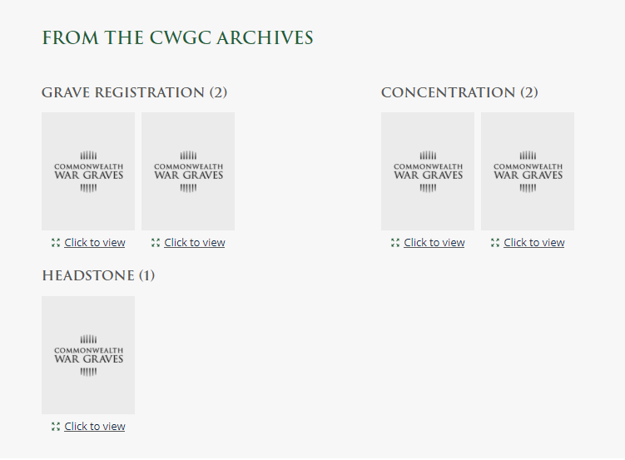
Explore Grave documents from CWGC (1)
Grave documents for your serviceperson can be found by scrolling down from the page where you originally found information about them.
Scroll down!
Notes:
Finally, the CWGC also holds, and has digitised, a number of documents linking to service people who are buried or remembered at their sites.
These include Grave Registration and Concentration Reports and Headstone Records. All offer slightly different information and not all of them are available for every serviceperson in the database.
Found by scrolling down from the original serviceperson fact file.
Images: Screenshots CWGC website https://www.cwgc.org/

Slide 22
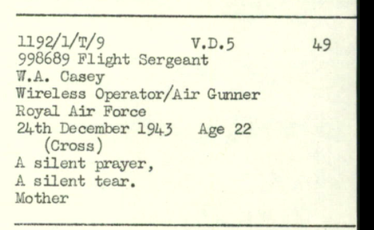
Grave documents (2) (2)
Grave Registration documents include Grave Registration Reports, compiled during the war by the CWGC and Grave Registers, compiled afterwards, which provide more detail.
Grave Concentration Reports record details of those who were originally buried in smaller or isolated cemeteries, but who were later reburied elsewhere.
Headstone records record the information inscribed on a serviceperson’s gravestone.
Notes:
Finally, the CWGC also holds, and has digitised, a number of documents linking to service people who are buried or remembered at their sites.
These include Grave Registration and Concentration Reports and Headstone Records. All offer slightly different information and not all of them are available for every serviceperson in the database.
Found by scrolling down from the original serviceperson fact file.
Images: Screenshots CWGC website https://www.cwgc.org/

Slide 23
Summary
The CWGC website can be used to find lots of information about service people listed on a local war memorial.
Exploring this information:
Helps young people to remember and pay their respects to local people who fought and died in world wars.
Enables young people to begin to appreciate the real impact that war has had on local people in the past.

Slide 24
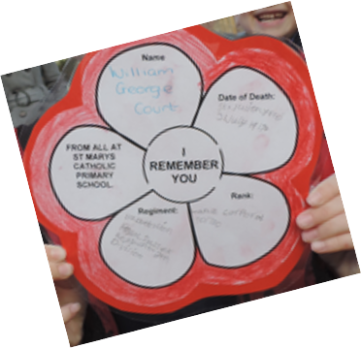
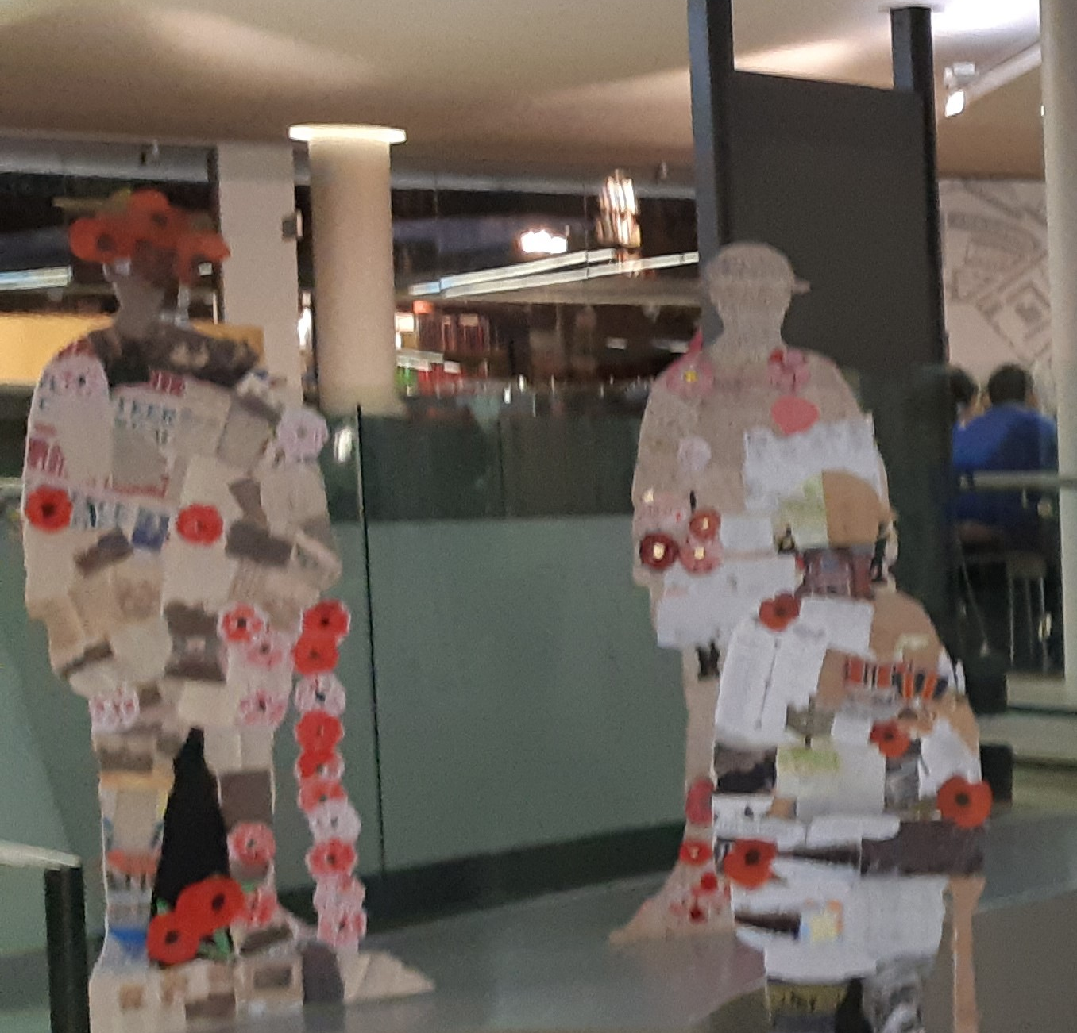
Next Steps: Remember your local serviceperson
“I Remember You” project
Remember the people listed on your memorial:
Hold a remembrance service at your local memorial.
Create a memorial display to tell others about your local serviceperson.
Remember your serviceperson by placing a virtual poppy on the British Legion’s Everyone Remembered website.
WW1 Remembrance Exhibition
Notes:
Images: ©Historic England

Slide 25
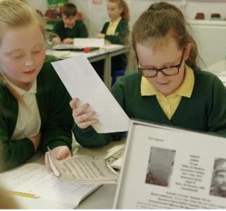
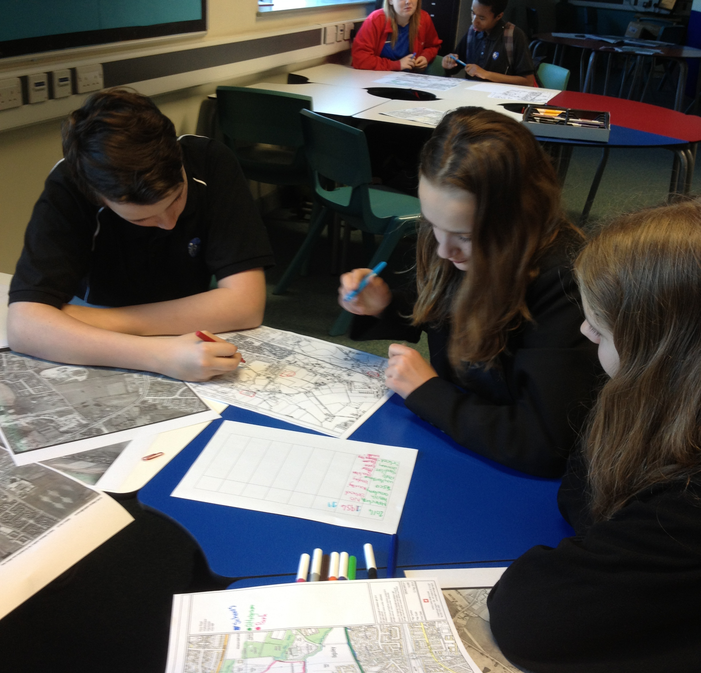
Next steps: Find out more about your serviceperson
Pupil research
Use the Historic England guide: How to find out more about a local soldier to explore other websites which will support you in researching the life of your serviceperson in greater depth.
Pupil Research
Notes:
Images: ©Historic England

Slide 26

Find more resources on the Historic England Website
www.historicengland.org.uk/education

