Slide 1
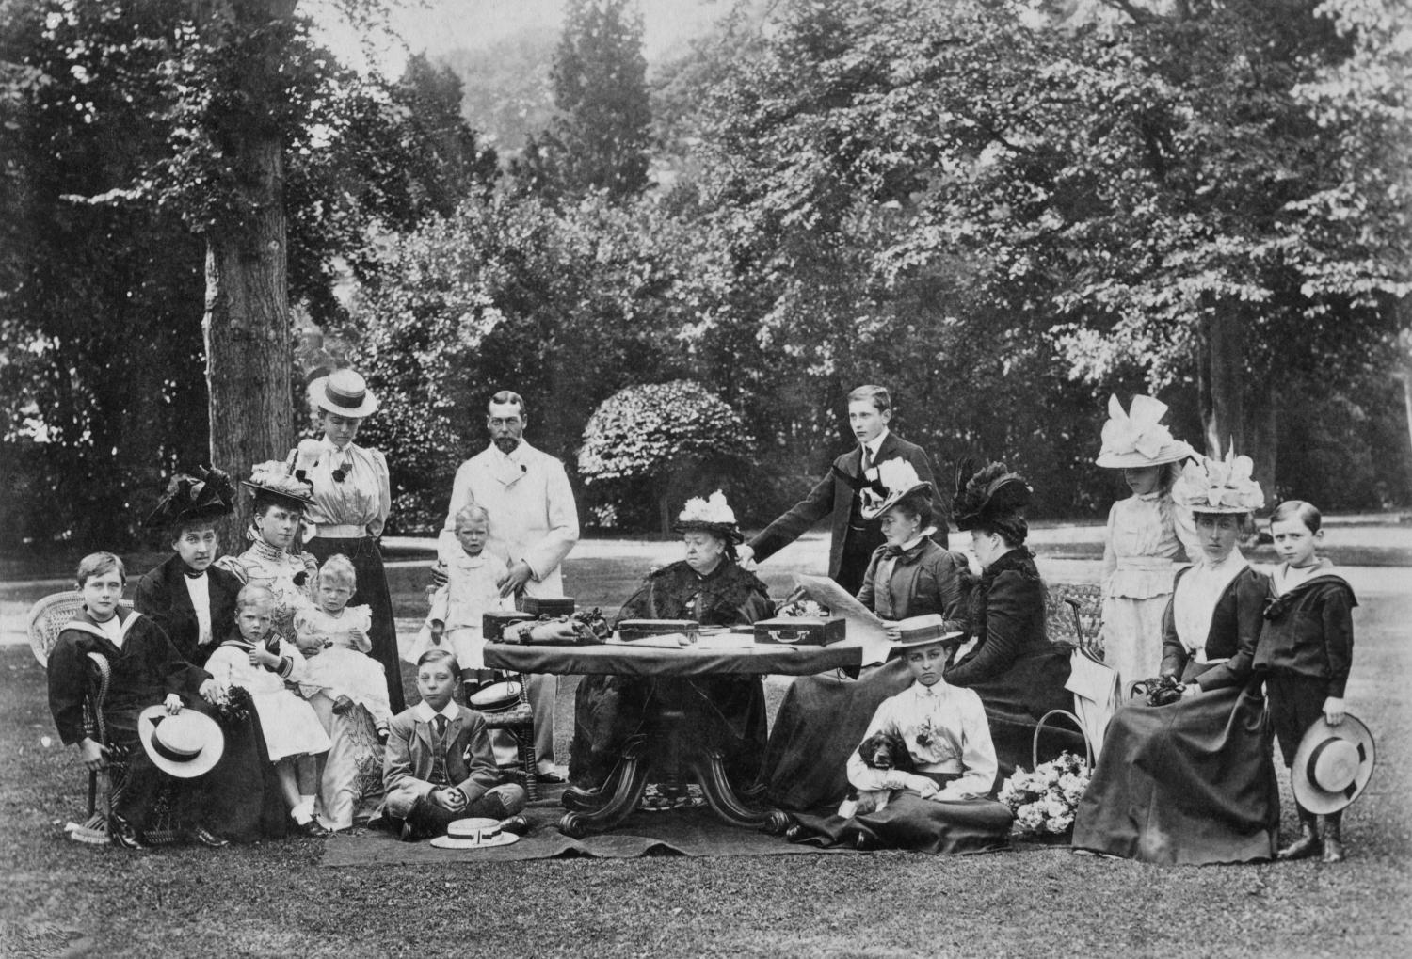
Industrial Revolution in Manchester
Industrial Revolution in Manchester

Slide 2
Industrial Revolution in Manchester
Key Stage 3: History
Learning Aims and Outcomes
To identify what students already know about the Industrial Revolution
To explore traditional interpretations of the Industrial Revolution
This Powerpoint relates to the Teaching Activity: ‘Mills and Factories were the only basis for the Industrial Revolution in Manchester’

Slide 3


Lesson 1
What do you know about the Industrial Revolution in Manchester?
Complete Row 1 of your Knowledge Record Sheet
Share your answers with a partner
Think, pair, share

Slide 4
Knowledge Record Sheet 1
Lesson | What do you know? | What would you like to know?
1.
2.
3.

Slide 5
Knowledge Record Sheet 2
Lesson | What do you know? | What would you like to know?
4.
5.
6.

Slide 6
Lesson 1: Traditional Interpretations of the Industrial Revolution
Say what you see in the clip
What can you learn about the Industrial Revolution from this clip?
Why do you think Danny Boyle calls it Pandemonium?
What do you think Danny Boyle’s interpretation of the Industrial Revolution is?
Fill in Column 1 of your Interpretations Table
Watch from 19:20min to 25:20min of the following film.
It shows the Industrial Revolution section of the Opening Ceremony to the London 2012 Olympic Games.
https://www.youtube.com/watch?v=4As0e4de-rI&t=1160
Notes:
https://www.youtube.com/watch?v=4As0e4de-rI&t=1160

Slide 7
Interpretations Table
Question | Source 1: Danny Boyle’s interpretation. (Pandemonium) | Source 2: Friedrich Engels’ interpretation | Source 3: Johanna Schopenhauer’s interpretation
What does the source tell you about the Industrial Revolution? (What can you see, hear read?)
What interpretation is being given? (What is the person trying to say about what the Industrial Revolution was like?)

Slide 8

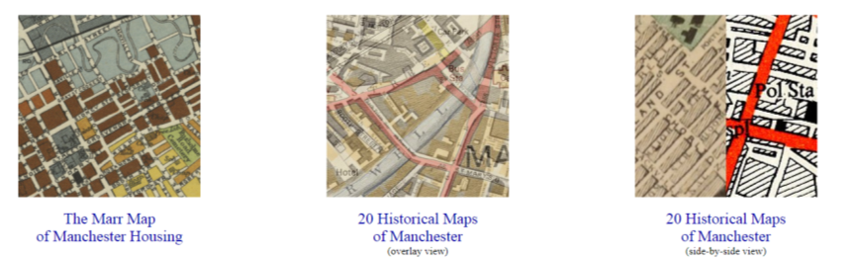
Lesson 1 – Homework
There are two activities to complete by comparing maps on: http://manchester.publicprofiler.org/
Use the side-by-side view to compare the “Tinkler (1772)” & “Slater (1848)” maps
Complete your ‘Lesson 1 – Homework Sheets’ which asks the question…
‘What can maps of Manchester in the 1700s and 1800s tell us about the city at this time?’

Slide 9

Lesson 1 – Homework sheet (1)
Go to the website http://manchester.publicprofiler.org/. Click on the icon “20 Historical Maps of Manchester (side by side)”.
You should then see two maps of the centre of Manchester on your screen.
Activity 1:
On the list of maps on the left hand side select “Tinkler (1772)”.
On the list of maps on the right hand side, select “Slater 1848”.
Complete the activities on the accompanying sheets to investigate the similarities and differences between the two maps.
Tinkler 1772
Slater 1848

Slide 10
Lesson 1 – Homework sheet (2)
1772
1848
Activity 1a:
Study the 1772 map and the 1848 map carefully.
In the left circle write down as many features as you can that appear only on the 1772 map.
In the right circle write down as many features as you can that appear only on the 1848 map.
In the central section write down as many features as you can that appear on both maps.
Can you write at least 5 things in each shape?
Both
Activity 1b:
What do your findings suggest about what happened in Manchester between 1772 and 1848?
____________________________________________________________________________________________________________
____________________________________________________________________________________________________________
____________________________________________________________________________________________________________
____________________________________________________________________________________________________________

Slide 11
Lesson 1 – Homework sheet (3)
Activity 2:
Select the Barts 1870 map from the list of maps on the left hand side.
Find Ancoats and list 3 street names from this area.
1. ________________________________________
2. ________________________________________
3. ________________________________________
Find Thomas Street and name two roads coming off it.
1. ________________________________________
2. ________________________________________
TIP: You can zoom in and out of the maps using the icon in the top left corner of the screen
Hint: You might find it easier to locate both areas on the old maps by finding them on Google Maps first. Ancoats is marked in larger, capital letters and Thomas Street it is quite close to the Infirmary, marked in green on the map

Slide 12
Lesson 2 - What are the traditional interpretations of the Industrial Revolution? Where did they come from?
Learning Aims and Outcomes
To compare contemporary and modern-day interpretations of the Industrial Revolution in Manchester
To reach conclusions about traditional interpretations of the Industrial Revolution and how and why these have originated
To make judgments on levels of wealth and poverty during the Industrial Revolution

Slide 13
Lesson 2: What do you know about the Industrial Revolution in Manchester?
What do you know about the Industrial Revolution in Manchester?
Complete Row 2 of your Knowledge Record Sheet.
Share your answers with a partner

Slide 14
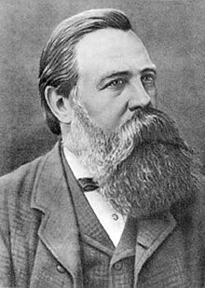
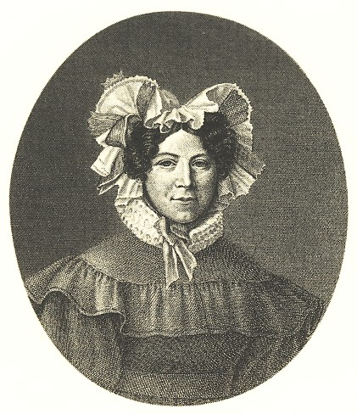
Lesson 2: What are the traditional interpretations of the Industrial Revolution? Where did they come from?
Read (and listen to) the following sources.
They show two contemporary visitor’s accounts of Manchester during the mid-1800s.
Notes:
A4 Printable versions of the accounts available in: https://historicengland.org.uk/content/docs/education/explorer/lessons-1-6-resources-industrial-revolution-manchester-pdf/
Image: William Hall (1826-1898), Public domain, via Wikimedia Commons - https://commons.wikimedia.org/wiki/File:Engels.jpg
Image: Public domain, via Wikimedia Commons - https://commons.wikimedia.org/wiki/File:Johanna_Schopenhauer.jpg

Slide 15
Lesson 2: Source 1 - Background
Friedrich Engels was the son of a rich German textile manufacturer who was sent to Manchester in 1842 to work. His father hoped to turn him into a respectable businessman, but Friedrich saw his time in Manchester as a great opportunity to study the effects of the British Industrial Revolution on workers.
His research resulted in a book, The Condition of the Working Class in England that was published in 1845. This book aimed to highlight the poor working and living conditions of workers. In it he wrote about Ancoats, an industrial area of Manchester:
Notes:
Engels, who went on to work with Karl Marx on the Communist Manifesto (1848), was keen to critique the impact of factory life on the new class of urban, industrial worker. In his work with Marx, he predicted that the widening gulf between the new working class (the proletariat) and their employers (the bourgeoisie) would result in revolution.
Image: William Hall (1826-1898), Public domain, via Wikimedia Commons - https://commons.wikimedia.org/wiki/File:Engels.jpg

Slide 16

Lesson 2: Source 1 - Ancoats Quote by Friedrich Engels
“In… Ancoats, stand the largest mills of Manchester lining the canals, colossal six and seven-storied buildings towering with their slender chimneys far above the low cottages of the workers. The population of the district consists chiefly of mill-hands …The walls of the cottages (in which they live) are as thin as it is possible to make them (and ...cellar dwellings are to be found under almost every cottage… Many streets are unpaved and without sewers…
Ancoats, built chiefly since the sudden growth of manufacture within the present century, contains a vast number of ruinous houses, most of them being, in fact, in the last stages of inhabitableness.
...(I have never seen a) more injurious and demoralising method of housing the workers. ...The working-man is constrained to occupy such ruinous dwellings because he cannot pay for others, and because there are no others in the vicinity of his mill; perhaps, too, because they belong to the employer, who engages him only on the condition of his taking such a cottage.”
In… Ancoats, stand the largest mills of Manchester lining the canals, colossal six and seven-storied buildings towering with their slender chimneys far above the low cottages of the workers. The population of the district consists chiefly of mill-hands …The walls of the cottages (in which they live) are as thin as it is possible to make them (and ...cellar dwellings are to be found under almost every cottage… Many streets are unpaved and without sewers…
Notes:
A4 Printable versions of the accounts available in: https://historicengland.org.uk/content/docs/education/explorer/lessons-1-6-resources-industrial-revolution-manchester-pdf/

Slide 17


Lesson 2: Source 1 - Glossary
Colossal / Vast
Huge
Ancoats
A part of Manchester city centre where, during the Industrial Revolution, there were lots of mills and factories.
Chiefly
Mainly
Cellar dwellings
Cellars of houses where the poorest families lived.
Engages
Employs
Inhabitable / Uninhabitable
Fit to live in / Not fit to live in
Ruinous
In a state of ruin / in a bad condition
Demoralising
Depressing
Is constrained to
Has no choice but to
Injurious
Dangerous

Slide 18
Lesson 2: Source 2 - Background
Johanna Schopenhauer was a German travel writer and novelist. She was married to a rich merchant. She spent a lot of time travelling around Europe, and her visit to Manchester was recorded in a publication from 1831, which is quoted from below.
She had a very positive view of industrialisation and was more interested in the ways in which things were made than the workers who made them:
Notes:
A4 Printable versions of the accounts available in: https://historicengland.org.uk/content/docs/education/explorer/lessons-1-6-resources-industrial-revolution-manchester-pdf/
Schopenhauer’s comments were typical of many affluent travel writers of the nineteenth century (especially the early part of the century) who were impressed by the industrial developments that they witnessed in Manchester. Unlike Engels, she did not travel round the back streets of Manchester and Salford to see how its poorer inhabitants lived, but was taken on tours by factory owners. She was little interested in providing social critiques and her views were coloured by her amazement at the ways in which new machines could increase productivity.
Image: Public domain, via Wikimedia Commons - https://commons.wikimedia.org/wiki/File:Johanna_Schopenhauer.jpg

Slide 19
Lesson 2: Source 2 - Factory Town Quote by Johanna Schopenhauer
“Towards mid-day we arrived at this famous, great factory town. Dark and smoky from the coal vapours, it resembles a huge… workshop. Work, profit and greed seem to be the only thoughts here. The clatter of cotton mills and the looms can be heard everywhere.
…We visited one of the biggest cotton mills. A steam engine in the basement powers almost all the …wheels and spindles which are fitted on many floors built one above the other like a tower. We went dizzy at the sight of the endless mechanical life in these great halls. In all of them we saw some women knotting together the yarns which rarely tore off from the constantly turning spindles, putting nappies on children and winding the yarn which had been spun.
In one hall the still unspun cotton was cleaned; it lay on large tables in big square pieces looking like cotton wool; a number of women and girls armed with a thin stick in each hand were happily thrashing it …Everything is done in the easiest way with machines, all of which seemed to us a miracle of industry.”
Towards mid-day we arrived at this famous, great factory town. Dark and smoky from the coal vapours, it resembles a huge… workshop. Work, profit and greed seem to be the only thoughts here. The clatter of cotton mills and the looms can be heard everywhere.
Notes:
A4 Printable versions of the accounts available in: https://historicengland.org.uk/content/docs/education/explorer/lessons-1-6-resources-industrial-revolution-manchester-pdf/

Slide 20
Lesson 2: Source 2 - Glossary
Resembles
Looks like
Vapours
Smells
Spindles
Part of a loom
Thrashin
Hitting
Looms
Machines used to make cotton

Slide 21
Lesson 2 - What are the traditional interpretations of the Industrial Revolution? Where did they come from? 1
Complete columns 2 and 3 of your Interpretations Table
What can you learn about the Industrial Revolution from these accounts?
What are the interpretations being provided by these visitors to Manchester? (What’s their version of the Industrial Revolution?)
How rich or poor do you think the people who wrote these descriptions were?

Slide 22
Lesson 2 - What are traditional interpretations of levels of wealth during the Industrial Revolution? 2
Look at the additional information in Lesson 2 – Images of Victorian families.
Try to imagine the level of wealth of each of the families you’ve looked at.
Place the images on a spectrum of rich to poor.
Rich?
Or Poor?
Notes:
A4 Printable versions of the additional images available in: https://historicengland.org.uk/content/docs/education/explorer/lessons-1-6-resources-industrial-revolution-manchester-pdf/

Slide 23

Lesson 2 - How wealthy do you think this family is? 1
Rich?
Or Poor?
Notes:
Photograph taken 1898 © Historic England Archive Photo Library ref: M888557

Slide 24
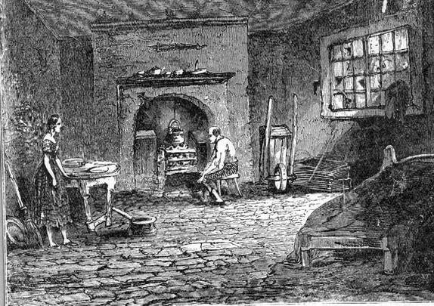
Lesson 2 - How wealthy do you think this family is? 2
Rich?
Or Poor?
Notes:
© Manchester Archives and local studies

Slide 25
Lesson 2 - What conclusions can we draw about traditional interpretations of the Industrial Revolution?
What’s your interpretation of the Industrial Revolution now?
Is Danny Boyle’s interpretation different or similar to that of the contemporary views?
What do you think might influence people like Danny Boyle’s interpretations of such an important event?

Slide 26
Lesson 3: Mills and Factories were the only basis for the Industrial Revolution in Manchester? To what extent do you agree with this statement?
Learning Aims and Outcomes
To examine primary source material relating to Thomas Street in the Northern Quarter, Manchester and to explore what these sources tell students about Manchester during the Industrial Revolution.
To compare this information with the traditional interpretations from previous lessons.
To reach conclusions about the extent to which traditional interpretations of the Industrial Revolution in Manchester reflect an accurate and complete picture of the city at this time.

Slide 27

Lesson 3 - Mills and Factories were the only basis for the Industrial Revolution in Manchester?
To what extent do you agree with this statement?
Complete row 3 of your Knowledge Record Sheet
Decide on your current interpretation of the growth of Manchester during this period
Justify your interpretation to the person sitting next to you.
Justify

Slide 28
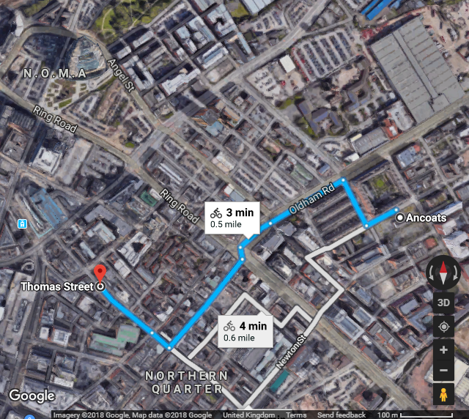
Lesson 3: What can Thomas Street reveal about the Industrial Revolution in Manchester?
Focus on work done for the Homework Sheets, identifying the location of Ancoats & Thomas Street.
Begin to enquire:
What can Thomas Street reveal about the Industrial Revolution in Manchester?

Slide 29
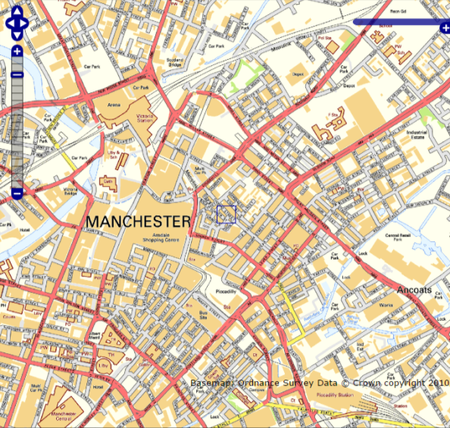
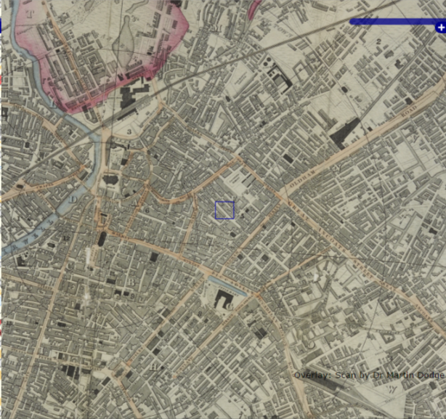
Lesson 3: Where is Thomas Street?
Locate Thomas Street on both the modern and 1848 maps on http://manchester.publicprofiler.org/
Modern
1848

Slide 30
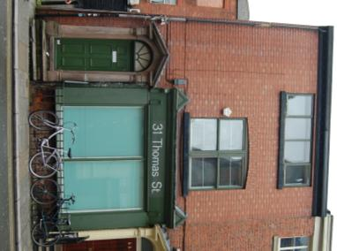
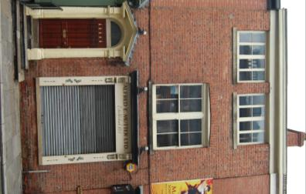
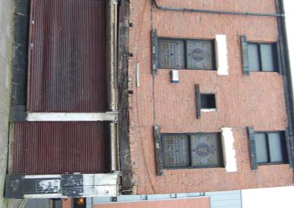
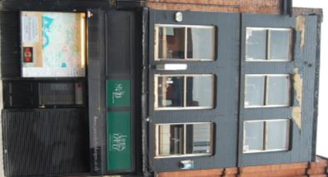
Lesson 3: What do the houses on Thomas Street look like? 1
31
Thomas Street
33
Thomas Street
52
Thomas Street
40
Thomas Street
Look at the street frontages and try to guess what type of family might have lived in each one.

Slide 31
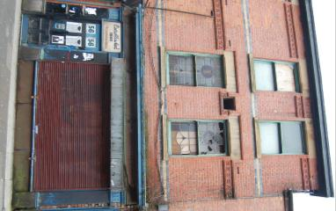
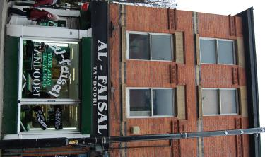
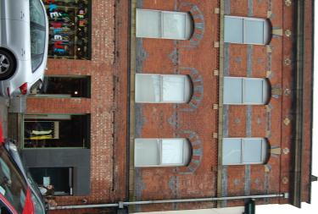
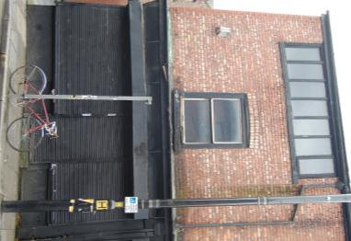
Lesson 3: What do the houses on Thomas Street look like? 2
56
Thomas Street
58
Thomas Street
65 Thomas Street
(as it would have looked)
65
Thomas Street
(Today)
Look at the street frontages and try to guess what type of family might have lived in each one.
Notes:
Look at the street frontages and try to guess what type of family might have lived in each one. Note No 65 is no longer the original building, it was knocked down and replaced with this on – the other photo is of a similar building, to give an idea of how No. 65 would have looked in 1841.

Slide 32
Lesson 3: Who lived on Thomas Street? 1
You will be given a ‘Happy Families Card’ - read the information about your person.
You have 10 minutes to go around the classroom and talk to other people about their person – what do you have in common with anyone else? Name, age, job etc.
Find your family – where there are two or more people with the same surname try to arrange yourselves into family groups who would have lived together in one house
If your person is not part of one of the larger families where do you think you lived?
Notes:
Using the ‘Happy Families Cards’ in the pdf, cut out all the cards and shuffle them. Hand out one card to each pupil - https://historicengland.org.uk/content/docs/education/explorer/lessons-1-6-resources-industrial-revolution-manchester-pdf/

Slide 33
Lesson 3: Who lived on Thomas Street? 2
In your family groups, use the image of your house frontage and the census to find out more about your household…
Note: Use the transcription on the back, if you need extra help working out where people lived and what they did in each house.
Are there any additional people living in your household?
How rich or poor do you think your household is?
Notes:
Using the ‘Happy Families Cards’, cut out all the cards and shuffle them. Hand out one card to each pupil

Slide 34
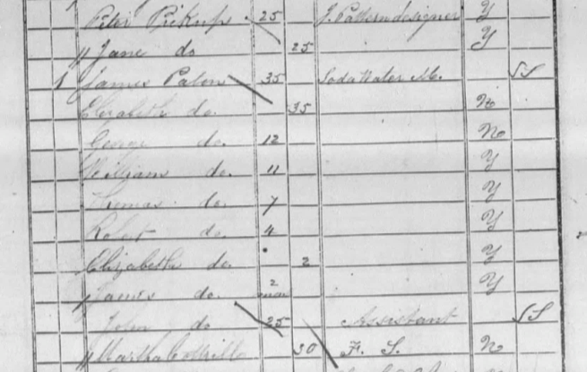
Lesson 3: Who lived on Thomas Street? 3
In your family groups, look at the original census descriptions.
Note that ‘do.’ means ditto or same as. So in this case, as well as James, 8 other people have the surname ‘Paton’.
For difficult to read names everyone must look at their person’s name to see if it might be a match.
31 Thomas Street - James Paton

Slide 35

Lesson 3: Who lived on Thomas Street? 4
31 Thomas Street
James Paton

Slide 36
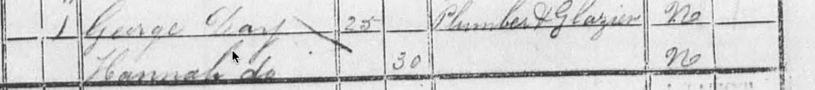
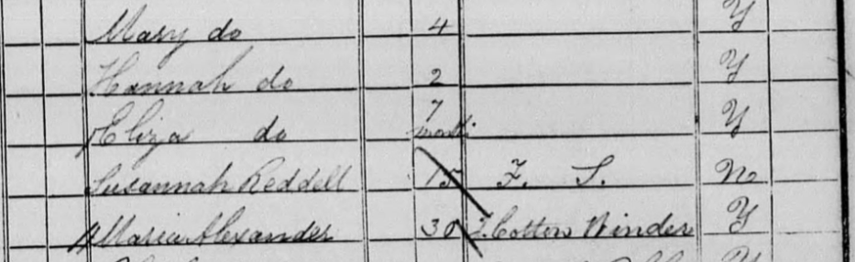
Lesson 3: Who lived on Thomas Street? 5
33 Thomas Street
George Day

Slide 37
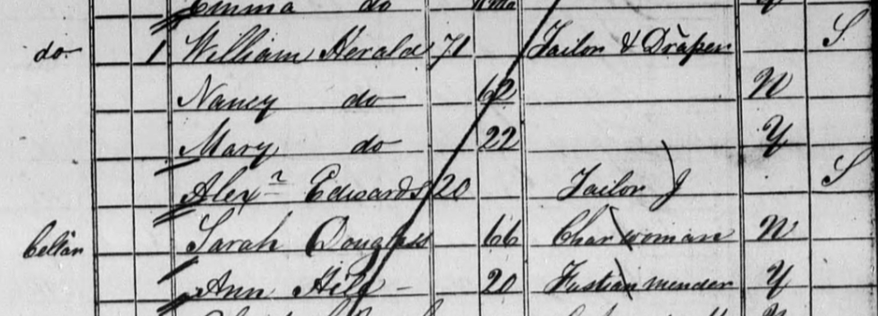
Lesson 3: Who lived on Thomas Street? 6
40 Thomas Street
William Herald

Slide 38
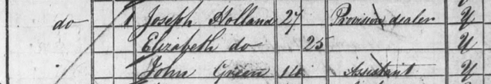
Lesson 3: Who lived on Thomas Street? 7
52 Thomas Street
Joseph Holland

Slide 39

Lesson 3: Who lived on Thomas Street? 8
56 Thomas Street
James Mullins

Slide 40
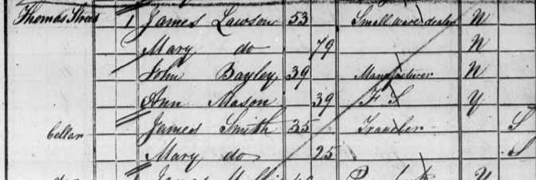
Lesson 3: Who lived on Thomas Street? 9
58 Thomas Street
James Lawson

Slide 41
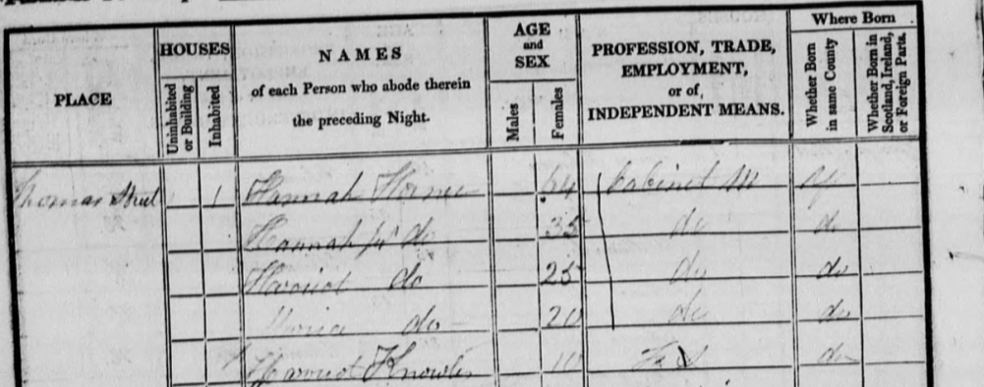
Lesson 3: Who lived on Thomas Street? 10
65 Thomas Street
Hannah Horne

Slide 42
Lesson 3: Who lived on Thomas Street? 11
31 Thomas Street
James Paton Male 35 years old Soda Water Manufacturer Scottish | Elizabeth Paton Female 35 years old No occupation given English, not born in Lancashire | George Paton Male 12 years old No occupation given English, not born in Lancashire | William Paton Male 11 years old No occupation given English, born in Lancashire | John Paton Male 25 years old Assistant Scottish
Thomas Paton Male 7 years old No occupation given English, born in Lancashire | Robert Paton Male 4 years old No occupation given English, born in Lancashire | Elizabeth Paton Female 2 years old No occupation given English, born in Lancashire | James Paton Male 2 months old No occupation given English, born in Lancashire | Martha Cothill Female 30 years old Servant English, not born in Lancashire
Notes:
Use this transcriptions if you need extra help working out where people lived and what they did in each house

Slide 43
Lesson 3: Who lived on Thomas Street? 12
33 Thomas Street
George Day Male 25 years old Plumber and Glazier English, not born in Lancashire | Hannah Day Female 30 years old No occupation given English, not born in Lancashire | Mary Day Female 4 years old No occupation given English, born in Lancashire | Hannah Day Female 2 years old No occupation given English, born in Lancashire
Eliza Day Female 7 months old No occupation given English, born in Lancashire | Susannah Reddill Female 15 years old Servant English, not born in Lancashire | Elizabeth Paton Female 2 years old No occupation given English, born in Lancashire | Maria Alexander Female 30 years old Journeyman Cotton Winder English, born in Lancashire
Notes:
Use this transcriptions if you need extra help working out where people lived and what they did in each house

Slide 44
Lesson 3: Who lived on Thomas Street? 13
40 Thomas Street
William Herald Male 71 years old Tailor and Draper Scottish | Nancy Herald Female 62 years old No occupation given English, not born in Lancashire | Mary Herald Female 22 years old No occupation given English, born in Lancashire | Alexander Edwards Male 20 years old Journeyman Tailor Scottish
Living in the cellar: Sarah Douglas Female 66 years old Charwoman English, not born in Lancashire | Living in the cellar: Ann Hill Female 20 years old Fustian Mender English, born in Lancashire
Notes:
Use this transcriptions if you need extra help working out where people lived and what they did in each house

Slide 45
Lesson 3: Who lived on Thomas Street? 14
52 Thomas Street
Joseph Holland Male 27 years old Provision Dealer English, born in Lancashire | Elizabeth Holland Female 25 years old No occupation given English, born in Lancashire | John Greene Male 14 years old Assistant English, born in Lancashire
56 Thomas Street
James Mullins Male 40 years old Pawnbroker English, born in Lancashire | Jane Mullins 40 years old No occupation given English, born in Lancashire
Notes:
Use this transcriptions if you need extra help working out where people lived and what they did in each house

Slide 46
Lesson 3: Who lived on Thomas Street? 15
58 Thomas Street
James Lawson Male 53 years old Smallware Dealer English, not born in Lancashire | Mary Lawson Female 79 years old No occupation given English, not born in Lancashire | John Bayley Male 39 years old Manufacturer English, not born in Lancashire | Ann Mason Female 39 years old Servant English, born in Lancashire
Living in the cellar: James Smith Male 35 years old Traveller Scottish | Living in the cellar: Mary Smith Female 25 years old Traveller Scottish
Notes:
Use this transcriptions if you need extra help working out where people lived and what they did in each house

Slide 47
Lesson 3: Who lived on Thomas Street? 16
65 Thomas Street
Hannah Horne Female 64 years old Cabinet maker English, born in Lancashire | Hannah Horne junior Female 35 years old Cabinet maker English, born in Lancashire | Harriet Horne Female 25 years old Cabinet maker English, born in Lancashire
Maria Horne Female 20 years old Cabinet maker English, born in Lancashire | Harriet Knowles Female 10 years old Servant English, born in Lancashire
Notes:
Use this transcriptions if you need extra help working out where people lived and what they did in each house

Slide 48
Lesson 3: Who lived on Thomas Street? 17
  How many people live in the house? What is their relationship with one another?
  How do people make their living? Look up any jobs listed if you don’t know what they mean
  Who is responsible for others in the household?
  How is the household similar to households today?
  Is there anything that surprises you about the households?
In your household groups, use the ‘Happy Families Cards’ and census information to write a summary of who lived in your household. Think about:
Notes:
Using the ‘Happy Families Cards’, cut out all the cards and shuffle them. Hand out one card to each pupil

Slide 49
Lesson 3: Summary of households
THOMAS STREET 1841
No 31. Head of Household: James Paton, a 35 year old Soda Water Manufacturer from Scotland. Lives with: wife and 6 children. Also living in house: an assistant and a servant | No 33. Head of Household: George Day, a 25 year old Plumber & Glazier. Lives with wife and 3 children. Also living in house: a 15 year old servant and a female lodger (journeyman cotton winder) | No 65. Head of Household: Hannah Horne, a 64 year old cabinet maker. Lives with 3 daughters who are also cabinet makers. Also living in house: a 10 year old servant. | No 40. Head of Household: William Herald a 71 year old Tailor & Draper Lives with wife and daughter. Also living in house: 1 employee and 2 unrelated cellar dwellers.
No 52. Head of Household: Joseph Holland, a 27 year old Provision Dealer. Lives with wife. Also living in house: a 14 year old assistant. | No 56. Head of Household: James Mullins, a 40 year old Pawnbroker Lives with wife. | No 58. Head of Household: James Lawson, a 53 year old Smallware Dealer Lives with mother. Also living in house: 2 cellar dwellers – husband and wife
Notes:
Look at these short descriptions of who lived in some of the houses on Thomas Street in the 1841 census. Then use the census extracts below to fill in the details about each on the earlier slides

Slide 50
Lesson 3 - What can Thomas Street reveal about the Industrial Revolution in Manchester?
What does this evidence tell us about Manchester during the Industrial Revolution?
Does this information agree or disagree with the interpretations that we’ve already seen/made?
Where would you put these households on your spectrum of Rich to Poor Victorian families from the Lesson 2 – Images of Victorian families?
How much does this change your view about wealth and poverty during this time?

Slide 51
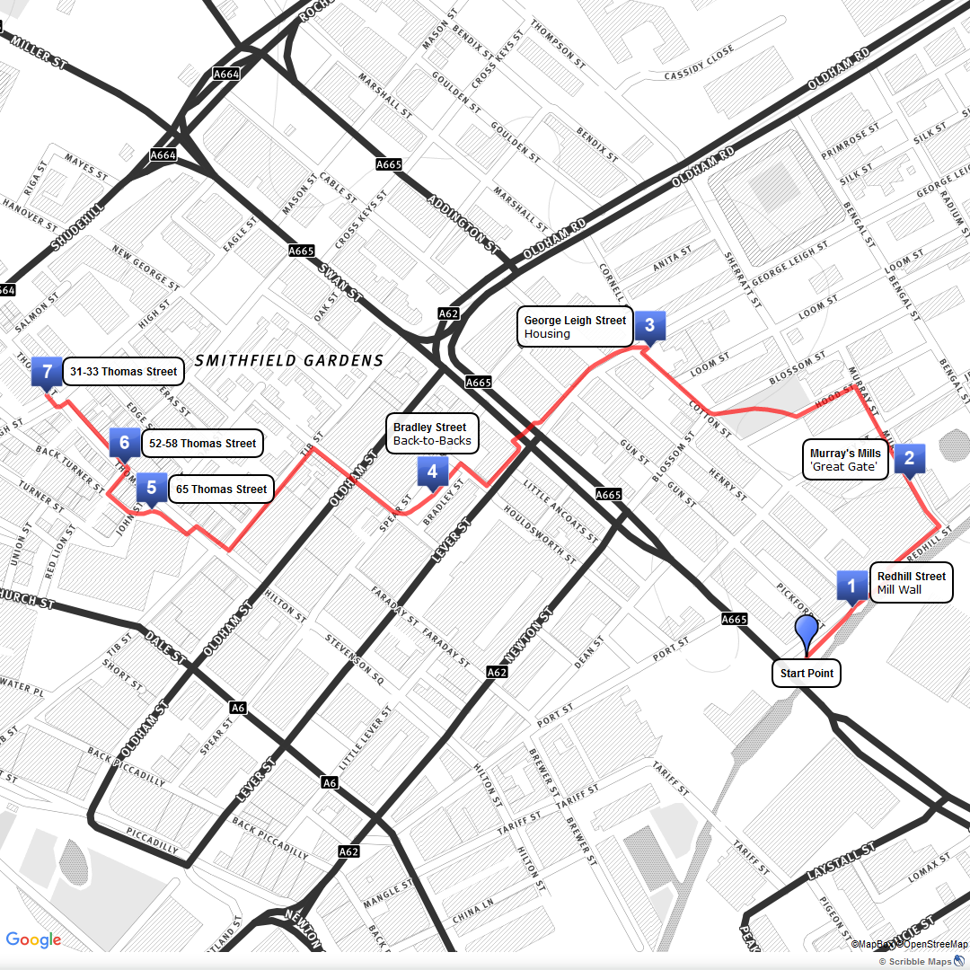
Lesson 4: Manchester during the Industrial Revolution – a Tour
Download Lesson 4 – Tour and instructions
This local heritage tour has been created in partnership, by Historic England’s Heritage Schools Programme, Archives+ Manchester, Hannah Barker, University of Manchester and Elizabeth Sibbering (Sibby), Manchester Tour Guide.
The purpose of this resource is to provide teachers and their students with knowledge and understanding of the history and heritage of the local area. We also hope that the stops and activities suggested on the tour will inspire further local history research and local heritage projects in the classroom.
Not in Manchester? Use Google Street View to carry out a ‘virtual’ version of the tour
Tour Route
Notes:
A4 Printable version of the tour available in: https://historicengland.org.uk/content/docs/education/explorer/lessons-1-6-resources-industrial-revolution-manchester-pdf/. If you don’t teach in Manchester, or are unable to do the tour, you could use Google Street View to carry out a ‘virtual’ version of the tour.

Slide 52
Lesson 5: Challenging traditional interpretations:
A focus on shopping!
Learning Aims and Outcomes
Examine primary source materials: adverts for goods in the 1840s.
Compare adverts from the mid-1800s with those from the present day to identify similarities and differences.
Reach conclusions about what these adverts tell us about Manchester during the Industrial Revolution & to make judgments about the extent to which their conclusions support traditional interpretations.

Slide 53
Lesson 5: Challenging traditional interpretations - a focus on shopping!
Complete row 3 on your Knowledge Record Sheet
What do you know now about the Industrial Revolution in Manchester?
How did our tour support the traditional interpretations?

Slide 54

Lesson 5: Challenging traditional interpretations – a focus on shopping!
What sells today?
Look at the following modern adverts and discuss:
What are they selling and who are they aimed at?
What methods do they use to sell the product?
What is the message?
Notes:
Alternatively look at adverts that the students have brought in themselves

Slide 55
Lesson 5: Challenging traditional interpretations - a focus on shopping! 1

Slide 56

Lesson 5: Challenging traditional interpretations - a focus on shopping! 2

Slide 57

Lesson 5: Challenging traditional interpretations - a focus on shopping! 3

Slide 58

Lesson 5: Challenging traditional interpretations - a focus on shopping! 4

Slide 59

Lesson 5: Challenging traditional interpretations - a focus on shopping! 5

Slide 60

Lesson 5: Challenging traditional interpretations - a focus on shopping! 6

Slide 61
Lesson 5: Challenging traditional interpretations – a focus on shopping! 7
What are they selling?
What methods do they use to sell the product?
Similarities and differences to modern adverts?
What is the message?
Who would buy and who is selling the product?
Would people on Thomas Street buy / sell the product?
What sold in 1841 & would the people living on Thomas Street buy them?
Look at the following adverts from 1841 and discuss:
Notes:
https://content.historicengland.org.uk/content/docs/education/explorer/lessons-1-6-resources-industrial-revolution-manchester.pdf
Printable versions to download

Slide 62
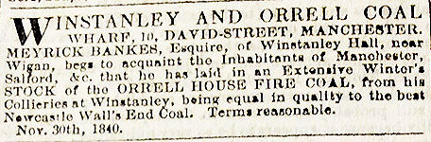
Lesson 5: Challenging traditional interpretations - a focus on shopping! 8
The Manchester Guardian, 9 January 1841
Notes:
Image: Pigot & Slater's Directory of Manchester & Salford, 1841 - https://specialcollections.le.ac.uk/digital/collection/p16445coll4/id/218320/

Slide 63
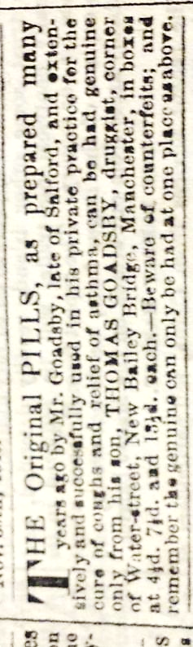
Lesson 5: Challenging traditional interpretations - a focus on shopping! 9
The Manchester Guardian, 9 January 1841
Notes:
Image: Pigot & Slater's Directory of Manchester & Salford, 1841 - https://specialcollections.le.ac.uk/digital/collection/p16445coll4/id/218320/

Slide 64
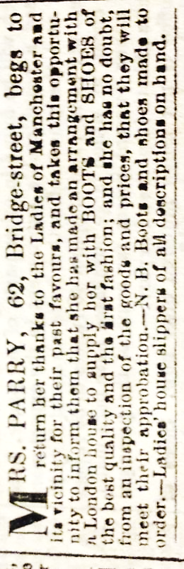
Lesson 5: Challenging traditional interpretations - a focus on shopping! 10
The Manchester Guardian, 9 January 1841
Notes:
Image: Pigot & Slater's Directory of Manchester & Salford, 1841 - https://specialcollections.le.ac.uk/digital/collection/p16445coll4/id/218320/

Slide 65
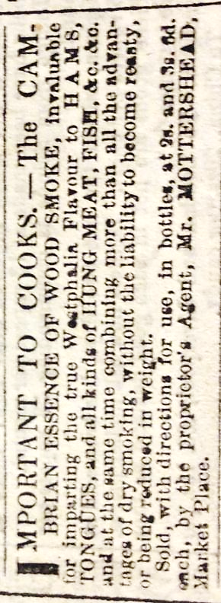
Lesson 5: Challenging traditional interpretations - a focus on shopping! 11
The Manchester Guardian, 9 January 1841
Notes:
Image: Pigot & Slater's Directory of Manchester & Salford, 1841 - https://specialcollections.le.ac.uk/digital/collection/p16445coll4/id/218320/

Slide 66
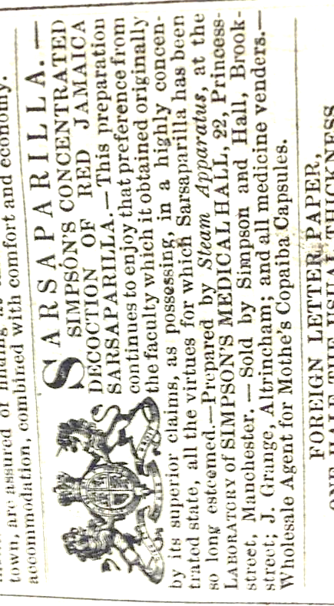
Lesson 5: Challenging traditional interpretations - a focus on shopping! 12
The Manchester Guardian, 13 February 1841
Notes:
Image: Pigot & Slater's Directory of Manchester & Salford, 1841 - https://specialcollections.le.ac.uk/digital/collection/p16445coll4/id/218320/

Slide 67
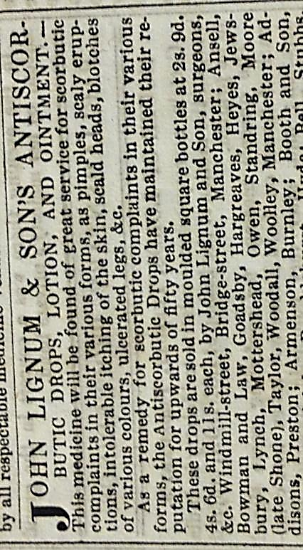
Lesson 5: Challenging traditional interpretations - a focus on shopping! 13
The Manchester Guardian, 13 February 1841
Notes:
Image: Pigot & Slater's Directory of Manchester & Salford, 1841 - https://specialcollections.le.ac.uk/digital/collection/p16445coll4/id/218320/

Slide 68
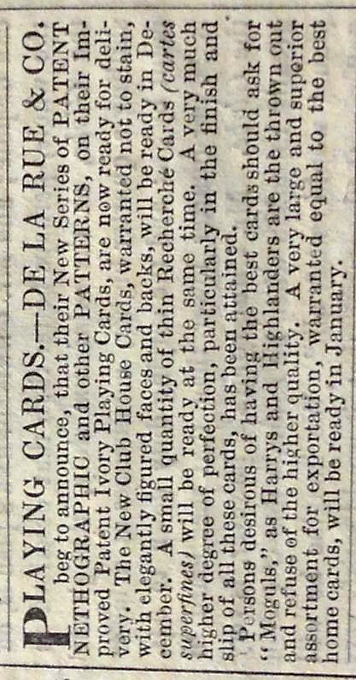
Lesson 5: Challenging traditional interpretations - a focus on shopping! 14
The Manchester Guardian, 24 December 1841
Notes:
Image: Pigot & Slater's Directory of Manchester & Salford, 1841 - https://specialcollections.le.ac.uk/digital/collection/p16445coll4/id/218320/

Slide 69
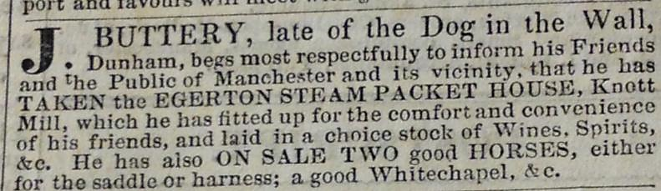
Lesson 5: Challenging traditional interpretations - a focus on shopping! 15
The Manchester Guardian, 24 December 1841
Notes:
Image: Pigot & Slater's Directory of Manchester & Salford, 1841 - https://specialcollections.le.ac.uk/digital/collection/p16445coll4/id/218320/

Slide 70
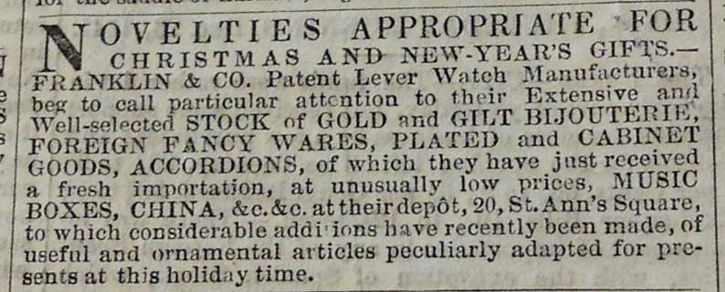
Lesson 5: Challenging traditional interpretations - a focus on shopping! 16
The Manchester Guardian, 24 December 1841

Slide 71
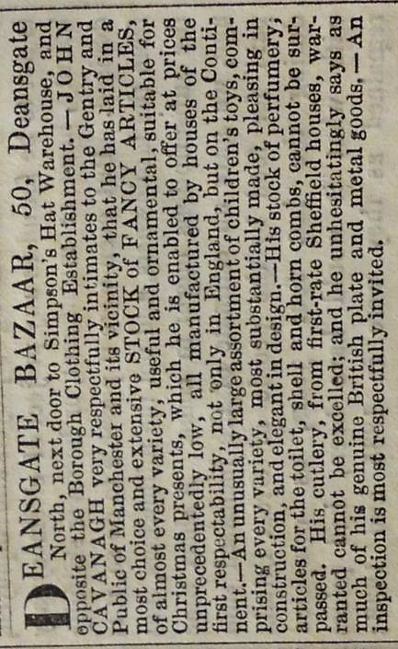
Lesson 5: Challenging traditional interpretations - a focus on shopping! 17
The Manchester Guardian, 24 December 1841
Notes:
Image: Pigot & Slater's Directory of Manchester & Salford, 1841 - https://specialcollections.le.ac.uk/digital/collection/p16445coll4/id/218320/

Slide 72
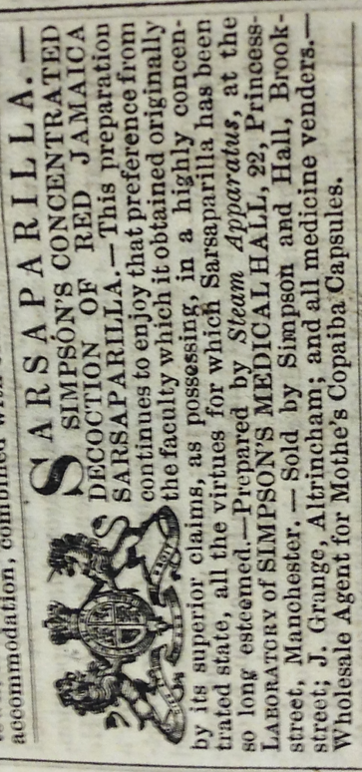
Lesson 5: Challenging traditional interpretations - a focus on shopping! 18
What are the similarities and differences?
Notes:
Image: Pigot & Slater's Directory of Manchester & Salford, 1841 - https://specialcollections.le.ac.uk/digital/collection/p16445coll4/id/218320/

Slide 73

Lesson 5: Challenging traditional interpretations - a focus on shopping! 19
Class discussion:
What do the adverts and accounts tell us about Manchester during the Industrial Revolution?
To what extent do these adverts support traditional interpretations of large-scale mill production, extremes of wealth and poverty and poor living and working conditions for the less well-off?
Class discussion

Slide 74
Lesson 5: What conclusions can we draw?
Taking into account all you now know; look again at the “rich and poor spectrum” you created in Lesson 2.
Where would you place the Thomas Street families on the Spectrum?
How far do the Thomas Street families challenge traditional interpretations of the Industrial Revolution and wealth and poverty during the period?
Class discussion

Slide 75
Lesson 6: Mills and Factories were the only basis for the Industrial Revolution in Manchester? To what extent do you agree with this statement?
Learning Aims and Outcomes
To reach conclusions and make judgments about the extent to which the traditional interpretation of Manchester during the Industrial Revolution reflects a complete and accurate picture of the city during this period.

Slide 76
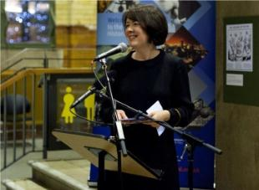
Lesson 6: Mills and Factories were the only basis for the Industrial Revolution in Manchester?
What do other historians think?
The Manchester region and the Industrial Revolution
By Professor Hannah Barker (2016). Hannah is a professor at the University of Manchester. Her research focuses on the era of the industrial revolution in Britain and on the north of England in particular.
The Industrial Revolution is a term used to describe huge increases in the amount of things that were made (or manufactured), that took place between about 1760 and 1840.
Listen to Hannah’s research
Notes:
Printable version to download - https://content.historicengland.org.uk/content/docs/education/explorer/lessons-1-6-resources-industrial-revolution-manchester.pdf

Slide 77
Lesson 6: Mills and Factories were the only basis for the Industrial Revolution in Manchester?
The Industrial Revolution is a term used to describe huge increases in the amount of things that were made (or manufactured), that took place between about 1760 and 1840.
This led to some people becoming very rich, whilst many others remained much poorer. The way in which many of these poorer people worked changed as they moved from the countryside into towns and began to work in manufacturing (or industry), rather than farming.
Notes:
Printable version to download - https://content.historicengland.org.uk/content/docs/education/explorer/lessons-1-6-resources-industrial-revolution-manchester.pdf

Slide 78
Lesson 6: Mills and Factories were the only basis for the Industrial Revolution in Manchester? 1
Traditionally, historians have described the Industrial Revolution in terms of new ways of making things (or products), and especially making things using new forms of technology (or inventions) in large buildings called factories.
This story of the past is particularly common when describing towns in Greater Manchester where even today you can still find cotton-making factories – known as mills – dating from the 1800s.
Notes:
Printable version to download - https://content.historicengland.org.uk/content/docs/education/explorer/lessons-1-6-resources-industrial-revolution-manchester.pdf

Slide 79
Lesson 6: Mills and Factories were the only basis for the Industrial Revolution in Manchester? 2
Yet though mills were very important in Manchester, cotton production by big businesses was not the only reason for the town’s quick growth in size and the large profits that were made.
These changes were also due to an increase in the number of small businesses in Manchester, which did not tend to use new technology, and which did not own factories. Most of these small businesses were run by people who were neither very rich, nor very poor.
Notes:
Printable version to download - https://content.historicengland.org.uk/content/docs/education/explorer/lessons-1-6-resources-industrial-revolution-manchester.pdf

Slide 80
Lesson 6: Mills and Factories were the only basis for the Industrial Revolution in Manchester? 3
Some of these businesses made things to sell, some of them just sold things made by others (like most shops today). The Industrial Revolution was not just caused by more things being made, but also because more things were being sold.
Notes:
Printable version to download - https://content.historicengland.org.uk/content/docs/education/explorer/lessons-1-6-resources-industrial-revolution-manchester.pdf

Slide 81
Lesson 6: Mills and Factories were the only basis for the Industrial Revolution in Manchester? 4
‘Mills and factories were the only basis for the Industrial Revolution in Manchester’.
To what extent do you agree with this statement?
Many people think that the Industrial Revolution in Manchester was characterised by the production of goods in mills and factories and by extremes of rich and poor.
In an essay, using the writing frames provided, you will consider to what extent this is an accurate and complete picture of Manchester during this period.

Slide 82
Lesson 6: Writing Frame 15
Statement | Word Bank
The traditional interpretation of Manchester during the Industrial Revolution is….. Write at least three paragraphs describing the traditional interpretation of the Industrial Revolution Where were goods made? What was it like for workers? Who made all the money? | Mills Factories Mass production Manufacture Poverty Wealth Polarized Exploit(ation)

Slide 83
Lesson 6: Writing Frame 25
Statement | Word Bank
Having carried out further research, however, it is clear that this traditional interpretation doesn’t fully describe what Manchester was like during this time. In fact, if we look at Thomas Street in the Northern Quarter, it can be seen that….. Write at least three paragraphs describing your findings from looking at Thomas Street. If you can, try to mention some of the sources you used. What sorts of businesses were there on Thomas Street? How rich or poor were the people who lived there? How did people spend their money in Manchester? | Trade Workshop Small scale production Middle class Consumer (ism) Disposable income Mixed society

Slide 84
Lesson 6: Writing Frame 35
Statement | Word Bank
In conclusion, the traditional interpretation is not at all / partly / mostly accurate to describe Manchester during the Industrial Revolution, however, research suggests that there was more going on at this time….. Write 3 or 4 sentences summing up your findings and what you have written in this essay | Useful linking words: However Nevertheless Therefore Furthermore Moreover In addition As opposed to Finally In conclusion

Slide 85
Assessment Mark Scheme for final essay
Level 4 | Level 5 | Level 6 | Level 7 | Level 8
Pupils describe the lives of the people of Thomas Street and those working in the mills. They can identify that people had different experiences but do not explain why. They begin to use their knowledge to test their ideas. Work is quite structured with appropriate use of dates and terms. | Pupils describe the lives of Manchester residents in the context of what was happening with regards to Industrialisation and living conditions. They appreciate that conditions were not the same for everyone. They begin to ask their own questions about the issues they have studied and test their own hypotheses. They begin to evaluate the sources that they have used. They can use accurate, technical vocabulary to create properly structured work. | Pupils begin to analyse the situations described and explore the sense of diversity. They link and evaluate sources to begin to explain how and why interpretations have varied and differed across time and place. They use an increasingly relevant and technical vocabulary to create a coherent and structured argument. | Pupils explain different interpretations in context. They refine the debate and create questions of their own which they begin to answer. They approach all sources critically and use the information to help refine their answer. The work is well organised with a sophisticated use of technical terms. | Pupils use all historical skills confidently and competently to offer and develop their own refined hypothesis on the topic. Language used is technical and sophisticated. They answer their own questions raised as a result of their research. They approach all sources critically and link to the wider context of nineteenth century developments
Notes:
Mark Scheme for final essay
Please note. This is a sample mark scheme based on the system used at Stretford Grammar. You may need to be adjust it in line with your school’s marking policy

