Slide 1
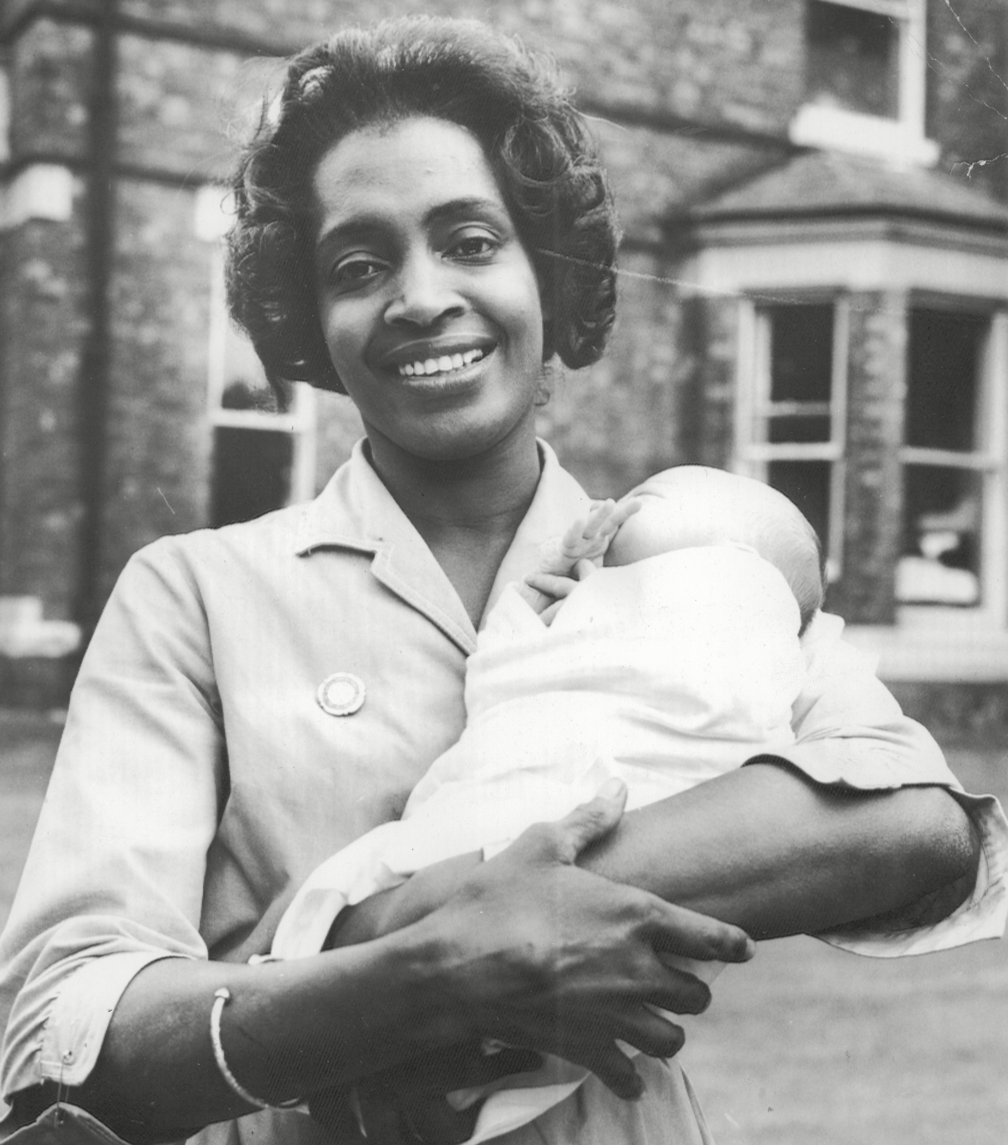
Who should we know about?
Local Significant People:
Daphne Steele
Notes:
Image: © ANL/Shutterstock

Slide 2
Local Significant People: Daphne Steele
Key Stage: 2 - History & Geography
To learn about significant historical events, people and places in their own locality
To study an aspect of history dating from a period beyond 1066 that is significant in the locality
To gain historical perspective by placing their growing knowledge into different contexts, understanding the connections between local, regional, national and international history
To use Daphne’s story to explore key events in British history such as the forming of the National Health Service (NHS) and the arrival of the Windrush Generation
To locate the world’s countries, using maps to focus on Europe and North and South America
To understand geographical similarities and differences between a region of the United Kingdom and a region within North or South America

Slide 3
Content Warning
This presentation covers some topics that may be sensitive and could be upsetting. These include, but are not limited to:
References to the British Empire
References to the racial prejudice experienced by Daphne and others​

Slide 4

What makes a person significant?
Questions to ask about a person.
Did they:
make big changes in their lifetime?
make a lot of people’s lives better or worse?
change the way people think about something?
have a lasting impact on their locality, the country or the world?
set a really good/bad example to people about how to live and behave?
Notes:
For this activity we’re using Ian ‘Dawson’s Model’ for significance criteria.

Slide 5








How can we find out about local significant people?
?
Ask people who might know about them
Use books and the internet to research them
Find buildings and places connected to them
Who’s local to me?

Slide 6
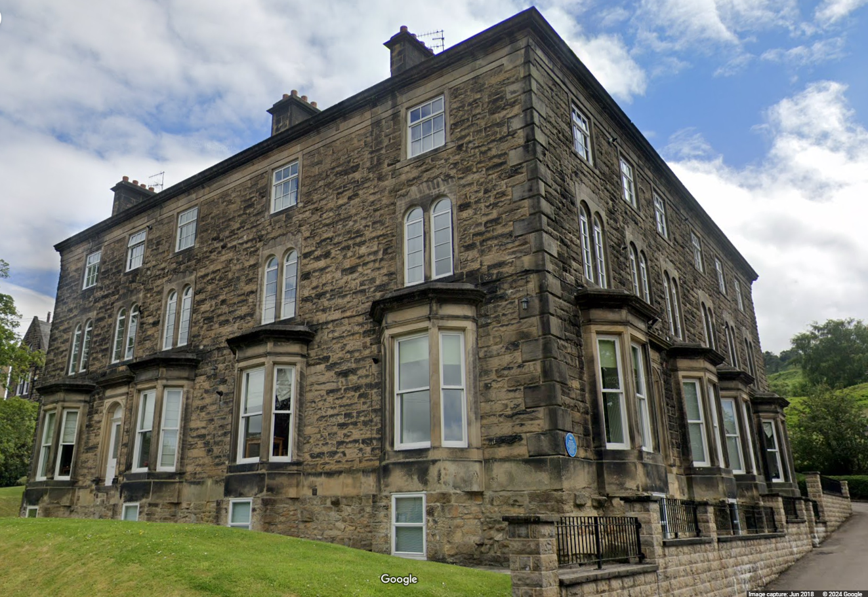
This is a building in Ilkley, West Yorkshire
Notes:
Image: © Google Maps 2024

Slide 7
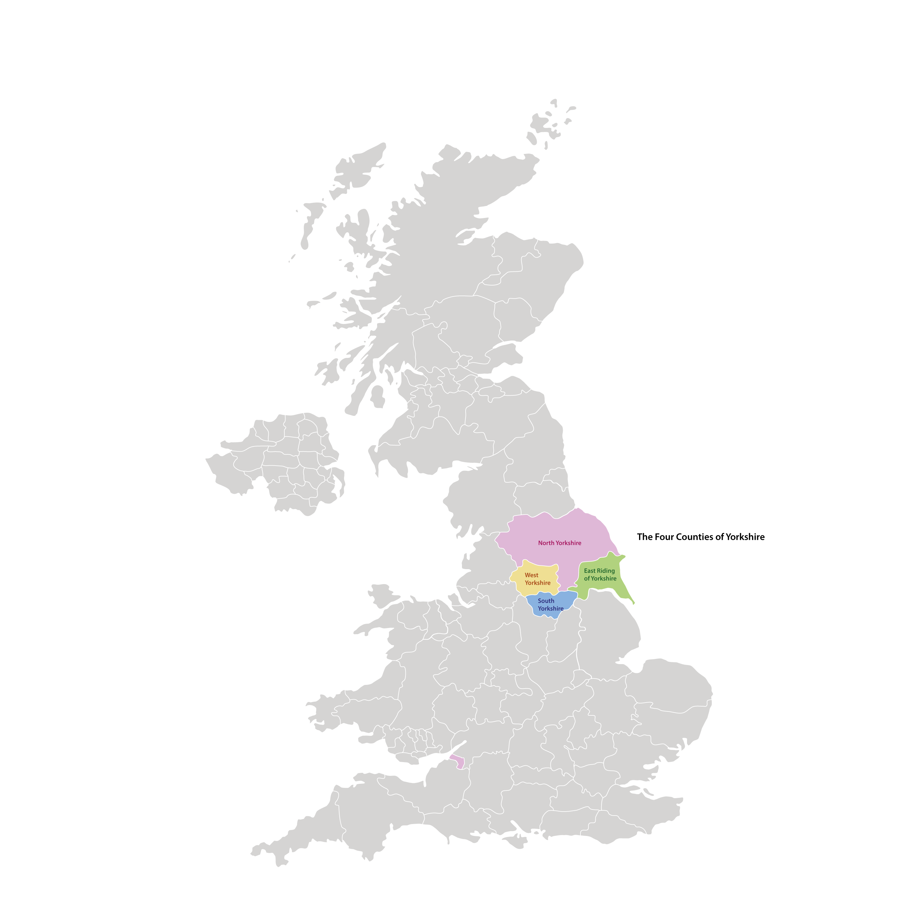
Where is West Yorkshire?
Where is West Yorkshire?
Notes:
Image: © Historic England Education

Slide 8
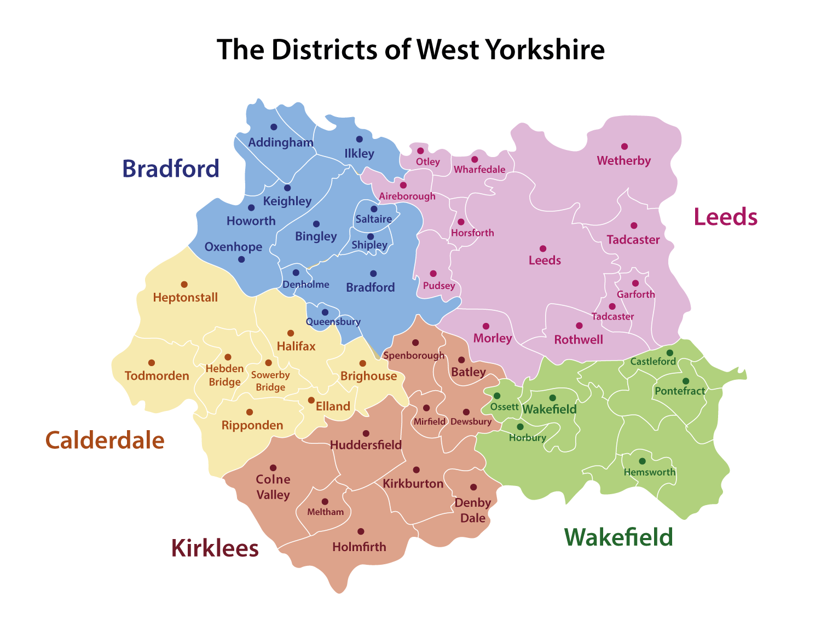
Where is Ilkely within West Yorkshire?
Where is Ilkely within West Yorkshire?
Notes:
Image: © Historic England Education

Slide 9
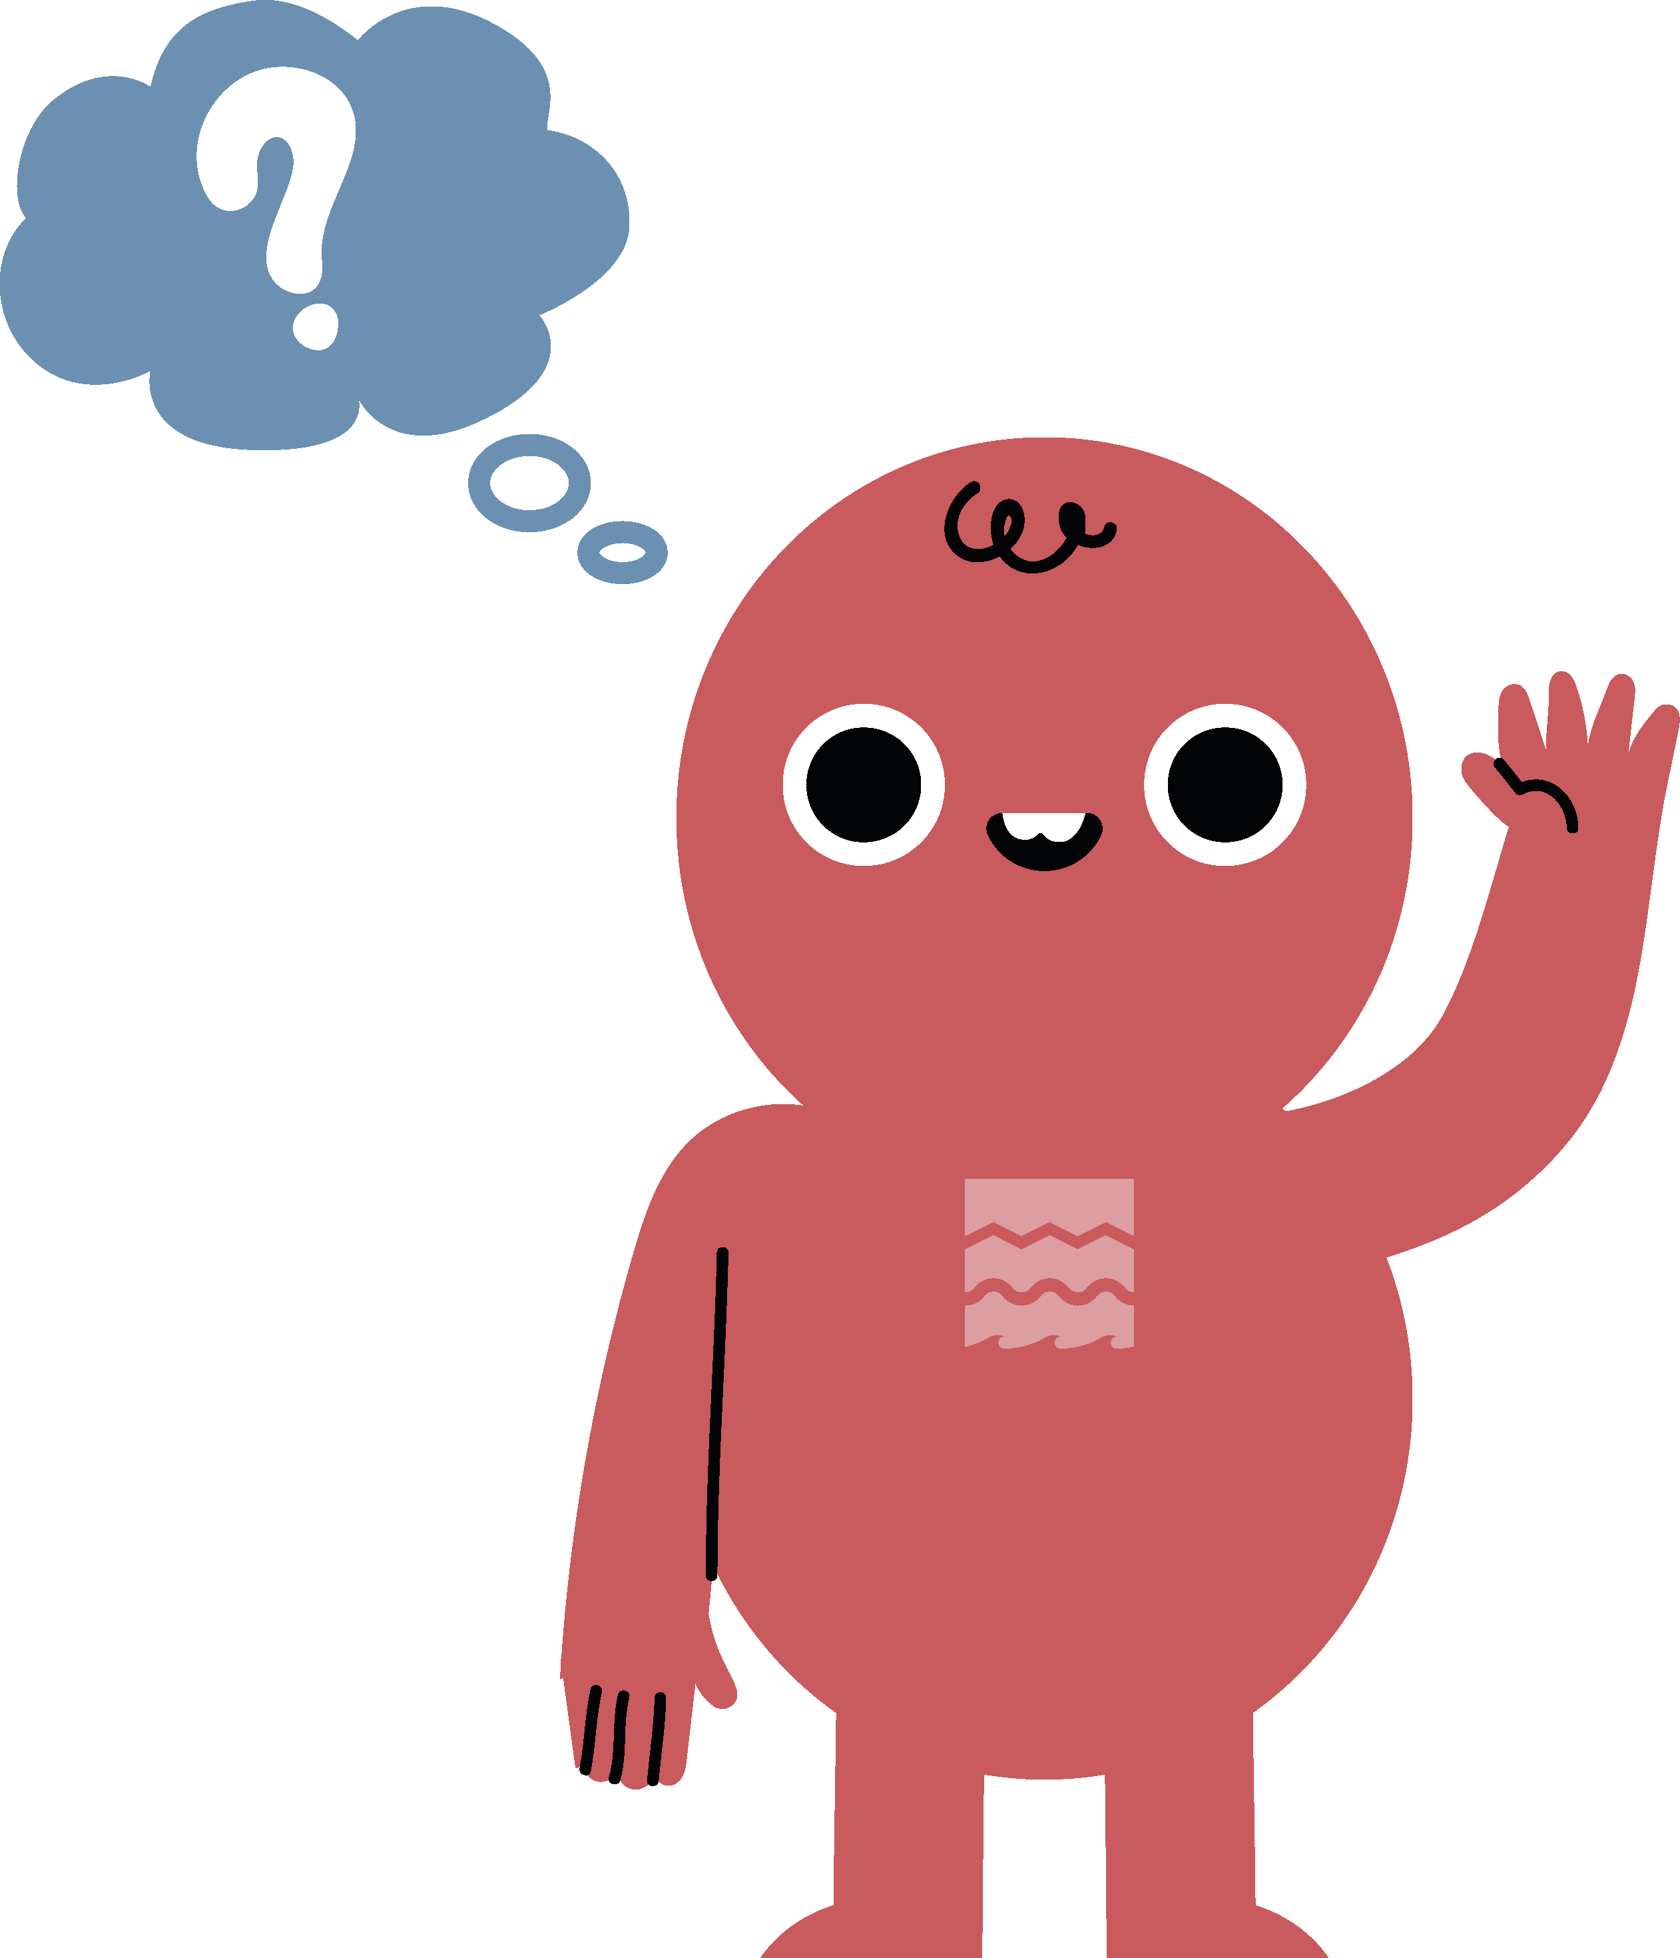


What can a building tell us? 1
What can a building tell us?
Notes:
Image: © Google Maps 2024

Slide 10
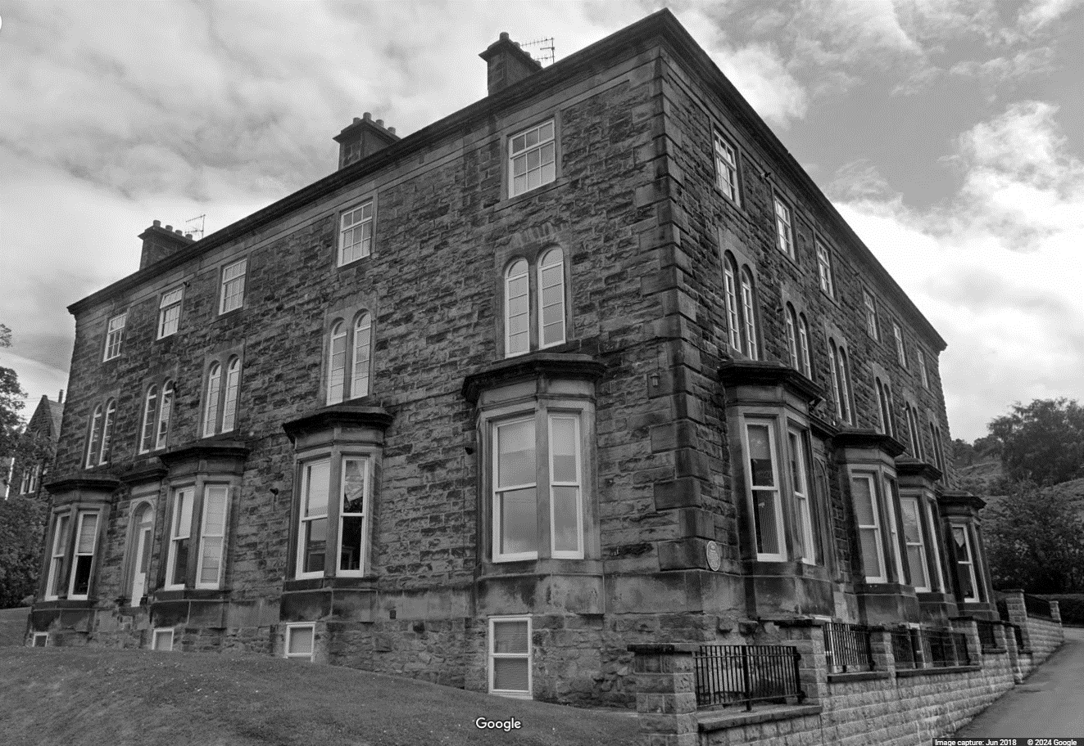
What can a building tell us? 2
Notes:
Image: © Google Maps 2024

Slide 11
What can you tell from this picture?
Notes:
Image: © ANL/Shutterstock

Slide 12
What can a building tell us?
Notes:
Image: © ANL/Shutterstock

Slide 13
Meet Daphne Steele 1
The woman in the picture is called Daphne Steele.
As part of this enquiry, we’ll find out what she did and why she might be considered to be a significant person.
We will also find out what part the building in the picture played in her life.
Notes:
Image: © ANL/Shutterstock

Slide 14
Meet Daphne Steele 2
Daphne Steele was born on 15th October 1927 in Guyana.
She was the eldest of nine children.
Her father worked as a pharmacist for the British government. His job meant the family moved to different areas of the country.
Daphne Steele
Notes:
Image: © ANL/Shutterstock

Slide 15
Meet Daphne Steele 3
Daphne Steele was born on 15th October 1927 in Guyana.
She was the eldest of nine children.
Her father worked as a pharmacist for the British government. His job meant the family moved to different areas of the country.
Reflection:
How do you think Daphne’s early life might have influenced her character and ambitions?
Daphne Steele
Notes:
Image: © ANL/Shutterstock

Slide 16
Meet Daphne Steele 4
Daphne Steele was born on 15th October 1927 in Guyana.
She was the eldest of nine children.
Her father worked as a pharmacist for the British government. His job meant the family moved to different areas of the country.
Let's find out about more about Guyana, the place where Daphne was born
Daphne Steele
Notes:
Image: © ANL/Shutterstock

Slide 17
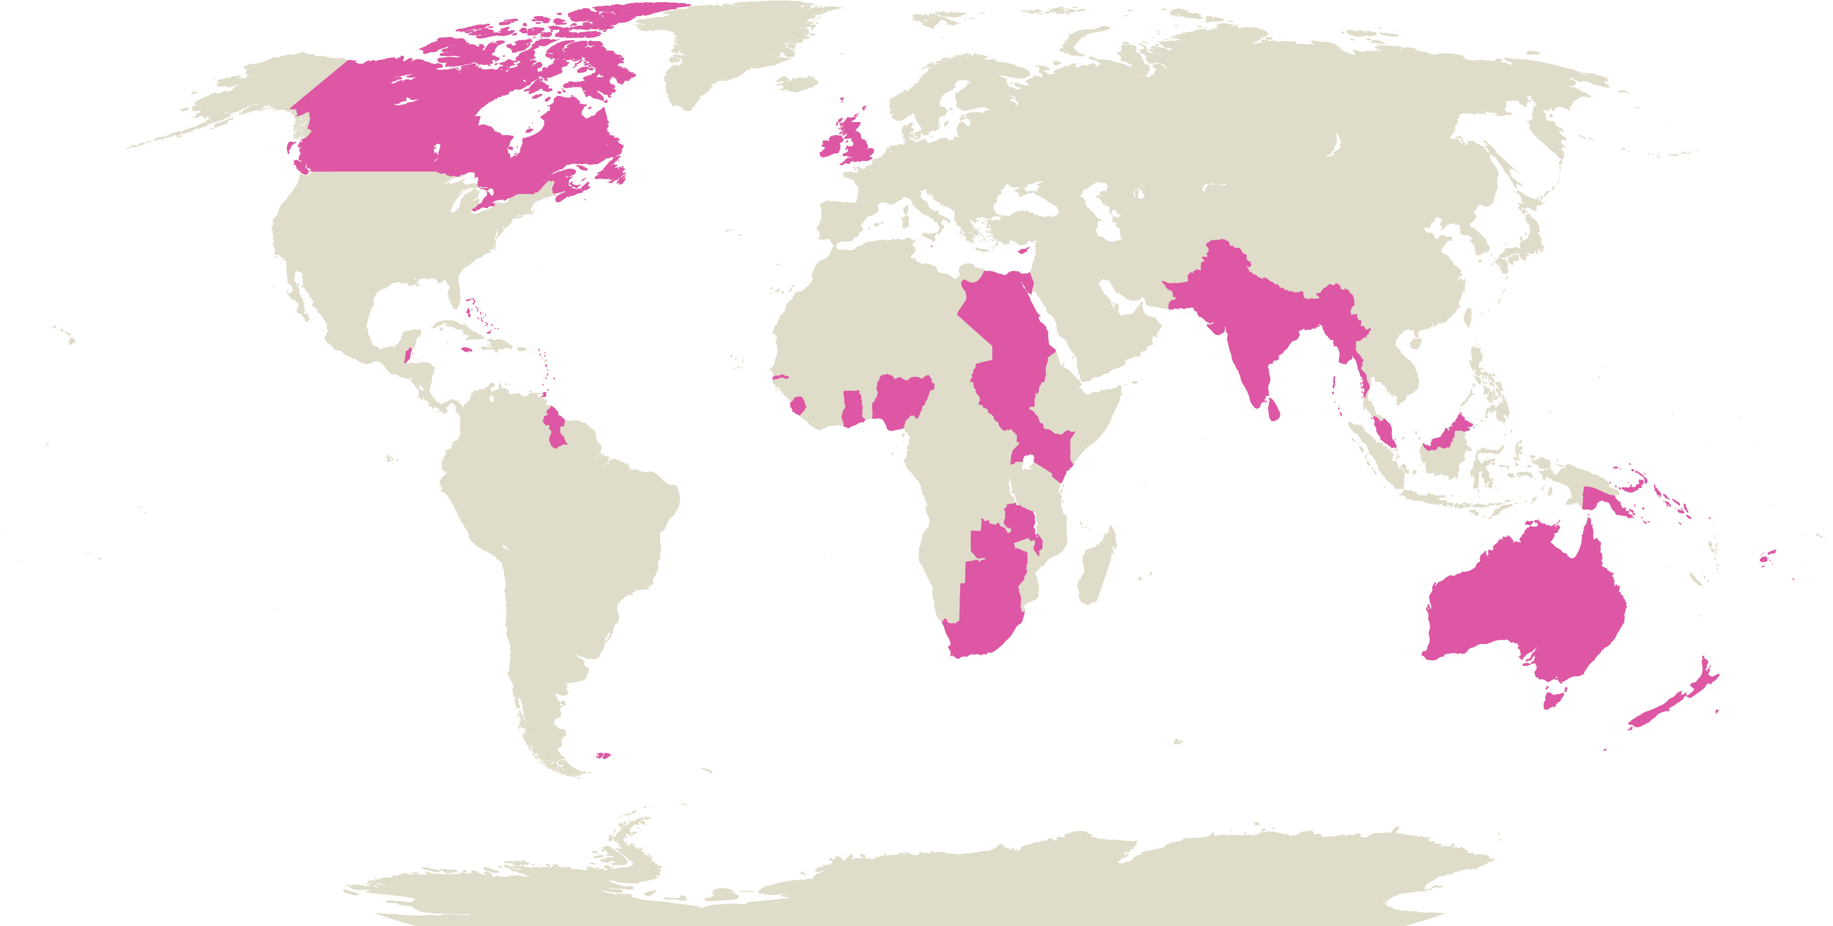
About Guyana 1
Guyana is on the north coast of South America.
Daphne was born in the Essequibo region of Guyana.
Guyana was once a colony of the British Empire, known as British Guiana.
This meant that it was governed by the British between 1814 and 1966.
Map of part of British Empire
Notes:
Image: © Historic England Education

Slide 18
About Guyana 2
Guyana achieved independence from Britain on 26 May 1966.
It became a republic on 23 February 1970, remaining a member of the Commonwealth.
Although Guyana is now an independent country, its colonial past has had a powerful influence on its culture and traditions.
Map of part of British Empire
Notes:
Image: © Historic England Education

Slide 19


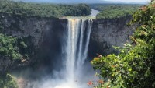
Where is Guyana?
Investigate
Locate Guyana on a world map
Find out how many miles Guyana is from your school
Watch ‘Welcome to Guyana’
Use the video to describe 3 similarities and 3 differences between the geography of Guyana and where your school is
‘Welcome to Guyana’

Slide 20
Guyana: Similarities and differences
My area is similar to Guyana because…… | My area is different from Guyana because……

Slide 21

Extension Task – Countries of the British Empire 1
Research
Can you use a map to label the other countries that were part of the British Empire?
Notes:
Image: © Historic England Education

Slide 22
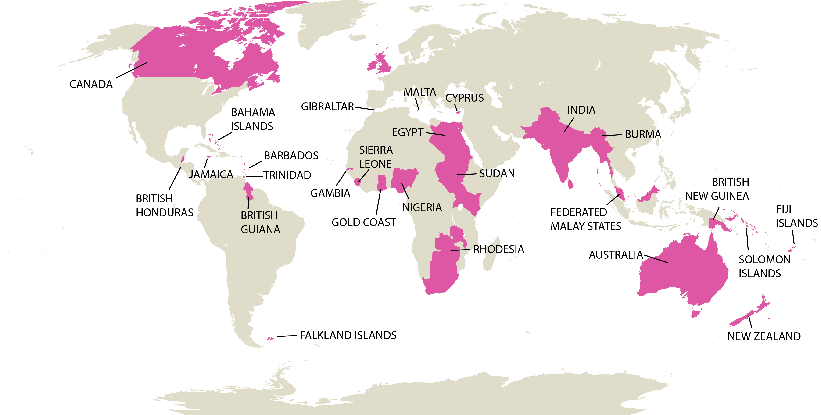
Extension Task – Countries of the British Empire 2
Research
Notes:
Image: © Historic England Education

Slide 23
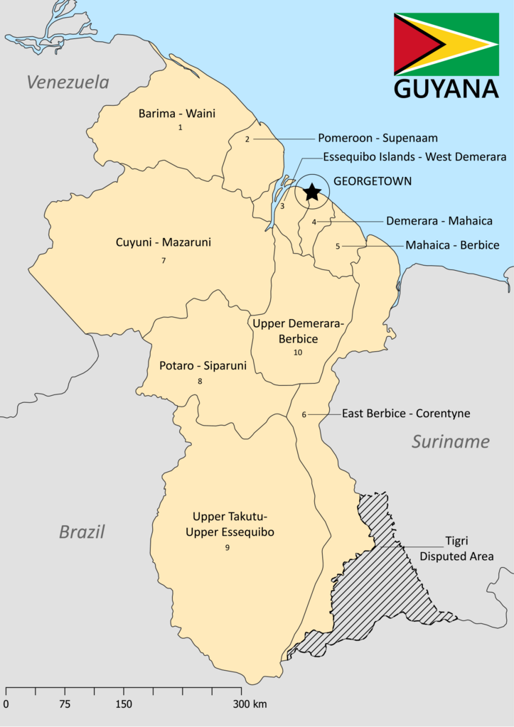
Daphne starts her nursing career 1
Daphne’s father’s job, as a pharmacist, may have inspired her. When she was young she wanted to become a doctor.
In 1945, aged 16, Daphne started training as a nurse and midwife at the public hospital in Georgetown, Guyana.
Look at historic images of Guyana, including one of the hospital from the 1940s.
Notes:
Image: SurinameCentral, CC BY-SA 4.0 <https://creativecommons.org/licenses/by-sa/4.0>, via Wikimedia Commons - https://commons.wikimedia.org/wiki/File:Guyana_Media_Map_Including_Regions.png
Historic Images: https://guyaneseonline.files.wordpress.com/2014/06/historical-guyana-in-pictures-dmitri-allicock.pdf - Hospital on Page 9

Slide 24
Daphne starts her nursing career 2
Daphne’s father’s job, as a pharmacist, may have inspired her. When she was young she wanted to become a doctor.
In 1945, aged 16, Daphne started training as a nurse and midwife at the public hospital in Georgetown, Guyana.
Look at historic images of Guyana, including one of the hospital from the 1940s.
Reflection:
Why do you think Daphne trained as a nurse and not as a doctor?
Notes:
Image: SurinameCentral, CC BY-SA 4.0 <https://creativecommons.org/licenses/by-sa/4.0>, via Wikimedia Commons - https://commons.wikimedia.org/wiki/File:Guyana_Media_Map_Including_Regions.png
Historic Images: https://guyaneseonline.files.wordpress.com/2014/06/historical-guyana-in-pictures-dmitri-allicock.pdf - Hospital on Page 9

Slide 25

Daphne moves to the UK11
Europe
South
America
Atlantic Ocean
Which continents did Daphne travel to and from?
What ocean did Daphne cross?
Notes:
Image: © Historic England Education

Slide 26
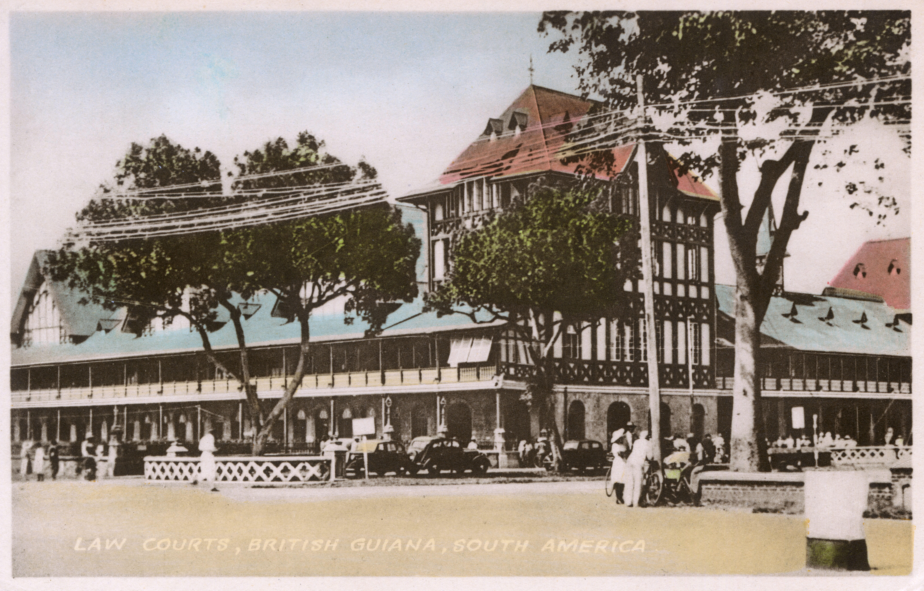
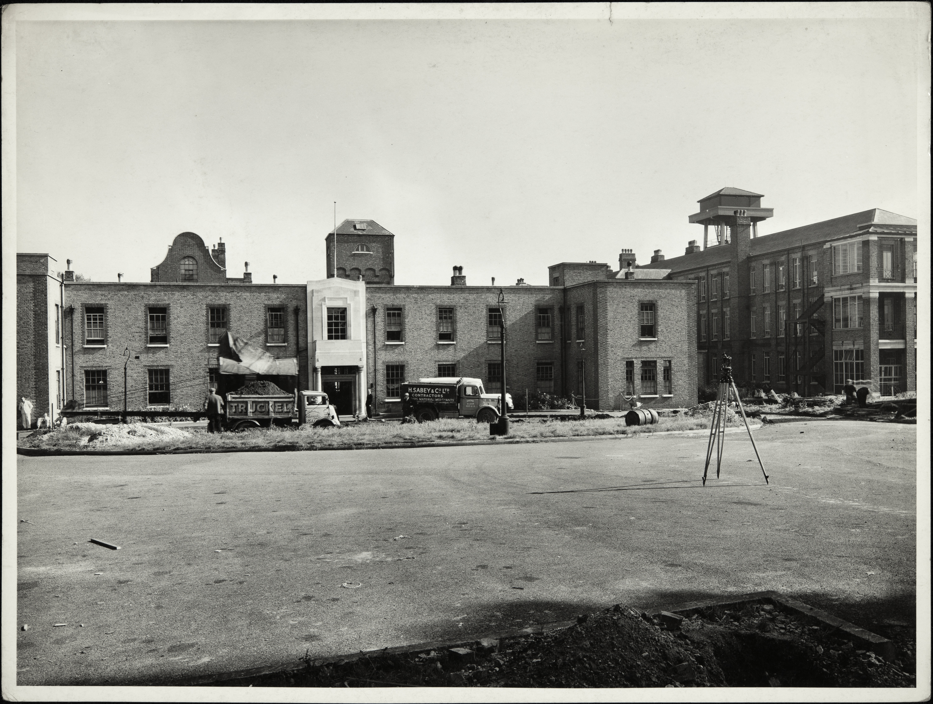

Daphne moves to the UK 212
Try to imagine how Daphne must have felt on the journey and when she arrived.
Write a postcard from Daphne back to her family in Guyana.
Notes:
Image: © Alamy Ref: G3D4XW
Image: © Historic England Archive Ref: BL/WP/11897 Date: 9 Oct 1951
Image: © Historic England Education

Slide 27


Write a postcard from Daphne to her family in in Guyana
Write
Notes:
Image: © Alamy Ref: T4XYC9

Slide 28

Write a postcard from Daphne to her family in in Guyana 2
Notes:
Image: © Alamy Ref: T4XYC9

Slide 29
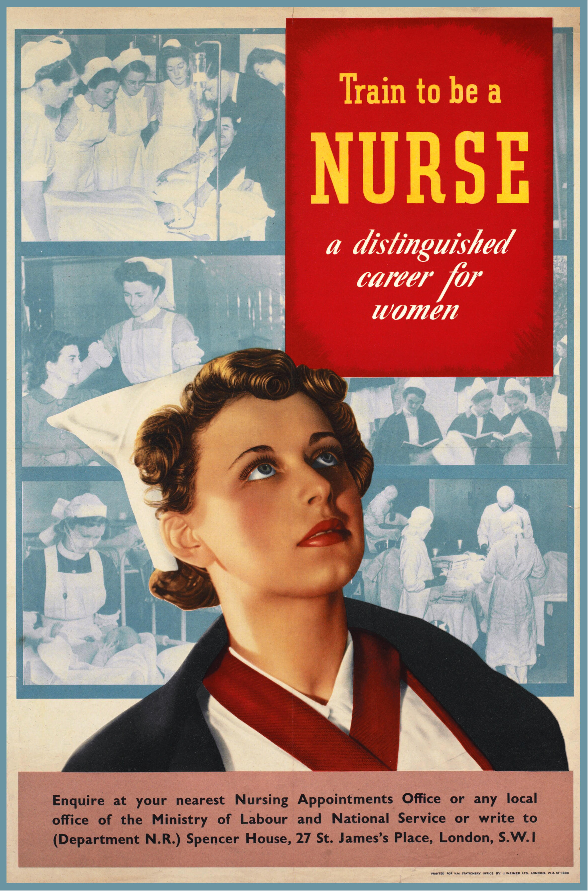
Daphne moves to the UK 3 1
Daphne decided to emigrate to the UK. She was encouraged by a British Government campaign for people to join the new National Health Service (NHS), formed in 1948.
She set off as a young woman on her own, leaving her family behind.
Daphne later said: "In the 1950s everybody was leaving. Folks were being encouraged to come and train.”
Notes:
Image: © Alamy Ref: MAEWT0

Slide 30
Daphne moves to the UK 4 1
Reflection:
How easy a decision do you think it would have been for Daphne to leave her home and travel to Britain?
Daphne decided to emigrate to the UK. She was encouraged by a British Government campaign for people to join the new National Health Service (NHS), formed in 1948.
She set off as a young woman on her own, leaving her family behind.
Daphne later said: "In the 1950s everybody was leaving. Folks were being encouraged to come and train.”
Notes:
Image: © Alamy Ref: MAEWT0

Slide 31
Daphne moves to the UK 2
In 1951 she arrived in Plymouth, after travelling for 14 days to get there.
She was surprised when a white man took her luggage for her, as in her native country white men only worked in managerial roles.
She enrolled on a ‘fast-track’ nursing course at St James’s Hospital, Balham, London.
St James’s Hospital, 1951
Notes:
Image: © Historic England Archive Ref: BL/WP/11897 Date: 9 Oct 1951 - https://historicengland.org.uk/images-books/photos/item/BL/WP/11897
https://en.wikipedia.org/wiki/Daphne_Steele#:~:text=Medical%20career,-She%20underwent%20training&text=The%20journey%20took%2014%20days,Hospital%20in%20Balham%2C%20South%20London

Slide 32
Daphne moves to the UK 5 2
In 1951 she arrived in Plymouth, after travelling for 14 days to get there.
She was surprised when a white man took her luggage for her, as in her native country white men only worked in managerial roles.
She enrolled on a ‘fast-track’ nursing course at St James’s Hospital, Balham, London.
Reflection:
Why do you think Daphne was put on a ‘fast-track’ course?
St James’s Hospital, 1951
Notes:
Image: © Historic England Archive Ref: BL/WP/11897 Date: 9 Oct 1951 - https://historicengland.org.uk/images-books/photos/item/BL/WP/11897
https://en.wikipedia.org/wiki/Daphne_Steele#:~:text=Medical%20career,-She%20underwent%20training&text=The%20journey%20took%2014%20days,Hospital%20in%20Balham%2C%20South%20London

Slide 33
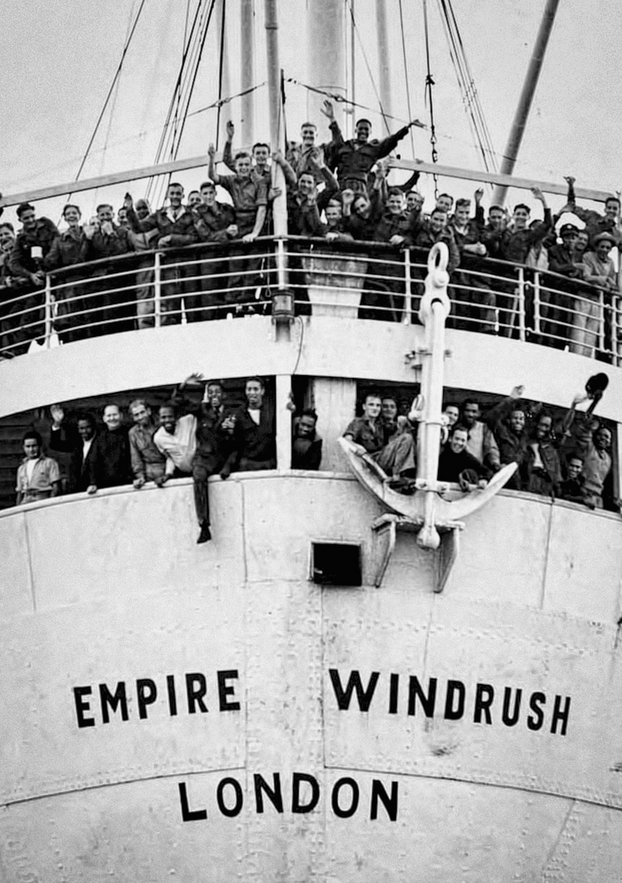
Windrush Generation 1
Although Daphne did not travel to Britain on the Empire Windrush, she was part of what became known as the ‘Windrush Generation’.
After the Second World War many people arrived in Britain from Caribbean countries.
The Caribbean was part of the British commonwealth, so people from there were automatically British subjects and free to permanently live and work in the UK.
People arriving from the Caribbean
Notes:
Image: © Alamy Ref: J4Y0KN

Slide 34
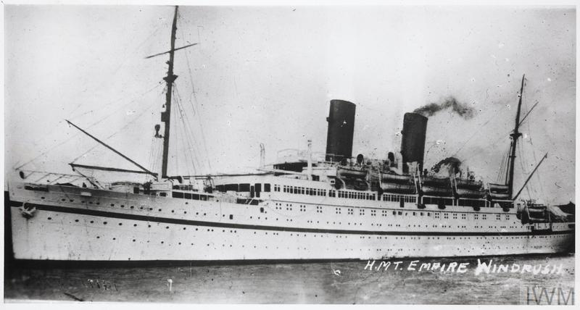
Windrush Generation 2
The name 'Windrush' derives from ‘HMT Empire Windrush’, the name of the ship which brought one of the first large groups of Caribbean people to the UK in 1948
Notes:
Image: © IWM FL 9448

Slide 35
Windrush Generation 3
People from Africa, the Caribbean and Asia were encouraged to come to England during this period.
However, on arrival, they often faced racism and discrimination.
Discriminating against people because of their colour, race, or ethnic or national origin did not become illegal until 1965.
People arriving from the Caribbean
Notes:
Image: © Alamy Ref: J4Y0KN
More Windrush links:
Webpage: Historic England Blog - ‘7 Places That Tell Stories of the Windrush Generation’
Film: National Archives – Holding History Windrush Animation (1 minute 43 seconds)Film: British Pathe – 'Empire Windrush' ship arrives in UK carrying Jamaican immigrants (1948) (20 seconds)
Webpage: The Windrush Generation: Norman’s experience https://www.horniman.ac.uk/story/the-windrush-generation-normans-experience/
Webpage: Alford Gardner A Windrush passenger 70 years on: 'I have no regrets about anything’ https://www.theguardian.com/uk-news/2018/jun/22/a-windrush-passenger-70-years-on-i-have-no-regrets-about-anything

Slide 36
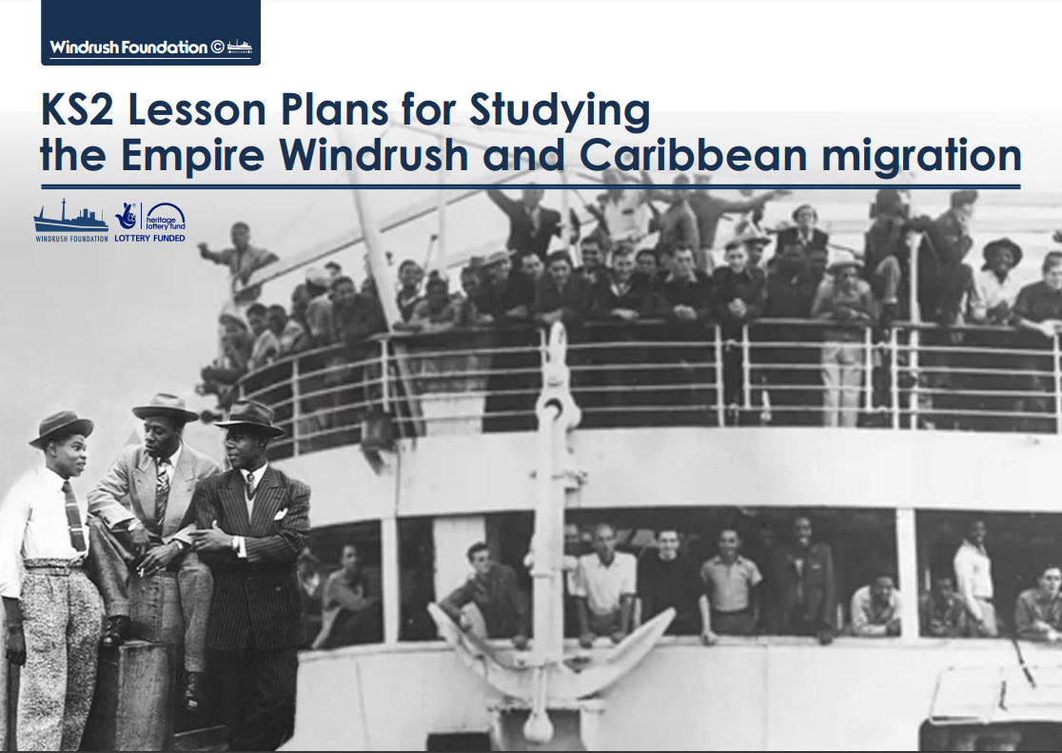

Windrush Foundation Teaching Resources
Download
resources
These resources from the Windrush Foundation are a great way to find out more about the ‘Windrush Generation’
Notes:
Image: Screenshot from https://windrushfoundation.com/wp-content/uploads/2019/06/WindrushFoundationEduPack2018_R10R4.pdf

Slide 37
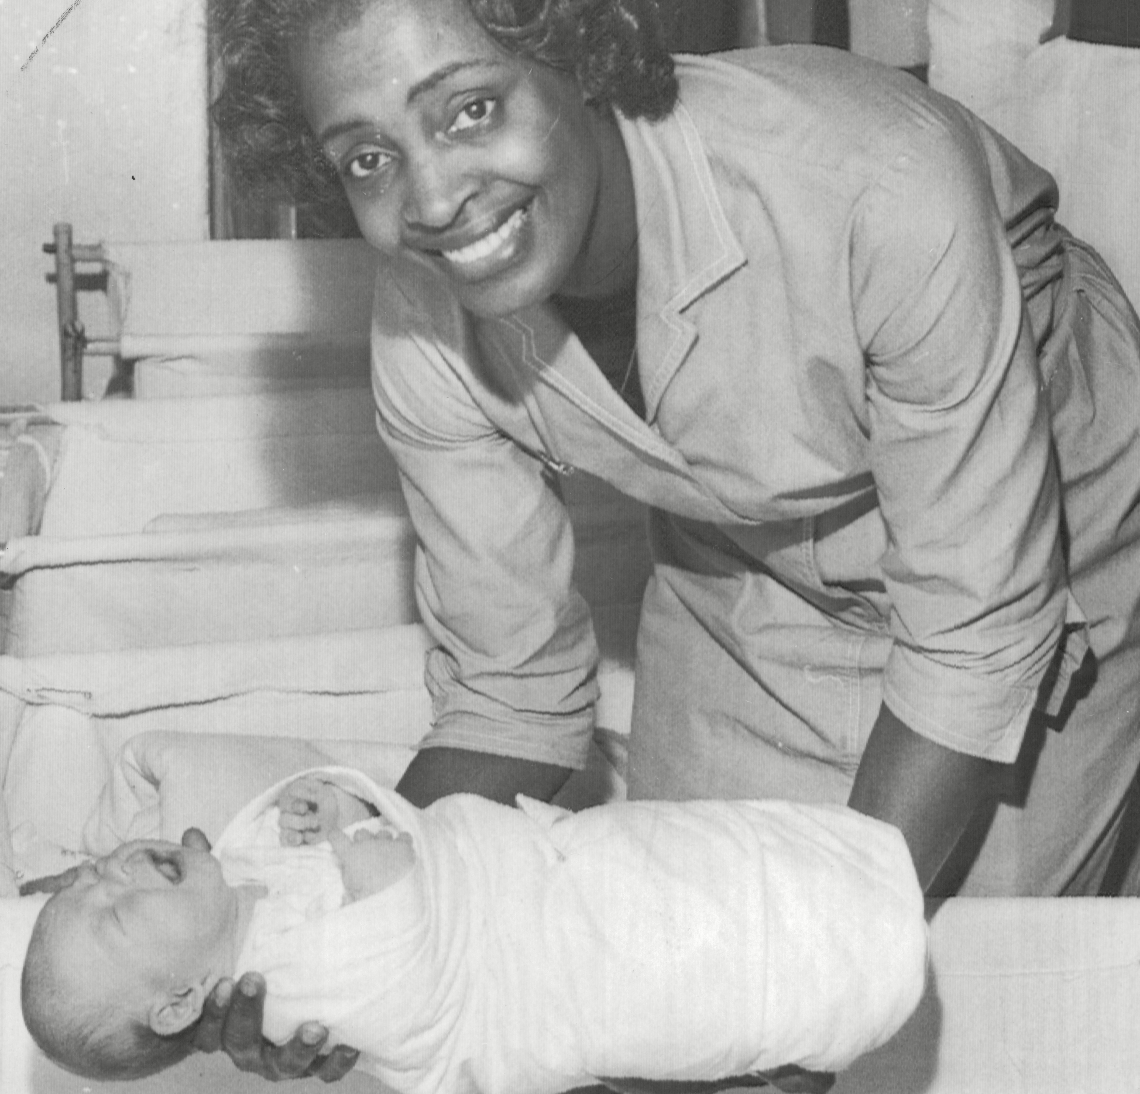
Daphne’s first experiences 1
At first, she did not find it easy.
She found the nurses’ training and the rules in the nurses’ home quite strict. She later said, ‘it was a bit like being in the army’.
She also later described how she experienced and witnessed, at first hand, racism from white colleagues and patients.
Daphne holding a baby
Notes:
Image: © ANL/Shutterstock
https://en.wikipedia.org/wiki/Daphne_Steele#:~:text=Medical%20career,-She%20underwent%20training&text=The%20journey%20took%2014%20days,Hospital%20in%20Balham%2C%20South%20London

Slide 38
Daphne’s first experiences 2
At first she did not find it easy.
She found the nurses’ training and the rules in the nurses’ home quite strict. She later said ‘it was a bit like being in the army’.
She also later described how she experienced and witnessed, at first hand, racism from white colleagues and patients.
Reflection:
How do you think Daphne might have felt about the way she was treated?
Daphne holding a baby
Notes:
Image: © ANL/Shutterstock
https://en.wikipedia.org/wiki/Daphne_Steele#:~:text=Medical%20career,-She%20underwent%20training&text=The%20journey%20took%2014%20days,Hospital%20in%20Balham%2C%20South%20London

Slide 39
Daphne’s becomes a qualified NHS nurse
She was registered as a nurse on 1 April 1953 and became a pupil midwife at the hospital in August 1953.
She completed her training in March 1954 and was praised for being ‘an excellent nurse in every way’ by Dorothy Morris, head of nurse training (St George’s Hospital archives).
Daphne holding a baby
Notes:
Image: © ANL/Shutterstock

Slide 40
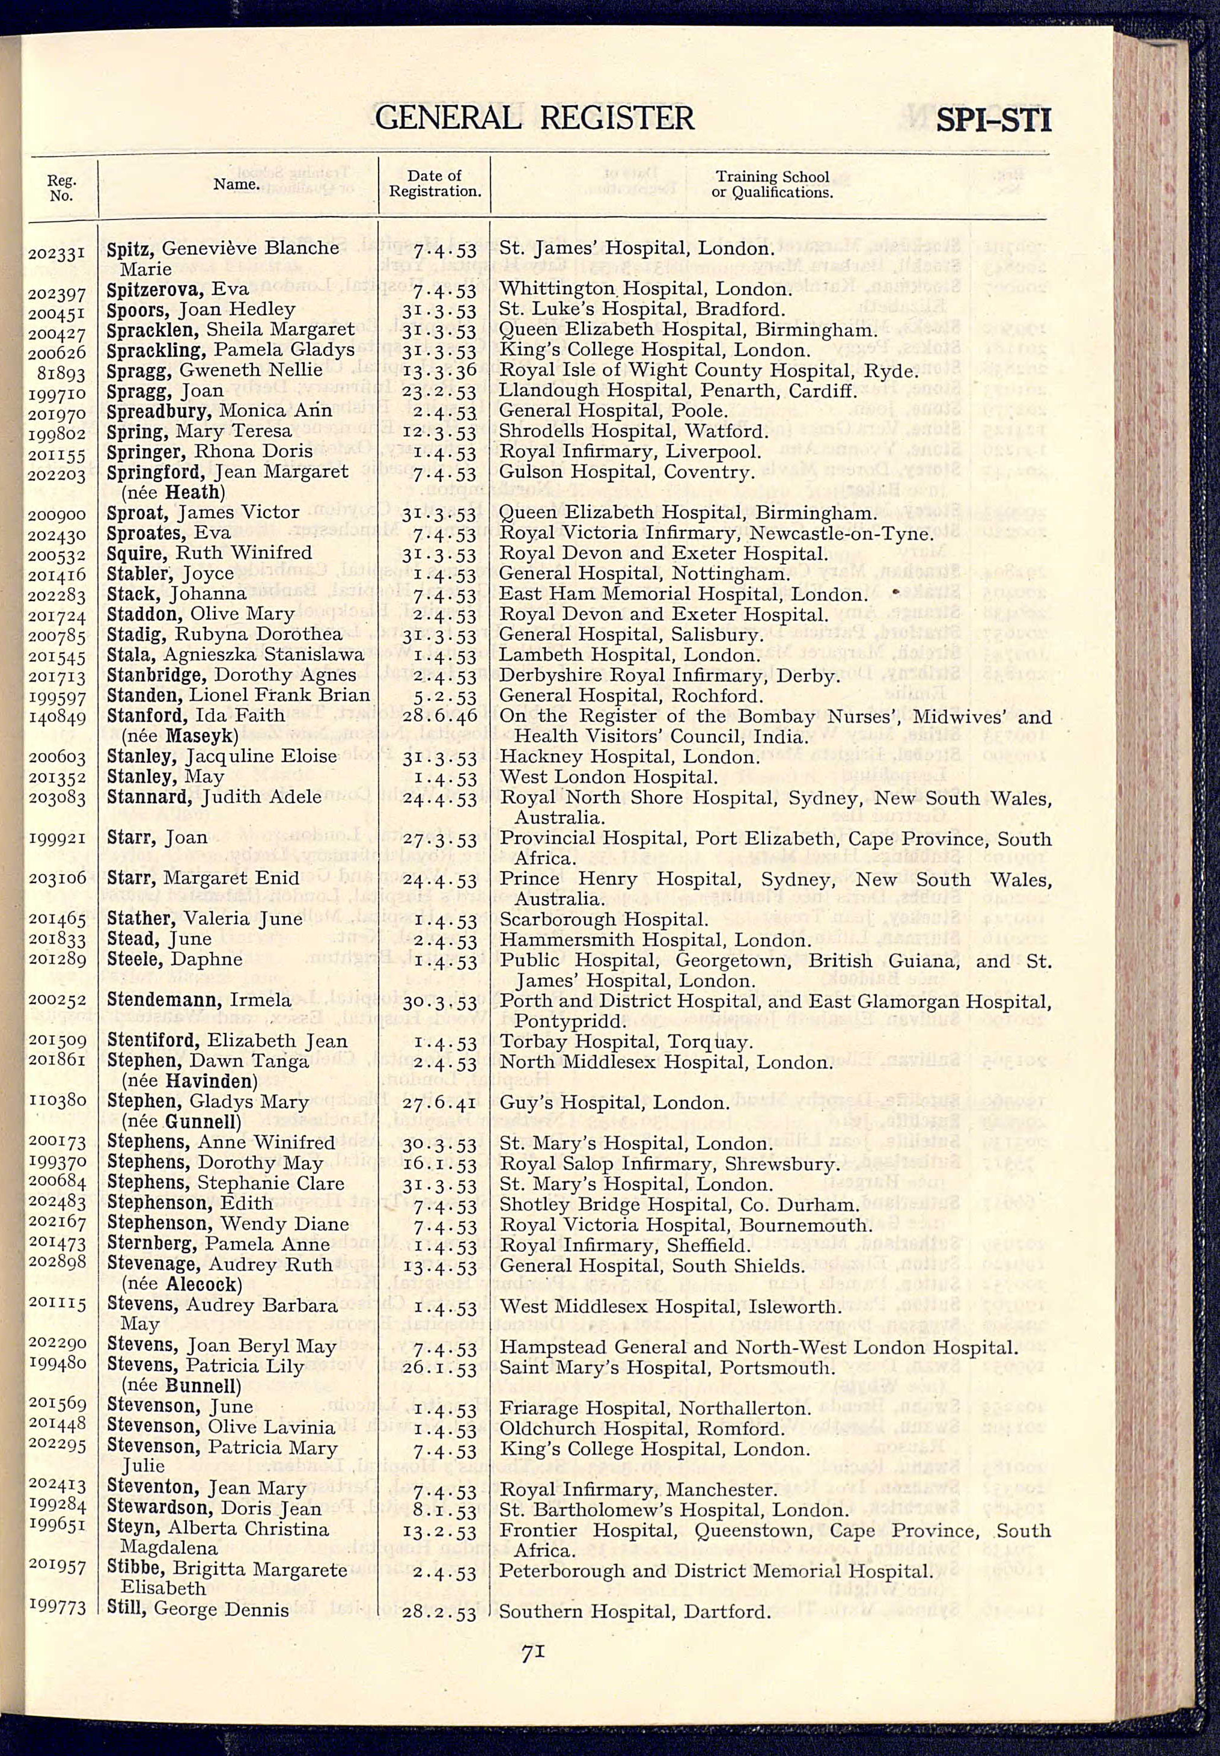
Extension Task
Use this page from the General Register of Nurses to find Daphne’s entry
Look through all the entries on the same page and map all of those not in the UK
How successful do you think the campaign to recruit more nurses was amongst Britain’s Commonwealth countries?
General Register of Nurses
Notes:
Image: Courtesy of Royal College of Nursing Archives

Slide 41
Page out of 1953 General Register of Nurses
Notes:
Image: Courtesy of Royal College of Nursing Archives

Slide 42
Extension Task - Answers2
1
1
2
2
Notes:
Image: © Historic England Education

Slide 43
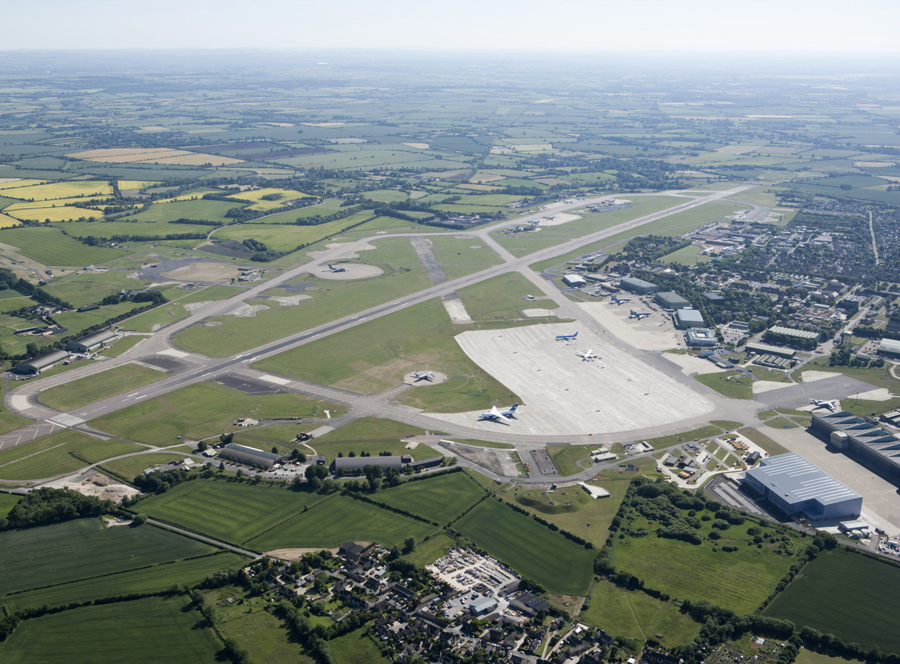
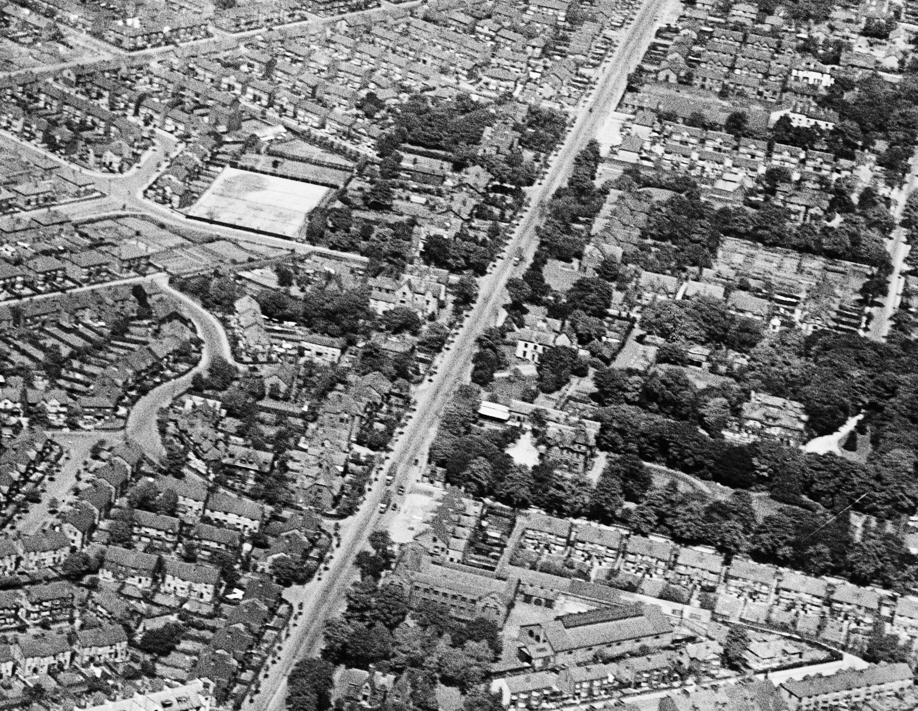
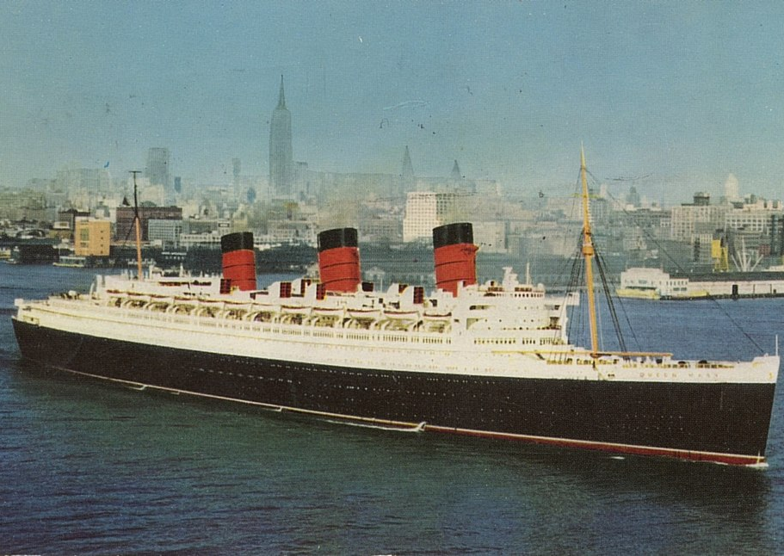
Daphne moves around
RMS Queen Mary
RAF Brize Norton
Doriscourt, Manchester
In May 1956 Daphne travelled on the Queen Mary to New York and worked in the United States for the following three years.
She returned to Britain in September 1959 and subsequently took up a nursing job at RAF Brize Norton in Oxfordshire.
She then moved to work as Deputy Matron at Doriscourt nursing and maternity home in Whalley Range, Manchester.
Notes:
Image 1: © Steve Knight from Halstead, United Kingdom, CC BY 2.0 <https://creativecommons.org/licenses/by/2.0>, via Wikimedia Commons - https://commons.wikimedia.org/wiki/File:RMS_Queen_Mary_in_New_York_Harbour_(50524304982).jpg
Image 2: © Historic England Archive Ref: 27220_021 Date: 22/06/2010 - https://historicengland.org.uk/images-books/archive/collections/aerial-photos/record/27220_021
Image 3: © Historic England Archive (Aerofilms Collection) Ref: EPW038548 Date: 1st June 1932 - https://historicengland.org.uk/images-books/archive/collections/aerial-photos/record/EPW038548

Slide 44
Daphne’s journey continues 1 1
Notes:
Image: © Historic England Education

Slide 45
Daphne’s journey continues 22
Notes:
Image: © Historic England Archive Ref: 27220_021 Date: 22/06/2010 - https://historicengland.org.uk/images-books/archive/collections/aerial-photos/record/27220_021
Image: © Historic England Archive (Aerofilms Collection) Ref: EPW038548 Date: 1st June 1932 - https://historicengland.org.uk/images-books/archive/collections/aerial-photos/record/EPW038548
Image: © Historic England Education

Slide 46
Doriscourt closes
Doriscourt was announced to be closing.
The Irish Matron with whom Daphne worked, recognised her talent and ambition.
She encouraged her to apply for the position of matron at a hospital in West Yorkshire, with the encouraging words of “Come on, Steele!”
Doriscourt, Manchester
Notes:
Image: © Historic England Archive (Aerofilms Collection) Ref: EPW038548 Date: 1st June 1932 - https://historicengland.org.uk/images-books/archive/collections/aerial-photos/record/EPW038548

Slide 47
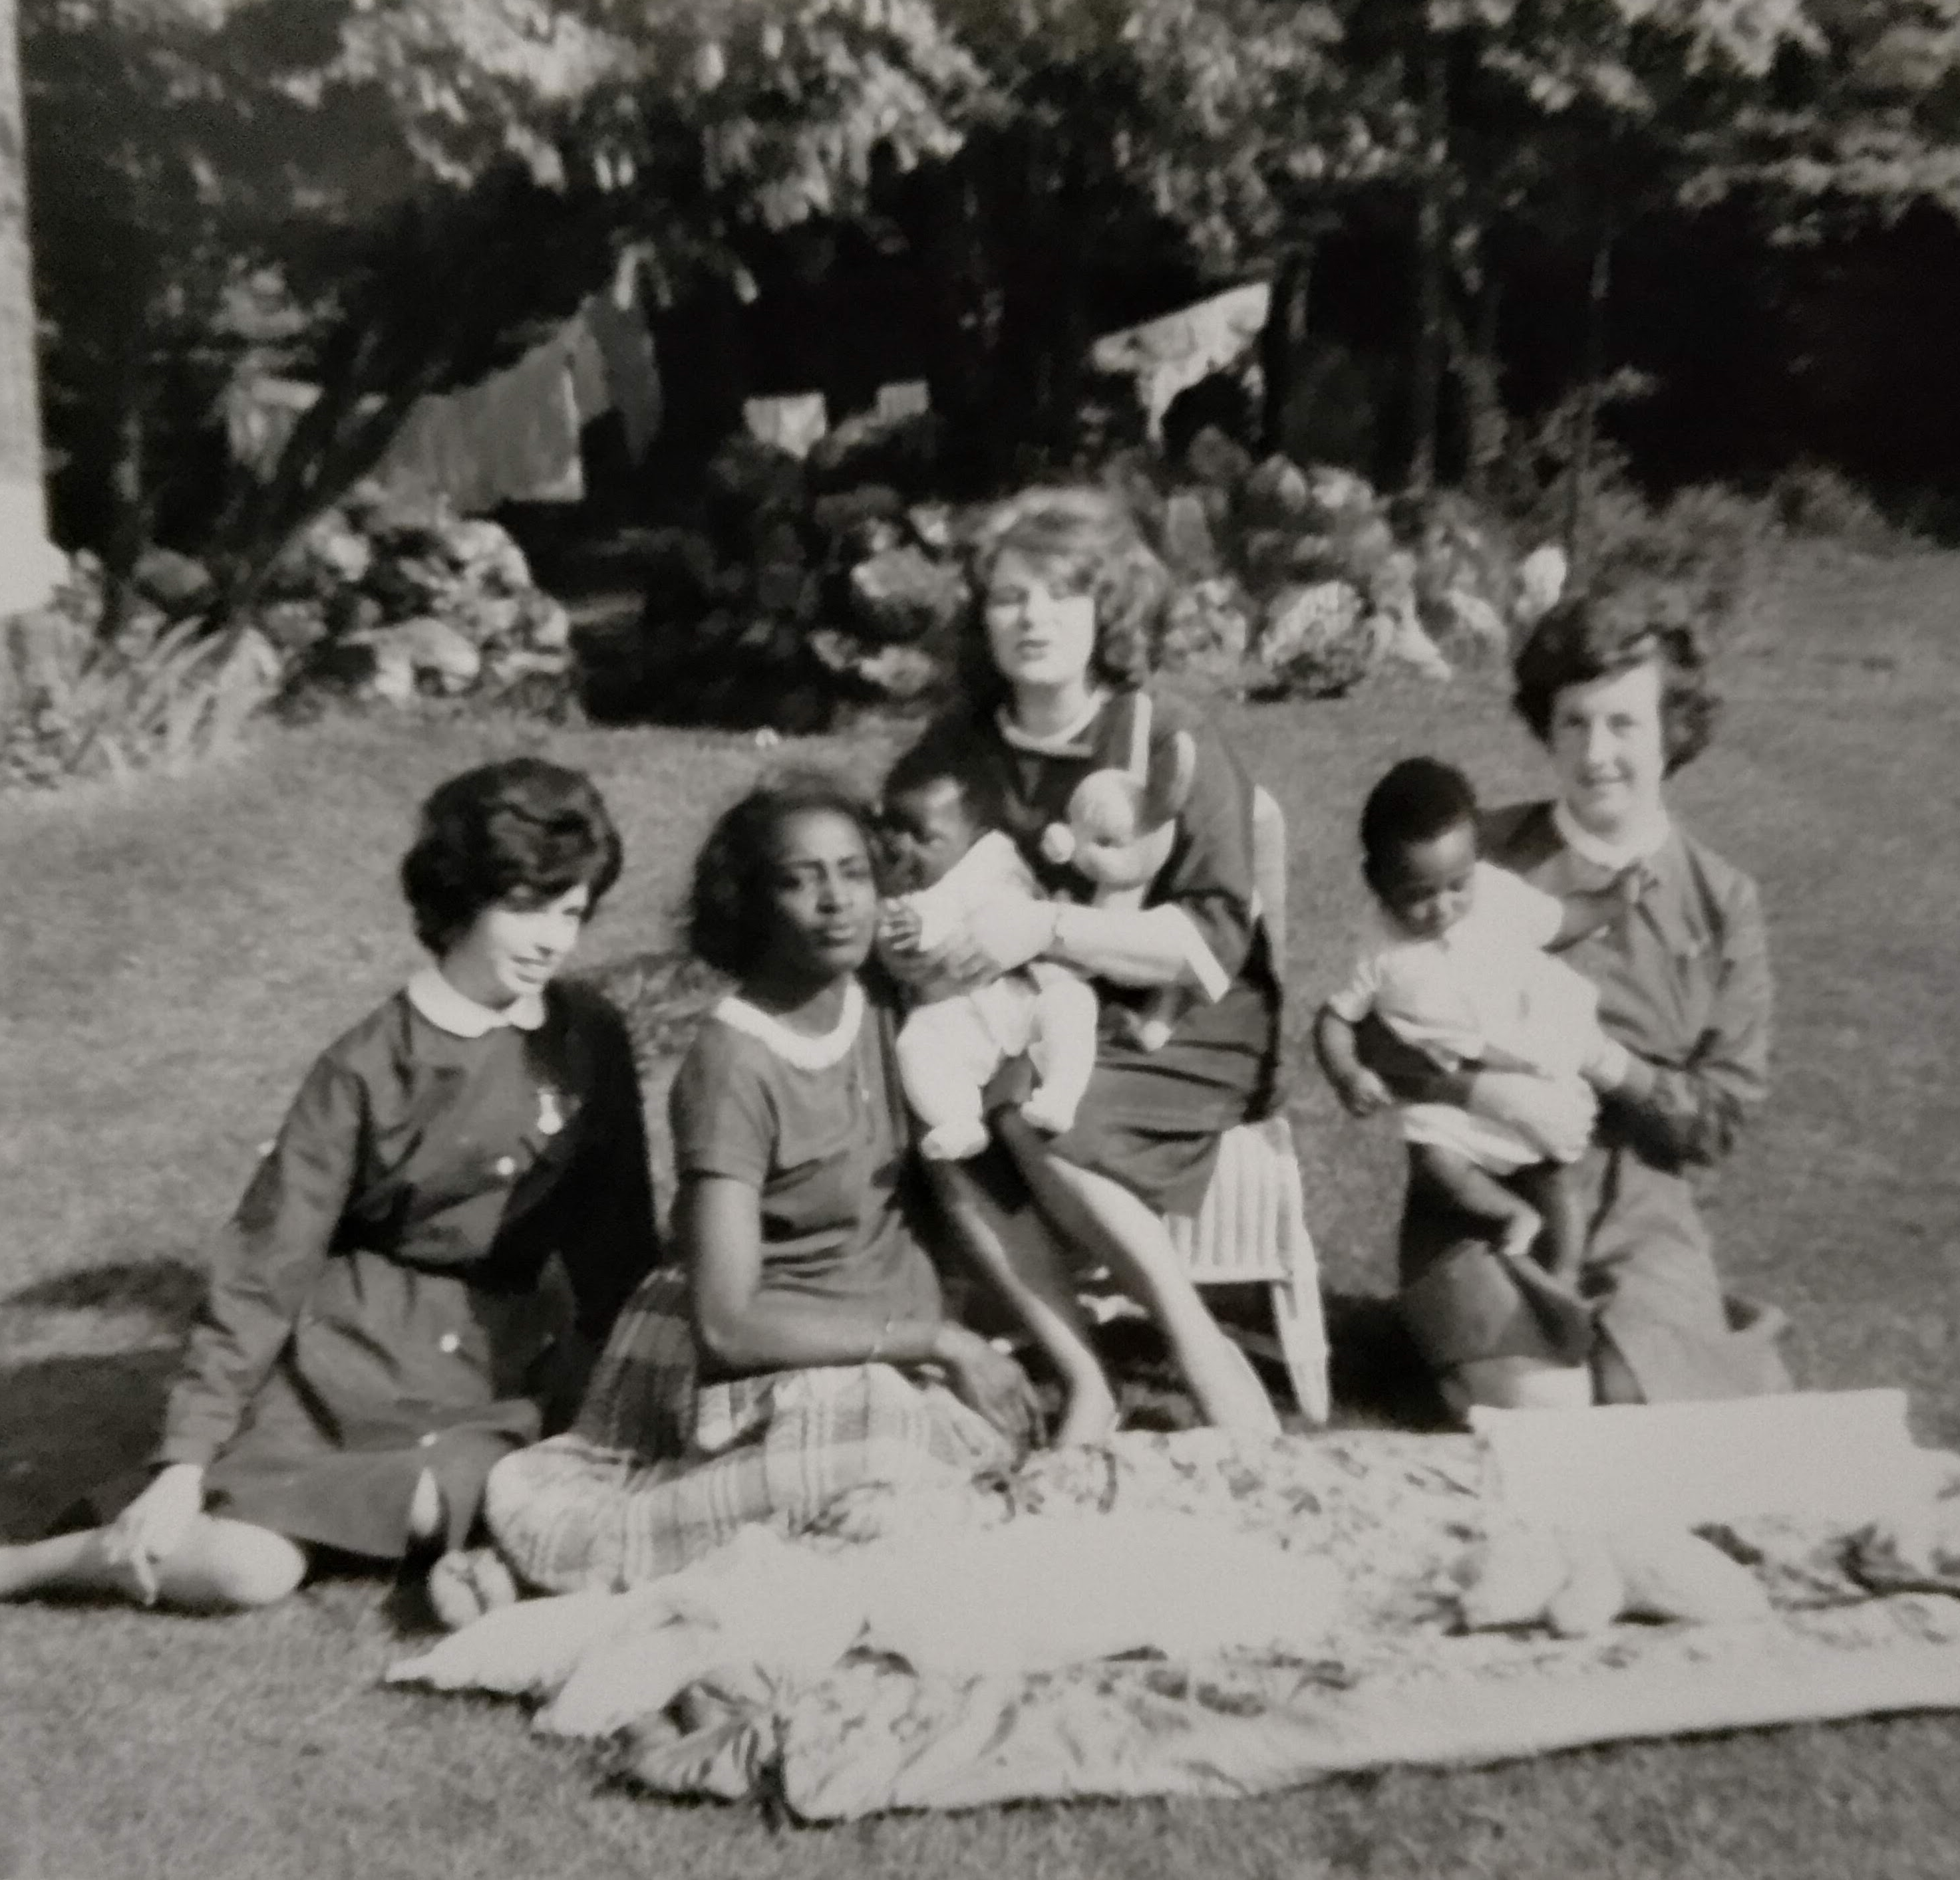
Daphne moves to Yorkshire
In spring 1964 Daphne gave birth to her son, Robert.
In August 1964, Daphne got the job as Matron at St. Winifred's Hospital in Ilkley, West Yorkshire.
This was a significant achievement because she became the first Black person to be appointed as a Matron anywhere in the NHS in Britain!
Daphne with her son Robert and fellow nurses
Notes:
Image: Courtesy of the Steele family

Slide 48
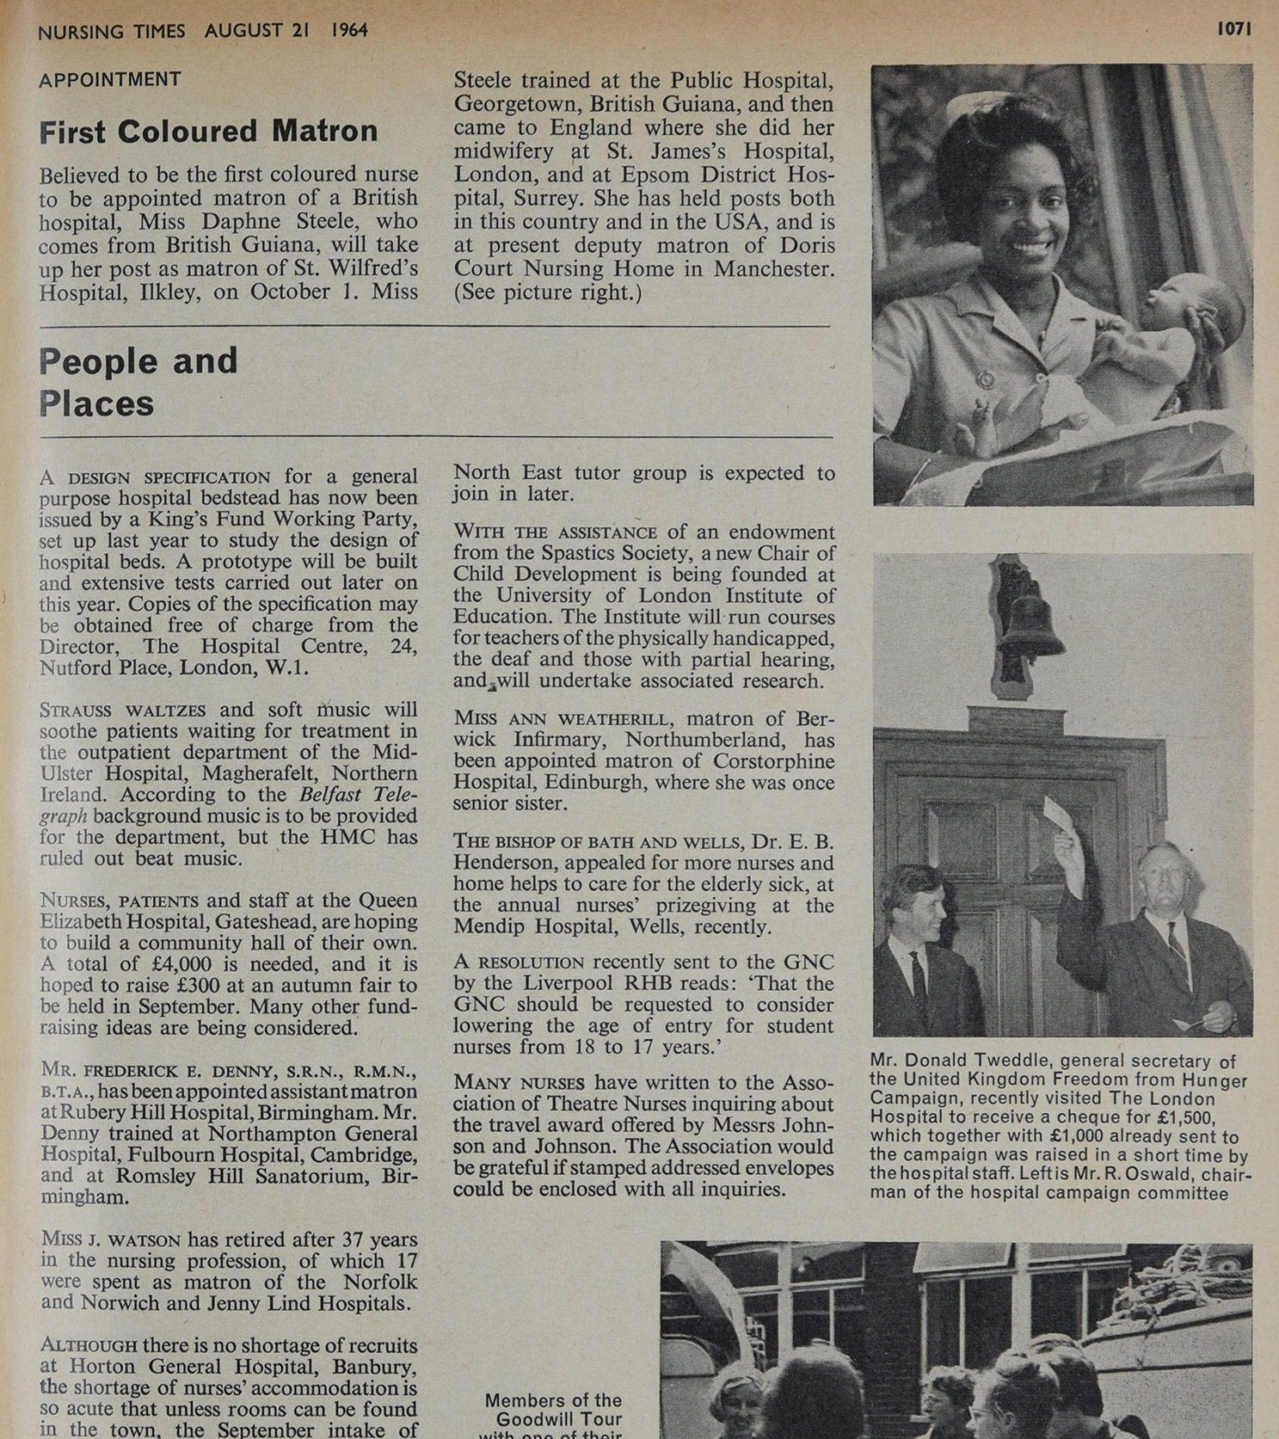
Daphne makes the headlines 1
Daphne received around 350 letters from well-wishers.
The appointment created a sensation and Daphne made newspaper headlines around the world!
For the time, Daphne’s achievement was nothing short of amazing.
Nursing Times, August 1964
Notes:
Image: Courtesy of Royal College of Nursing Archives

Slide 49
Daphne makes the headlines 2
The word ‘coloured’ was used to describe a Black person. This is an historic and offensive term that is no longer used.
Daphne received around 350 letters from well-wishers.
The appointment created a sensation and Daphne made newspaper headlines around the world!
For the time, Daphne’s achievement was nothing short of amazing.
Nursing Times, August 1964
Notes:
Image: Courtesy of Royal College of Nursing Archives

Slide 50
Daphne in her own words 1
On becoming the first Black matron in the British NHS she said:
“it did something for race relations and it also did something for other blacks because if one can do it we can all do it” (Ilkley Gazette, 25 October 2001). ”

Slide 51
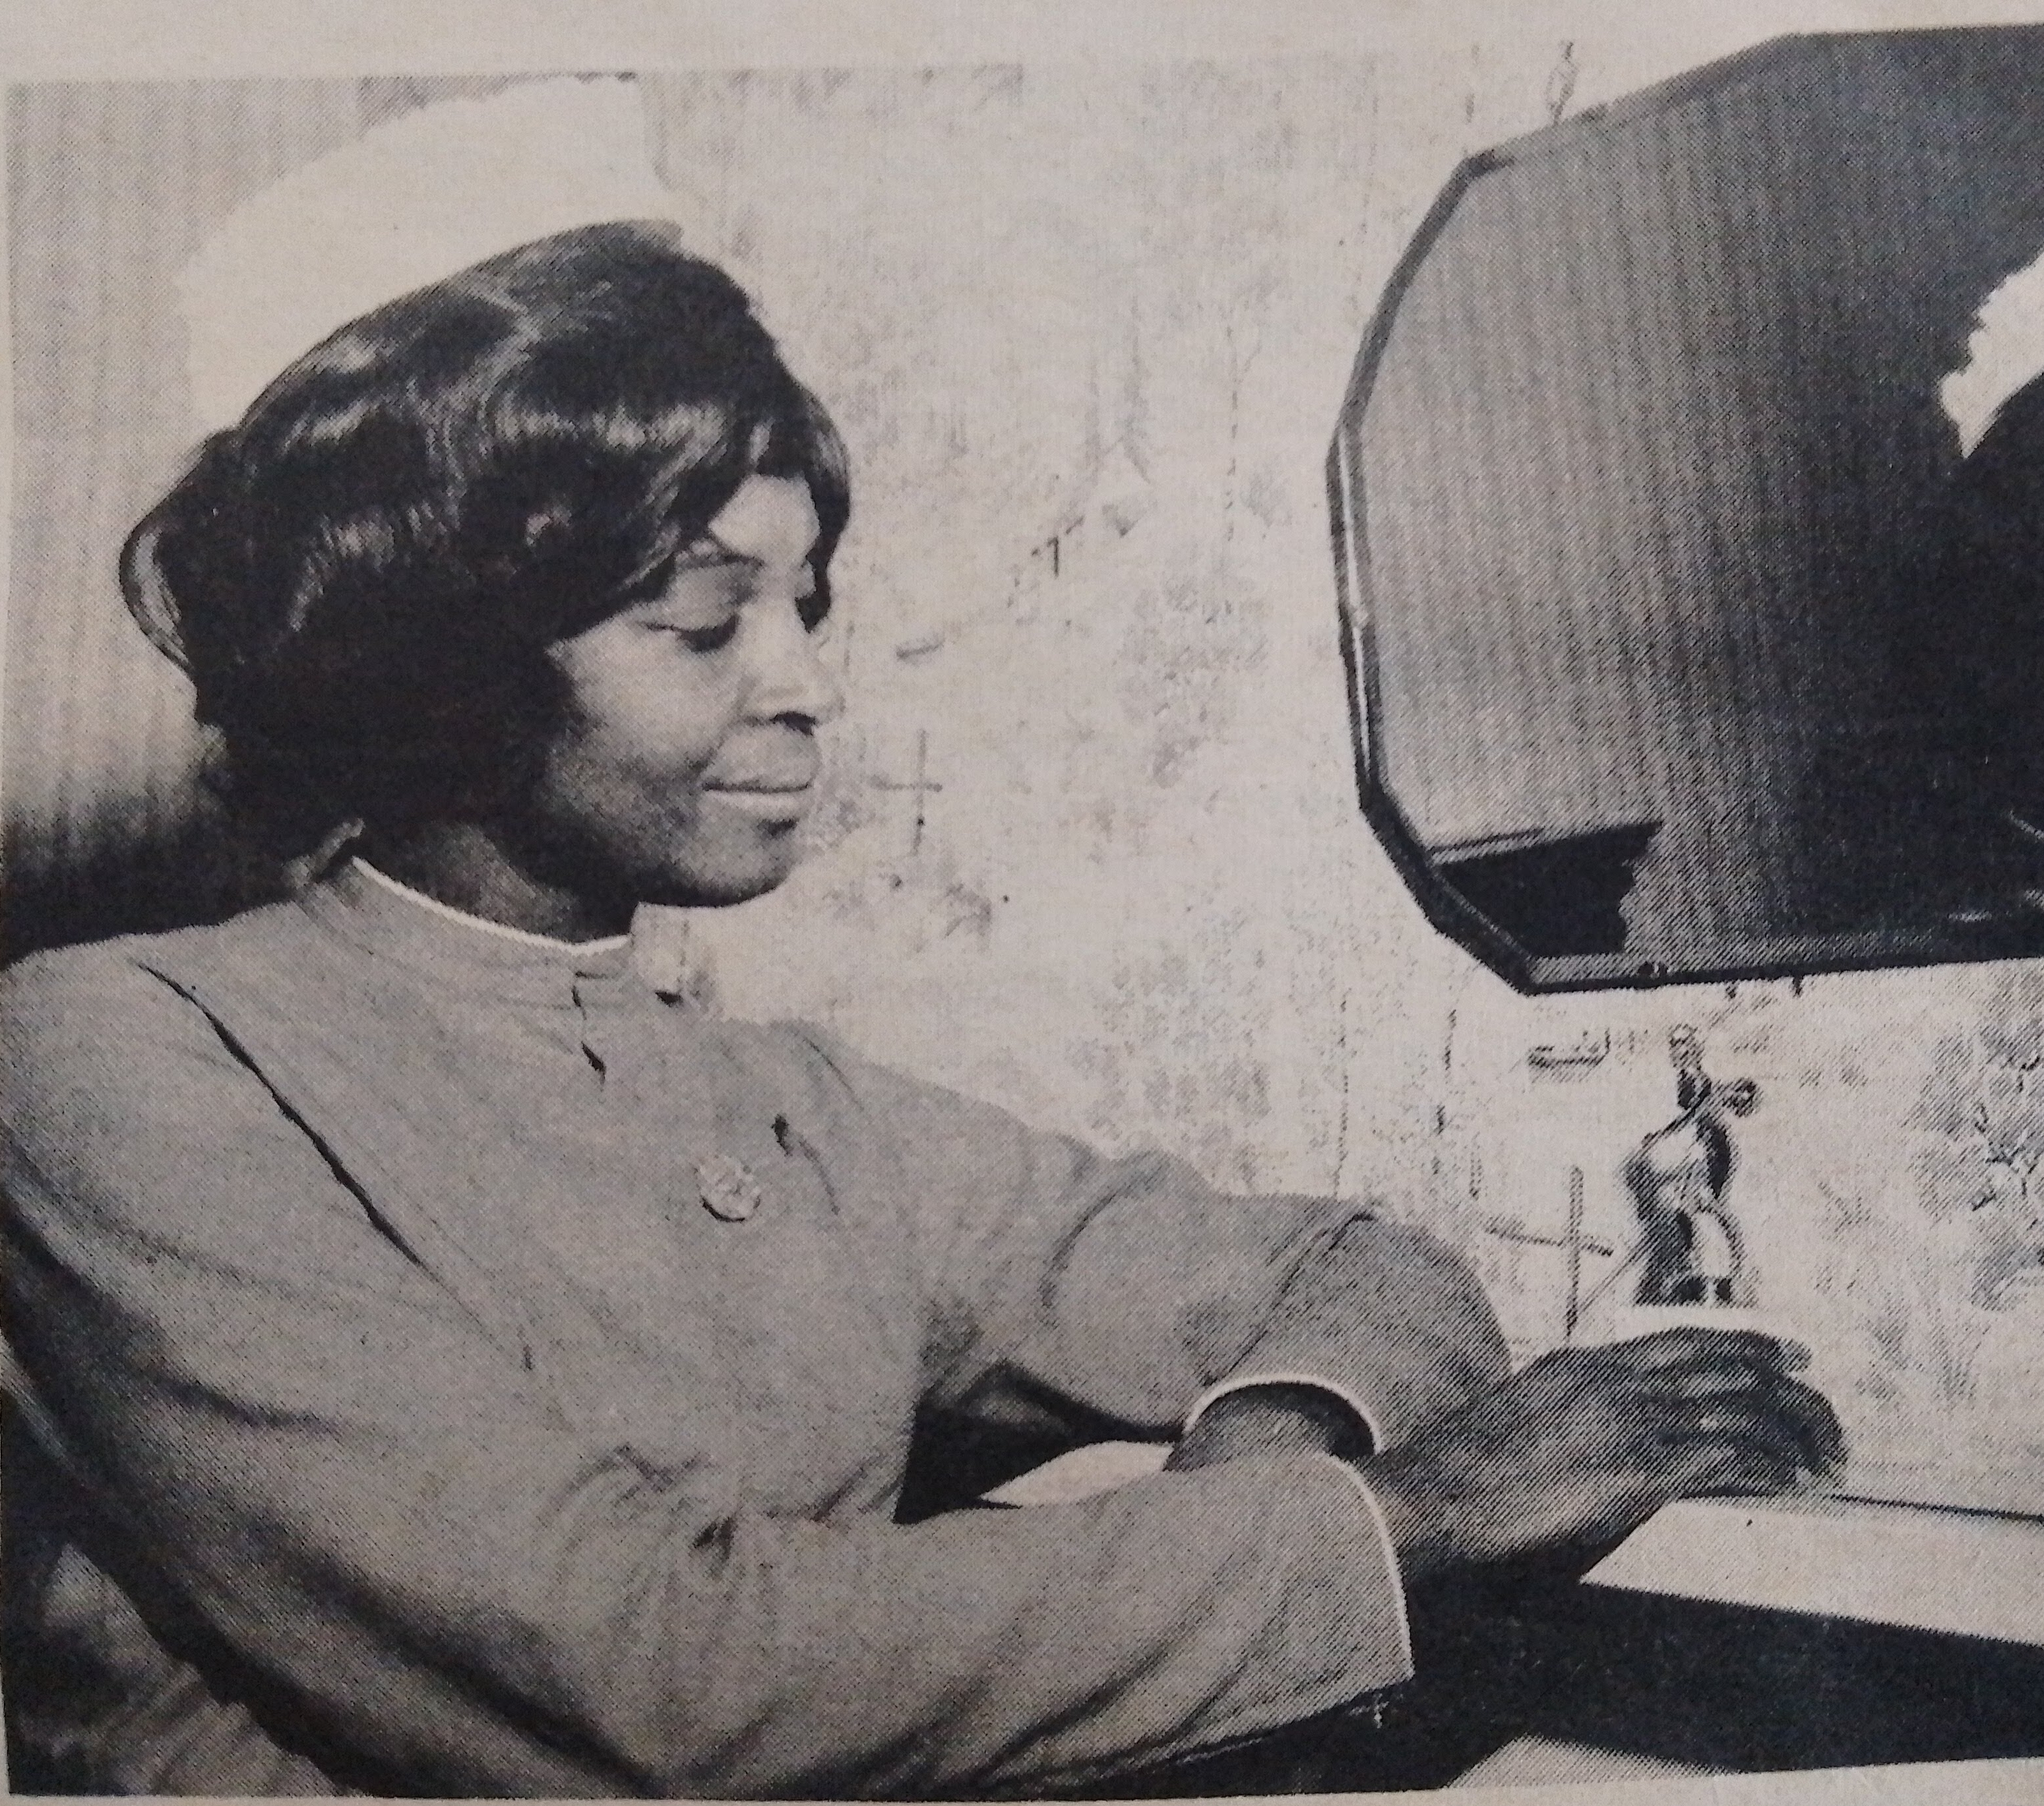
Racial prejudice
Daphne experienced racial prejudice in her work. In a quote for a newspaper article, she recounted that:
‘some people assume I couldn’t possibly be in charge, walk right past me. I’m always slightly on the defensive, but it never bothers me to the extent I’d lose sleep or worry about it’
Daphne at St Winifrid’s
Notes:
Image: © Pulse Magazine
Quote from: (Sunday Times, 22 February 1970).

Slide 52
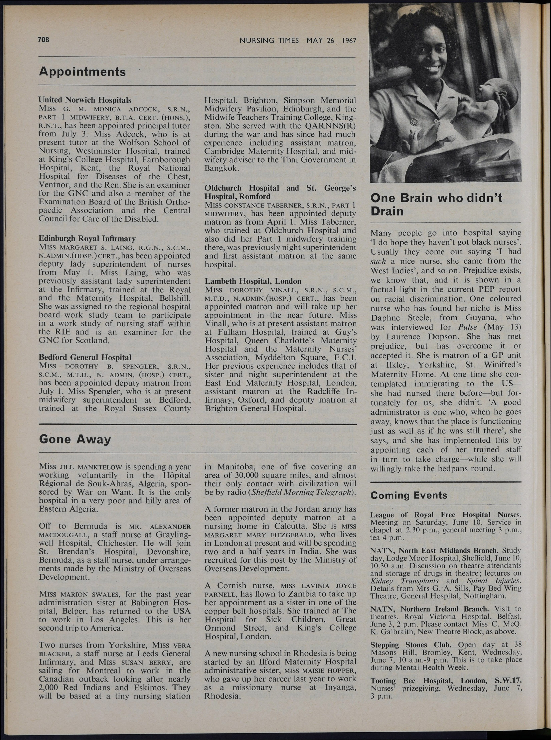

Racial prejudice - Extension
Read this article about Daphne that was published in 1967
What does it tell you about attitudes at the time?
It states that Daphne ‘met prejudice, but has overcome it or accepted it’.
Discuss in groups how this sentence makes you feel and what life must have been like for Daphne at this time.
Nursing Times article
Notes:
Image: Courtesy of Royal College of Nursing Archives
Quote from: (Sunday Times, 22 February 1970).

Slide 53
Page out of 1967 Nursing Times magazine
Notes:
Image: Courtesy of Royal College of Nursing Archives

Slide 54
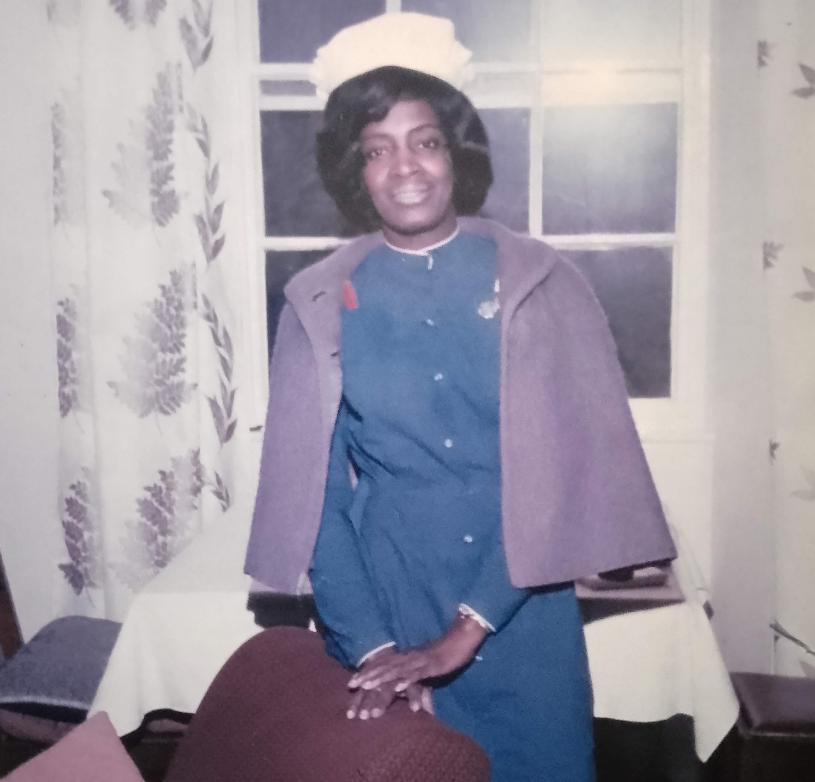
Daphne in Yorkshire 1
In September 1964 Daphne started work and delivered her first baby on 8th October.
She ran the 14-bed hospital and oversaw between 250 and 300 deliveries a year, attending about 10% of the births herself.
Daphne at St Winifred’s
Notes:
Image: Courtesy of the Steele family

Slide 55
Daphne in her own words 2
Daphne loved her time at St Winifred’s:
‘it was such a happy place. I am already seeing the children of the children I delivered … if you live and work in the same town there are advantages.’

Slide 56
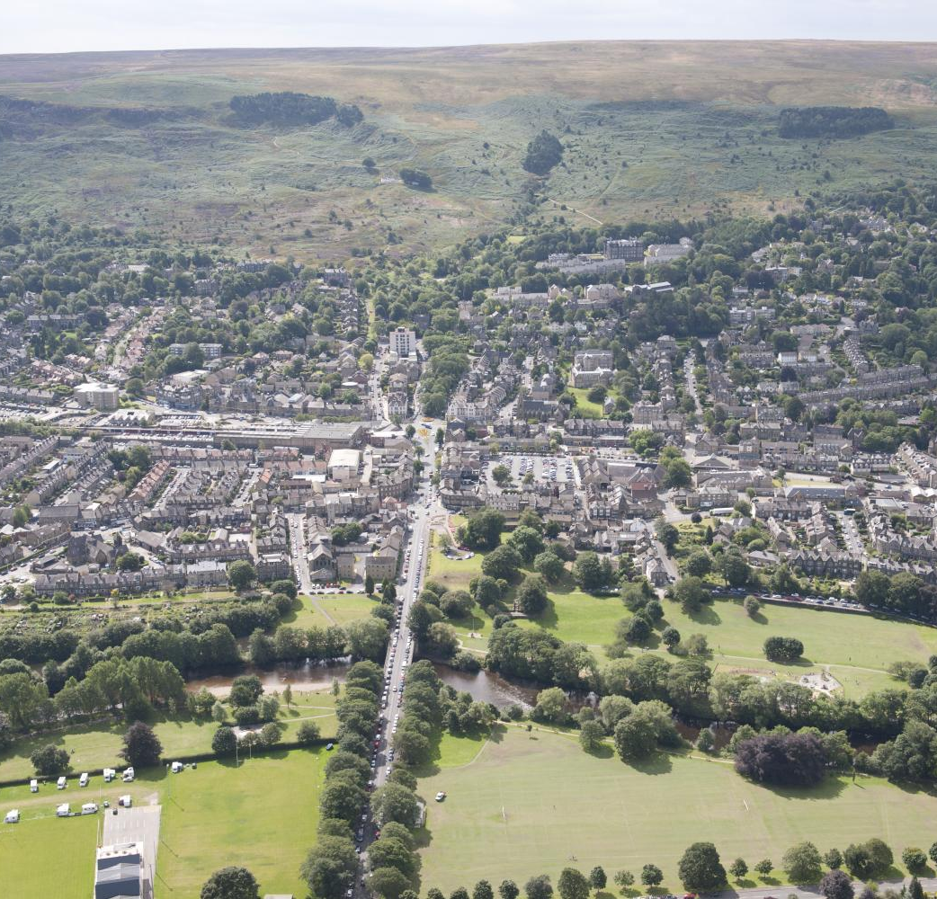
Daphne in Yorkshire 2
Daphne’s son, Robert, later said that when they arrived in Ilkley, the Black population of the town increased by two, to a total of … two.
She was a devout Methodist, committed to worshipping and working at Christchurch, Ilkley.
She remained in Ilkley for the rest of her life.
Ilkley, West Yorkshire
Notes:
Image: © Historic England Archive Ref: 28599_019 Date: 07/008/2014 - https://historicengland.org.uk/images-books/archive/collections/aerial-photos/record/28599_019

Slide 57
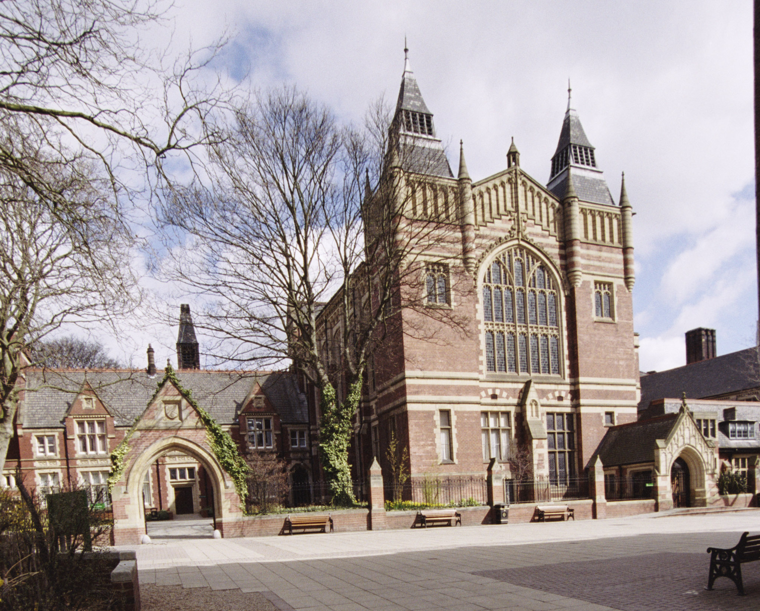
Next steps 1
St Winifred’s closed in 1971 and Daphne found a new job working in a children’s hospital.
However, she decided to retrain at Leeds University to become a health visitor.
Once qualified she worked in Ilkley and Bingley, becoming a familiar and friendly figure to countless families in the area.
Great Hall, University of Leeds
Notes:
Image: © Mr Dennis Carr. Source: Historic England Archive Ref: IOE01/14610/09 Date: 14/04/2006 - https://historicengland.org.uk/images-books/photos/item/IOE01/14610/09

Slide 58
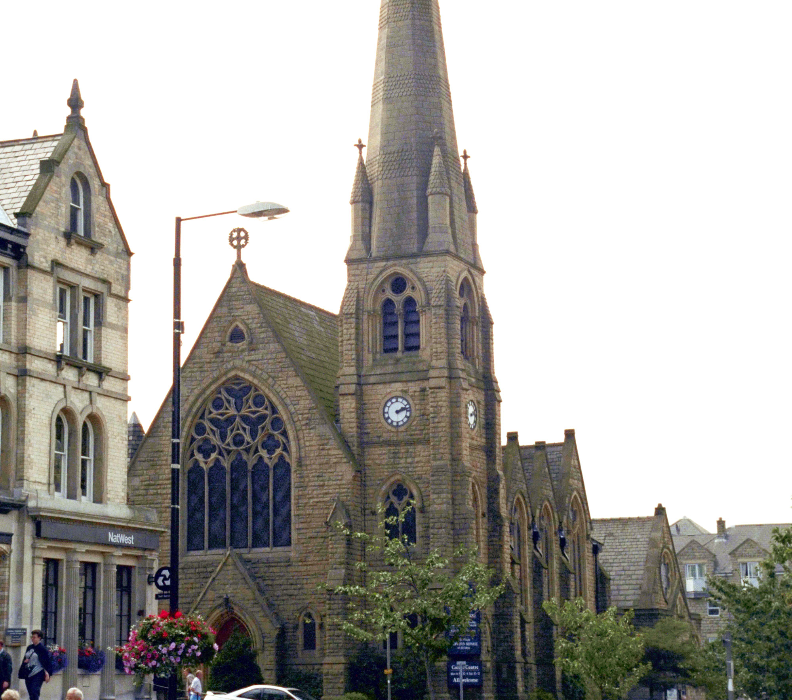
Daphne retires2
Daphne retired in 1987 and devoted more time to her church, serving as steward as well as making regular visits to the sick, elderly and needy.
She often baked large batches of scones or cakes and would leave some on friends’ doorsteps, prompting comments of ‘Daphne’s been round!’.
Christchurch, Ilkley
Notes:
Image: © Mr TE Wright. Source: Historic England Archive Ref: IOE01/00939/12 Date: 01/09/1999 - https://historicengland.org.uk/images-books/photos/item/IOE01/00939/12

Slide 59
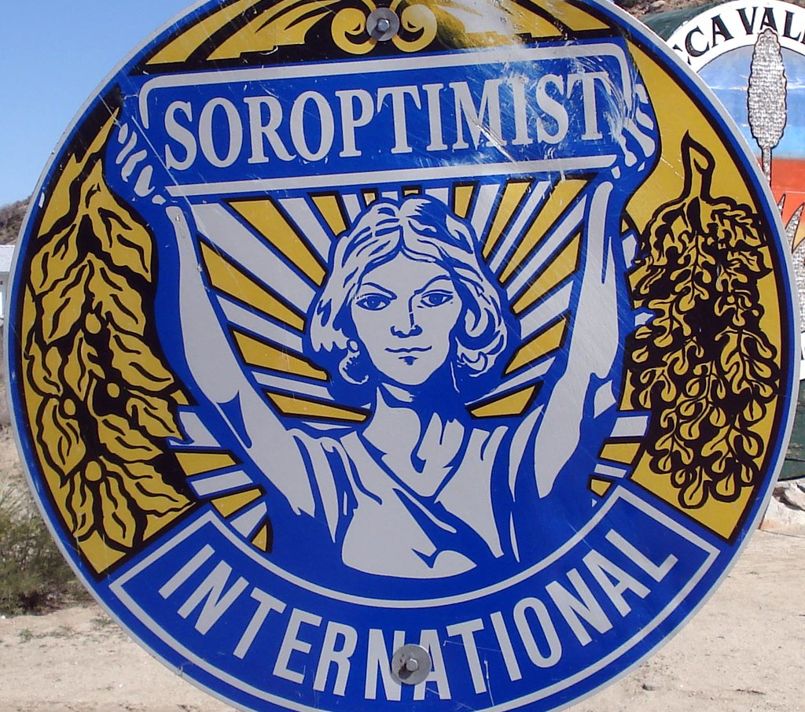
Daphne retires 2
She volunteered for a variety of organisations, such as Soroptomist International - whose aim is to Educate, Empower and Enable opportunities for women and girls around the world.
She was vice president for the Association of Guyanese Nurses and Allied Professionals (AGNAP).
Soroptomist International logo
Notes:
Image: © Tom Magliery Attribution-NonCommercial-ShareAlike (CC BY-NC-SA 2.0) - https://www.flickr.com/photos/mag3737/3738362788

Slide 60

Other achievements 1 1
Her pioneering career prompted many invitations to speak at local groups and schools.
In 2001 Daphne received official recognition of her professional achievement when presented with an award from the Guyanese High Commission, a moment which she described as ‘smashing’.

Slide 61
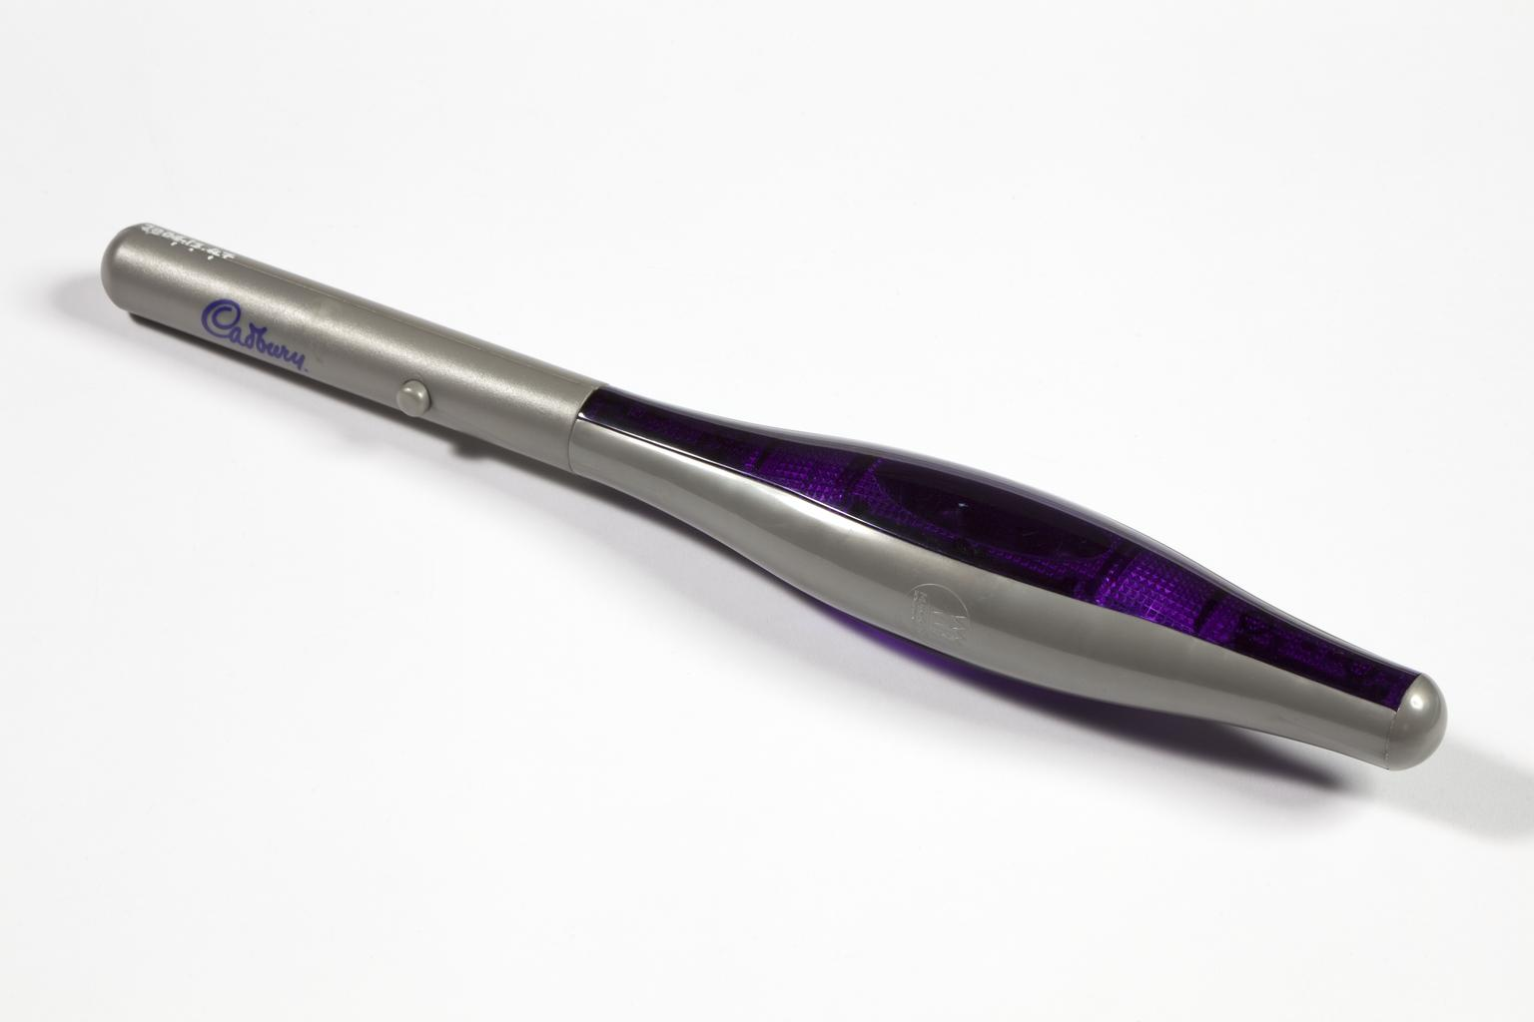
Other achievements 2 2
In 2002 Daphne was chosen to carry the Queen's Jubilee Relay Baton through Shipley.
She said she was ‘mainly doing it for my community, but the fact that I come from a Commonwealth country is good’ .
Queen's Jubilee Relay Baton
Notes:
© The Board of Trustees of the Science Museum
Quote: (Ilkley Gazette, 27 June 2002)

Slide 62
Other achievements 3 2
Sadly, Daphne died suddenly in 2004.
She is remembered fondly by all of her family and friends and with affection by many former patients in and around Ilkley.
Daphne Steele 1927 - 2004
Notes:
Image: © ANL/Shutterstock

Slide 63
Praise for Daphne 1 1
“She helped to shape aspirations for BME (Black and Minority Ethnic) nurses across the profession who sought to follow in her footsteps”
“Daphne led with dignity and determination.”
Notes:
Quotes from Nola Ishmael Former Deputy Director of Nursing at the Department of Health.
Nola Ishmael OBE is a former Department of Health nursing officer and was the first black and minority ethnic (BME) director of nursing in London
https://www.nursingtimes.net/news/hospital/blue-plaque-for-inspirational-nurse-from-windrush-generation-04-10-2018/

Slide 64
Praise for Daphne 2 1
“On becoming Britain’s first Black matron she set new goals for her fellow Windrush nurses and those who followed”
“Decades ahead of her time.”
“A woman of courage with a heart of gold”
Notes:
Quotes from Jak Beula, chief executive of the Nubian Jak Community Trust, who described Ms Steele as “decades ahead of her time”.
Thelma Lewis, president of AGNAP, said of Ms Steele “On becoming Britain’s first Black matron she set new goals for her fellow Windrush nurses and those who followed,”
https://www.nursingtimes.net/news/hospital/blue-plaque-for-inspirational-nurse-from-windrush-generation-04-10-2018/
Her sister, Carmen Munroe, described Daphne as ‘A woman of courage with a heart of gold’

Slide 65
Recognition for Daphne 2
The new Health and Wellbeing Academy at the University of Huddersfield will be named after her
A plaque was put up by the Nubian Jak Community Trust at the site of St James’s Hospital in Balham in 2018
An annual Daphne Steele Day has been inaugurated at St George’s Hospital, Tooting, on her birthday
An Historic England Blue Plaque was put up on the building that was St Winifred’s Hospital

Slide 66
Extension Task: Additional Reflections 1
Reflection:
Look back at Daphne's life. Why might it be described as ‘inspirational’?
Reflection:
What do you think were the key influences in Daphne’s life?

Slide 67
Extension Task: Additional Reflections 2
Reflection:
What barriers did Daphne have to overcome in her life?
Reflection:
What qualities did Daphne have which might have contributed to her success in life?

Slide 68
Extension Task: Make a timeline of Daphne’s Life

Slide 69
Can Daphne be considered a significant person? 1
In groups discuss the criteria in relation to Daphne.
Did she:
make big changes in her lifetime?
make a lot of people’s lives better or worse?
change the way people think about something?
have a lasting impact on her locality, the country or the world?
set a really good/bad example to people of how to live and behave?
Notes:
For this activity we’re using Ian ‘Dawson’s Model’ for significance criteria.

Slide 70
Can Daphne be considered a significant person? 2
In groups discuss the criteria in relation to Daphne.
Did she:
make big changes in her lifetime?
make a lot of people’s lives better or worse?
change the way people think about something?
have a lasting impact on her locality, the country or the world?
set a really good/bad example to people of how to live and behave?
Use the chart provided to document your discussions
Notes:
For this activity we’re using Ian ‘Dawson’s Model’ for significance criteria.

Slide 71
Can Daphne be considered a significant person? 3
Action | Evidence
Made big changes in her lifetime
Made a lot of people’s lives better or worse
Changed the way people thought
Had a lasting impact on her locality, the country or the world
Set a really good/bad example to people of how to live and behave
Notes:
For this activity we’re using Ian ‘Dawson’s Model’ for significance criteria.

Slide 72
Can Daphne be considered a significant person? 4
Action | Evidence
Made big changes in her lifetime
Made a lot of people’s lives better or worse
Changed the way people thought
Had a lasting impact on her locality, the country or the world
Set a really good/bad example to people of how to live and behave
Notes:
For this activity we’re using Ian ‘Dawson’s Model’ for significance criteria.

Slide 73
Can Daphne be considered a significant person? 5
What did you decide?
Notes:
For this activity we’re using Ian ‘Dawson’s Model’ for significance criteria.

Slide 74
St Winifred's Maternity Home
Do you recognise this building from our starter activity?
This is the building where Daphne worked as a matron. At the time it was called St Winifred's Maternity Home. ​
Before being a maternity home, it was a boarding house called 'Hillside'.
St Winifred's Maternity Home
Notes:
Image: © Google Maps 2024

Slide 75
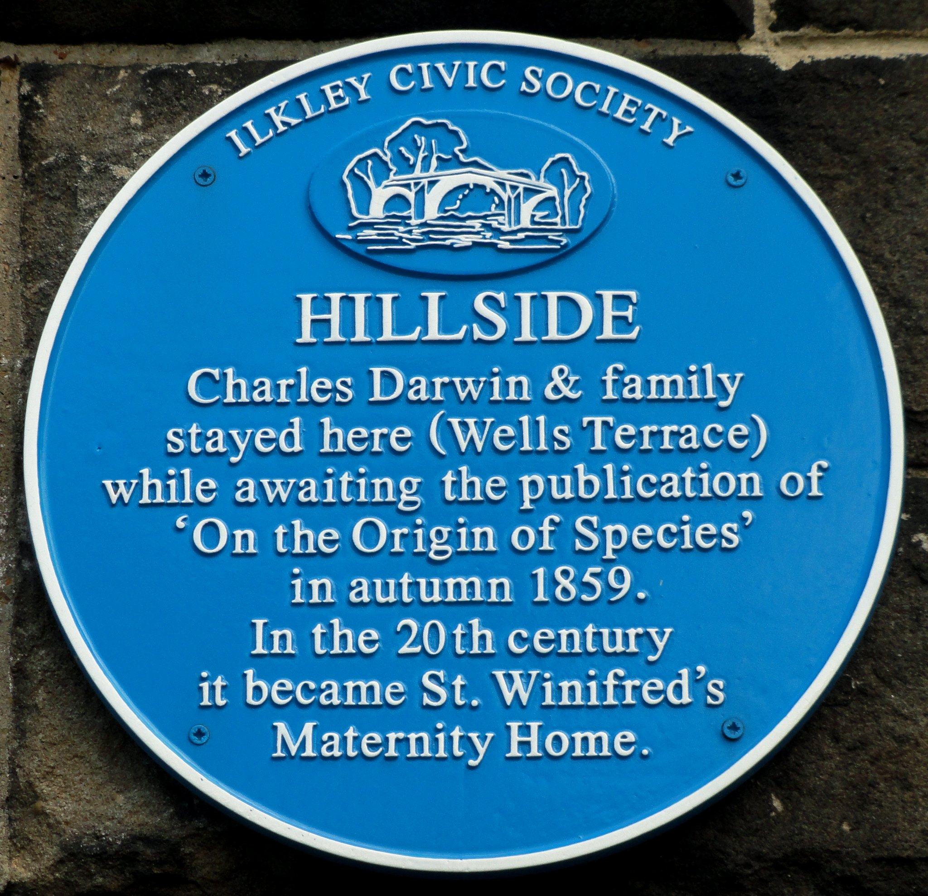
St Winifred's Maternity Home 2
Ilkley at the time was one of the country's leading spa towns. Many of its visitors came to enjoy its natural spring waters.
One famous visitor was the scientist Sir Charles Darwin.
A plaque commemorates Charles’ stay at nearby in North House in 1859 – while he awaiting the publication of ‘On the Origin of Species’
Civic Society Plaque
Notes:
Image: © Google Maps 2024
Peter Hughes - Attribution-NonCommercial-ShareAlike (CC BY-NC-SA 2.0) - https://www.flickr.com/photos/sgwarnog/9509790347

Slide 76
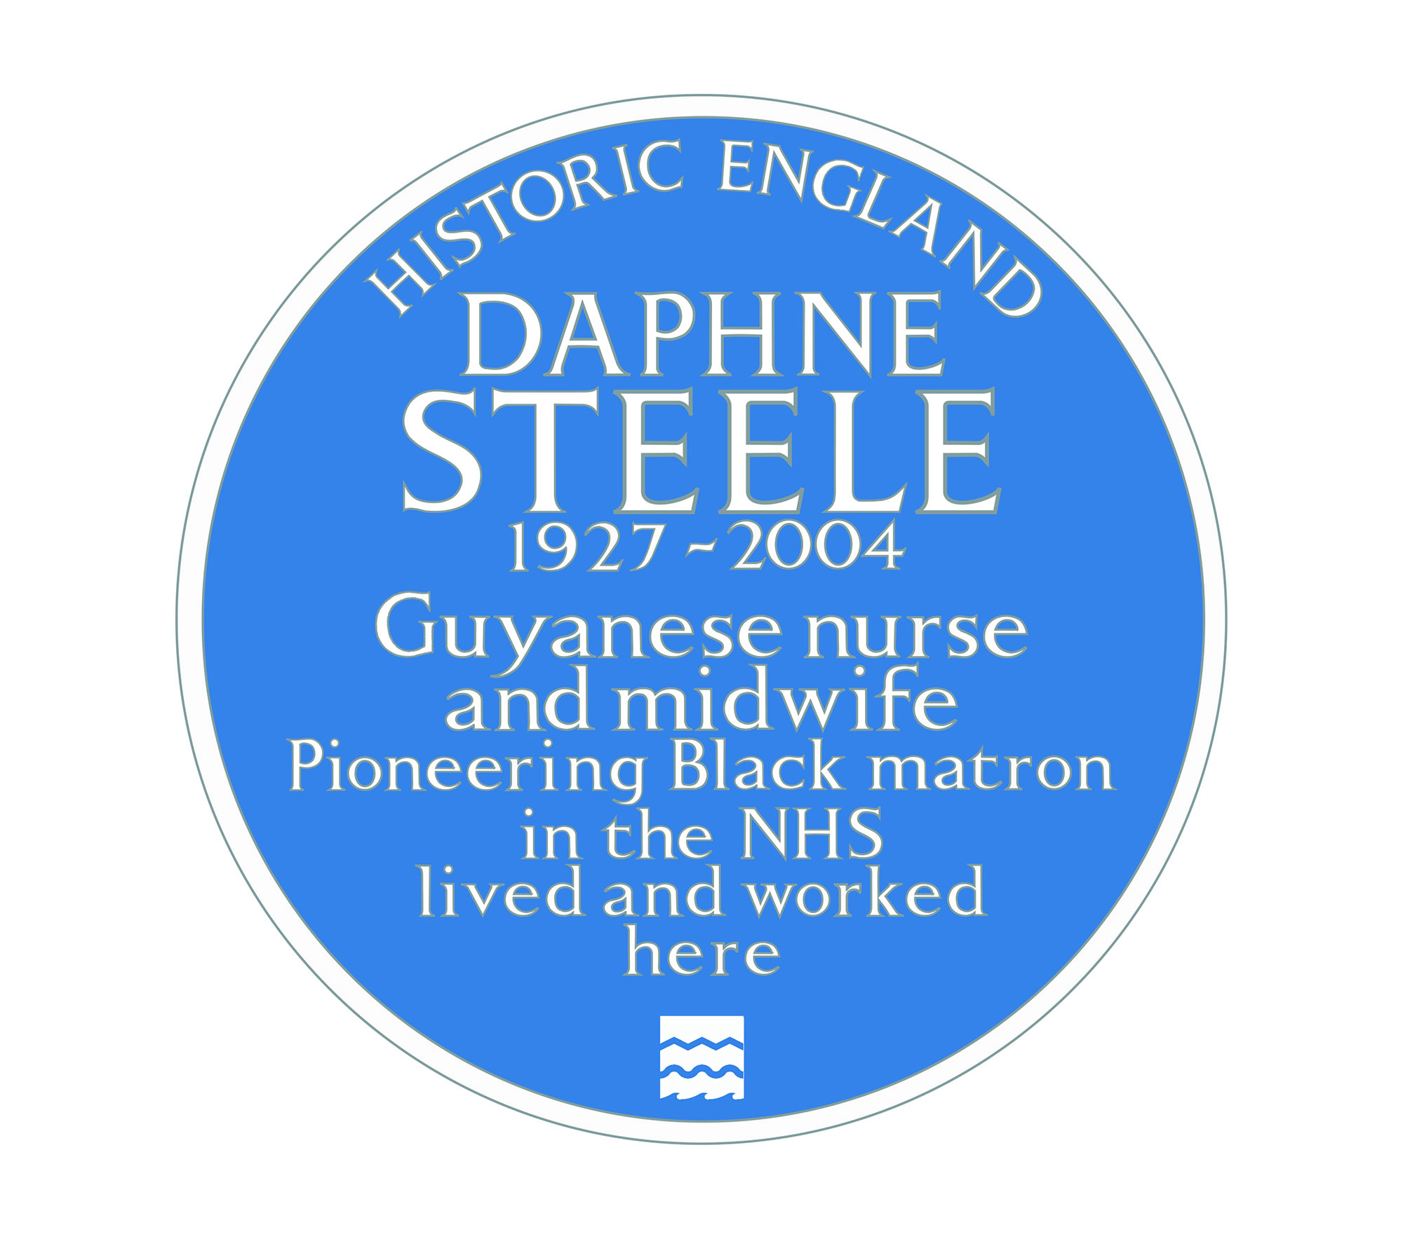
St Winifred's Maternity Home 32
When the hospital closed, the building was taken over by Ilkley College before being converted into flats.​
Today the building has a blue plaque to mark the place where Daphne worked as matron and to commemorate her achievement.
Historic England Blue Plaque
Notes:
Image: Courtesy Historic England

Slide 77


Create a word cloud to celebrate Daphne’s life
Notes:
Ask pupils to think of words to reflect Daphne and her life, then pop them into a free online Word Cloud generator such as: https://www.presentermedia.com/wordclouds or alternatively they could draw/create their own having been shown the examples of what a word cloud looks like
Image: Screenshot from https://www.presentermedia.com/wordclouds

Slide 78
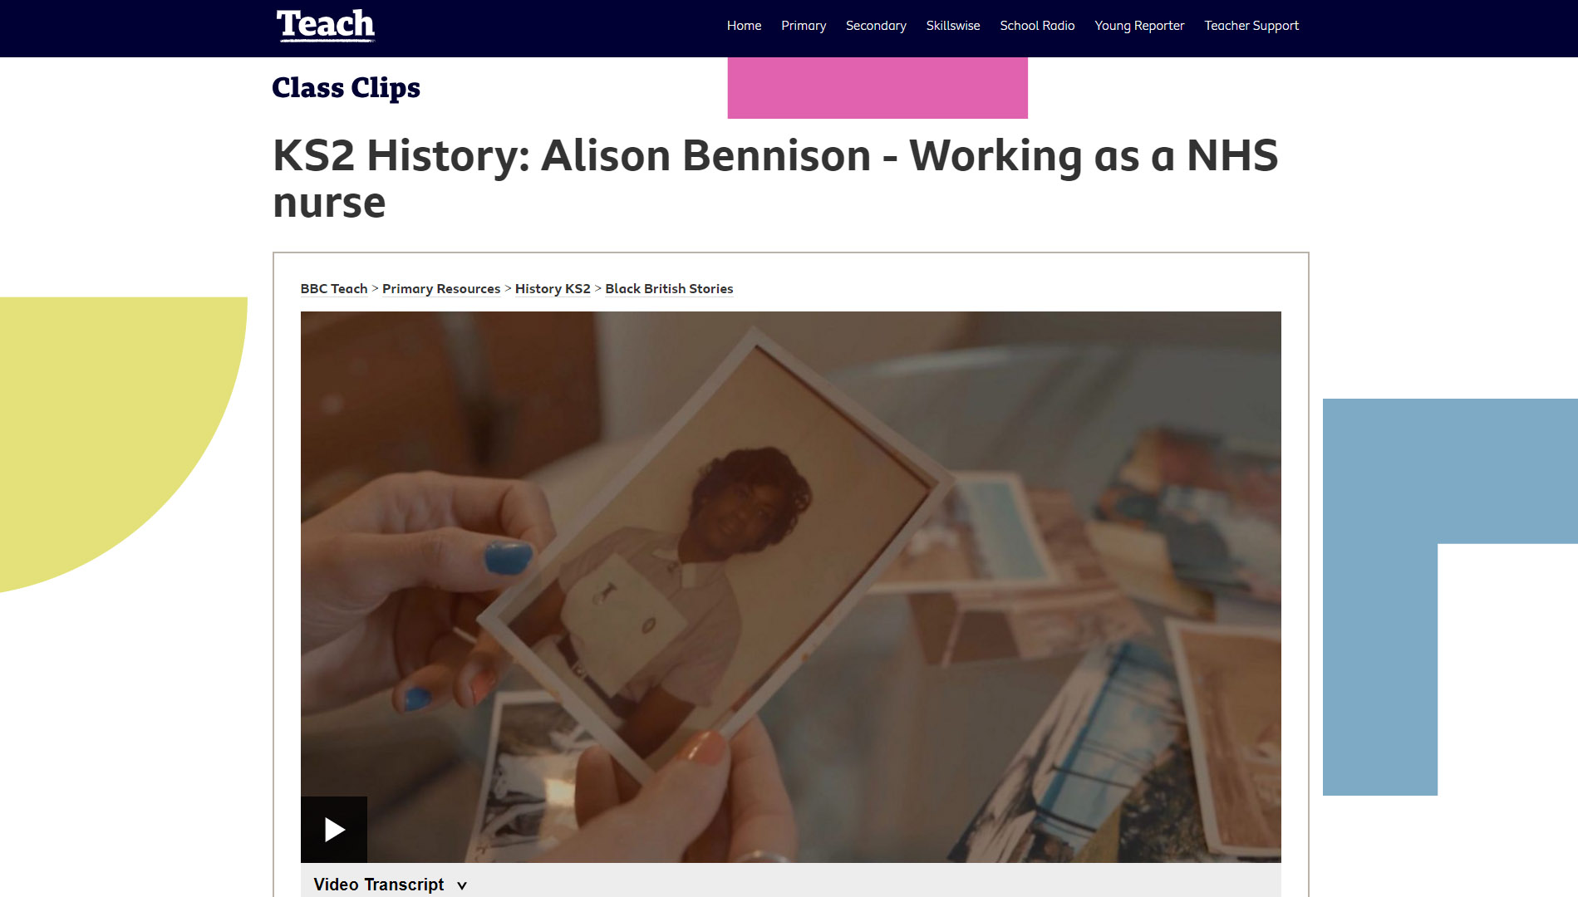
Find out about other NHS Nurses like Daphne
Research
This short film is from the BBC Teach series, Black British Stories
Notes:
Alison Bennison - Working as a NHS nurse: https://www.bbc.co.uk/teach/class-clips-video/history-ks2-black-british-stories-alison-bennison/zs9cbqt
Black British Stories: https://www.bbc.co.uk/teach/class-clips-video/history-ks2-black-british-stories/z3w84xs
Image: Screenshot from https://www.bbc.co.uk/teach/class-clips-video/history-ks2-black-british-stories-alison-bennison/zs9cbqt

