Slide 1
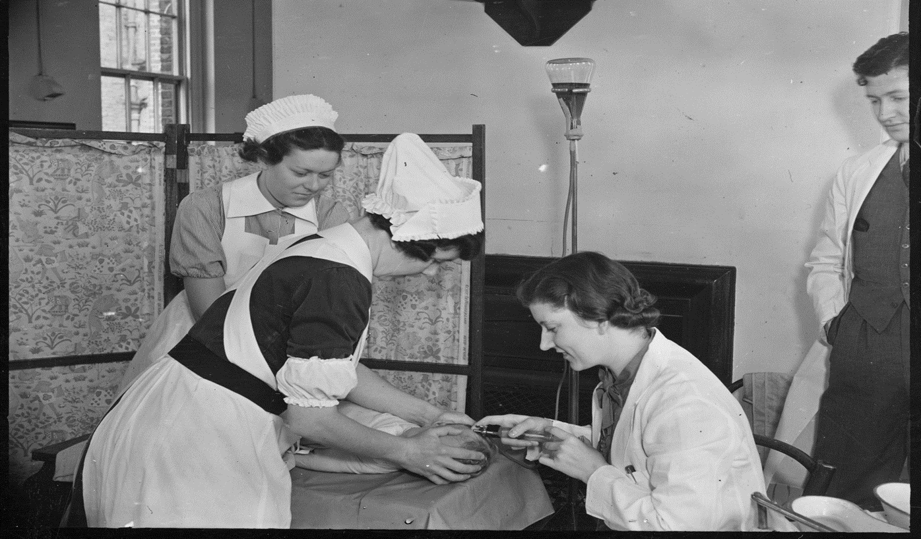
To what extent was the Second World War (1939-45) a factor in the development of medical and surgical knowledge?
To what extent was the Second World War (1939-45) a factor in the development of medical and surgical knowledge?
Notes:
Image: Source: Historic England Archive Ref: MED01/01/0516 Date: 11 Aug 1939 - https://historicengland.org.uk/images-books/photos/item/MED01/01/0516

Slide 2
To what extent was the Second World War (1939-45) a factor in the development of medical and surgical knowledge?
Key Stage 3 and 4: History
Learning Aims and Outcomes
Students will examine medical techniques developed in the Second World War.
Students will be able to use evidence to evaluate the importance of war as a factor on the advancement of medicine and health
Students will be able to demonstrate skills in selecting evidence and collaborative learning.
Students will have a more secure basis on which to judge the impact of war on the advancement of medicine and health.
Relates to: Edexcel Medicine Through Time and AQA Health and the People.
This PPT relates to the Teaching Activity: To what extent was the Second World War a factor in the development of medical knowledge?

Slide 3


To what extent was the Second World War (1939-45) a factor in the development of medical and surgical knowledge? 1
Key Stage 3 and 4: History
Learning Aims and Outcomes
Students will examine medical techniques developed in the Second World War.
Students will be able to use evidence to evaluate the importance of war as a factor on the advancement of medicine and health
Students will be able to demonstrate skills in selecting evidence and collaborative learning.
Students will have a more secure basis on which to judge the impact of war on the advancement of medicine and health.
Relates to: Edexcel Medicine Through Time and AQA Health and the People.
This PPT relates to the Teaching Activity: To what extent was the Second World War a factor in the development of medical knowledge?
Content Warning
This presentation contains graphic images of medical conditions. It also shows the original captions used for images, some of which might now be considered to include inappropriate terminology for medical conditions.

Slide 4


Picture reveal activity
I am going to reveal a picture to you – slowly.
What do you think is happening in the image?
Where do you think it is?
When do you think this was?
What questions could we ask as historians to find out more?
Look

Slide 5
Photo 1
Notes:
Image: Source: Historic England Archive Ref: MED01/01/0516 Date: 11 Aug 1939 - https://historicengland.org.uk/images-books/photos/item/MED01/01/0516

Slide 6
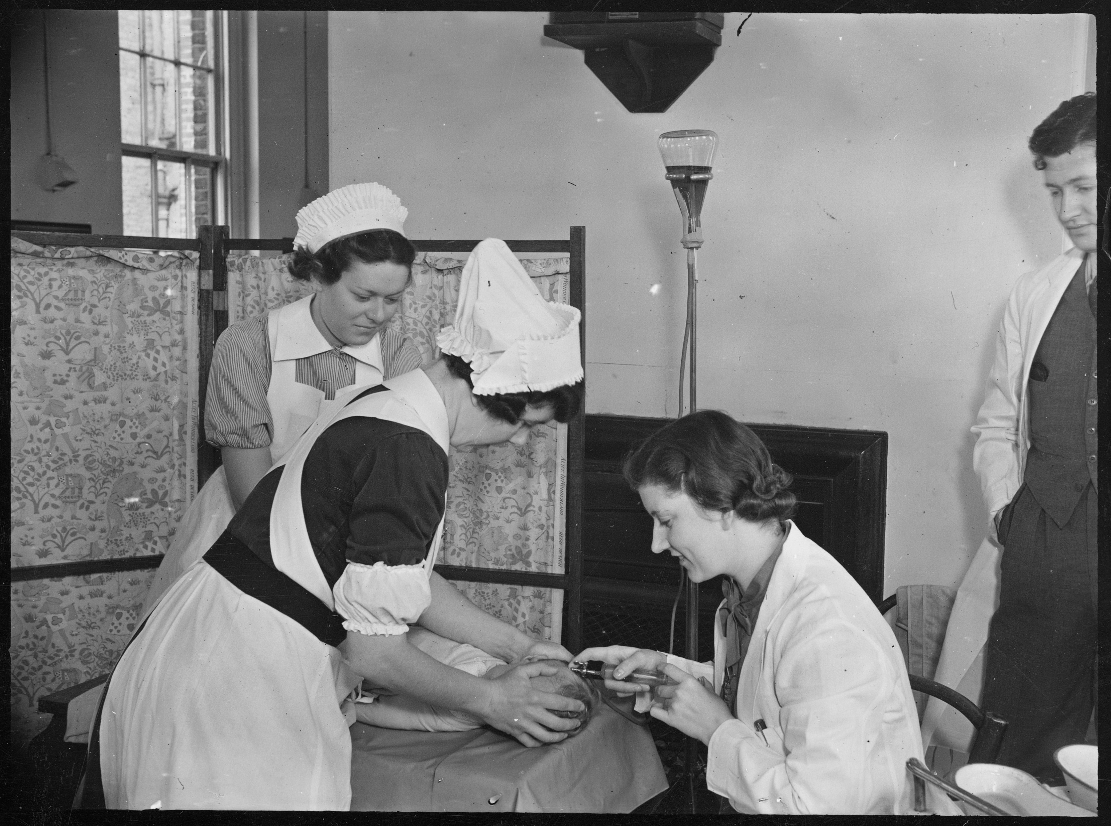

Photo 2
Taking the baby’s temperature?
Cleaning the
baby’s ears?
Notes:
Image: Source: Historic England Archive Ref: MED01/01/0516 Date: 11 Aug 1939 - https://historicengland.org.uk/images-books/photos/item/MED01/01/0516

Slide 7
Photo 3
This picture was taken on 11th August 1939
and it shows a method of blood transfusion.
Notes:
Image: Source: Historic England Archive Ref: MED01/01/0516 Date: 11 Aug 1939 - https://historicengland.org.uk/images-books/photos/item/MED01/01/0516

Slide 8
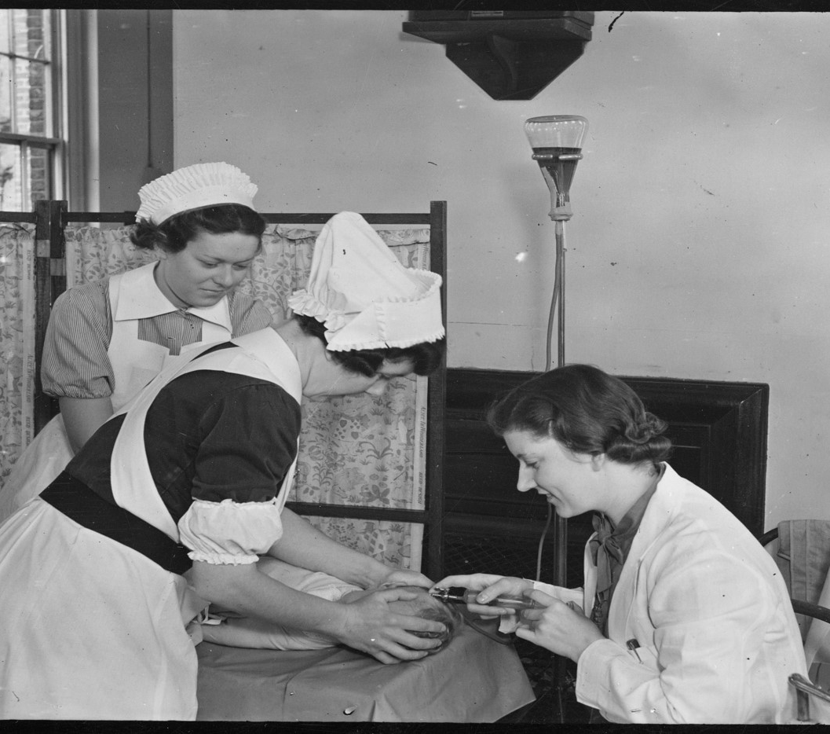

Procedure of blood transfusion
Blood supply
The patient is mummified (wrapped up) with a blanket to keep the arms by the side and laid flat on the back with a hot water bottle on either side. Pressure is placed on the vein and a two way-syringe is inserted and blood is pumped from a container on a stand. This baby is 10 months old.
Notes:
Image: Source: Historic England Archive Ref: MED01/01/0516 Date: 11 Aug 1939 - https://historicengland.org.uk/images-books/photos/item/MED01/01/0516

Slide 9

Activity 1
Think about the photo
whilst you hear Brian Ford’s view:
What are the greatest blessings
he refers to?
“If any good can be said to come of war,
then the Second War must go on record
as assisting and accelerating
one of the greatest blessings that the
20th Century has conferred on Man”
Brian J Ford.
Notes:
Read out the quote to students and ask them what they think about Brian Ford’s ideas

Slide 10

Activity 2
Why might war have created
a great blessing?
What connections can we make
with our ideas
and the starter image?

Slide 11

Brian J Ford statement
“If any good can be said to come of war, then the Second War must go on record as assisting and accelerating one of the greatest blessings that the 20th Century has conferred on Man – the huge advances in medical knowledge and surgical techniques.”
Brian J Ford.
Notes:
Read out the quote to students and ask them what they think about Brian Ford’s ideas

Slide 12


Group Work
You are now going to split into 4 groups with each group
researching a different aspect of medical knowledge
and surgical techniques. Your challenge is to investigate the following using the information provided:
What development occurred in World War Two?
Why did the development occur?
How did it advance medical and surgical techniques and practices?
How might it have affected medicine after the war ended
(e.g. Use in general practice and the NHS)?
Write all your findings in the section of your worksheet that you are researching.
Group work
Research

Slide 13
Activity 3
Army Blood Supply Depot | Blood Plasma
Treatment of burns victims | Infection
Notes:
Make sure students leave the central box empty at this stage

Slide 14
The Army Blood Supply Depot
In 1938, a Spanish man, Frederic Durán-Jordà had escaped to Britain as a result of the Spanish Civil War, he had previously established a blood bank in Barcelona that helped the wounded during the Spanish conflict. When he arrived in Britain, he worked with Dr Janet Vaughan at the Royal Postgraduate Medical School at Hammersmith Hospital. They worked together to create a system of national blood banks in London. By 1938 it was clear that war was going to happen and as a result the War Office decided to created the Army Blood Supply Depot (ABSD) which was responsible for four large blood depots around the country.
In America it had been decided that to provide blood on the front line they would take blood donations from the troops at the front. Britain decided to take a different policy and took blood from these depots to supply Military Personnel this way. 700,000 donors provided blood during the war and as a result it was very effective in providing a blood supply for the military. Consequently, the success of this then developed into the National Blood Transfusion Service which was set up in 1946.
Notes:
Army blood supply depot – use alongside slides 14 and 16

Slide 15
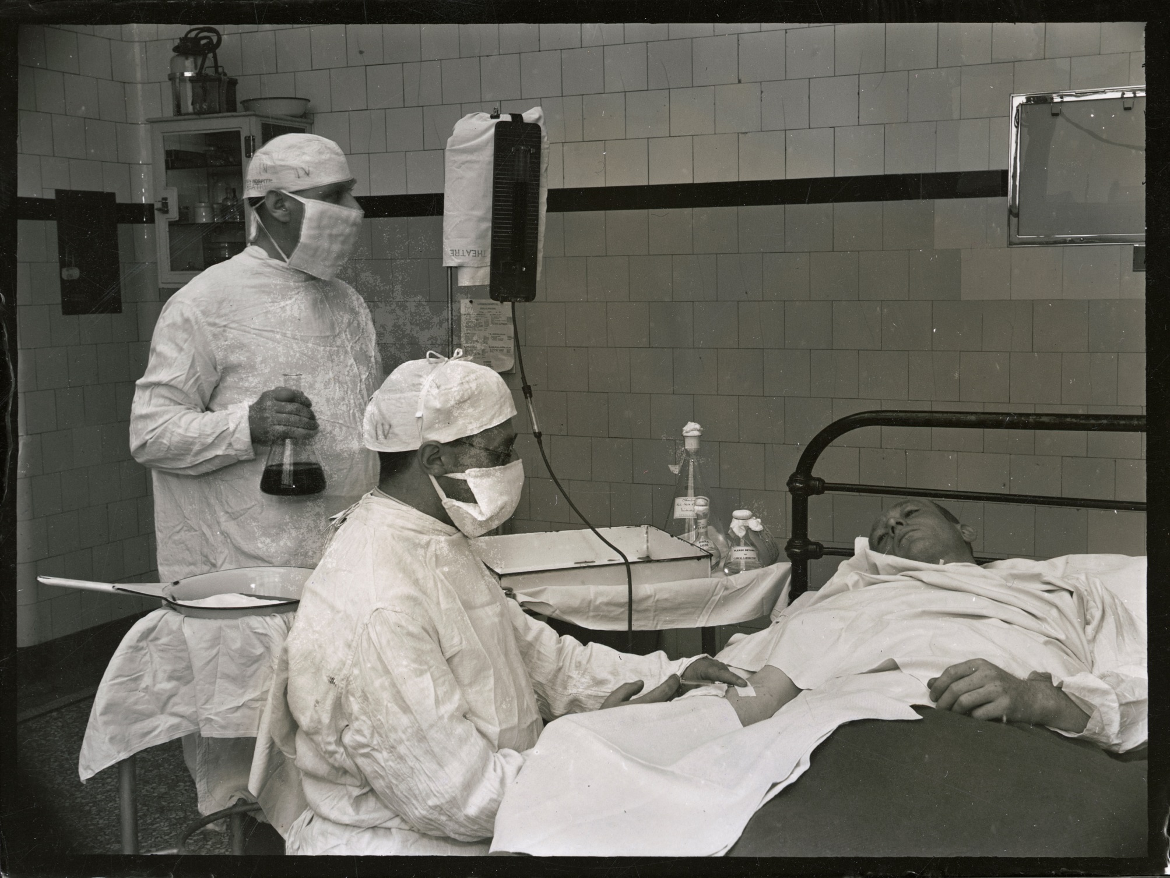
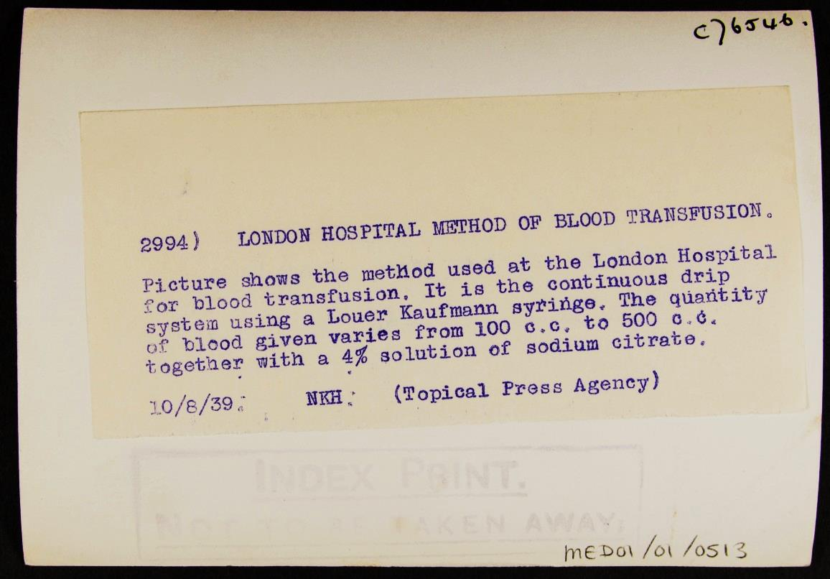
Photo 4
Notes:
Image: Source: Historic England Archive Ref: MED01/01/0513 Date: 10 Aug 1939 - https://historicengland.org.uk/images-books/photos/item/MED01/01/0513

Slide 16
Additional image information 1
Patient having a blood transfusion, London Hospital, Whitechapel Road, Whitechapel, Greater London
Two doctors giving a patient a blood transfusion at the London Hospital. The earliest known blood transfusion was attempted in 1628. In 1665 the first successful blood transfusion was recorded, after a doctor transfused blood between dogs, but it was not until 1818 that the first successful transfusion of human blood was recorded. Both the discovery of human blood groups in 1901 and of the Rhesus blood group system in 1939 made transfusions far safer. Anticoagulants such as sodium citrate were found to preserve blood during WWI. Along with refrigeration, this made blood banks and blood transportation viable; previously, blood had to be transfused from donor to patient before coagulation.

Slide 17
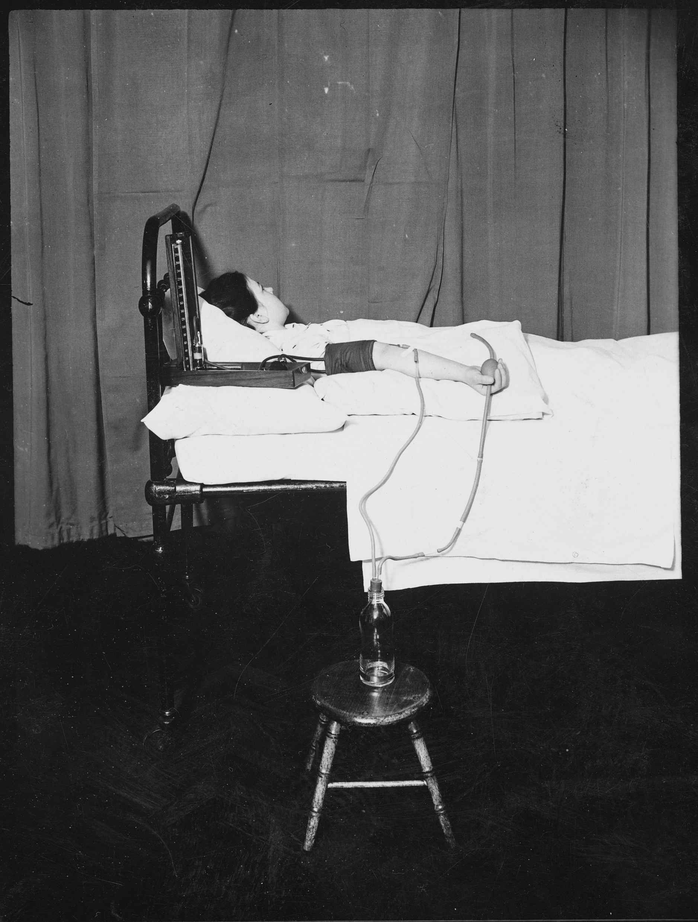
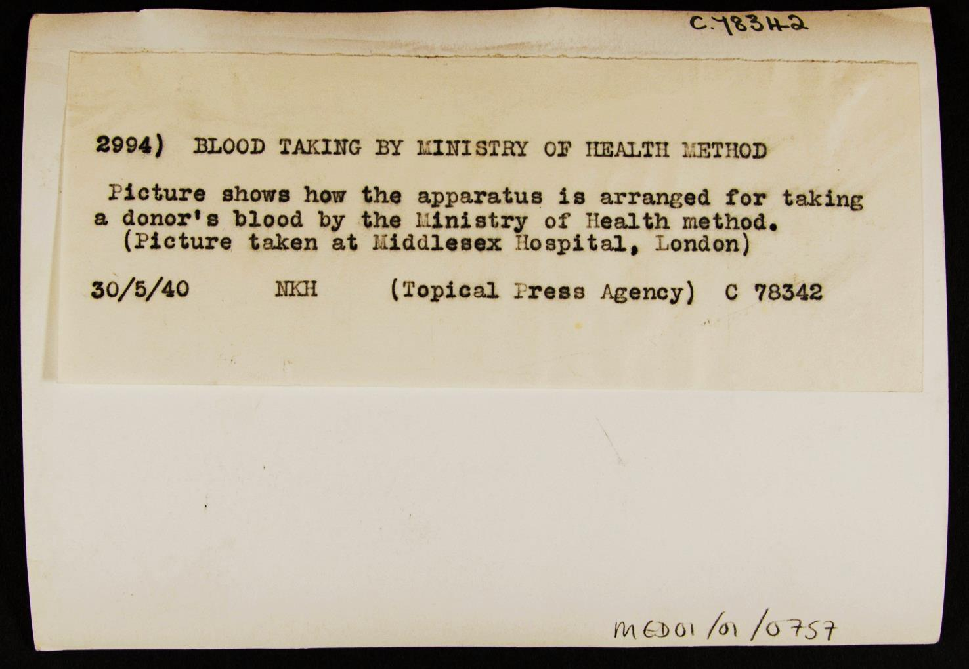
Photo 5
Notes:
Image: Source: Historic England Archive Ref: MED01/01/0757 Date: 30 May 1940 - https://historicengland.org.uk/images-books/photos/item/MED01/01/0757

Slide 18
Additional image information 2
Blood taking using Ministry of Health method, Middlesex Hospital, Mortimer Street, Westminster, Greater London
This shows how equipment was arranged for taking a donor’s blood by the Ministry of Health method. A “blood depot”, the predecessor modern blood banks, was established during World War One in order to store blood for wounded troops. In anticipation of civilian causalities, before the outbreak of World War Two four depots were established in the English Home Counties to collect, store, and distribute blood for air raid casualties. The National Blood Transfusion Service was later set up in 1946 under the control of the Ministry of Health.

Slide 19
Blood Plasma
The need for blood stores during the war was essential to help the injured and reduce fatalities. The use of blood plasma instead of whole blood for transfusions had been raised many years before, but it wasn’t until the start of the Second World War that plasma started to be used. Liquid plasma had been used at the start of the war but in August 1940 it was discovered that you could dehydrate blood to make dried plasma. This made it easier to store and transport and reduced breakages of containers (a problem in transporting liquid blood plasma) and by the later stages of the war, plastic wallets replaced bottles. By combining the dried plasma with distilled water, the plasma could be ready in around 3 minutes and once combined it had to be used within 4 hours.
In the early 1940s a “Blood for Britain” programme was launched in America collecting blood donations from citizens of New York to export to Britain. By the end of the war, America had provided enough blood for over 6 million plasma packages. Any surplus at the end of the war was returned to the USA for use by citizens. New techniques were later developed in the 1950s and dried blood plasma became replaced.
Notes:
Plasma and storage – use alongside slides 19 and 21

Slide 20
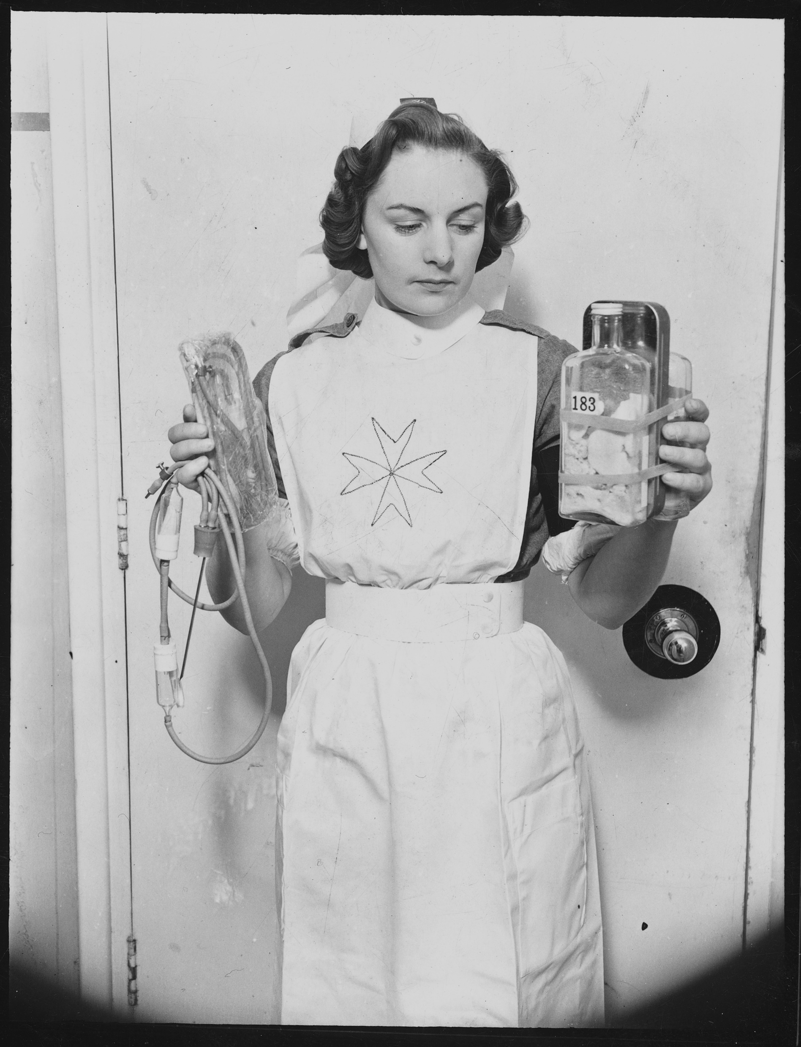
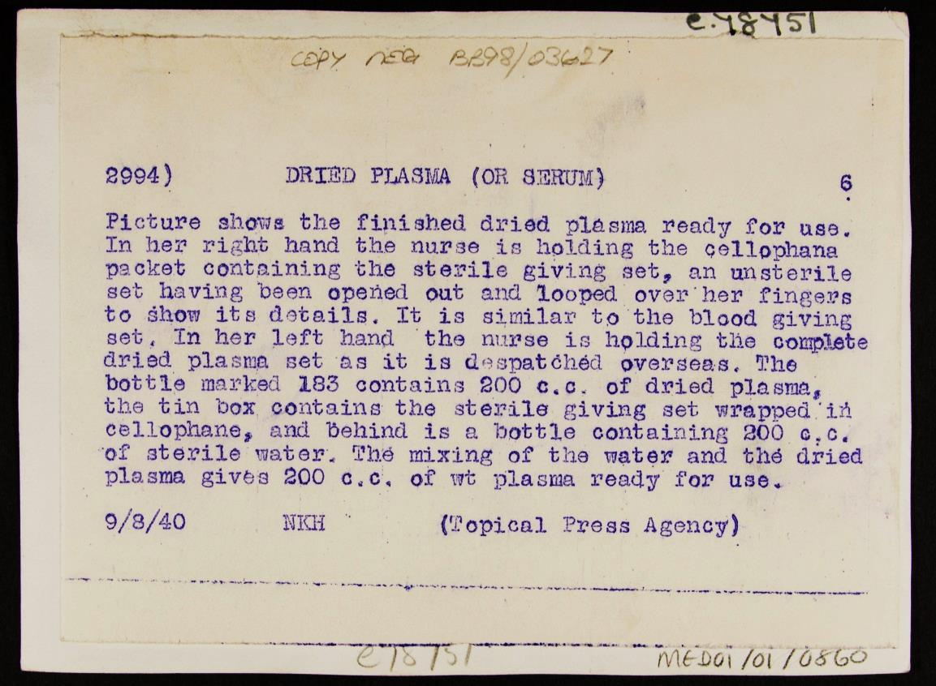
Photo 6
Notes:
Image: Source: Historic England Archive Ref: MED01/01/0860 Date: 9 Aug 1940 - https://historicengland.org.uk/images-books/photos/item/MED01/01/0860

Slide 21
Additional image information 3
Nurse holding equipment needed for a blood transfusion, Army Blood Supply Depot, Southmead Hospital, Southmead Road, Bristol
A nurse holding equipment for the transfusion of serum, and a dried plasma set consisting of dried plasma, equipment for transfusion, and sterile water, both used for giving blood transfusions. The mixing of the sterile water and the dried plasma gives 200 c.c. of plasma ready for use in a blood transfusion. The Army Blood Supply Depot, based at Southmead Hospital, was established in 1938 and began collecting blood from local donors in summer 1939. During the campaign in France in 1940, the Army Blood Supply Depot provided nearly all the blood and plasma required. Donated blood could be exchanged between the civilian and military blood depots, but the two services drew blood from separate pools of donors. Britain’s blood depot, established during WWI, and its fully functioning transfusion service pre-war meant that the transfusion service of the British army was well-organised compared to other armed forces.

Slide 22
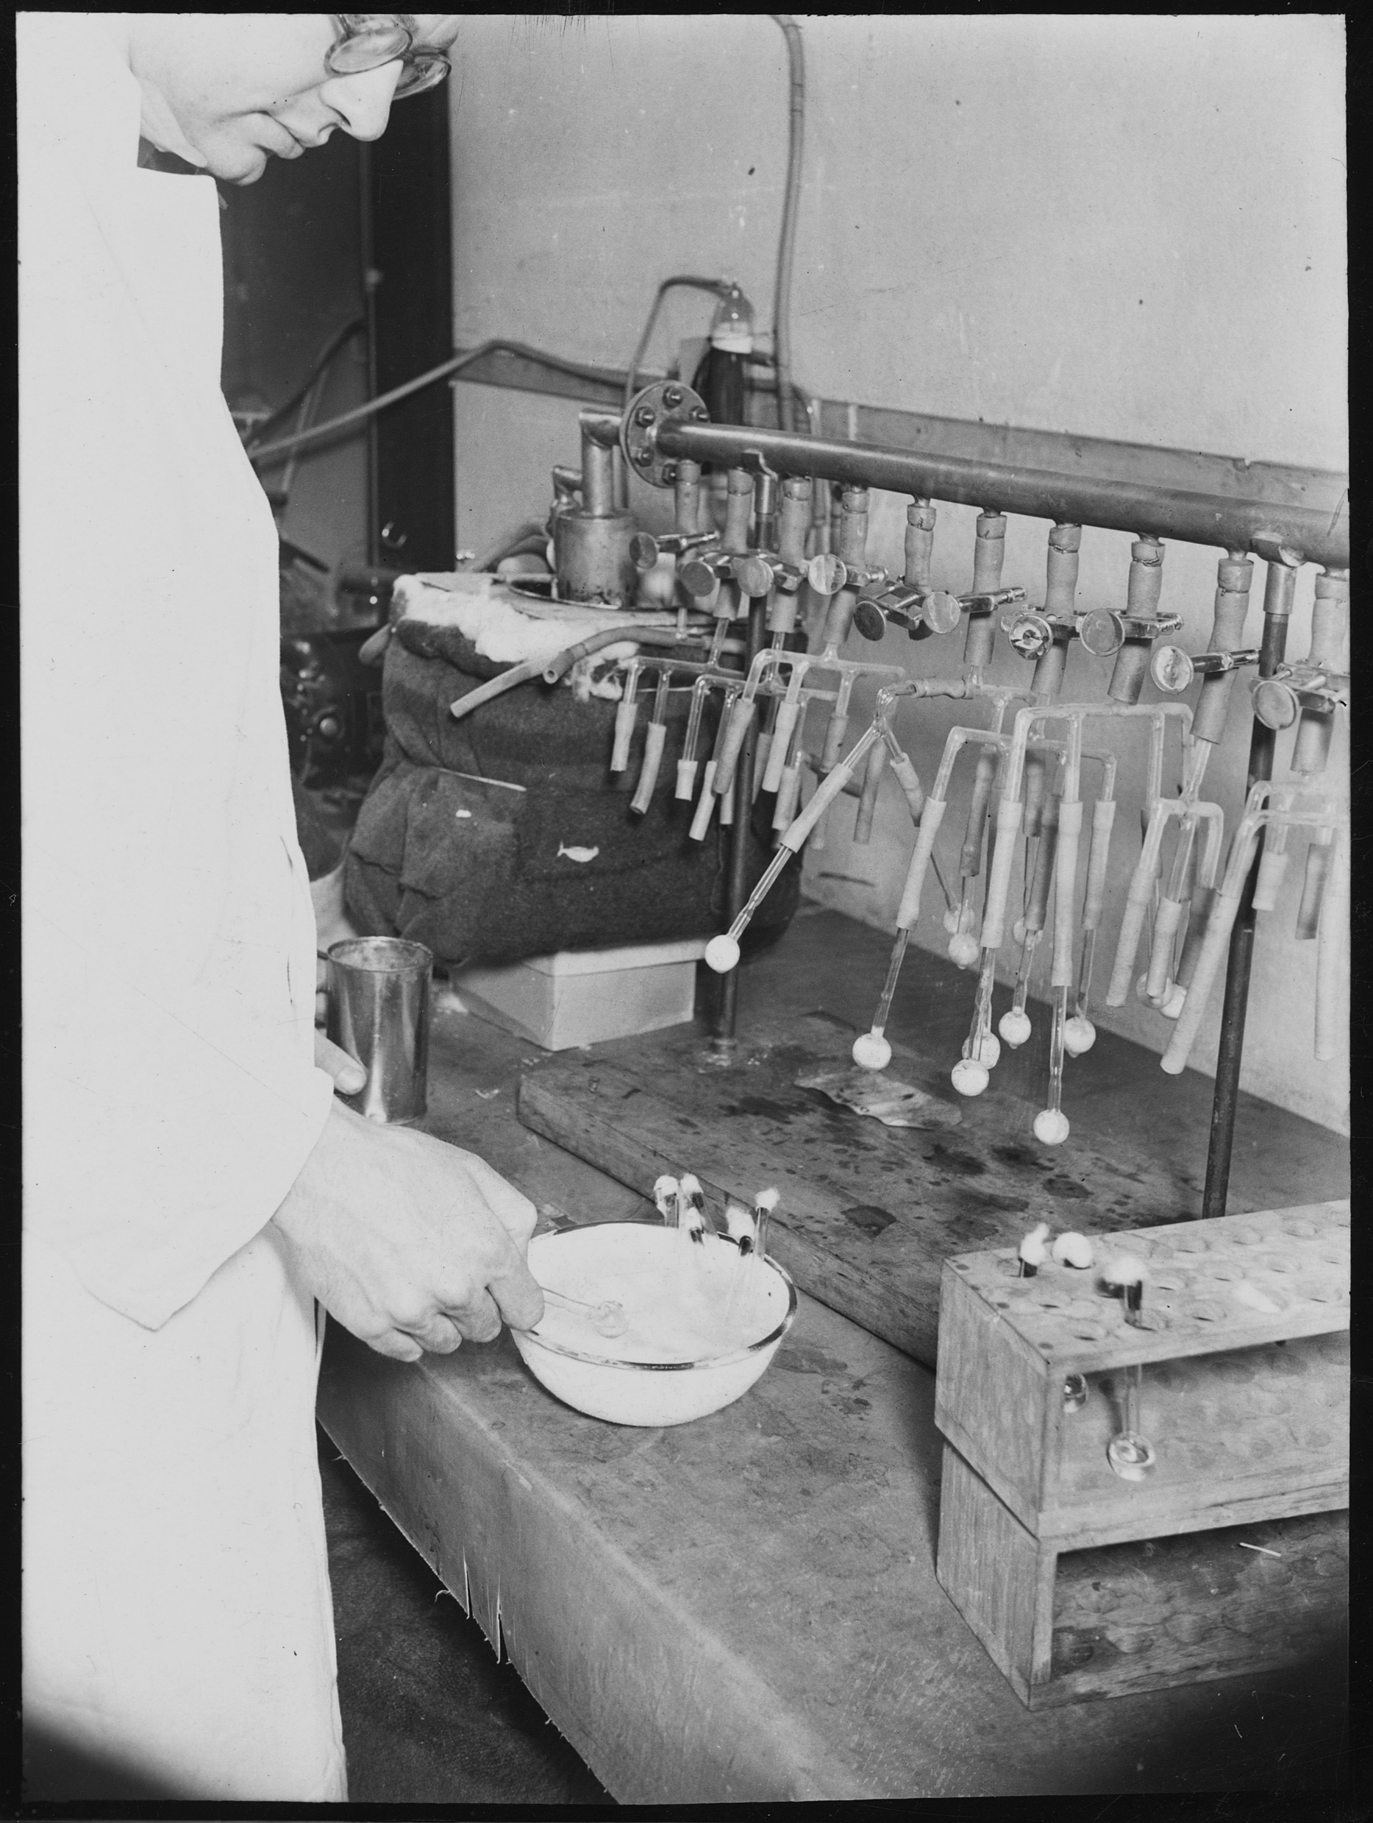
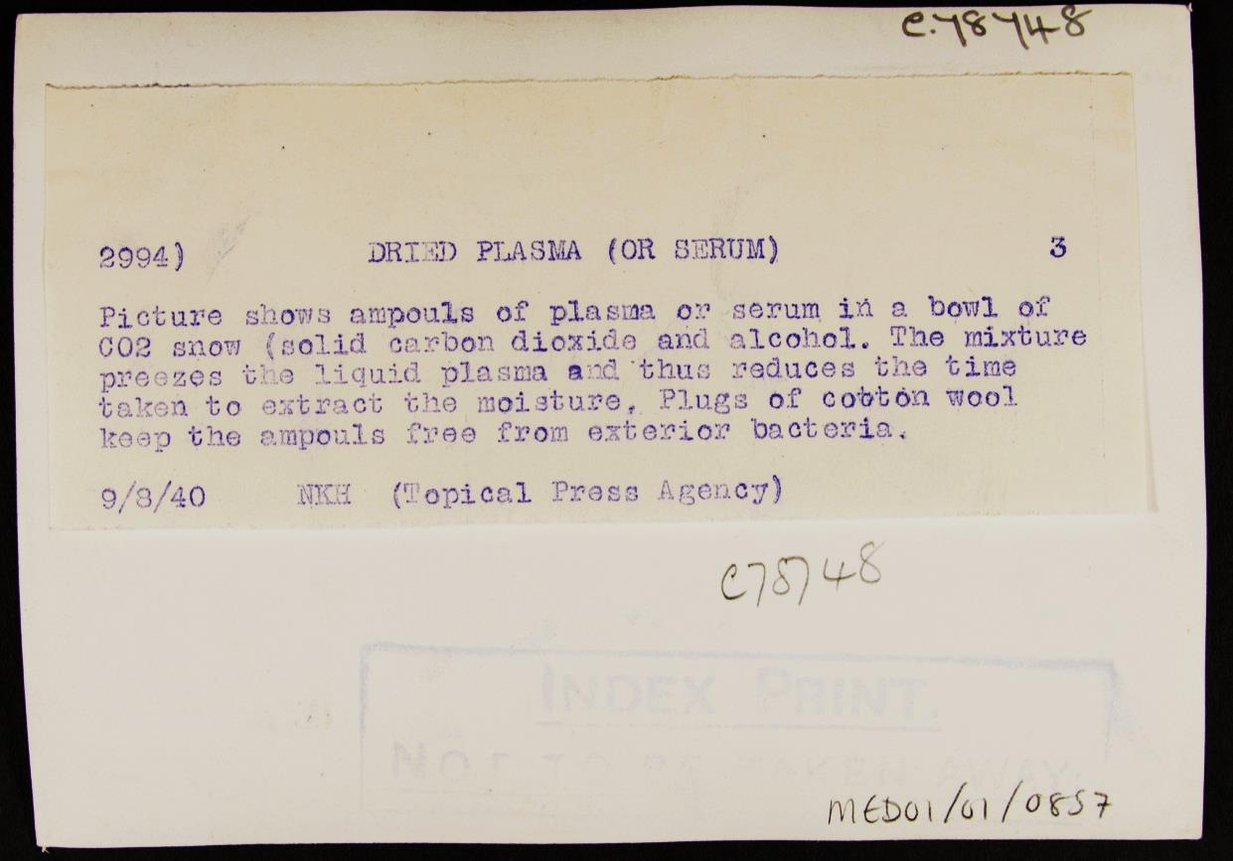
Photo 7
Notes:
Image: Source: Historic England Archive Ref: MED01/01/0857 Date: 9 Aug 1940 - https://historicengland.org.uk/images-books/photos/item/MED01/01/0857

Slide 23
Additional image information 4
Freezing plasma for transportation, Army Blood Supply Depot, Southmead Hospital, Southmead Road, Bristol
Samples of plasma or serum extracted from blood donations being placed in a bowl of CO2 snow (solid carbon dioxide and alcohol). This process freezes the liquid plasma and thus reduces the time taken to extract the moisture to dry it. Plugs of cotton wool keep the ampouls free from exterior bacteria. Once dried the plasma is much easier and lighter to transport. It can then be rehydrated ready for use when required, whereas a 'whole' blood does not keep well and is difficult to transport. The Army Blood Supply Depot, based at Southmead Hospital, was established in 1938 and began collecting blood from local donors in summer 1939. During the campaign in France in 1940, the Army Blood Supply Depot provided nearly all the blood and plasma required. Donated blood could be exchanged between the civilian and military blood depots, but the two services drew blood from separate pools of donors. Britain’s blood depot, established during World War One, and its fully functioning transfusion service pre-war meant that the transfusion service of the British army was well-organised compared to other armed forces.

Slide 24
Treatment of burns
Sir Archibald McIndoe was knighted for his experimental work on burns victims during the Second World War. Many RAF pilots suffered horrific burns when their planes were attacked and techniques of skin grafting and plastic surgery were developed by McIndoe at his hospital in East Grinstead. He developed techniques discovered during the First World War as well as identifying new techniques, for example, from seeing the difference in recovery time for pilots who crashed in the sea compared to those who crashed on land, he used saline baths for baths victims to aid and encourage the healing process. He also developed techniques of rehabilitation by spending time with patients and helping them to reintegrate into society without fear of being stared at because of their facial disfigurement.
His patients set up “The Guinea Pig Club” and became a strong support for each other, something that was very important to McIndoe and his patients.
Notes:
Info on burns treatment – use alongside slides 24 and 26

Slide 25
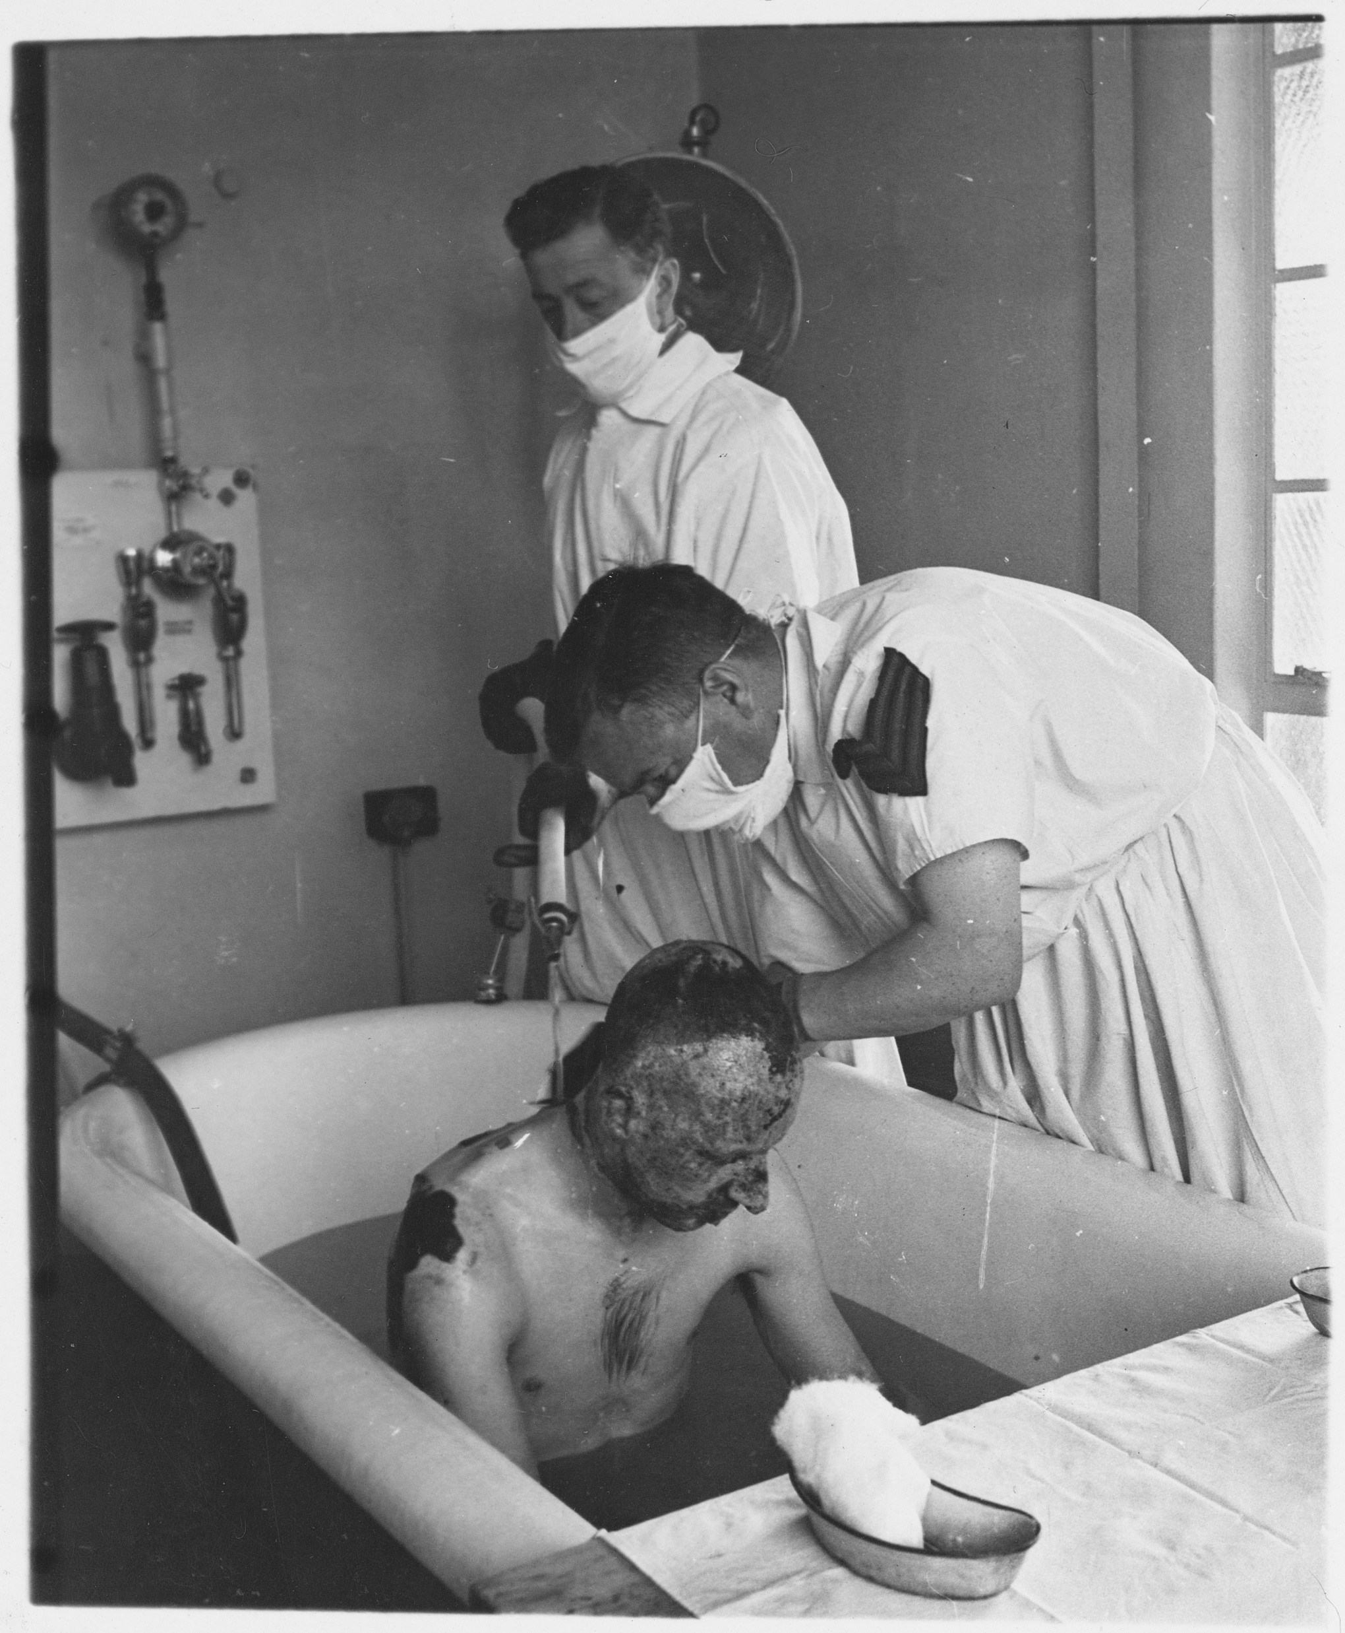
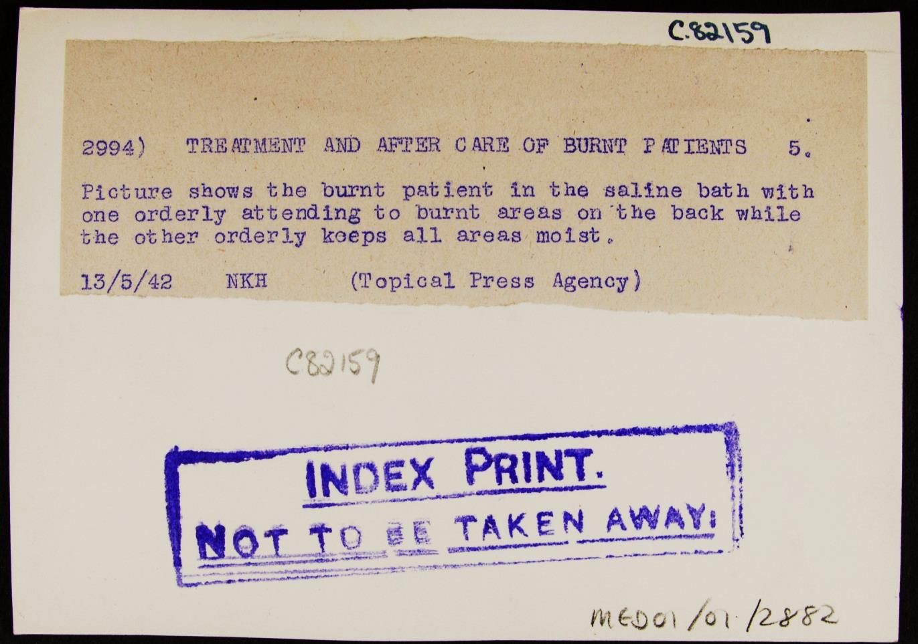
Photo 8
Notes:
Image: Source: Historic England Archive Ref: MED01/01/2882 Date: 13 May 1942 - https://historicengland.org.uk/images-books/photos/item/MED01/01/2882

Slide 26
Additional image information 5
Giving a burns patient a saline bath, Queen Victoria Hospital, Holtye Road, East Grinstead, West Sussex
Two orderlies giving a burns patient a saline bath. In September 1939, Archibald McIndoe arrived at the Queen Victoria Hospital to run the new Centre for Plastic and Jaw Surgery, bringing with him key members of his operating theatre staff. McIndoe was the Consultant Plastic Surgeon to the RAF, and during his time at the Queen Victoria Hospital treated thousands of patients who had suffered burns. The medical techniques he used were pioneering, and went on to form the basis of burns treatment worldwide. McIndoe treated burn injuries by keeping the wounds open, washing wounds with saline, and regularly changing dressings. The discovery that saline could be used to promote healing was, some say, a serendipitous discovery following observation of the healing rates of injured pilots who had landed in the sea. In addition to developing these treatments, McIndoe recognised the importance of social rehabilitation of patients. In 1947 McIndoe received a knighthood. The Queen Victoria Hospital remains renowned in England for its expertise and treatment of burns.

Slide 27
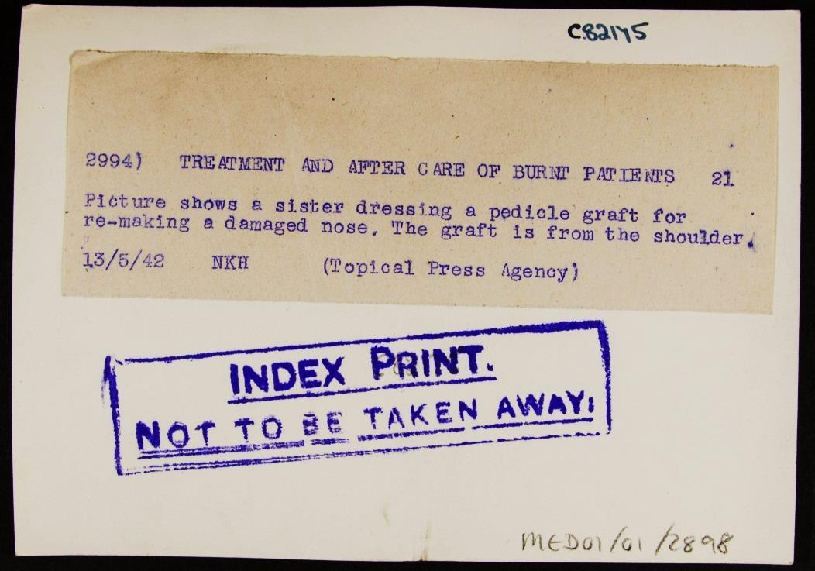
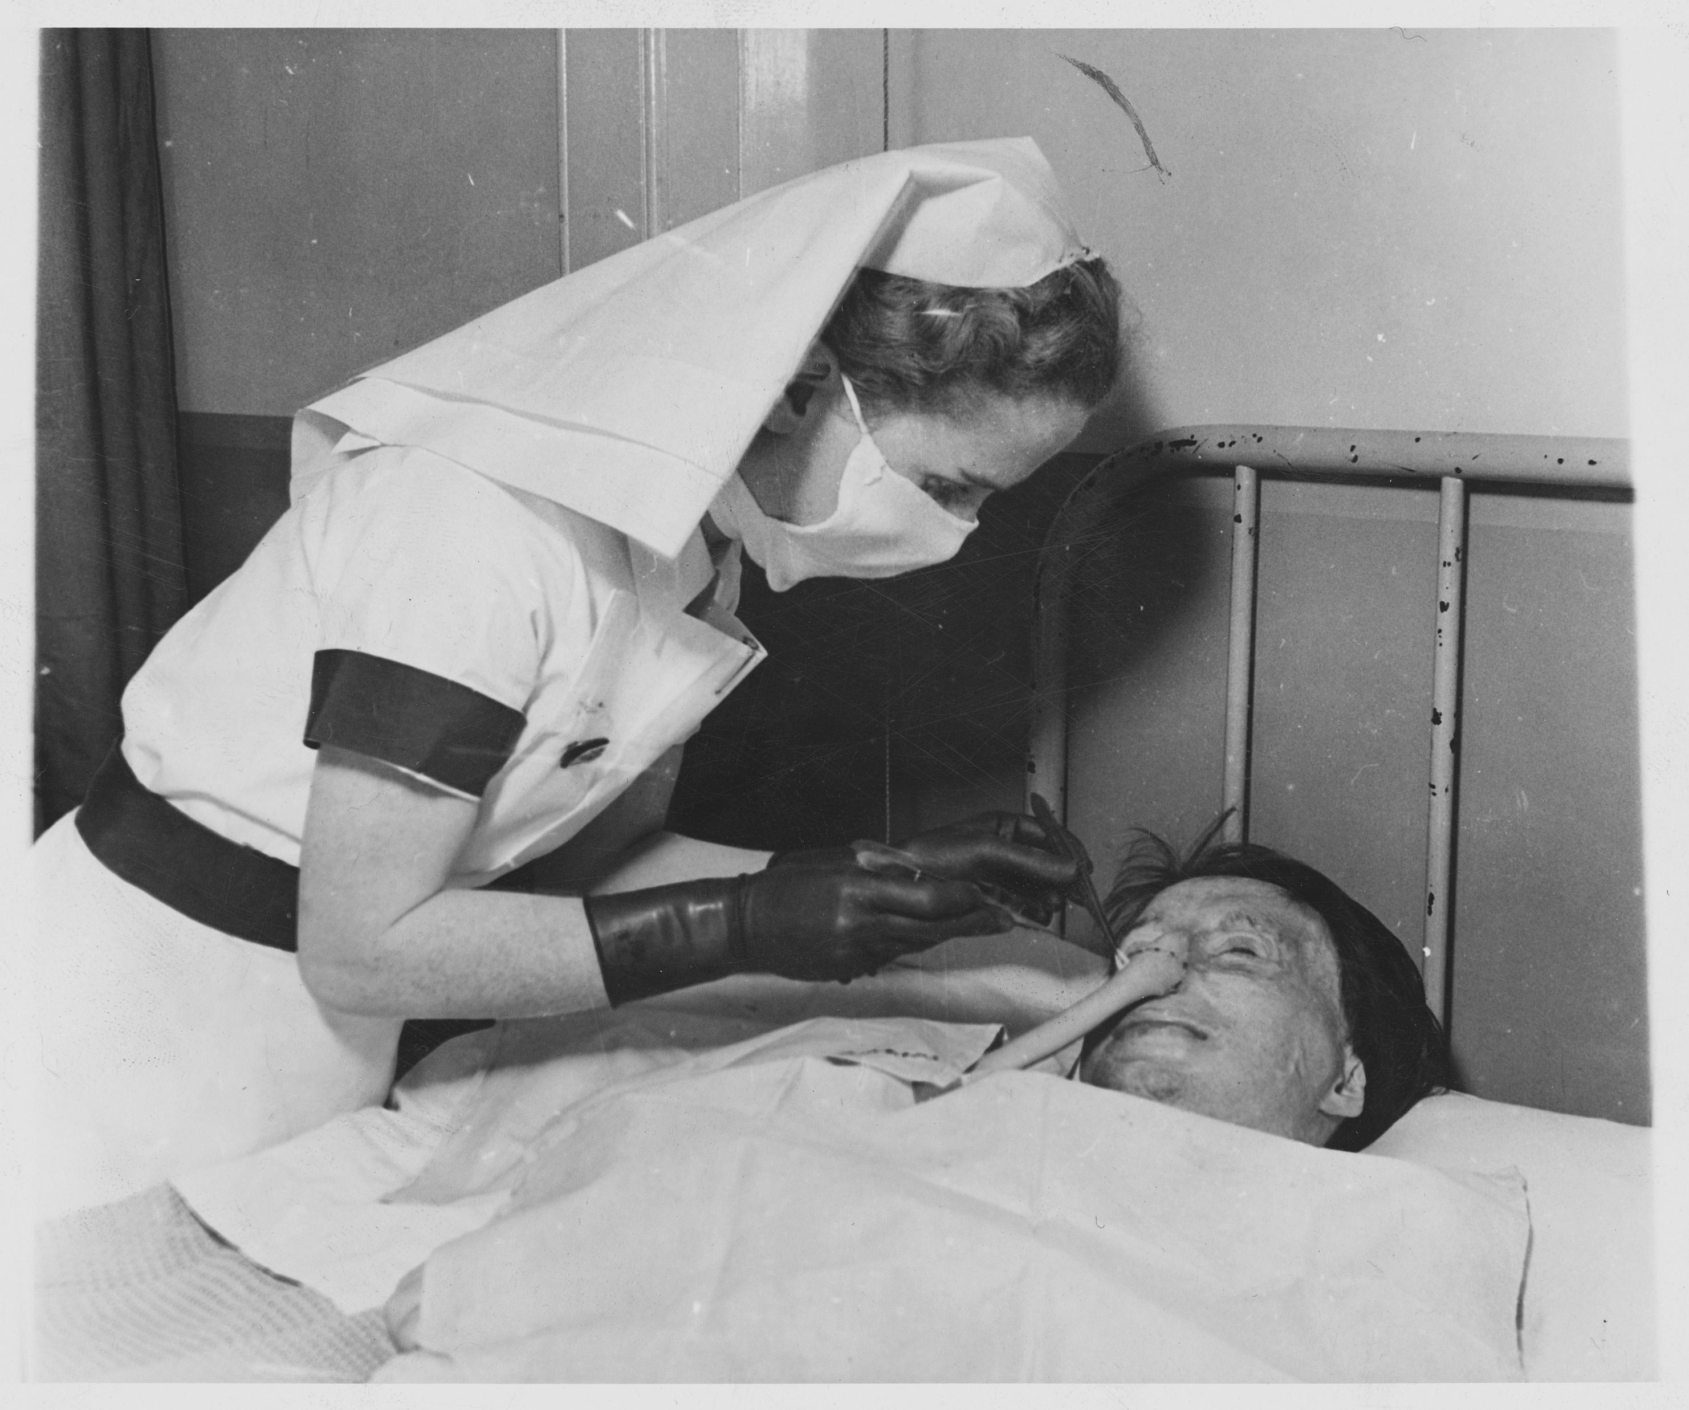
Photo 9
Notes:
Image: Source: Historic England Archive Ref: MED01/01/2898 Date: 13 May 1942 - https://historicengland.org.uk/images-books/photos/item/MED01/01/2898

Slide 28
Additional image information 6
Dressing a pedicle skin graft, Queen Victoria Hospital, Holtye Road, East Grinstead, West Sussex
AA sister dressing a pedicle skin graft used to treat a patient's damaged nose. In September 1939, Archibald McIndoe arrived at the Queen Victoria Hospital to run the new Centre for Plastic and Jaw Surgery, bringing with him key members of his operating theatre staff. McIndoe was the Consultant Plastic Surgeon to the RAF, and during his time at the Queen Victoria Hospital treated thousands of patients who had suffered burns. The medical techniques he used were pioneering, and went on to form the basis of burns treatment worldwide. McIndoe treated burn injuries by keeping the wounds open, washing wounds with saline, and regularly changing dressings. The discovery that saline could be used to promote healing was, some say, a serendipitous discovery following observation of the healing rates of injured pilots who had landed in the sea. In addition to developing these treatments, McIndoe recognised the importance of social rehabilitation of patients. In 1947 McIndoe received a knighthood. The Queen Victoria Hospital remains renowned in England for its expertise and treatment of burns.

Slide 29
Additional information 7
Infection
Penicillin had been discovered in 1928 by Alexander Fleming. Howard Florey teamed up with Ernst Chain in 1938 to look at natural anti-bacterial substances, which then led to their interest in manufacturing penicillin.
The first human trial was conducted in 1940 but it was not until 1943 that sufficient quantities and strength could be produced for use on the battlefield. It’s first large scale use was in North Africa in 1943 and, by June 1944, the use of penicillin was crucial in saving lives during the D Day landings. Due to the use of penicillin there was a reduction in gangrene and infections. This further reduced the risk of infection developing, or worsening, during the time between the wound occurring and surgery taking place (the average time for this was 14 hours). Alexander Fleming, Howard Florey & Ernst Chain shared the Nobel Prize in 1945 for their achievements.
Alongside the use of penicillin, the production of medical equipment and training was improved. Improvements to rubber gloves and their production helped to decrease the changes of infection. Nurses were also trained to “Don’t do that” focusing on reducing the chances of infection and the use of sterilisation.
Notes:
Info on infection prevention – use alongside slides 29 and 31

Slide 30
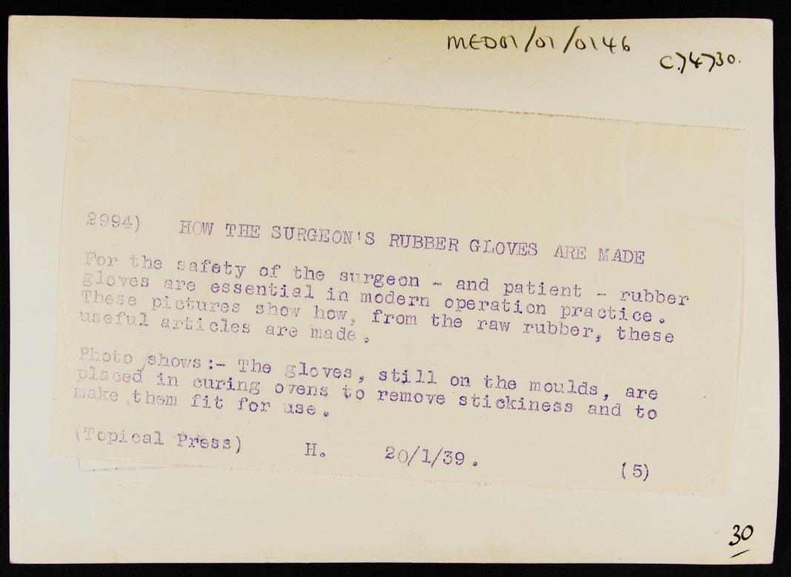
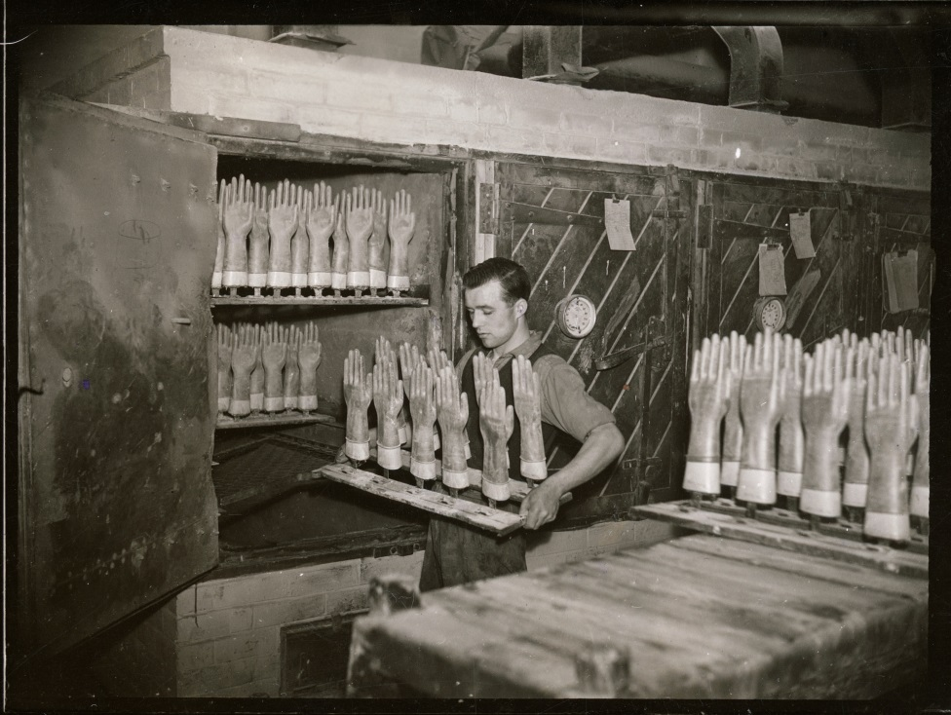
Photo 10
Notes:
Image: Source: Historic England Archive Ref: MED01/01/0146 Date: 20 Jan 1939 - https://historicengland.org.uk/images-books/photos/item/MED01/01/0146

Slide 31
Additional image information 8
How the surgeon’s rubber gloves are made
This photograph had the caption "For the safety of the surgeon – and the patient – rubber gloves are essential in modern operation practice." It shows gloves, still on the moulds, being placed in curing ovens to remove stickiness and to make them fit for use. The rubber glove was invented by William Stewart Halsted, chief of surgery at Johns Hopkins Hospital, after a nurse developed dermatitis from handling chemicals in 1889. Gloves were first used in surgery in 1894, and soon the incidence of infection following operations reduced considerably.

Slide 32
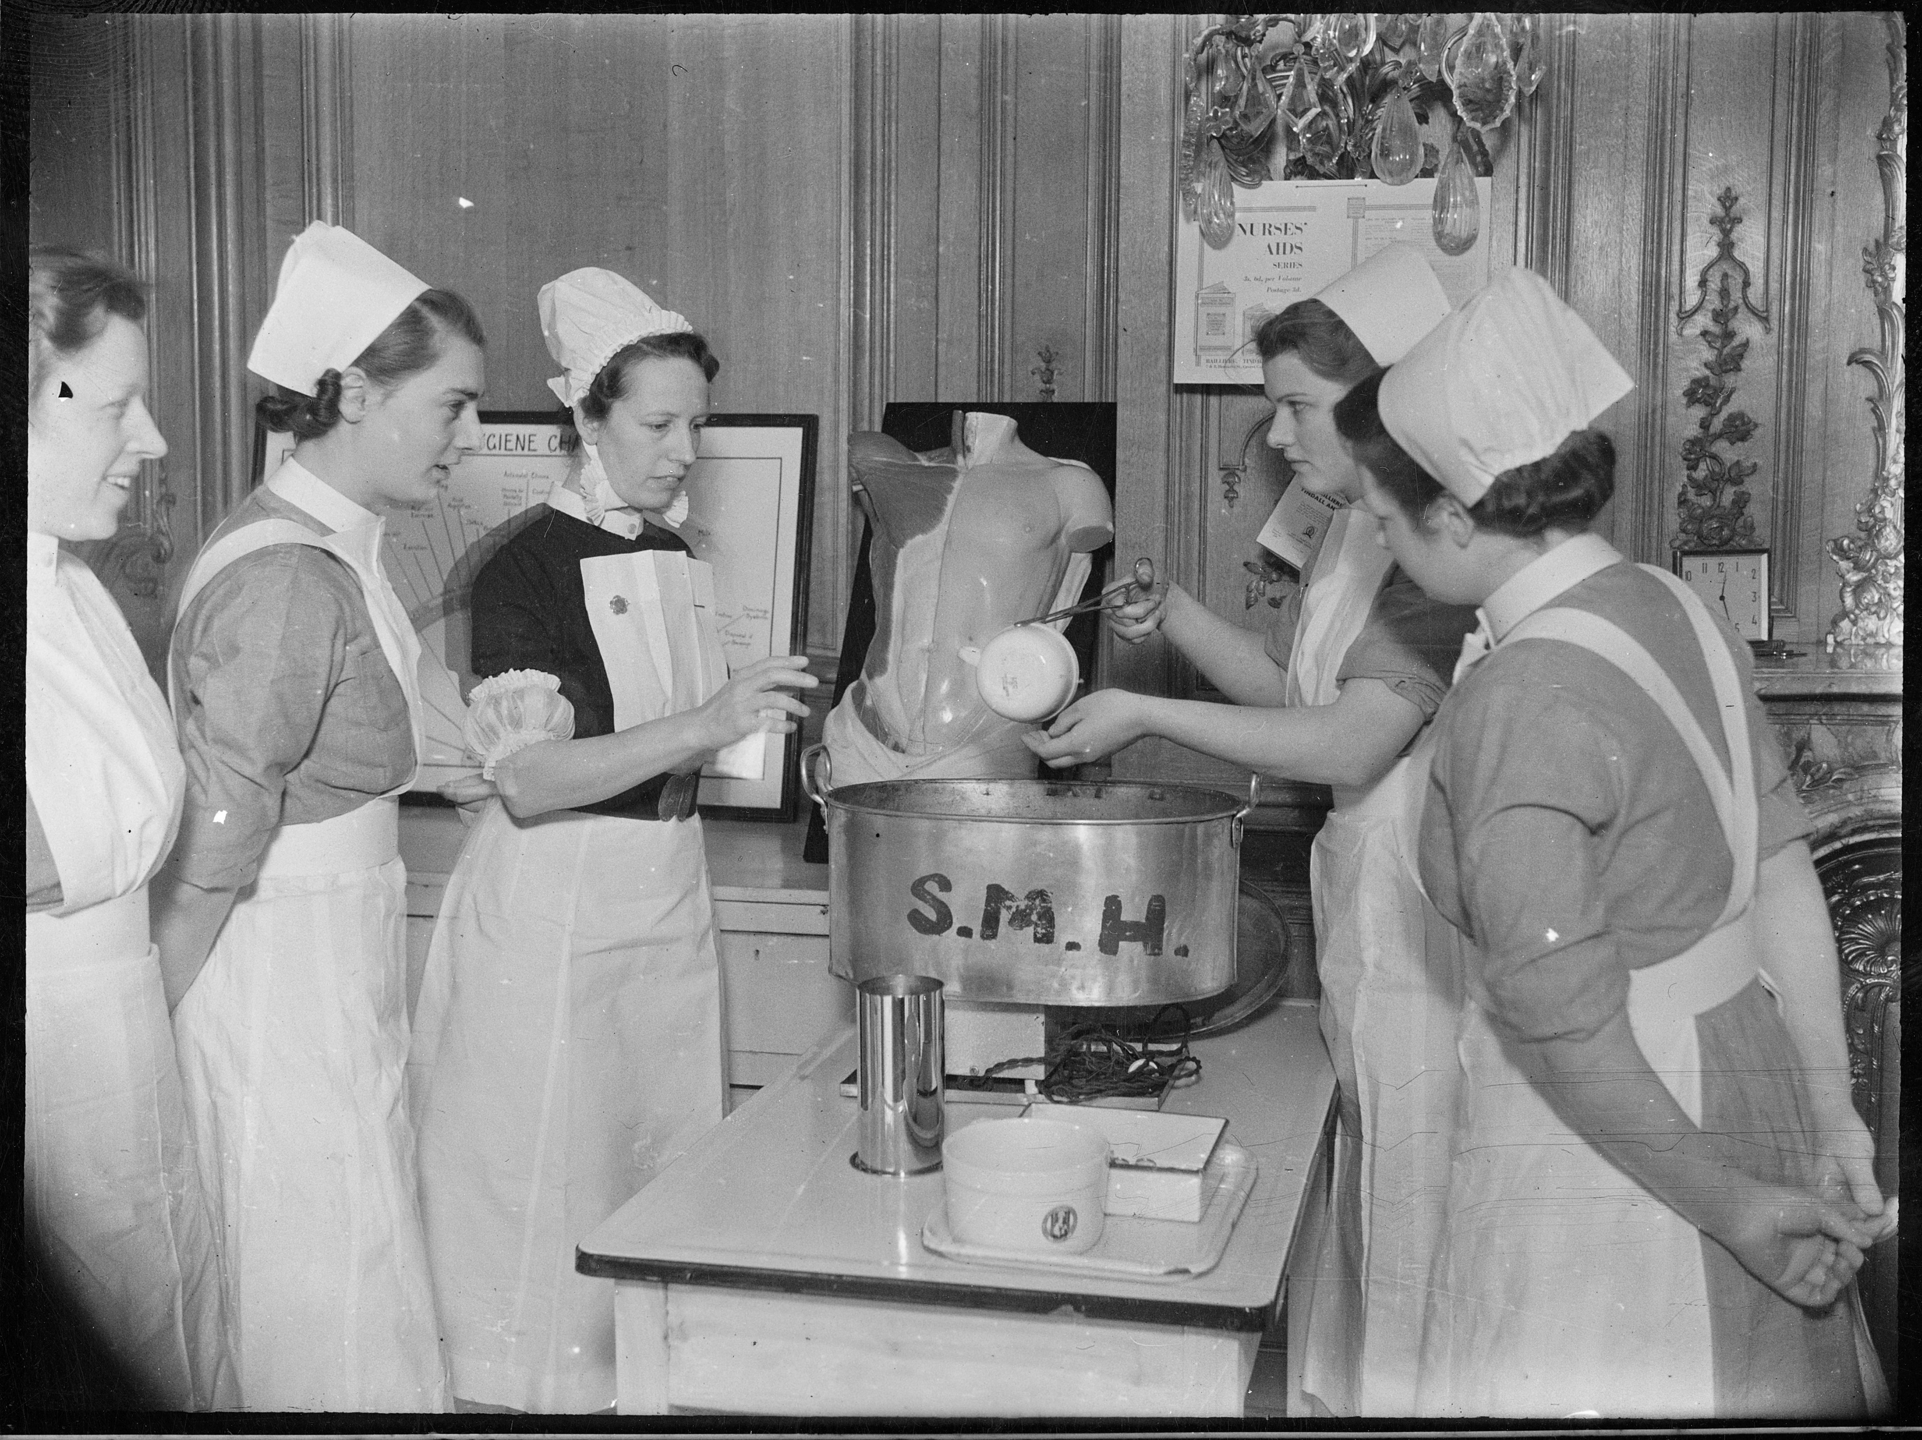
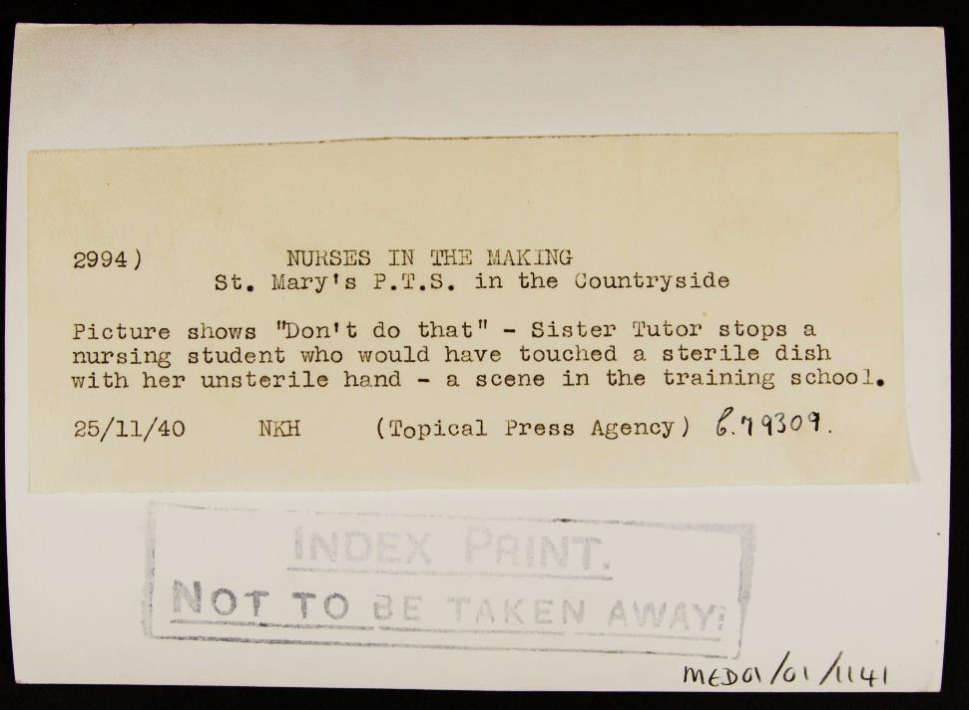
Photo 11
Notes:
Image: Source: Historic England Archive Ref: MED01/01/1141 Date: 25 Nov 1940 - https://historicengland.org.uk/images-books/photos/item/MED01/01/1141

Slide 33
Additional image information 9
Nurses in the making, Joyce Grove Convalescent Home, Nettlebed, Oxfordshire
A sister tutor instructing student nurses on the handling of sterile equipment. It was originally titled “Don’t do that” as the Sister Tutor is stopping a student nurse who would have touched a sterile dish with her unsterile hand. A preliminary training school was established at St Mary’s Hospital, London in the early 1920s. It then moved to Joyce Grove Convalescent Home and formed a Joint Preliminary Training School with Westminster Hospital.
Under the supervision of a Sister Tutor, probationers would spend three months learning basic skills in hygiene, first aid, nursing and cookery. Typically probationers would then take an examination and, if successful, would proceed to spending time in the wards before entry into a school of nursing if they were good enough.

Slide 34

Re-group
You are now going to re-group. Each group needs at least 1 person from each feature as you are going to teach each other about what you have discovered. Make sure that you cover the questions below when discussing your findings. Keep adding your research to your worksheet.
What development occurred in World War Two?
Why did the development occur?
How did it advance medical and surgical techniques and practices?
How might it have affected medicine after the war ended (e.g. Use in general practice and the NHS)?
Describe

Slide 35

Activity 4
Army Blood Supply Depot | Blood Plasma
Treatment of burns victims | Infection
You should now have lots of information about the medical and surgical practices and techniques that developed during World War Two

Slide 36
How far was the Second World War a factor in the development of medicine?
“If any good can be said to come of war, then the Second War must go on record as assisting and accelerating one of the greatest blessings that the 20th Century has conferred on Man – the huge advances in medical knowledge and surgical techniques.”
Brian J Ford.
At the start of the lesson, we heard Brian Ford’s view on the Second World War and his view on medical developments.
Your challenge now is to respond to Brian Ford’s viewpoint and your evidence: Is he correct in what he is saying? How far do you agree with Brian Ford?
Write your opinion in the middle box of your worksheet.
Notes:
Differentiation – ask higher ability students to try and disagree with the statement

Slide 37
Activity 6
Army Blood Supply Depot | Blood Plasma
Treatment of burns victims | Infection
Write your opinion in here

Slide 38

Complete Brian’s statement with your ideas!
To finish, you need to add to Brian Ford’s statement.
You only have 25 words, so you have to decide which feature you are going to use to support his viewpoint.
Which feature do you think was most important to demonstrate how accurate Brian Ford is?
Which feature had the biggest impact
on medical advancement?

Slide 39

Statement
If any good can be said to come of war, then the Second War must go on record as assisting and accelerating one of the greatest blessings that the 20th Century has conferred on Man – the huge advances in medical knowledge and surgical techniques……

Slide 40
Activity 7
greatest blessings?
How would you describe the medical developments in the Second World War?

Slide 41
Activity 8
Army Blood Supply Depot | Blood Plasma
Treatment of burns victims | Infection

Slide 42

More resources
MORE RESOURSCES AT
HistoricEngland.org.uk/Education

