Slide 1

Queen Elizabeth II Platinum Jubilee
Story Map
Key Stage 2: History & Geography
Learning Aims and Outcomes
Pupils understand more about the role of the Queen by exploring the Story Map of some of her visits to different places across England
Pupils learn about the Queen’s visits to significant places/events in their region of the country through her 70-year reign
Pupils develop a sense of place through mapwork
Pupils can identify regions of England and locate places in the region they live in
Pupils take part in celebrating a significant historical event
This learning resource supports the Historic England Platinum Jubilee Teaching Activity
Notes:
This resource is intended to be used with the Historic England Jubilee Story Map which documents some of the many places the Queen has visited throughout her reign. Pupils are able to explore the pins on the map of their region of the country to find out about the significant buildings and events the Queen has visited. The Story Map contains information about the visit, a brief history of the building and images of the Queen and the building.

Slide 2
Curriculum links for History KS1 & KS2
KS1 & KS2 Pupils should:
know and understand the history of these islands as a coherent, chronological narrative
should understand historical concepts such as continuity and change, cause and consequence, similarity and difference, and significance, and use them to make connections, draw contrasts, analyse trends, frame historically valid questions and create their own structured accounts, including written narratives and analyses.
gain historical perspective by placing their growing knowledge into different contexts, understanding the connections between local, regional, national and international history; between cultural, economic, military, political, religious and social history; and between short- and long-term timescales.
KS1 Pupils should be taught about:
changes within living memory. Where appropriate, these should be used to reveal aspects of change in national life
significant historical events, people and places in their own locality
KS2 Pupils should be taught about:
A local history study
a study over time tracing how several aspects of national history are reflected in the locality
a study of an aspect of history or a site dating from a period beyond 1066 that is significant in the locality.
A study of an aspect or theme in British history that extends pupils’ chronological knowledge beyond 1066
e.g. the changing power of monarchs using case studies

Slide 3
Curriculum links for Geography KS1 & KS2
Key stage 1
Pupils should develop knowledge about the world, the United Kingdom and their locality. They should understand basic subject-specific vocabulary relating to human and physical geography and begin to use geographical skills, including first-hand observation, to enhance their locational awareness.
Pupils should be taught to:
Place knowledge
understand geographical similarities and differences through studying the human and physical geography of a small area of the United Kingdom
Human and physical geography
use basic geographical vocabulary to refer to:
key physical features, including: beach, cliff, coast, forest, hill, mountain, sea, ocean, river, soil, valley, vegetation, season and weather
key human features, including: city, town, village, factory, farm, house, office, port, harbour and shop
Geographical skills and fieldwork
use simple compass directions (North, South, East and West) and locational and directional language [for example, near and far; left and right], to describe the location of features and routes on a map
use aerial photographs and plan perspectives to recognise landmarks and basic human and physical features; devise a simple map; and use and construct basic symbols in a key
Key stage 2
Pupils should extend their knowledge and understanding beyond the local area to include the United Kingdom
They should develop their use of geographical knowledge, understanding and skills to enhance their locational and place knowledge
Pupils should be taught to:
Locational knowledge
name and locate counties and cities of the United Kingdom, geographical regions and their identifying human and physical characteristics, key topographical features (including hills, mountains, coasts and rivers)
Place knowledge
understand geographical similarities and differences through the study of human and physical geography of region of the United Kingdom
Geographical skills and fieldwork
use maps, atlases, globes and digital/computer mapping to locate countries and describe features studied
use the eight points of a compass, four and six-figure grid references, symbols and key (including the use of Ordnance Survey maps) to build their knowledge of the United Kingdom and the wider world
Notes:
Ensure all pupils are competent in the geographical skills needed to: interpret a range of sources of geographical information, including maps, diagrams, globes, aerial photographs and Geographical Information Systems (GIS)

Slide 4
Introduction
An official visit from the Queen is an extremely prestigious occasion and can bring great benefits to the area visited such as increased public awareness, local pride and an opportunity to celebrate or commemorate a local event, place or achievement. This is part of the role of the Queen.
The Queen has regularly carried out over 300 public engagements, including visits, each year throughout her 70-year reign. This makes a total of over 21 000 public engagements in which she is always accompanied by an official photographer.
In her 70-year reign, the Queen has covered the length and breadth of England undertaking public engagements. At Historic England we have collected photographs from across the country and across Queen Elizabeth’s reign to create a Story Map of some of her official visits, to commemorate her Platinum Jubilee.
Notes:
As part of an introduction you may also wish to use the schools resources about the Queen and the Jubilee created by the Royal Collections Trust: https://www.rct.uk/discover/school-resources/school-resources-for-the-platinum-jubilee-2022

Slide 5
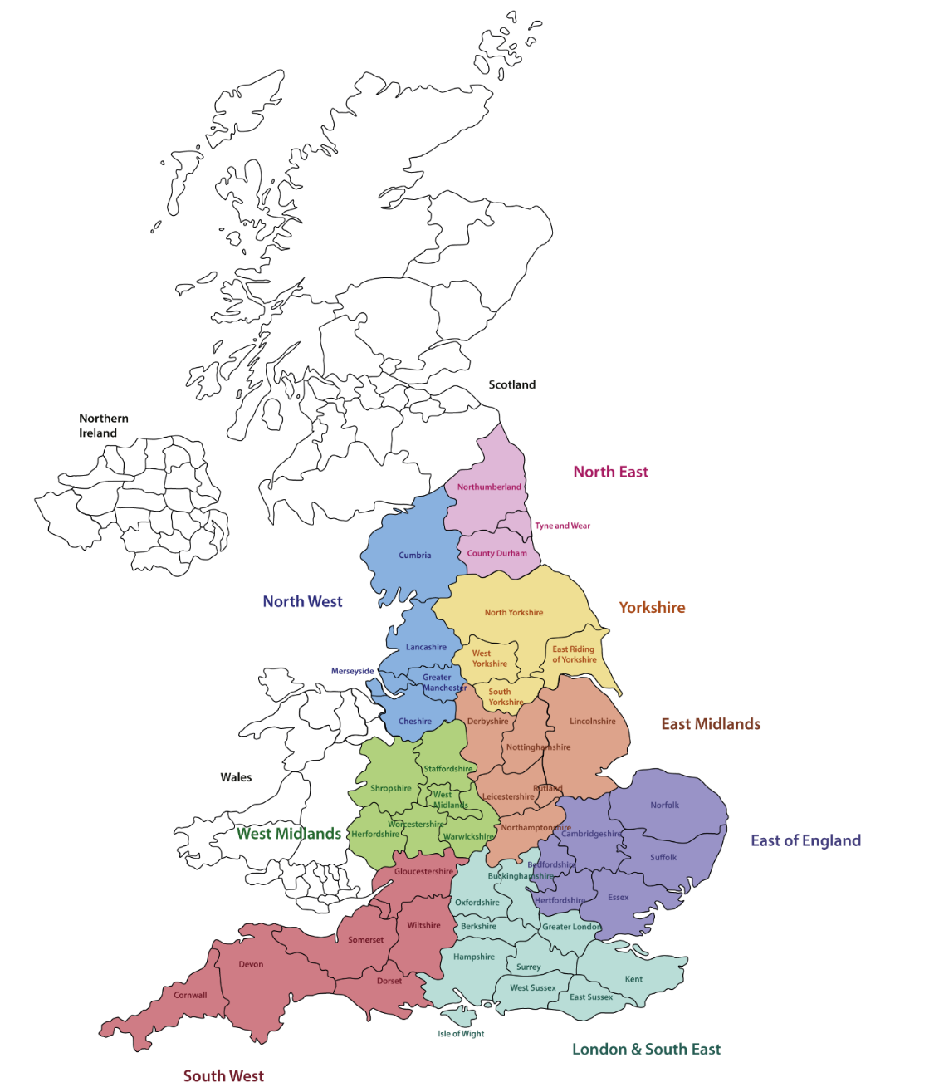
Explore the Story Map - Which Region?
To explore where the Queen has visited near you, identify which region of England you live in.
The map here is divided into the following regions:
North East
North West
Yorkshire
West Midlands
East Midlands
East of England
South West
London and South East
Notes:
Map Image © Historic England Heritage Schools

Slide 6
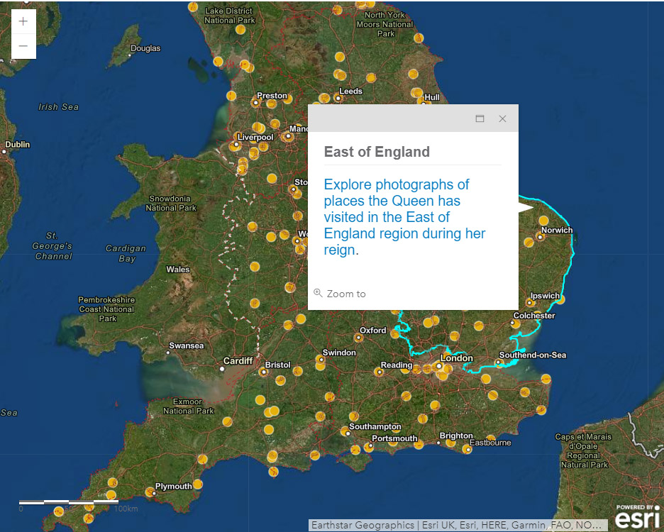
Explore the Story Map – Select a Region
Follow a regional link to open a regional map
Notes:
https://historicengland.org.uk/services-skills/education/teaching-activities/platinum-jubilee/

Slide 7
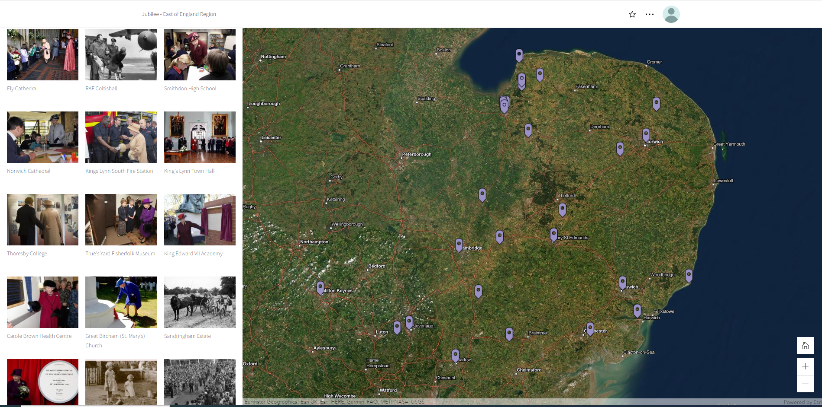
Explore the Story Map – Explore a Region
Click on an image or a map pin to find out more

Slide 8
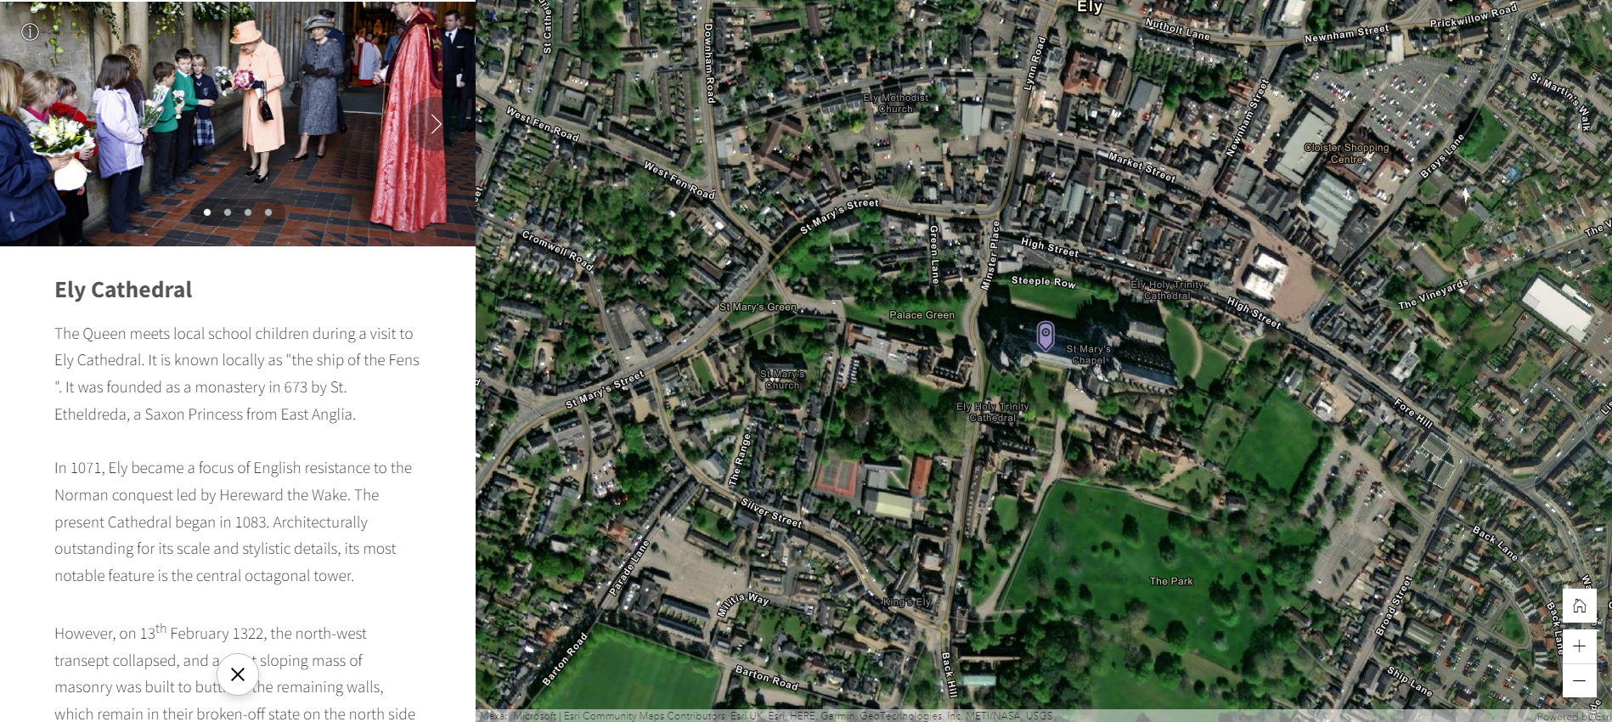
Explore the Story Map – Explore a Region
Once you’re viewing a place you can click the arrow to find more images

Slide 9
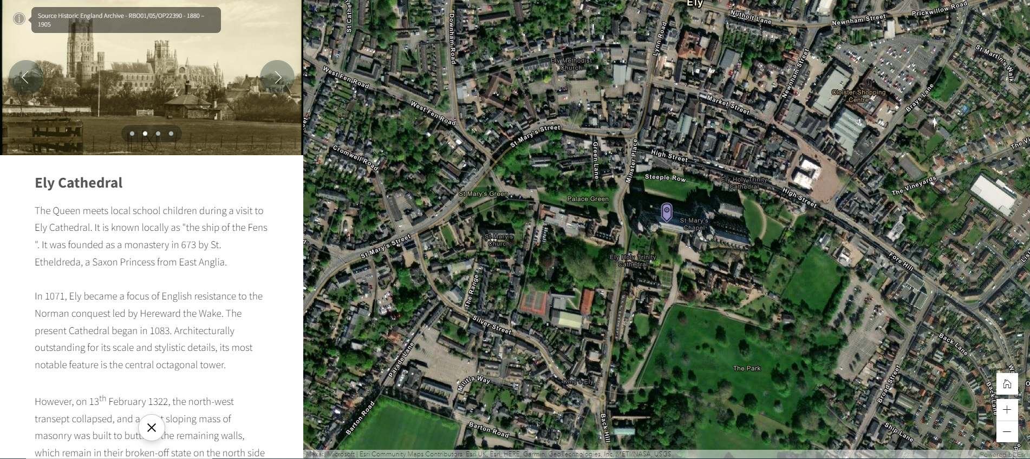
Explore the Story Map – Explore a Region
The ‘i’ icon on each image tells you the date it was taken

Slide 10
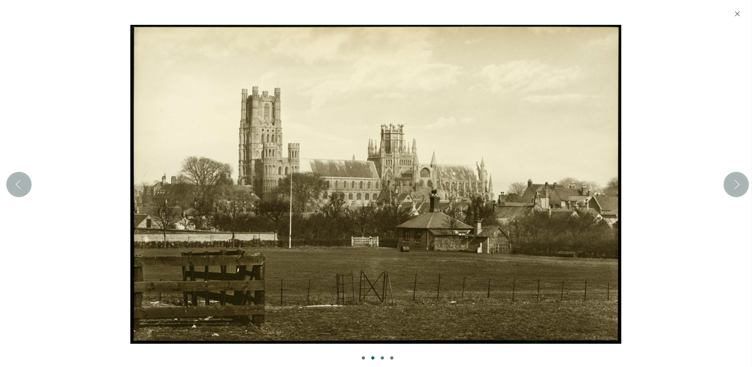
Explore the Story Map – Explore a Region
Click on any image to view a larger version of it

Slide 11
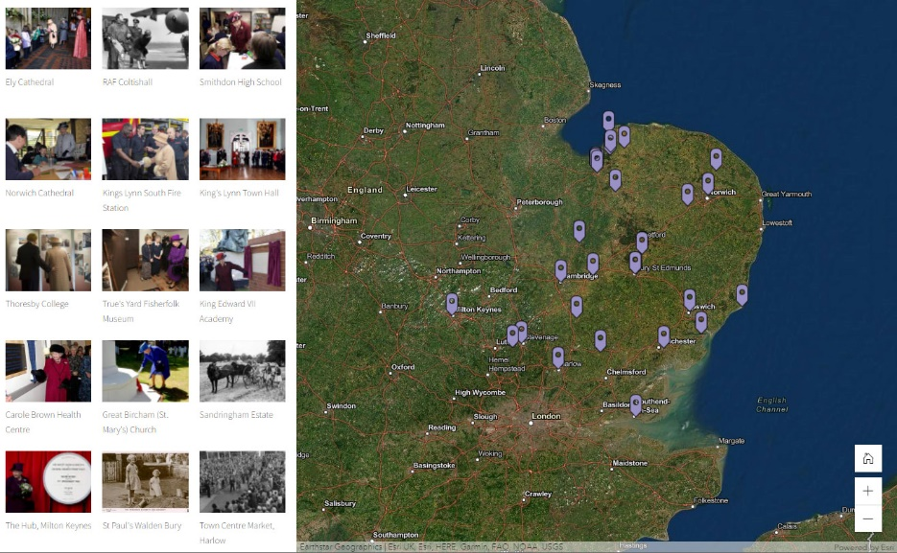
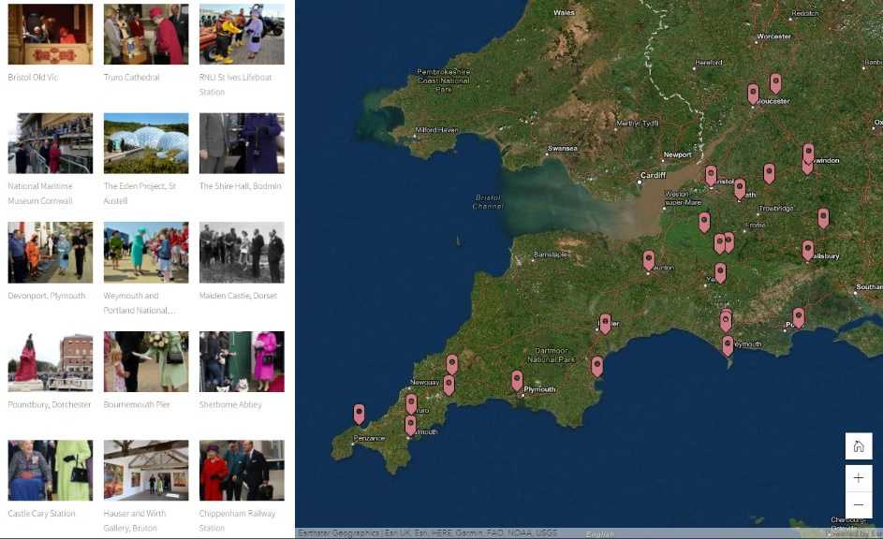
Where has the Queen visited near you?
Use Historic England’s Story Map (link) to explore your region
Click on the pins and find out about some of the places the queen has visited in your region
Using the information on the Story Map find out:
  Where she visited
  When she visited
  What the reason was for her visit
  Why the place is important to your area
Notes:
Geography Curriculum Pupils should be taught to:
Place knowledge
understand geographical similarities and differences through studying the human and physical geography of a small area of the United Kingdom

Slide 12
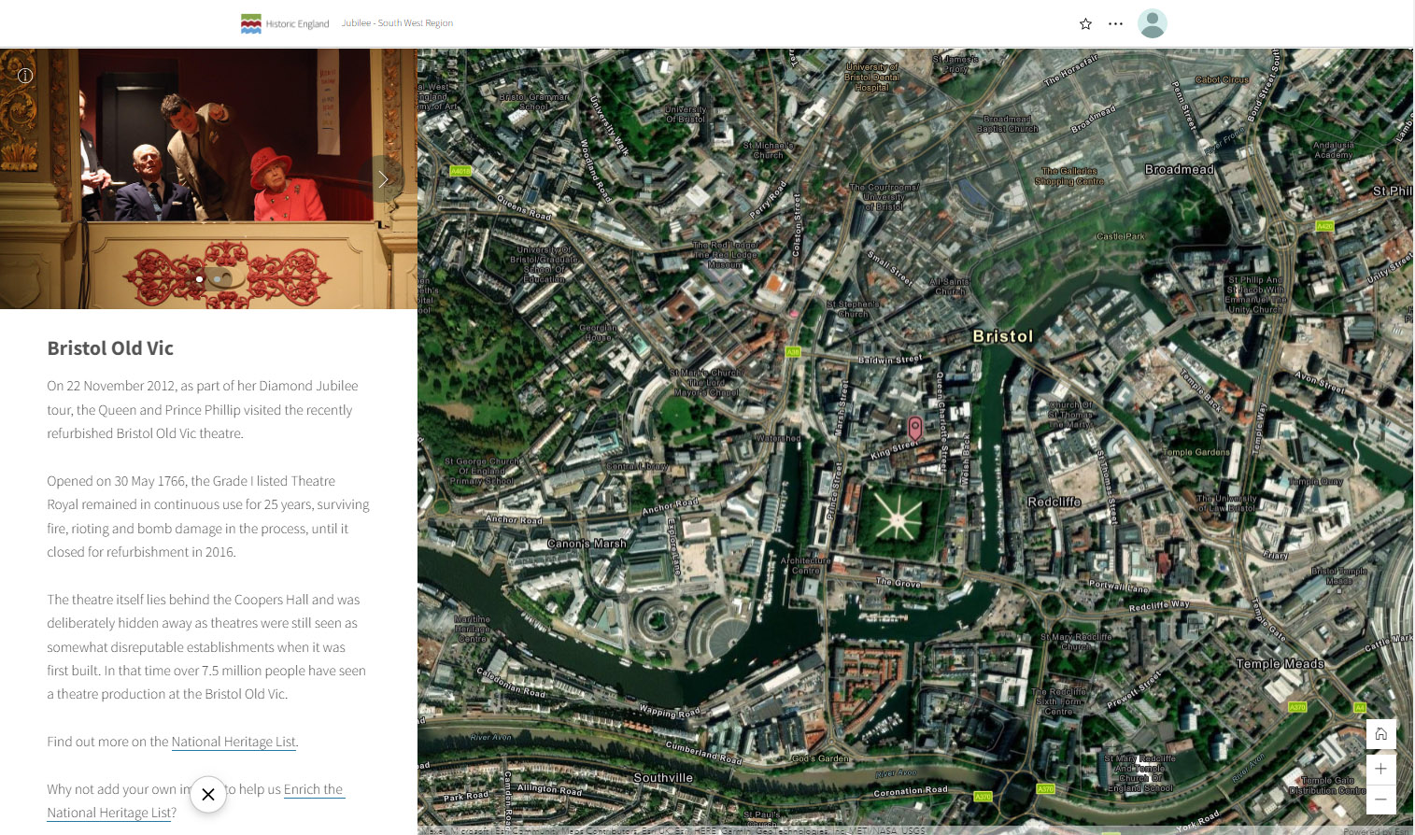
South West Example
Notes:
Click on any of the pins or images on the Story Map to find out more. You can also download you Regional Images PPT to find the images and information about each pin on the map. https://historicengland.org.uk/services-skills/education/teaching-activities/platinum-jubilee/

Slide 13
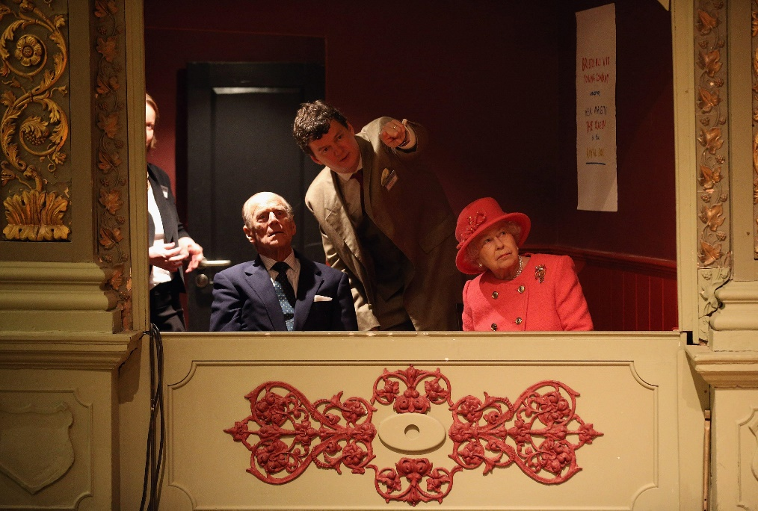
South West Example
Where has she visited?
The Theatre Royal in Bristol also known as the Bristol Old Vic
When did she visit?
She visited in 2012 as part of her Diamond Jubilee Tour
What was the reason for her visit?
The Bristol Old Vic had recently been refurbished
Why is this place important to your area?
The Bristol Old Vic was, at the time, the oldest continually operating theatre in the country, having been originally opened in 1766
Image from Story Map
Notes:
Image Bristol Old Vic © Alamy G5MHP1 – 22.11.2012

Slide 14
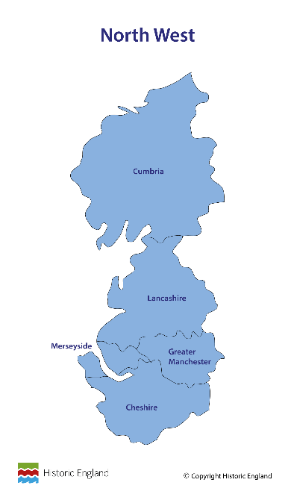
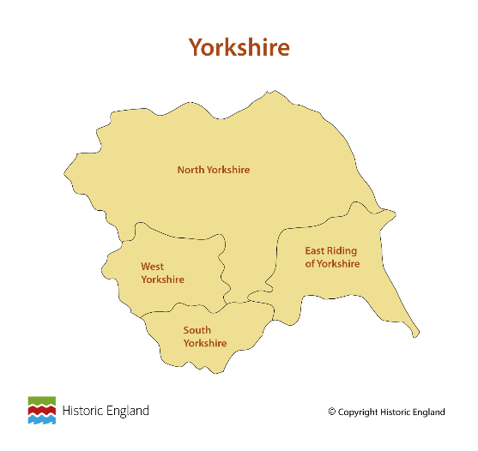
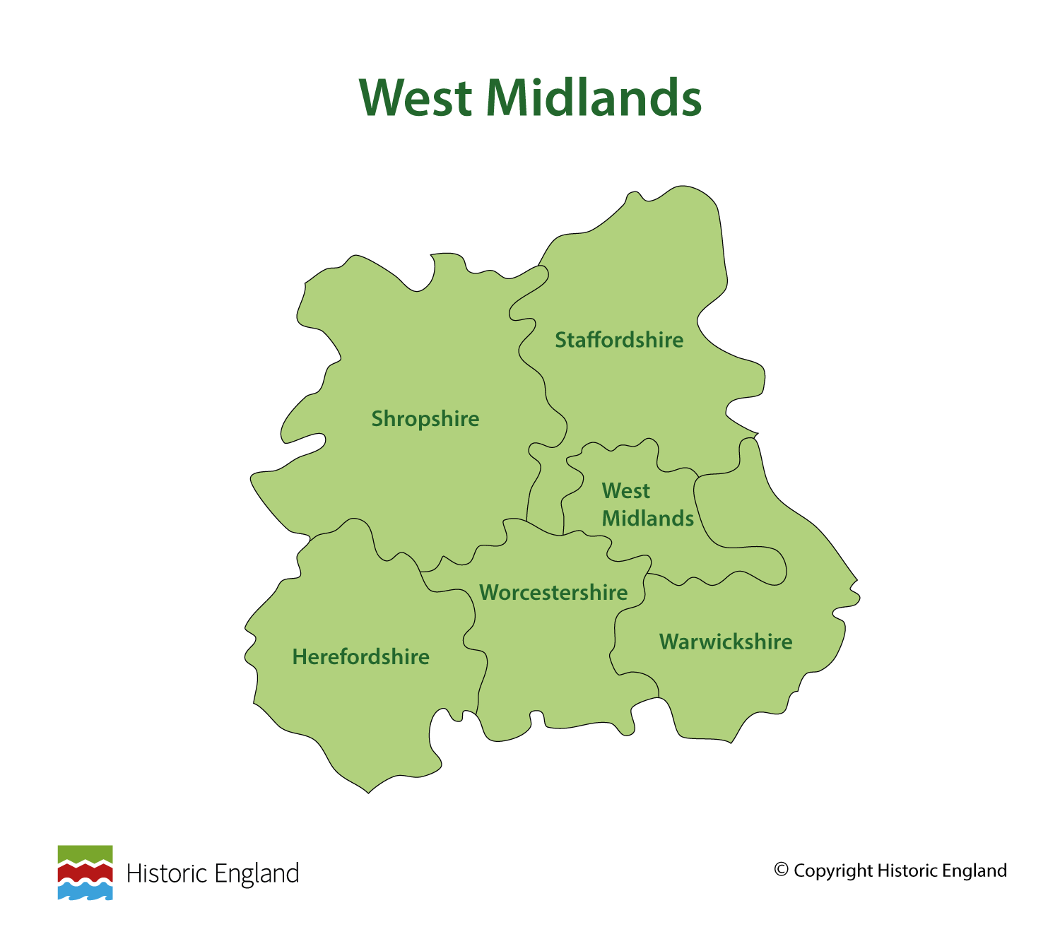
What have you found out about your region from the places the Queen has visited?
Using the photographs and information from the Story Map you could:
Create a Heritage Trail of the important places the Queen has visited in your region
Write a Tour Guide for visitors to your region based on the Queen’s visits
Imagine you are one of the people in the photograph with the Queen, and write a story about the visit and how you felt when she visited
Write a letter to the Queen suggesting some other important places in your region or local area she should visit next
Notes:
Map Images © Historic England Heritage Schools
History KS1 & KS2 Pupils should:
know and understand the history of these islands as a coherent, chronological narrative
should understand historical concepts such as continuity and change, cause and consequence, similarity and difference, and significance, and use them to make connections, draw contrasts, analyse trends, frame historically valid questions and create their own structured accounts, including written narratives and analyses.
KS1 Pupils should be taught about:
changes within living memory. Where appropriate, these should be used to reveal aspects of change in national life
significant historical events, people and places in their own locality
KS2 Pupils should be taught about:
A local history study
a study over time tracing how several aspects of national history are reflected in the locality
a study of an aspect of history or a site dating from a period beyond 1066 that is significant in the locality.

Slide 15
Find out more
What can you find out about the buildings the Queen has visited in your region?
Can you find it on a Google map? Use Google Street View to see what it looks like.
How far is it from your school or where you live?
If you have visited this building, what was the reason or the occasion?
Find out about the buildings that are ‘listed’:
  Some buildings are very special and are listed on the National Heritage List for England (NHLE)
  Buildings that are ‘listed’ on the NHLE are protected by law, so people cannot alter them without permission.
  Find out if the building is a listed building by following the links on the Story Map entry to discover more about why the building is on Historic England’s list
  Learn how you can ‘enrich the list entry’ with your own responses to the building e.g. by adding photographs, drawings, poems or additional information
Notes:
You can also find the nearest listed buildings to your school by putting your postcode into the Map Search: https://historicengland.org.uk/listing/the-list/map-search

Slide 16
Why are buildings listed?
If any of the buildings the Queen has visited in your region are ‘listed’ on the National Heritage List for England, it means that they are protected because they are significant or special in some way.
What makes some buildings special enough to be listed?
The style, design or architecture of the building is special
The style, design or architecture of the building is typical of the era it was built e.g. Victorian, Tudor, 1930’s etc.
The building tells the story of the history or heritage of the place e.g. a war memorial, a Mosque, a racecourse, a mill
A significant event took place in the building or on the site
The building is special to the local area, the region, the country or the world

Slide 17
Why is Listing important?
Listing helps to protect significant buildings and structures in our local area
Listed buildings are important to people and communities – they have stories and memories attached to them
Listed buildings are a window into the past
Listing buildings is a good way to show what we are proud of from our past
Listed buildings are an important part of our heritage
Listed buildings give clues about how people lived, how people felt and what things were like in the past
Listed buildings help our understanding of significant events, people and time periods in the past
Buildings that are listed are more likely to be looked after and preserved

Slide 18
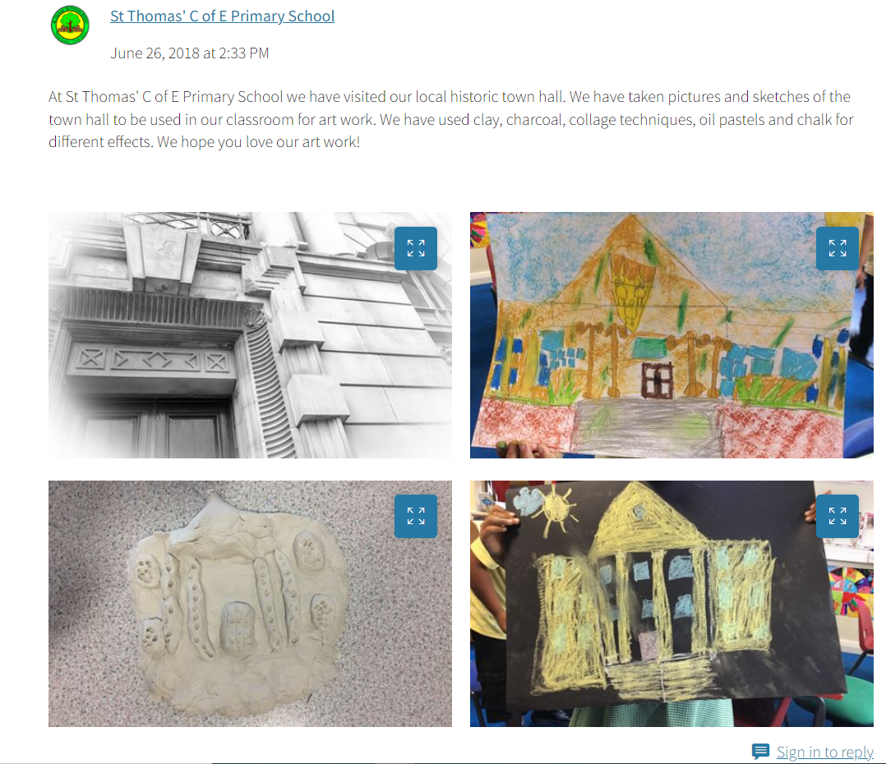
How your class can Enrich the List
Notes:
An example of how a school ‘enriched the list’ after visiting a listed building near them. https://historicengland.org.uk/services-skills/education/teaching-activities/how-you-can-enrich-the-list/

Slide 19
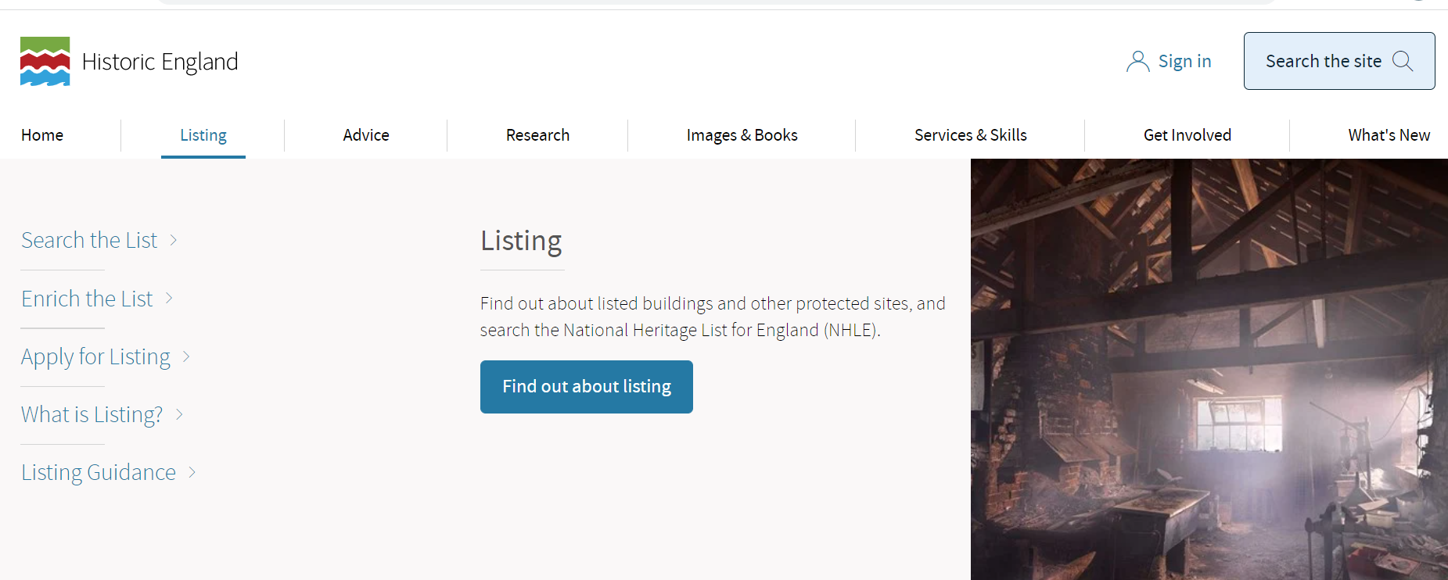
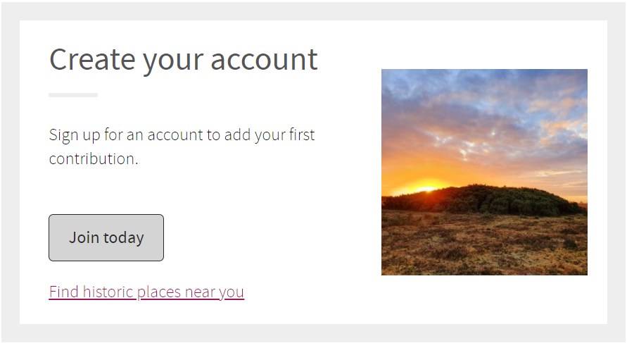
How your class can Enrich the List
To Enrich the List a teacher or another adult needs to create an account on the Historic England website
On the Historic England website click on the Listing tab at the top of the page
Click Enrich the List in the menu on the left, then scroll down and click create an account

Slide 20
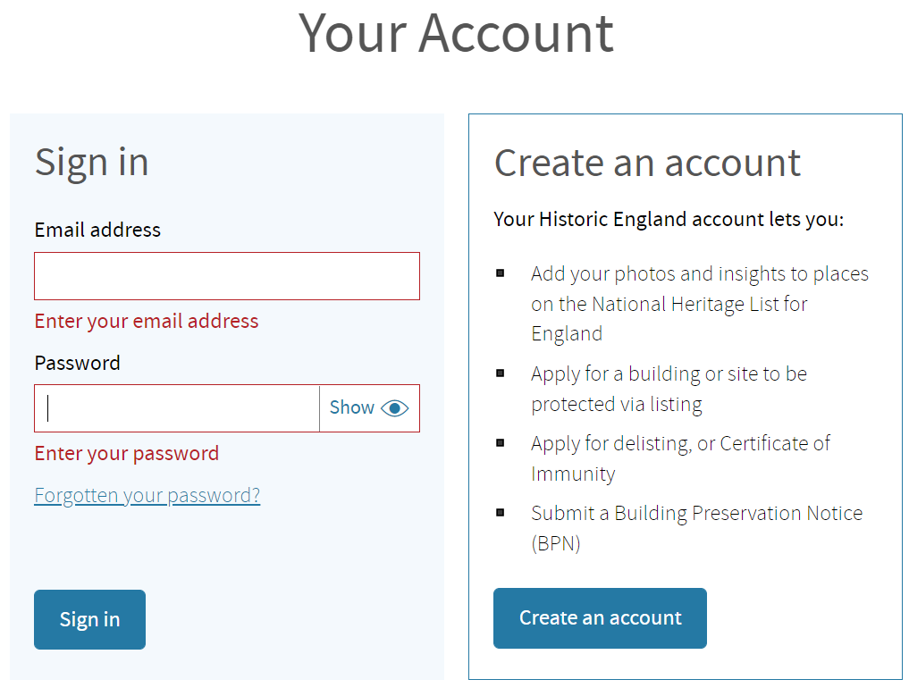
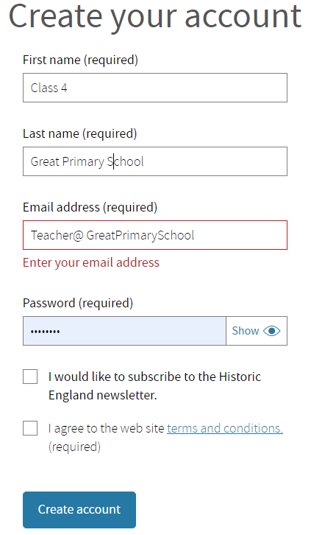
Setting up your account
Provide a name, email address and create a password
The First name could be the class name e.g. Class 4
The Last name could be your school name e.g. Great Primary School

Slide 21
Setting up your account
Once you have created an account, you will receive an email. Then you can follow the links to the List entries on the Story Map and Enrich the List by adding information or uploading photographs, paintings and drawings.
Your contributions will be added to the List entry and be there for the world to learn from and enjoy!

Slide 22
Ideas for Enriching the List of the buildings the Queen has visited in your region
Visit the building and photograph it and upload it
Draw or paint a picture of the Queen visiting the building
Add some information about when and why the Queen visited
Add some information about the history of the building
Add some information about what the building is used for now
Write a poem about the Queen’s visit or the building to celebrate her Platinum Jubilee
Draw or paint a picture of the building, then scan and upload it
Add some information about why the building is special to you or to people locally

Slide 23
Date the photographs like a historian
When historians are trying to work out the date of a photograph, the first thing they do is study it carefully looking for clues and ask these questions:
What and who is this a photograph of?
What is happening?
What are the people doing?
Is there anything I recognise?
What do I already know about the people/things in this photograph?
What does the colour and quality of this photograph tell me about when it was taken?
Have I seen similar photographs and what do I know about them? - in family photos or in books, newspapers or websites?
What do the clothes tell me about this period of time?
What do the hair styles tell me about this period of time?
Are there any cars, building, signs, food or objects in this photograph that can help me work out the time the photograph was taken?

Slide 24
Frame of inference
Where can I find out?
What questions do I want to ask ?
What can I infer?
What
What can I see ?
Notes:
Use the frame of inference by putting any image of the Queen or one of the buildings she’s visited in the centre of the green box, then look at it to try and answer each of the 4 questions.

Slide 25
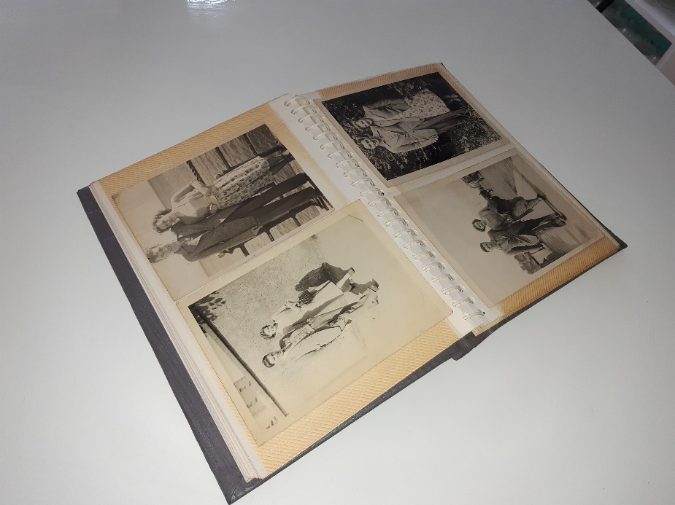
Family and friends
Try to find out if any of your family and friends have any older photographs that you can look at from the different decades during the Queen’s reign. Look at the clothes, hairstyles, cars, buses, objects and buildings in the photographs – can you spot similarities?
Princess Elizabeth became Queen in 1952. Does anyone in your family remember this event?
Do they have any photographs from the 1950s?
Maybe your grandparents or great grandparents have some photographs from this time

Slide 26
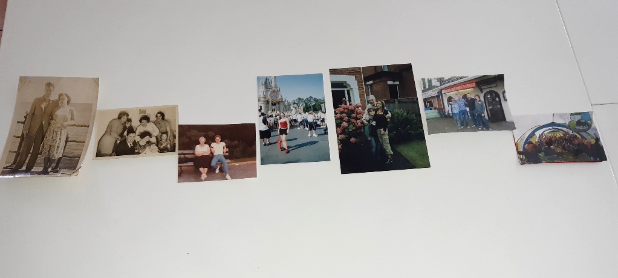
Photos through the decades of the Queen’s reign
If you have collected some photographs, arrange them in chronological order in the decades of the Queen’s reign.
1950s
1960s
1970s
1980s
1990s
2000s
2010s
2020s
Maybe your family and friends have photograph albums you could look at. These are often arranged in chronological order and are of special family occasions.
What are the special occasions when your family take photographs?

Slide 27
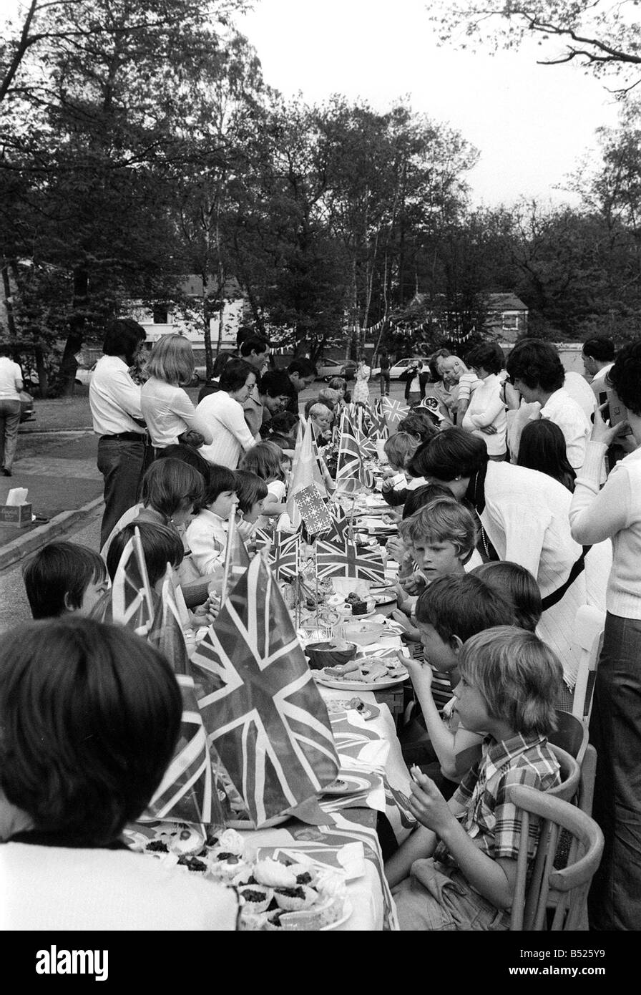
Jubilees
The Queen’s Silver Jubilee was in 1977 when she had been Queen for 25 years – does anyone in your family remember this or have any photographs?
The Queen’s Golden Jubilee was in 2002 when she had been Queen for 50 years – does anyone in your family remember this or have any photographs?
The Queen’s Diamond Jubilee was in 2012 when she had been Queen for 60 years – does anyone in your family remember this or have any photographs?
Find out more about Jubilees and explore the Royal Collection Trust’s learning resources
Notes:
Image
Street Parties for the Queen’s Silver Jubilee June 1977 Silver Jubilee Party for Elizabeth II In Grosvenor Square London 2002 © Alamy B525Y9 (RM) 05.06. 1977

Slide 28
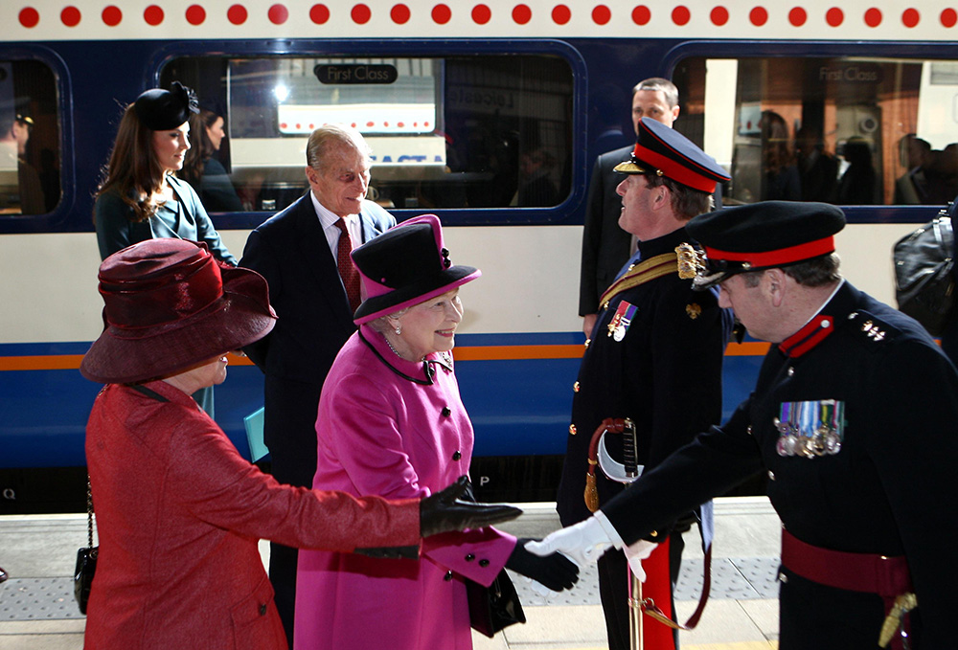
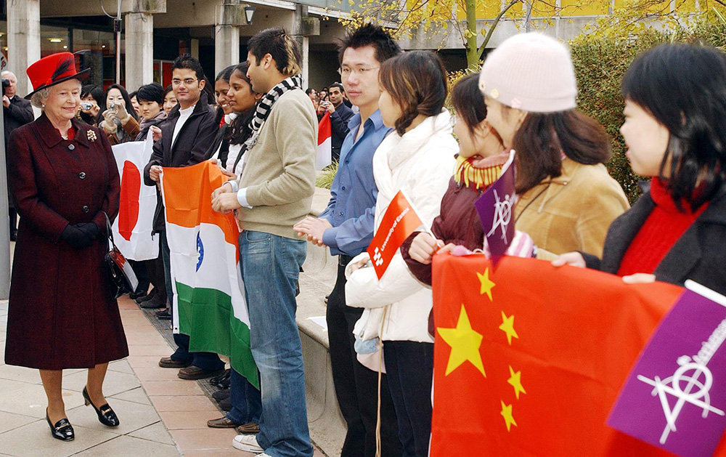
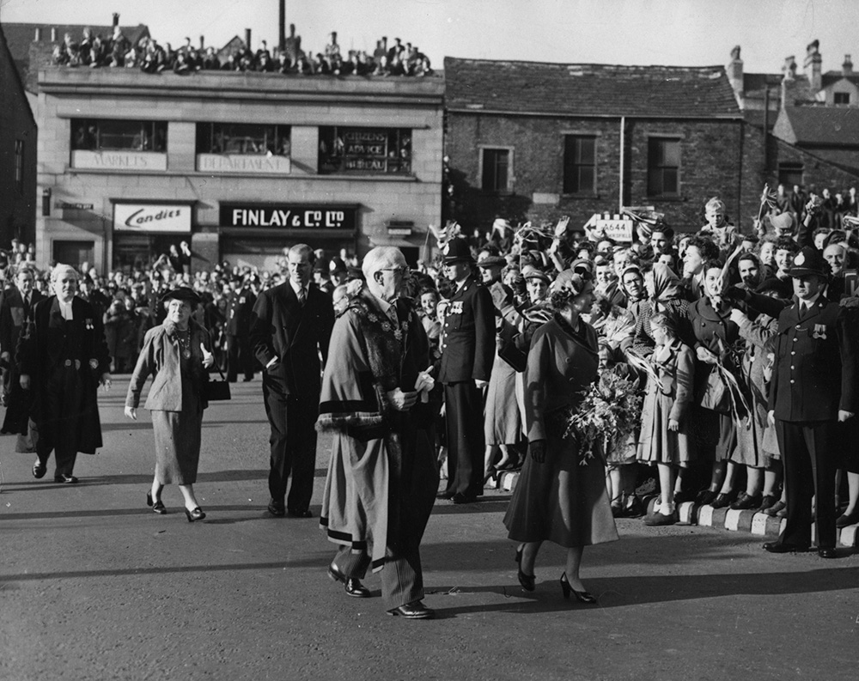
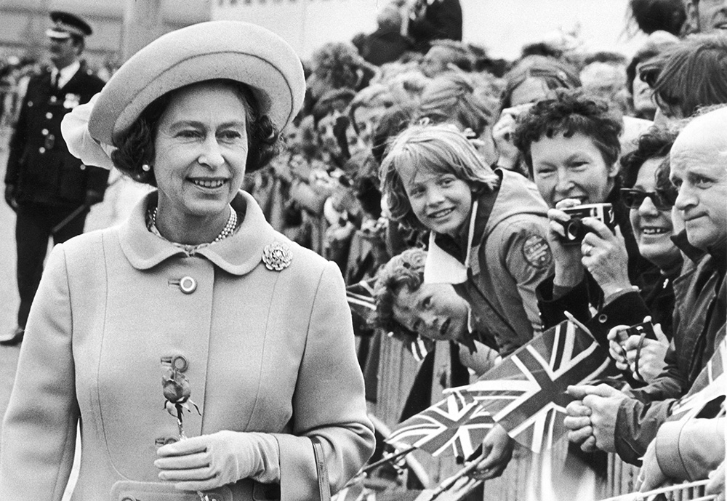
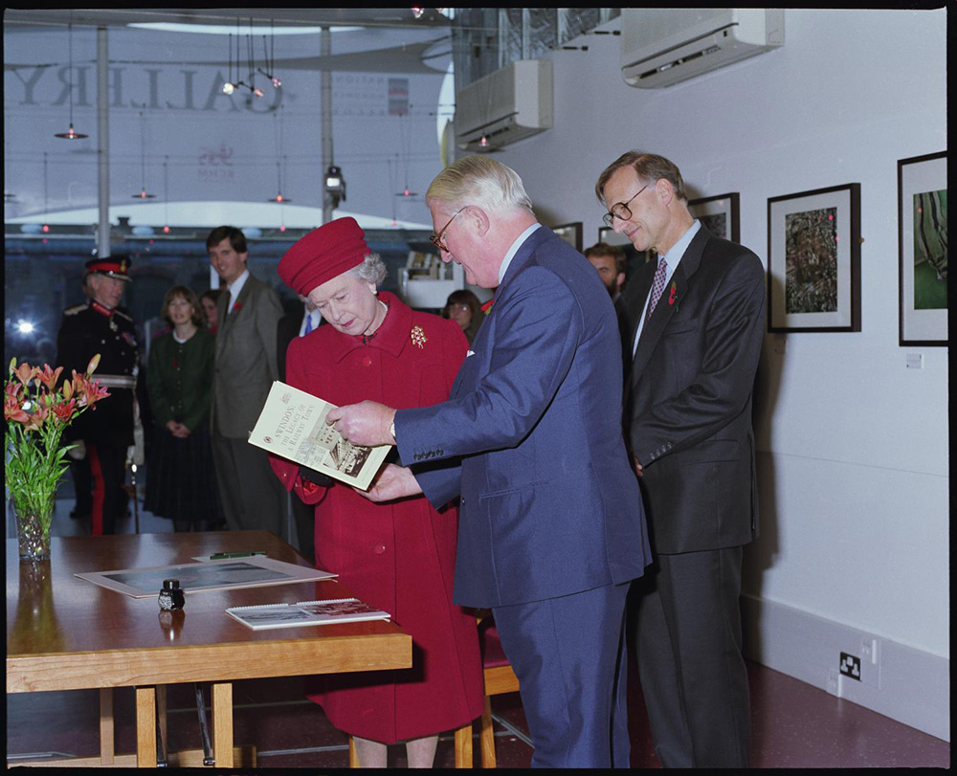
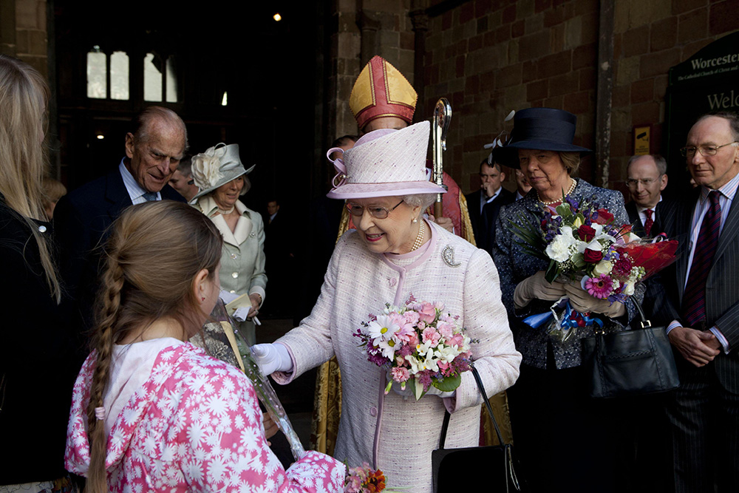
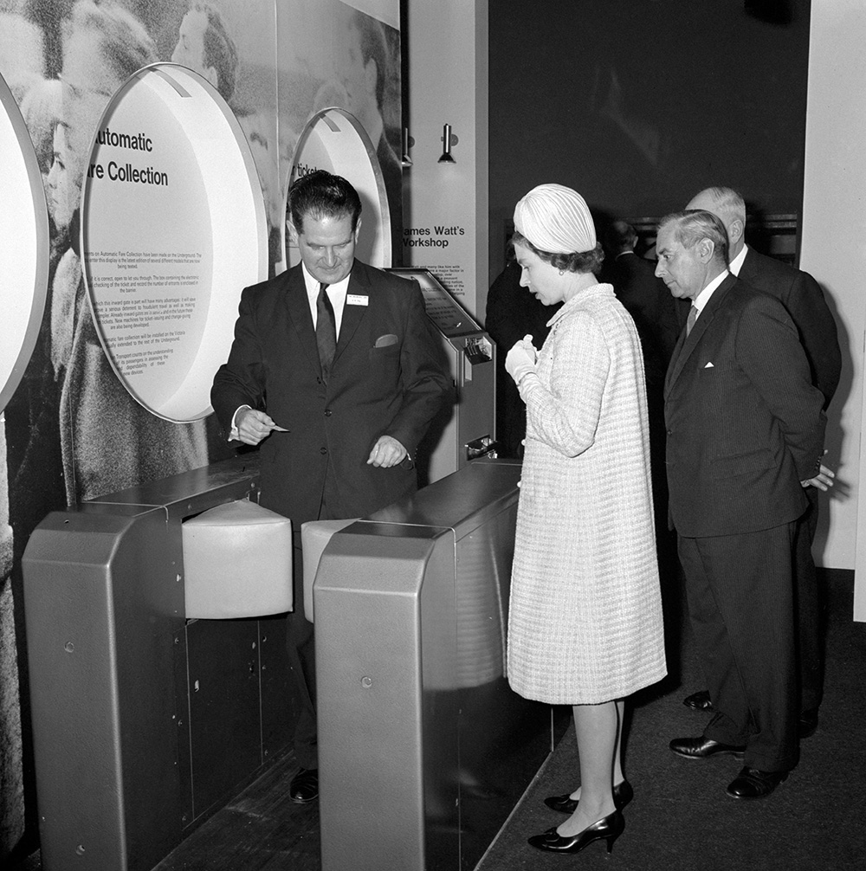
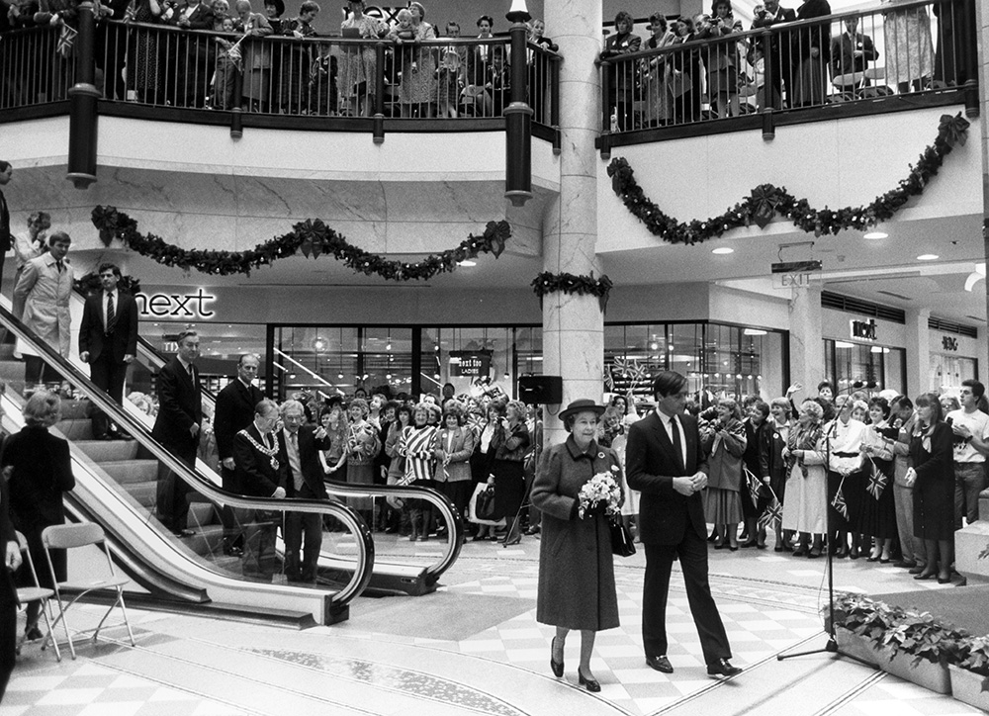
Try to put these images of the Queen into chronological order
What clues can help you?
1950s
2020s
Older
Newer
Notes:
1954 image Dewsbury Town Hall © Alamy G4PMCG 27.10 1954
1965 image The Science Museum © Alamy GG52DR4 18.11.1966
1977 image Tess Dock Transporter Bridge © Alamy ERT19K 14.07.1977
1988 image Bolton Market Hall © Alamy EP2D66 01.12.1988
1997 image Historic England Archive © Crown Copyright Historic England Archive AA97/07146 – 07.11.1997
2004 image Colchester Campus University © Alamy G7EGAR 25.11.2004
2012 image Leicester Train Station © Alamy G51COG 08.03.2012
2021 image Worcester Cathedral © Alamy G5A75P 11.07.2021

Slide 29

Looking for clues
What does the colour and quality of the photograph tell you?
Have you spotted the woman with the camera? Does it look like a modern camera?
What do the styles of the clothes tell you?
How old do you think the Queen might be in this photograph?
What do the hair styles tell you?
Lots of people have Union Jack flags – what type of an event do you think this might be?
Notes:
Image - The Queen visiting the Tees Dock Transporter Bridge © Alamy ERT19K 14.07.1977

Slide 30
Answer sheet
1977
1988
1954
1965
1997
2004
2012
2021
1950s
2020s
Older
Newer
Notes:
1954 image Dewsbury Town Hall © Alamy G4PMCG 27.10 1954
1965 image The Science Museum © Alamy GG52DR4 18.11.1966
1977 image Tees Dock Transporter Bridge © Alamy ERT19K 14.07.1977
1988 image Bolton Market Hall © Alamy EP2D66 01.12.1988
1997 image Historic England Archive © Crown Copyright Historic England Archive AA97/07146 – 07.11.1997
2004 image Colchester Campus University © Alamy G7EGAR 25.11.2004
2012 image Leicester Train Station © Alamy G51COG 08.03.2012
2021 image Worcester Cathedral © Alamy G5A75P 11.07.2021

Slide 31
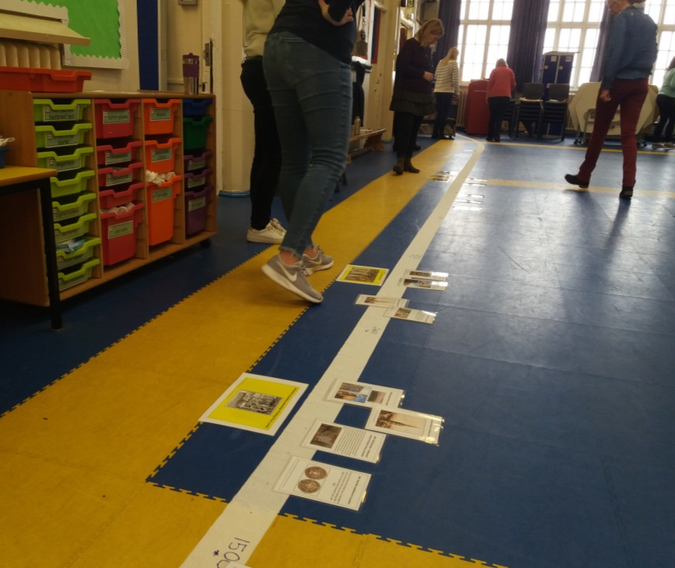
Make a timeline of the Queen
Download the PowerPoint of images of the Queen in your region.
Make a note of when the images were taken.
Make a timeline by putting them in chronological order
1952
2022
Notes:
The Regional Images PowerPoints can be downloaded from - https://historicengland.org.uk/services-skills/education/teaching-activities/platinum-jubilee/
Image © Historic England Heritage Schools

Slide 32
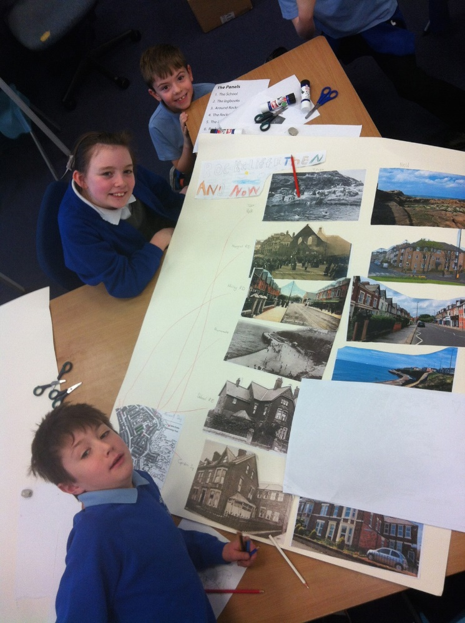
Make a timeline of the buildings
Download the PowerPoint of images of the buildings in your region.
Make a note of when the images were taken.
Make a timeline by putting them in chronological order
Older
Newer
Notes:
The Regional Images PowerPoints can be downloaded from - https://historicengland.org.uk/services-skills/education/teaching-activities/platinum-jubilee/
Image © Historic England Heritage Schools

Slide 33
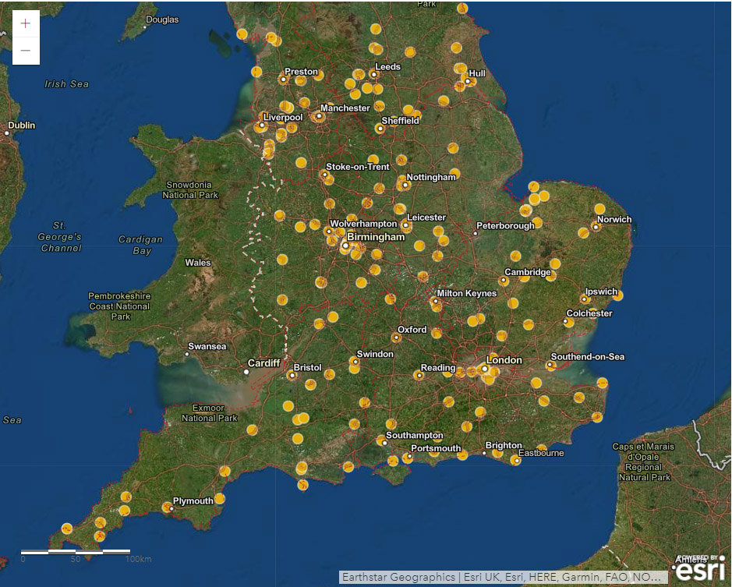
Put your regional heritage in a national context
After you have practiced dating photographs on the Story Map in your own region, try dating the photographs in other regions of the country.
Notes:
https://historicengland.org.uk/services-skills/education/teaching-activities/platinum-jubilee/

Slide 34
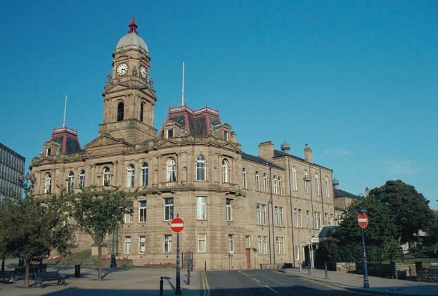
‘Top Trumps’ listed buildings
Create your own Top Trumps Game of the listed buildings the Queen has visited in your region.
Copy the images of the listed buildings from your region’s PowerPoint to make the cards.
Use the information on the Story Map to create the scoring system
Ideas for scoring:
Number of royal visits (highest trumps)
Date built/opened (oldest trumps)
Date of the Queen’s last visit (most recent trumps)
Images on the NHLE (highest trumps)
Date listed (oldest listing trumps)
Grade of listing (highest grade trumps)
Dewsbury Town Hall
Royal Visits 3
Date built/opened between 1888-9
Date of the Queen’s last visit 07.10.1954
Images on the NHLE 2
Date listed 08.11.1977
Grade of listing Grade II
Notes:
Town Hall, including the Magistrates' Court. © Mr Richard Turner. Source: Historic England Archive: IOE01/00888/13 - 04 Sept 1999

Slide 35
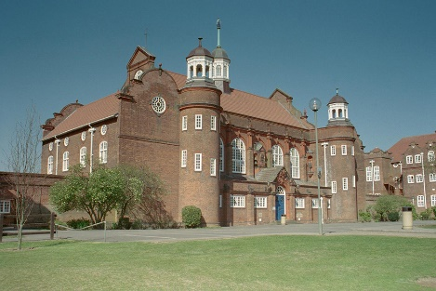
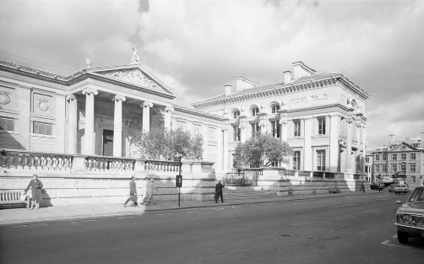
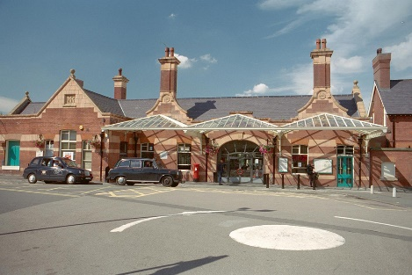
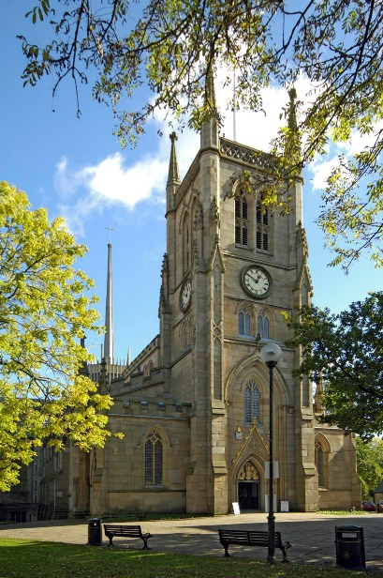
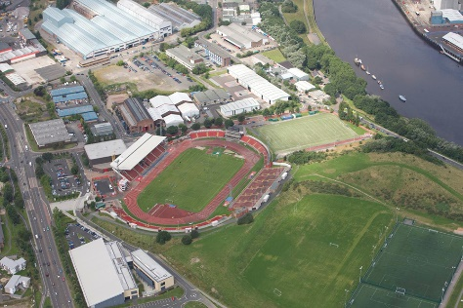
Different ‘types’ of buildings
School
Museum
Can you put the buildings into different groups or categories?
Health
Education
Faith
Military
Sport
Arts, Culture & Heritage
Industry & retail
Transport
Train Station
Cathedral
Stadium
Notes:
King Edward VII Academy
Source: Historic England Archive - IOE01/07474/32- 17 Apr 2003
Kettering Station© Mr Roger Ashley. Source: Historic England Archive - IOE01/08379/22 - 8 Feb 2002
Ashmolean Museum. Source Historic England - AA98/04780 - 1945 – 1980
International Stadium © Historic England Archive - 20925_062 – 6 August 2009
Blackburn Cathedral © Historic England Archive - DP033702 - 17 Oct 2007

Slide 36
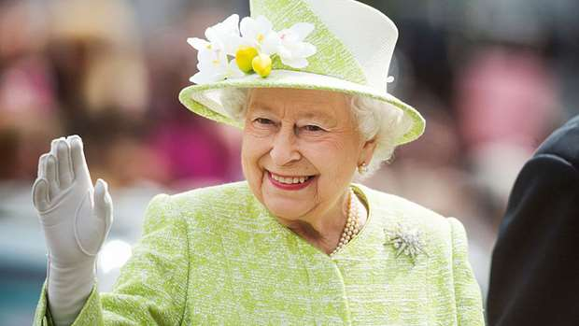
‘Where’s the Queen?’
Play: Where’s the Queen?
Get into pairs, find another pair to play with.
In turns:
First choose an image of the Queen visiting your region
Each pair must try to guess where she is using no more than 20 questions
Notes:
When playing this game with children it may be necessary to provide scaffolding in the form of vocabulary lists or compass roses. Some children may need some pre-learning on what the symbols on the maps represent. The game is really effective in drawing children into an historical map, they will start to notice all kinds of details that they wouldn’t have seen at first glance.
Geography Curriculum Key Stage 1
Pupils should be taught to:
Geography Curriculum
Place knowledge
understand geographical similarities and differences through studying the human and physical geography of a small area of the United Kingdom
Human and physical geography
use basic geographical vocabulary to refer to:
key physical features, including: beach, cliff, coast, forest, hill, mountain, sea, ocean, river, soil, valley, vegetation, season and weather
key human features, including: city, town, village, factory, farm, house, office, port, harbour and shop
Geographical skills and fieldwork
use simple compass directions (North, South, East and West) and locational and directional language [for example, near and far; left and right], to describe the location of features and routes on a map
Geography Curriculum KS2
Pupils should be taught to:
Locational knowledge
name and locate counties and cities of the United Kingdom, geographical regions and their identifying human and physical characteristics, key topographical features (including hills, mountains, coasts and rivers)
Place knowledge
understand geographical similarities and differences through the study of human and physical geography of region of the United Kingdom
Geographical skills and fieldwork
use maps, atlases, globes and digital/computer mapping to locate countries and describe features studied
use the eight points of a compass, four and six-figure grid references, symbols and key (including the use of Ordnance Survey maps) to build their knowledge of the United Kingdom and the wider world
The game is really effective in drawing children into an historical map, they will start to notice all kinds of details that they wouldn’t have seen at first glance.

Slide 37
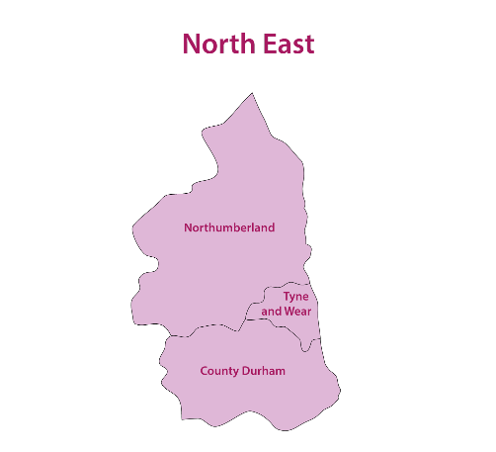
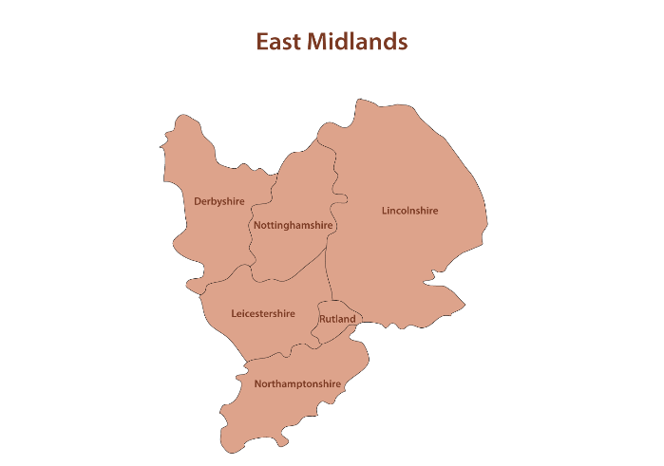
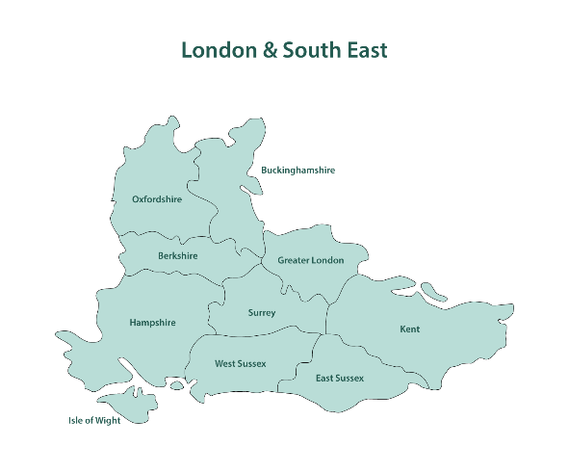
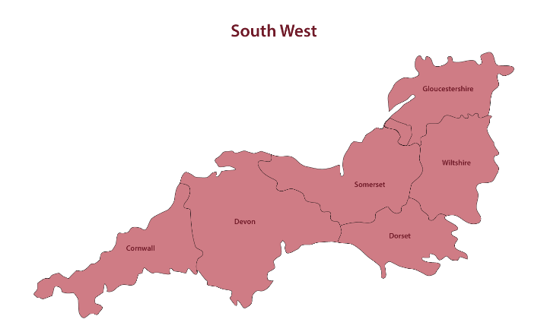
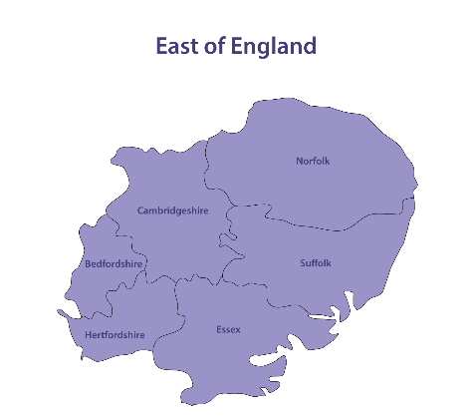
First, work out which county or district the Queen has visited in your region
Play: Use the counties map for your region
Notes:
These can be found in the Regional Images PPTs on https://historicengland.org.uk/services-skills/education/teaching-activities/platinum-jubilee/
Images © Historic England Heritage Schools

Slide 38
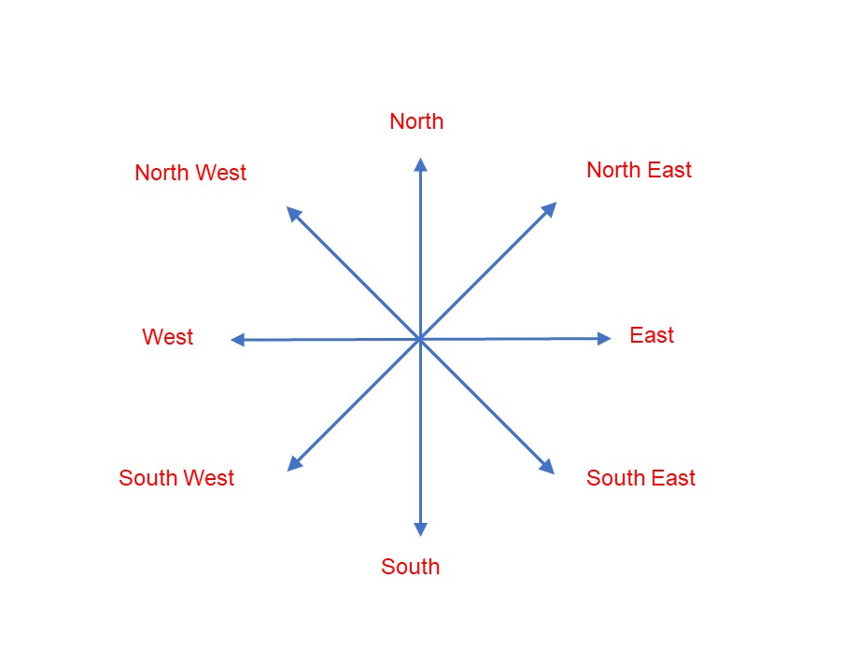

Play: Use Cardinal points to help find her
Remember the top of a map is always north
Are there any landmarks you can use as a starting point?
For example:
Is the Queen north of the river?

Slide 39
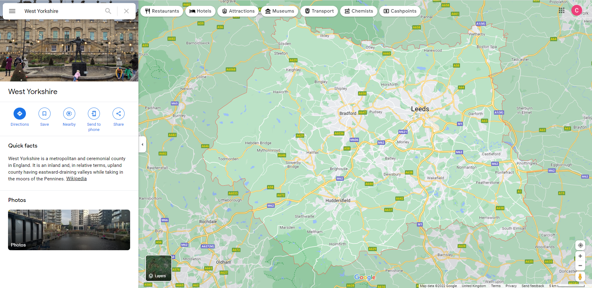
Play: Use a Google Maps to ask more questions
Is the Queen north of the M62?
Is the Queen in a city?
Is the Queen in a faith building?
Notes:
These can be found in the Regional Images PPTs on https://historicengland.org.uk/services-skills/education/teaching-activities/platinum-jubilee/
Images © Historic England Heritage Schools

Slide 40
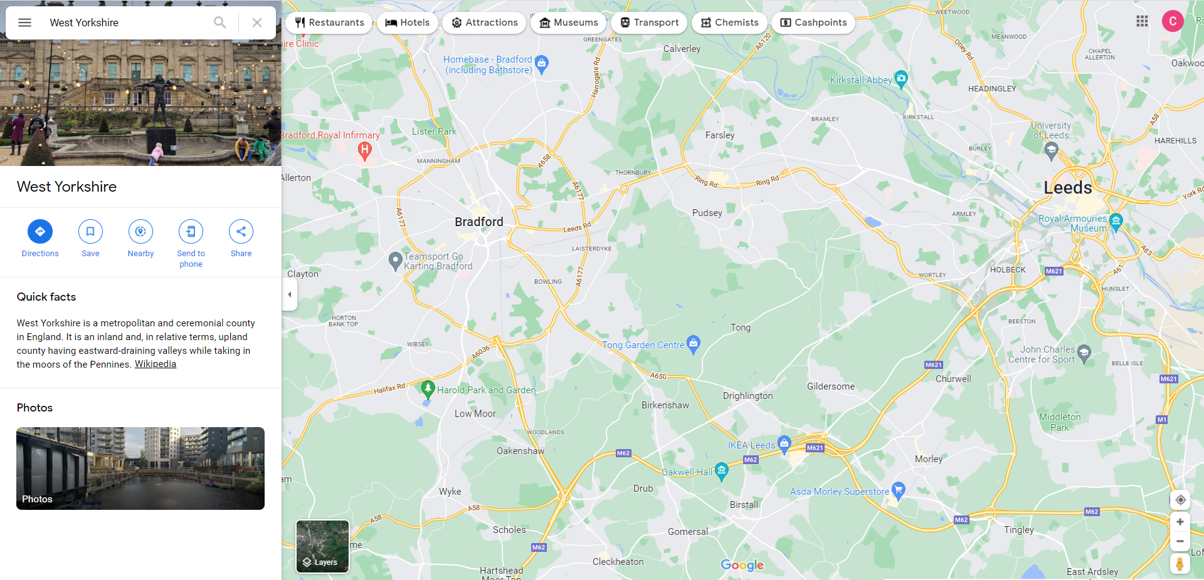
Play: Narrow down the map as you go…
Is the Queen north of the M62? yes
Is the Queen in a city? yes
Is the Queen in a faith building? no
Notes:
These can be found in the Regional Images PPTs on https://historicengland.org.uk/services-skills/education/teaching-activities/platinum-jubilee/
Images © Historic England Heritage Schools

Slide 41
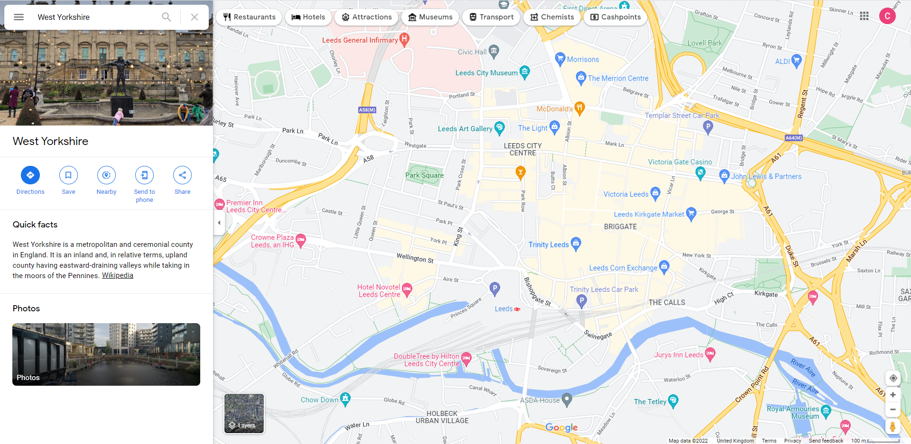
Play: Narrow down the map as you go…
Does the city begin with ‘L’? yes
Is she north of the River Aire? yes
Is she west of Park Square? no
Notes:
Keep going until you find the building!
Images © Historic England Heritage Schools

Slide 42
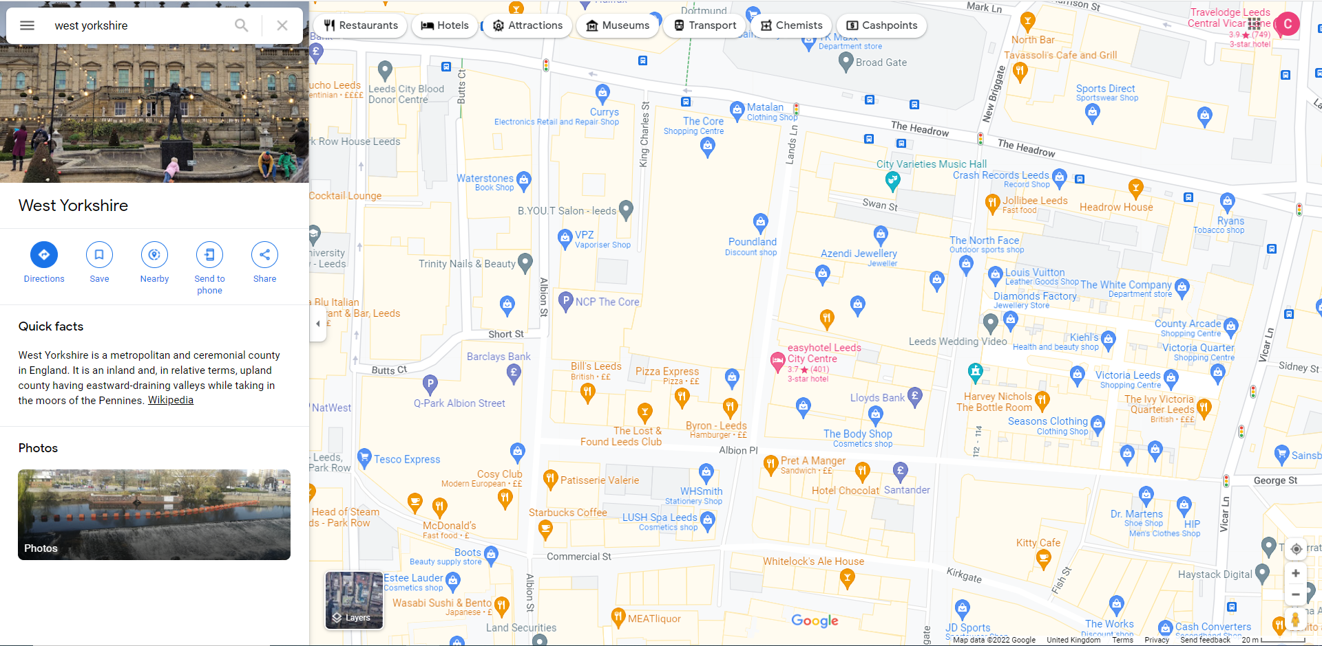
Play: Narrow down the map as you go…
Is she east of The Core shops? yes
Is she east of Victoria Leeds shops? no
Is she in a place of arts & culture? yes
Notes:
Keep going until you find the building!
Images © Historic England Heritage Schools

Slide 43
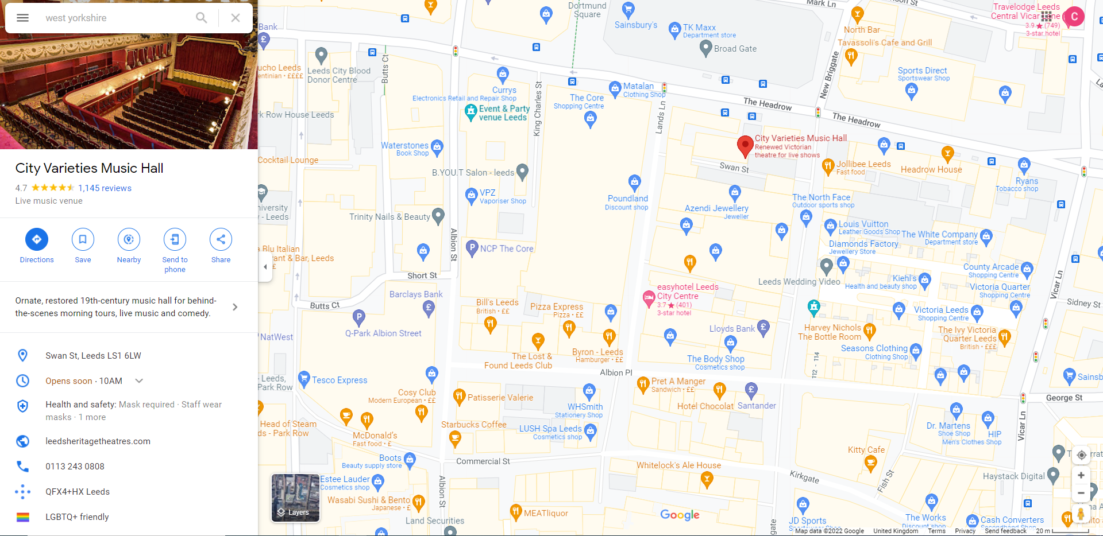

Play: Narrow down the map as you go…
YES!
Is she in the City Varieties Music Hall?
Notes:
Keep going until you find the building!
Images © Historic England Heritage Schools

Slide 44

Where is the Queen?
First work out which region she is in.
Try playing the game for the whole country!
Notes:
Images © Historic England Heritage Schools
Key stage 2
Pupils should extend their knowledge and understanding beyond the local area to include the United Kingdom
They should develop their use of geographical knowledge, understanding and skills to enhance their locational and place knowledge

Slide 45


Create your own map of the Queen’s visits
Draw or trace the map of your region
Draw significant landmarks like rivers, hills, woods, ports and beaches etc.
Label some of the main cities, towns and villages
Design a key for different places the Queen has visited and insert them on the map e.g.
  faith buildings
  arts and heritage buildings
  hospitals
  education buildings etc
Draw your own map
Draw the buildings on the map or draw the Queen on the map
Notes:
Images © Historic England Heritage Schools
Geography Curriculum
use aerial photographs and plan perspectives to recognise landmarks and basic human and physical features; devise a simple map; and use and construct basic symbols in a key

Slide 46


Extension Enquiry
Compare life
for people living in
Queen Elizabeth II’s reign to people living in Queen Victoria’s reign
Notes:
Compare the reign of Queen Victoria with that of Queen Elizabeth II - https://historicengland.org.uk/services-skills/education/teaching-activities/reign-queen-victoria/
Queen Vitoria image Source Historic England © Historic England Archive Photo Library ref: N880023
Queen Elizabeth II image © Alamy G5TC57 08.05.2002 https://historicengland.org.uk/services-skills/education/teaching-activities/reign-queen-vic
Link to Who is our Queen Royal Collection Trust https://www.rct.uk/discover/school-resources/platinum-jubilee/who-is-our-queen
KS1 Pupils should be taught about:
changes within living memory. Where appropriate, these should be used to reveal aspects of change in national life
significant historical events, people and places in their own locality
Link to Reign of Queen Victoria Historic England
KS2 Pupils should be taught about:
A local history study
a study over time tracing how several aspects of national history are reflected in the locality
a study of an aspect of history or a site dating from a period beyond 1066 that is significant in the locality.
A study of an aspect or theme in British history that extends pupils’ chronological knowledge beyond 1066
e.g. the changing power of monarchs using case studies

Slide 47
Find more teaching resources at:
HistoricEngland.org.uk/Education

