Slide 1
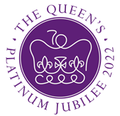
Queen Elizabeth II Platinum Jubilee
Story Map – East Region Images
Key Stage 2: History & Geography
Learning Aims and Outcomes
Pupils understand more about the role of the Queen by exploring the Story Map of some of her visits to different places across England
Pupils learn about the Queen’s visits to significant places/events in their region of the country through her 70-year reign
Pupils develop a sense of place through mapwork
Pupils can identify regions of England and locate places in the region they live in
Pupils take part in celebrating a significant historical event
This learning resource supports the Historic England Platinum Jubilee Story Map & Platinum Jubilee Activities PPT
Notes:
This resource is intended to be used with the Historic England Jubilee Story Map which documents some of the many places the Queen has visited throughout her reign. Pupils are able to explore the pins on the map of their region of the country to find out about the significant buildings and events the Queen has visited. The Story Map contains information about the visit, a brief history of the building and images of the Queen and the building.

Slide 2
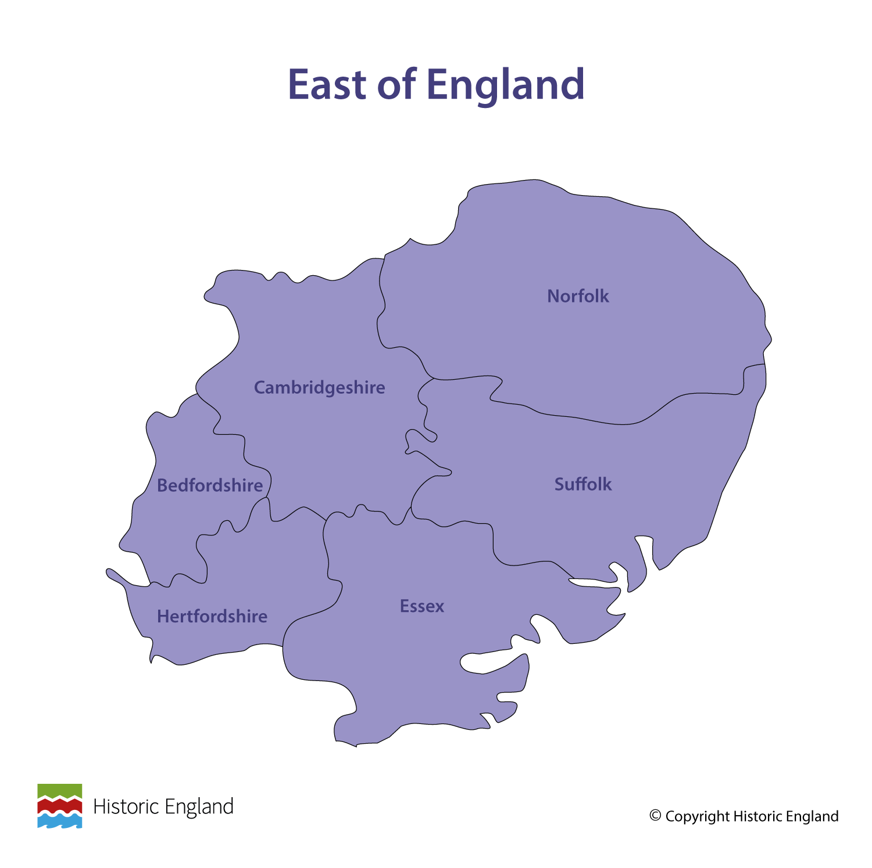
Notes:
Before following the link to your regional Story Map you may wish to discuss with pupils what counties are covered in your region.

Slide 3
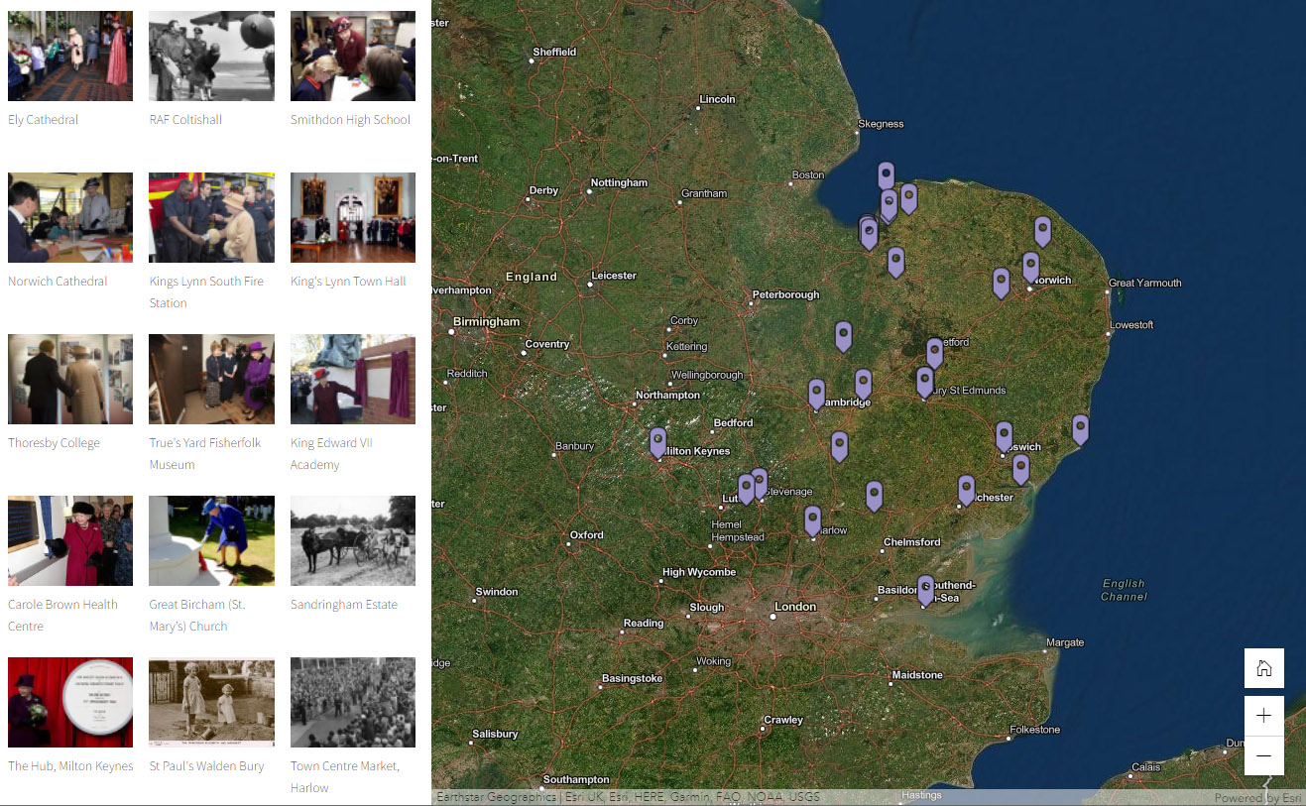
Notes:
Follow the link to the East of England Story Map - https://storymaps.arcgis.com/stories/4a772ad5468c434ea51d5b3d350a06a2

Slide 4
Ely Cathedral
The Queen meets local school children during a visit to Ely Cathedral 19th November 2009. It is known locally as "the ship of the Fens". It was founded as a monastery in 673 by St. Etheldreda, a Saxon Princess from East Anglia.
In 1071, Ely became a focus of English resistance to the Norman conquest led by Hereward the Wake. The present Cathedral began in 1083. Architecturally outstanding for its scale and stylistic details, its most notable feature is the central octagonal tower.
However, on 13th February 1322, the north-west transept collapsed, and a great sloping mass of masonry was built to buttress the remaining walls, which remain in their broken-off state on the north side of the tower.
Find out more on the National Heritage List.

Slide 5
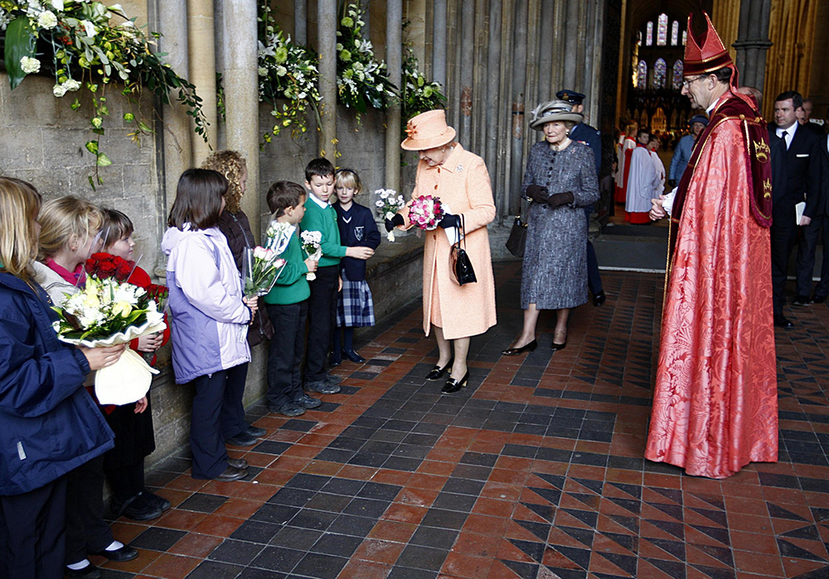
Notes:
The Queen accepting posies of flowers from local school children inside the cathedral, as a Bishop looks on. © Alamy - GC6ARN - 19 November 2009

Slide 6
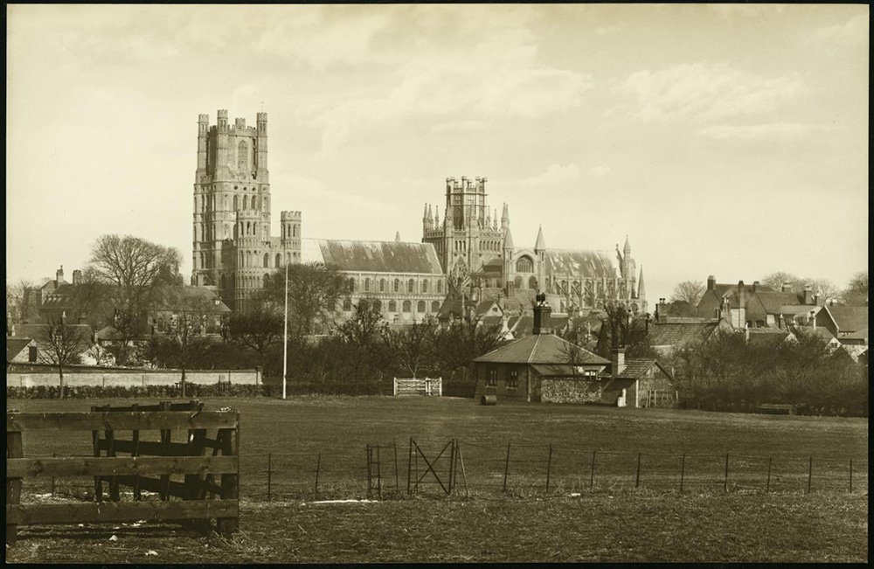
Notes:
A black and white view of Ely Cathedral from the south-west, with a sports pitch in the foreground. Source Historic England Archive - RBO01/05/OP22390 - 1880 –1905

Slide 7
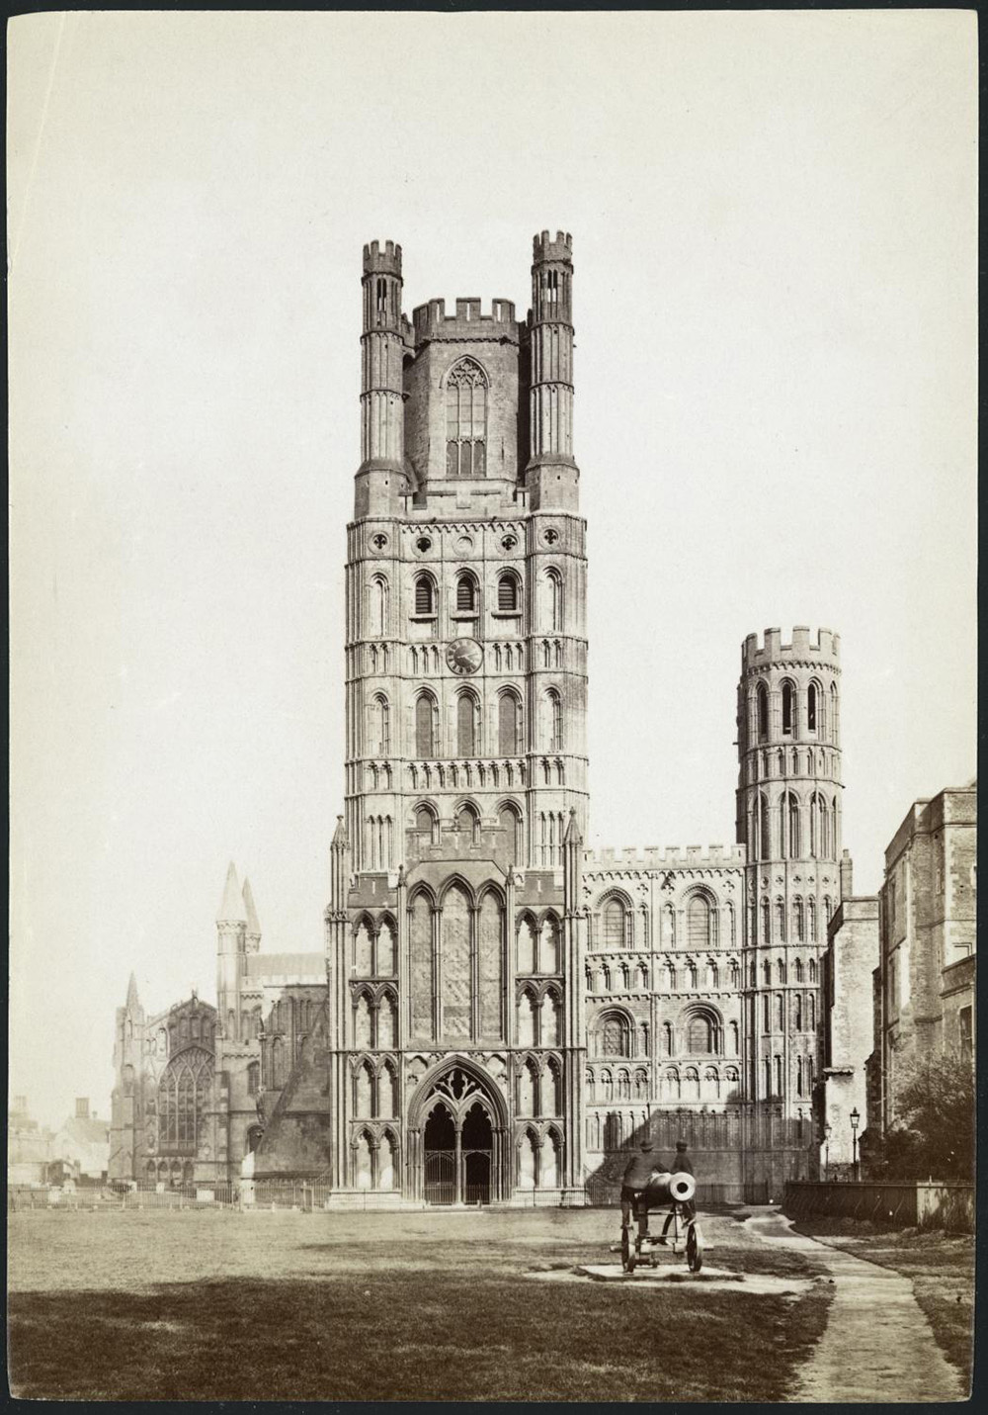
Notes:
A black and white view of the west front of Ely Cathedral, with two people leaning on a canon in the foreground. Source Historic England Archive - RBO01/05/OP22312 - 1890 –1910

Slide 8
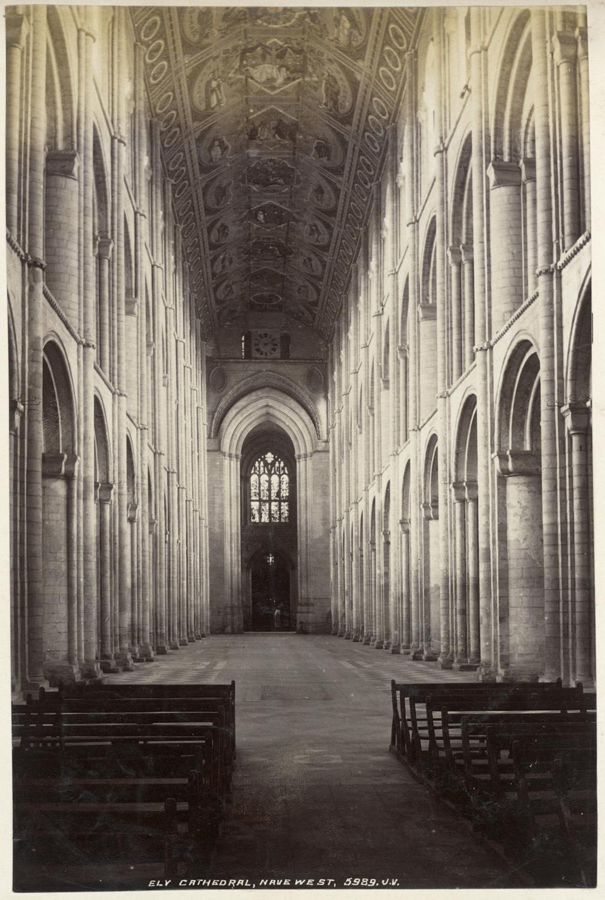
Notes:
A black and white view of the nave of Ely Cathedral, looking west. Source Historic England Archive - RBO01/05/OP22548 - 1875 -1905

Slide 9
RAF Coltishall
The Queen has visited RAF Coltishall more than once. She inspected planes on a visit in 1983 and her most recent visit was on 17 November 2005, to mark the 65th anniversary of the airfield. RAF Coltishall operated from 1938 to 2006.
It was a fighter airfield in the Second World War; a front-line fighter station in the Cold War; then a station for night fighters then ground attack aircraft until closure. During its prime, RAF Coltishall was a flourishing military base with many individuals involved in its running. Many acts of bravery were displayed by these courageous men and women, with some receiving legendary status.
Former RAF Coltishall is one of Norfolk’s most important historic airfields, now in the care of Norfolk County Council.
Find out more on the National Heritage List.

Slide 10
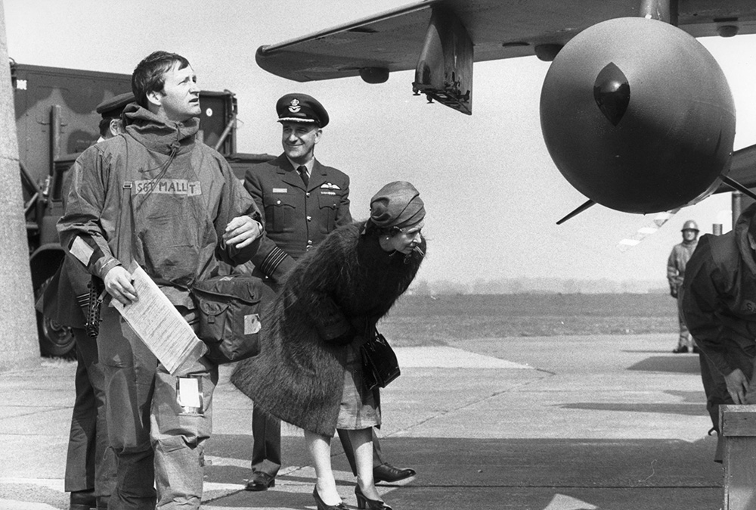
Notes:
A black and white image if the Queen looking at the underside of a Jaguar reconnaissance aircraft during a visit to RAF Coltishall. In the background is Group Captain Richie Profit. © Alamy - G7G1N8 - 5 May 1983

Slide 11
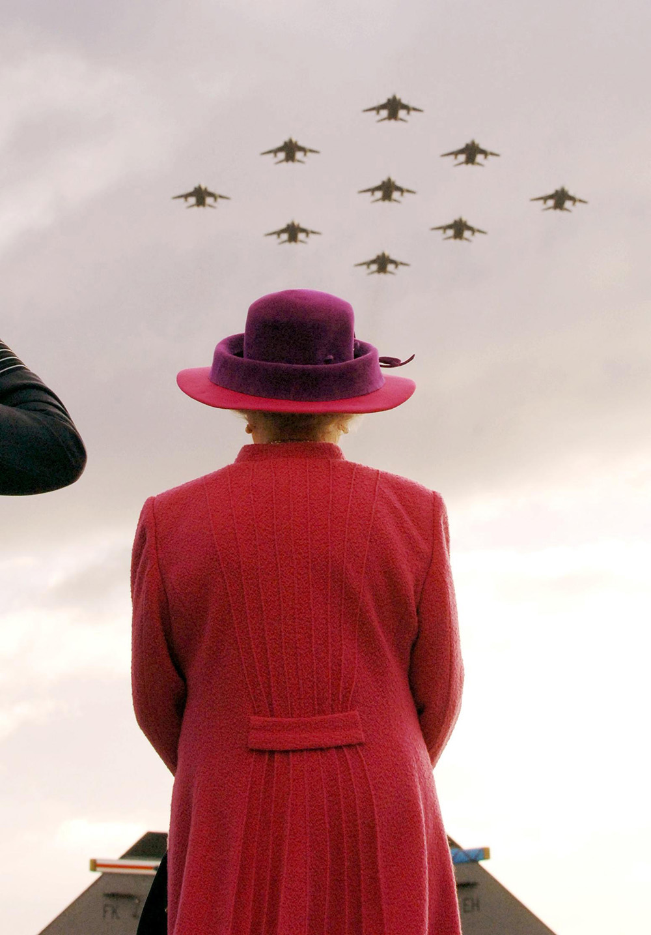
Notes:
The Queen watches a flypast by RAF Jaguars in a diamond 9 formation at RAF Coltishall during a visit to the airbase, marking the 65th anniversary of the airfield. © Alamy - G915RB - 17 November 2005

Slide 12
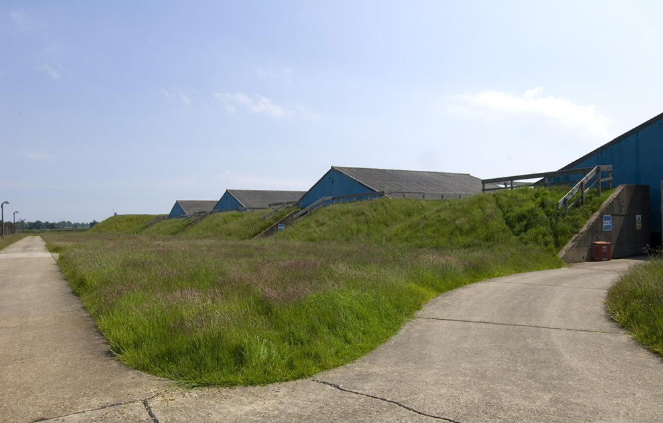
Notes:
The tops of three buildings rise out of the ground and the entrance to a fourth are the remains of a 1950s missile store at RAF Coltishall. © Historic England Archive – DP027175 - 8 Jun 2006

Slide 13
Smithdon High School
The Queen with students in the Curriculum Learning support classroom during her visit to Smithdon High School in Hunstanton, Norfolk on 31 January 2001. The school was built in 1954 during the post-war period and the baby boom following World War Two.
A national competition for architecture was won by the Smithsons, who designed the school in their “New Brutalism” style. It was one of their first designs. It remains a significant building to this day and has Grade II listed status.
In 1980, the school became a comprehensive school. The name Smithdon comes from the administrative division of a larger region, dating back to before Norman times. The Smithdon Hundred, was a collection of parishes around Hunstanton.
Find out more on the National Heritage List.

Slide 14
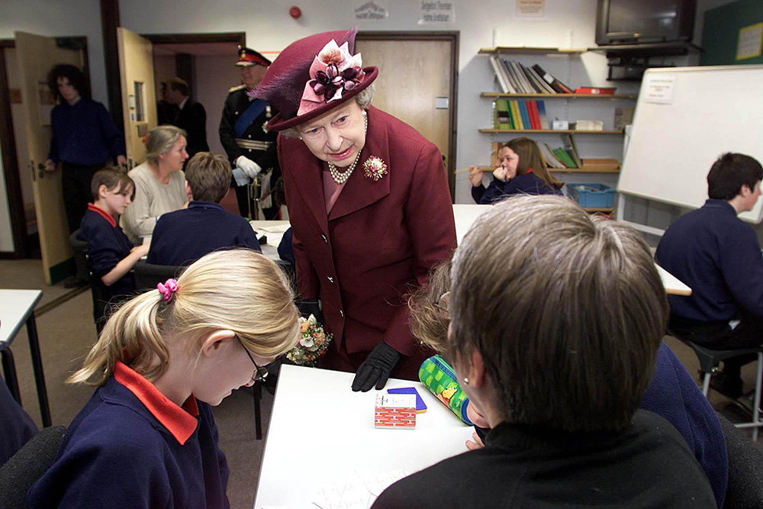
Notes:
The Queen with students in the Curriculum Learning support classroom during her visit to the Special Educational Needs Unit and Learning Resource Centre at Smithdon High School. © Alamy - G59BJW - 31 January 2001

Slide 15
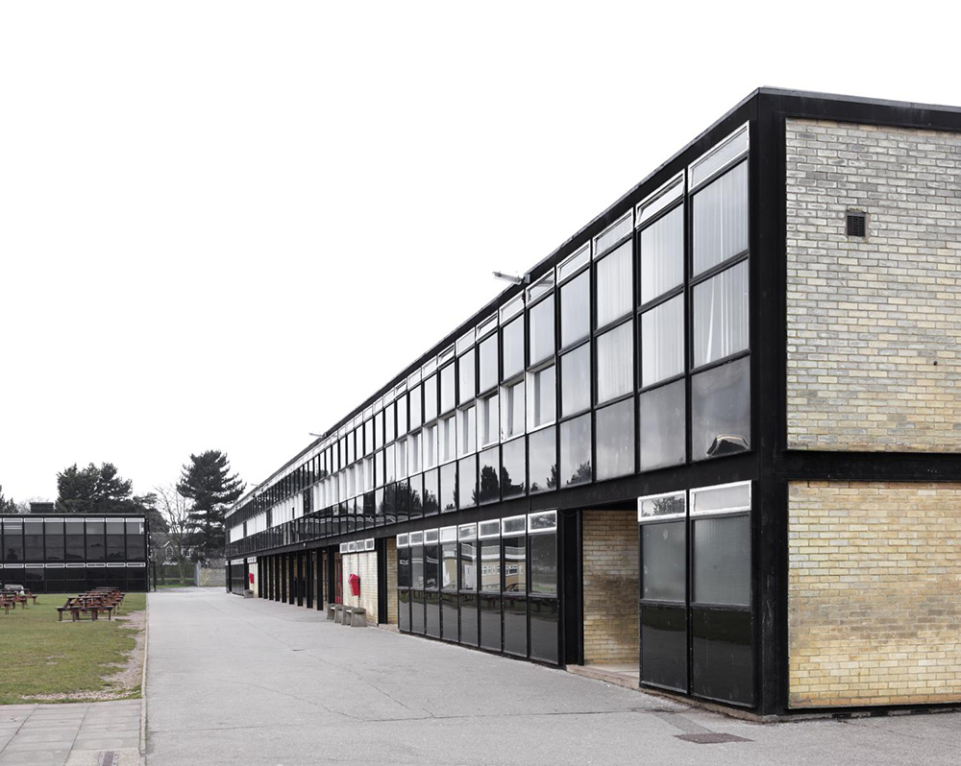
Notes:
A view of the south side of the main classroom block at Smithdon School, showing how it is almost entirely made up of windows. © Historic England Archive - DP180592- 27 Jan 2015

Slide 16
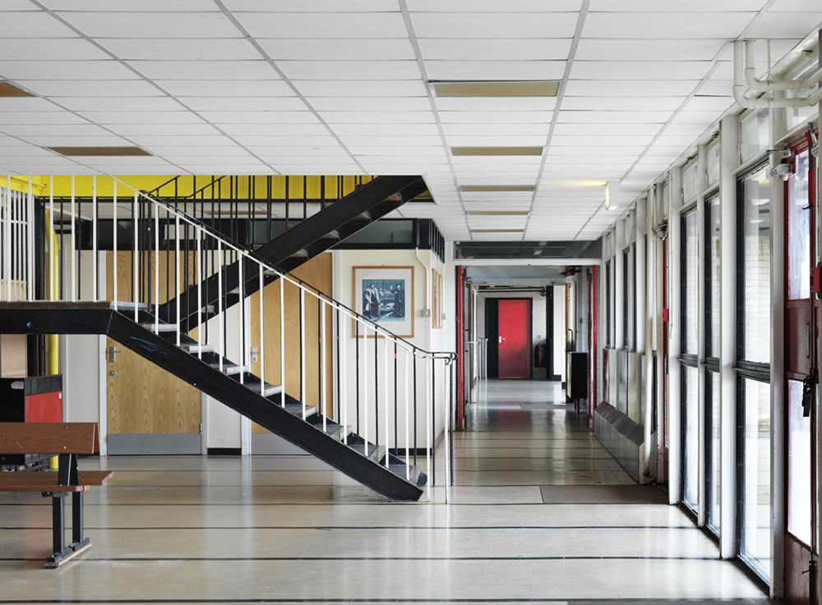
Notes:
A view of a corridor and staircase in Smithdon School. © Historic England Archive - DP180595 - 27 Jan 2015

Slide 17
Norwich Cathedral
The Queen visited Norwich Cathedral for a service of Dedication for the new hostry and refectory on 4 May 2010.
Begun in 1096, the structure of the cathedral is primarily in the Norman style. An Anglo-Saxon settlement and two churches were demolished to make room for the buildings and a canal cut to allow access to the River Wensum.
The cathedral was completed in 1145 but over the next 600 years, suffered damage through riots, storms, lightning strikes, fires and civil war. Rebuilding was done in both gothic and perpendicular styles. However, the roof bosses survived, and are one of the world's greatest medieval sculptural treasures.
Find out more on the National Heritage List.

Slide 18
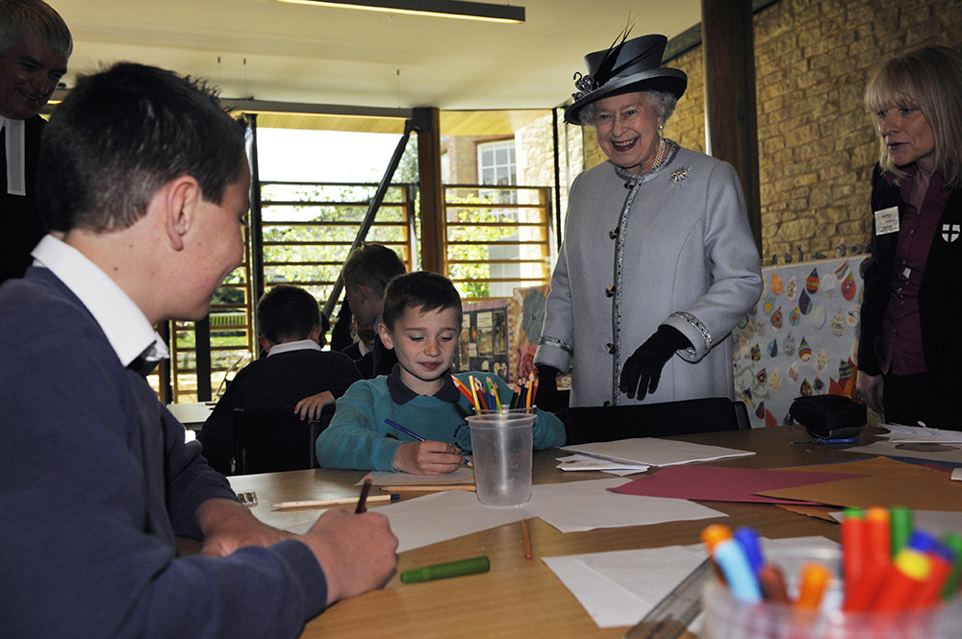
Notes:
The Queen smiling as she meets children in the Education room at Norwich Cathedral. © Alamy - GCFJ0J - 4 May 2010

Slide 19
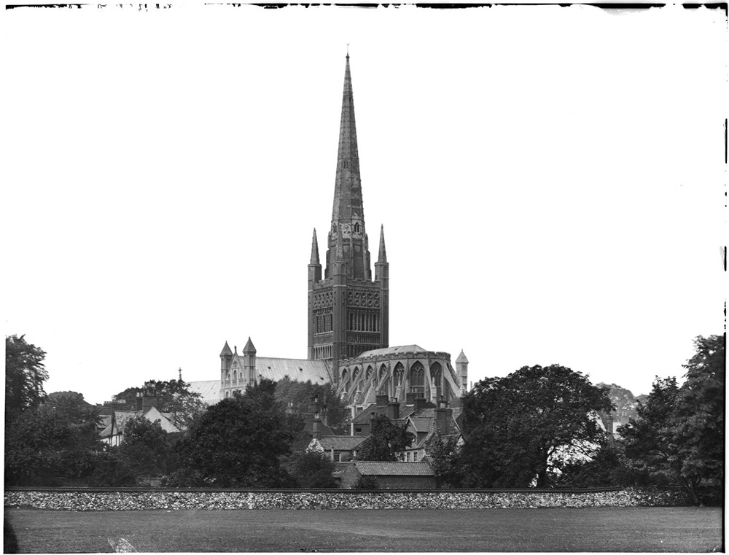
Notes:
A black and white view showing Norwich Cathedral from Norwich School's cricket ground to the east. Source Historic England Archive - CC76/00378 - 6 Jul 1920 - 10 Jul 1920

Slide 20
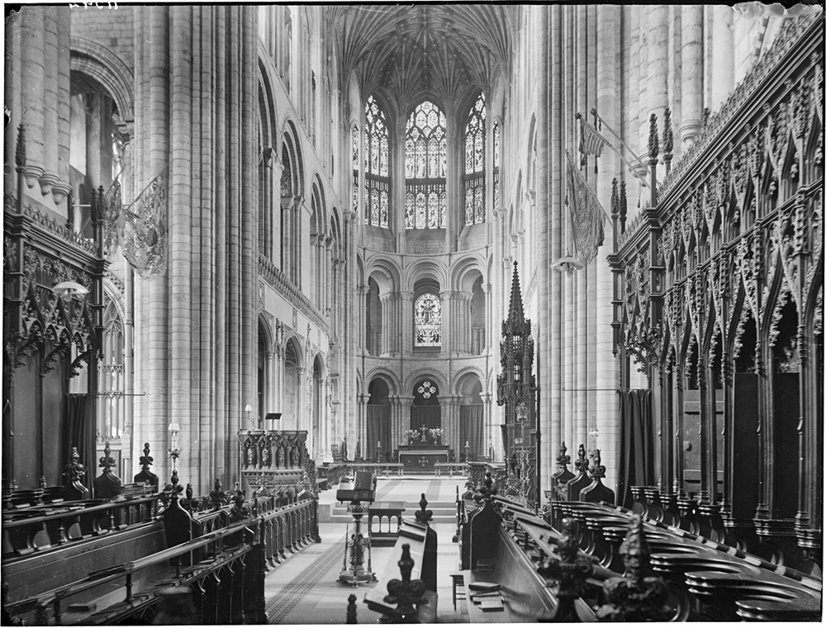
Notes:
A black and white interior view looking east across the choir of Norwich Cathedral. Source: Historic England Archive - CC78/00175 - 6 Jul 1920 - 10 Jul 1920

Slide 21
Kings Lynn South Fire Station
The Queen meets firefighters as she formally opens the new Kings Lynn South Fire Station, 2 February 2015. She unveiled a plaque to mark the official opening.
The station has a Fire Appliance staffed by Wholetime Duty System (WDS) Firefighters available twenty-four hours a day, seven days a week working in teams, known as watches.
Thousands more homes are likely to be built over the next decade along the A10 corridor to accommodate Lynn's growing population. The new station offers a much faster response south of Lynn. As part of their community outreach they also offer visits to local schools.
Find out more about Kings Lynn South Fire Station.

Slide 22
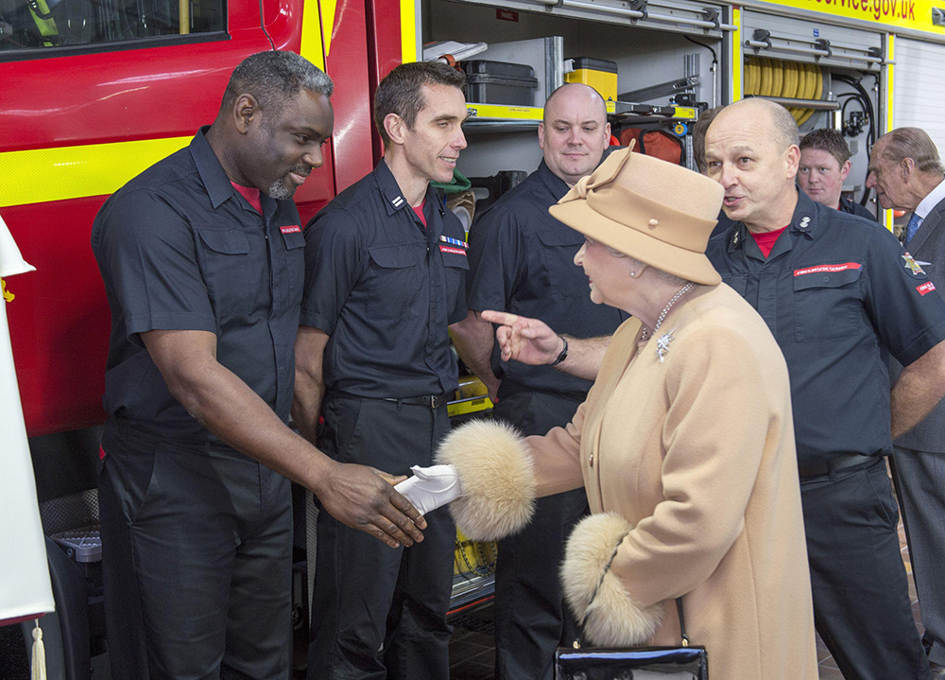
Notes:
The Queen smiles as she shakes hands with a line of firefighters as she formally opens the new South Lynn Fire Station. © Alamy - G7N0FC - 2 February 2015

Slide 23
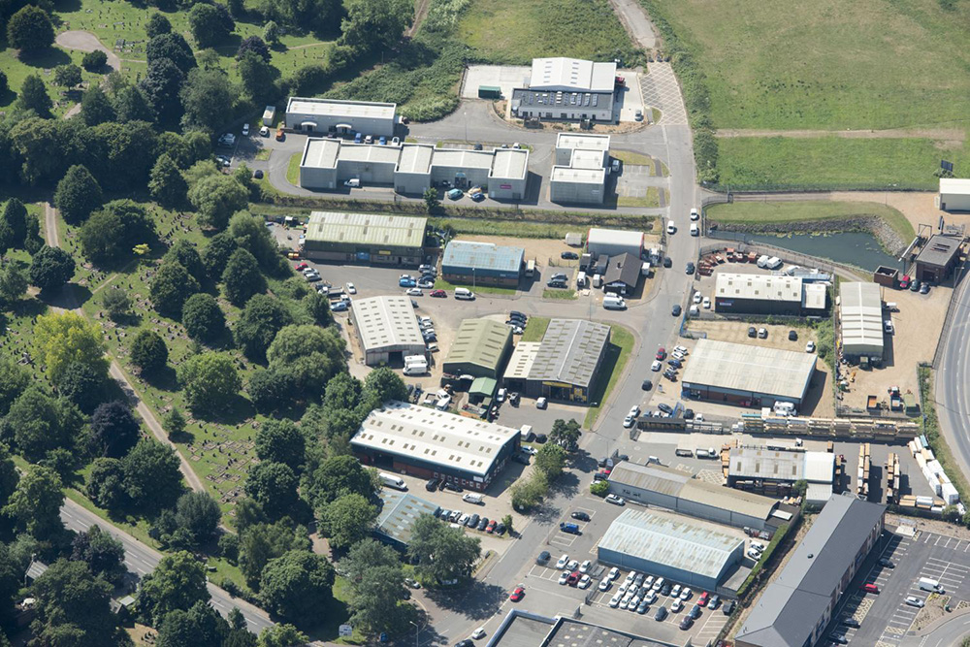
Notes:
An aerial view showing the location of the South Lynn Fire Station on the edge of an industrial estate. © Historic England Archive - 33197_020 – 19 June 2017

Slide 24
King's Lynn Town Hall
The Queen visited Kings Lynn Town Hall in Norfolk where she saw exhibits and met local dignitaries on 6 February 2012.
Originally home to the Trinity Guild, King’s Lynn Town Hall has been at the centre of life in the town for over eight centuries and the Borough Mayor is still based here. The heart of the Guildhall is Stone Hall, a medieval hall built in 1421 with a stone floor and oak-beamed ceiling.
After the Reformation closed the Guilds, the undercroft was used as a prison and a Bridewell (jail), a courtroom and ornate Assembly Room were added in the Georgian era. It is recognisable by its striking chequerboard pattern of flintwork facing onto the Saturday Market Place.
Find out more on the National Heritage List.

Slide 25
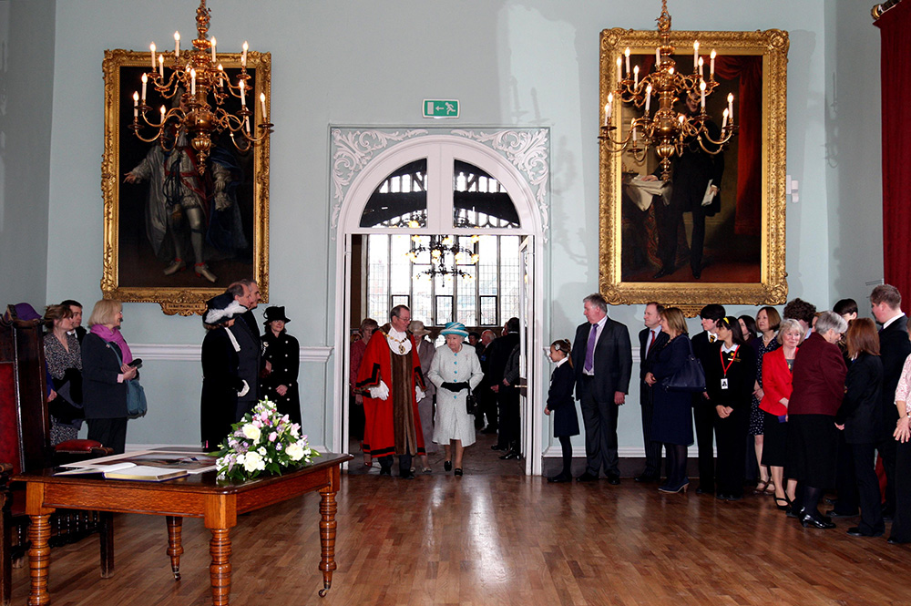
Notes:
The Queen and Mayor walk into a grand room within the Town Hall where a group of people are waiting to meet the Queen. The are large gold framed paintings on the wall and ornate chandeliers hanging from the ceiling. © Alamy - G4XNP8 - 6 February 2012

Slide 26
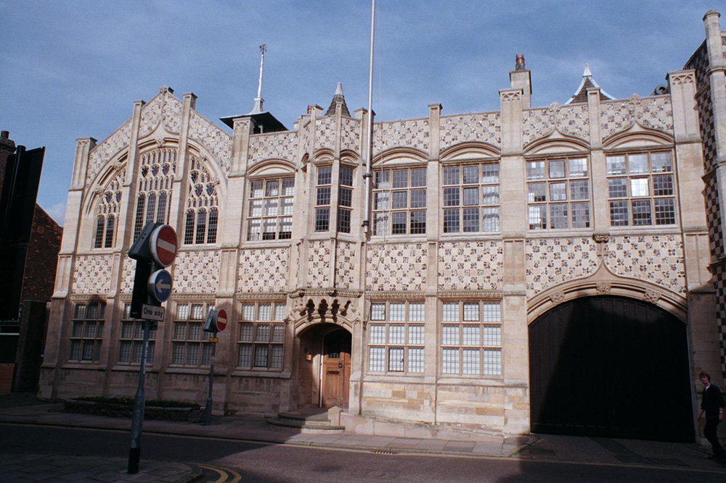
Notes:
A view of the front of the Town Hall with a distinctive stone and flint chequerboard pattern, designed to match the nearby, much older, Guildhall. © Graham Brown. Source: Historic England Archive - IOE01/00201/18 - 15 Oct 2000

Slide 27
Thoresby College
The Queen is shown an exhibition at the King's Lynn Preservation Trust in Thoresbury College, Kings Lynn Norfolk on 24 January 2008. Thoresby College is one of the most complete survivals of medieval Lynn.
Originally named Trinity College, it was the creation of Thomas Thoresby, burgess, merchant and three times Mayor of the Borough. Building started in 1508 and provided accommodation for priests of the Trinity Guild to pray for him and his family ‘as long as the world shall endure’.
After the Reformation, the college was sold and adapted for domestic and commercial use. In 1963, it was presented to the King’s Lynn Preservation Trust for restoration, with the request that the building be used for the benefit of the whole community.
Find out more on the National Heritage List.

Slide 28
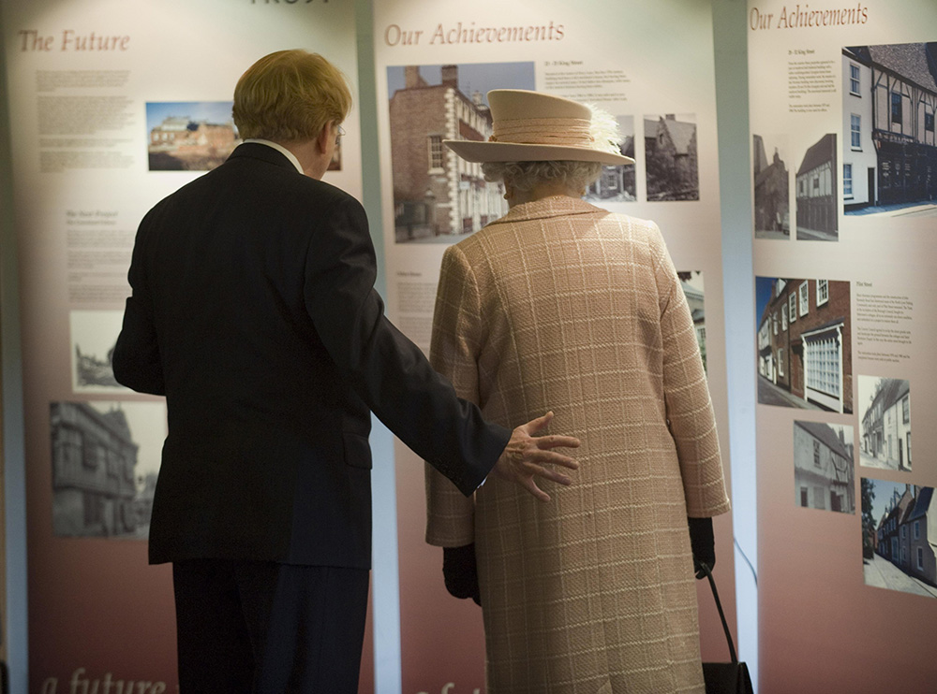
Notes:
The Queen and a man in a suit stand looking at exhibition panels by the King's Lynn Preservation Trust about the history of the Trust. © Alamy - GAGXK1 - 24January 2008

Slide 29
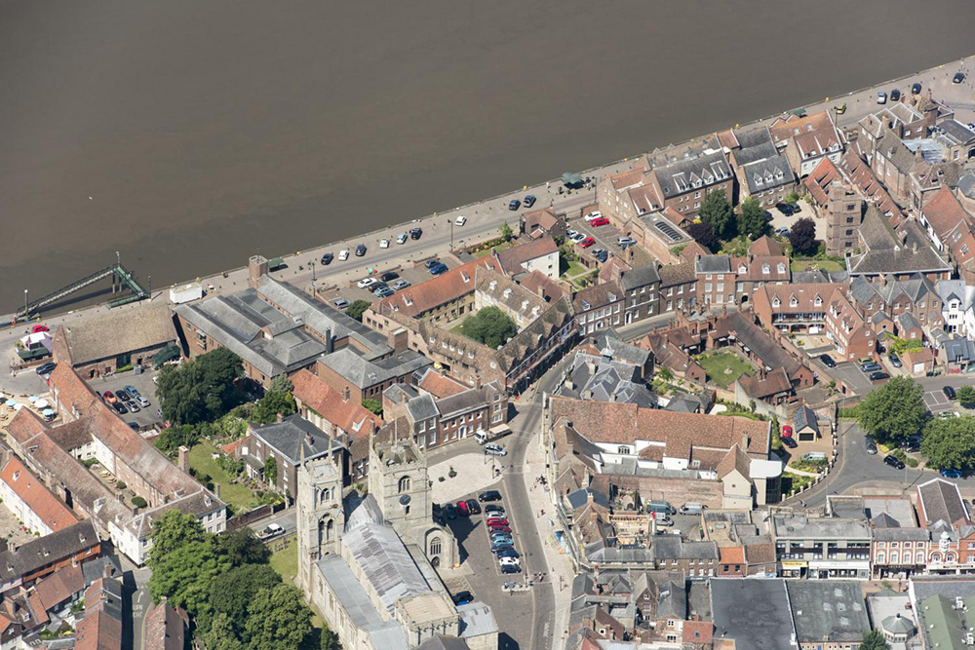
Notes:
An aerial view of Thoresby College showing its location between the river and the Town Hall © Historic England Archive - 33198_028 – 19 June 2017

Slide 30
True's Yard Fisherfolk Museum
The Queen visited True's Yard in King's Lynn on 5 February 2010. True’s Yard is a heritage site and town museum celebrating the fishing community which made such a significant contribution to Lynn’s economic and social life for 90 years.
The two cottages and smoke house are virtually all that remains of the North End. They are a physical reminder of the harsh lives of the hundreds of families, who once lived close by to the beautiful medieval chapel of St. Nicholas.
The North End had its own boat builders, chandlers, sailmakers, pubs, bakehouses and school. The fishing fleet still sails from King’s Lynn, but the old way of life has gone.
Find out more on the National Heritage List.

Slide 31
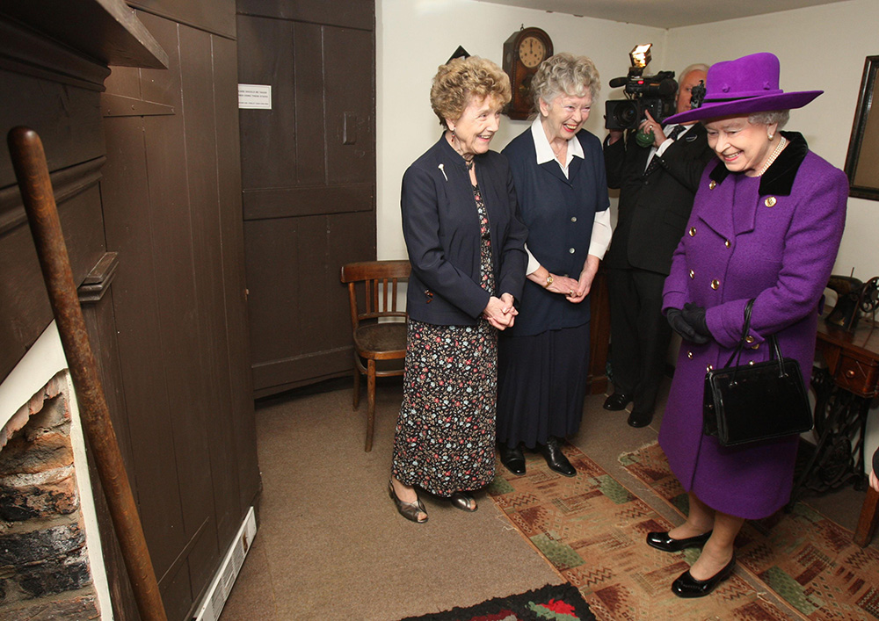
Notes:
The Queen smiles as she meets two women in one of the cottages that make up part of the heritage site. © Alamy - GCABTR - 5 February 2010

Slide 32
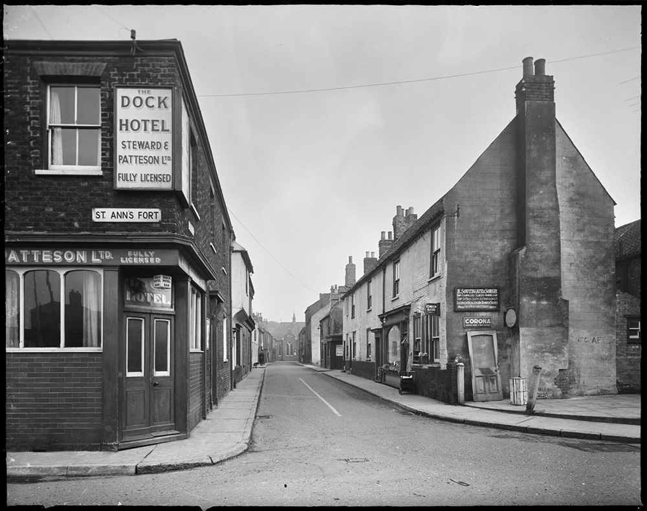
Notes:
A black and white image of North Street viewed from the junction of St Ann's Fort with True's Yard in the right foreground. © Historic England Archive - BB58/00143 - 1950 - 1958

Slide 33
King Edward VII Academy
The Queen visited King Edward VII High School in King's Lynn, Norfolk to unveil a plaque commemorating the School's Centenary year on January 24, 2007.
King Edward VII Academy was founded in 1510 by Thomas Thoresby, a former Mayor of Lynn, who made provision in his will for a priest to teach ‘grammar and song’. The name was changed to King Edward Vll Grammar School in 1903 when it was amalgamated with the King’s Lynn Technical School.
The current academy building was designed by Basil Champneys and opened in 1906 by King Edward VII. In 2014 the school became an academy and changed its name to King Edward VII Academy.
Find out more on the National Heritage List.

Slide 34
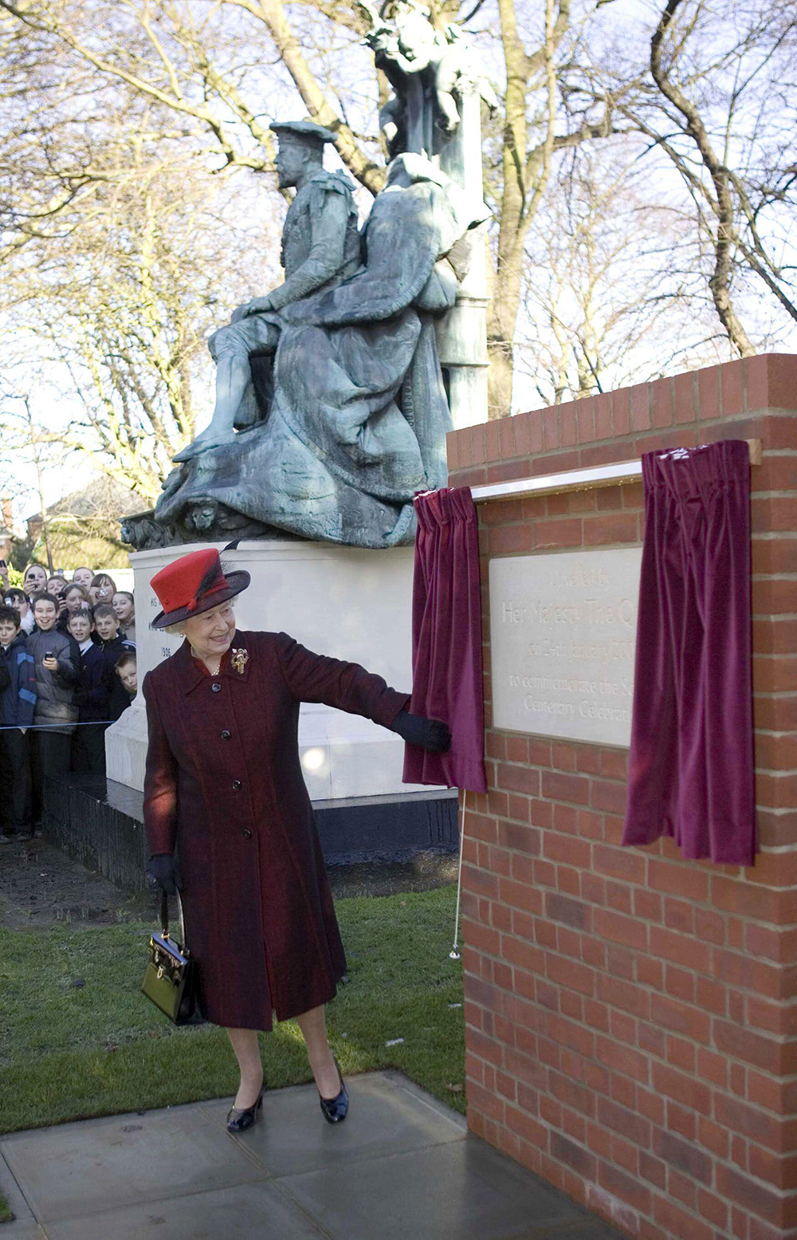
Notes:
The Queen pulling a cord to open some purple curtains a reveal a new stone plaque. © Alamy - 2GXC1HF - 24 January 2007

Slide 35
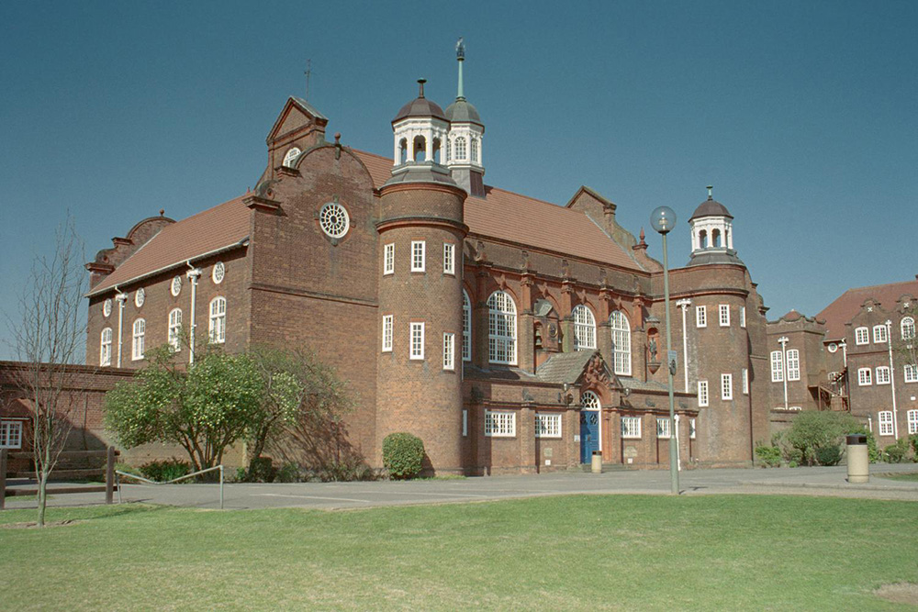
Notes:
A view of the ornate red brick building in an architectural style known as Queen Anne Revival. © Graham Brown. Source: Historic England Archive - IOE01/07474/32- 17 Apr 2003

Slide 36
Carole Brown Health Centre
The Queen arrived without her 87-year-old husband to open the Carole Brown Health Centre on 3 February 2009. She was greeted by more than 200 well-wishers.
She seemed visibly amused as she unveiled a plaque to officially open the health centre, which read: 'This plaque was unveiled by Her Majesty The Queen, accompanied by HRH The Duke of Edinburgh.' Prince Philip was due to join the Queen but was recovering from a back problem suffered while carriage-driving at Sandringham.
Among the large crowd were more than 100 children from Dersingham First and Nursery School, who waved handmade union flags. The Queen was given flowers by seven-year-old Phoebe Ward, whose grandmother is a nurse at the centre.

Slide 37
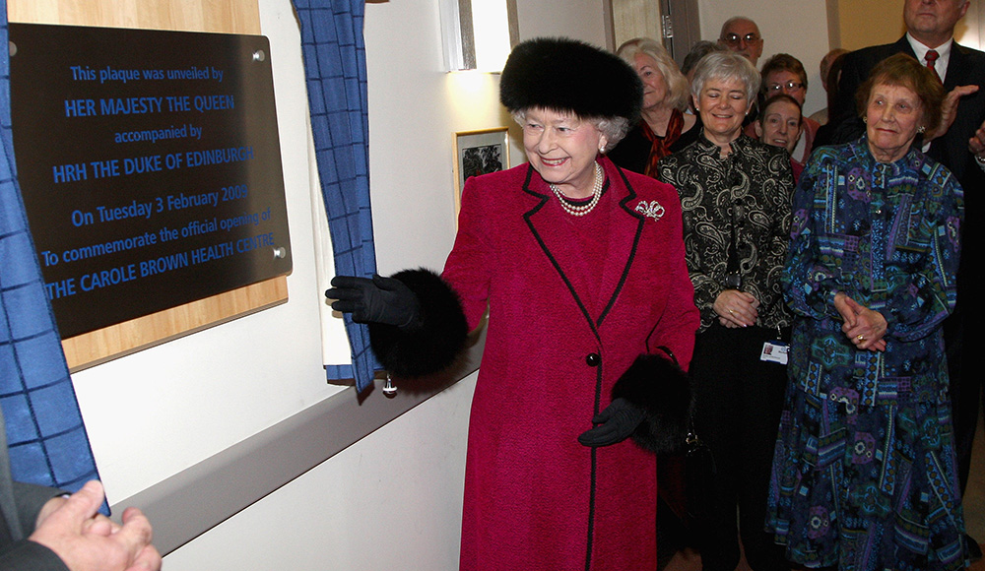
Notes:
The Queen smiles as she unveils a plaque to celebrate the opening of a new Health Centre. © Alamy – GBCAXB - 3 February 2009

Slide 38
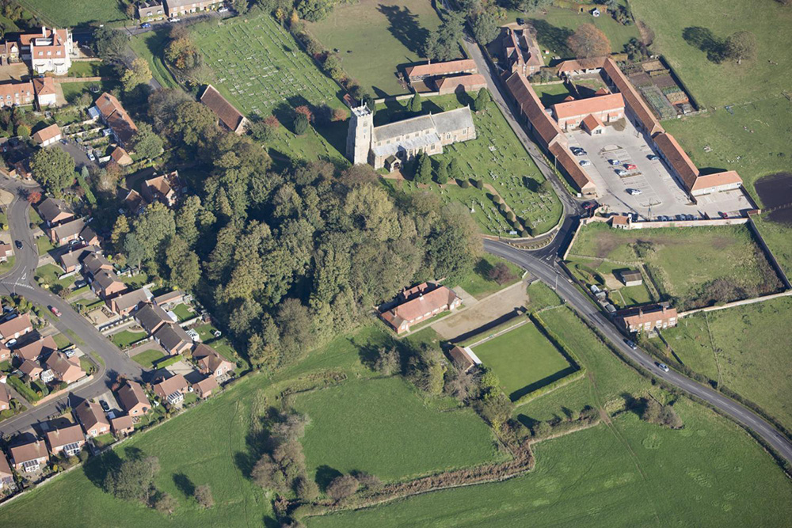
Notes:
An aerial view showing the Carole Brown Health Centre. © Historic England Archive - 26159_009 – 29 Oct 2008

Slide 39
Great Bircham (St. Mary’s) Church
The Queen laid a wreath at the Cross of Sacrifice at St Mary's Church, Great Bircham, Norfolk on 1 July 2006 , to mark the 60th anniversary of the unveiling of the first Cross of Sacrifice to be completed after the Second World War.
During the 1939-1945 war the Grade II listed Norman church’s churchyard was used for the burial of airmen from RAF Bircham Newton, service dead whose bodies were washed up by the sea and German airmen brought down in the Battle of Britain.
The cross of Sacrifice, the first to be erected after the 1939-1945 war, was unveiled by His Majesty King George VI on 14th July 1946. There is now one, 1914-1918 war casualty and nearly 80, 1939-1945 war casualties commemorated in the churchyard.
Find out more on the National Heritage List.

Slide 40
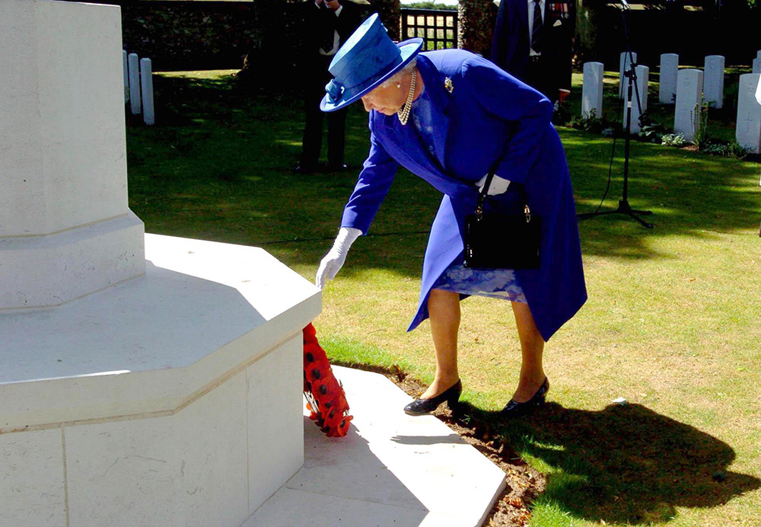
Notes:
The Queen bending down to lay a wreath at the Cross of Sacrifice at St Mary's Church, Great Bircham. © Alamy – G9ENFJ - 16 July 2006

Slide 41
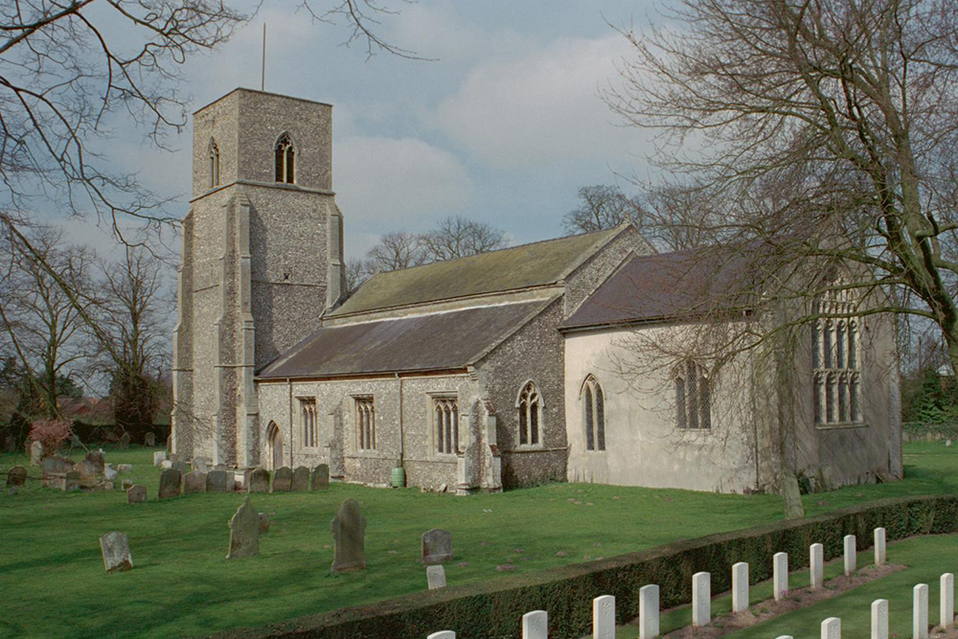
Notes:
A general view of the church, including its rare early Norman tower. © Mr Brian R. Faulkner. Source: Historic England Archive - IOE01/04690/04 - 27 Mar 2002

Slide 42
Sandringham Estate
Sandringham House and Estate are a royal residence. The house has been occupied since the 16th century but only became a royal residence in 1862, when the future King Edward VII had the house almost completely rebuilt. It was the setting for the first Christmas broadcast in 1932 by George V.
The Queen spends each winter on the Sandringham Estate, including the anniversary of her father's death and her accession in February, since 1952. In 1957, she broadcast her first televised Christmas message from there.
In 1977, for her Silver Jubilee, the house and grounds were opened to the public for the first time. In early February 2022, the Queen stayed at the house to mark her Platinum Jubilee.
Find out more on the National Heritage List.

Slide 43
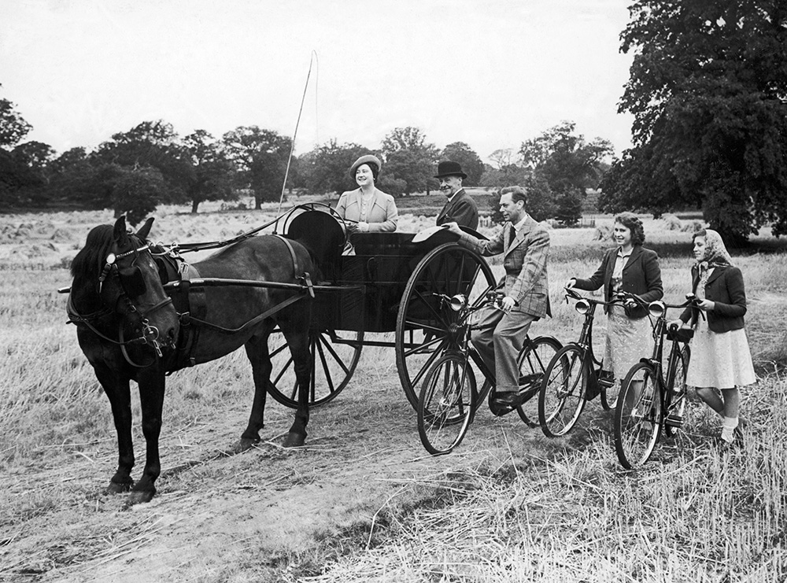
Notes:
A black and white photo showing (right to left) Princess Margaret, Princess Elizabeth (later the Queen) and their father King George VI on bicycles, next to a horse and carriage with Princess Elizabeth's mum (later the Queen Mother) and a driver sat in the carriage. They are inspecting the crops on the Sandringham Estate during the Second World War. © Alamy – EJNEPN - 13 August 1943

Slide 44
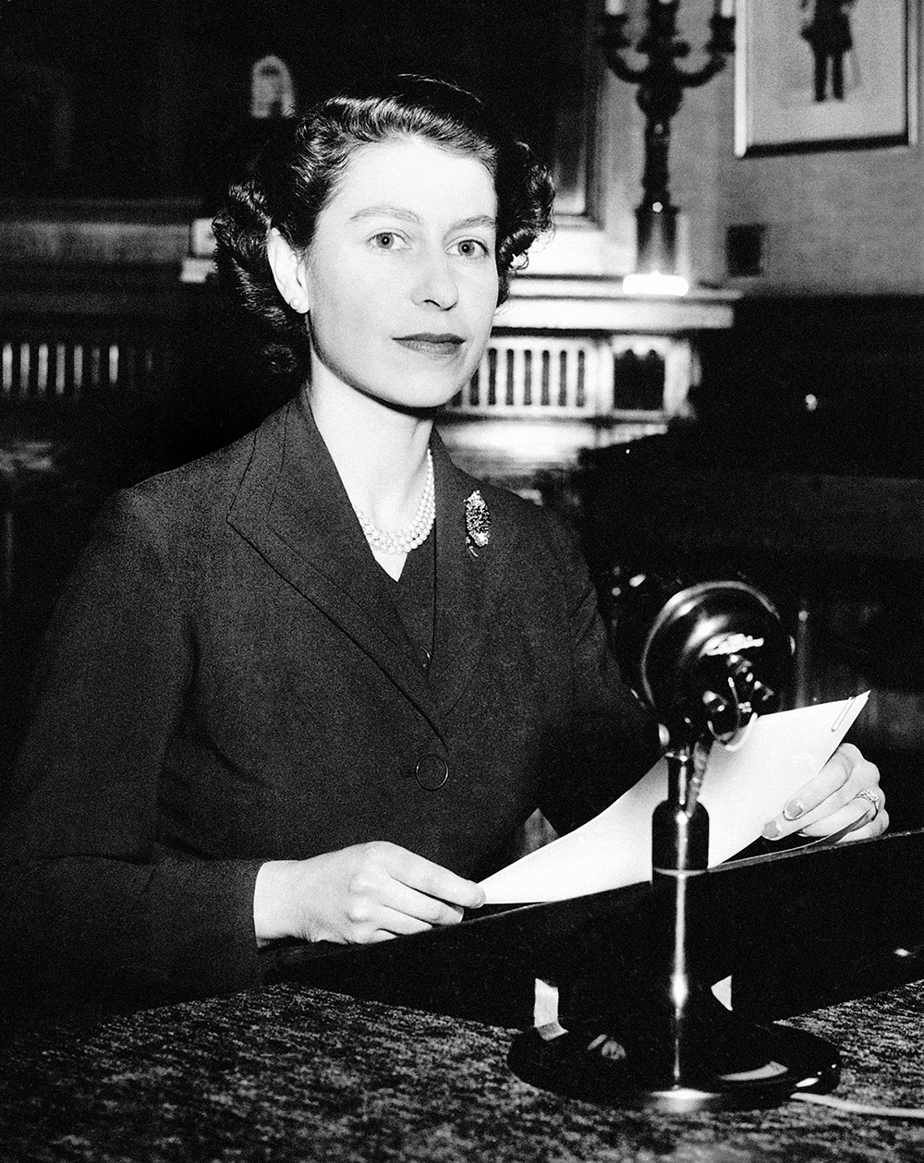
Notes:
A black and white image of the queen, aged 26, holding a script and sat in front of a microphone making her first ever Christmas speech., which she did at Sandringham. © Alamy – G4GP36 - 25 December 1952

Slide 45
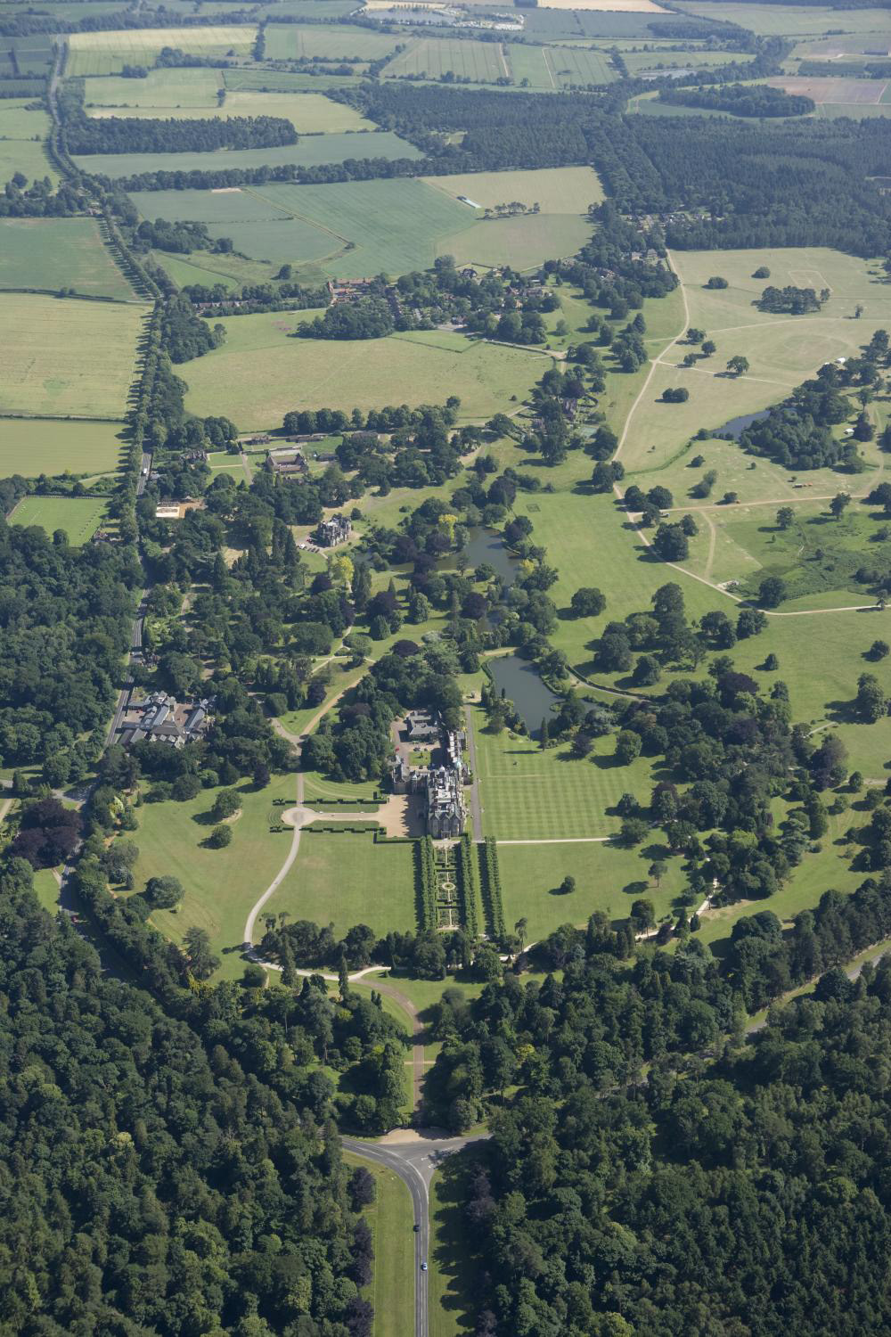
Notes:
An aerial view of the Sandringham Estate and House. © Historic England Archive - 26057_023 – 01 July 2008

Slide 46
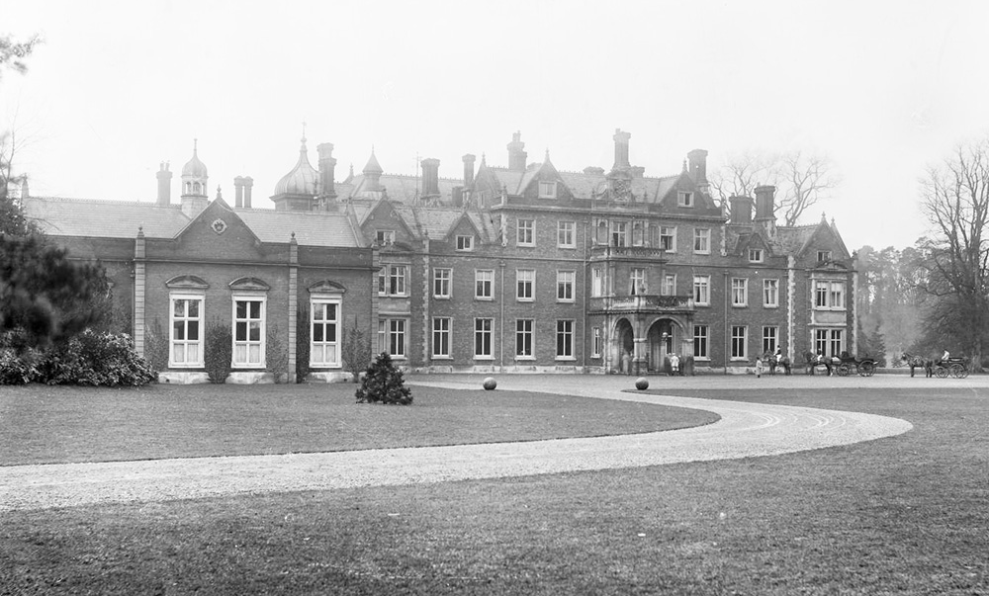
Notes:
A black and white view of the east front at Sandringham House showing people and carriages by the entrance. Source Historic England - BL09102 - Jan 1889

Slide 47
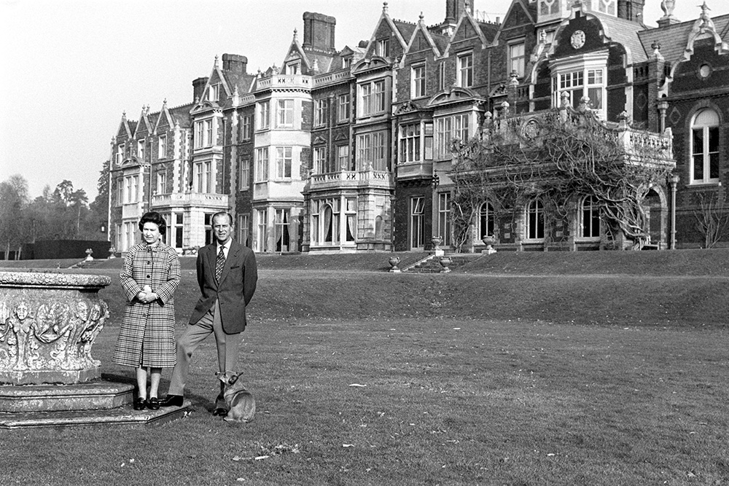
Notes:
A black and white image of the Queen and Prince Philip posing in front of Sandringham House, Norfolk, to mark the 30th anniversary of the Queen's accession to the throne. © Alamy – G4FP8X - 6 February 1982

Slide 48
The Hub, Milton Keynes
The Queen unveils a plaque marking the 40th anniversary of Milton Keynes at the Hub on 29 November 2007.
In January 1967, the decision was taken build a new town, enveloping several existing towns and villages near Bletchley and be named after one of them, Milton Keynes. This was planned as a series of grid squares divided by roads and strips of parkland. The 'city centre’ was to be an American style 'downtown strip', most successfully realised in the Shopping Building.
The Shopping Building, the largest covered arcade then built, was unprecedented in Britain. The original design was informed by the play of natural light and the arcades are aligned so that on Midsummer Day, the sun sets along the arcades.
Find out more on the National Heritage List.

Slide 49
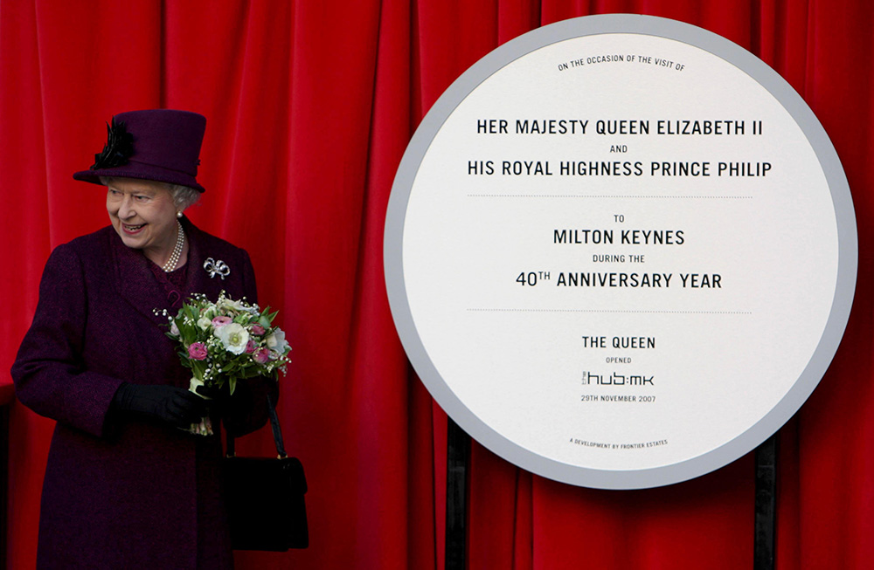
Notes:
The Queen, holding a bunch of flowers, stands in front of a large red curtain and next to a large circular plaque celebrating 40 years of Milton Keynes. © Alamy – GAEWFR - 29 November 2007

Slide 50
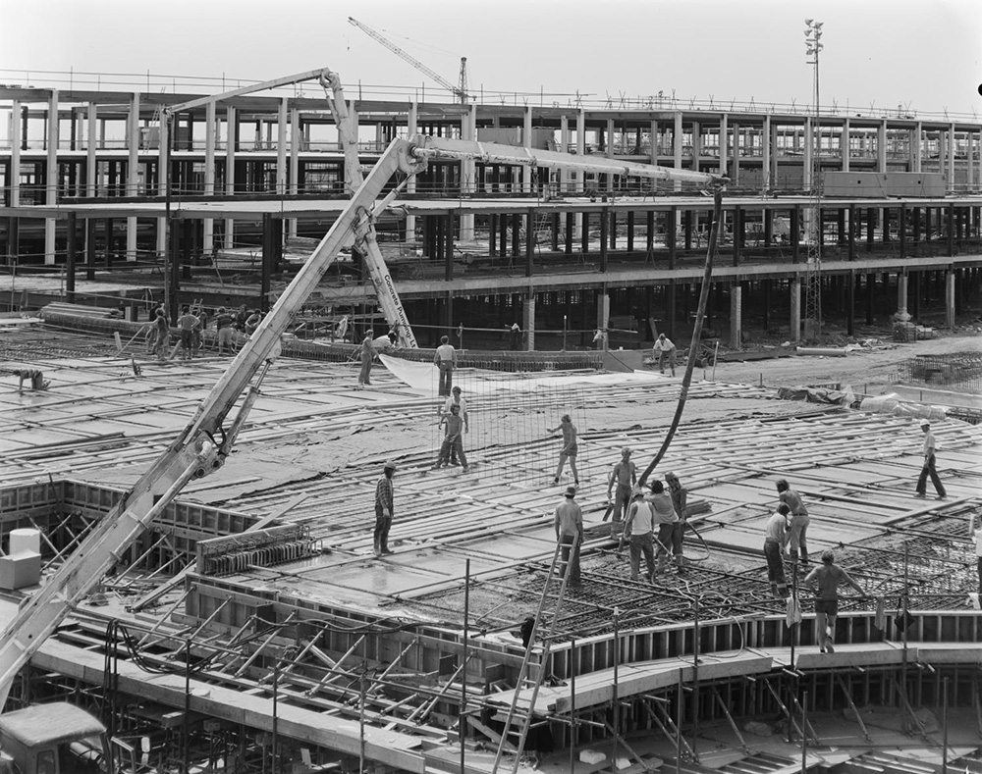
Notes:
A black and white image of a team of workers building a raised roadway at the junction of Secklow Gate and Silbury Boulevard during the construction of Milton Keynes town centre. © Historic England Archive. John Laing PhotographicCollection - JLP01/09/761543 - 10 Jul 1976

Slide 51
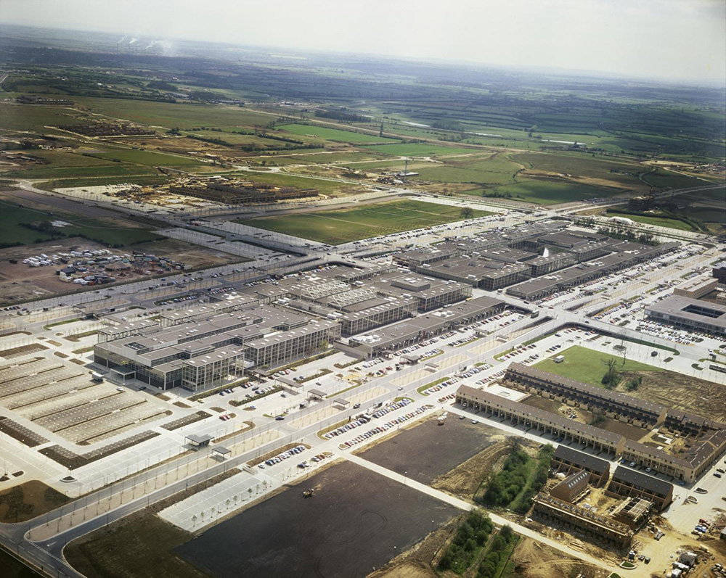
Notes:
An oblique aerial view of the shopping centre in Milton Keynes, looking south. © Historic England Archive. John Laing Photographic Collection - JLP01/10/07749 - Jun 1980

Slide 52
St Paul's Walden Bury
Princesses Elizabeth (1926-) (later Queen Elizabeth II) and Margaret (1930-2002) playing in the sandpit at St. Paul's Walden Bury in 1932. This was the home of their grandparents Claude Bowes-Lyon, 14th Earl of Strathmore and Kinghorne and Cecilia Cave.
St Paul’s Walden Bury was the childhood home of the Queen’s mum, Elizabeth the Queen Mother. The house was built in c1730, along with ornamented formal pleasure grounds in the adjacent woodland.
The estate stayed with the Bowes-Lyon family during the 19th and 20th centuries. The gardens were restored from the 1930s to the 1960s.
Find out more on the National Heritage List.

Slide 53
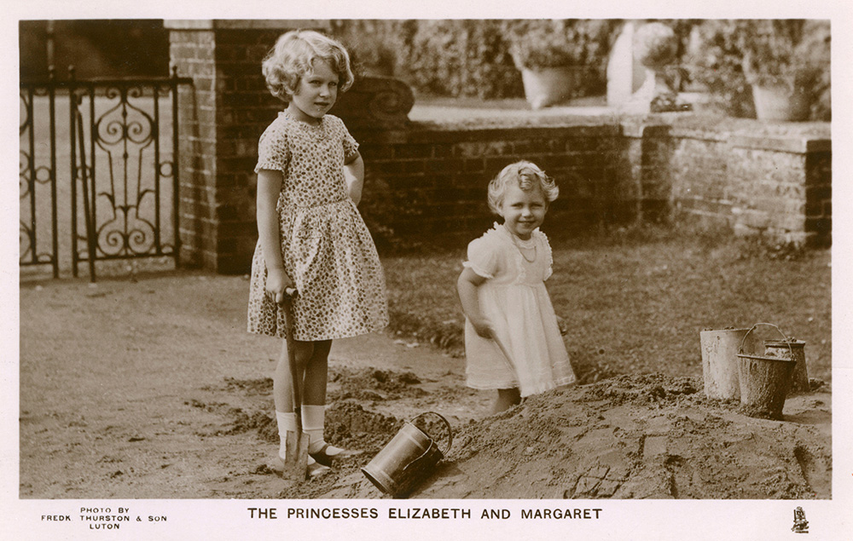
Notes:
A black and white image of the Princesses Elizabeth and Margaret, aged about 7 and 3, playing in a sandpit. © Alamy - HH4FY3 – 1932

Slide 54
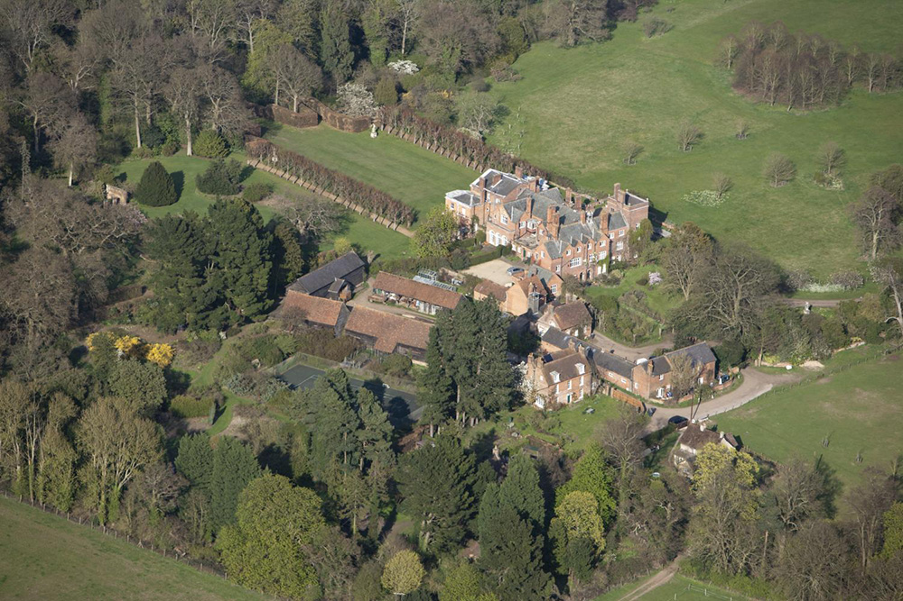
Notes:
An aerial view showing the house and grounds at Walden Bury. © Historic England Archive - 26858_026 – 20 April 2010

Slide 55
Town Centre Market, Harlow
The Queen smiles at the crowds packed behind the barriers as, followed by Prince Philip, she arrives in Market Square during her visit to Harlow New Town on 30 October 1957.
Harlow New Town was built after World War II to ease overcrowding in London caused by bombing during the Blitz. The development incorporated historic villages like Old Harlow but kept ‘Green Wedges’ to separate neighbourhoods of the town.
Many of the country's leading post-war architects were invited to design buildings, which included Britain's first pedestrian precinct and first modern-style residential tower block, The Lawn, constructed in 1951. There was also a focus, by the Harlow Arts Trust, on including public art and sculptures such as the now Grade II listed ‘The Meat Porters’ sculpture.
Find out more on the National Heritage List.

Slide 56
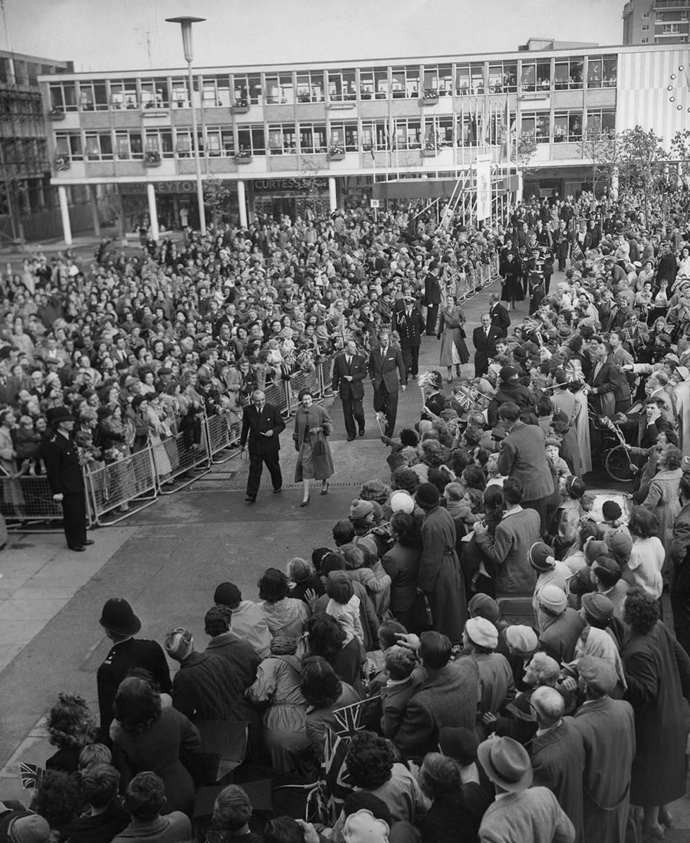
Notes:
A black and white image of the Queen, accompanied by local dignitaries, walking through crowds of well-wishers in Harlow Market Square. © Alamy - G4PJYK - 30 October 1957

Slide 57
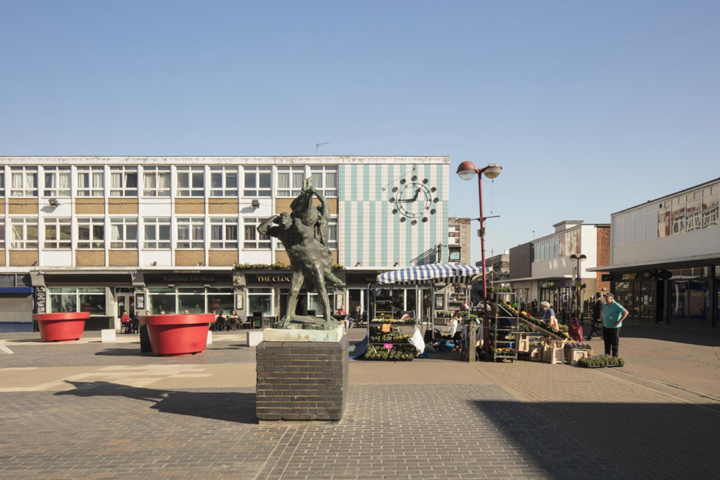
Notes:
A general view looking east towards the Clock House, with the sculpture 'The Meat Porters' by Ralph Brown in the foreground. Also within the Market Square is a market stall with a blue and white striped canvas roof. © Historic England Archive - DP247640 - 26 Feb 2019

Slide 58
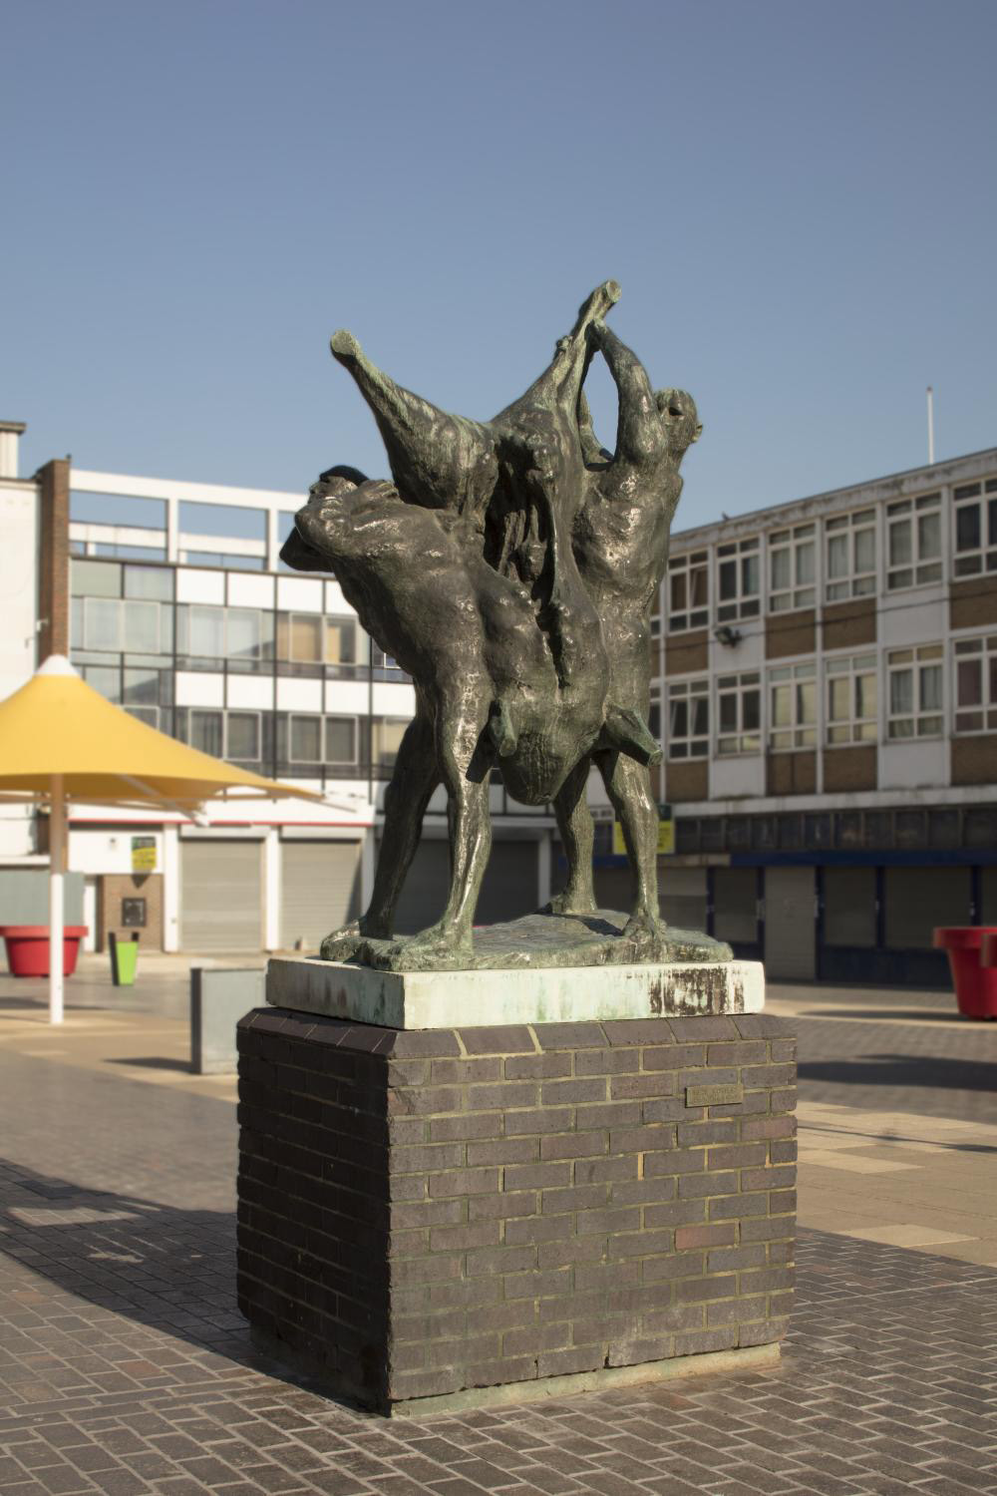
Notes:
A general view of the sculpture 'The Meat Porters' by Ralph Brown in the market square, from the south-west. The sculpture is made of bronze shows two men carrying the butchered pig carcass between them. © Historic England Archive - DP247645 - 27 Feb 2019

Slide 59
Felsted Old School Room
The Queen and Prince Philip met staff and pupils during their visit to Felsted School in Essex, where she unveiled two plaques to commemorate the School's 450th anniversary and completion of a new boarding house on 6 May 2014.
Felsted was founded as a Grammar school in 1564 by Richard Riche, Lord Chancellor to Edward VI. The school became popular for boys from Puritan families in the 17th century, including four of Oliver Cromwell's sons. Originally the school was housed in the converted Guild Hall which is still used today.
The Victorian independent public school was built between 1860 and 1867 and buildings have been added in the 20th and 21st centuries. The Old School Room is still used as Art Rooms by the school.
Find out more on the National Heritage List.

Slide 60
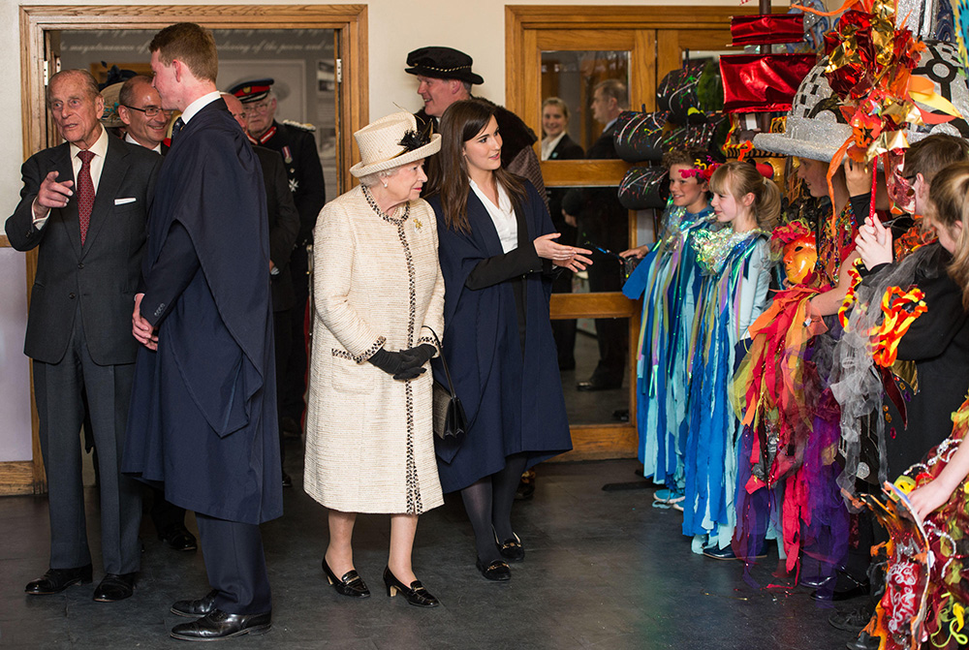
Notes:
The Queen is being introduced to children dressed in colourful costumes, while Prince Philip chats with dignitaries from the school. © Alamy - G72C6J - 6 May 2014

Slide 61
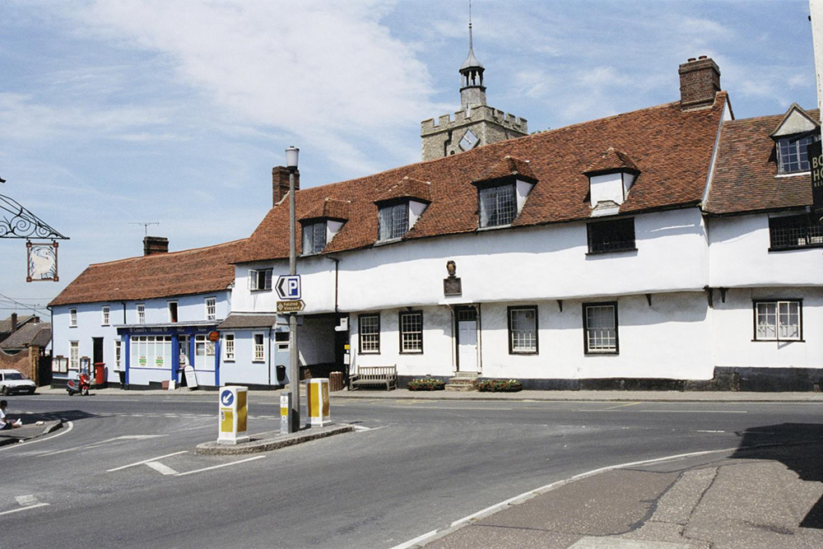
Notes:
A view of the white rendered, timber-framed, old school room, with its upper storey that sticks out over the ground floor like so many old timber framed buildings. © Mr G.W. Garthwaite. Source: Historic England Archive - IOE01/13063/23 - 23 Jun 2005

Slide 62
Colchester Campus, University of Essex
The Queen smiles as she talks with students from around the world, during a visit to Essex University near Colchester on 25 November 2004, which celebrated its 40th anniversary in that year.
The University of Essex was established in 1964 as one of the ‘plate glass’ universities. These were a series of new universities that were typically named after the county or wider area they served, rather than the town or city in which they were based.
The 6 tower blocks on the Wivenhoe Campus were some of the tallest loadbearing structures in Europe at the time and remain a local landmark. The campus is set in the historic Wivenhoe Park, originally landscaped in the eighteenth century and painted by celebrated artist John Constable.
Find out more on the National Heritage List.

Slide 63
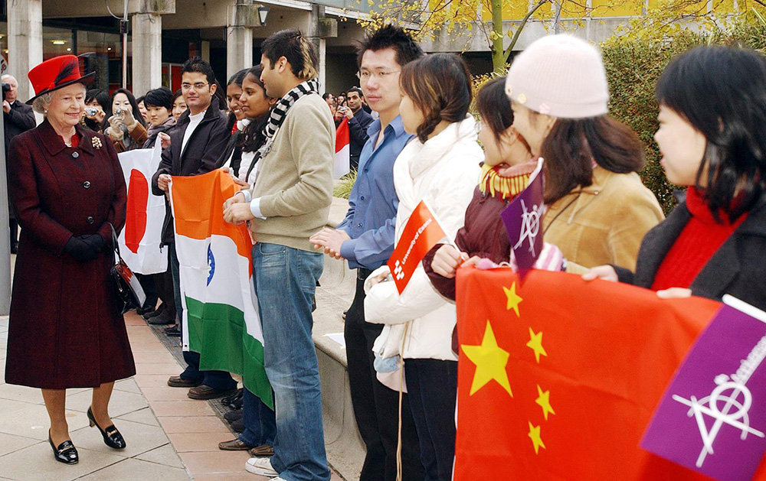
Notes:
The Queen smiles as she walks students from around the world, holding flags representing their countries. © Alamy - G7EGAR - 25 November 2004

Slide 64
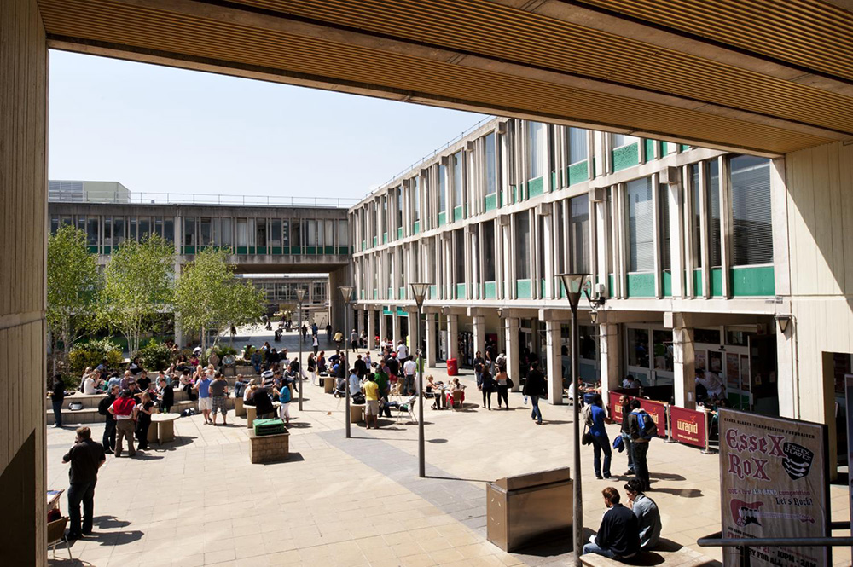
Notes:
A general view of the central buildings of the university campus, from the west. They are typical examples of 1960s concrete buildings. © Historic England Archive - DP100971 - 19 May 2010

Slide 65
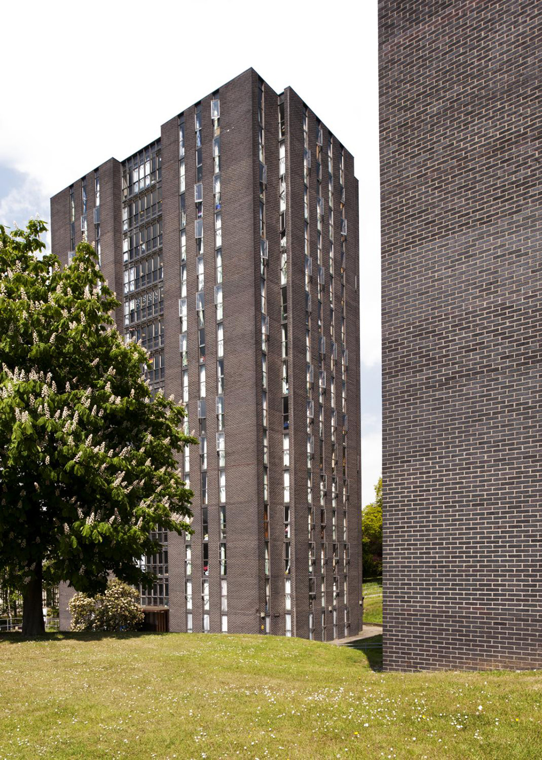
Notes:
A view of tower blocks, made from dark purple-brown bricks, on the university campus. © Historic England Archive - DP100983 - 19 May 2010

Slide 66
Harwich International Port
The Queen and Prince Philip walk up the gangway to embark on the Royal Yacht Britannia at Harwich, Essex, for their three-day State visit to Holland on 24 March 1958. Boys from the Royal Navy Junior Training Establishment, HMS Ganges, mount a guard of honour beside the gangway.
Harwich International Port is a North Sea Haven port on the south bank of the River Stour opposite the Port of Felixstowe. The Great Eastern Railway operated passenger steamers to continental Europe and opened Parkeston Quay in 1883, with its own railway station and hotel.
Today, it is the port for ferries to the Hook of Holland, freighters to Rotterdam Europort and for wind farms in the southern North Sea.
Find out more about the International Port.

Slide 67
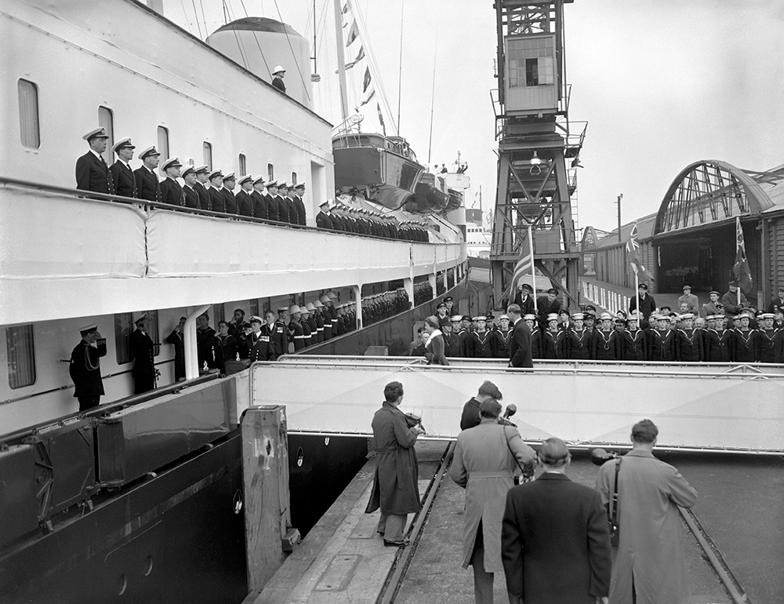
Notes:
A black and white image of the Queen and Prince Philip walking up the gangway to embark on the Royal Yacht Britannia at Harwich. Boys from the Royal Navy Junior Training Establishment, HMS Ganges, are standing as a guard of honour beside the gangway and sailors in uniform are lined up on the deck of the Royal Yacht. © Alamy - G4R90P - 24 March 1958

Slide 68
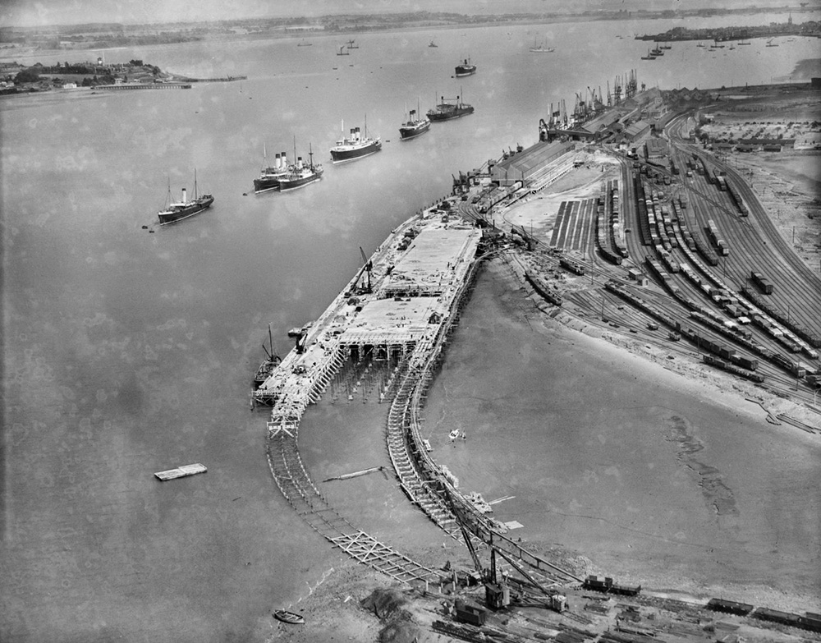
Notes:
A black and white aerial view of Parkeston Quay West railway station under construction at Harwich International Port, showing multiple train lines leading up to the port and ships in the sea next to the port. © Historic England. Aerofilms Collection - EPW042608 – August 1933

Slide 69
Bury St Edmunds Cathedral
The Queen leaving Bury St Edmunds Cathedral with clergy after attending the traditional Maundy Thursday Service on 9 April 2009.
A church has stood on this site since at least 1065. Originally, a parish church, it was rebuilt in the 12 th century and dedicated to St James. In 16 th century, it was rebuilt again in the Perpendicular style. Further alterations to the building were undertaken in the 18th and 19th centuries.
When the Diocese of St Edmundsbury and Ipswich was created in 1914, St James's Church became the cathedral. In 1959, new building work began to transform the former parish church into a cathedral building.
Find out more on the National Heritage List.

Slide 70

Notes:
The Queen is walking out of the cathedral next to a member of the clergy and heading towards in Bishop in his bright gold coloured robes, to the right a several Yeomen of the Guards, dressed in their bright red uniforms. © Alamy - GBJ879 - 9 April 2009

Slide 71

Notes:
A view of the cathedral from within the cloisters and looking up towards the tower. © Historic England Archive - DP129891 - 17 Aug 2010

Slide 72

Notes:
A black and white aerial view of the cathedral and abbey gardens in 1949, before the restoration work was started on the cathedral. © Historic England. Aerofilms Collection - EAW024397– 6 July 1949

Slide 73
Abbey Gardens, Bury St Edmunds
The Queen and Prince Philip chat while seated during a musical performance in the Abbey Gardens, during her Golden Jubilee visit to Suffolk on 17 July 2002.
The Abbey Gardens occupy the site of St Edmund's Abbey, one of the largest and most important Benedictine abbeys in medieval England. The site became home to the remains of the martyred King Edmund in 903 and continued to be a place of pilgrimage until dissolved by Henry VIII in 1539. Though the abbey precinct was quickly stripped of valuable building material, the abbot’s palace survived as a house.
A botanic garden was established in the abbey grounds in 1821, this was expanded from 1831-1885. The grounds were opened to the public, but with a high entrance fee. The Borough Council leased the grounds and a free park was opened in 1912.
Find out more on the National Heritage List.

Slide 74

Notes:
The Queen and Prince Philip are sat chatting in wooden chairs specially made for their visit. © Alamy - G5YWRE - 17 July 2002

Slide 75

Notes:
A view of a ruined stone wall which was once the hall of pleas and part of the south wall of the Great Court, both of which are part of the abbey ruins. © Mr Luke Barber. Source: Historic England Archive - IOE01/09244/19 - 30 Jul 2003

Slide 76

Notes:
A black and white aerial view of the Abbey Gardens as they looked in 1950. © Historic England. Aerofilms Collection - EAW029744 – 30 May 1950

Slide 77
RAF Honington
The Queen and Prince Philip visit family and friends of personnel serving in the Gulf, Monday 24 March 2003 at RAF Honington, Suffolk.
Although used as a bomber station by both the British and American air forces during the Second World War, RAF Honington is now the RAF Regiment depot. Construction of Honington airfield, which was undertaken by John Laing & Son, began in 1935, and the facility was opened on 3 May 1937.
Two rare Second World War era field fortifications survive within the airfield boundary.
Find out more on the National Heritage List.

Slide 78

Notes:
The Queen smiles as she talks to the families and friends of personnel serving in the Gulf, there are women holding babies and children looking bored! © Alamy - 2GX8XNA - 24 March 2003

Slide 79

Notes:
An aerial view of the airfield's runways and its associated buildings. © Historic England Archive - 27582_003 – 31 August 2012

Slide 80
King's College, Cambridge
The Queen and Prince Philip, who was the Chancellor of Cambridge University, attend a service at King's College Chapel, to mark the 800th anniversary of the University on 19 November 2009.
King's College is part of the University of Cambridge and was founded in 1441 by Henry VI soon after he had founded its sister college in Eton. Both Henry VII and Henry VIII also took an interest in the college.
King's College Chapel is regarded as one of the greatest examples of late Gothic English architecture. It has the world's largest fan vault, while the chapel's stained-glass windows and wooden chancel screen are considered some of the finest from their era. The building is seen as emblematic of Cambridge.
Find out more on the National Heritage List.

Slide 81

Notes:
The Queen and Prince Philip walk in a procession outside King's College Chapel. Prince Philip, who was the Chancellor of Cambridge University, wears a formal outfit and has a page boy carrying his coat tails. © Alamy - GC6B2W - 19 November 2009

Slide 82

Notes:
A black and white view of the interior of the chapel of King's College, showing all the choir stalls and its magnificent fan-vaulted stone ceiling. Source: Historic England Archive - RBO01/05/OP22394 – 1891

Slide 83

Notes:
Cattle grazing on the lawns in front of King's College Chapel in Cambridge. © Historic England Archive - AA086466 - 1963

Slide 84
Orfordness Lighthouse
The Queen looks at an optic from the decommissioned Orfordness Lighthouse in Suffolk built in 1913, during a visit to the International Maritime Organization, London on 6 March 2018, to mark the 70th year of its formation.
After 228 years of safeguarding and providing a navigation mark for mariners, Orfordness Lighthouse is being undermined by the encroaching sea. Over the years there have been 11 different lighthouses on Orford Ness, the first built in 1792 by Lord Braybrooke of Audley End.
Until 1965 the lighthouse was manned by resident lighthouse keepers with their families living on site until 1938. The lantern room and other artefacts will pass to the Orfordness Lighthouse Trust charity and form the basis of a lighthouse memorial structure.
Find out more on the National Heritage List.

Slide 85

Notes:
The Queen stares at a giant lens from within the Orfordness Lighthouse. © Alamy - M6TM0N - 6 March 2018

Slide 86

Notes:
A view of the red and white striped lighthouse. © Historic England Archive - DP068422 - 1 Jul 2008

Slide 87
Stevenage
The Queen visited some new homes during her visit for the official opening of the pedestrianised town centre in Stevenage New Town on 2 April 1959. Stevenage was designated the first New Town under the New Towns Act in 1946.
The plan was not popular and local people protested at a meeting held in the town hall before Lewis Silkin, minister in the Labour Government of Clement Attlee. In keeping with the sociological outlook of the day, the town was planned with six self-contained neighbourhoods with a separate industrial area.
The pedestrianised town centre was the first purpose-built traffic-free shopping zone in Britain, taking its inspiration from the Lijnbaan in Rotterdam. Although revolutionary for its time, the town centre began showing signs of age and, in 2005, plans were revealed for a major regeneration.
Find out more on the National Heritage List.

Slide 88

Notes:
A black and white image of the Queen standing amongst a crowd of people on a housing estate, a policeman in the crowd is saluting her. © Alamy - G4MGPD - 20 April 1959

Slide 89

Notes:
A view of the simple metal Clock Tower and surrounding raised pool in Stevenage Town Centre. © Mr A. Gude. Source: Historic England Archive - IOE01/15569/09 - 9 Aug 2006

Slide 90
Cornhill, Ipswich
The Queen receives a rose from an onlooker, during a walkabout among the crowds in Ipswich, during her Silver Jubilee Tour of Britain on 11 July 1977.
The Cornhill was packed as Her Majesty did a walkabout to meet the crowds. In Medieval times the Cornhill became the centre of trade and local government in the centre of Ipswich, surrounded by many grand buildings.
NatWest Bank’s Grade II building on the corner of Tavern Street and Cornhill was designed in 1928 for the National Provincial Bank. Founded in 1833, this bank opened branches outside London so it could issue its own banknotes and gradually establish a national branch network. In 1968 the bank announced its merger with Westminster Bank, and NatWest launched in 1970.
Find out more on the National Heritage List.

Slide 91

Notes:
A black and white image of the Queen greeting crowds of well-wisher in the centre of Ipswich, with the NatWest Bank visible in the background. © Alamy – G43M2K - 11 July 1977

Slide 92

Notes:
A view of the Grade II listed red brick NatWest Bank building in the centre of Ipswich. © Alamy – G5B7P2 - 3 April 2001

Slide 93
St Mary’s, Saffron Walden
The Royal Family left the Church of St Mary the Virgin in the Essex village of Saffron Walden, after the wedding of James Ogilvy and Julia Rawlinson on 30 July 1988.
The Grade I listed parish church is the largest in Essex. There was probably a Saxon wooden church here and an Anglo-Saxon cross survives in the porch. The Norman stone church was rebuilt and enlarged in the ‘Perpendicular’ style by royal master masons when events of 1485 meant work temporarily ceased at King's College, Cambridge. The Saffron Crocus and Tudor symbols can be found throughout.
The Muniment room was the meeting place of Guild of Holy Trinity, later the Town Council. The Howard vault is the resting place of the Earls of Suffolk who built Audley End.
Find out more on the National Heritage List.

Slide 94

Notes:
A black and white image of the Queen, Princess Margaret, Diana the Princess of Wales and Prince Edward all walking out of St Mary's Church. © Alamy - GCXKT7 - 30 July 1988

Slide 95

Notes:
A view of the very large, pale coloured stone built church, with its tall spire dominating the skyline. © Dr Tony Phillips. Source: Historic England Archive - IOE01/07628/25 - 9 Jan 2003

Slide 96
RAF Marham
The Queen visited RAF Marham on 4 February 2008. She watched a flypast and spoke to RAF personnel who had recently returned from operations in Iraq and Afghanistan.
It opened in 1916 to defend Norfolk from raids by the German Zeppelin airships during World War One. By 1939, it was home to Wellington bombers, which flew some of the first raids of World War Two.
During the Cold War, the Atom Bomb arrived at RAF Marham and it was home to flying tanker units that pioneered air-to-air refuelling, seen in the Falklands conflict in 1982. Since 1990 RAF Marham has seen continuous operations in the Middle East and North Africa. Over 3600 Service Personnel work there.
Find out more about RAF Marham.

Slide 97

Notes:
The Queen smiles and laughs with two engineers in blue boiler suits, stood in front of an aeroplane with its nosecone open, showing the mechanics inside. Two RAF Officers in uniform are walking towards the Queen. © Alamy - 2GXCET2 - 4 February 2008

Slide 98

Notes:
A black and white image of a runway with a row of 9 Vickers Valliant B1 V Bomber planes lined up along it. © Alamy - B4FTW0 - 21 March 1956

Slide 99
Norfolk Constabulary - Operations and Communications Centre
The Queen watched a demonstration given by PC Jason Newman from the Norfolk Police Dog Section and his dog Murphy who has a camera strapped to his head, as she opened the Norfolk Constabulary Operations and Communications Centre on 5 February 2002.
Norfolk Constabulary was founded in 1839 under the County Police Act 1839 and was one of the first county forces to be formed.
In 1965, it had an establishment of 636 officers and an actual strength of 529. In 1968 it amalgamated with Norwich City Police and Great Yarmouth Borough Police to form the Norfolk Joint Constabulary. In 1974, it returned to the name Norfolk Constabulary.
Find out more about the Norfolk Constabulary.

Slide 100

Notes:
The Queen talking to two police officers, one of whom is PC Jason Newman, with his dog Murphy as they stand in front of a van. © Alamy - G5NW16 - 5 February 2002

Slide 101

Notes:
A view of the modern red brick and glass building of the Norfolk Constabulary. © Katy Walters / Norfolk Constabulary HQ, Wymondham

Slide 102
Newmarket Racecourse
The Queen is all smiles after her horse, Highclere, wins the 100 Guineas at Newmarket on 2 May 1974.
Newmarket is often referred to as the headquarters of British horseracing and is home to two of the Classics. The Racecourse is made up of the Rowley Mile Course (after Old Rowley, favourite racehorse of Charles II) and the July Course. Both are wide, galloping tracks used for Flat racing only. The new Millennium Grandstand at the Rowley Mile was constructed in 1999.
Both courses have grass airstrips, which were used during the Second World War by the RAF, though the racecourse remained operational throughout the war. The ancient Devil's Dyke runs past, and half the racecourse is actually in Cambridgeshire.
Find out more about Newmarket Racecourse.

Slide 103

Notes:
A black and white image of the Queen smiling as she looks on at her horse 'Highclere' and a female horse trainer whose handling the horse. In the background men in suits and crowds of people look on. © Alamy - G55GWG - 2 May 1974

Slide 104

Notes:
An aerial view showing the buildings and racetrack at Newmarket. © Alamy - ERPM01 - 21 May 2015

Slide 105
Marine Parade, Southend-on-Sea
The Queen walked down Marine Parade during her first visit to Southend on 12 March 1999, where she was greeted by hundreds of people who cheered and waved Union Jack flags.
Many of the Georgian buildings on Marine Parade are Grade II listed, including the Hope Hotel. The building is said to have been used by Richard Parker and the Nore mutineers in 1794.
Parker was an English sailor who was executed for his role as president of the so-called "Floating Republic". This was a mutiny within the Royal Navy because of the squalid and overcrowded conditions the sailors felt they had to suffer. It happened at a place called Nore between 12 May and 1 6 June 1797.
Find out more on the National Heritage List.

Slide 106

Notes:
The Queen walked down Marine Parade during her first visit to Southend on 12 March 1999, where she was greeted by hundreds of people who cheered and waved Union Jack flags. © Alamy - G4J633 - 12 March 1999

Slide 107

Notes:
A view of the white painted Georgian style, Hope Hotel, on Marine Parade. © Mr Ken Clark. Source: Historic England Archive - IOE01/00839/19 - 13 Oct 1999

