Slide 1
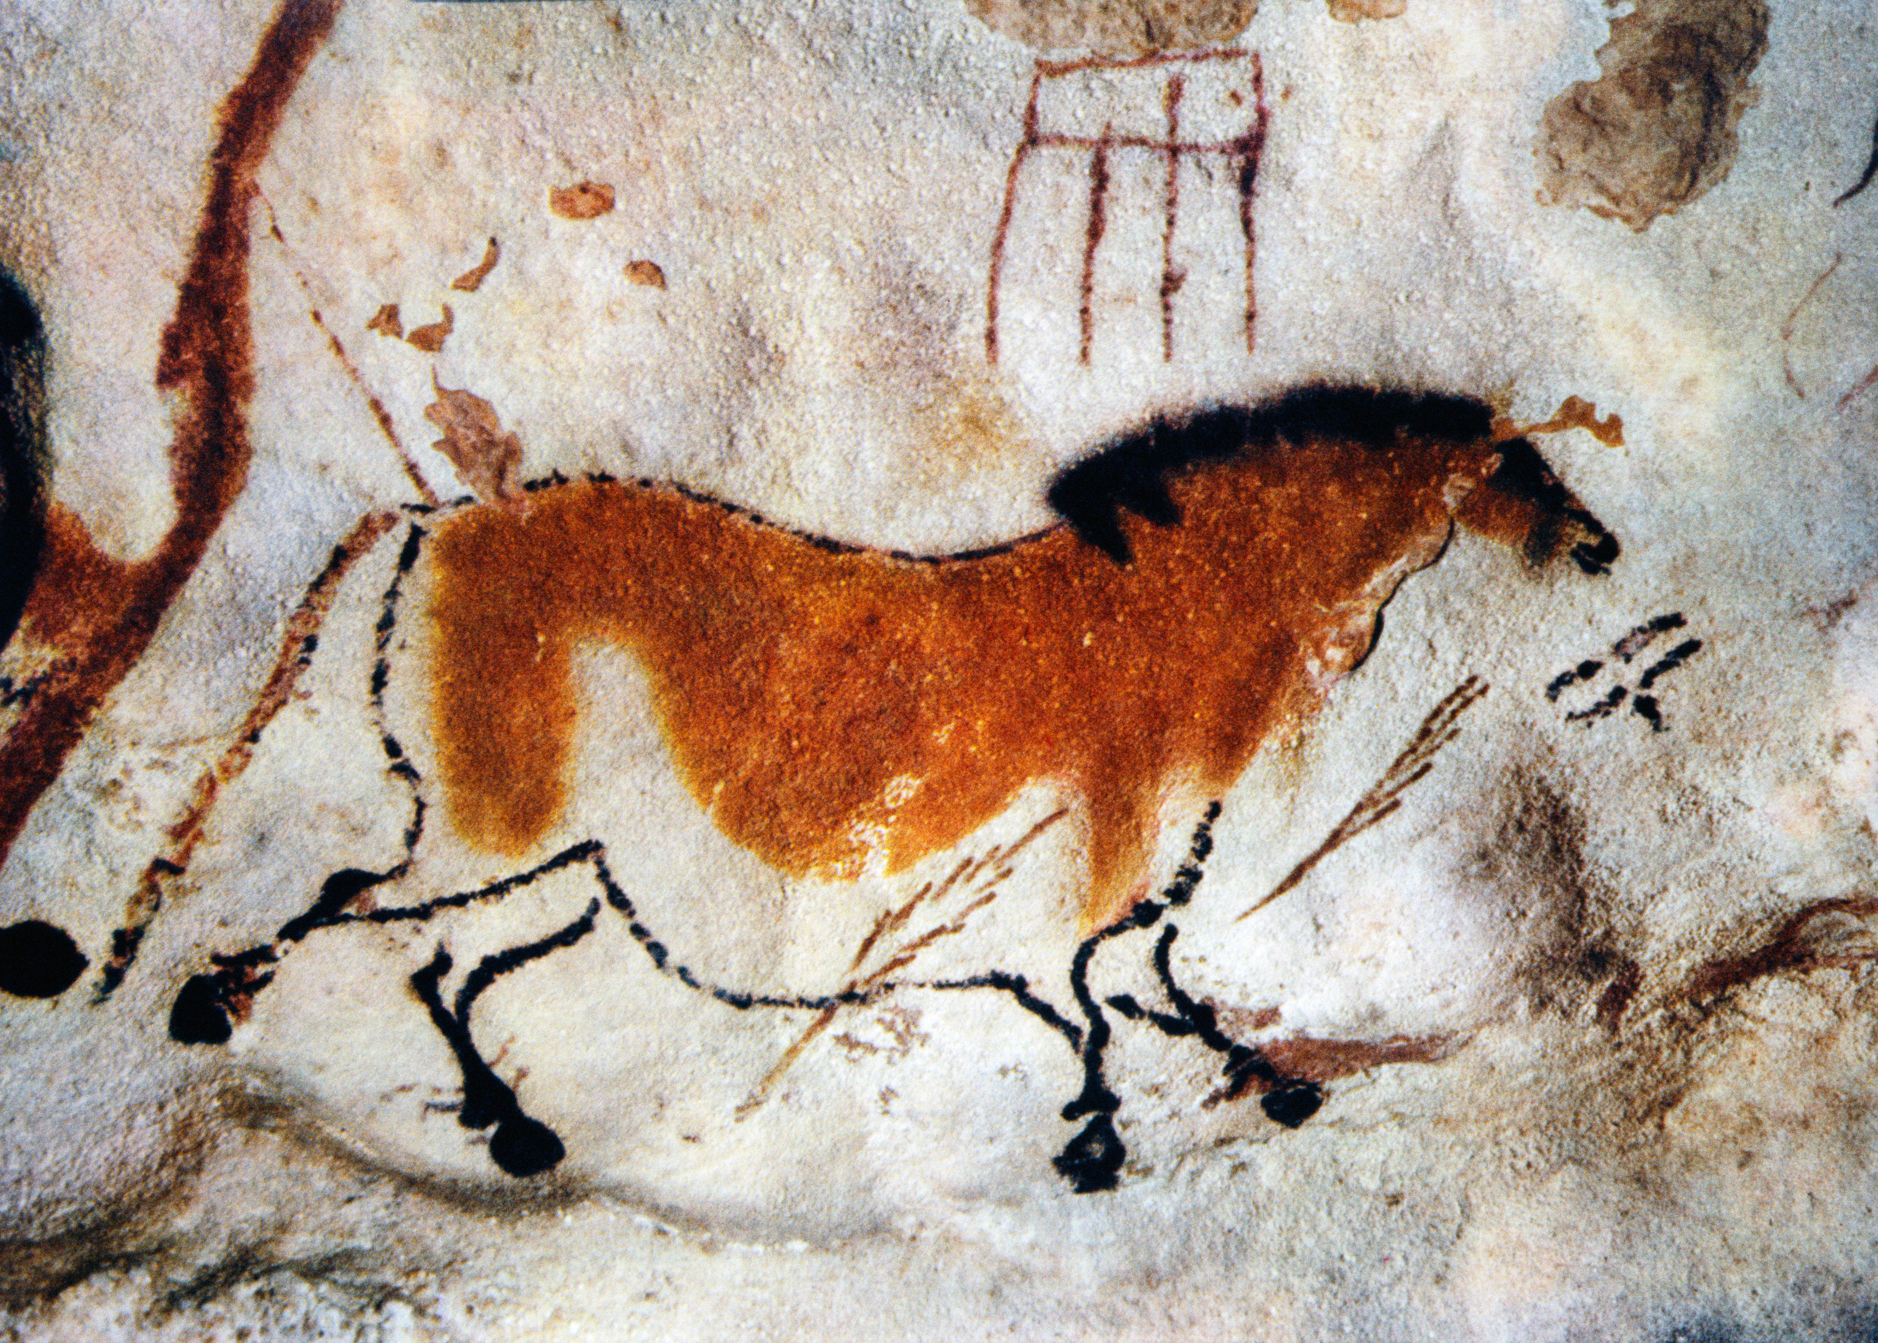
Prehistoric Rock Art: Culture and Beliefs
Make you own Rock Art?
Prehistoric Rock Art: Culture and Beliefs - Make you own Rock Art?
Notes:
IMAGE:
Cave painting, Lascaux, France © robertharding/Alamy Ref: W9K7BD

Slide 2
Prehistoric Rock Art: Culture and Beliefs - Make you own Rock Art?
Key Stage 2: History
Learning Aims and Outcomes
Pupils will understand how our knowledge of the past is constructed from a range of sources
Pupils will learn about Bronze Age religion, technology and travel
Pupils will produce creative work, exploring their ideas and recording their experience
Pupils will evaluate and analyse creative works using the language of art, craft and design
Notes:
This PowerPoint relates to the Teaching Activity: Prehistoric Rock Art: Make you own Rock Art

Slide 3
How to use this PPT
Contents
Starter Activity – Symbols Quiz
Types of Rock Art - Petroglyphs
Types of Rock Art - Pictographs
Types of Rock Art - Petroforms
Rock Art around the world
Rock Art in Britain
Activity: Make your own rock carving (petroglyph)
Pupils learn how archaeologists study ‘Rock Art’ to tell us about past cultures and their beliefs.
They can then make their own ‘Rock Art’ and try to interpret each others
There is additional information for teachers in the ‘notes’ section below each slide, including links to other sites and resources.

Slide 4













Starter Activity - Symbols Quiz 1
Can you work out what these symbols mean?
Notes:
Starter activity
Play the symbols quiz to get pupils thinking about art/images as a form of writing/language – lead them to understand that they can ‘read’ these symbols because they’re part of ‘their culture’.
Don’t give away the answers just yet, you’ll come back to this quiz later after slides 15 & 18 to talk about ‘representative’ and ‘abstract’ forms of art. Let them work together in teams to do the quiz – it’s a fun challenge to get them thinking/talking, not an actual test.

Slide 5
Starter Activity - Symbols Quiz 2

Slide 6












Starter Activity - Symbols Quiz – Additional 1
What about these too?
Notes:
Starter activity
Play the symbols quiz to get pupils thinking about art/images as a form of writing/language – lead them to understand that they can ‘read’ these symbols because they’re part of ‘their culture’.
Don’t give away the answers just yet, you’ll come back to this quiz later after slides 15 & 18 to talk about ‘representative’ and ‘abstract’ forms of art. Let them work together in teams to do the quiz – it’s a fun challenge to get them thinking/talking, not an actual test.

Slide 7
Starter Activity - Symbols Quiz – Additional 2

Slide 8

Rock Art 1
For 1000's of years people have expressed their thoughts and feelings by drawing, painting or carving pictures on to rocks or stone surfaces or using them to make patterns and shapes.
Archaeologists have given these drawings special names:

Slide 9
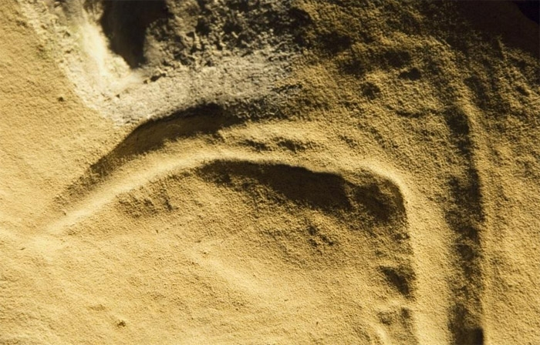

Petroglyphs (pet-ro-gliffs) - pictures carved into stones
This image, along with many others discovered on the wall within Church Hole Cave, Creswell Crags, Derbyshire in 2003.
It is the oldest known Rock Art in England!
‘Bird’ carving Creswell Crags, Derbyshire, UK - Palaeolithic (Old Stone Age), over 12,000 years old
Notes:
A petroglyph is an image pecked or engraved on a rock surface. This image, along with many others were discovered on the wall within Church Hole Cave, Creswell Crags, in 2003. This image has been interpreted as representing a bird. Detailed scientific dating suggests the image was carved more than 12,800 years ago – making it the oldest known Rock Art in England.
IMAGE:
‘Bird’ carving from Creswell Crags, Derbyshire. © Historic England
LINK:
http://www.creswell-crags.org.uk/

Slide 10
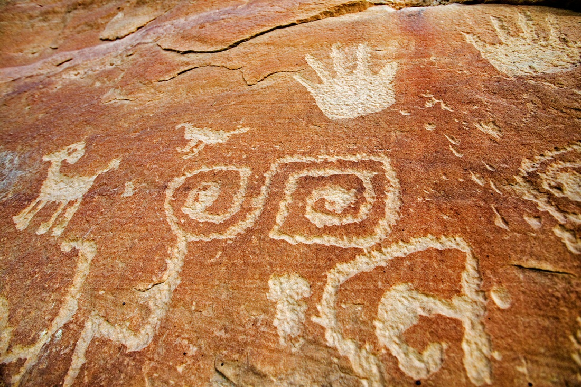
Petroglyphs (pet-ro-gliffs) - pictures carved into stones.
The Anasazi or "Ancient Ones“ are thought to be ancestors of modern Pueblo Indians (Native Americans).
They lived southern and central America from about 1800 – 700 years ago.
Anasazi petroglyphs at Mesa Verde National Park, Colorado, USA – c AD 200 to AD 1300
Notes:
A petroglyph is an image pecked or engraved on a rock surface. The Anasazi ("Ancient Ones"), thought to be ancestors of the modern Pueblo Indians (Native Americans), inhabited the Four Corners country of southern Utah, southwestern Colorado, north-western New Mexico, and northern Arizona from about A.D. 200 to A.D. 1300. According to one Hopi elder (the Hopi are a tribe of Pueblo Indians (Native Americans) descended from the Anasazi), this petroglyph, found on Mesa Verde’s Petroglyph Point Trail, may tell the story of two clans (the Mountain Sheep Clan and the Eagle Clan) separating from other people and returning to their place of origin. The boxy spiral shape is likely to represent a Sipapu, the place where Pueblo people believe they emerged from the earth (believed to be near the Grand Canyon).
IMAGE:
Anasazi petroglyphs at Mesa Verde National Park, Colorado, USA © age fotostock/Alamy
LINK:
http://whc.unesco.org/en/list/27

Slide 11
Pictographs (pic-to-graffs ) - pictures drawn or painted onto a stone surface (be that a cave wall or a pebble)
The caves at Lascaux in south west France contain around 2,000 images!
About 900 of which are animals, the rest are geometric symbols of varying shapes.
‘Chinese Horse’, Lascaux, France - Palaeolithic, estimated to be 17,300 years old
Notes:
Pictures drawn or painted onto a stone surface. Lascaux, in the Dordogne region of southwestern France, is especially famous for its cave paintings. The caves contain some 2,000 images, about 900 of which are animals, the rest are geometric symbols of varying shapes. Some of which are estimated to be up to 20,000 years old. Lascaux is just one cave within the Vézère valley which contains 147 prehistoric sites dating from the Palaeolithic and 25 decorated caves.
IMAGE:
Cave painting, Lascaux, France © robertharding/Alamy
LINK:
http://whc.unesco.org/en/list/85

Slide 12
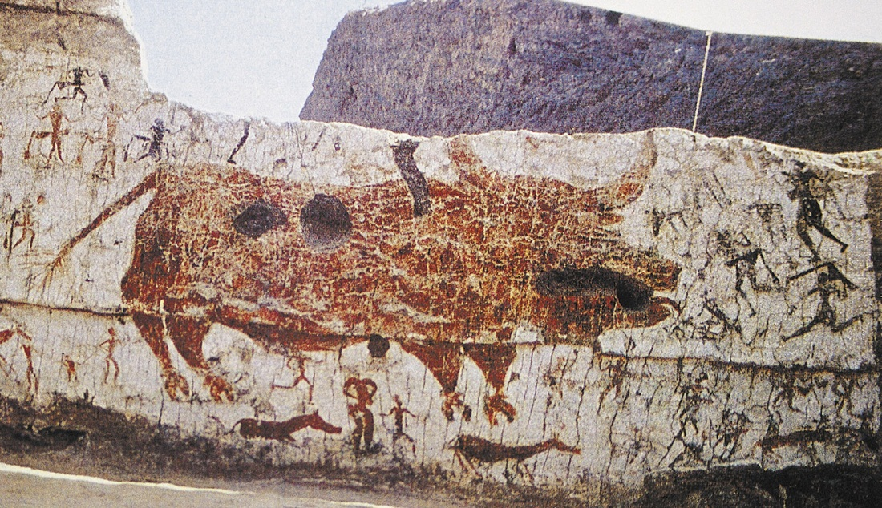
Pictographs (pic-to-graffs ) - pictures drawn or painted onto a stone surface (be that a cave wall or a pebble).
All the images from Çatalhöyük are on mudbrick and plaster walls, not rock.
This is because there is no rock on the Konya Plain in Turkey, where Çatalhöyük was built!
Hunters attacking a bull in Catalhoyuk, Turkey – Neolithic, 7500 BC to 5700 BC
Notes:
Pictures drawn or painted onto a surface. This wall painting appears to show people attacking a bull. This type of Rock Art is typical of that found during the Neolithic Period at Çatalhöyük in Turkey. Çatalhöyük provides important evidence of the transition from settled villages to urban living, in the same location for over 2,000 years. It features a unique streetless settlement of houses clustered back to back with roof access into the buildings. All the images there are on mudbrick and plaster, not rock, because there is no rock on the Konya Plain in Turkey, where Çatalhöyük was built. Note that the dates for the Neolithic in Europe are different for those in Britain (7500BC – 5700BC in Turkey and 4000BC – 2200BC in Britain).
IMAGE:
Wall painting showing human-bull interaction is classic to Neolithic Period Catalhoyuk Turkey © Images & Stories/Alamy
LINK:
http://whc.unesco.org/en/list/1405

Slide 13
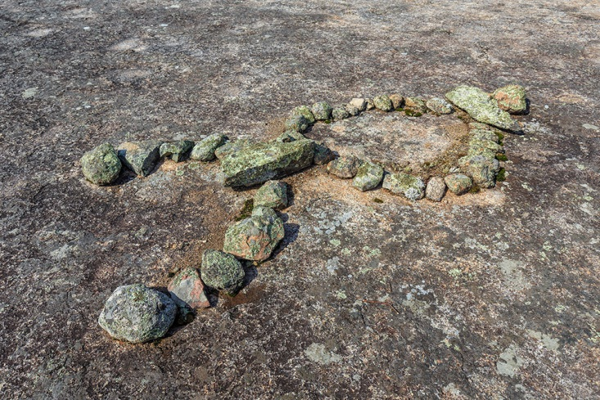
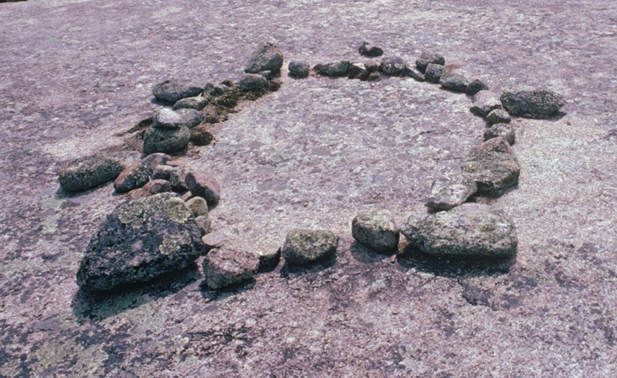
Petroforms (pet-ro-forms) - pictures laid out on the ground using stones
‘Human’ (left) and ‘Turtle’ (right) petroforms
Whiteshell Provincial Park, Canada - Estimated to be up to 2,000 years old
First Nations people believe that they were left here long ago for the benefit of all people that might visit this site to receive their teachings and healing.
Notes:
Pictures laid out on the ground using stones. These two petroforms are both from Whiteshell Provincial Park, Manitoba, Canada. The one on the left is thought to represent a human and the one on the right a turtle. First Nations people believe that they were left here long ago for the benefit of all people that might visit this site to receive their teachings and healing. There are no fixed interpretations of the figures.
IMAGE:
Left: Petroform of a human at Bannock Point, an Ojibway aboriginal site, Whiteshell Provincial Park, Manitoba, Canada.© Ken Gillespie Photography/Alamy
Right: Turtle petroform created by ancient indians in Whiteshell Provincial Park in Manitoba Canada.© Bill Brooks/Alamy
LINK:
https://www.gov.mb.ca/sd/parks/education-and-interpretation/parkinclassroom/index.html

Slide 14
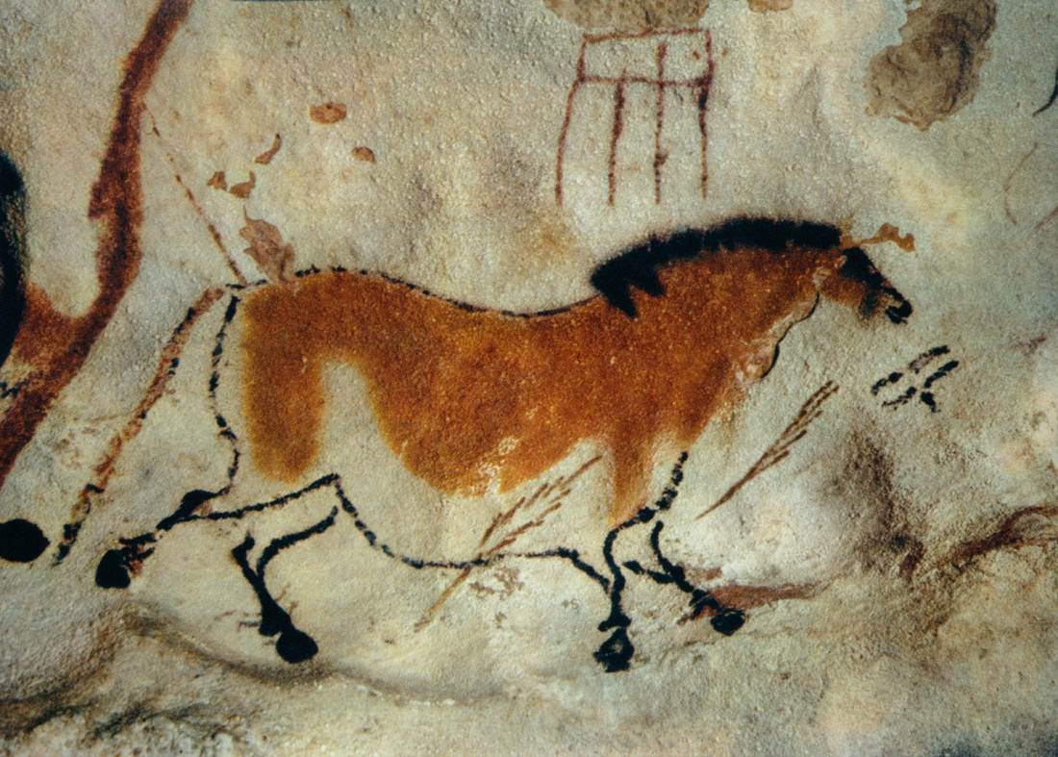
The pictures that are drawn or carved are described as being either representative or abstract
Representative
Pictures of things that we would recognise such as people or animals, like this cave painting of a horse from Lascaux in France.
Notes:
There are two main ways of describing the images seen in Rock Art. The first is ‘representative’ – the images look like (represent) an actual thing that we would recognise such as animals and people.
IMAGE:
Cave painting, Lascaux, France © robertharding/Alamy

Slide 15
Symbols Quiz – Answers – How did you do?
No smoking
Lift
No cars/driving
Don’t iron
Coffee/Cafe
Recycle
Women’s/Ladies
Men’s/Gents
Danger of slipping
WIFI
Don’t litter
Poison/Toxic
Notes:
Go back to the Symbols Quiz you did at the start. Ask the pupils to give you their answers for each of the symbols – the right answer will appear under each symbol as you click ‘next’ on the ppt.

Slide 16
Symbols Quiz – Which are representative?
No smoking
Lift
No cars/driving
Don’t iron
Coffee/Cafe
Recycle
Women’s/Ladies
Men’s/Gents
Danger of slipping
WIFI
Don’t litter
Poison/Toxic
Notes:
Now ask pupils to pick out the ones that are ‘representative’, i.e. look like an actual, physical object that they could touch.

Slide 17
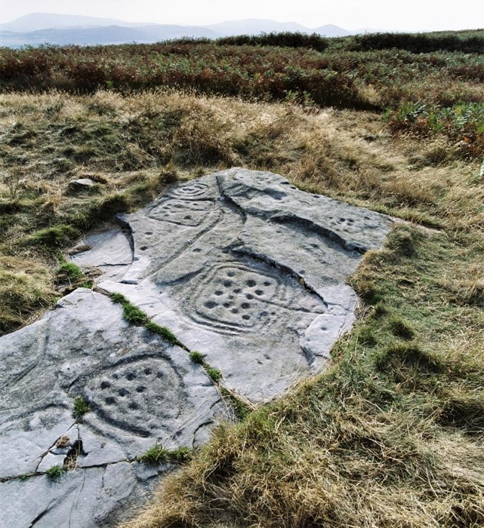
The pictures that are drawn or carved are described as being either representative or abstract
Abstract
Shapes or patterns that do not have one clear meaning.
Such as the 'cup and ring' symbols, shown in the picture, that are found here in the UK.
They may have done in the past – we just don’t know how to ‘read’ them anymore!
Notes:
The second type of rock art is ‘abstract’ – the images do not have one definite meaning to people today. (Though they may have done in the past – we just don’t know how to ‘read’ them anymore!)
IMAGE:
Prehistoric Rock Art, Doddington, Northumberland © Historic England Ref: AA045828 - https://historicengland.org.uk/images-books/photos/item/AA045828

Slide 18
Symbols Quiz – Additional Answers – How did you do?
Play
Rewind
Stop
Fast forward
Pause
Shuffle
Repeat/Loop
Power (On/Off)
Eject
Skip backwards
Record
Settings
Notes:
Go back to the Symbols Quiz you did at the start. Ask the pupils to give you their answers for each of the symbols – the right answer will appear under each symbol as you click ‘next’ on the ppt

Slide 19
Symbols Quiz – Which are abstract?
Play
Stop
Fast forward
Abstract
Rewind
Pause
Shuffle
Repeat/Loop
Power (On/Off)
Eject
Skip backwards
Record
Settings
Notes:
Explain that they are ALL abstract symbols – it’s just we know how to read them – or not – if pupils are too young to recognise them. If they got stuck the could have asked an ‘elder’ (teacher/parent etc.) to help them ‘read’ them.

Slide 20
Thoughts or Beliefs
Whatever the image used, be it a picture of an animal or an abstract shape, it represents peoples’ thoughts or beliefs.
Many archaeologists believe that rock art can give us valuable clues about the people who made it, such as:
Who they were
When they lived
What they thought
This is really important to archaeologists as it is very hard to work out what people in the past actually thought!

Slide 21
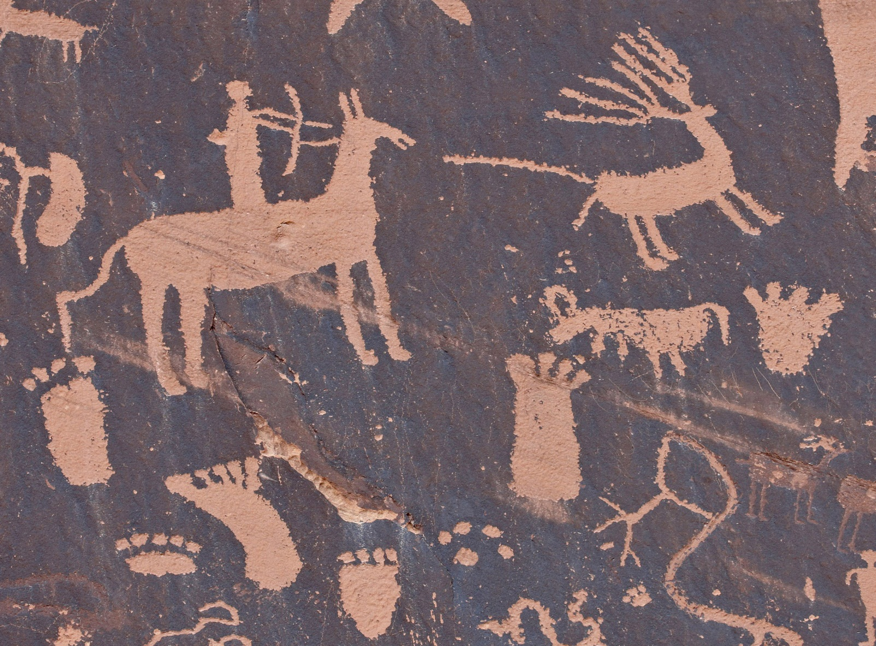
Rock Art 2
Rock art has been found on every continent and was made by very different societies from farmers to fishermen!
Notes:
Rock Art has been found on every continent and was made by very different societies from farmers to fishermen. This suggests that art and the need to express oneself through art is an important part of every human society – something we all have in common.
IMAGE:
Petroglyphs on Newspaper Rock, Utah, USA © robertharding/Alamy
LINK:
https://www.nps.gov/pefo/learn/historyculture/newspaper-rock.htm

Slide 22
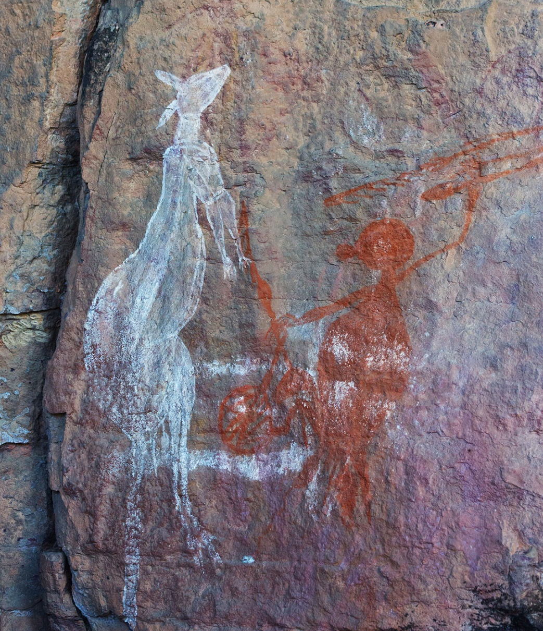
Aboriginal Rock Art
Archaeologists have estimated that there are over 50 million recorded rock art images around the world!
Notes:
In some parts of the world, it is still done today, e.g., Australian Aboriginal Peoples. This image comes from the Kakadu National Park in the Northern Territory of Australia. It shows a kangaroo and an aboriginal person using a spear-thrower. This area has been inhabited continuously for more than 40,000 years. The cave paintings, rock carvings and archaeological sites record the skills and way of life of the region’s inhabitants, from the hunter-gatherers of prehistoric times to the Aboriginal people still living there.
IMAGE:
Aboriginal rock art of a kangaroo, Anbangbang Gallery, Nourlangie, Kakadu National Park, Northern Territory, Australia © Marc Anderson/Alamy
LINKS:
http://whc.unesco.org/en/list/147
http://www.mylearning.org/australian-aboriginal-spear-thrower/p-4306/

Slide 23
British Rock Art 1
Here in Britain most of our rock art images are Petroglyphs. Most (but not all) are found in Northern England, Scotland and Ireland.
Archaeologists have dated many of these carvings to the Neolithic (6000-4400years ago) and Bronze Age (4400-2700 years ago).
They were able to do this because some of the carvings were found on stone slabs, inside burial chambers (large graves).
The other objects from these graves, such as pottery, could be dated.
This told us that the carvings belonged to the Bronze Age, some 4000 years ago!

Slide 24
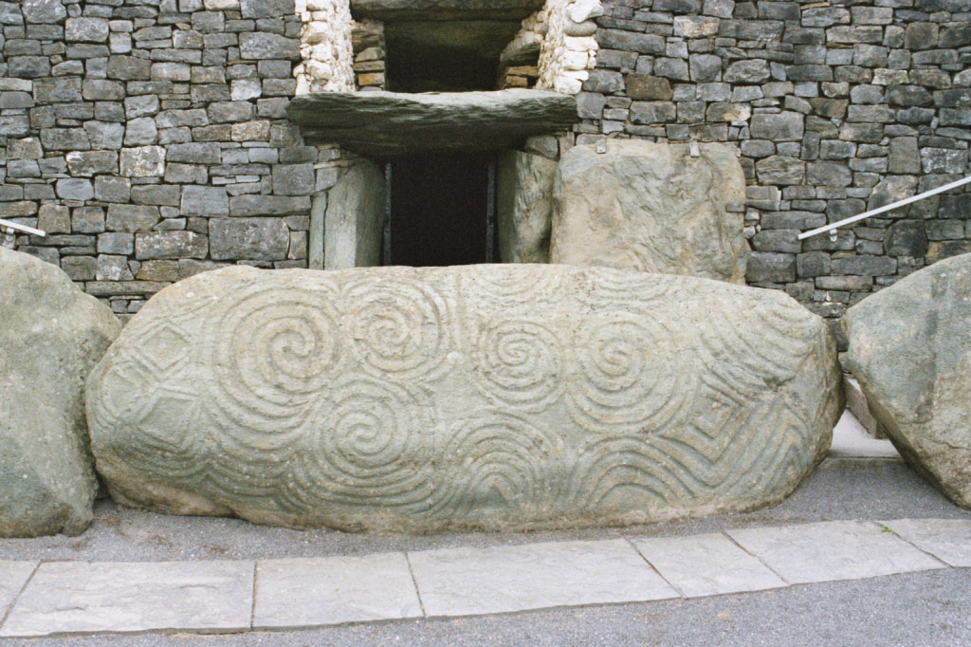
Carved stone from New Grange, Republic of Ireland
Notes:
The passage tomb we know as Newgrange was built during the Neolithic period, approximately 3200BC. Many of the structural stones at Newgrange are decorated with Rock Art. Although many theories have been put forward regarding the meaning of these carvings, no one can say for certain exactly what the carvings represent.
IMAGE:
Entrance to the passage tomb at Newgrange, Republic of Ireland © Radharc Images/Alamy
LINK:
http://whc.unesco.org/en/list/659
https://www.worldheritageireland.ie/wp-content/uploads/2022/08/History-Primary-School.pdf

Slide 25
British Rock Art 2
Beneath or behind some of these Bronze Age carved slabs were natural stone outcrops that had also been carved.
They appeared to be quite badly eroded (worn away), which led archaeologists to believe that they must be much older.
They have been dated as up to 6000 years old (the Early Neolithic).
By studying these carvings, we can tell that they were made using stone tools.
Sometimes these tools were just held in their hand and used to 'peck' away at the stone and sometimes extra force was needed using two stones - one to hit the other, like hammering.

Slide 26
Northumbrian Rock Art 1
This stone carving probably dates from the late Stone Age or early Bronze Age (approximately 3800BC to 1500BC).
We think this because of the type of carvings on it.
It has ‘cup' marks (shallow bowl-shaped depressions a few centimetres across) and ‘cup-and-ring’ marks (a cup mark that has one or more grooves around it).
Prehistoric Rock Art on Doddington Moor, Northumberland
Notes:
The English county of Northumberland has many examples of rock art. This carved stone dates back to prehistoric times. In Britain, the term ‘rock art’ is sometimes used loosely to refer to all prehistoric carvings on rock. This stone carving probably dates from the late Stone Age or early Bronze Age (approximately 3800BC to 1500BC). This is because of the type of carving on it. It has ‘cup' marks (shallow bowl-shaped depressions a few centimetres across) and ‘cup-and-ring’ marks (a cup mark surrounded by one or more concentric circular grooves).
IMAGE:
Rock Art on Doddington Moor, Northumberland © Historic England Ref: AA045828 - https://historicengland.org.uk/images-books/photos/item/AA045828
LINK:
http://archaeologydataservice.ac.uk/era/

Slide 27
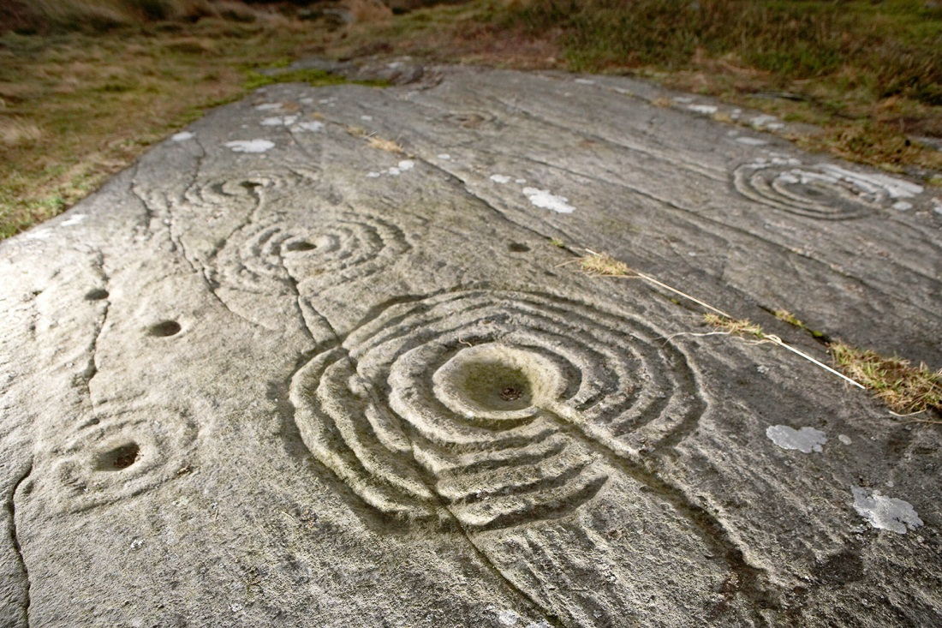
Northumbrian Rock Art 2
This carved stone is just of 26 known panels of ’Cup and Ring’ mark petroglyphs on Weetwood Moor.
It has been dated to between 1500 and 3800 BC
Prehistoric Rock Art on Weetwood Moor, Northumberland
Notes:
This carved stone is just of 26 known panels of ’Cup and Ring’ mark petroglyphs on Weetwood Moor. The Rock Art is prehistoric and could be either Neolithic or early Bronze Age as it has been dated to between 1500 and 3800 BCE.
IMAGE:
Rock Art on Weetwood Moor, Northumberland © Alamy – Ref: A3258T
LINK:
http://archaeologydataservice.ac.uk/era/

Slide 28
Northumberland Rock Art
All of the shapes carved on the panels are ‘abstract’.
These are the most common shapes.
Because all they are abstract people today can only really guess at what exactly they meant!
Notes:
Because all these images/symbols are abstract people today can only really guess at what exactly they meant. Refer pupils back to the symbols quiz and all our ‘abstract’ symbols to help them understand this concept
All sorts of different interpretations have been suggested, on the next slide are just a few

Slide 29



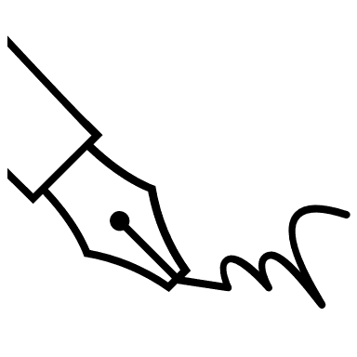





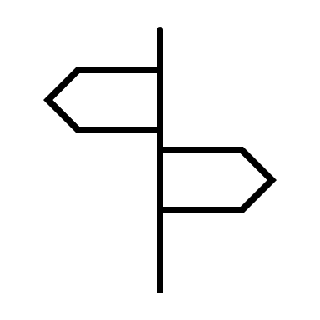

What do you think, feel free to add your own ideas!!
Star charts
Decorations
Places of sacrifice
Religious or magical symbols
Pilgrimage markers
(like milestones)
Maps of ancient camps or settlements
An early form of writing
Records of local burials
Boundary markers
Ownership markers
Sun symbols
Notes:
Having looked at this presentation have a go at our ‘Teacher’s Notes: Make you own Rock Art’ Activity Sheet.
Find more teaching resources at: HistoricEngland.org.uk/Education

Slide 30
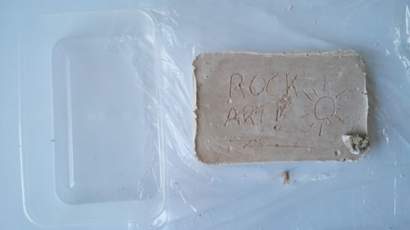
Activity: Make your own rock carving (petroglyph)
What you will need:
Dental plaster (Or other child-friendly plaster like plaster of Paris, dental is hypoallergenic and sets in 10-15 minutes, plaster of Paris takes about an hour.)
Sand (children’s play sand is best and safest)
Water
Small flat plastic tubs (flat based take-away style tubs are ideal, if planning the session in advance you could ask pupils to bring these in from home for free)
Cling-film
Small stones/pebbles (preferably with pointy but not sharp edges, these could be bought, or the children could ‘gather’ their own under supervision from around the school grounds)
Small plastic cups (supermarket ‘basics/value’ type, like you get in a vending machine)
Mixing bowls (any small bowl will do, but if you get extra takeaway tubs these work well, especially the slightly deeper ones)
Sticks for mixing (you could buy lollypop sticks or the children could ‘gather’ their own stick under supervision from around the school grounds)
Create you own Rock Art

Slide 31
Activity: Session plan – Part 1 – Make your ‘rock’
Explain to pupils that monuments like Stonehenge aren’t the only symbols left for us to use to try and understand what prehistoric people thought. Another really good source of evidence for archaeologists is ‘Rock Art’. In this session they will learn about Rock Art and have a go at making some of their own.
First they need to make their own ‘rock’ – mix plaster with sand (use a 2:1 ratio of sand to plaster, amounts will vary depending on size of your tubs – but for the ‘take-away’ type mentioned above 1 plastic cup of sand to 1/2 cup of plaster works well or 200g sand to 100g plaster), add water (1/4 cup) and mix. Pour into the small plastic tubs lined with cling-film, to about 1-1.5 cm thick; gently tap the tub on the table to knock out any air bubbles. (If you’re feeling impish you might want to swap these first two points around – have them come in and make their ‘rock’ but not tell them what it is or why they’re making it – it can make for some good discussions amongst pupils trying to guess what they might be doing!)
SEE SLIDES 35-38 FOR STEP-BY-STEP PHOTOS & INSTRUCTIONS

Slide 32
Session plan – Part 2 – Design your petroglyph
Whilst their ‘rocks’ set (about 20-30 minutes) use the information provided (in the ppt) to look at Rock Art around the world and in Britain.
Now focus their attention on the British Rock Art and how it is almost entirely made by carving shapes into rocks. They should now have learnt that the archaeological word for this is a petroglyph. Give each pupil a blank piece of paper and ask them to design their own petroglyph – they can make it ‘representative’ or ‘abstract’ (see ppt), but they mustn’t tell anyone else what it means….
When they have done their design and their ‘rock’ is set they can use one of the small stones to carve their petroglyph into the rock. They must take care – you can’t rub out mistakes in rock! Nor can you fix it if you push too hard and break it – our ancestors used great skill in creating their Rock Art.

Slide 33
Session plan – Part 3 – Be archaeologists 1
After all the pupils have created their petroglyphs put them all in one place so that everyone can see each other’s. They are now archaeologists – they must look at all the designs and try to work out what their meaning is. Give them 5-10 minutes to look at them all – remind them they must remain totally silent, no asking questions or discussing just yet.
To start the discussion pick up one of the petroglyphs, ask who made it, and then ask them to come to the front, but stay totally silent. Now start a discussion amongst the whole class – what do they think it’s a carving of? What might it tell us? What might it tell us about the person who made it? Let them use their imaginations – based on the evidence in front of them, like all good archaeologists do. After you feel the discussion has reached a conclusion ask the pupil who made it to explain their thoughts and reasons behind their design.
This will allow you to introduce the concept of ‘interpretation’ and how one object can have many different interpretations. Raise the question of what would they have done if they hadn’t been able to ask their fellow pupil what the real interpretation was?

Slide 34
Session plan – Part 3 – Be archaeologists 2
Ask each pupil to pick up their petroglyph then split the class into groups so that they can repeat the same interpretation activity within each group. This way everyone gets to experience someone else trying to interpret their petroglyph.
Finish by asking pupils what they have learnt about ancient cultures and how we as ‘modern’ archaeologists interpret them. Encourage higher level empathy and understanding of these historical concepts. What do they think an archaeologist in the future would make of their class as a society/culture based on their collection of petroglyphs? (Why not put all the petroglyphs on display for other pupils/teachers/parents and see what they make of your class based on the evidence before them! ;0)
You could also do the same activity but instead of using a stone to carve a ‘petroglyph’, pupils could just use paints on their ‘rock’ to create a ‘pictograph’. Or get real value from your ‘rock’ and carve one side and paint the other! All of their ‘rocks’ could then be displayed as a ‘petroform’!

Slide 35
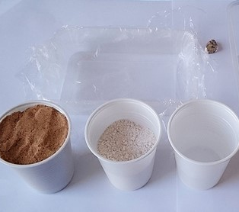
Step 1: Get the ‘ingredients’ ready
Assemble everything you’ll need.
Each pupils needs:
Shallow take-away tub lined with clingfilm
Mixing tub and stirring stick
1 cup sand
½ cup plaster
¼ cup water
Pointy (but not sharp) pebble
(To save waste I don’t give each pupil a plastic cup, I assign a sand monitor, plaster monitor and water monitor – either adult helpers or responsible pupils, preferably an adult for the plaster.
They stay in one place and the other pupils come around with their mixing bowls to receive their measures of sand, plaster and water - think Oliver Twist!)
Get the ‘ingredients’ ready

Slide 36
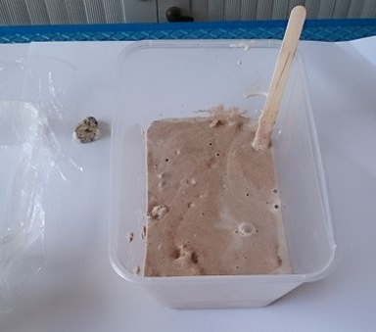
Step 2: Mix it all together
Mix the sand and plaster together whilst still dry.
Then add the water and mix.
‘Sloppy porridge’ is a good description of the consistency you’re after.
Mix it all together

Slide 37
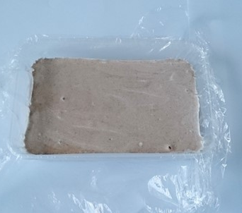
Step 3: Tip & wait
Tip the mix into the shallow tub lined with cling film.
Give the tub a few gentle taps on the table to knock out any bubbles.
Leave to set for c.20 minutes (depending on the type of plaster you’ve used).
Tip & wait

Slide 38
Step 4: Get carving
Gently push the plastic tub from the bottom and your ‘rock’ should pop out.
Then use your stone to carve it, making a ‘petroglyph’.
(Make even more use of it by turning it over to paint a ‘pictograph’ on the other side and then arrange everyone’s to make a ‘petroform’!)
Get carving

Slide 39

More resources
MORE RESOURSCES AT
HistoricEngland.org.uk/Education
contact@historicengland.org.uk

