Slide 1
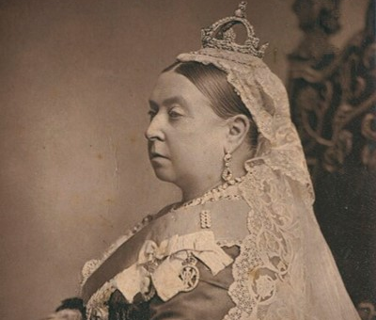
The Reign of Queen Victoria
The Reign of Queen Victoria
Notes:
Image
Queen Victoria by Alexander Bassano, c, 1887 (1882),NPG x13844,© National Portrait Gallery, London

Slide 2
The Reign of Queen Victoria 11
Key Stage 2: History
Pupils extend their chronological knowledge of British history beyond 1066
Pupils learn about the changing power of Monarchs i.e. Queen Victoria
Pupils learn about a significant turning point in British history (Industrial Revolution and the British Empire)
Pupils learn about how aspects of national history are reflected in their locality
Pupils produce creative work, exploring their ideas and recording their experiences
Pupils develop their reading, comprehension, transcription and composition of writing skills
Notes:
Although the resource will mainly cover History, it will also cover:
Literacy:
Reading and comprehension, transcription and composition of writing.
Art and Design:
Produce creative work, exploring their ideas and recording their experiences.
An increased vocabulary linked to chronological historical periods and Victorian era.
About key periods and events in Victorian history.
To develop local history research skills and comparing sources.
To compare and contrast developments during the period.
To increase knowledge of the British Empire
To increase knowledge of Victoria and Albert's memorialisation.
To research local significant industrial and transport developments from the Victorian era.
To identify Victorian buildings, monuments, parks and gardens on the National Heritage List for England, nationally and in your local area.

Slide 3
Introduction to the resource
The resource is split into 5 sections:
The aim of this resource is to engage students in the life of Queen Victoria and explore the Victorian era, recognising key industrial developments and significant events.
It includes examples of Victorian life, information about monuments, instructions to research your locality for Victorian buildings and identifying the impact of this period. It provides a range of activity suggestions to help you do this.
1. All about Victoria
2. The industrial revolution and its impact on your local area
3. The British Empire
4. Remembering Victoria and Albert – monuments
5. ‘Missing Pieces Project’
Notes:
In addition to the information provided, you can also choose to take part in local history research, to ‘Enrich the List’ by adding your local images of listed Victorian buildings or monuments to our online resource. Information on how to do this is provided, however, you will require access to the internet.
You may choose to plan the research element in advance. If you have a local Victorian building, you may wish to arrange a visit to see it and take photos, draw it or you may wish to print photos out for your class to look at.

Slide 4
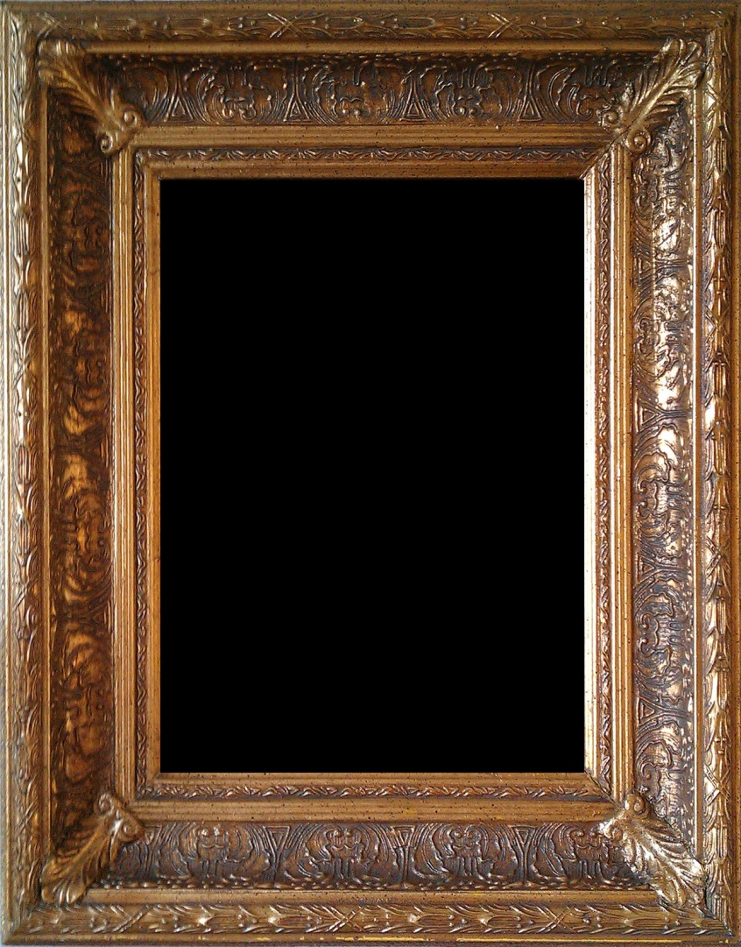
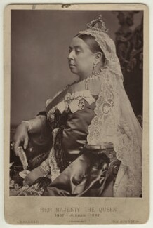
The Reign of Queen Victoria 2
It is over 200 years since
Queen Victoria was born in 1819.
The Victorian era brought many changes to Britain and the wider world.
Notes:
Image
Queen Victoria by Alexander Bassano, c, 1887 (1882),NPG x13844,© National Portrait Gallery, London

Slide 5






Who was Queen Victoria?
Where did she rule?
What was life like for the people she ruled?
What was the British Empire?
How do we remember her?
What was the impact of Victoria’s rule?
Notes:
Ask the questions on the power point to see how many students are aware of Victoria. We will learn the answers a little later, as we progress through the activities.

Slide 6
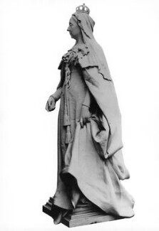
Queen Victoria
It is over 200 years since Queen Victoria was born in 1819, and we will be learning about important developments which took place during her lifetime, such as the industrial revolution and the expansion of the British Empire.
Notes:
We will also learn about Victoria and her husband Prince Albert and how they have been remembered since their death.
Key words to explore:
Monument – statue, stone or building set up in memory of an important person or event.
Monarchy – country ruled by a king or queen.
Coronation – ceremony of the crowning of a new king or queen.
Empire – large area of land, ruled over by another country.
Industrial Revolution – fast development of industry that occurred in Britain in the late 18th and 19th centuries, brought about by the introduction of machinery.
Image:
Queen Victoria
by Sir Thomas Brock, marble statue, before 1902, NPG 6174,© National Portrait Gallery, London,

Slide 7

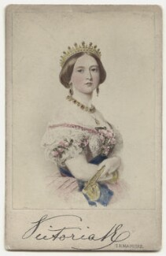



Facts about Queen Victoria 1
She was the first monarch to be photographed.
She was born on the 24th May 1819.
Victoria was only 18 when she became queen.
She was christened Alexandrina Victoria.
There were 8 attempts to assassinate Victoria.
At 13, Victoria was given a diary and wrote in it for most of her life.
She was the first monarch to live in Buckingham Palace.
Victoria didn’t go to school; she was educated at home by a governess.
She was only 1.52m tall!
Notes:
Section 1. All About Victoria
Image
Queen Victoria by and after Thomas Herbert Maguire, hand-coloured albumen carte-de-visite, 1860s,NPG x135655,© National Portrait Gallery, London

Slide 8
Facts about Queen Victoria 2
Victoria had 9 children and 42 grandchildren.
Victoria had to propose to her husband as she was Queen.
Victoria ruled the British Empire, but she did not support the campaign for women’s voting rights.
Until recently, Queen Victoria was the longest reigning monarch and had ruled for 63 years. Queen Elizabeth II overtook her and in 2022 she celebrated her Platinum Jubilee, commemorating 70 years on the throne.
She is the great, great grandmother of Queen Elizabeth II.
Notes:
Section 1. All About Victoria
Image
Queen Victoria by Alexander Bassano, c, 1887 (1882),NPG x13844,© National Portrait Gallery, London

Slide 9


Activity 1
Which fact surprises you the most?
Which facts tell you the most about the kind of person she was?
Think
Write
Notes:
Activity:
Which fact surprises you the most? You could ask pupils to write a Tweet to be posted from your school’s Twitter account (eg. Happy 200th birthday Queen Victoria – 9 children, 42 grandchildren, 8 assassination attempts – what a lady!). If you don’t have/approve of Twitter ask pupils to write a short newspaper article about Victoria.

Slide 10

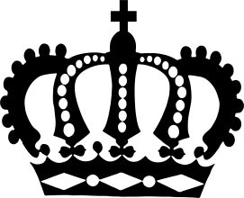
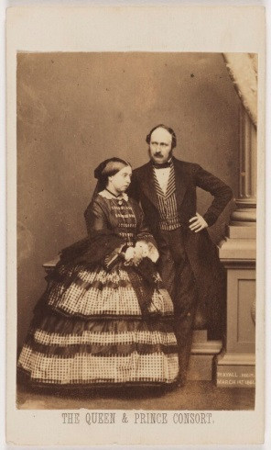
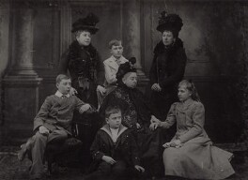
Queen Victoria’s Timeline 1
1841
A son is born, he is called Albert Edward but known as ‘Bertie’.
1819
Victoria is born on 24th May.
1838
Queen Victoria’s coronation.
1840
Queen Victoria marries Prince Albert of Saxe-Coburg and Gotha.
1837
King William IV dies.
–
Victoria becomes Queen of the UK and all the countries in the British Empire.
1840
A baby girl is born, she is called Victoria but known as ‘Vicky’.
Notes:
Go through the two ‘Victoria’s Timeline’ slides with the class to learn even more about her life.
Images
Victoria by Thomas Herbert Maguire, hand-coloured albumen carte-de-visite, 1860s,NPG x135655,© National Portrait Gallery, London
Queen Victoria; Prince Albert of Saxe-Coburg-Gotha by John Jabez Edwin Mayall, albumen carte-de-visite, February 1861
NPG x26100, © National Portrait Gallery, London
Queen Victoria and family, by Lafayette, bromide proof print, April 1900,NPG Ax29330
© National Portrait Gallery, London

Slide 11
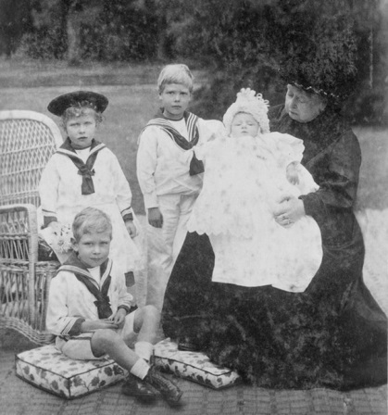
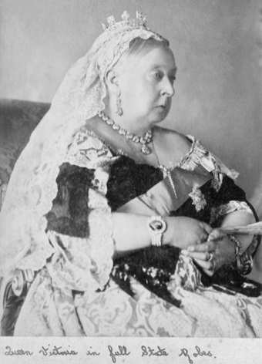
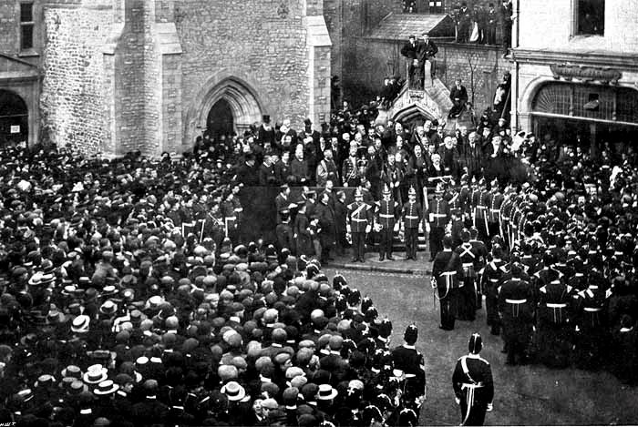

Queen Victoria’s Timeline 2
1901
Queen Victoria dies on 22nd January aged 81. She has been queen for 63 years.
1842
Attempted assassination of the queen.
1897
The Diamond Jubilee is celebrated for 60 years on the throne.
1861
Prince Albert dies from typhoid. Queen Victoria wears black for the rest of her life.
1877
Queen Victoria is named Empress of India.
1843 – 1847
has 7 more children.
Notes:
Go through the two ‘Victoria’s Timeline’ slides with the class to learn even more about her life.
Images
Victoria and grandchildren Photograph taken 1900 © Historic England Archive Photo Library ref: N880028
https://historicengland.org.uk/services-skills/education/educational-images/queen-victoria-grandchildren-osborne-house-east-cowes-10646
Victoria at Osborne House © Historic England Archive Photo Library ref: N880023
https://historicengland.org.uk/services-skills/education/educational-images/queen-victoria-osborne-house-east-cowes-10642
George becomes king. Photograph taken 1901 © Reproduced by permission of Oxfordshire County Council

Slide 12
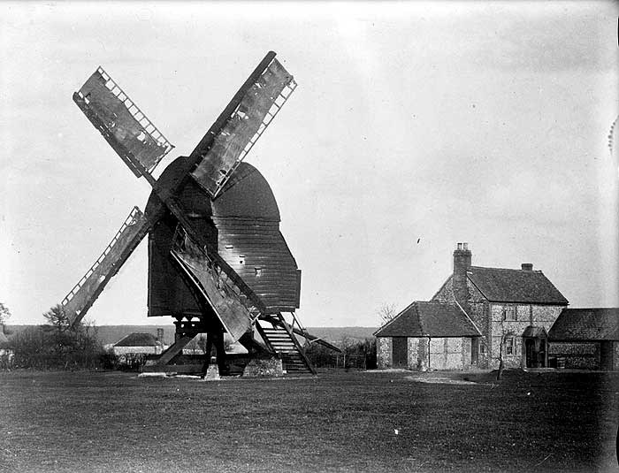
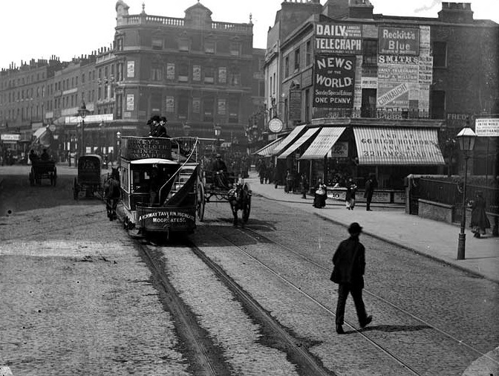
The Industrial Revolution
What was life like for the people she ruled?
Notes:
Section 2. Industrial Revolution
How did life change under Victoria's rule?
When Victoria became Queen, although the industrial revolution had begun, most people were living off the land (Rural life image), farming and growing crops. By the end of her reign, most people lived in towns or cities, working in factories or on the railways.
Britain became the most powerful country in the world , leading in the industrial revolution with steam power and technological advances. The City life image shows a busy street view, looking towards the Angel Hotel in London, with horse-drawn vehicles (including a tramcar) and shops in the background. Tramcars were introduced in 1861 by George Francis Train.
As we have seen in the timeline, due to Victoria and Albert’s passion for new ideas and technology, many new inventions and discoveries took place.
Links
Use the additional resources to find out more about the importance of Victorian buildings and the life of a Victorian child
https://historicengland.org.uk/services-skills/education/teaching-activities/what-can-victorian-buildings-tell-us-about-how-the-victorians-thought/
https://historicengland.org.uk/services-skills/education/teaching-activities/what-was-life-like-for-victorian-children-did-it-get-any-better/
Image
https://historicengland.org.uk/services-skills/education/educational-images/bledlow-ridge-windmill-bledlow-1387
Photograph taken 1870 - 1900 © Reproduced by permission of Historic England Archive ref: AA78/01560
https://historicengland.org.uk/services-skills/education/educational-images/city-road-islington-3830
Photograph taken 1870 - 1900 © Reproduced by permission of Historic England Archive ref: CC97/01264

Slide 13
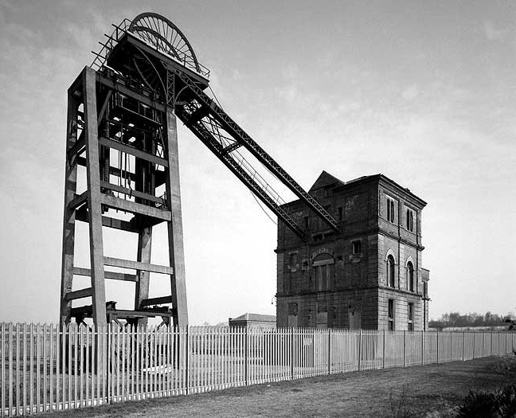
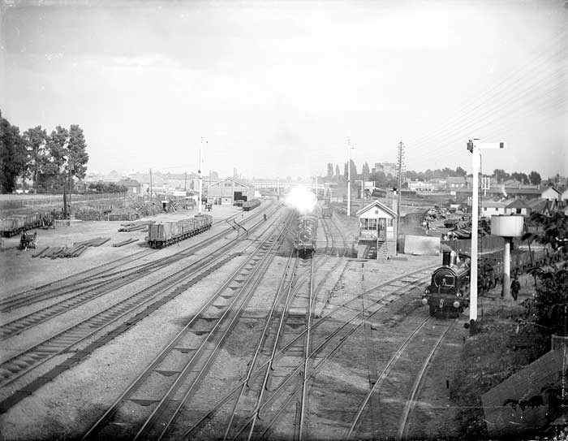
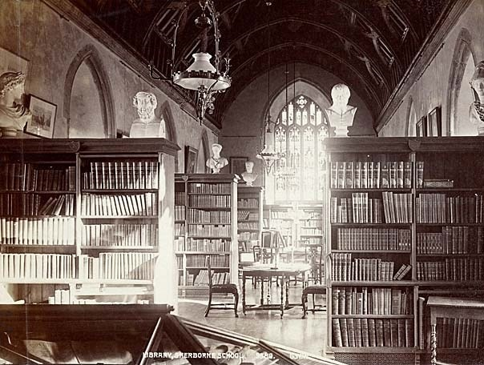
The Industrial Revolution Timeline 1
1844
The Factory Act says that children between 8-13 cannot work more than 6.5 hours in factories.
1851 The Great Exhibition opens at The Crystal Palace in Hyde Park.
1841
The Great Western Railway line is completed between Bristol and London. .
1851
The first public library opens in Winchester.
1842
The Mines Act says that children under 10 cannot work underground in the coal mines.
1844-45 Railway tracks are built around Britain.
Notes:
Talk through the two ‘Industrial Timeline’ slides, you can click on several of the images to see larger more detailed versions of them.
Images
A colliery in Nottingham Photograph taken December 1993 © Copyright Crown copyright. NMR ref: AA93/03125
historicengland.org.uk/services-skills/education/educational-images/bestwood-colliery-bestwood-st-albans-2804
Train station in Slough. Photograph taken 1883 © Reproduced by permission of Historic England Archive ref: CC73/00887
https://historicengland.org.uk/services-skills/education/educational-images/great-western-railway-slough-berkshire-4272
Dorset library Photograph taken 1870 - 1900 © Reproduced by permission of Historic England Archive ref: OP10410
https://historicengland.org.uk/services-skills/education/educational-images/the-library-sherborne-school-sherborne-10549

Slide 14
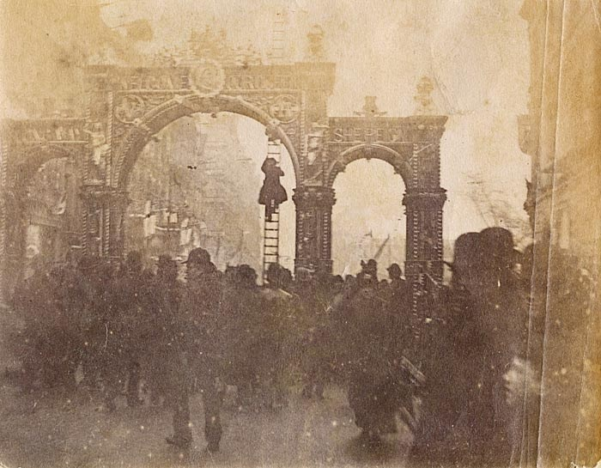
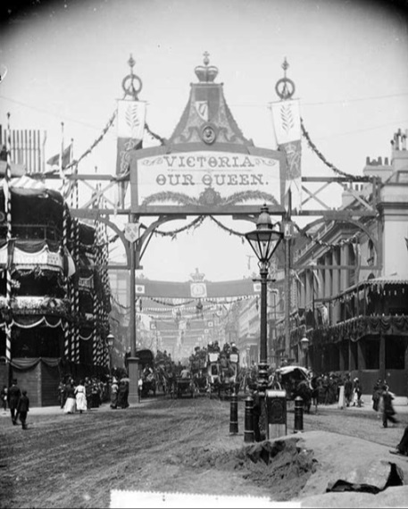
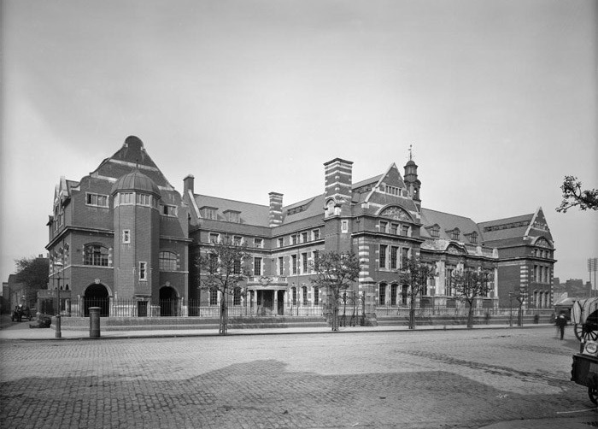
The Industrial Revolution Timeline 2
1871
Queen Victoria opens the Albert Hall.
1878
London has the first public electric lights, which replace the old gas lamps in the street.
1863
The first underground railway opens in London.
1856
Police forces created in every county.
1880 – The Education Act makes it compulsory for all children, who are aged 5-10, to go to school.
1876 – Alexander Bell invents the telephone.
1864 – An Act is passed to try to stop children from working as chimney sweeps.
Notes:
Talk through the two ‘Industrial Timeline’ slides, you can click on several of the images to see larger more detailed versions of them.
Images
Birmingham workers arch - Photograph taken 23 March 1887 © Historic England Archive ref: op14837
https://historicengland.org.uk/services-skills/education/educational-images/metal-workers-arch-colmore-row-birmingham-11363
Jubilee Arch. Photograph taken 1887 © Reproduced by permission of Historic England Archive ref: CC97/00921
https://historicengland.org.uk/services-skills/education/educational-images/regent-street-westminster-london-4572
St Olave's Grammar school from the south-west. Photograph taken May 1899 - Jun 1899 © Reproduced by permission of Historic England Archive ref: bl15371
https://historicengland.org.uk/services-skills/education/educational-images/st-olaves-school-southwark-10416

Slide 15

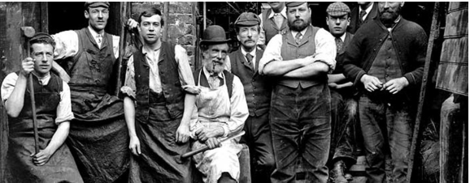
Activity 2 - Picture detectives
Investigate
Use the images on the following slides to spot as many differences as possible between ‘Farm life’ & ‘City life’ in Victorian times.
Can you spot any more differences?
Notes:
Use the Images by Theme photos of ‘Victorian’s at work’ to find more examples of ‘Farm life’ & ‘City life’.

Slide 16
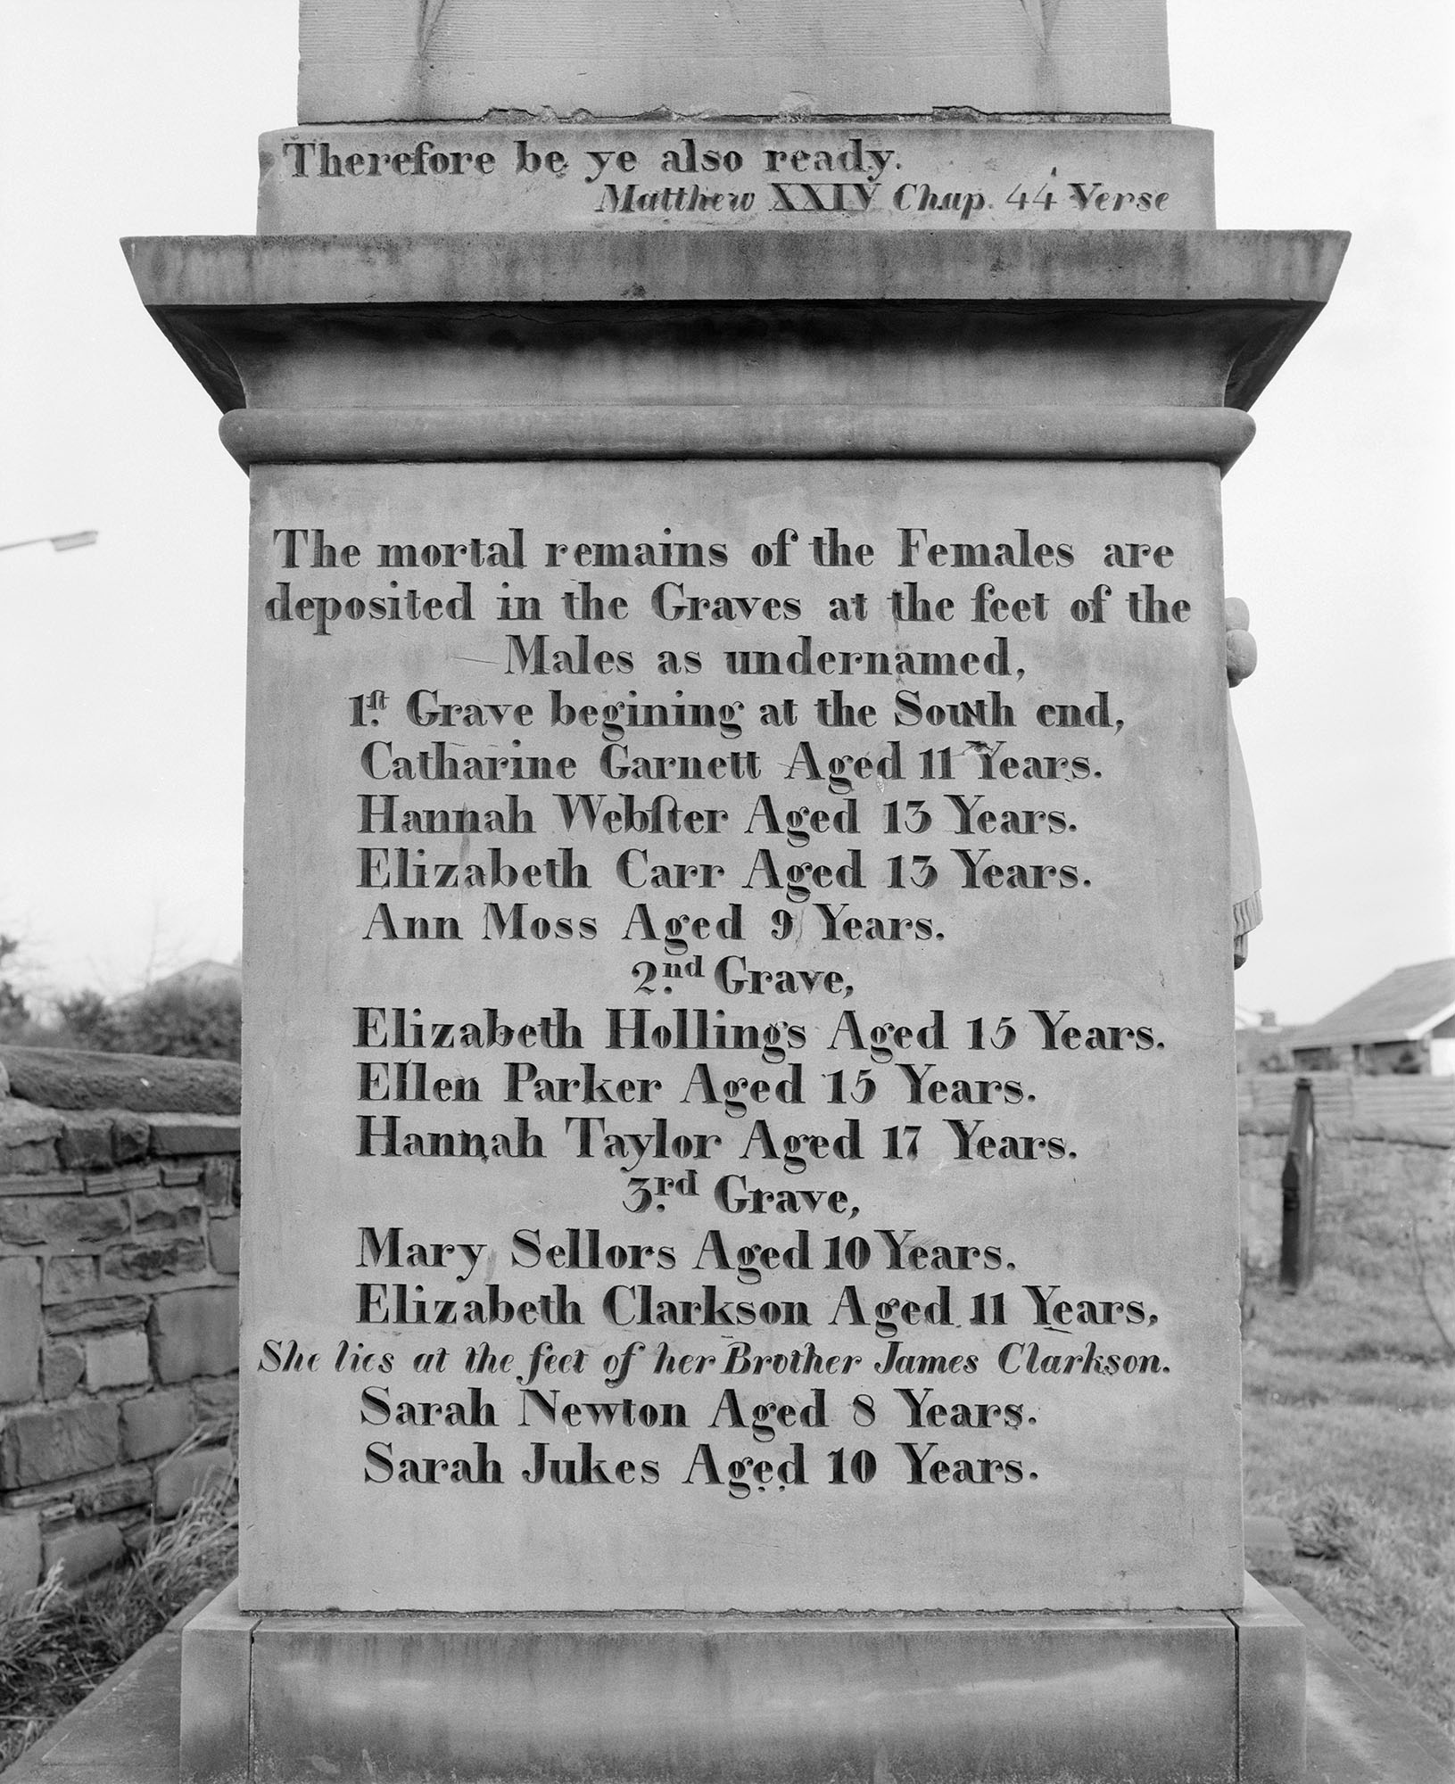

Working Conditions
Many children worked in factories and mines when Victoria became queen.
Watch this short film to find out more about coal mining and the working conditions in a coal pit.
The names on this memorial stone are of children who worked in a Yorkshire mine in 1838. They were all drowned when the mine flooded.
Notes:
Link to Resources Pack on working conditions for Victorian children.
https://historicengland.org.uk/services-skills/education/teaching-activities/what-was-life-like-for-victorian-children-did-it-get-any-better/
Image: Memorial to victims of the Huskar Pit mining disaster, in which 26 chiildren drowned on the 4th July 1838. © Crown copyright. Historic England Archive. Ref: AA93/01061 https://historicengland.org.uk/images-books/photos/item/AA93/01061
BBC Bitesize Short Film Victorian Children working in coal mines https://www.bbc.com/bitesize/clips/z73b4wx

Slide 17
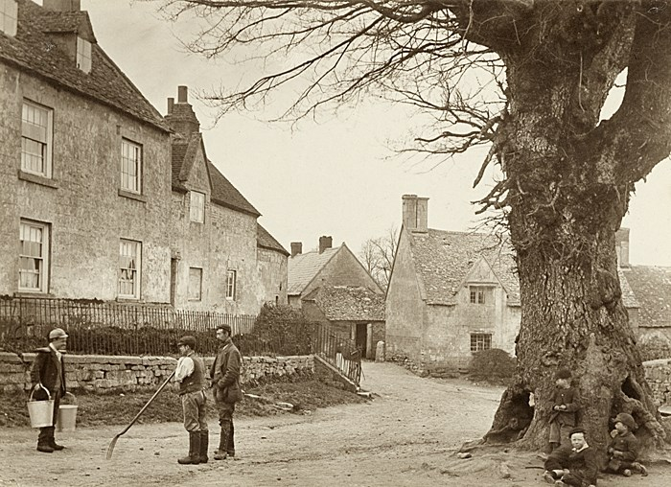
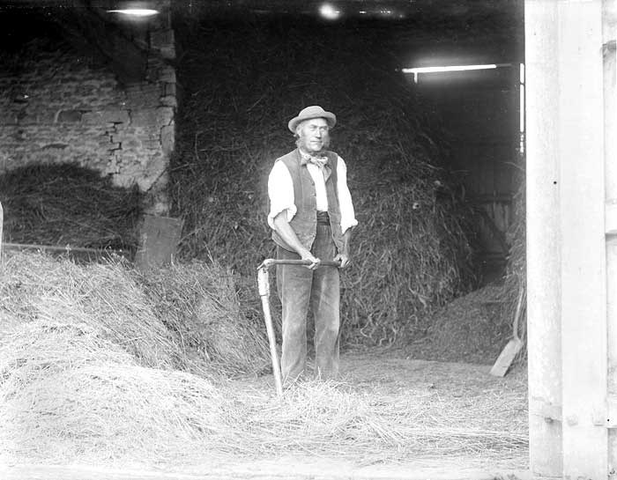
Farm Life
When Victoria became queen, many people were farmers and children would work too. Towards the end of the era, children had to go to school by law, even in the countryside.
Look at the pictures.
What can you see?
Notes:
Click on the images to see larger more detailed versions of them to help you spot the differences.
Image
Photograph taken 1895 © Reproduced by permission of Historic England Archive ref: CC72/01123
https://historicengland.org.uk/services-skills/education/educational-images/threshing-in-great-barrington-barn-great-barrington-1992
Photograph taken 04 Apr 1896 © Historic England Archive ref: OP16118
https://historicengland.org.uk/services-skills/education/educational-images/stretton-on-fosse-11210

Slide 18
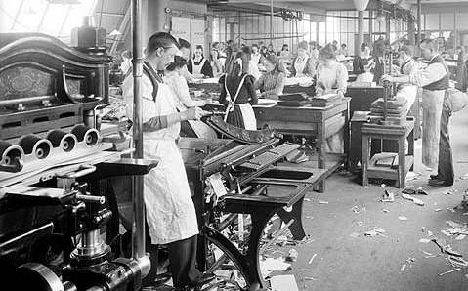
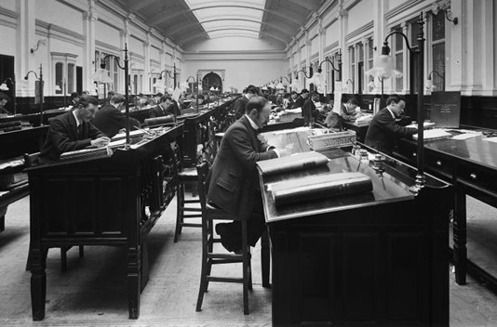
City Life 1
During Victoria’s reign as queen the number of people doing manual working in factories increase greatly. Towards the end of her reign, improved education meant less people did manual work and more did written work.
Look at the pictures.
What can you see?
Notes:
Click on the images to see larger more detailed versions of them to help you spot the differences.
Image
Photograph taken 1900 © Reproduced by permission of Historic England Archive ref: BL/15892
https://historicengland.org.uk/services-skills/education/educational-images/tootal-broadhurst-and-lee-warehouse-oxford-road-manchester-2053
Photograph taken Apr 1897 © Reproduced by permission of Historic England Archive ref: BL14041_013
https://historicengland.org.uk/services-skills/education/educational-images/lever-house-wood-street-port-sunlight-bebington-9977

Slide 19
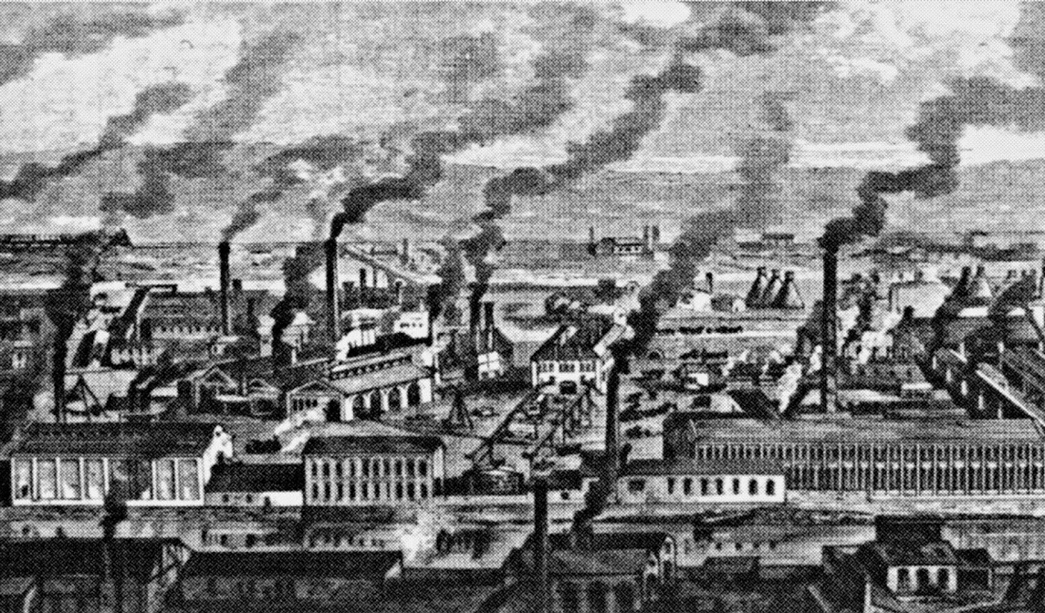
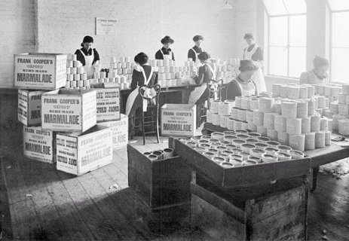
City Life 2
Look at the pictures.
What can you see?
Notes:
The industrial revolution was huge! It was one of the biggest changes in human history, when machines began to replace people and more people lived in cities. It was the first time things, such as clothes, could be mass produced.
As more people had jobs, conditions improved for most people and they could afford to buy better clothes, however, industrialisation caused new problems, such as pollution and waste.
Questions
Put your detective hat on again, look at the two photos. What do you see? Look at the clothes the people are wearing. What are they doing? How are the inside and outside of the buildings different from the ones we see today? Can you compare the farm life photos to the city life ones ?
Image
Cooper’s Marmalade Works, Oxford, 1900 © Reproduced by permission of Historic England Archive ref: cc73_00613
https://historicengland.org.uk/services-skills/education/educational-images/frank-coopers-works-victoria-buildings-oxford-oxfordshire-10472
©Google images creative commons.
To build the picture of the poverty and appalling living conditions in Victorian Britain research Victorian Slums and show your pupils :https://www.bl.uk/romantics-and-victorians/articles/slums

Slide 20
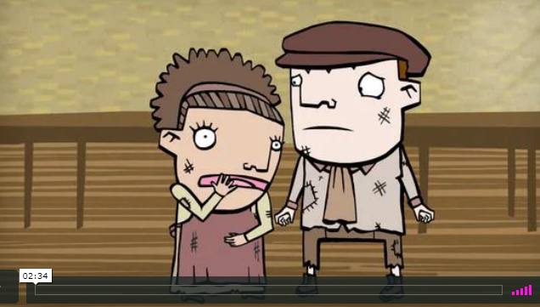
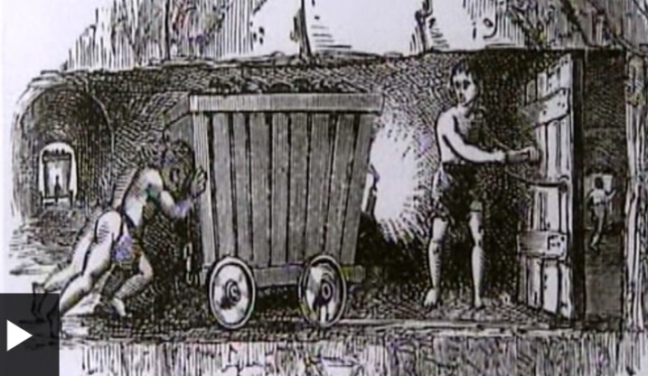
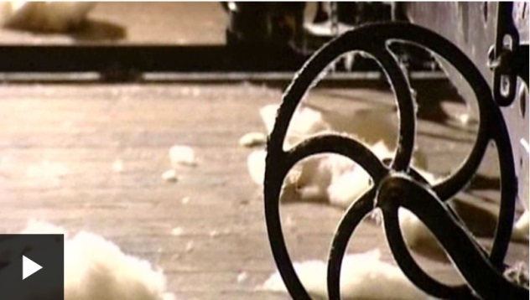
Victorian Jobs
There were many different types of jobs during the Victorian times and children worked too. Watch the short videos here to see what jobs children did and the conditions they worked in.
Notes:
https://www.bing.com/videos/search?q=bbc+bite+size+victortians+&&view=detail&mid=6752795E2319E694081D6752795E2319E694081D&&FORM=VRDGAR
Other useful links:
BBC Bitesize short film links : Children working in textile mills https://www.bbc.com/bitesize/clips/zsdw2hv
Children working in Mines https://www.bbc.com/bitesize/clips/z73b4wx
BBC Primary Education: Children working as domestic servants https://www.bbc.co.uk/programmes/p01145qm
Improving the working conditions of Victorian children https://www.bbc.co.uk/programmes/p0115gmh
https://historicengland.org.uk/services-skills/education/teaching-activities/what-was-life-like-for-victorian-children-did-it-get-any-better/
https://historicengland.org.uk/services-skills/education/teaching-activities/what-was-life-like-for-victorian-school-children/
http://primaryfacts.com/1683/victorian-factories-and-the-machines-of-industry-facts-and-information/

Slide 21
Match the job
Home workers
The Workhouse
Domestic services
Railways workers
Farming
Factory work
Chimney sweep
Engineer
Coal miners
People working from home, such as weaving and card making.
Machines replaced people, but people were needed to make sure the machines ran smoothly. Big buildings, often with chimneys, were created near coal mines, as coal was used to power machines.
Place where very poor people worked and lived. They were very strict, almost like a prison. The buildings were large and many are listed today.
Household services for the rich people. This included cooking, cleaning and looking after children.
As the population increased during the Victorian period, more food was needed. New inventions improved how the land was ploughed.
Rail lines were built all over the country. Working on the railway was a hot, dangerous job, shovelling coal.
Working under ground was a dangerous job often given to children, filling coal buckets, until it was banned.
Designing wheels, tubes, steam gauges, building bridges, buildings, machines and trains.
Children aged 6 were the best age to sweep chimneys, cleaning away soot.
Notes:
Here are a range of different jobs available during the industrial revolution.
Question
Would you like to do any of these jobs? Which would you rather do: go to school or work?
Activity
Match the type of job to the description. Print out the slide and ask pupils to draw a line between the job on the left and the correct description on the right.

Slide 22
Match the job print version
Home workers
The Workhouse
Domestic services
Railways workers
Farming
Factory work
Chimney sweep
Engineer
Coal miners
People working from home, such as weaving and card making.
Machines replaced people, but people were needed to make sure the machines ran smoothly. Big buildings, often with chimneys, were created near coal mines, as coal was used to power machines.
Place where very poor people worked and lived. They were very strict, almost like a prison. The buildings were large and many are listed today.
Household services for the rich people. This included cooking, cleaning and looking after children.
As the population increased during the Victorian period, more food was needed. New inventions improved how the land was ploughed.
Rail lines were built all over the country. Working on the railway was a hot, dangerous job, shovelling coal.
Working under ground was a dangerous job often given to children, filling coal buckets, until it was banned.
Designing wheels, tubes, steam gauges, building bridges, buildings, machines and trains.
Children aged 6 were the best age to sweep chimneys, cleaning away soot.
Notes:
Here are a range of different jobs available during the industrial revolution.
Question
Would you like to do any of these jobs? Which would you rather do: go to school or work?
Activity
Match the type of job to the description. Print out the slide and ask pupils to draw a line between the job on the left and the correct description on the right.

Slide 23
Match the job – Answers 1
Home workers
The Workhouse
Domestic services
Railways workers
Farming
Factory work
Chimney sweep
Engineer
Coal miners
People working from home, such as weaving and card making.
Machines replaced people, but people were needed to make sure the machines ran smoothly. Big buildings, often with chimneys, were created near coal mines, as coal was used to power machines.
Place where very poor people worked and lived. They were very strict, almost like a prison. The buildings were large and many are listed today.
Household services for the rich people. This included cooking, cleaning and looking after children.
As the population increased during the Victorian period, more food was needed. New inventions improved how the land was ploughed.
Rail lines were built all over the country. Working on the railway was a hot, dangerous job, shovelling coal.
Working under ground was a dangerous job often given to children, filling coal buckets, until it was banned.
Designing wheels, tubes, steam gauges, building bridges, buildings, machines and trains.
Children aged 6 were the best age to sweep chimneys, cleaning away soot.
Notes:
Here are a range of different jobs available during the industrial revolution.
Question
Would you like to do any of these jobs? Which would you rather do: go to school or work?
Activity
Match the type of job to the description. Print out the slide and ask pupils to draw a line between the job on the left and the correct description on the right.

Slide 24
Match the job – Answers 2
Home workers
The Workhouse
Domestic services
Railways workers
Farming
Factory work
Chimney sweep
Engineer
Coal miners
People working from home, such as weaving and card making.
Place where very poor people worked and lived. They were very strict, almost like a prison. The buildings were large and many are listed today.
Household services for the rich people. This included cooking, cleaning and looking after children.
Rail lines were built all over the country. Working on the railway was a hot, dangerous job, shovelling coal.
As the population increased during the Victorian period, more food was needed. New inventions improved how the land was ploughed.
Machines replaced people, but people were needed to make sure the machines ran smoothly. Big buildings, often with chimneys, were created near coal mines, as coal was used to power machines.
Children aged 6 were the best age to sweep chimneys, cleaning away soot.
Designing wheels, tubes, steam gauges, building bridges, buildings, machines and trains.
Working under ground was a dangerous job often given to children, filling coal buckets, until it was banned.
Notes:
Answers
Activity
Match the type of job to the description.

Slide 25
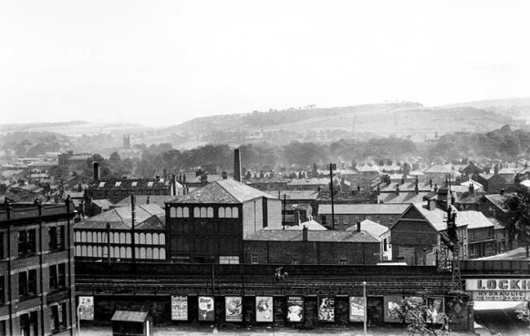
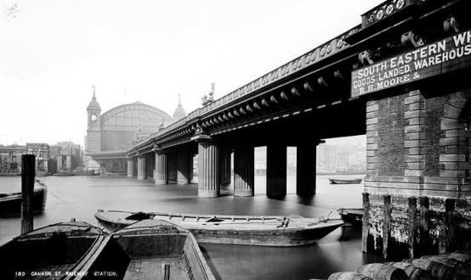
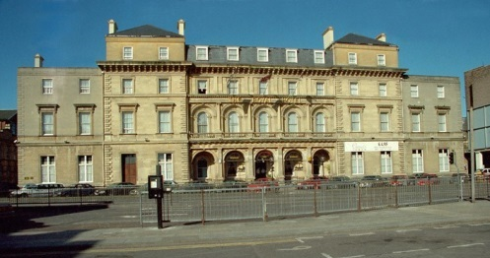
The Built Environment 1
The Industrial Revolution had a huge impact on the built environment in Britain
Bridges
Train Stations
Mills
Notes:
Left to right from top: Historic England
Cannon Street Station railway bridge, London
Train Station, Kingston-upon-Hull
Macclesfield Mills, Cheshire

Slide 26
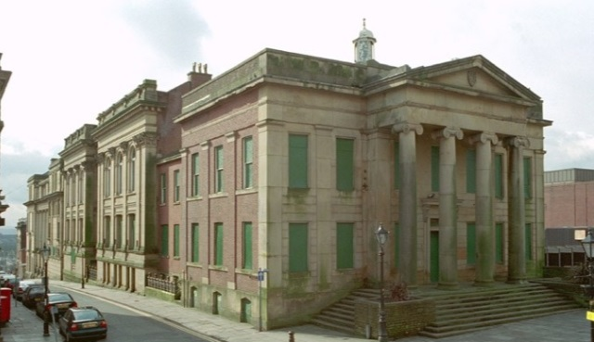
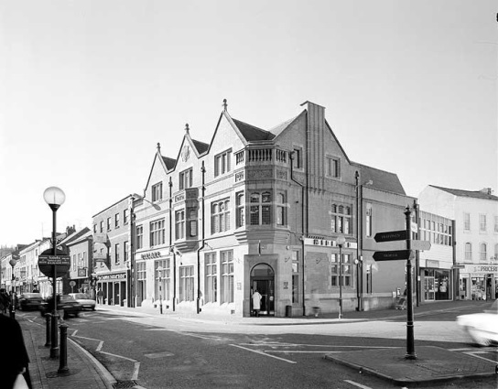
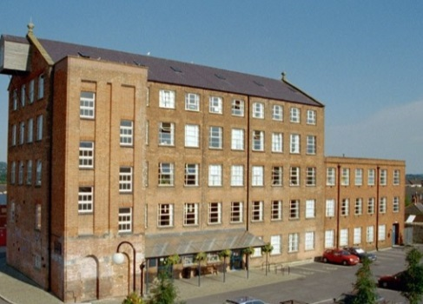
The Built Environment 2
The Industrial Revolution had a huge impact on the built environment in Britain
Town Halls
Banks
Factories
Notes:
Left to right from top: Historic England
Town Hall, Oldham
Midland Bank, Owestry
Former Lace Factory, Somerset

Slide 27
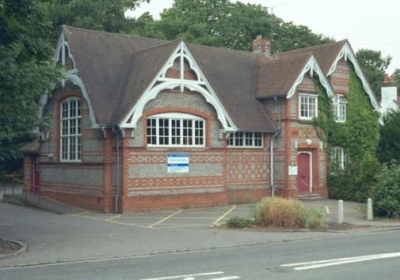
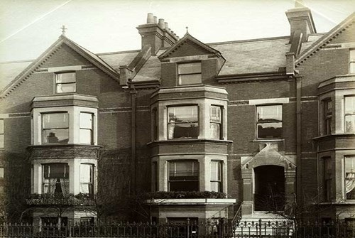
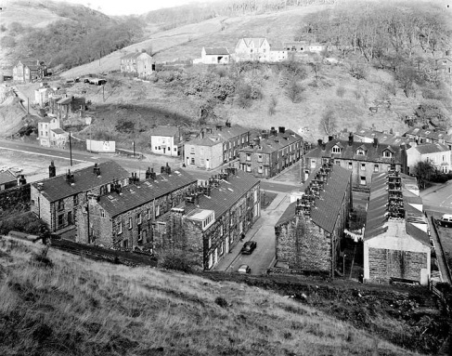
The Built Environment 3
The Industrial Revolution had a huge impact on the built environment in Britain
Schools
Terraced Houses
Workers’ Houses
Notes:
Left to right from top: Historic England
School, Berkshire
Middle Class Houses, Swindon
Workers Houses, Yorkshire

Slide 28
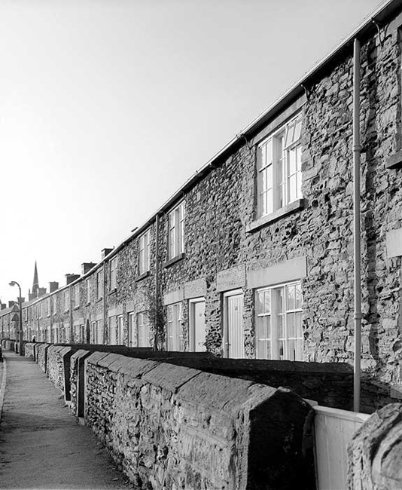
Workers’ Houses 1
Towns and cities across the country grew, with many terraced houses being built for workers.
Use these Images by Theme photos of ‘Victorian’s houses’ to find more examples of typical Victorian homes
Can you find any houses like this near your school?
Notes:
Houses
Victorian towns grew, with the population increasing to over 50% of people living in towns and cities by the end of Victoria's reign. As people flocked to the cities for work, there was a shortage of houses, so many people had to share a room in other people’s homes. Often ten or twelve people shared one room.
Because of this shortage of houses in the cities many factory owners built houses for their workers near their factories. Often the houses were built close together, really quickly and cheaply. However so owners cared more for their workers and tried to create not just houses, but communities, with shops, sports grounds and other facilities for their workers, one such example is Bourneville in Birmingham. Look at these additional photos to find more examples of Victorian houses: https://historicengland.org.uk/services-skills/education/images-by-theme/victorian-houses
Many of these houses survive today and now make lovely homes for a single family, but can you imagine what it would have been like to live in a house like this with so many people crammed into each room and no indoor toilet! Can you find any houses like this near your school?
Image
Photograph taken January 1993 © Crown copyright. NMR ref: aa93/01014
https://historicengland.org.uk/services-skills/education/educational-images/workers-housing-reform-row-wath-road-elsecar-2899

Slide 29
Workers’ Houses 2
Would you have liked to live in these conditions?
Why not ?
Do you have Victorian factories and terraced houses in your area?
Notes:
Houses
Question
Would you have liked to live in these conditions? Why not? Having looked at all the other Victorian Houses in the Image by Theme collection do you think life was the same for everyone? Do you have Victorian factories and terraced houses in your area?
Research more information and images on Victorian slum housing and living conditions
http://www.victorianweb.org/victorian/history/slums.html
https://www.historyextra.com/period/victorian/life-in-19th-century-slums-victorian-londons-homes-from-hell/
Image
Photograph taken January 1993 © Crown copyright. NMR ref: aa93/01014
https://historicengland.org.uk/services-skills/education/educational-images/workers-housing-reform-row-wath-road-elsecar-2899

Slide 30
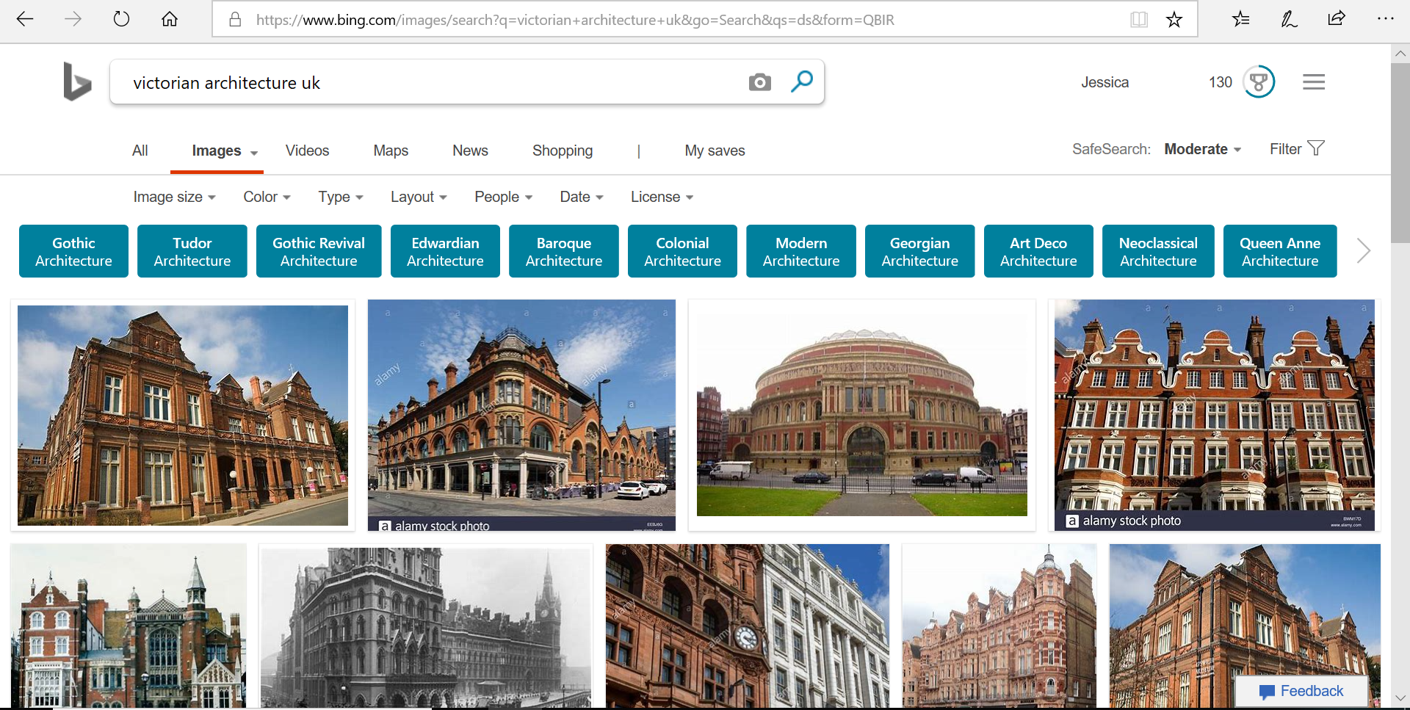
Posh Houses and public buildings
Classical or Gothic?
Over the next few slides, print a range of pictures out, some Victorian Gothic and others Classical and the chart.
Can you identify which is which style and stick the images into the correct category?
Notes:
During the Victorian era people gained inspiration for architecture from all across the world. It was also during this time that the job of being an Architect really grew.
The new railways also meant building materials, such as iron, steel, glass, bricks and tiles could be transported more cheaply across the country.
There were many competitions to win contracts to design new buildings. Many were designed in either a Classical or a Gothic style of architecture.
The first image here shows ‘The Royal Exchange’ in London with columns inspired by Greek and Roman architecture, a classical style.
The second image shows Osbourne house, architecture in a Italianate style. Osbourne house was a holiday home for Victoria and Albert, also classical.
The third image is in a gothic style and was a very practical building. It is Blyth Police Station and is probably the most common style of Victorian architecture. This is because it was decided towards the end of Victoria area that it was the national architecture style and many important buildings, such as a newly rebuilt parliament, were gothic. If you search Victorian architecture you will find many examples.
Activity
Classical or Gothic. Over the next few slides, print a range of pictures out, some Victorian Gothic and others Classical and the chart.Can students identify which is which style and stick the images into the correct category?
Osborne House, Isle of Wight, Hampshire © Historic England DP16722
Blyth Police Station, Northumberland © Mr Erik Borg. Source Historic England Archive Ref:236000
The Royal Exchange, City of London © Historic England DP18328

Slide 31
Activity 3: Victorian Buildings 1
Gothic Shapes
Classical shapes
Notes:
Activity
Look at these shapes to help you decide if a building is Gothic or Classical in style

Slide 32
Activity 3: Victorian Buildings print version1
Gothic Shapes
Classical shapes
Notes:
Activity
Look at these shapes to help you decide if a building is Gothic or Classical in style

Slide 33
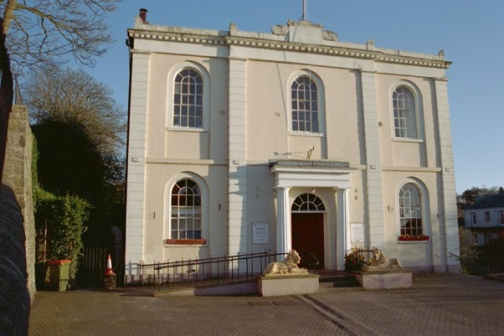
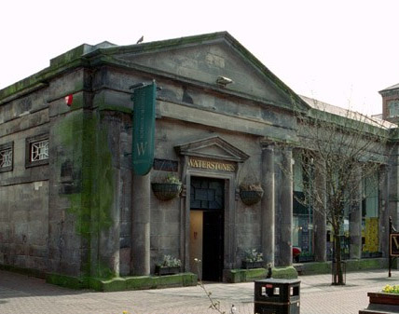
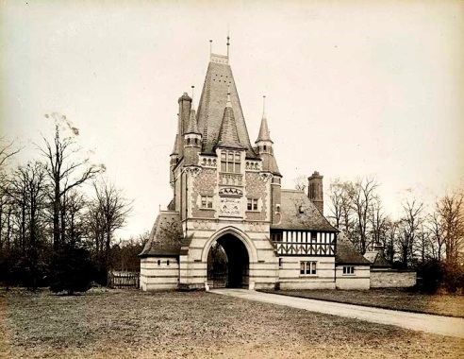
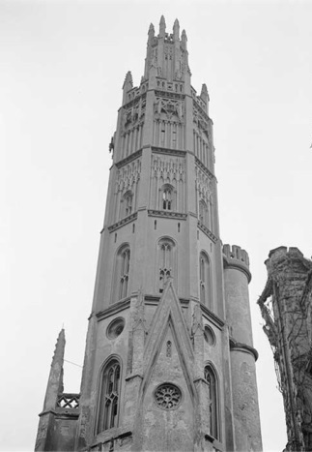
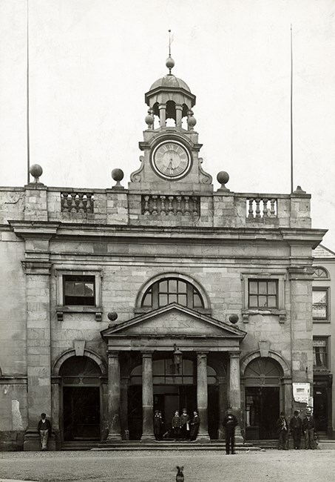
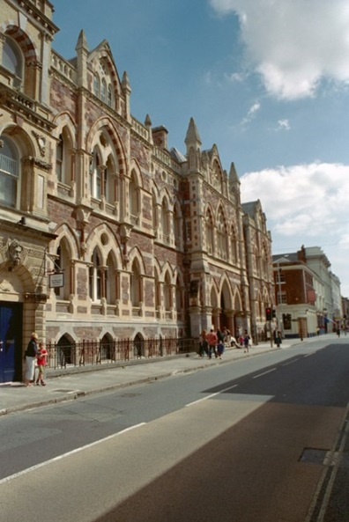
Activity3 : Victorian Buildings 2
Classical or Gothic?
Cut out each picture
Notes:
Images
Photograph taken 1887 © Reproduced by permission of Historic England Archive ref: BL08278
https://historicengland.org.uk/services-skills/education/educational-images/eccleston-hill-lodge-chester-approach-eaton-hall-eccleston-1582
Photograph taken 1945 - 1980 © Historic England Archive ref: AA98/05043 https://historicengland.org.uk/services-skills/education/educational-images/hadlow-castle-hadlow-2225
Photograph taken 1880-1920 © Historic England Archive ref: op05918
https://historicengland.org.uk/services-skills/education/educational-images/butter-cross-ludlow-9709
Photograph taken 26 August 2002 © Mr Terence Harper. Source Historic England Archive ref: 418852https://historicengland.org.uk/services-skills/education/educational-images/royal-albert-memorial-museum-queen-street-exeter-7051
Photograph taken 15 April 2002 © Mr Julian Thurgood. Source Historic England Archive ref: 71738
https://historicengland.org.uk/services-skills/education/educational-images/town-hall-market-street-cockermouth-6843
Photograph taken 01 April 2001 © Mr Brian Peach LRPS. Source Historic England Archive ref: 384502
https://historicengland.org.uk/services-skills/education/educational-images/the-tontine-shops-hanley-6473

Slide 34
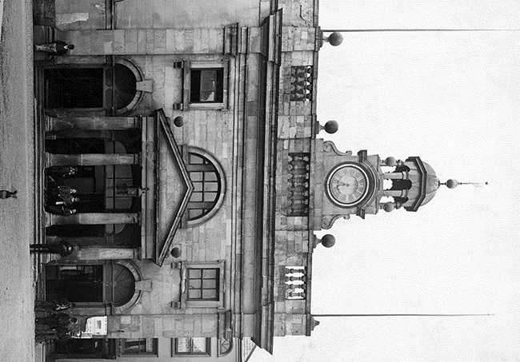
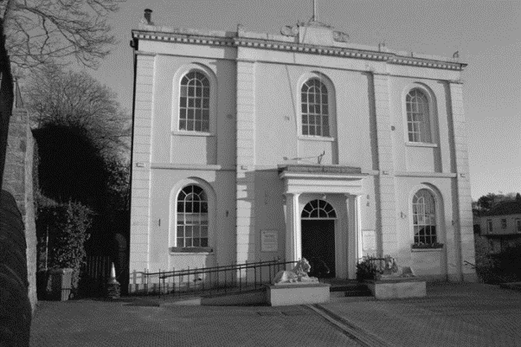
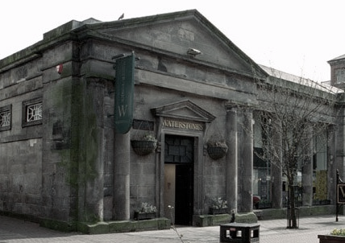



Activity3 : Victorian Buildings print version 22
Classical or Gothic?
Cut out each picture
Notes:
Images
Photograph taken 1887 © Reproduced by permission of Historic England Archive ref: BL08278
https://historicengland.org.uk/services-skills/education/educational-images/eccleston-hill-lodge-chester-approach-eaton-hall-eccleston-1582
Photograph taken 1945 - 1980 © Historic England Archive ref: AA98/05043 https://historicengland.org.uk/services-skills/education/educational-images/hadlow-castle-hadlow-2225
Photograph taken 1880-1920 © Historic England Archive ref: op05918
https://historicengland.org.uk/services-skills/education/educational-images/butter-cross-ludlow-9709
Photograph taken 26 August 2002 © Mr Terence Harper. Source Historic England Archive ref: 418852https://historicengland.org.uk/services-skills/education/educational-images/royal-albert-memorial-museum-queen-street-exeter-7051
Photograph taken 15 April 2002 © Mr Julian Thurgood. Source Historic England Archive ref: 71738
https://historicengland.org.uk/services-skills/education/educational-images/town-hall-market-street-cockermouth-6843
Photograph taken 01 April 2001 © Mr Brian Peach LRPS. Source Historic England Archive ref: 384502
https://historicengland.org.uk/services-skills/education/educational-images/the-tontine-shops-hanley-6473

Slide 35
Activity 3: Victorian Buildings 3
Gothic | Classical
Notes:
Activity
Stick the correct style of architecture into the correct column. Which is Gothic and which is classic?

Slide 36




Activity 4: Victorian Buildings - Answers 4
Gothic | Classical
Notes:
Answers
Images
Photograph taken 1887 © Reproduced by permission of Historic England Archive ref: BL08278
https://historicengland.org.uk/services-skills/education/educational-images/eccleston-hill-lodge-chester-approach-eaton-hall-eccleston-1582
Photograph taken 1945 - 1980 © Historic England Archive ref: AA98/05043 https://historicengland.org.uk/services-skills/education/educational-images/hadlow-castle-hadlow-2225
Photograph taken 1880-1920 © Historic England Archive ref: op05918
https://historicengland.org.uk/services-skills/education/educational-images/butter-cross-ludlow-9709
Photograph taken 26 August 2002 © Mr Terence Harper. Source Historic England Archive ref: 418852https://historicengland.org.uk/services-skills/education/educational-images/royal-albert-memorial-museum-queen-street-exeter-7051
Photograph taken 15 April 2002 © Mr Julian Thurgood. Source Historic England Archive ref: 71738
https://historicengland.org.uk/services-skills/education/educational-images/town-hall-market-street-cockermouth-6843
Photograph taken 01 April 2001 © Mr Brian Peach LRPS. Source Historic England Archive ref: 384502
https://historicengland.org.uk/services-skills/education/educational-images/the-tontine-shops-hanley-6473

Slide 37

Activity 5: What impact did the industrial revolution have on your local area?
Notes:
Maps are a great way of seeing how your town has developed and grown over the years. Use the National Library of Scotland’s free website to find old maps of your town. https://maps.nls.uk/geo/find/

Slide 38


Example: Rugby
This example shows how the town of Rugby grew between 1886 to 1903. Find and download two maps of your town/village
Notes:
Look at the increase in houses, roads and train lines. The road network here was very important for trade, transporting goods across the country. This also meant there was a increase in jobs, particularly in factories.
Activity
Find your local areas on two maps using the https://maps.nls.uk/geo/find/ (free online historic maps). Try to find one from near the start of her reign (1837) and one from near the end (1901).
Compare the two maps :
Look at maps of your village/town/city
Think about and compare the following:
Population
Number of houses
Rail lines and stations
Number of factories/ businesses
Public services such as schools, libraries and town halls
What impact did the industrial revolution have on your area? Using the worksheet on the next page record your answers.
Why not research further into the local industries of your area.
Activity 2:
Map marking - using tracing paper, mark key buildings and monuments over the maps.

Slide 39
How did your local area change between 1837-1901?
Describe the differences between the two maps | MAP 1 Date of Map: | Map 2 Date of map:
Houses
Industry
Transport links
Public services (e.g. libraries )
Notes:
The industrial revolution made a great impact on many areas. Coal was very important during the time, as it was used to power many of the machines, therefore, coal mining increased greatly in areas across the country.
New factories opened, also schools, grand Victorian buildings and railways. Over course of the era their were improvements in social care and working conditions.
Question: How did your area change between 1837 and 1901?
Activity:
Using maps of your area compare the changes. You could also research the dates of when buildings where opened, i.e. the library, the town hall, the local station. Some may have been built in the Victorian era.
How to research information about Victorian monuments, industrial developments etc. in your area.
There are a range of ways to find answers to your questions and complete your challenge as a local history detective:
Online:
Maps of your area https://maps.nls.uk/geo/find/
Find listed Victorian listed buildings and images https://historicengland.org.uk/listing/the-list/map-search
and https://historicengland.org.uk/services-skills/education/educational-images/
Using physical records by:
Contacting your local library, who may have local history books covering Victorian period or archives, such as old newspapers or photographs. Search by dates or themes.
Contact your nearest museum, they may have information, archives or objects to help you piece together the developments and changes at the time.
Contact your local history group, they may have a website with information or may be able to support you.

Slide 40


The Great Exhibition
Notes:
Let’s show off :The Great Exhibition
https://www.bl.uk/victorian-britain/articles/the-great-exhibition
‘The Great Exhibition of the Works of Industry of All Nations’ or ‘The Great Exhibition’ as it became known, was an international exhibition that took place in Hyde Park, London, from 1 May to 15 October 1851. It showcased the outstanding industry from both Britain and around the world and was organised by Prince Albert. Over 100,000 objects were on display in The Crystal Palace, which was purpose built for the exhibition. Over half of these objects were from Britain, other areas of the exhibition represented the art and culture from countries across the Empire – like these giant figures depicting the Egyptian pharaoh Rameses II, copied from those carved from the rock at the entrance to the temple at Abu Simbel. You can find more images of the exhibition and the Crystal Palace here: https://historicengland.org.uk/services-skills/education/educational-images/?searchType=Educational%20Images&search=Crystal%20Palace&page=&filterOption=&facetValues=&pageId=32278
Image
©Google images creative commons.
Photograph taken circa 1859 © Copyright Historic England Archive ref: dp004613
https://historicengland.org.uk/services-skills/education/educational-images/egyptian-figures-in-the-crystal-palace-sydenham-4001

Slide 41

What Industry was your area famous for? 1
Notes:
Question:
Did your area become famous for a certain type of industry? Was this showcased at The Great Exhibition?
Activity:
If your area had a famous trade, use the worksheet to draw items on the stall.
If not, is your area famous for any type of industry today? What would you take to the exhibition now? Draw these items on the stall.

Slide 42

What Industry was your area famous for? 2
Notes:
Activity:
If you want to be real history detectives, you can even go online and search the actual catalogue from the exhibition: https://archive.org/details/officialcatalog06unkngoog/page/n10
Just type the name of your town into the ‘Search inside’ box to see what you can find. If you get no results for your town, try your nearest large town/city – Newcastle, Manchester etc.

Slide 43

The beginnings of the British Empire
In 1607, almost two hundred years before Victoria was born, the first successful English settlement in America began at Jamestown in Virginia. A second 'colony' followed in 1620 at Plymouth, Massachusetts’.
Meanwhile, in 1617, English merchants were granted the right to trade in India by the great Emperor Jahangir. Before long, they began to force out other European merchants and take control of land round their trading posts.
Notes:
Section 3 – The British Empire
Replica of the Mayflower, which carried the ‘Pilgrim Fathers’ to America. [© Visions of America, LLC/Alamy]

Slide 44

The British Empire 1
During Queen Victoria’s reign Britain took control of even more countries around the world, and they became part of the British Empire.
Notes:
During Queen Victoria's reign, her army and navy invaded (took over) many other countries all over the world. The people of those countries then worked for Victoria and she became their queen too, whether they liked it or not! These countries became known as the British Empire. Some countries include Australia, India, Canada and parts of Africa.
Find out more at the link below:
https://www.dkfindout.com/uk/history/victorian-britain/british-empire/

Slide 45
Nations in the British Empire
Nation | From | Until
Ireland | 1600s | 1962
American Colonies | 1607 | 1776
India (inc’ Pakistan & Bangladesh) | 1609 | 1947
Jamaica | 1655 | 1962
Canada | 1763 | 1931
New Zealand | 1769 | 1947
Malaysia | 1786 | 1957
Australia | 1788 | 1942
Sri Lanka | 1815 | 1949
Nation | From | Until
South Africa | 1815 | 1931
Myanmar (Burma) | 1824 | 1948
Hong Kong | 1842 | 1997
Egypt | 1882 | 1954
Somaliland | 1884 | 1960
Kenya | 1888 | 1963
Uganda | 1888 | 1962
Zimbabwe | 1890 | 1965
Sudan | 1898 | 1956
Notes:
Use a map of the world to familiarise pupils with the countries that were part of the British Empire
Additional resources can be found at http://www.coreknowledge.org.uk/yr5historyBritishEmpire.php

Slide 46

Activity 6: Empire
Which countries became part of the British Empire during Queen Victoria’s reign 1837 -1901 ?
Which nation was the first to gain control back from Britain?
Which nation was the last to gain control back from Britain?
Which nation was under British rule for the longest?
Find the countries that were part of the British Empire on a map of the world.
In groups research different countries that were part of the British Empire, and find out about their culture and the resources/foods they produce.
How do you think people living in these countries felt about being ruled by Britain?
Notes:
http://www.nationalarchives.gov.uk/education/empire/
Ask children to work in groups or pairs and choose a country to research. Find out about the culture and the resources and foods the county produces. Ask them to think about:
How the people in the country might have felt about being ruled by Britain?
Why would the resources the country produced would be of interest to Britain?
What were the living and working conditions like for people working in the country while they were part of the British Empire?
How do you think the people in the country felt about Victoria being their queen?

Slide 47

The British Empire and Commonwealth Countries
Many countries that were once part of the British Empire became members of the Commonwealth of Nations which was established in 1926.
What can you find out about the Commonwealth of Nations?
Notes:
This map can be copied into a word document and will print well in A4 or A3
Activity suggestion : research and add the flags for all these countries. Include these flags on bunting if you are holding a VE Day event or make paper flags.
https://www.worldometers.info/geography/flags-of-the-world/

Slide 48

British Empire
The colonies in the British Empire produced raw materials that British manufacturers made into different products and sold all over the world.
This made lots of British factory owners and businesses very rich, but most workers were very poor.
Why do you think people in South Africa vandalised this statue of Queen Victoria outside the Port City library in South Africa?
Notes:
Websites:
http://www.coreknowledge.org.uk/yr5historyBritishEmpire.php
http://www.nationalarchives.gov.uk/education/empire/g2/cs4/background.htm#bullet1
https://www.tes.com/teaching-resources/blog/best-reviewed-british-values-resources
Image ©Associated Press via https://www.dailymail.co.uk/news/article-3038655/Memorials-British-colonials-attacked-South-Africa-protesters-demand-statues-honouring-racist-figures-past-removed.html

Slide 49
Consider the different aspects of Victorian life
How would you describe this period in history?
Development of railways
Reform acts to make life better for working people
Working conditions in mines
Working conditions in factories
Pollution from factories
Living conditions for poor people
Buildings, construction and architecture
Education for children
New machinery to speed up production in factories
Children working
Britain taking over countries to make them part of the British Empire

Slide 50

Marking the Reign of Queen Victoria
How would you commemorate the different aspects of Victoria’s reign?
Notes:
Research different ways people and events are commemorated in the local area.
Ask pupils to make a list of the different kinds of structures that are made to remember significant events and people.
Image: Memorial to victims of the Huskar Pit mining disaster, in which 26 chiildren drowned on the 4th July 1838. © Crown copyright. Historic England Archive. Ref: AA93/01061 https://historicengland.org.uk/images-books/photos/item/AA93/01061
Image: Statue of Queen Victoria. © National Portrait Gallery, London Ref: NPG 6174 https://www.npg.org.uk/collections/search/portrait/mw08272/Queen-Victoria

Slide 51


How is Queen Victoria remembered?
Is anything named after Victoria or Albert in your town?
How do you remember people who have past away? Some people have a special photo framed, or piece of jewelry or a bench.
Notes:
Section 4 Remembering Victoria and Albert
Question How did we remember Queen Victoria and Albert? How do we remember Kings and Queens?
Memorialisation – Is to preserve the memory of someone. This can take place by building a monument - a statue, building, or other structure built to commemorate a notable person or event. There are hundreds of statues of Victoria and Albert around the country and the world.
Kings and Queens were remembered in different ways, such as statues, pubs, monuments, buildings named after them, streets named after them, stamps, coins, parks and bridges.
They are a mark of respect and councils and towns would raise taxes to pay for the statues for their towns.
Examples of monuments include statues, memorials, historical buildings, archaeological sites, and cultural assets. If there is a public interest in looking after the monument, it can, for example be listed. Historic England records these listed buildings. Find listed buildings here https://historicengland.org.uk/listing/the-list/map-search
Question:
Do you have anything named after Victoria or Albert in your town?
How do you remember people who have past away? Some people have a special photo framed, a necklace or piece of jewellery or a bench.
Can you think of any other ways or remembering people?
Images:
Victoria Statue in Photograph taken 1887 - 1900 © Reproduced by permission of Historic England Archive ref: CC97/00976
https://historicengland.org.uk/services-skills/education/educational-images/queen-victoria-statue-castle-hill-windsor-3354
Prince Albert statue in Wolverhampton - Photograph taken 29 July 2001 © Mr D.R. Smith LRPS. Source Historic England Archive ref: 378536
https://historicengland.org.uk/services-skills/education/educational-images/prince-albert-statue-wolverhampton-5439

Slide 52
Remembering Victoria and Albert
Memorialisation – To preserve the memory of someone, often by building a monument.
Monument – A statue, building, or other structure built to commemorate a notable person or event
Who comes to see monuments?
Who funds monuments?
Why is it important to remember?
Why are monuments created?
Notes:
Section 4. Remembering Victoria and Albert
Question How did we remember Queen Victoria and Albert? How do we remember Kings and Queens?
Memorialisation – Is to preserve the memory of someone. This can take place by building a monument - a statue, building, or other structure built to commemorate a notable person or event. There are hundreds of statues of Victoria and Albert around the country and the world.
Question
Why is it important to remember? To maintain the memory and achievements of a person.
Why are they created? – Power, status, pride, to be remembered.
Who funds monuments? Mostly the public through taxes. Other countries in the British Empire also contributed towards the Queen Victoria monument outside Buckingham Palace.
Who comes to see them? Everyone, all are welcome and monuments often become meeting points for special events.
Images:
Victoria Statue in Photograph taken 1887 - 1900 © Reproduced by permission of Historic England Archive ref: CC97/00976
Prince Albert statue in Wolverhampton - Photograph taken 29 July 2001 © Mr D.R. Smith LRPS. Source Historic England Archive ref: 378536

Slide 53

Prince Albert Memorials
Notes:
Prince Albert
After his death, Victoria was very, very sad. She requested a range of important monuments and buildings to be created in his honour.
The photo of The Albert Memorial is in the image on the right. The monument was built between 1863 and 1872 and contains a gilded 14 foot high statue of the Prince Consort. It stands in Hyde Park, Kensington Gardens, Greater London. George Gilbert Scott's design was chosen by Queen Victoria for the monument.
On the left is a corner view of the Prince Consort statue and fountain which was built by Joseph Durham as a memorial to the Great Exhibition of 1851. Prince Albert looked after the Royal Commission which raised funds for the exhibition. The memorial is at the Royal Horticultural Society Gardens, Fountain, Greater London.
The Royal Albert Hall was built with the funding from the Great Exhibition and was supposed to promote the arts and science. Victoria laid the first brick and the hall was an important building to remember Albert.
The V&A was also an important museum started while Victoria and Albert were still alive, but was finished after their death. This is a key building which now commemorate the monarchs.
Images
Albert Memorial. © Reproduced by permission of Historic England Archive ref: DD97/00028 https://archive.historicengland.org.uk/SingleResult/Default.aspx?id=471201&t=Quick&l=all&cr=DD97%2f00028&io=True
Prince Albert Statue, Holborn Circus, © Reproduced by permission of Historic England Archive ref: CC97/00500
https://archive.historicengland.org.uk/SingleResult/Default.aspx?id=465500&t=Quick&l=all&cr=Prince+Albert&io=True&page=7
Albert Hall © Reproduced by permission of Historic England Archive ref: DD000706
https://archive.historicengland.org.uk/SingleResult/Default.aspx?id=333717&t=Quick&l=all&cr=DD000706&io=True

Slide 54


Activity
Imagine
Pretend you are organising a bus tour for tourists to view the different monuments and buildings commemorating Victoria or built in the Victorian era.
Create a trail map to show the bus driver and tourists where to stop and information about each monument / building.
What is interesting about each one?
Notes:
Activity
Pretend you are organising a bus tour for tourists to view the different monuments and buildings commemorating Victoria and Albert in your area. Create a trail map to show the bus driver and tourists where to stop and information about each monument/building. What is interesting about each one? If you create a free Google My Maps account you can create your map online and add text and images to it as well – you could even share a link to it with other people to show them the work that you’ve done. https://www.google.co.uk/maps/about/mymaps/
Images
The Queen Victoria Memorial outside Buckingham Palace, The Mall, St James, Greater London Authority © Reproduced by permission of Historic England Archive ref: SAM01/03/1212
https://archive.historicengland.org.uk/SingleResult/Default.aspx?id=380213&t=Quick&cr=SAM01%2f03%2f1212&io=True&l=all

Slide 55



Queen Victoria Monuments
Why are there so many monuments of Queen Victoria?
The public were proud of her and thought she was a good queen, so it was a way of supporting her.
Victoria reigned for a long time, but also many statues were created as part of her golden and then diamond jubilee.
The British Empire liked to show off by displaying symbols of power.
Statues made use of and showed off the skills of the sculptors who made them.
Can you think of any other reasons?
Notes:
Why are there so many monuments of Queen Victoria?
1) The public were proud of her and thought she was a good queen, so it was a way of supporting her.
2) Victoria reigned for a long time, but also many statues were created as part of her golden and then diamond jubilee.
3) The British Empire liked to show off by displaying symbols of power.
4) Statues made use of and showed off the skills of the sculptors who made them.
Can you think of any other reasons?
Images
Queen Victoria by Sir Thomas Brock, marble statue, before 1902,© National Portrait Gallery, London, NPG 6174
Queen Victoria Memorial in Dalton Square, Lancaster © Reproduced by permission of Historic England DP033637
https://archive.historicengland.org.uk/SingleResult/Default.aspx?id=1355331&t=Quick&l=all&cr=DP033637&io=True
The Queen Victoria Memorial statue facing Lancaster Town Hall © Reproduced by permission of Historic England Archive ref: DP033637
https://archive.historicengland.org.uk/SingleResult/Default.aspx?id=1355331&t=Quick&cr=Queen+victoria+memorial&io=True&l=all&page
Queen Victoria Monument, Derby Square, Liverpool, Liverpool, AA010797 © Reproduced by permission of Historic England
https://archive.historicengland.org.uk/SingleResult/Default.aspx?id=3578386&t=Quick&cr=AA010797&io=True&l=all

Slide 56

Activity: Queen Victoria Monuments
Create your own statue, monument or memorial a famous local Victorian or event using one of the following ideas
Build a mod rock or clay monument of a famous local Victorian.
Draw and design a sculpture to go somewhere in your local area. What would it represent and what achievements would it celebrate or what event would it commemorate?
Forest school/ playground activity. Create a sculpture/monument using a range cardboard boxes, or natural materials.
Notes:
Activity
Create your own statue, monument or memorial using one of the following ideas:
Forest school/ playground activity. Create a sculpture/monument using a range cardboard boxes, or natural materials.
Build a mod rock or clay monument of the queen to memorialise her.
Draw and design a sculpture to go somewhere in your local area. What would it represent and what achievements would it celebrate?

Slide 57




Research Local Victorian Buildings
The Industrial Revolution and the British Empire has had a huge impact on the landscape of Britain.
Research your local built environment, and find out about Victorian buildings, monuments, parks and gardens that have been included on the National Heritage List for England.
Notes:
Section 5: Enriching the List
Clockwise from top left:
Clifton Suspension Bridge, Bristol: Historic England
Manchester Town Hall : Historic England
Albert Dock, Liverpool : Historic England
Terrace of 24 cottages, Railway Village, Swindon: Historic England

Slide 58

Missing Pieces Project - How to share your research
Did you know you can share what you find with other people?
Notes:
Missing Pieces Project
If you have the internet, allow YouTube and you can use the video link above to watch a film about the Missing Pieces Project - https://www.youtube.com/watch?v=0lYTdtxNEts

Slide 59
Missing Pieces Project - How you can add a Missing Piece
Get started in 3 easy steps!
Step 1: Register
Step 2: Use the Map Search & enter your school’s postcode to find your nearest listed building
Step 3: Go out, visit, take a photo, draw/paint a picture and upload it to add the ‘missing piece’!
Notes:
Add to the list
Users must be over 16, so for younger pupils it would be up to the teacher/LSA to register. https://historicengland.org.uk/services-skills/education/teaching-activities/how-you-can-provide-the-missing-pieces/
It takes 5-10 minutes to register https://services.historicengland.org.uk/passportserver/registration.aspx
When you register select the dropdown option to say you’re registering a group/class ask – you can then change the name displayed on screen from your own to the name of your school/class if you want to – so that the pupils can see the work they’ve done.
It means that when you upload an image/post a comment it’ll say Class 4, St Peter’s School etc, not Sarah Smith or whoever the person who registered is.
Find Listed Buildings using your postcode and the Map Search: https://historicengland.org.uk/listing/the-list/map-search

Slide 60

Activity ideas for Missing Pieces Project 1
Create a list of the Victorian buildings and monuments by checking the dates when they were built.
Many Victorian buildings had the date printed into a brick near the doorway too.
Notes:
Once you’ve registered and are ready to go, there are many others ways you can use ‘The List’ with your pupils.
Activity
Set a challenge – Search the Historic England list for Monuments in your area using the Map Search https://historicengland.org.uk/listing/the-list/map-search. Show students a map with blue triangles marking listed buildings. Check the dates of the buildings to see if they were built in the Victorian era.

Slide 61


Activity ideas for Missing Pieces Project 2
Can you find and photograph and Victorian monuments or buildings near you?
Take photos and create your own maps. Create or annotate maps to show where your local Victorian monuments or buildings are.
Notes:
Can you find and photograph and Victorian monuments or buildings near you? The children's photos can then be uploaded to Enrich the List. Create or annotate maps to show where your local Victorian monuments or buildings are.

Slide 62


Activity ideas for Missing Pieces Project 3
Recreate the Victorian monuments and buildings.
Draw, paint or make models.
Scan or photograph your creations and add them to the website to ‘Enrich the List’
Notes:
Once students have seen some of their local listed buildings, ask them to pick their favourite. They can then draw it, paint it or even make a model of it. Photos or scans of their work can then be added to the website to ‘Enrich the List’ – it doesn’t just have to be photographs of the listed building. Go to https://historicengland.org.uk/listing/enrich-the-list/

Slide 63




Activity ideas for Missing Pieces Project 4
You can provide extra information about the building you are ‘enriching
Why I like this building?
Why this building is important to where I live?
Why should this building be protected?
Why it was an important Victorian building/monument?
Notes:
Enriching the list
For younger pupils simply taking a photo or producing a piece of art work is plenty to Enrich the List. For older pupils, however, you might like to consider adding some additional information as well as just images to help Enrich the List. Above are just a few suggestions of how pupils might think about doing this.
Other suggested ways of enriching the list:
Drawings and paintings of memorials.
Photos, photos layered and collaged.
Sculpt a monument out of clay/mod rock/wire/cardboard
Images
More examples of recreating the monuments and buildings in lego and pastels.

Slide 64
Activity ideas for Missing Pieces Project 5
Draw a portrait of Victoria, a famous local Victorian or Victorian children and workers and create a gallery.
Interview with Victoria What questions would you ask?
Write an acrostic poem using VICTORIAN
Write a diary entry for a child working in a coal mine.
Interview with a factory worker - What questions would you ask?
Make a piece of royal jewellery using foil and gems.
Create a story board of her life.

Slide 65
Activity ideas for Missing Pieces Project 6
Draw a timeline on the playground in chalk. Create key buildings or industrial inventions using recycled materials and place them on the timeline.
Award ceremony! Create voting boxes, each with a label for a particular theme and achievement during Victoria’s reign, such as best invention, most important law, biggest change. Ask children to vote for their favourite. Create awards for each winner to hand out.

Slide 66

Activity ideas for Missing Pieces Project 7
Message in a bottle
If you had been Queen Victoria’s adviser, what would you have said to her? Would you make any suggestions about how she should rule?
Write a letter pretending to be
Victoria’s adviser.
Notes:
Find more great FREE teaching resources
https://historicengland.org.uk/services-skills/education/

Slide 67

More resources
MORE RESOURSCES AT
HistoricEngland.org.uk/Education
contact@historicengland.org.uk

