Slide 1
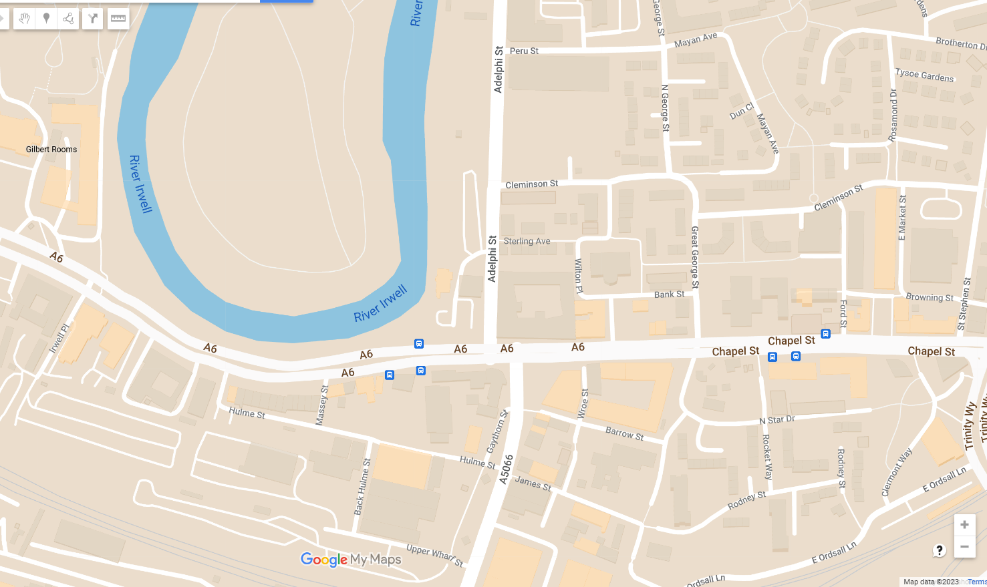
KS1 Route Map
 | Islington Mill |  | Cathedral
 | Partington Pots |  | St Philip's Square
 | Islington Park |  | St Philip's Church
 | Bexley Square |  | Vimto Gardens
 | Salford Board School |  | Barrow Street
1
6
2
7
3
8
4
9
5
10
7
8
5
4
6
9
10
3
2
1
Notes:
View the stops named on this route online on the StoryMap: https://storymaps.arcgis.com/stories/02c8288dd376403c80f012dd5fe84cec

