Slide 1
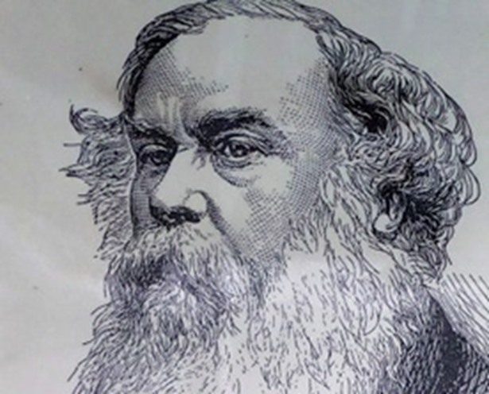
Lesson Two
Sir Titus Salt and the Building of Salt’s Mill
Engraving of Sir Titus Salt, courtesy of Saltaire Collection

Slide 2
Meet Sir Titus Salt.
Have you already heard of him?
Why did he become a significant historical figure both in Bradford and in the country?
Engraving of Sir Titus Salt, courtesy of Saltaire Collection
Notes:
Meet Sir Titus Salt. Have you heard of him? Why was he such an important historical figure (locally and nationally)? Brainstorm baseline children’s knowledge and link to any prior learning.

Slide 3
Introducing Titus Salt
Aims
To enable pupils to :
learn about Titus Salt’s early background
understand the reasons why Titus Salt chose to build Salt’s Mill and why he chose its location

Slide 4
Key lesson components:
‘Do it now’ – Brainstorm existing knowledge
Starter – Locate Bradford
Development 1 – Construct a timeline of Salt’s early life
Development 2 – Spot the difference to introduce salt’s Mill and Saltaire
Development 3 – Promote discussion of Salt’s motives
Development 4 – ‘Zoom in’ on specific features of the Mill (optional)
Plenary – To respond briefly to the enquiry question.

Slide 5
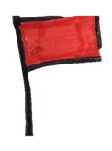
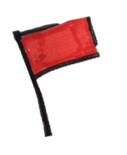
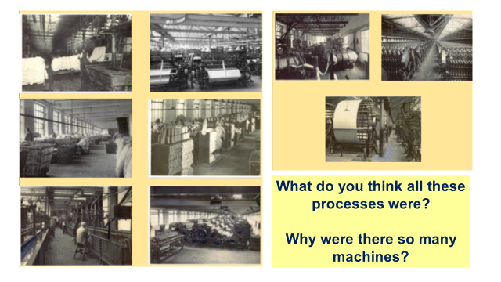
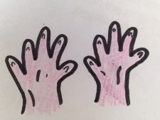
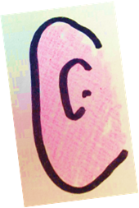
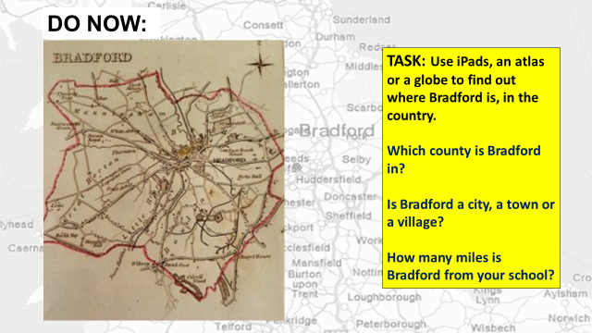
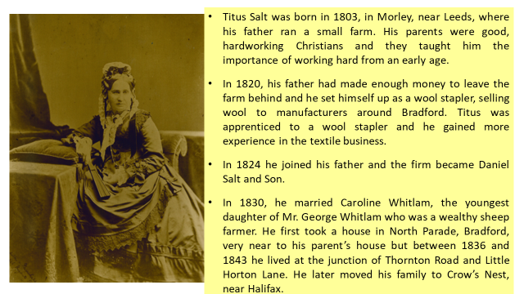
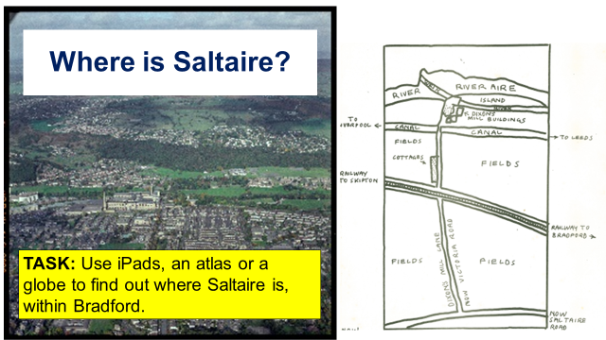
The significance of Titus Salt and his mill
Learning intention:
To explore the reasons why Titus Salt built Salt’s Mill and apply these facts to construct an informed response.
Sources and pictures used for educational purposes. Courtesy of Saltaire Collection www.saltairecollection.org
Pictures hand drawn by Rachel Wood on behalf of Saltaire Collection
Notes:
Share learning intention and VAK planner.
Go through the Learning Outcomes:
All children will find out about Bradford and the area that Saltaire was built. They will be aware of who Titus Salt was and that he built a huge mill and a model village.
Most children will understand why Titus Salt was an important historical figure to the Bradford area. Most children will understand that by Titus Salt building the mill in the way he did and a village for his workers, this was a new way of thinking for a businessman.
Some children will start to create their own opinions about Titus Salt and be able to use their understanding of the knowledge that they have been given to support their views.

Slide 6
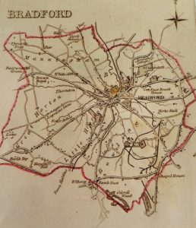
Where is Bradford?
TASK: Use iPads, an atlas or a globe to find out where Bradford is, in the country.
Which county is Bradford in?
Is Bradford a city, a town or a village?
How many miles is Bradford from your school?
Map courtesy of Saltaire Collection
Notes:
Gaining a sense of place in terms of geography.
Where is Bradford?
Pupils could work in groups or individually and use iPads, an atlas or a globe to find out where Bradford is, in the country.
Which county is Bradford in?
Is Bradford a city, a town or a village?
How many miles is Bradford from your school?

Slide 7
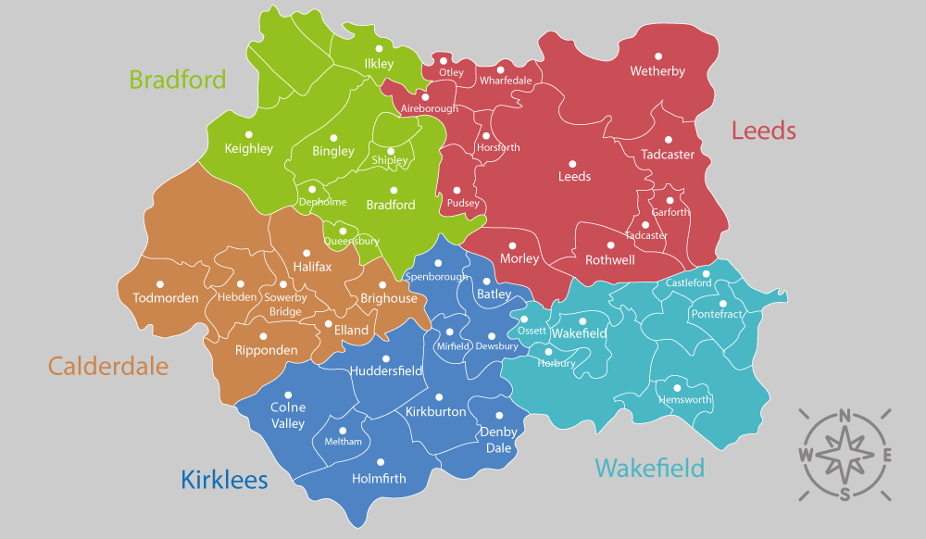
TASK
Can you pinpoint Bradford on this map?
Can you pinpoint Saltaire on this map?

Slide 8
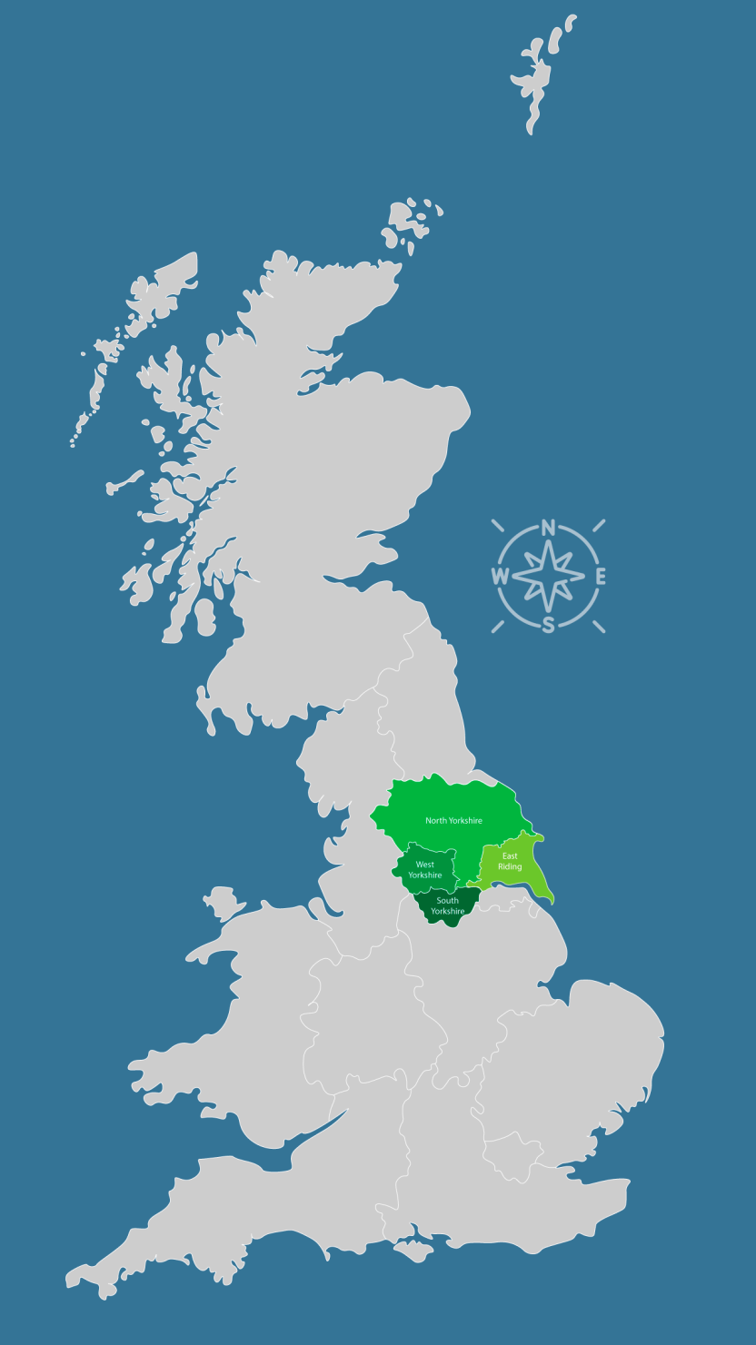
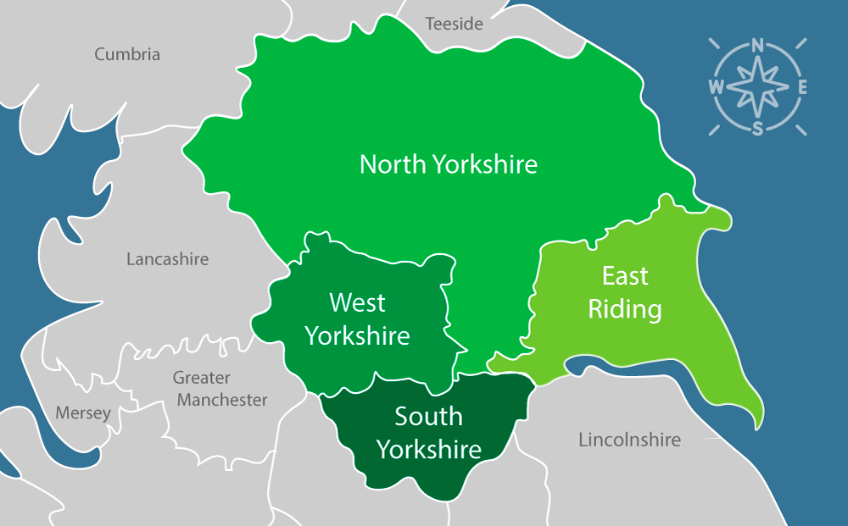
TASK
Can you pinpoint Saltaire on this map?
In which county is Saltaire situated ?

Slide 9
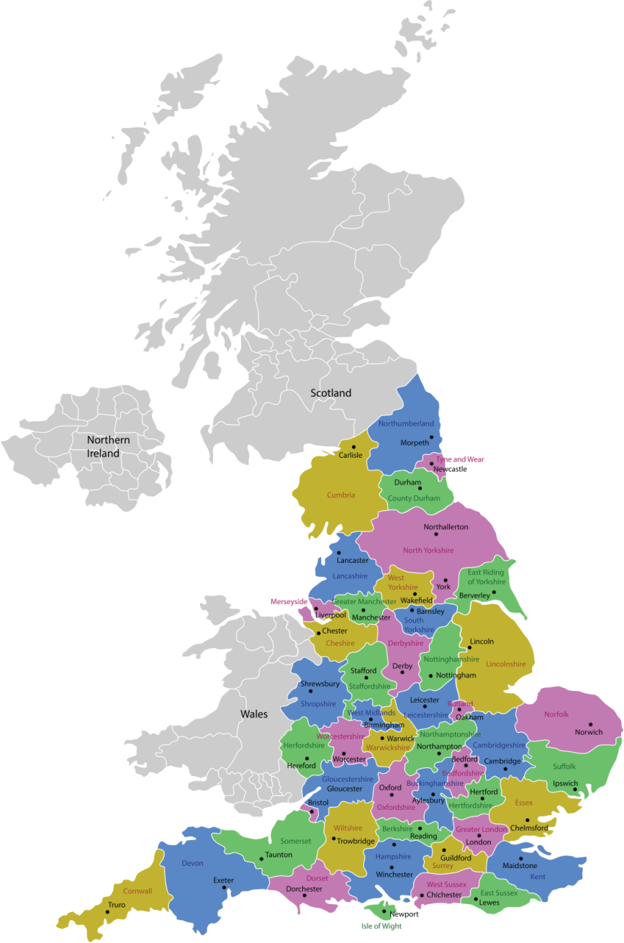
Location of Saltaire
TASK
Can you pinpoint on this Saltaire map?
How far is Saltaire from your school ?

Slide 10
Sir Titus Salt
Example of a timeline
Titus Salt born in Morley, near Leeds
Salts Mill
opened.
1803
1824
1853
1820
Notes:
Explain that pupils will be using what they learn to create a timeline for the life of Titus Salt .
Model with pupils how a timeline is set out and ask them to create a timeline with key events in the Life of Titus Salt.

Slide 11
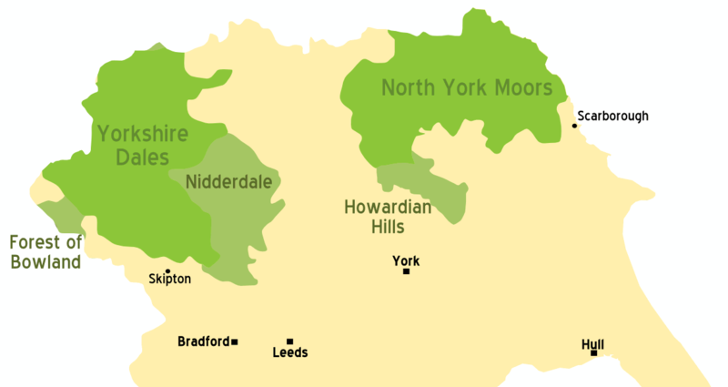
Early life
Titus Salt was born in 1803, in Morley, near Leeds.
He was educated at Morley, Batley and Wakefield.
His father leased a 100 acre farm where he worked hard and prospered.
His mother, Grace, was the daughter of Isaac Smithies, of The Manor House, Morley.
He was the eldest of 6 children.
They lived at Manor Farm (now The Manor, a pub) in Crofton, near Wakefield, between 1813 and 1819.
His parents were good, hardworking Christians and they taught him the importance of working hard from an early age.
Notes:
By User: (WT-shared) Paul. at wts wikivoyage - :Image:UK map.svg, CC BY-SA 1.0, https://commons.wikimedia.org/w/index.php?curid=22748454

Slide 12
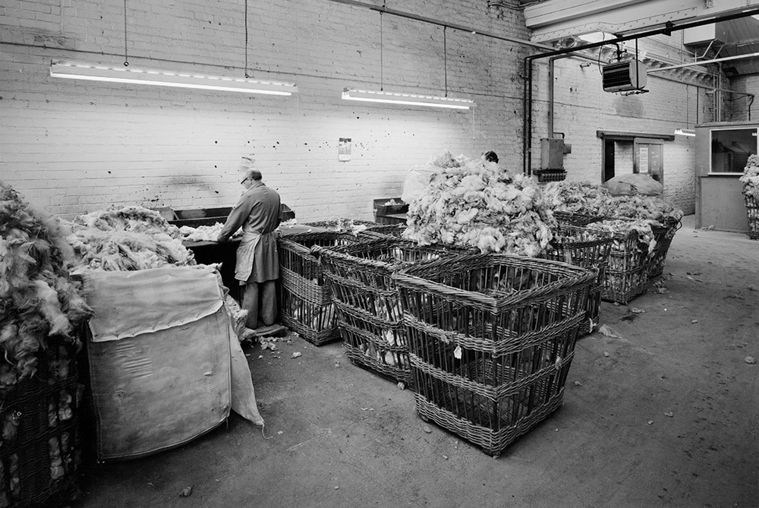
Early working life
In 1820, having made money as a farmer, Salt’s father decided to set himself up as a wool stapler.
Wool stapling involved sorting and grading wool according to its quality.
Salt’s father then sold the wool to manufacturers around Bradford.
At first, Titus wanted to be a doctor but he couldn't cope with the sight of blood.
Instead his father arranged for him to become an apprentice to a wool stapler to learn the trade.
Here Salt gained his first experience of the textile business.
In 1824 he joined his father’s firm in Bradford which became known as Daniel Salt and Son.
Wool Sorters at work, Bradford 1988. Ref: BB88/04524 © Historic England Archive
Notes:
A wool stapler is a person who buys wool from a producer, grades it, and sells it to a manufacturer.
Image: Wool sorters at work in Cumberland Works, Wool sorters at work in Cumberland Works. Ref: BB88/04524 Date Taken: March 1988 © Historic England Archive https://historicengland.org.uk/images-books/photos/item/BB88/04524

Slide 13
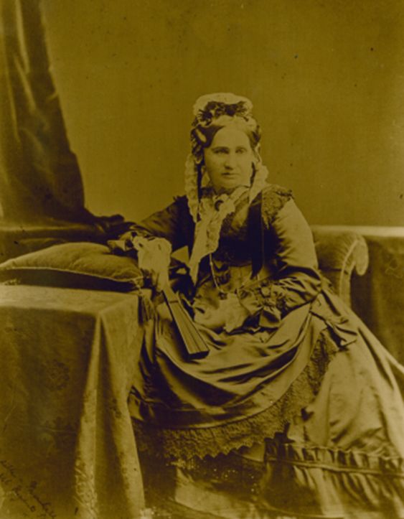
Marriage
In 1830, he married Caroline Whitlam, the youngest daughter of George Whitlam, a wealthy sheep farmer.
They went on to have five sons and three daughters.
At first they lived in Bradford on North Parade very near to his parents’ house.
Between 1836 and 1843 they lived in Bradford at the junction of Thornton Road and Little Horton Lane.
Later they moved to Crow’s Nest, near Halifax.
Photograph of Caroline Salt, courtesy of Saltaire Collection

Slide 14
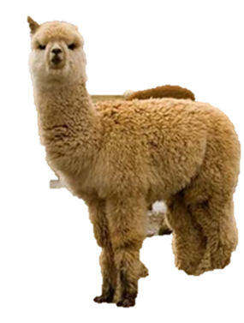
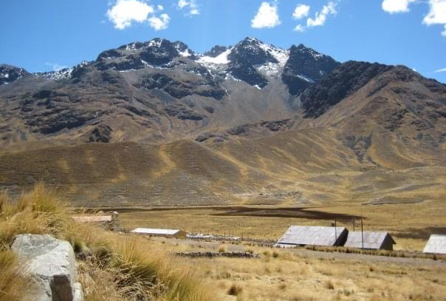
Salt’s unique idea - creating a new cloth
At the age of 28, Salt had the idea of selling unusual wool, but none of Bradford’s wool spinners were interested.
He therefore decided to start his own business, where he could experiment with different kinds of wool .
In 1836, on a visit to Liverpool he saw bales of alpaca wool and took some away in order to experiment .
He began importing alpaca from Peru and created a new soft and shiny cloth which soon became very popular and fashionable.
Titus Salt was unique at the time because he was the only manufacturer to use alpaca in this way .
An alpaca
Peru
Photographs taken by Rachel Wood, on behalf of Saltaire Collection
Notes:
Ask pupils :
Why was experimenting with different wool a good move for Titus?
Find out more about alpaca wool and its differences to sheep’s wool .

Slide 15
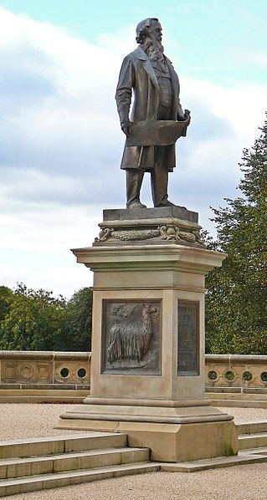
Success
In 1833 he took over his father's business.
His mill went from strength to strength and within twenty years he had become the largest employer in Bradford.
By the time he was 40, Titus Salt was one of the richest men in Yorkshire.
In 1848 Titus Salt became Mayor of Bradford.
Some of his work was even displayed at the Great Exhibition in London in 1851.
https://commons.wikimedia.org/wiki/File:Sir_Titus_Salt_(5023607947).jpg
Notes:
Activities
Ask pupils :
What does a Mayor do? What kind of responsibility would he have had?
Find out about the Great Exhibition in London in 1851 .
Why do you think Salts wool would have been chosen for display?

Slide 16
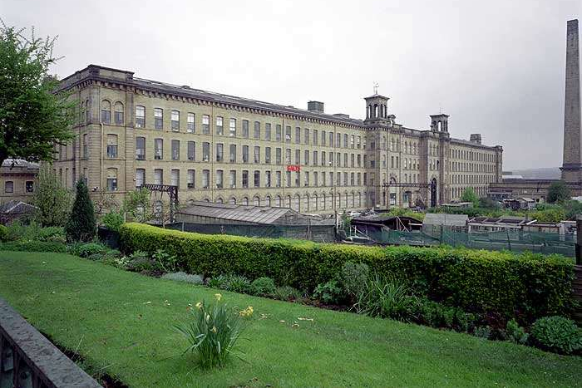
Part Two
The building of Salt’s Mill
Photograph taken November 1998 © Copyright Crown copyright. NMR ref: aa010818
Notes:
https://historicengland.org.uk/images-books/photos/item/AA010818

Slide 17
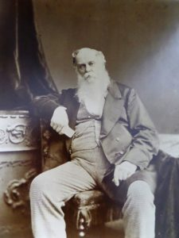
1850 – Another unique idea!
Around 1850 Salt decided to build a new mill
This mill would be unique because it would be large enough to house all of the processes and machines for cloth making in one place. This would improve the speed of production.
He also wanted his new mill to be far away from the over-crowded streets and foul air of Bradford.
The Mill would be the largest factory in the world.
Salt also planned to build a village for his workers
TASK
What did he want to achieve by doing this?
Why was this such a new way of thinking?
Photographs courtesy of Saltaire Collection
Notes:
Introduce Titus Salt’s big idea of a mill and a model village. What did he want to achieve by doing this? Why was this such a new way of thinking?
Salt had a mixture of motives. Salt’s Mill helped him to make bigger profits. Some of the money earned could be used to demonstrate his wealth and success as a ‘nouveau riche’ aping the landed aristocracy. Saltaire meant that he had his workforce close by and under close control (it was a desirable place to live and work). As a committed Christian he also genuinely wanted to improve the lives of those who worked for him.

Slide 18
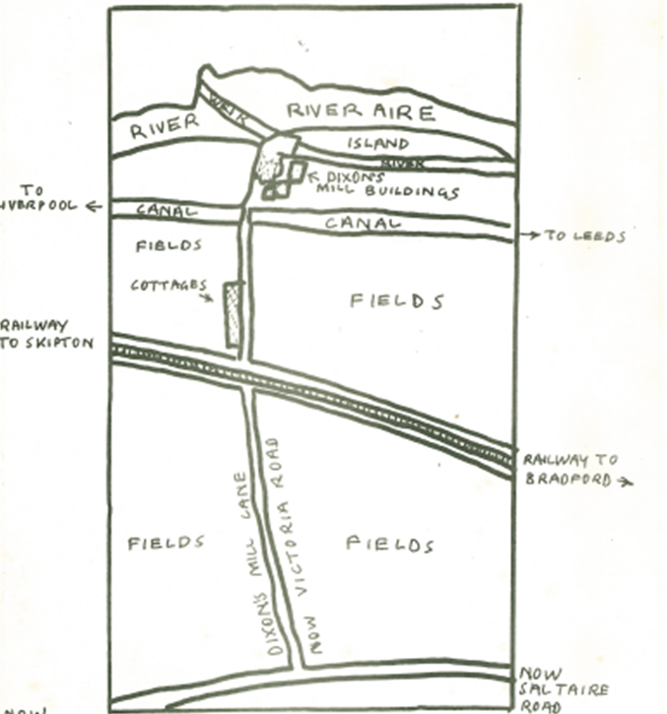
Choosing a location
Salt wanted to build his mill away from Bradford where it was dirty and unhealthy . He did not want his workers or family to live there.
He thought the cleaner Aire Valley would help protect his workers from the Cholera epidemics which were common around the centre of Bradford. Salt needed a plot of land which was suited to the workings of a mill.
Around 1850 he bought some land outside of Bradford which he believed had many advantages for his business.
The land was three miles from Bradford in Shipley next to the River Aire, the Leeds and Liverpool Canal and the Midland Railway.
Why were these things important?
Why did he call it Saltaire?
Map of Saltaire from 1848, is taken from Dorothy Sharp’s ‘Saltaire Resource Pack, 1984’, courtesy of Saltaire Collection.
Notes:
Activities
Introduce the area where Saltaire was built. Children to look at the map. A river, a canal and a railway – why were these things so important to Titus Salt? Why did he call it Saltaire? (target questions depending on individual ability).

Slide 19
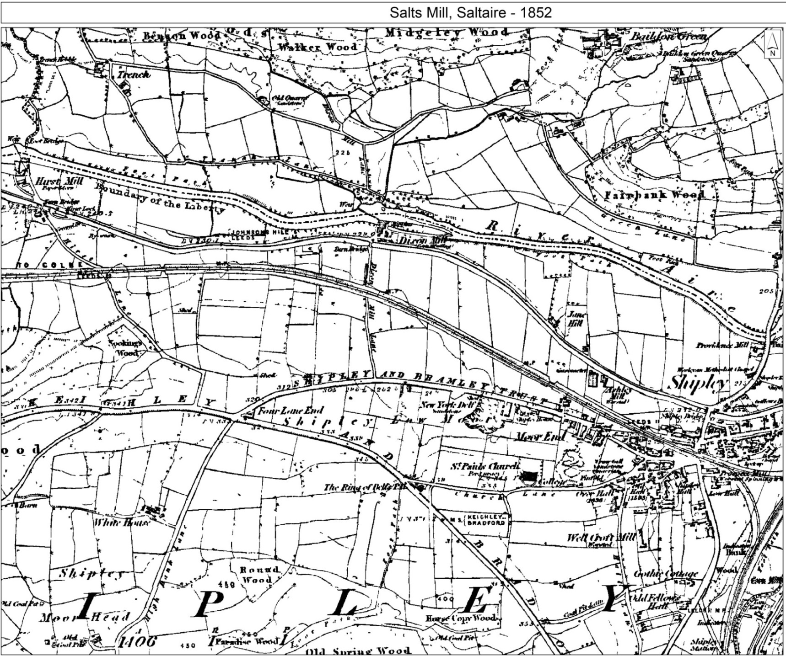
Salt’s location for his new mill and village.
Notes:
Activities
Introduce the area where Saltaire was built.
Children to look at the map.
Use iPads, an atlas or a globe to find out where Saltaire is, within Bradford.
Find the river, canal and railway
Ask why these things were so important to Titus Salt?
The canal was useful for bringing in bulky raw materials like wool and coal.
The railway gradually took over this function, as well as providing fast transport for perishable food, business and leisure trips.
Salt combined his name with the name of the River Aire.
Why did he call it Saltaire? Salt combined his name with the name of the River Aire.

Slide 20
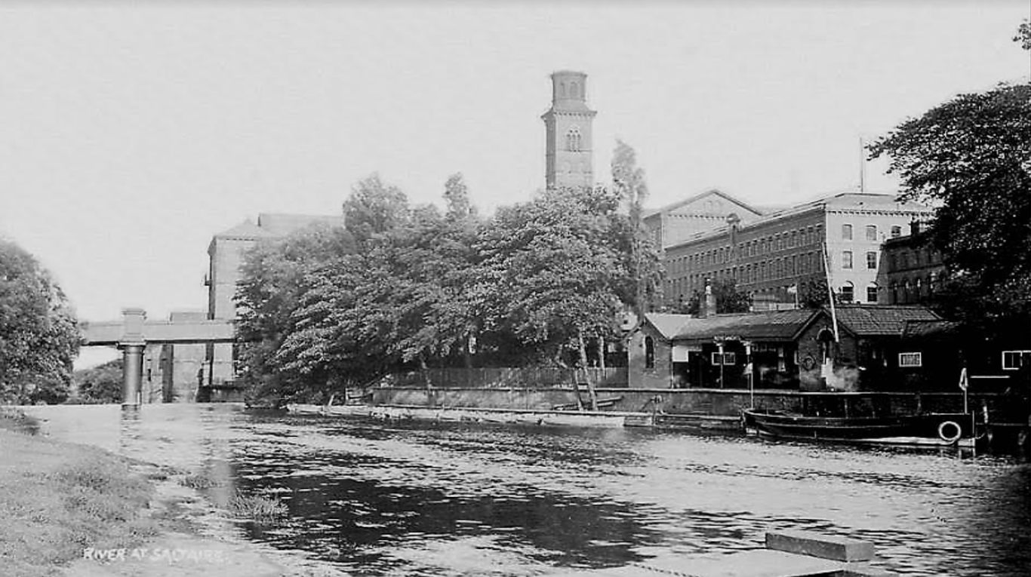
The river Aire alongside the mill provided essential water supplies.
It was extremely important in Titus Salt’s decision to build here.
Industrial machinery in the mid-19th century required huge quantities of water to power it.
Photograph courtesy of the Saltaire Collection

Slide 21
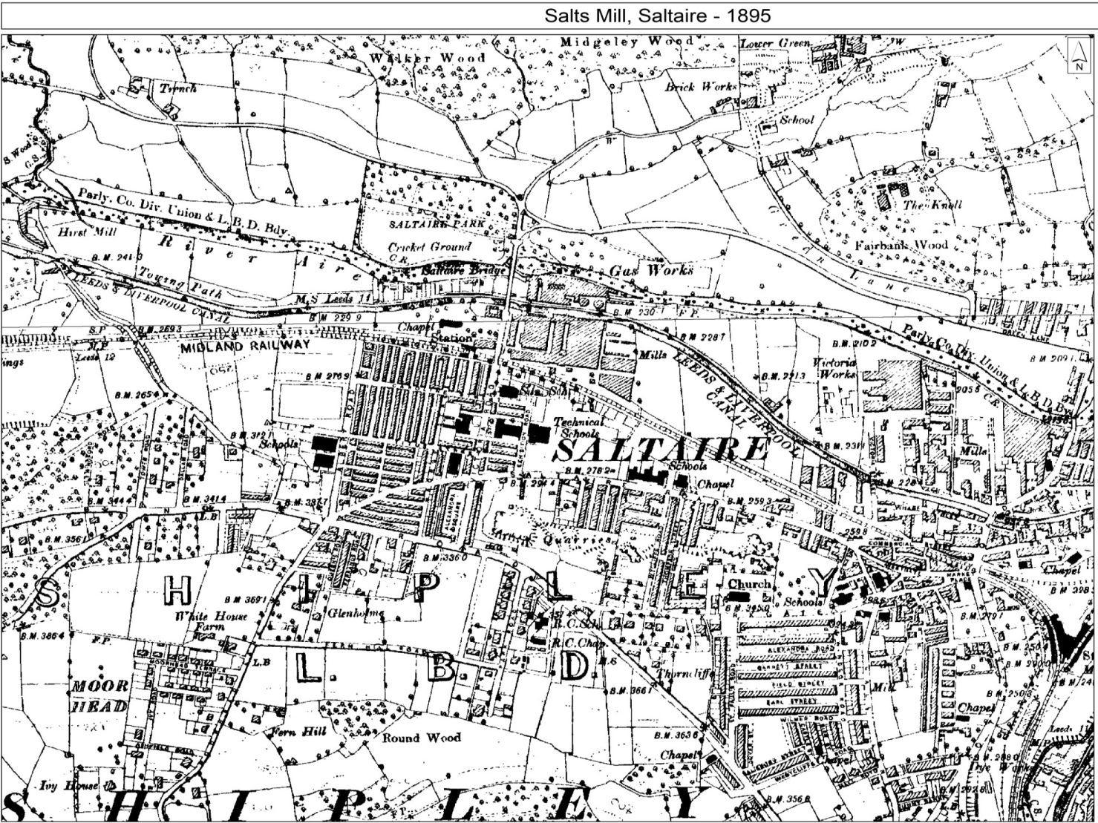
Spot the difference
In what ways had the same area just outside Bradford changed between1852 and 1895?

Slide 22
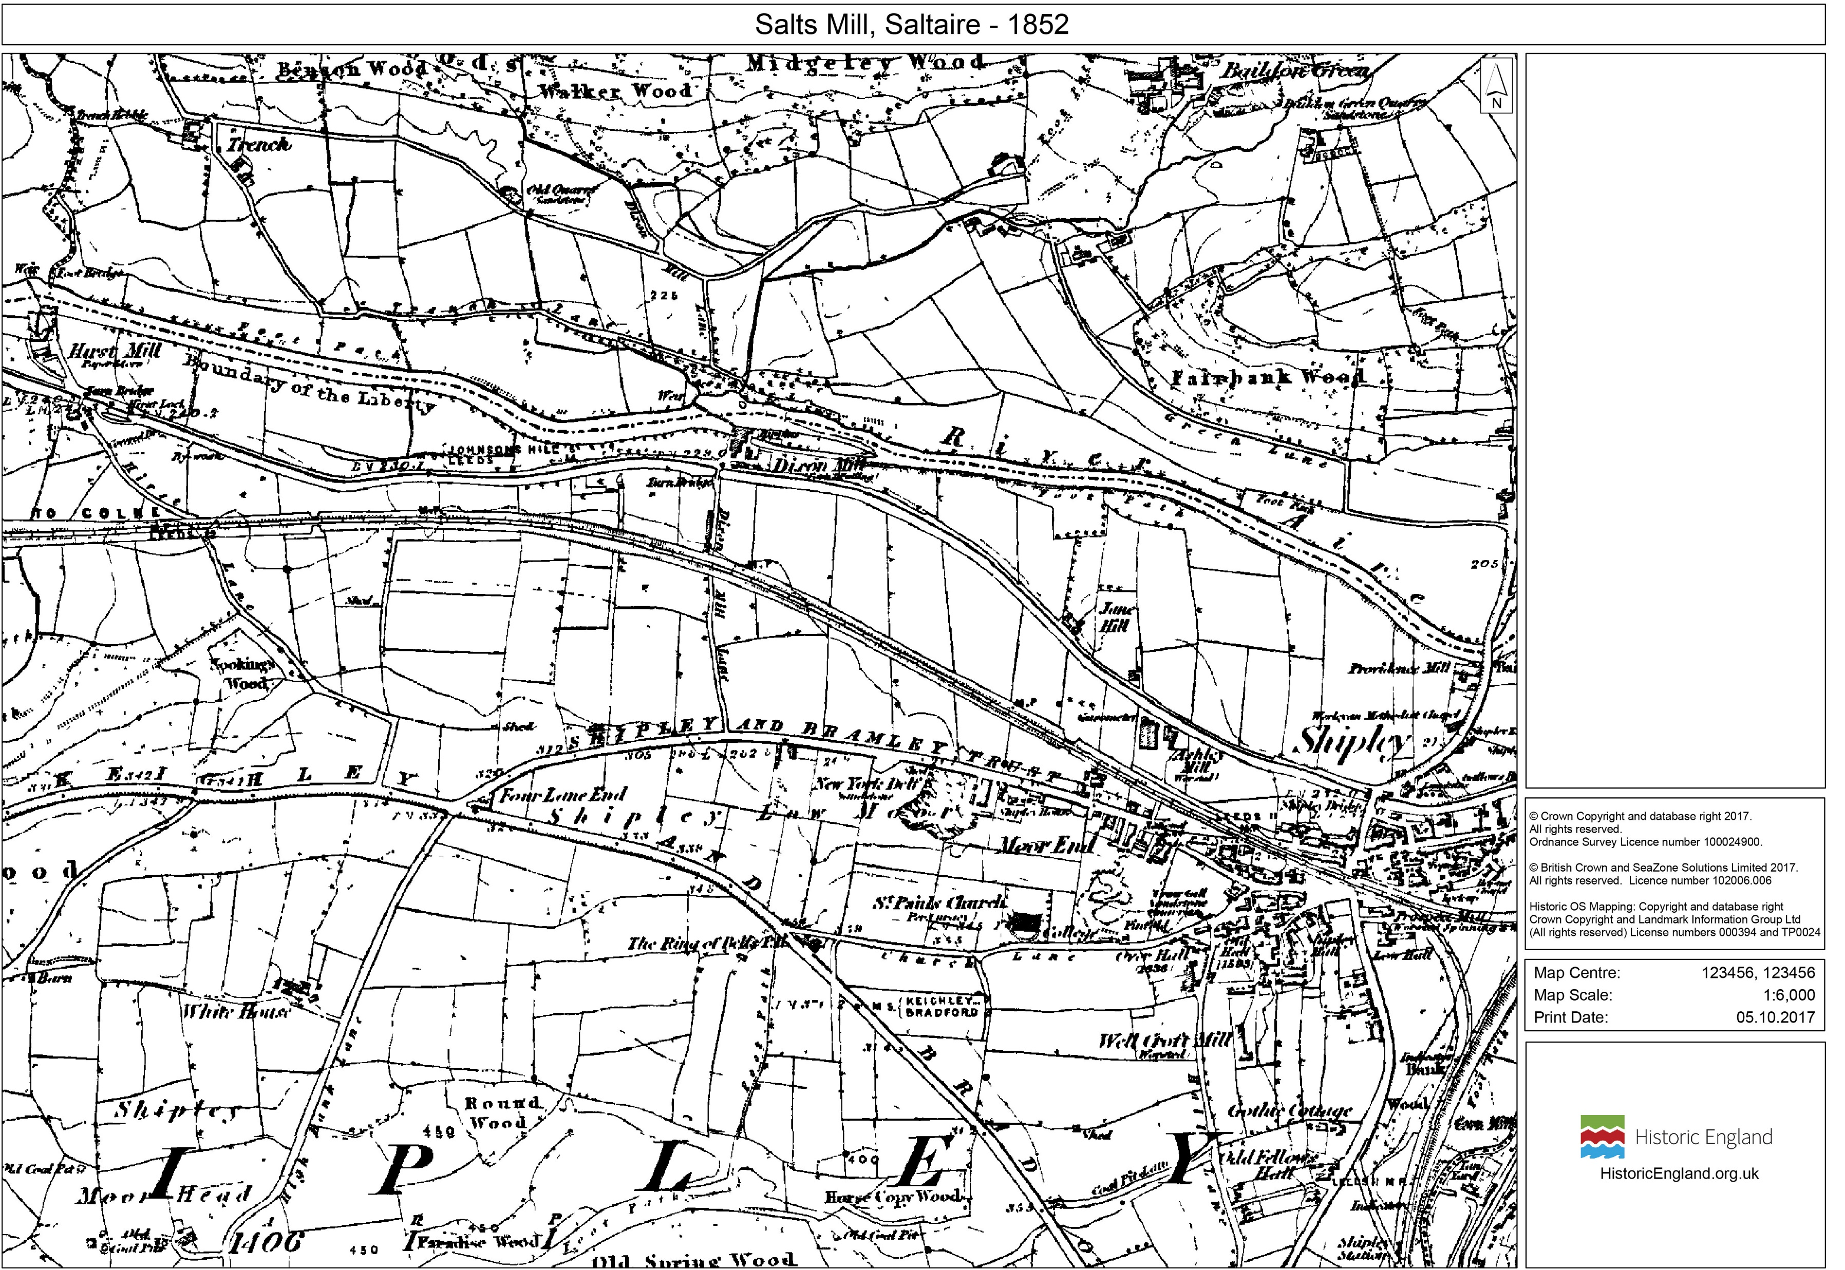
Notes:
Print this page if you want a larger copy of the 1852 map for students to use when playing ‘spot the difference’

Slide 23
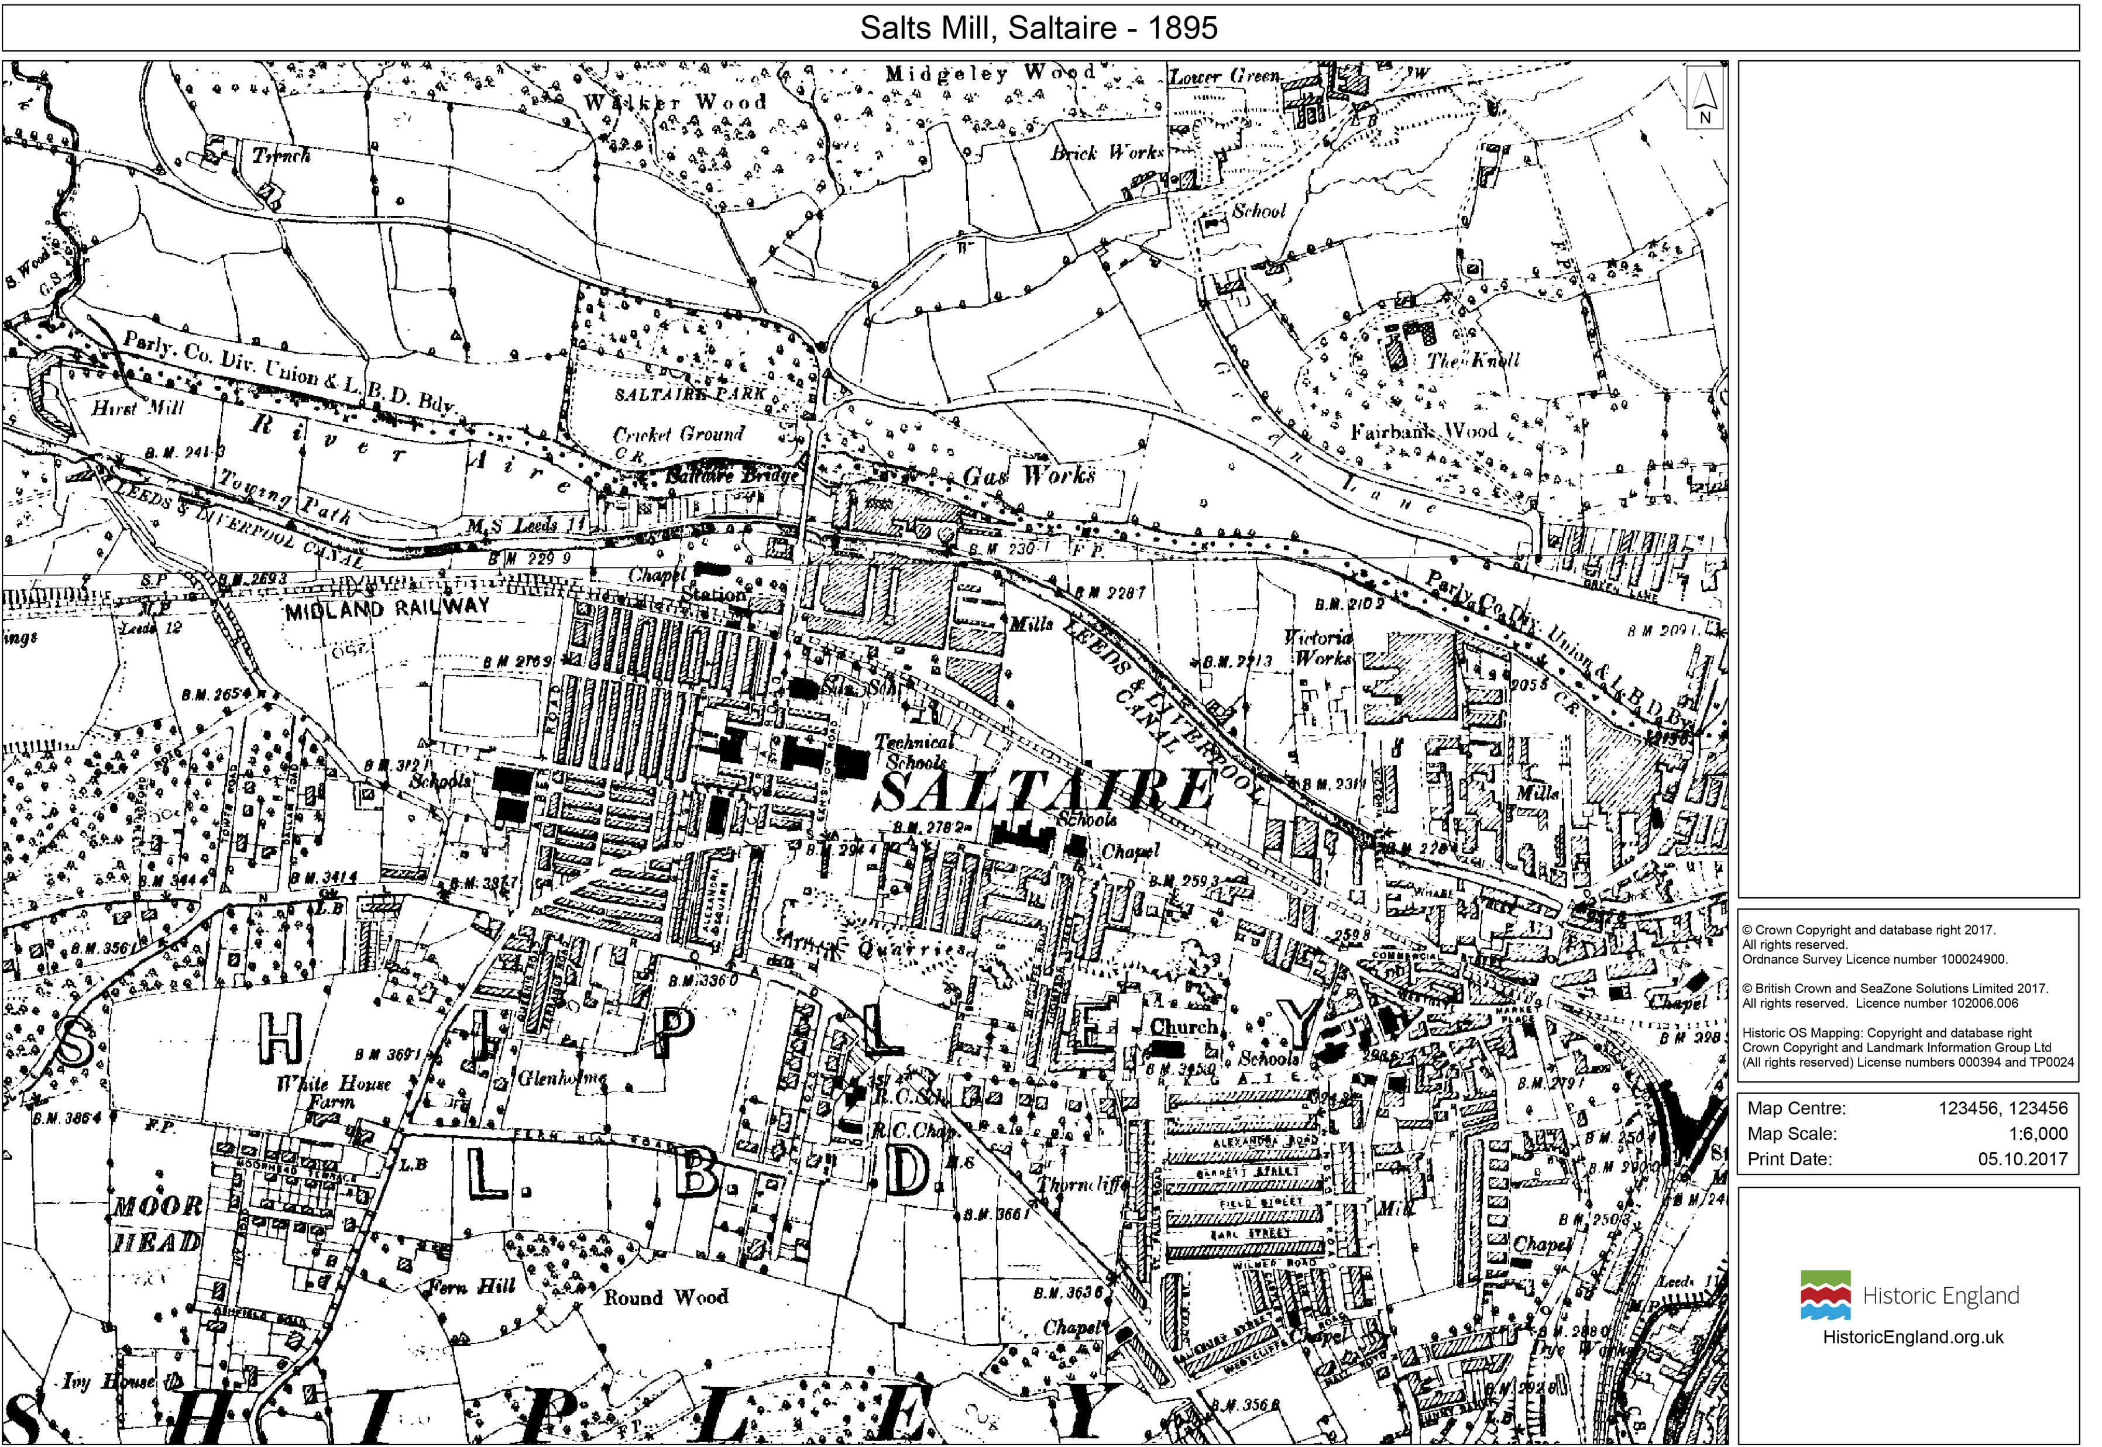
Notes:
Print this page if you want a larger copy of the 1895 map for students to use when playing ‘spot the difference’

Slide 24
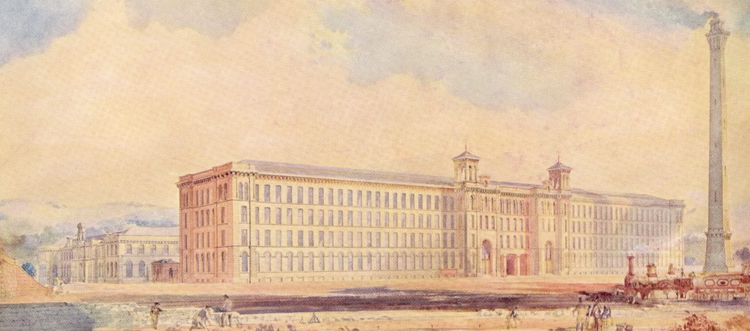
The Mill Design
Building began in 1851.
Salt chose local architects, Henry Lockwood and Richard Mawson to design the mill.
They planned its appearance in a grand Italianate style. ( A style of architecture popular in the mid-19th century based on the palaces of Renaissance Italy).
The whole structure was built of stone externally, with a brick and cast iron internal framework to minimise the risk of fire.
Photograph courtesy of Saltaire Collection
This is a poster of the original architect-commissioned watercolour of Salts Mill.
Notes:
Activities
What other buildings in Bradford were designed by Lockwood and Mawson?
https://historicengland.org.uk/services-skills/education/teaching-activities/knowing-bradford/

Slide 25
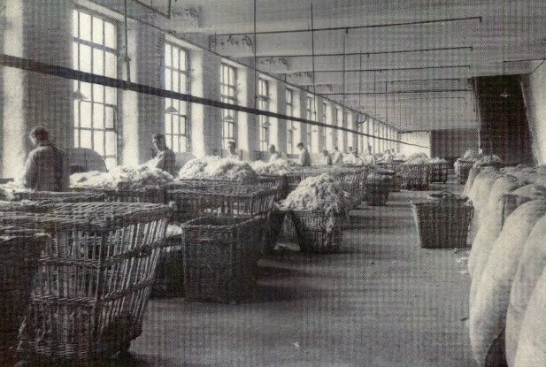
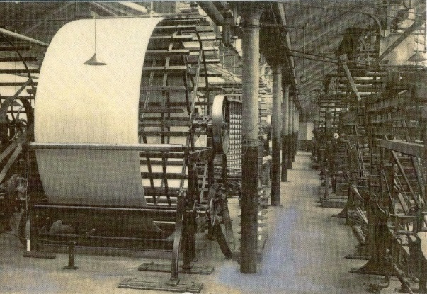
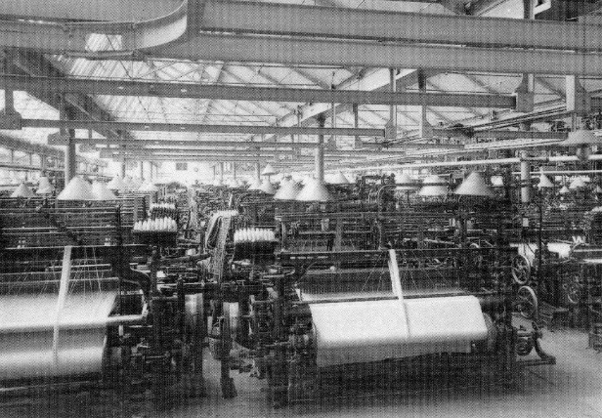
Inside the Mill
William Fairbairn planned the layout and machinery of the works.
The drive shafts and machinery were located under the floor to reduce noise and risk of injury.
Large flues removed dust and dirt.
The neighbourhood was protected from polluted air by Rodda Smoke Burners fitted to the chimney.
Every precaution was taken to keep the mill at a good temperature with healthy ventilation.
The mill was an outstanding example of integration where almost the whole of worsted production was done under one roof.
Photographs courtesy of Saltaire Collection
Notes:
Activities
How was the design of the mill made to provide for the safety and comfort of workers ?

Slide 26
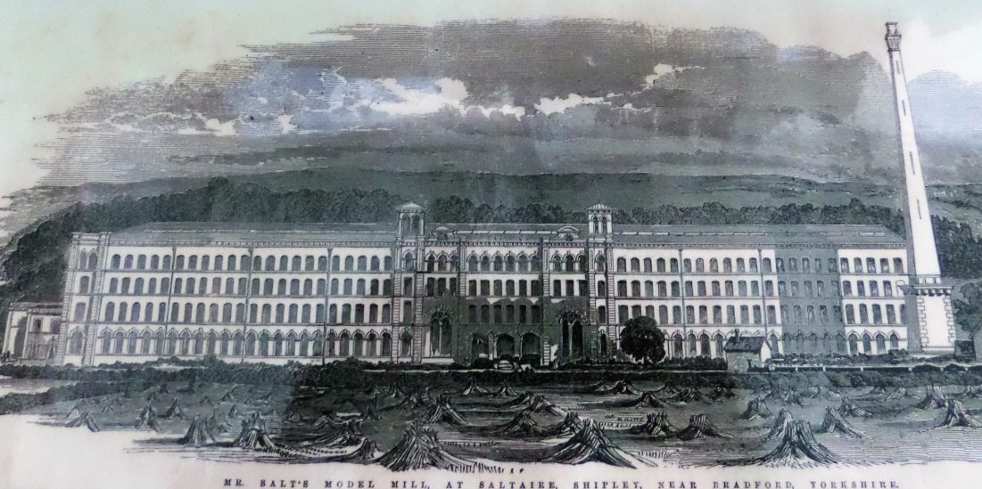
Grand Opening
The main part of the mill opened in 1853 on Salt’s 50th birthday.
A great feast was held in the combing shed to celebrate.
Food was ordered for 3750 guests, who included the workers.
At that time, it must have seemed an enormous building and an extraordinary project.
Photographs courtesy of Saltaire Collection

Slide 27
Salt’s Mills Notable Architectural Features

Slide 28
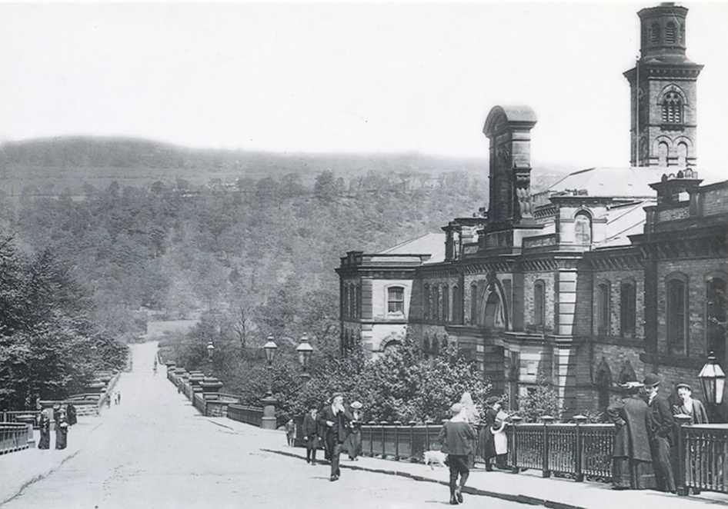
The Mill Entrance on Victoria Road
The main frontage was on Victoria Road and was designed to face the railway.
Photograph courtesy of the Saltaire Collection
Notes:
Activities
Why do you think the main front faced the railway?
How would you describe its appearance?

Slide 29
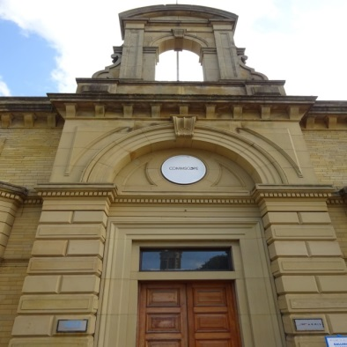
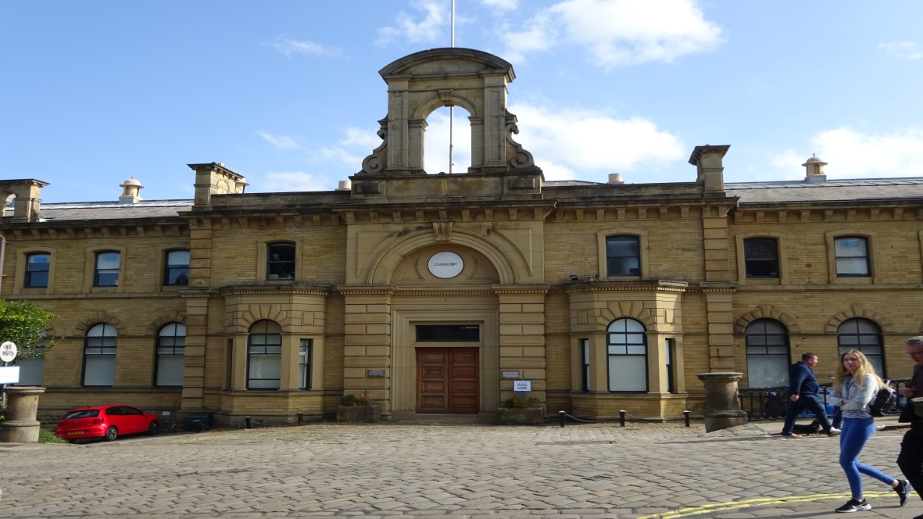
The Mill Entrance and Bellcote
The office building was the main entrance
Its visual appearance is unaltered apart from the blinds at the windows.
Above the entrance is what was known as a bellcote – an arch with a bell
Bellcotes are most common in church architecture.
What do you think was the purpose of such a grand entrance?
Photographs by Julie Edwards, Historic England
Notes:
Activity
Why might Salt be keen on features of church architecture on his building?

Slide 30
The Spinning Mill
The part seen here is the spinning mill where Salt's famous worsted cloth was produced.
The long south range has five storeys and a basement.
It is Italianate in style and symmetrical, with two central entrance arches flanked by a pair of matching turrets.
Why do you think the Mill has so many very large windows?
Photograph taken November 1998 © Crown copyright. NMR ref: aa010818
Notes:
https://historicengland.org.uk/images-books/photos/item/AA010818

Slide 31
The Bell Tower
It was topped with distinctive 'bell ‘ turrets.
Each symmetrically placed.
Why do you think bells featured such a lot in the design of the mill?
Photograph: Julie Edwards Historic England
Notes:
Few workers would have owned timepieces, so the bells announced the working hours etc. On one level it was a form of social control.

Slide 32
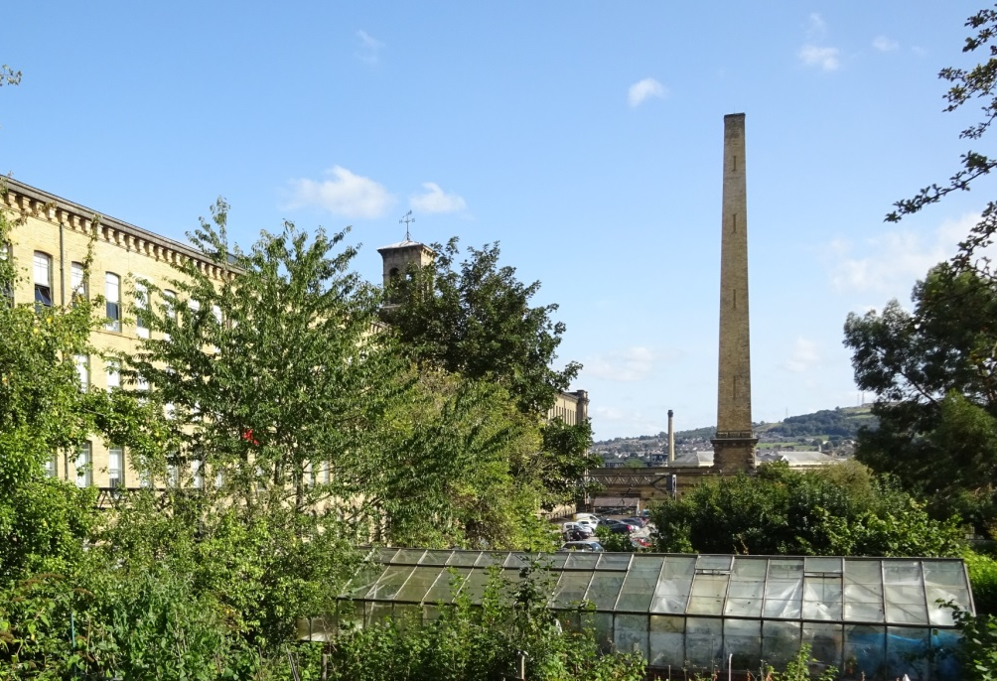
The Chimney
At Salt’s request a massive chimney was added in 1868.
It is 68 metres high and is built of hammer-dressed stone.
It tapers upwards from a square base.
Why do you think it was built so tall?
Photographs: Julie Edwards, Historic England
Notes:
The height of the chimney helped to keep the smoke away from Saltaire itself.

Slide 33
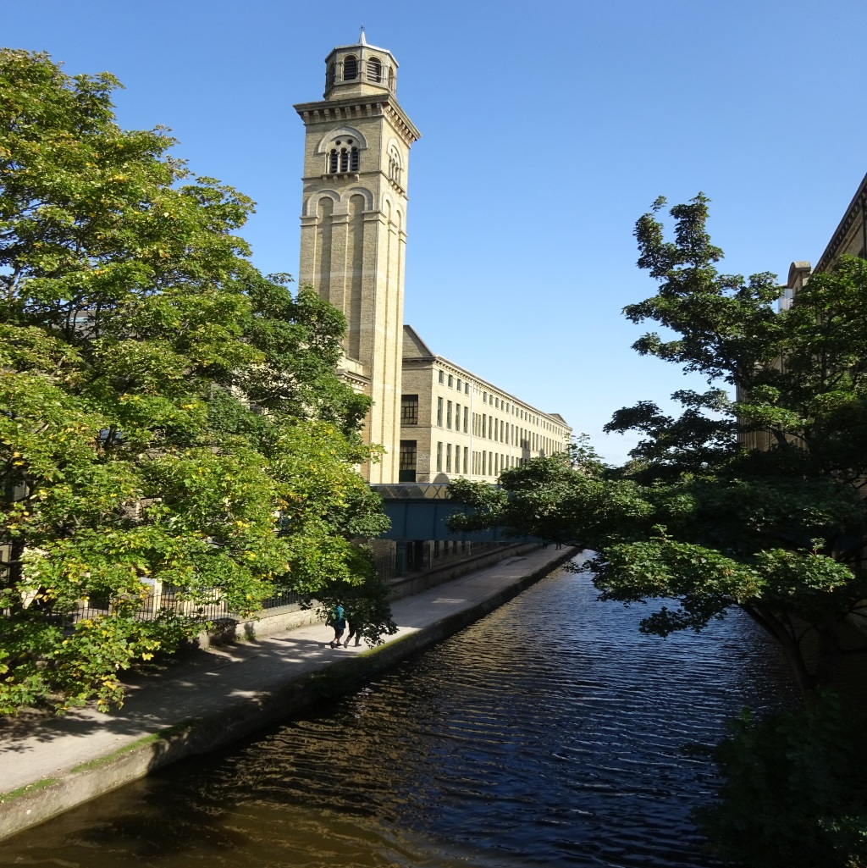
New Mill with Italianate Tower
The 'New Mill' was built in 1868 to house new spinning and dying machinery.
It has a chimney design based on the bell tower of the Santa Maria Gloriosa dei Frari in Venice.
Photograph: Julie Edwards, Historic England
Notes:
Activity :
Use Google to try to find an image of the bell tower of the Santa Maria Gloriosa dei Frari in Venice.
Why do you think Salt was keen to copy architectural styles from other countries?

Slide 34
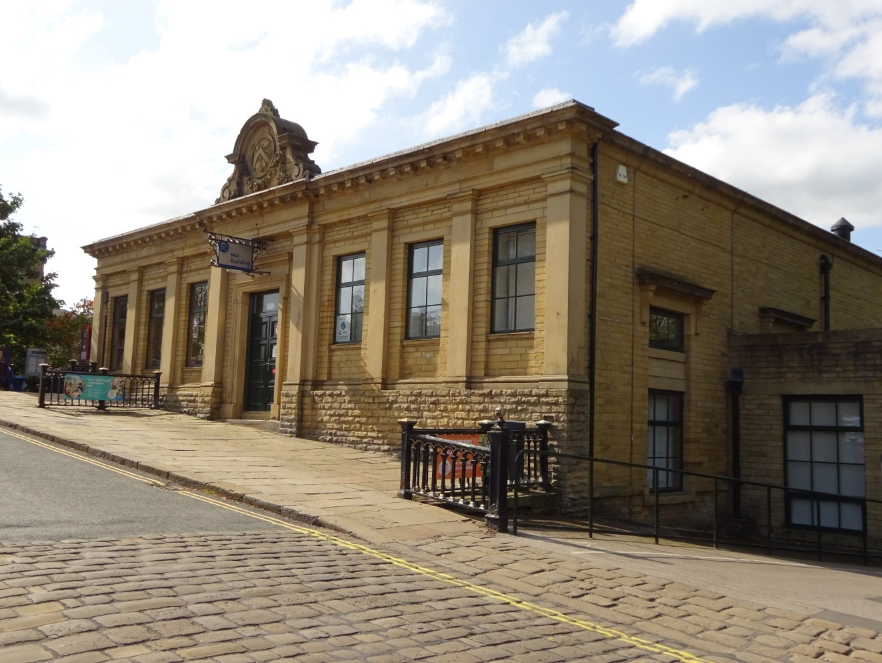
The Dining Hall
The mill had its own dining hall opposite the main entrance.
It served 600 breakfasts and 700 dinners every day .
At first it was also used as a school for ‘half-timers’, children who would work in the mill during the morning, then attend school in the afternoon.
Today it is owned by Shipley College.
Photograph: Julie Edwards Historic England
Notes:
Activity:
The food in the dining hall was subsidised. Why do you think a dinning hall was provided?

Slide 35
Images of the
Mill from the air

Slide 36
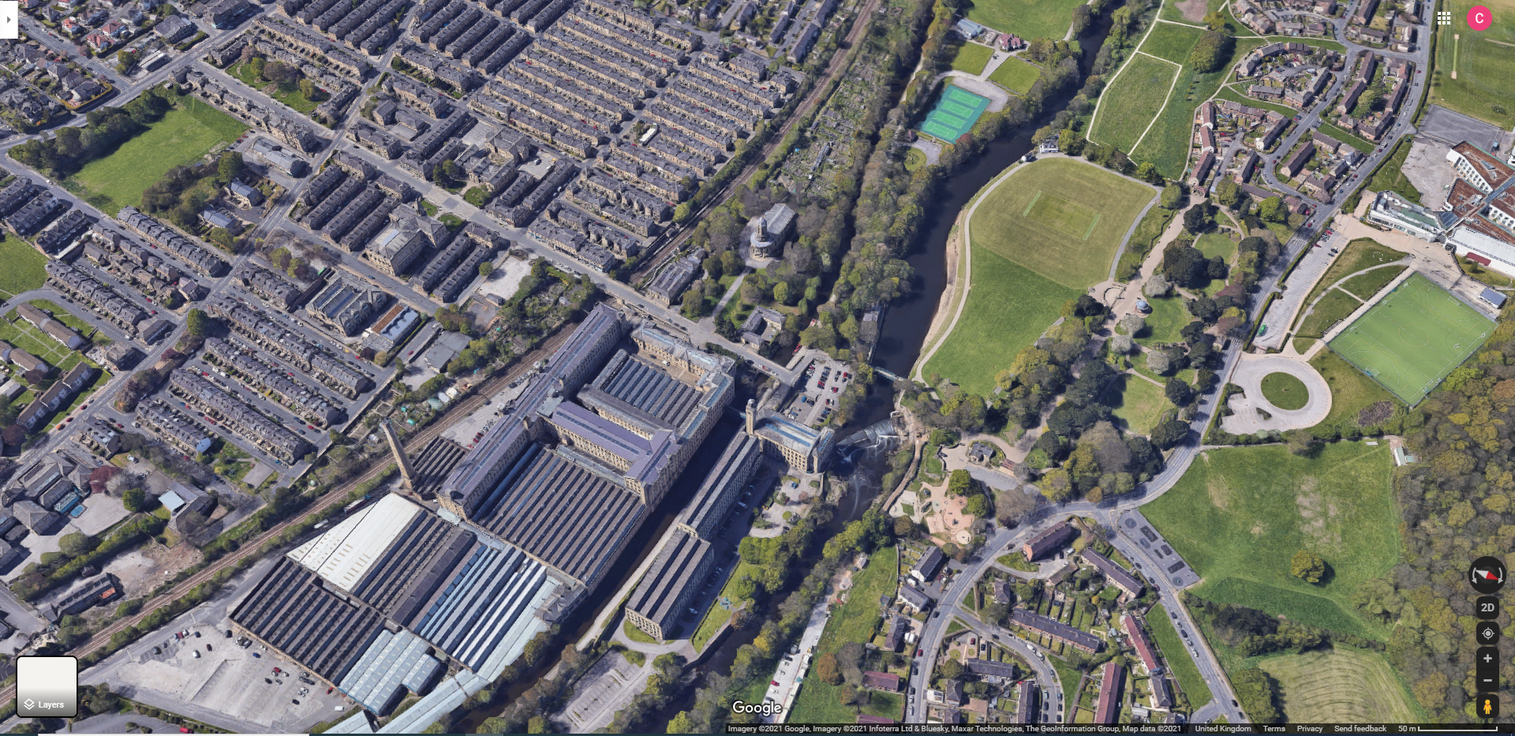
Can you see a letter in the Mill’s layout? What is it?
What does this suggest about Titus Salt?
Notes:
Titus Salt wanted the chimney to be really tall for Salt Mill – why do you think he wanted this? What does the letter ‘T’ suggest? Accept all answers from children. All around Saltaire there are the letters ‘T’ and ‘S’ – why do we write our name on something that we have produced?

Slide 37
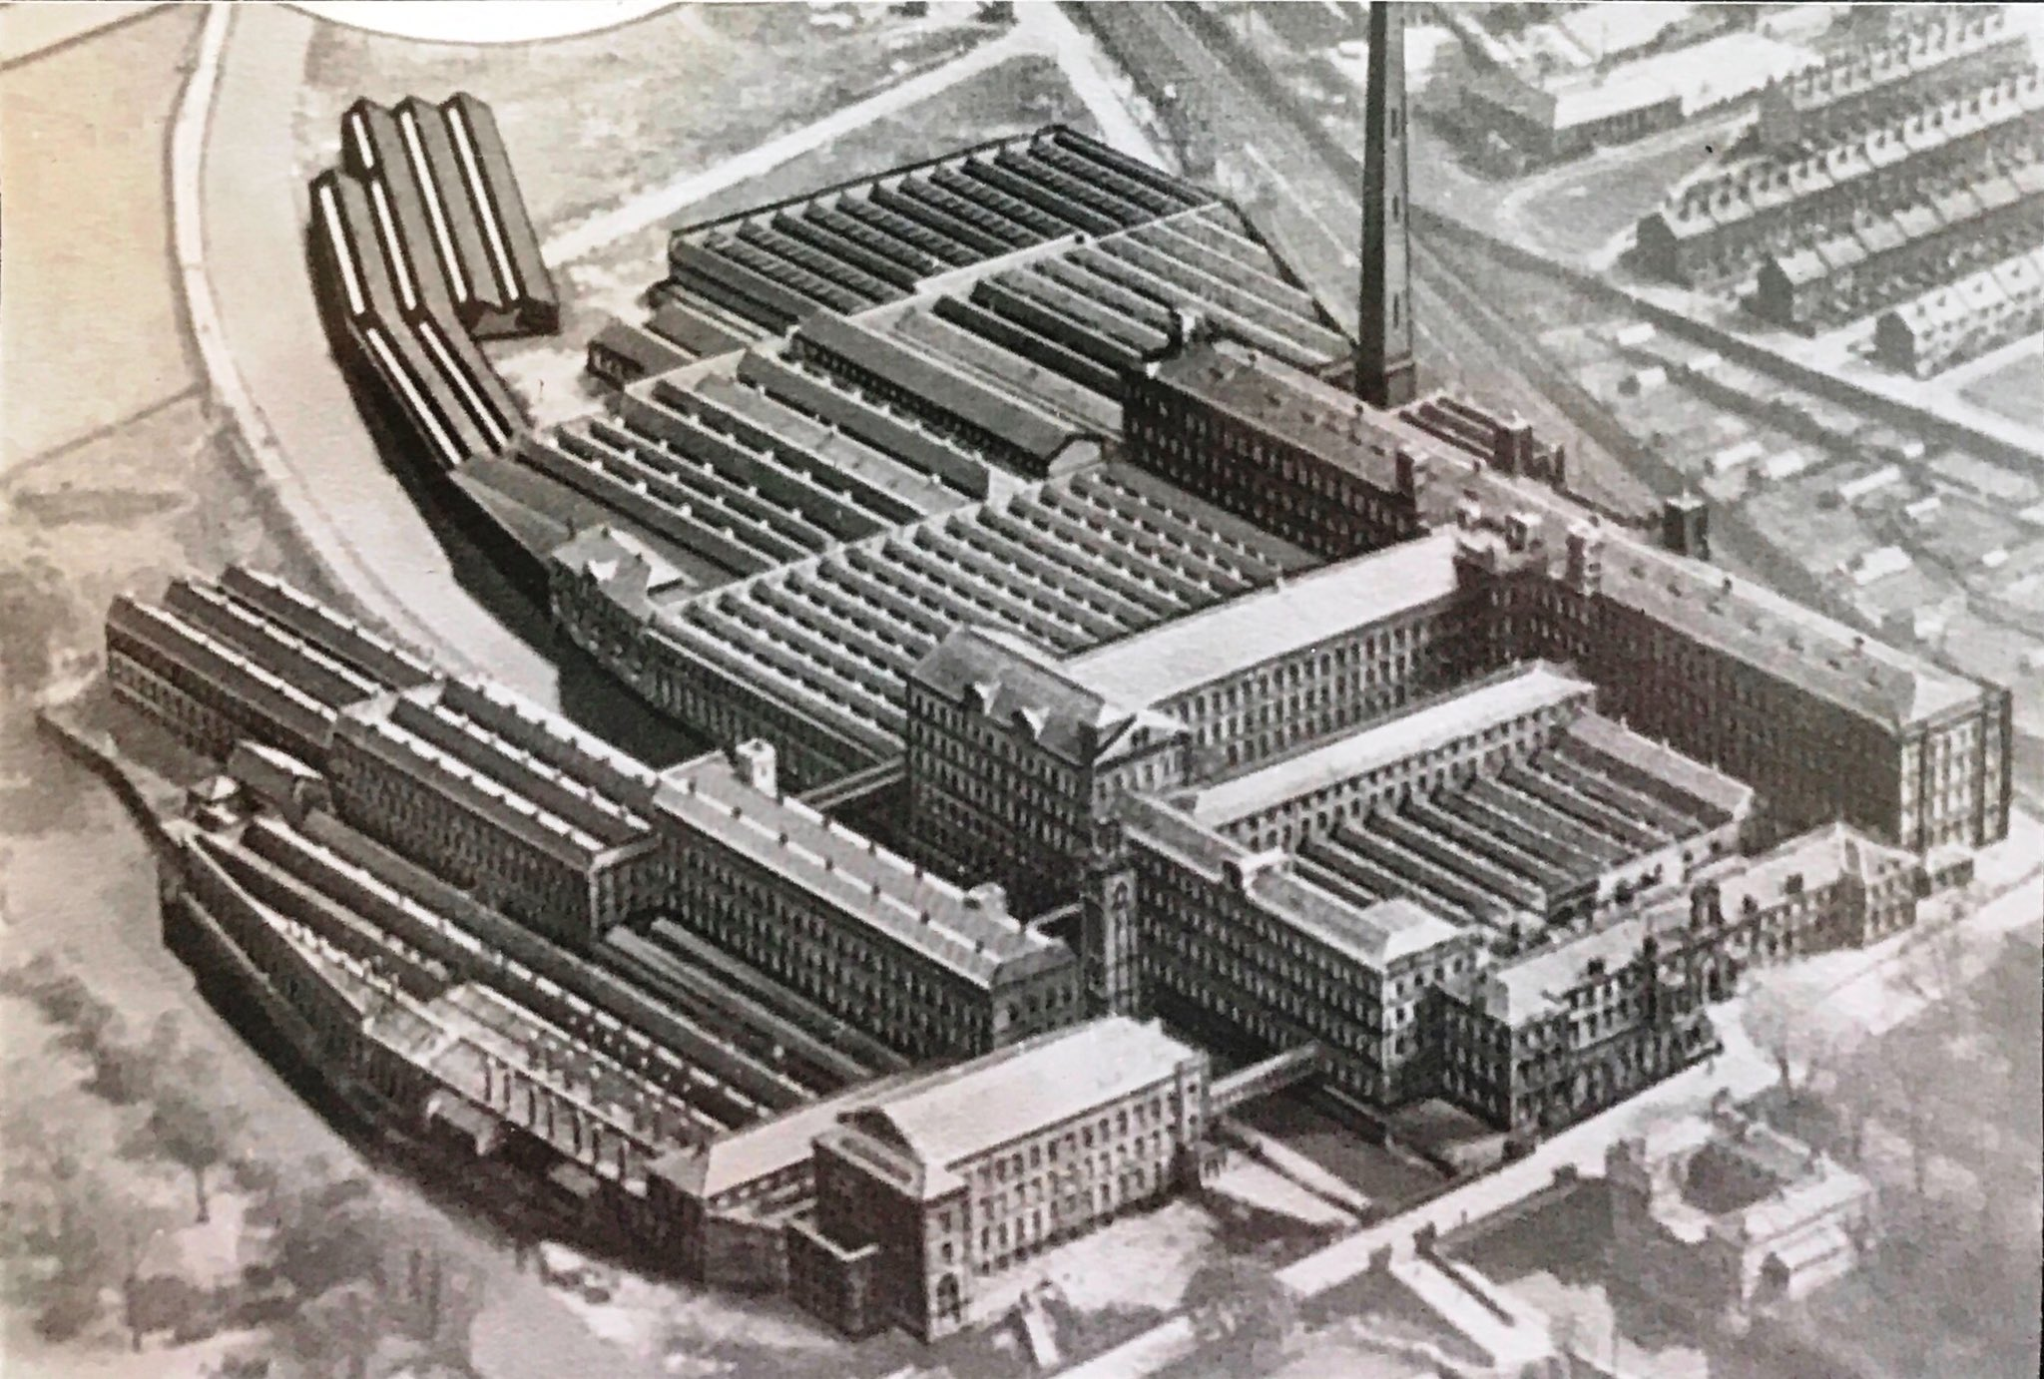
Can you see a letter in the Mill’s layout? What is it?
What does this suggest about Titus Salt?
Permission given to use photograph from Maria Glot, Salts Walks and Tours
Notes:
The letter T – Salt’s initial. There are Ts and Ss all around Saltaire – why do we write our initials on things?

Slide 38
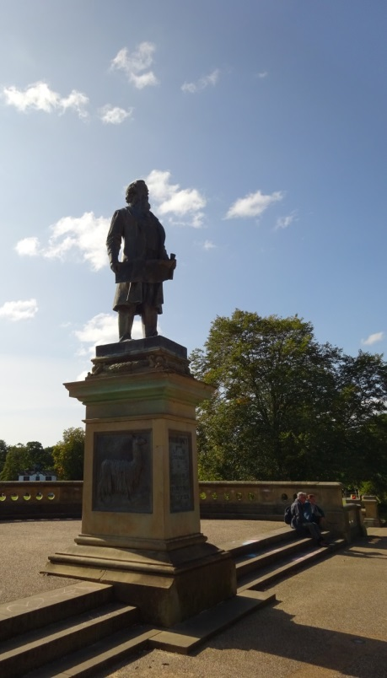
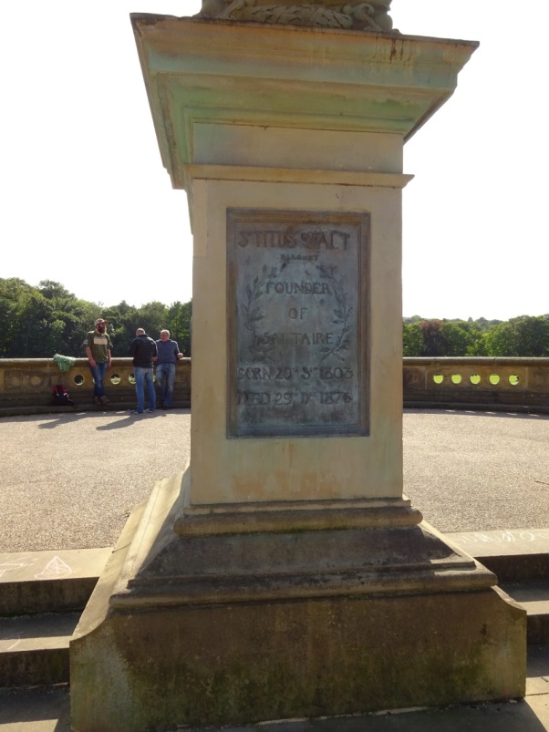
Why did Sir Titus Salt become a significant historical figure, both in Bradford and in the country?
We’re too far away to be able to read the inscription on Salt’s statue in Saltaire.
Use what you have learned today to complete the inscription.
Try to sum up what Salt achieved.
There are carvings on the inscription, so you could add drawings too.
Sir Titus Salt
Born 20th Sept 1803
Died 29th Dec 1876
Salt’s statue in Roberts Park, Saltaire

