Slide 1
What was life like in Edwardian times and hoe does it compare with life today?
What was life like in Edwardian times and hoe does it compare with life today?
Notes:
© Reproduced by permission of Historic England Archive ref: BB98/06009 Date: 1908 - https://historicengland.org.uk/images-books/photos/item/BB98/06009

Slide 2
What was life like in Edwardian times and how does it compare with life today? 1
Key Stage 2: History
Learning Aims and Outcomes
To select and record information about Roman ways of life
To use the terms 'invade' and 'settle'
To learn how evidence can tell you about Roman life
To ask and answer questions about what survived from the Roman settlement of Britain
To present information to show an understanding of the impact of Roman settlement on Britain

Slide 3
Were the Edwardians like us?
The Edwardian period covers the years after the death of Queen Victoria (1901) and up to the start of the First World War (1914).
It is called ‘Edwardian’ because for much of the period the country was ruled by King Edward VII (1901-1910).

Slide 4
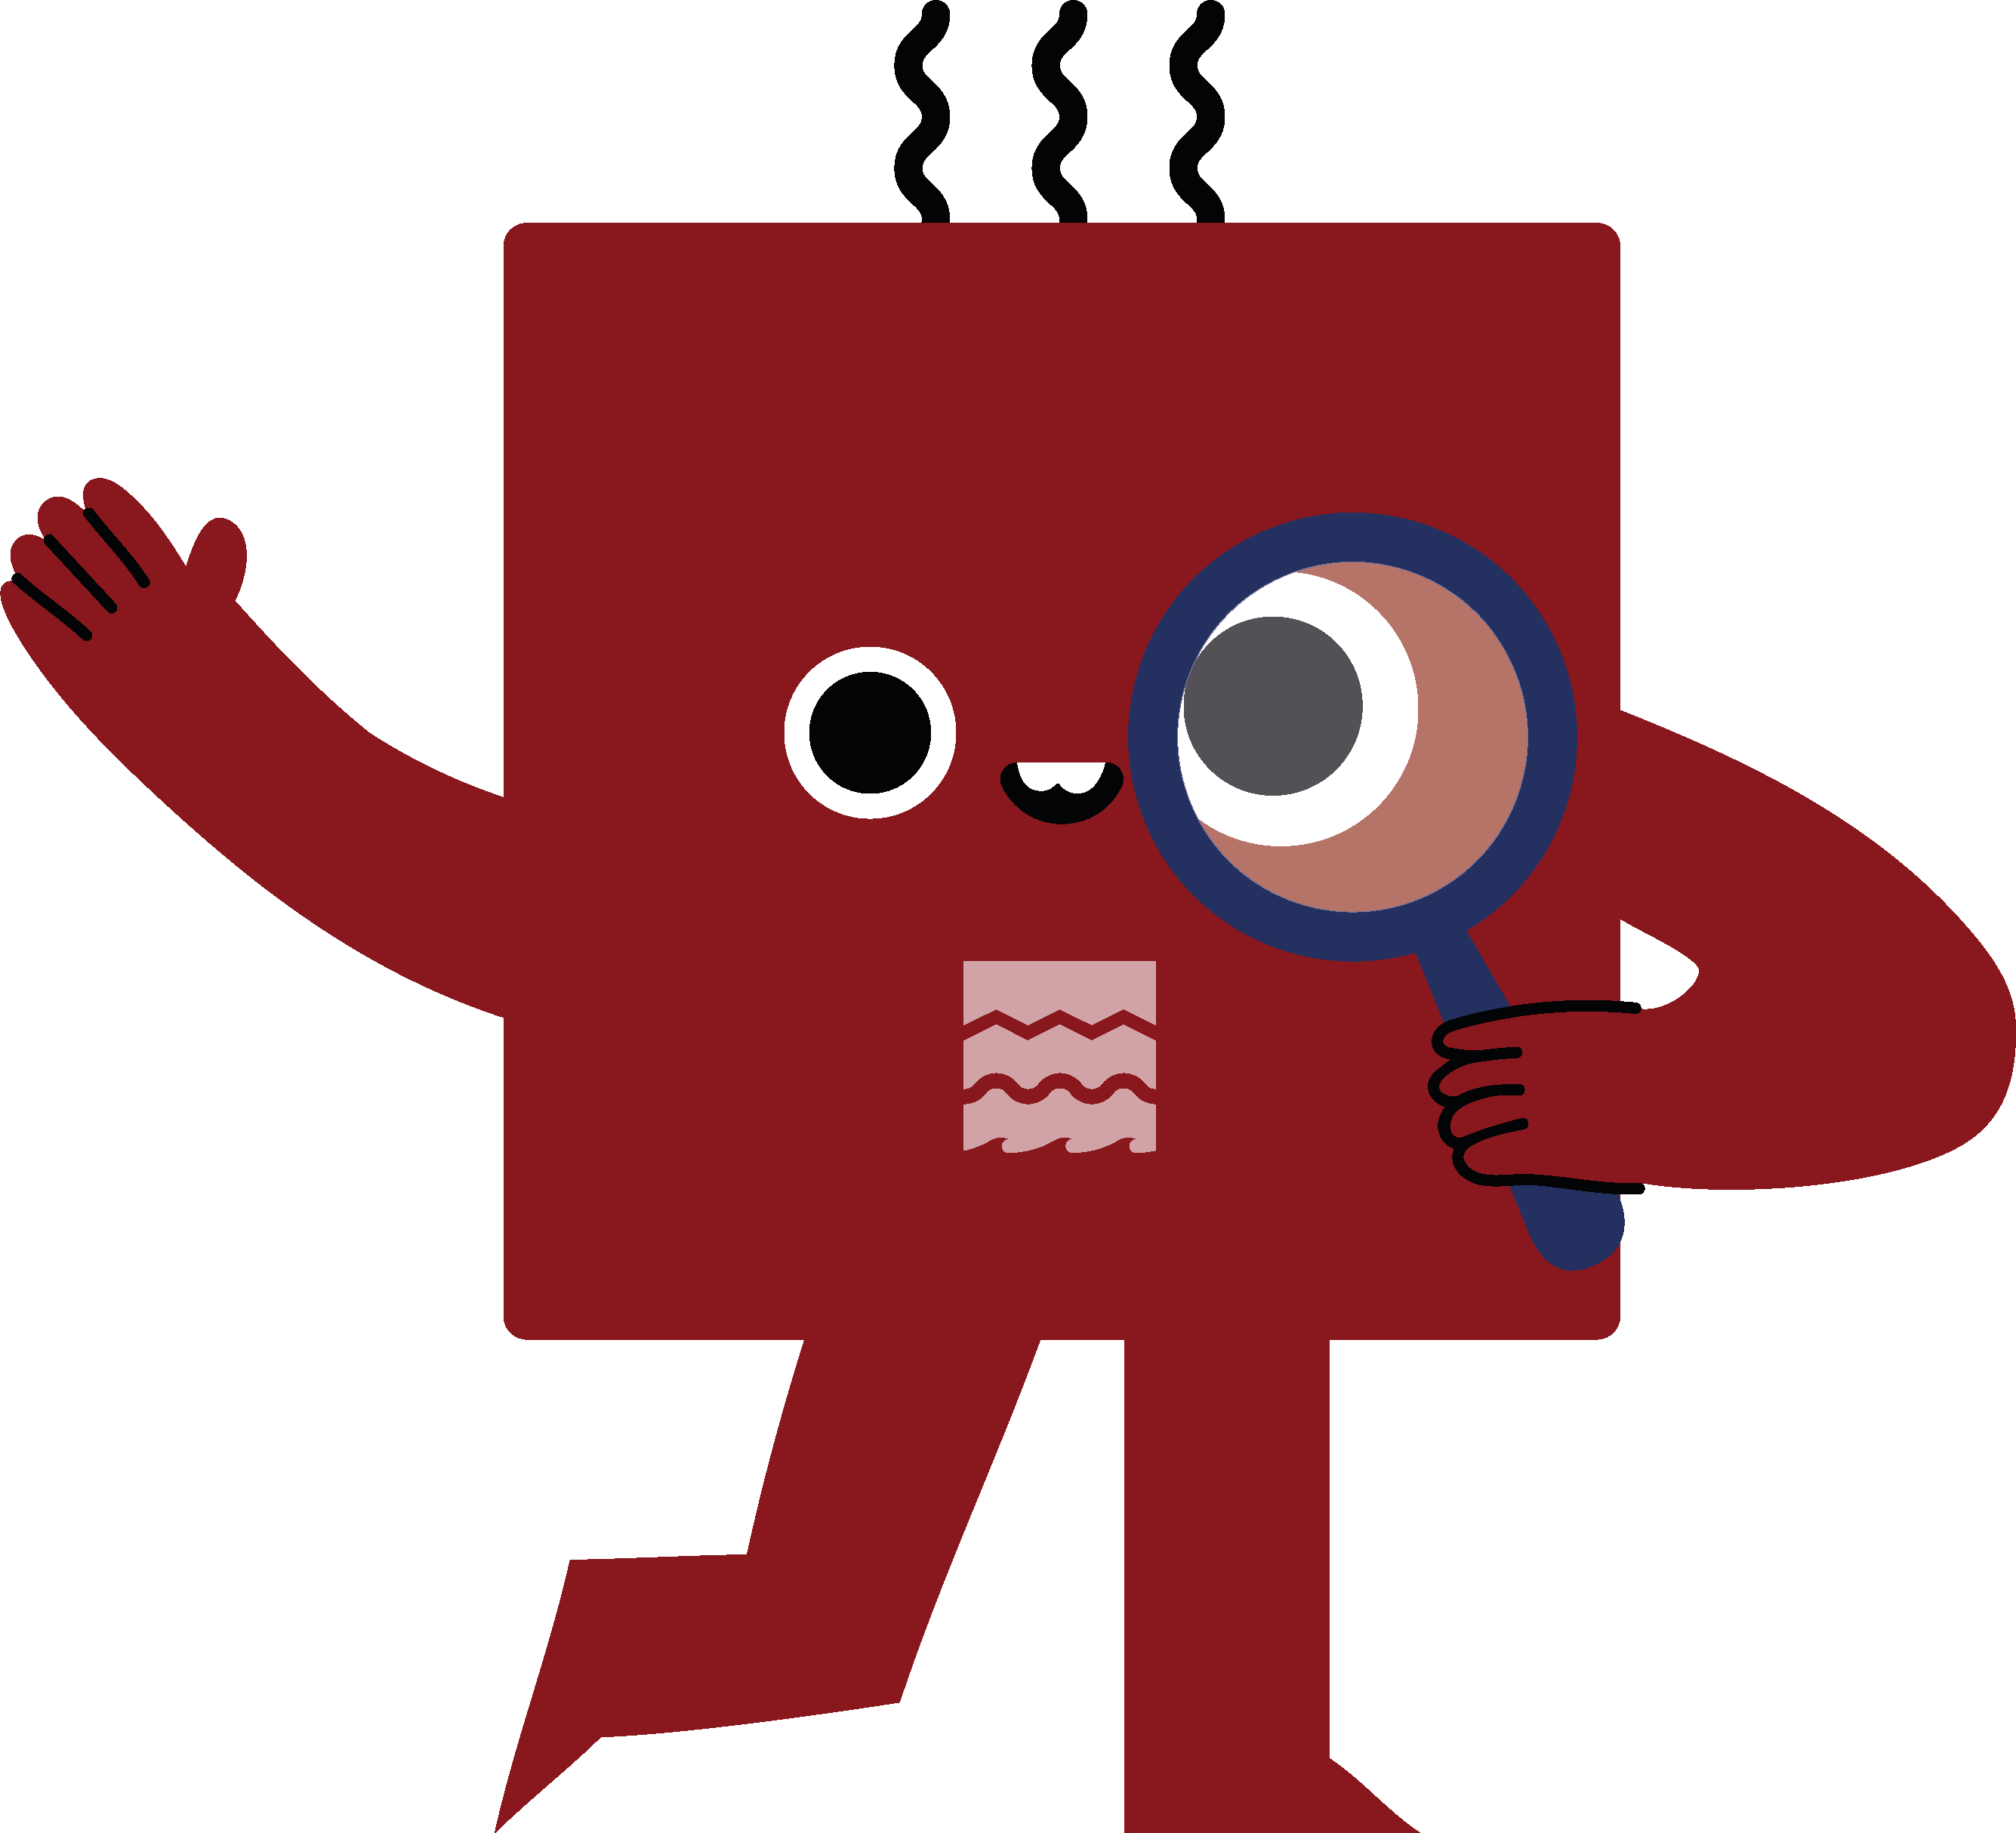
What was Edwardian life really like and how does it compare with life today?
Look through the following photographs and fill in the charts to help you assess the evidence and come to your own conclusions.
The photographs are divided into 4 groups:
Work
Leisure
Transport
Childhood
You can look at them all or split into teams.
Examine

Slide 5
Work
What kind of jobs did the Edwardians do?
Do we still do the same kind of jobs today?
Look at the following photographs and then fill in the chart at the end of the photographs, this will help you to assess the evidence.
Examine

Slide 6
Chyandour Smelting Works, Penzance, Cornwall – c.1907
Notes:
© Reproduced by permission of Historic England Archive ref: AA67/02848 Date: c 1907 - https://historicengland.org.uk/images-books/photos/item/AA67/02848

Slide 7
Chyandour Smelting Works Penzance, Cornwall – c.1907
These men are posed for a long exposure photograph.
Note the long-handled shovel for use in the smelting furnace, and the sacks tied around the men's waists to offer some protection from the heat.
Smelting removed metal from ore (stone) i.e., iron from iron stone.
Men at Smelting Works
Notes:
© Reproduced by permission of Historic England Archive ref: AA67/02848 Date: c 1907 - https://historicengland.org.uk/images-books/photos/item/AA67/02848

Slide 8
J Plater’s Cart, Van & Carriage Works, Haddenham, Bucks – 1903 1
Notes:
© Reproduced by permission of Historic England Archive ref: bb97/08210 Date: 1903 - https://historicengland.org.uk/images-books/photos/item/BB97/08210

Slide 9
J Plater’s Cart, Van & Carriage Works, Haddenham, Bucks – 1903 2
The staff at J Plater's Carriage Works pose for a group photograph.
Several different crafts are visible: carpenter, wheelwright and blacksmith (in the background). Two of the apprentices look particularly young.
Workers at a Carriage Works
Notes:
© Reproduced by permission of Historic England Archive ref: bb97/08210 Date: 1903 - https://historicengland.org.uk/images-books/photos/item/BB97/08210

Slide 10
Thames & Severn Canal, Gloucestershire – 1904 1
Notes:
© Reproduced by permission of Historic England Archive ref: CC71/00077 Date: 1904 - https://historicengland.org.uk/images-books/photos/item/CC71/00077

Slide 11
Thames & Severn Canal, Gloucestershire – 1904 2
Canal labourers dig clay from the large pit at Bluehouse Bridge near Siddington.
Clay was essential for 'puddling', the process of making watertight the base of a canal.
Canal Workers
Notes:
© Reproduced by permission of Historic England Archive ref: CC71/00077 Date: 1904 - https://historicengland.org.uk/images-books/photos/item/CC71/00077

Slide 12
Billingham & Keely’s Grocery Store, Stockport, Gt Manchester – 1903 1
Notes:
© Reproduced by permission of Historic England Archive ref: AA97/05332 Date: 1903 - https://historicengland.org.uk/images-books/photos/item/AA97/05332

Slide 13
Billingham & Keely’s Grocery Store, Stockport, Gt Manchester – 1903 2
This grocers has just received a delivery of starch, flour and assorted biscuits to the back entrance.
The owner oversees while his assistants carry bags and scoops with which to serve out the produce. The grocer's boy is sitting down before doing his rounds.
Workers at a Grocery Store
Notes:
© Reproduced by permission of Historic England Archive ref: AA97/05332 Date: 1903 - https://historicengland.org.uk/images-books/photos/item/AA97/05332

Slide 14
Wood’s Restaurant, Berwick-upon-Tweed, Northumberland – 1902 1
Notes:
© Reproduced by permission of Historic England Archive ref: aa97/05220 Date: 1902 - https://historicengland.org.uk/images-books/photos/item/AA97/05220

Slide 15
Wood’s Restaurant, Berwick-upon-Tweed, Northumberland – 1902 2
Waitresses serve afternoon tea in Wood's Restaurant.
A sign on the wall advertises 'OXO served hot'.
Wood’s Restaurant
Notes:
© Reproduced by permission of Historic England Archive ref: aa97/05220 Date: 1902 - https://historicengland.org.uk/images-books/photos/item/AA97/05220

Slide 16
Harvesting at Haddenham, Buckinghamshire – August 1903 1
Notes:
© Reproduced by permission of Historic England Archive ref: bb97/08222 Date: August 1903 - https://historicengland.org.uk/images-books/photos/item/BB97/08222

Slide 17
Harvesting at Haddenham, Buckinghamshire – August 1903 2
A view of a horse pulled machine cutting corn. The farm hands in the image all look very young.
Everyone had to help at harvest time and some rural schools closed to allow pupils to help in the fields.
Harvesting at Haddenham
Notes:
© Reproduced by permission of Historic England Archive ref: bb97/08222 Date: August 1903 - https://historicengland.org.uk/images-books/photos/item/BB97/08222

Slide 18
Pay day at Butlers Wharf, London – c. 1910 1
Notes:
© Reproduced by permission of Historic England Archive ref: BB87/09666 Date: c1910 - https://historicengland.org.uk/images-books/photos/item/BB87/09666

Slide 19
Pay day at Butlers Wharf, London – c. 1910 2
Most people were paid weekly in cash until relatively recently.
These men are waiting patiently on Friday afternoon while the paymaster looks on.
For security reasons the wages were kept in a locked room.
Workers queue for wags
Notes:
© Reproduced by permission of Historic England Archive ref: BB87/09666 Date: c1910 - https://historicengland.org.uk/images-books/photos/item/BB87/09666

Slide 20
Chart: Work
Now try to fill in the chart below & discuss your answers (You may need to research some of your answers in books or on the internet)
Do we still do similar jobs today?
Edwardian job | Done today? ✓ or × | Modern example
Smelting ore to make metal
Making carts, carriages & vans
Manual labour/building work
Shop assistant/Delivery person
Waitress
Farm work/agriculture

Slide 21
Leisure
What did the Edwardians do for fun?
Do we still do the same kind activities today?
Look at the following photographs and then fill in the chart at the end of the photographs, this will help you to assess the evidence.
Examine

Slide 22
Tennis Match, Buckinghamshire – c. 1896 – 1920 1
Notes:
© Reproduced by permission of Historic England Archive ref: BB98/05518 Date: 1896 – 1920 - https://historicengland.org.uk/images-books/photos/item/BB98/05518

Slide 23
Tennis Match, Buckinghamshire – c. 1896 – 1920 2
A group playing a doubles match of lawn tennis.
People playing tennis
Notes:
© Reproduced by permission of Historic England Archive ref: BB98/05518 Date: 1896 – 1920 - https://historicengland.org.uk/images-books/photos/item/BB98/05518

Slide 24
Boating at Biddlesden Park House, Buckinghamshire – c. 1896 – 1920 1
Notes:
© Reproduced by permission of Historic England Archive ref: BB98/05563 Date: 1896-1920 - https://historicengland.org.uk/images-books/photos/item/BB98/05563

Slide 25
Boating at Biddlesden Park House, Buckinghamshire – c. 1896 – 1920 2
Five ladies in a rowing boat on one of the fishponds at Biddlesden Park House, while a man in the boat house holds them steady.
Ladies in a rowing boat
Notes:
© Reproduced by permission of Historic England Archive ref: BB98/05563 Date: 1896-1920 - https://historicengland.org.uk/images-books/photos/item/BB98/05563

Slide 26
The Miss Bromleys, Byfield, Northamptonshire – September 1904 1
Notes:
© Reproduced by permission of Historic England Archive ref: AA97/06018 Date: 1904 - https://historicengland.org.uk/images-books/photos/item/AA97/06018

Slide 27
The Miss Bromleys, Byfield, Northamptonshire – September 1904 2
The three Miss Bromleys with their bicycles at the side of the road.
Three women with bicycles

Slide 28
St Giles’ Fair, Oxford, Oxfordshire – September 1907 1
Notes:
© Reproduced by permission of Historic England Archive ref: CC49/00527 Date: 1907 - https://historicengland.org.uk/images-books/photos/item/CC49/00527

Slide 29
St Giles’ Fair, Oxford, Oxfordshire – September 1907 2
The ‘Collins Helter Skelters’ standing in St Giles' during the annual fair held at the beginning of September, with a large crowd gathered outside.
St Giles’ Fair, Oxford
Notes:
© Reproduced by permission of Historic England Archive ref: CC49/00527 Date: 1907 - https://historicengland.org.uk/images-books/photos/item/CC49/00527

Slide 30
St Giles’ Fair, Oxford, Oxfordshire – September 1909 1
Notes:
© Reproduced by permission of Historic England Archive ref: CC49/00511 Date: 1909 - https://historicengland.org.uk/images-books/photos/item/CC49/00511

Slide 31
St Giles’ Fair, Oxford, Oxfordshire – September 1909 2
Four female wrestlers, posing outside their stall at St Giles' Fair.
The owner of the stall is advertising to the crowd to pay to come in and watch them wrestle.
Four female wrestlers
Notes:
© Reproduced by permission of Historic England Archive ref: CC49/00511 Date: 1909 - https://historicengland.org.uk/images-books/photos/item/CC49/00511

Slide 32
Burnham-on-Sea, Somerset – 1909 1
Notes:
© Reproduced by permission of Historic England Archive ref: cc76/00331 Date: 1909 - https://historicengland.org.uk/images-books/photos/item/CC76/00331

Slide 33
Burnham-on-Sea, Somerset – 1909 2
These children are paddling in the sea. Bathing huts can be seen parked further up the beach.
Children playing in the sea
Notes:
© Reproduced by permission of Historic England Archive ref: cc76/00331 Date: 1909 - https://historicengland.org.uk/images-books/photos/item/CC76/00331

Slide 34
Chart: Leisure
Now try to fill in the chart below & discuss your answers (You may need to research some of your answers in books or on the internet)
Do we still do similar leisure activities today?
Edwardian job | Done today? ✓ or × | Modern example
Playing tennis
Boating / Boat rides
Riding bikes
Fairground rides
Fairground shows
Playing on the beach

Slide 35
Transport
How did the Edwardians travel?
Do we still use the same kind of transport today?
Look at the following photographs and then fill in the chart at the end of the photographs, this will help you to assess the evidence.
Examine

Slide 36
High Street, Oxford, Oxfordshire – c. 1905 1
Notes:
© Reproduced by permission of Historic England Archive ref: CC73/01178 Date: 1905 - https://historicengland.org.uk/images-books/photos/item/CC73/01178

Slide 37
High Street, Oxford, Oxfordshire – c. 1905 2
Two horse-drawn trams passing in the street with advertising panels attached to the roofs.
Magdalen Bridge was widened in 1899 by the Oxford Local Board to accommodate horse-drawn trams, but by 1913 motor buses began to appear as well.
Two horse-drawn trams
Notes:
© Reproduced by permission of Historic England Archive ref: CC73/01178 Date: 1905 - https://historicengland.org.uk/images-books/photos/item/CC73/01178

Slide 38
Marine Parade, Great Yarmouth, Norfolk – 1904 1
Notes:
© Historic England Archive ref: CC76/00469 Date: September 1904 - https://historicengland.org.uk/images-books/photos/item/CC76/00469

Slide 39
Marine Parade, Great Yarmouth, Norfolk – 1904 2
The Marine Parade runs behind the beach and is crowded with tourists. All of them are wearing much more formal clothing than modern tourists would.
The electric trams ran between the two piers and into the town, you can see the overhead cables. The first electric tram in Yarmouth ran in 1902.
Marine Parade, Great Yarmouth
Notes:
© Historic England Archive ref: CC76/00469 Date: September 1904 - https://historicengland.org.uk/images-books/photos/item/CC76/00469

Slide 40
‘Royal Blue’ horse omnibus, London – August 1912 1
Notes:
© Reproduced by permission of Historic England Archive ref: aa82/00044 Date: August 1912 - https://historicengland.org.uk/images-books/photos/item/AA82/00044

Slide 41
‘Royal Blue’ horse omnibus, London – August 1912 2
The 'Royal Blue' horse omnibus outside 5-9 Euston Road. The bus carries route information and an advert for Selfridge’s.
The shops behind, including Boots the Chemist, Stewart & Wright's Cocoa Rooms and the Northumberland Hotel, are covered in advertisements.
'Royal Blue' horse omnibus
Notes:
© Reproduced by permission of Historic England Archive ref: aa82/00044 Date: August 1912 - https://historicengland.org.uk/images-books/photos/item/AA82/00044

Slide 42
Omnibus at Cross Lanes, Cury, Cornwall – 1910 1
Notes:
© Reproduced by permission of Historic England Archive ref: BB98/06177 Date: 1910 - https://historicengland.org.uk/images-books/photos/item/BB98/06177

Slide 43
Omnibus at Cross Lanes, Cury, Cornwall – 1910 2
A view of a bus with an open drivers compartment at the front.
The conductor can be seen at the back of the bus in a white coat with his ticket machine over his shoulder. It is passing a horse and cart on the other side of the road - the horse appears to be eating the hedge!
Omnibus at Cross Lanes
Notes:
© Reproduced by permission of Historic England Archive ref: BB98/06177 Date: 1910 - https://historicengland.org.uk/images-books/photos/item/BB98/06177

Slide 44
Car lift at Mitchell’s Motors, Wardour Street, London – August 1907 1
Notes:
© Reproduced by permission of Historic England Archive ref: BL 19998 Date: August 1907 - https://historicengland.org.uk/images-books/photos/item/BL19998

Slide 45
Car lift at Mitchell’s Motors, Wardour Street, London – August 1907 2
A chauffeur sits in an early Rolls Royce car in the car lift at the Mitchell Motor Company in Wardour Street.
Lifts are still used today in preference to ramps where parking space is at a premium.
Car lift at Mitchell’s Motors

Slide 46
The Carpenter’s Arms, Boughton, Northamptonshire – c. 1896-1920 1
Notes:
© Reproduced by permission of Historic England Archive ref: BB98/02580 Date: 1896-1920 - https://historicengland.org.uk/images-books/photos/item/BB98/02580

Slide 47
The Carpenter’s Arms, Boughton, Northamptonshire – c. 1896-1920 2
A crowd has gathered outside the public house to watch the photographer at work.
You can see two common types of transport, the bicycle and the horse and cart.
The Carpenter’s Arms, Boughton
Notes:
© Reproduced by permission of Historic England Archive ref: BB98/02580 Date: 1896-1920 - https://historicengland.org.uk/images-books/photos/item/BB98/02580

Slide 48
Bank of England and the Royal Exchange, City of London – 1902 1
Notes:
© Reproduced by permission of Historic England Archive ref: aa82/00060 Date: 1902 - https://historicengland.org.uk/images-books/photos/item/AA82/00060

Slide 49
Bank of England and the Royal Exchange, City of London – 1902 2
A view of Threadneedle Street crowded with horse omnibuses and other horse-drawn traffic. The Bank of England and the Royal Exchange are both decorated for the coronation of Edward VII.
After a delay due to ill health, the King was finally crowned on 9th August 1902.
(Can you spot the man picking his nose!).
Horse-drawn omnibuses
Notes:
© Reproduced by permission of Historic England Archive ref: aa82/00060 Date: 1902 - https://historicengland.org.uk/images-books/photos/item/AA82/00060

Slide 50
Chart: Transport
Now try to fill in the chart below & discuss your answers (You may need to research some of your answers in books or on the internet)
Do we still use similar types of transport today?
Edwardian transport type | Done today? ✓ or × | Modern example
Horse-drawn Tram
Electric Tram
Horse-drawn bus
Motorised bus
Bicycle
Horse & Cart

Slide 51
Childhood
What was it like to be an Edwardian child?
Do YOU still do the same things today?
Look at the following photographs and then fill in the chart at the end of the photographs, this will help you to assess the evidence.
Examine

Slide 52
Charwelton Station, Charwelton, Northamptonshire – 18 May 1905 1
Notes:
© Reproduced by permission of Historic England Archive ref: BB98/05907 Date: 18 May 1905 - https://historicengland.org.uk/images-books/photos/item/BB98/05907

Slide 53
Charwelton Station, Charwelton, Northamptonshire – 18 May 1905 2
A welcoming party of children, awaiting the arrival of HRH The Duchess of Albany at Charwelton railway station.
She was the wife of Queen Victoria’s Youngest son, Leopold.
Children at Charwelton Station
Notes:
© Reproduced by permission of Historic England Archive ref: BB98/05907 Date: 18 May 1905 - https://historicengland.org.uk/images-books/photos/item/BB98/05907

Slide 54
Fancy Dress, Hellidon, Northamptonshire – c.1896-1920 1
Notes:
© Reproduced by permission of Historic England Archive ref: BB98/10578 Date: 1896-1920 - https://historicengland.org.uk/images-books/photos/item/BB98/10578

Slide 55
Fancy Dress, Hellidon, Northamptonshire – c.1896-1920 2
A view of two boys dressed as American Indians.
Boys in fancy dress
Notes:
© Reproduced by permission of Historic England Archive ref: BB98/10578 Date: 1896-1920 - https://historicengland.org.uk/images-books/photos/item/BB98/10578

Slide 56
A family at Monks Risborough, Buckinghamshire – 1904 1
Notes:
© Reproduced by permission of Historic England Archive ref: AA97/05328 Date: 1904 - https://historicengland.org.uk/images-books/photos/item/AA97/05328

Slide 57
A family at Monks Risborough, Buckinghamshire – 1904 2
A family pose together for a photograph.
The sign behind the gentleman with the beard reads ‘R Whites Gingerbeer’.
Family photograph
Notes:
© Reproduced by permission of Historic England Archive ref: AA97/05328 Date: 1904 - https://historicengland.org.uk/images-books/photos/item/AA97/05328

Slide 58
Group portrait, Buckinghamshire – c.1896-1920 1
Notes:
© Reproduced by permission of Historic England Archive ref: BB98/02248 Date: 1896-1920 - https://historicengland.org.uk/images-books/photos/item/BB98/02248

Slide 59
Group portrait, Buckinghamshire – c.1896-1920 2
A photo of four small children and a servant/nanny
Group portrait
Notes:
© Reproduced by permission of Historic England Archive ref: BB98/02248 Date: 1896-1920 - https://historicengland.org.uk/images-books/photos/item/BB98/02248

Slide 60
Group portrait, Cotswold, Gloucestershire – 1908 1
Notes:
© Reproduced by permission of Historic England Archive ref: BB98/06009 Date: 1908 - https://historicengland.org.uk/images-books/photos/item/BB98/06009

Slide 61
Group portrait, Cotswold, Gloucestershire – 1908 2
A group of girls (possibly sisters) stand in a gateway in Wyck Rissington or Icomb parishes.
They are posed and wearing smart clothes.
A group of girls
Notes:
© Reproduced by permission of Historic England Archive ref: BB98/06009 Date: 1908 - https://historicengland.org.uk/images-books/photos/item/BB98/06009

Slide 62
Portrait, Stockport, Greater Manchester – 1903 1 1
Notes:
© Reproduced by permission of Historic England Archive ref: AA97/07527 Date: 1903 - https://historicengland.org.uk/images-books/photos/item/AA97/07527

Slide 63
Portrait, Stockport, Greater Manchester – 1903 2 1
A portrait of a boy (possibly of Arthur Billingham Junior), taken in the garden of 160 Grenville Street.
A portrait of a boy
Notes:
© Reproduced by permission of Historic England Archive ref: AA97/07527 Date: 1903 - https://historicengland.org.uk/images-books/photos/item/AA97/07527

Slide 64
Bric-a-brac stall, Hellidon, Northamptonshire – c.1896-1920 1
Notes:
© Reproduced by permission of Historic England Archive ref: bb98/01605 Date: 1896-1920 - https://historicengland.org.uk/images-books/photos/item/BB98/01605

Slide 65
Bric-a-brac stall, Hellidon, Northamptonshire – c.1896-1920 2
Children gather around a bric-a-brac stall outside the Red Lion.
They are nearly all wearing hats. A boy sitting on the ground has a toy trumpet.
Children at a bric-a-brac stall
Notes:
© Reproduced by permission of Historic England Archive ref: bb98/01605 Date: 1896-1920 - https://historicengland.org.uk/images-books/photos/item/BB98/01605

Slide 66
Chart: Childhood
Now try to fill in the chart below & discuss your answers (You may need to research some of your answers in books or on the internet)
Do children still do similar things today?
Edwardian transport type | Done today? ✓ or × | Modern example
Celebrate royal events
Dress up in ‘fancy dress’
Take family photos
Go to fairs/fetes
Have servants look after children
Pose for photographs

Slide 67
Look at all the EVIDENCE 1
Now look at all your charts, what does the evidence tell you?
Can you now answer the question:
What was Edwardian life really like and how does it compare with life today?

Slide 68
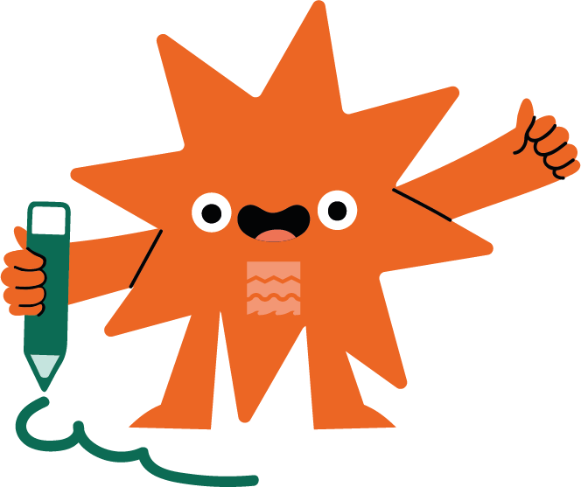
Look at all the EVIDENCE 2
Draw
Choose 1 of the photos to do a 'Then & Now' drawing.
Simply draw a picture of what the photo might look like if it had been taken TODAY.
Notes:
Find more teaching resources at: HistoricEngland.org.uk/Education

