Slide 1
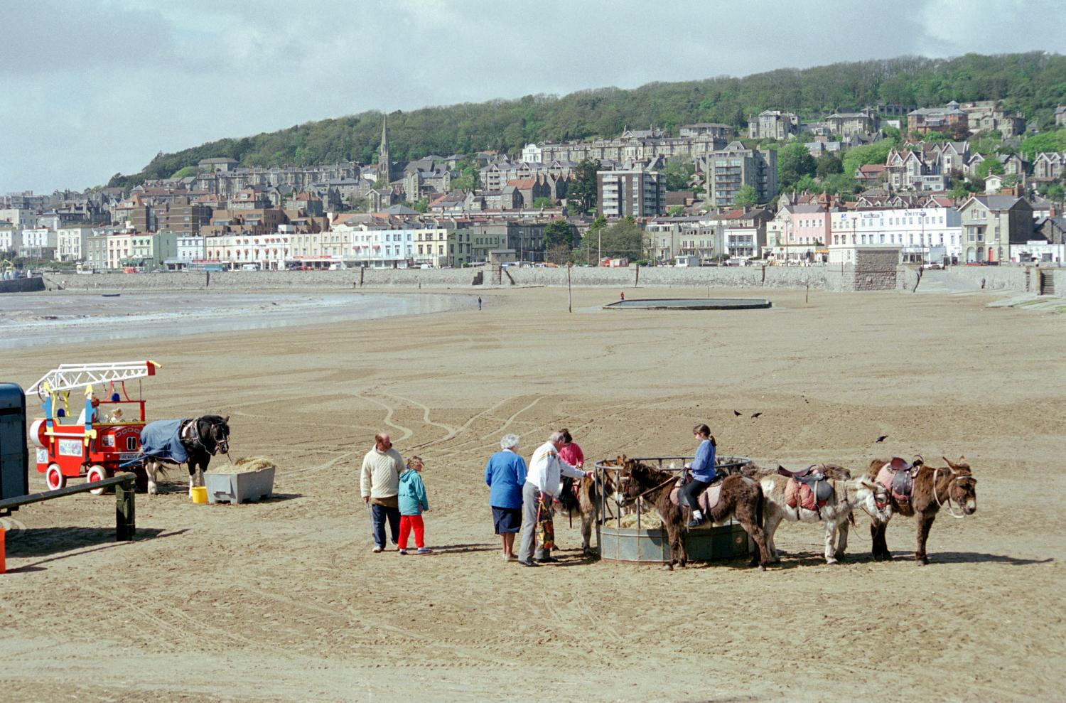
What can we learn about food in the past from a photograph of a seaside picnic? 1
What can we learn about food in the past from a photograph of a seaside picnic?
Notes:
© Copyright Crown copyright.NMR ref: 258Z/27 - https://historicengland.org.uk/services-skills/education/educational-images/the-beach-weston-super-mare-2663

Slide 2
What can we learn about food in the past from a photograph of a seaside picnic? 2
Key Stage 1: History
Learning Aims and Outcomes
Compare seaside holidays in the past with ones today
Identify similarities and differences
Infer information from a picture or photograph
Ask appropriate questions about seaside holidays in the past

Slide 3
Going to the Seaside: Picnics
Imagine that you are going to the Seaside for the day.
You have to take some food with you, so that you can have a picnic on the beach.
What sort of food would you like to eat on your picnic?
Notes:
© Copyright Crown copyright.NMR ref: 258Z/27 - https://historicengland.org.uk/services-skills/education/educational-images/the-beach-weston-super-mare-2663

Slide 4
Foods that I would like to eat on my picnic today are: 1
Draw the foods you’d like to eat on to the plate.

Slide 5
Foods that I would like to eat on my picnic today are: 2
Draw the foods you’d like to eat on to the plate.
Notes:
Differentiated version for higher ability/age children

Slide 6
Picnic Food
Foods that I would like to eat on my picnic are:
1. | 5.
2. | 6.
3. | 7.
4. | 8.
Notes:
Differentiated version for higher ability/age children

Slide 7
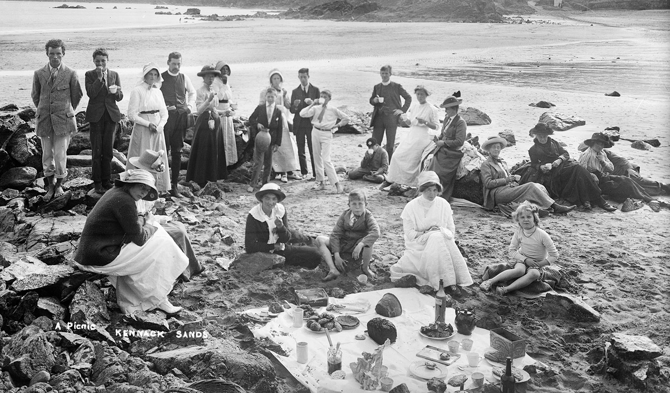
What were picnics like 100 years ago?
How is this picnic different from a picnic today?
How is it the same?
Notes:
Image: Source: Historic England Archive Ref: BB98/02415 Date: 1896 – 1920 - https://historicengland.org.uk/images-books/photos/item/BB98/02415

Slide 8
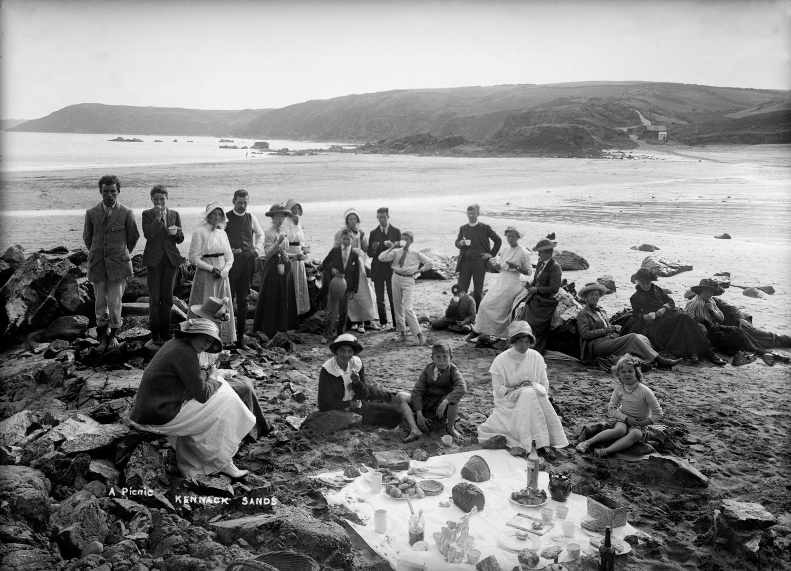
Photo of people on a beach
Notes:
Image: Source: Historic England Archive Ref: BB98/02415 Date: 1896 – 1920 - https://historicengland.org.uk/images-books/photos/item/BB98/02415

Slide 9
Photo of people on a beach to print out
Notes:
Image: Source: Historic England Archive Ref: BB98/02415 Date: 1896 – 1920 - https://historicengland.org.uk/images-books/photos/item/BB98/02415

Slide 10
Different and the Same
It is different because: | It is the same because:
1. | 1.
2. | 2.
3. | 3.

Slide 11
Different and the Same to print out
It is different because: | It is the same because:
1. | 1.
2. | 2.
3. | 3.

Slide 12





What foods from our picnic list could we have eaten on a picnic 100 years ago?
Click on the words to find out more
Sliced Bread
Chocolate
Sliced bread was first sold in 1930, it was called ‘Wonderbread’
Cadbury's Dairy Milk was first sold in 1905
Crisps
Crisps were not around in packets until the 1920's!
Processed Cheese
Fizzy pop
Processed cheese was first made in 1916
Bottled lemonade was invented in 1834

Slide 13
Foods that I would like to eat on my historic picnic are: 1
Draw the foods you’d like to eat on to the plate.

Slide 14
Foods that I would like to eat on my historic picnic are: 2
Draw the foods you’d like to eat on to the plate.
Notes:
Differentiated version for higher ability/age children

Slide 15
Historic Picnic
Why not have your own historic picnic! What foods would/could you take?
Is your historic picnic healthier than a modern picnic?
1. | 5.
2. | 6.
3. | 7.
4. | 8.
Notes:
Find more teaching resources at: HistoricEngland.org.uk/Education

Slide 16


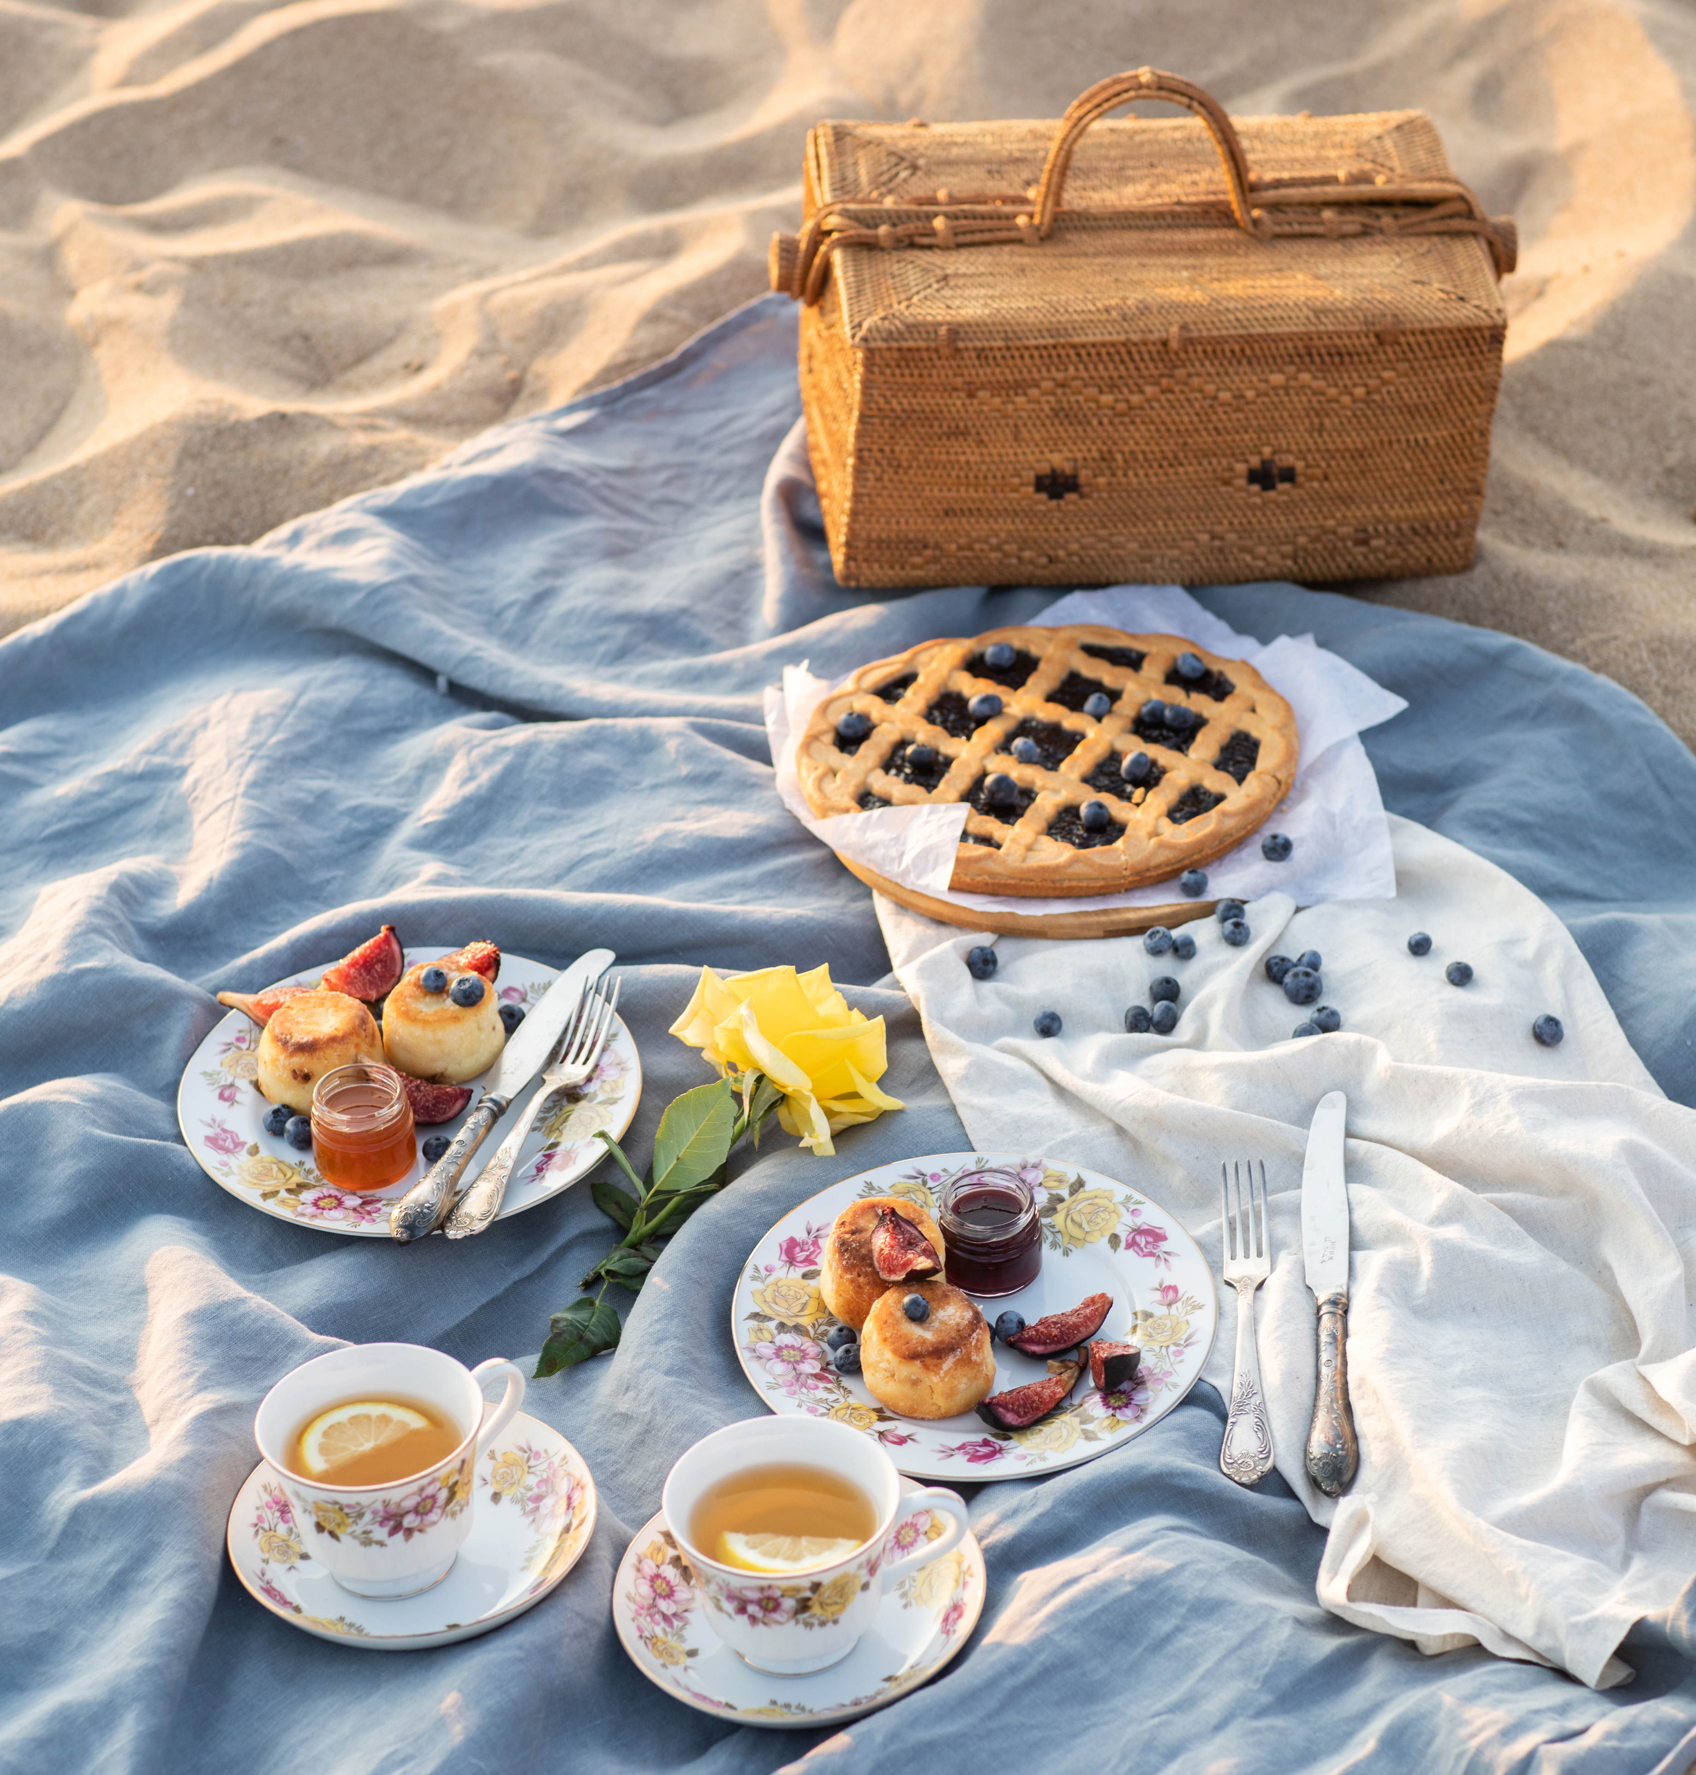
Which do you think is healthier, a picnic today or a picnic 100 from years ago?
Consider
Notes:
Left = PPT stock image, Right = Image: Source: Historic England Archive Ref: BB98/02415 Date: 1896 – 1920 - https://historicengland.org.uk/images-books/photos/item/BB98/02415

Slide 17
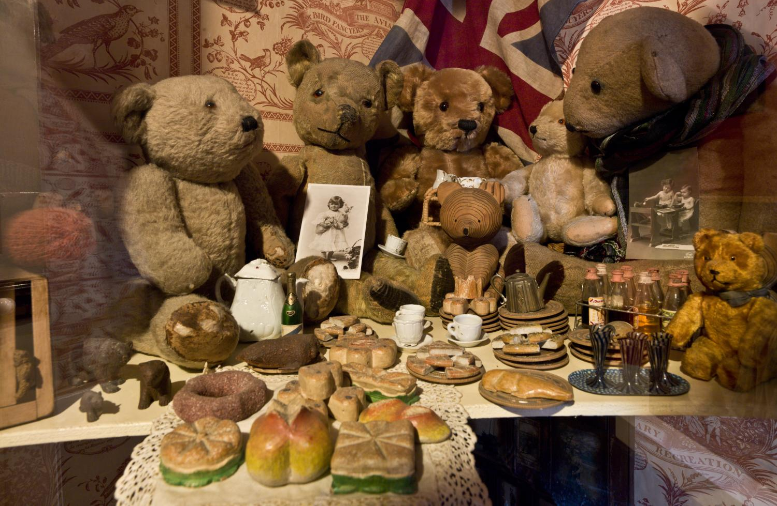
Rainy day? Why not plan a Teddy Bear’s Picnic!
Notes:
Image: Source: Historic England Archive Ref: DP134715 Date: 6 Dec 2012 - https://historicengland.org.uk/images-books/photos/item/DP134715

Slide 18
Additional Teacher’s Notes
The timeline below is designed to help pupils to plan a picnic from 100 years ago
1762 The Fourth Earl of Sandwich invents the sandwich
1785 Rawlings of London produce the first bottled soda water
1834 Schweppes first produces bottled lemonade
1847 Fry’s produce their first chocolate bar
1876 Heinz first produce tomato ketchup
1902 Marmite is first produced
1905 Cadbury’s first produce a bar of Dairy Milk chocolate
1916 Kraft produce the first processed cheese
1920s Smith’s make the first packet of crisps
1930 First slice bread sold in the UK, it was called ‘Wonderbread’

