Slide 1
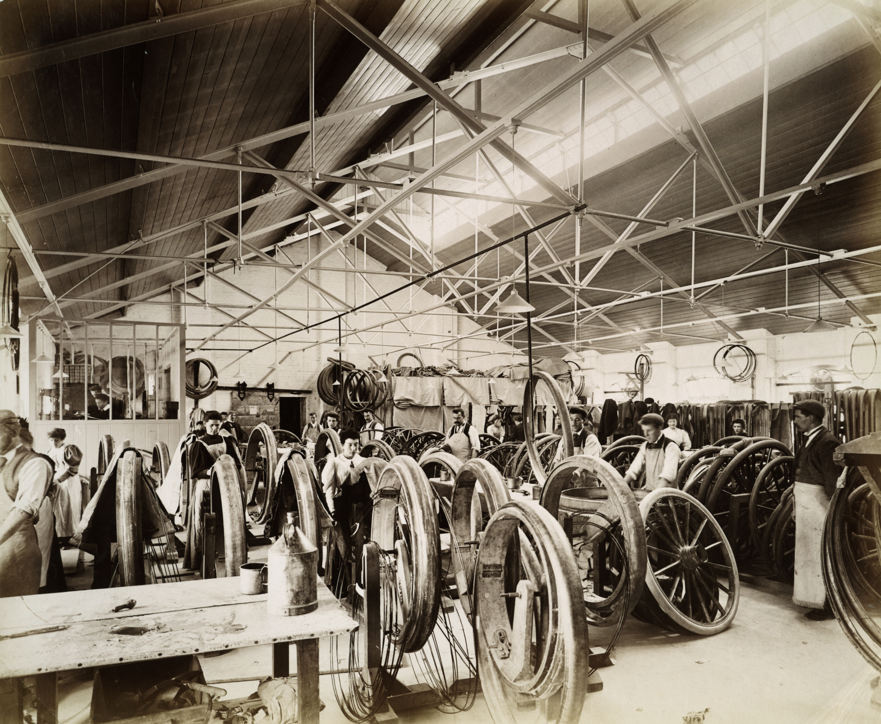
To what extent were women's lives already changing before World War One?
To what extent were women's lives already changing before World War One?
Notes:
Image: Source: Historic England Archive Ref: BL14391 Date: Jul 1897 - https://historicengland.org.uk/services-skills/education/educational-images/dunlop-pneumatic-tyre-company-limited-alma-street-coventry-3197

Slide 2
To what extent were women's lives already changing before World War One?
Key Stage 4: History
Students will use primary evidence to help in their understanding of women's lives in the period leading up to WW1
Students will be able to demonstrate skills in assessing and using primary evidence, such as the creation of criteria
Students will have a more secure basis on which to judge the effects of WW1 and the suffrage movement on women's lives
Relates to: OCR B - Britain in Peace and War, 1900–1918 - Women

Slide 3
Background
Women's lives were different after World War One - one important change being that they were allowed to vote.
But when did women's lives begin to change? Were they already changing before the war?
In order to answer this question we will look at evidence to help us build up a better picture of how women from different social backgrounds lived in the period leading up to it - the late Victorian and Edwardian periods (1880s - 1914).

Slide 4


Activity 1
Look carefully at the following photographs. They were all taken during the late Victorian (1880s - 1900) or Edwardian period (1901 - 1914) and show real women going about their daily lives.
For each photograph note down:
What are the women doing?
If they are working, what job are they doing?
Describe their clothing and surroundings; are they are rich or poor?
Anything else it tells you about women's lives.
Use the table on the next slide for your notes - you can copy and paste the small images into the table/worksheet.
Write

Slide 5
Table 1
Image | Description | Job | Rich or Poor? | More…..
1
2
3
4
5
6

Slide 6
Table 2
Image | Description | Job | Rich or Poor? | More…..
7
8
9
10
11
12

Slide 7
Photo 1
1
Women at work, alongside men, in the Dunlop Pneumatic Tyre factory in Coventry in July 1897. All the workers are dressed in their everyday clothes and wearing aprons to protect them. These jobs were skilled, indoor jobs, rather than manual labour and this is reflected in the clothing.
Notes:
Image: Source: Historic England Archive Ref: BL14391 Date: Jul 1897 - https://historicengland.org.uk/services-skills/education/educational-images/dunlop-pneumatic-tyre-company-limited-alma-street-coventry-3197

Slide 8
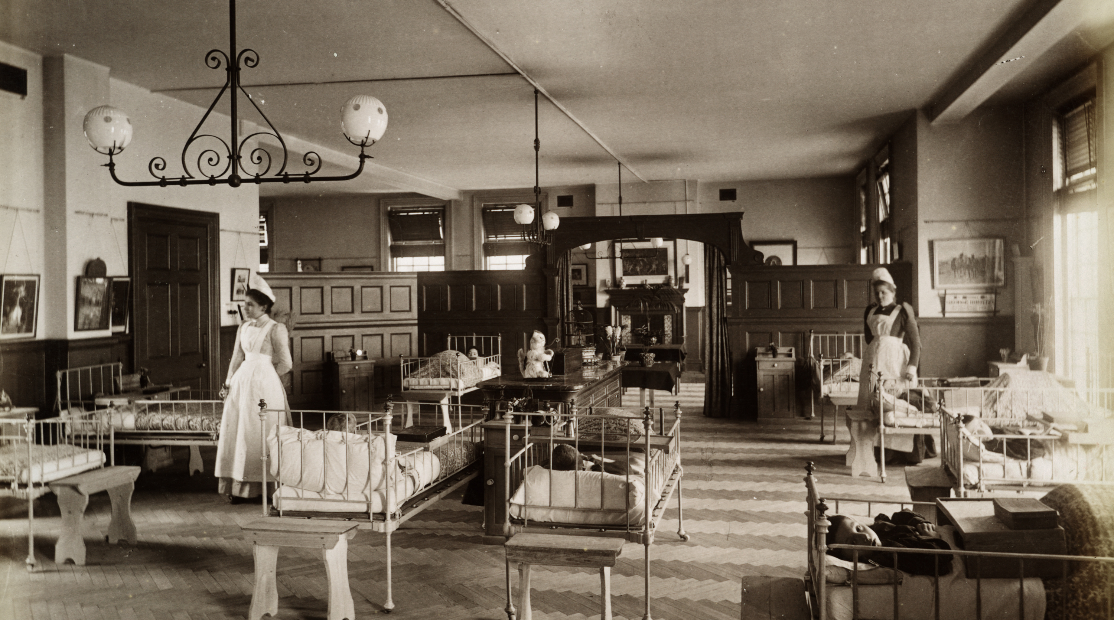
Photo 2
2
Two nurses at Cheyne Hospital for Sick and Incurable Children, Chelsea, Greater London in 1893.
Notes:
Image: Source: Historic England Archive Ref: BL11996/006 Date: 1893 - https://historicengland.org.uk/services-skills/education/educational-images/cheyne-hospital-for-sick-and-incurable-children-62-cheyne-walk-chelsea-3784

Slide 9
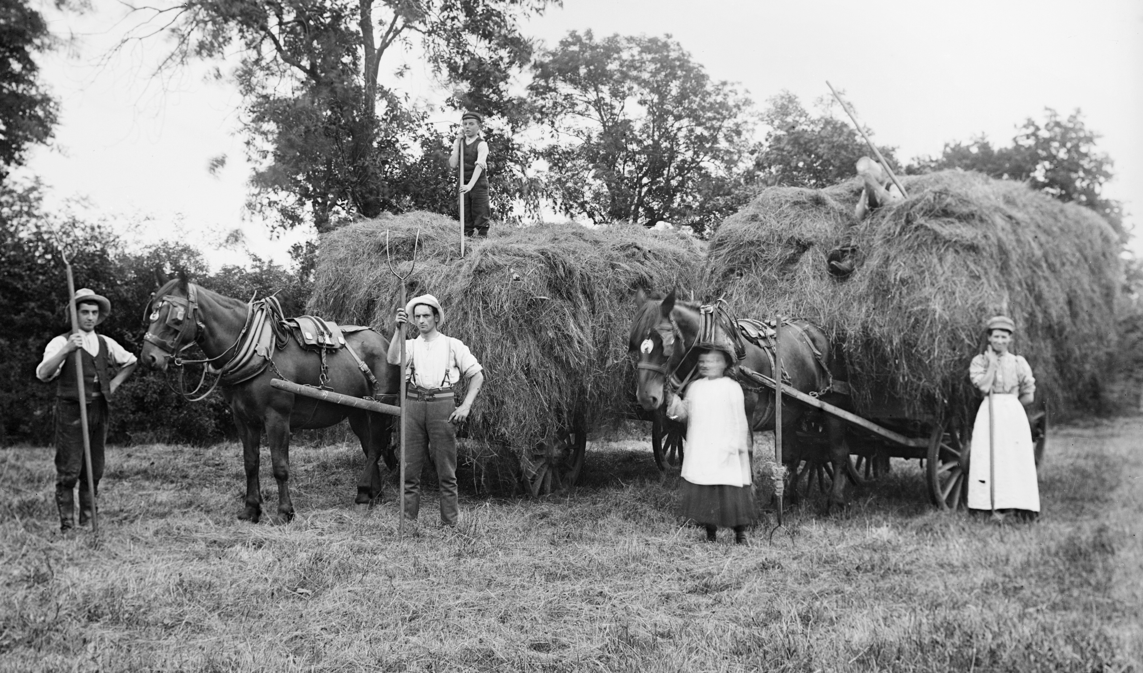
Photo 3
3
Agricultural workers, Hellidon, Northamptonshire, in 1904.
Notes:
Image: Source: Historic England Archive Ref: BB97/08348 Date: 1904 - https://historicengland.org.uk/services-skills/education/educational-images/agricultural-workers-hellidon-2707

Slide 10
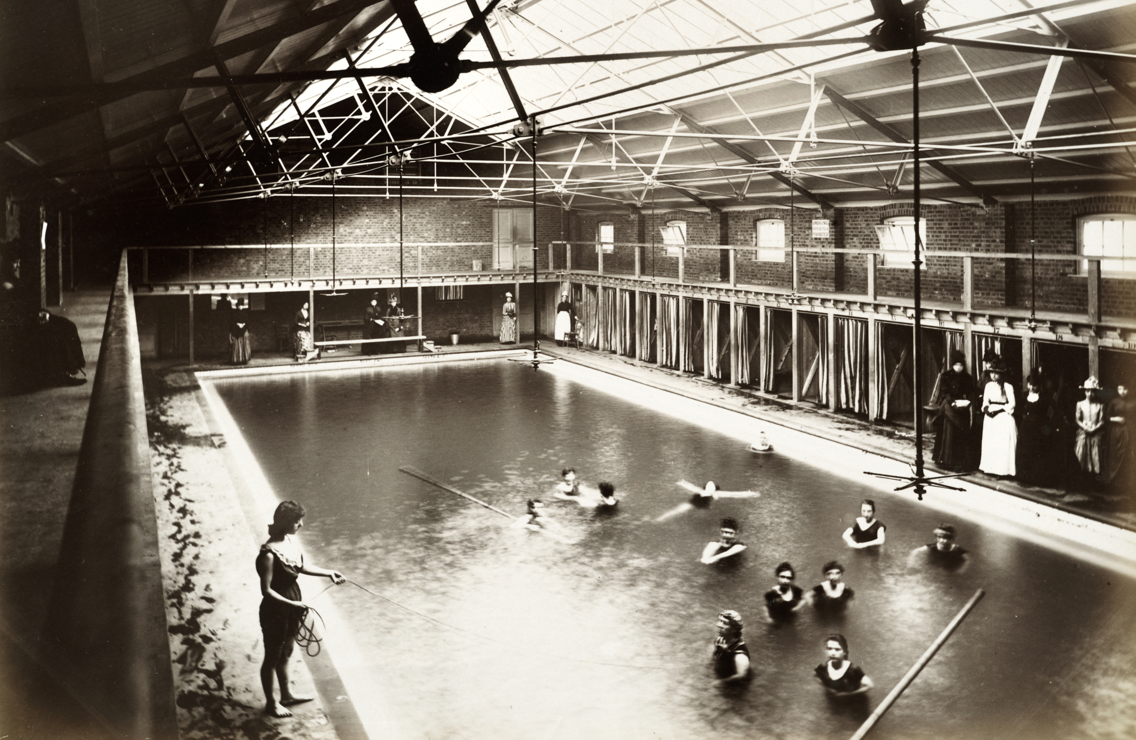
Photo 4
4
A female swimming session at the Peoples Palace in the Mile End Road, Stepney, Greater London in 1888.
Notes:
Image: Source: Historic England Archive Ref: BL08718 Date: 12 Jun 1888 - https://historicengland.org.uk/services-skills/education/educational-images/peoples-palace-mile-end-road-stepney-3630

Slide 11
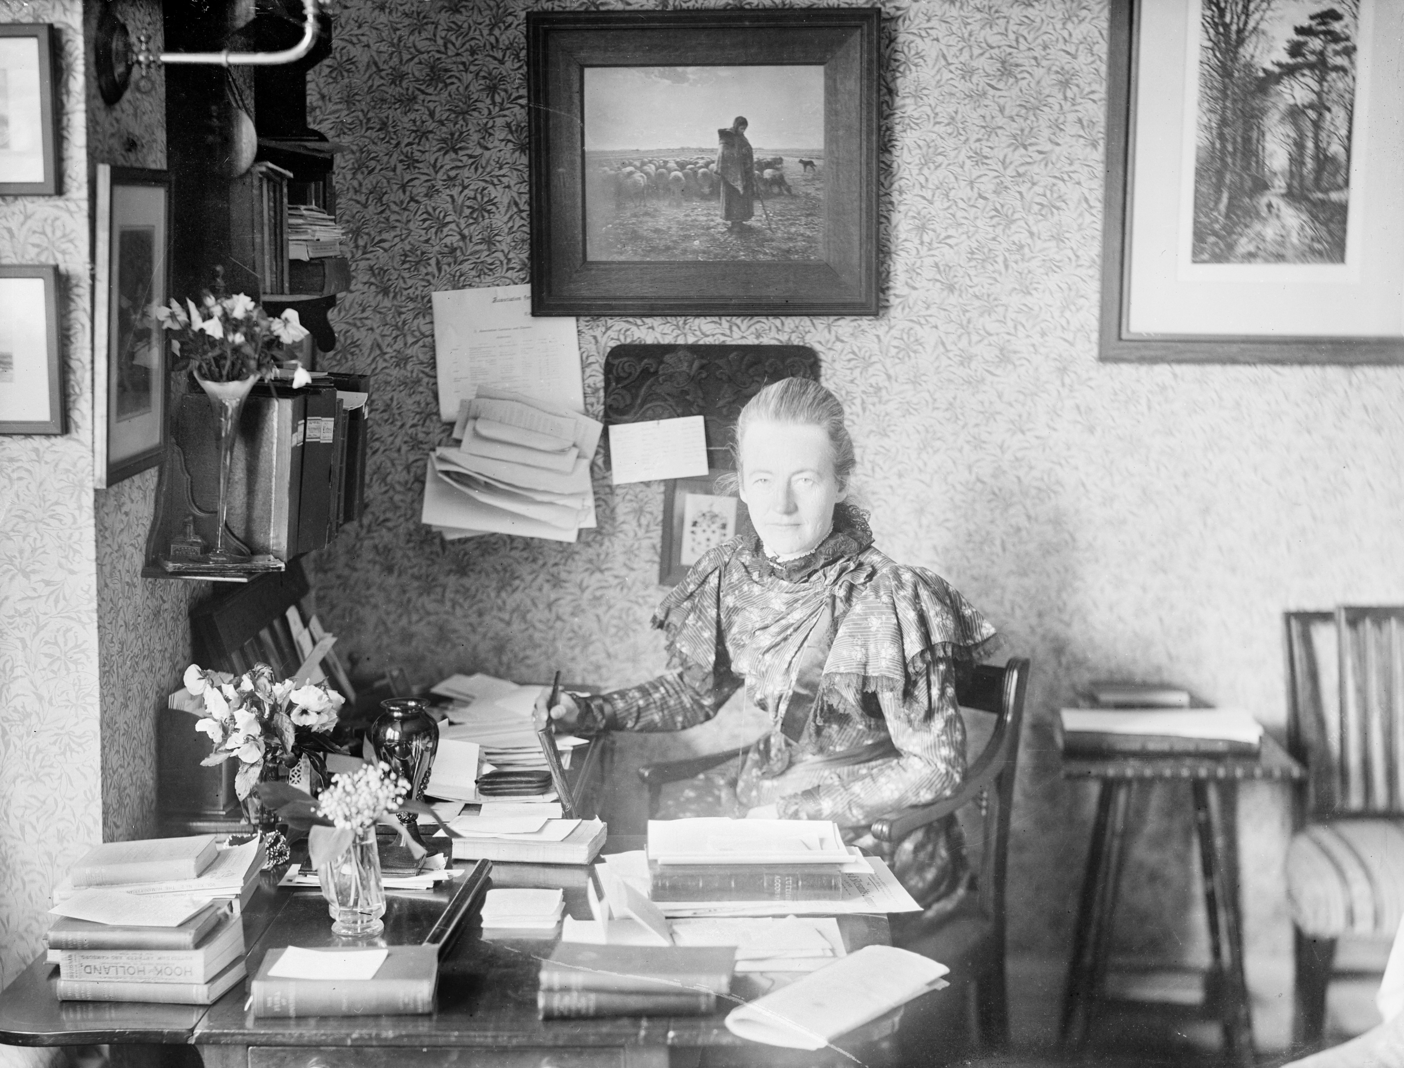
Photo 5
5
Agnes Maitland, the second Principal of Somerville College, Oxford in 1895.
Notes:
Image: Source: Historic England Archive Ref: CC50/00695 Date: 1895 - https://historicengland.org.uk/services-skills/education/educational-images/somerville-college-woodstock-road-oxford-4063

Slide 12
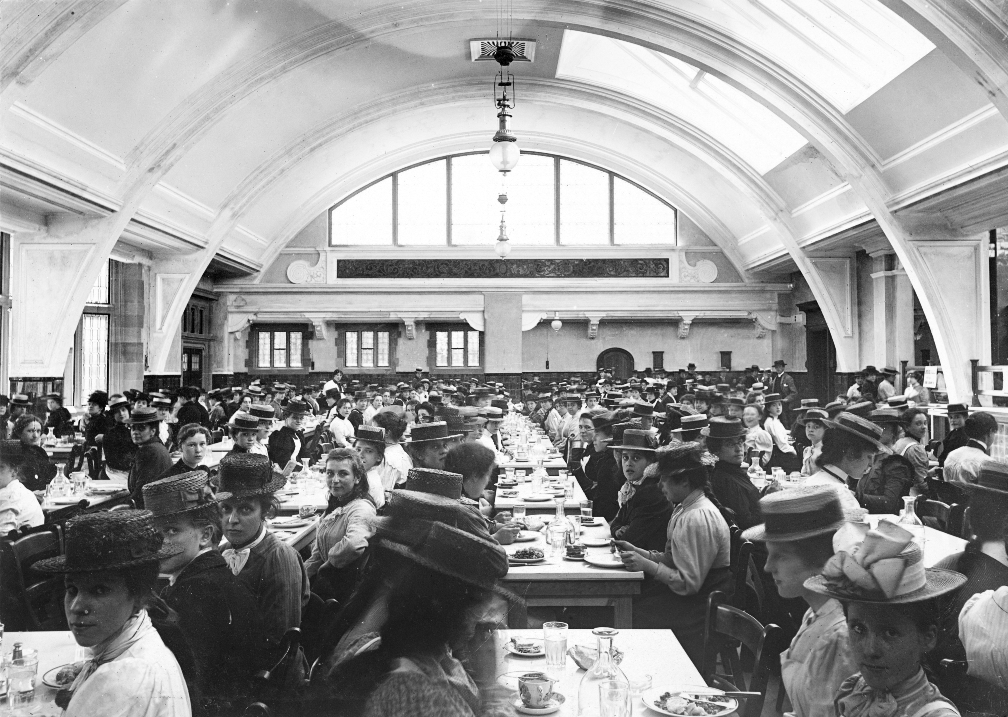
Photo 6
6
These young women are having a meal at Hulme Hall. Hulme Hall was designed to provide dining facilities for female employees of the Port Sunlight Factory.
Notes:
Image: Reproduced by permission of Historic England Archive ref: al1914_008_02 Date: Jan 1906 - Apr 1907 - https://historicengland.org.uk/services-skills/education/educational-images/hulme-hall-port-sunlight-11074

Slide 13
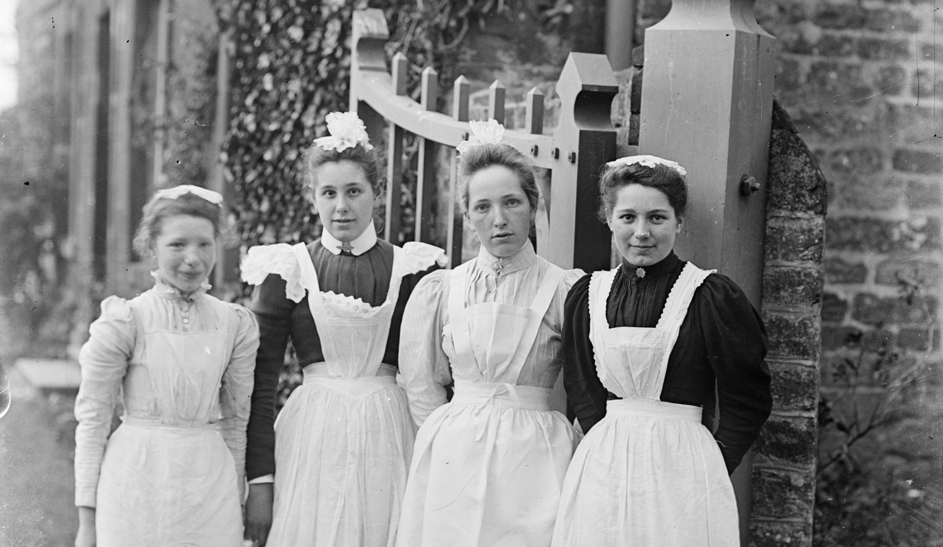
Photo 7
7
Maids at Church House, Charwelton, Northamptonshire, in 1903.
Notes:
Image: Source: Historic England Archive Ref: BB98/06049 Date: 1903 - https://historicengland.org.uk/services-skills/education/educational-images/maids-at-church-house-charwelton-2720

Slide 14
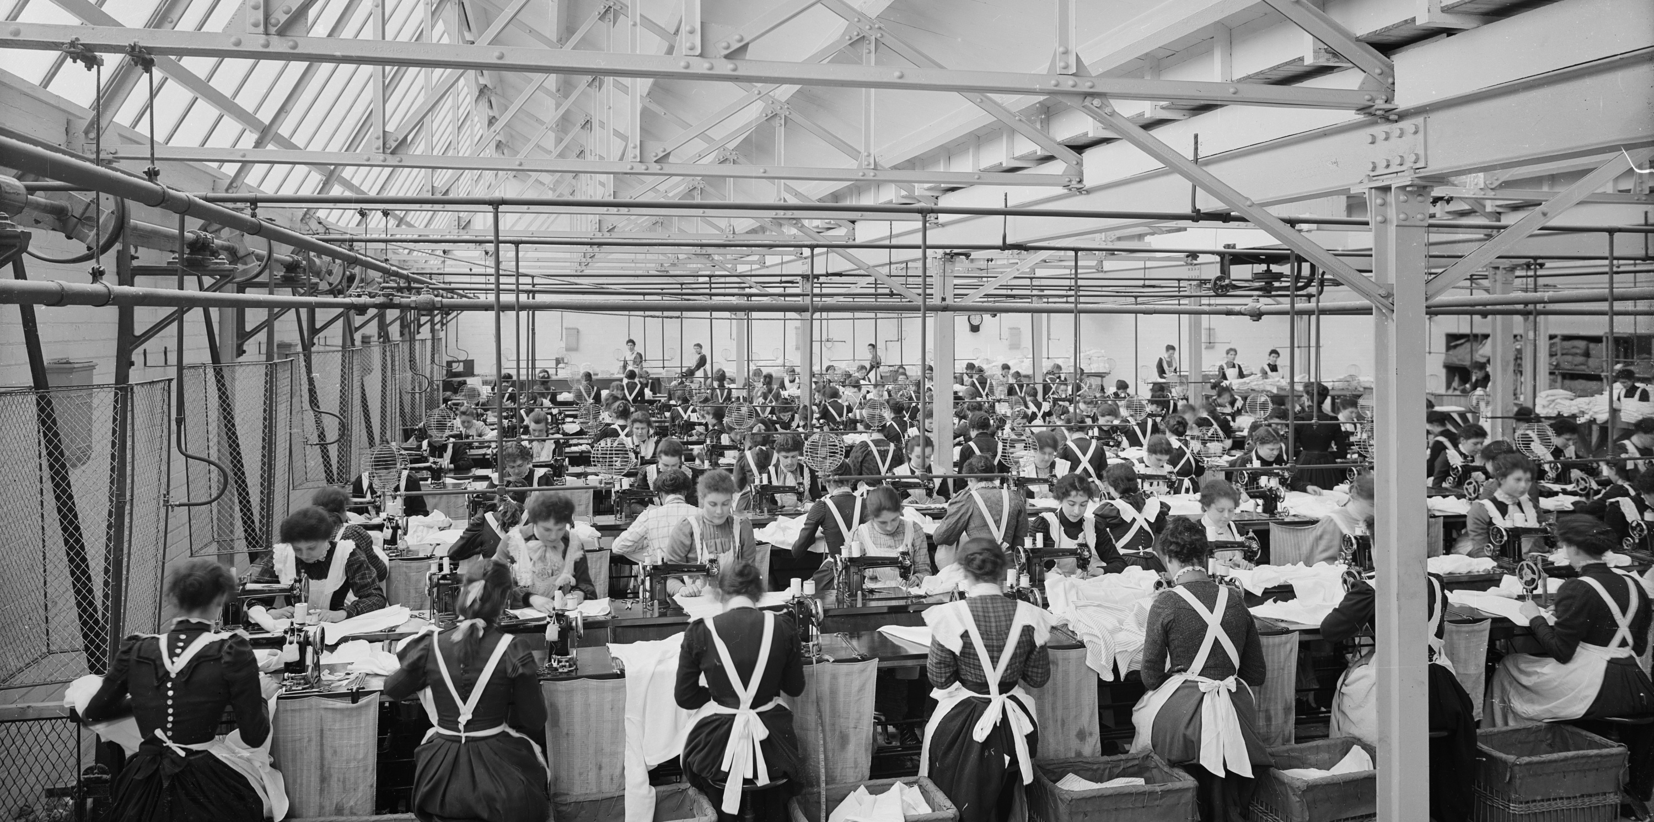
Photo 8
8
Rows of women sitting at sewing machines making various items of clothing for the Cellular Clothing Company in Swindon in 1902.
Notes:
Image: Source: Historic England Archive Ref: BL16856A Date: Jan 1902 - https://historicengland.org.uk/services-skills/education/educational-images/cellular-clothing-co-ltd-morris-street-swindon-9425

Slide 15
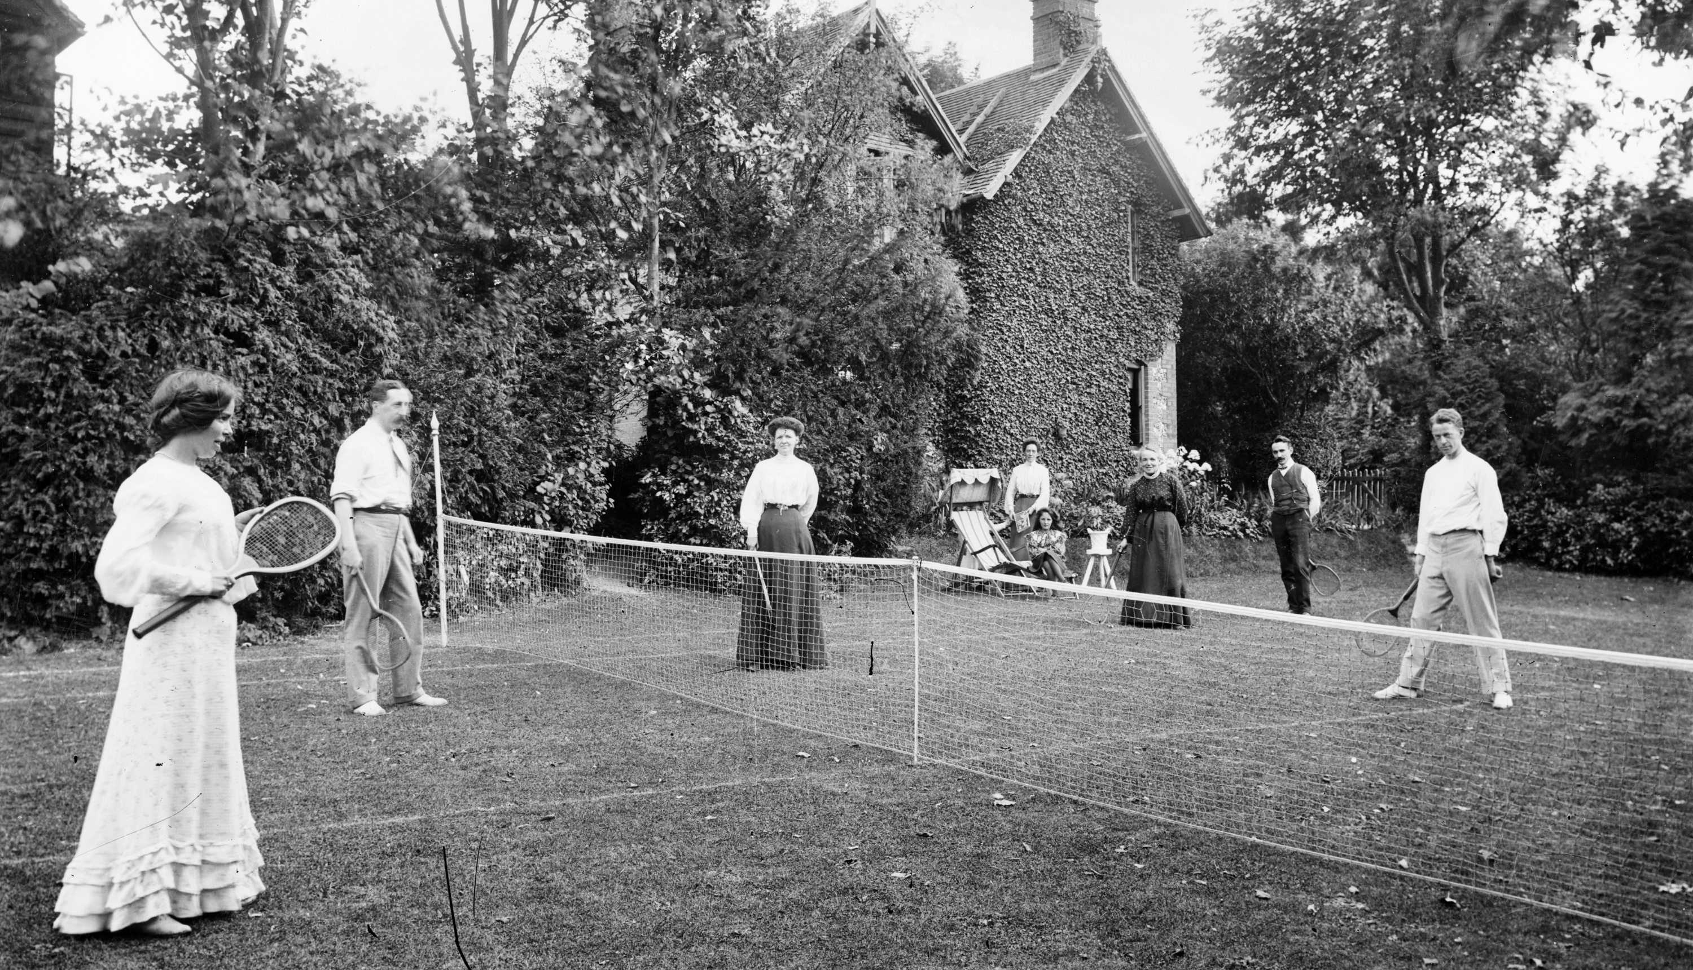
Photo 9
9
A tennis match in Buckinghamshire some time between 1896 and 1920.
Notes:
Image: Source: Historic England Archive Ref: BB98/05518 Date: 1896 – 1920 - https://historicengland.org.uk/services-skills/education/educational-images/tennis-match-1441

Slide 16
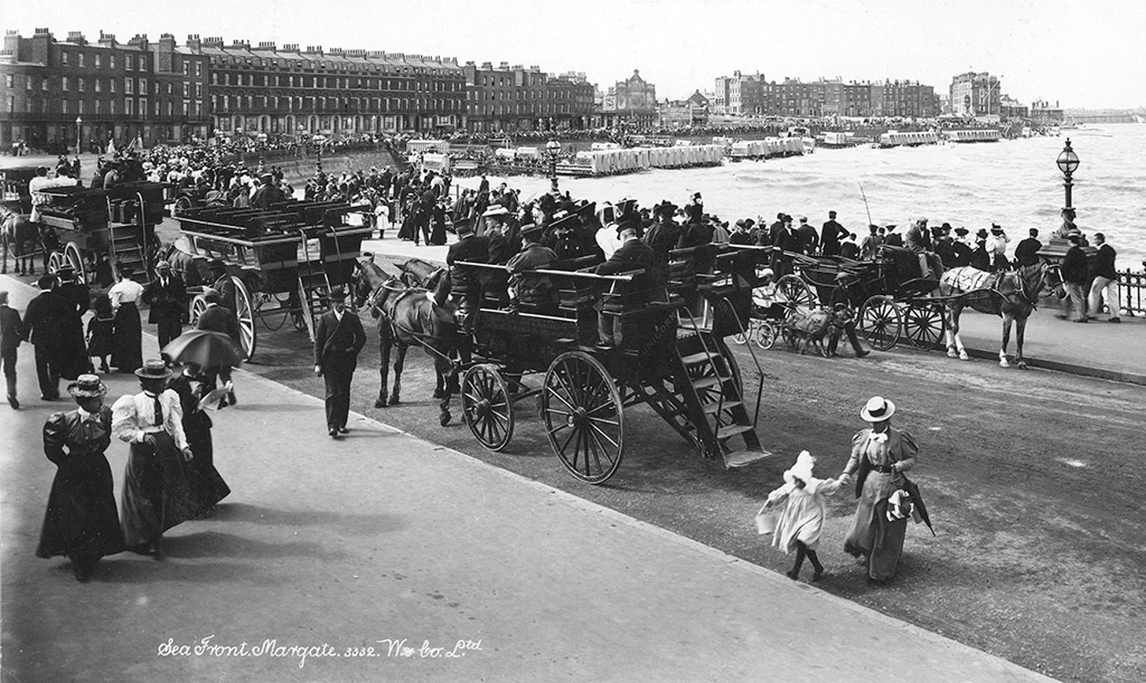
Photo 10
10
Crowds on the promenade at Margate, Kent, between 1890 and 1910.
Notes:
Image: Source: Historic England Archive Ref: OP00638 Date: 1890 – 1910 - https://historicengland.org.uk/services-skills/education/educational-images/margate-2337

Slide 17
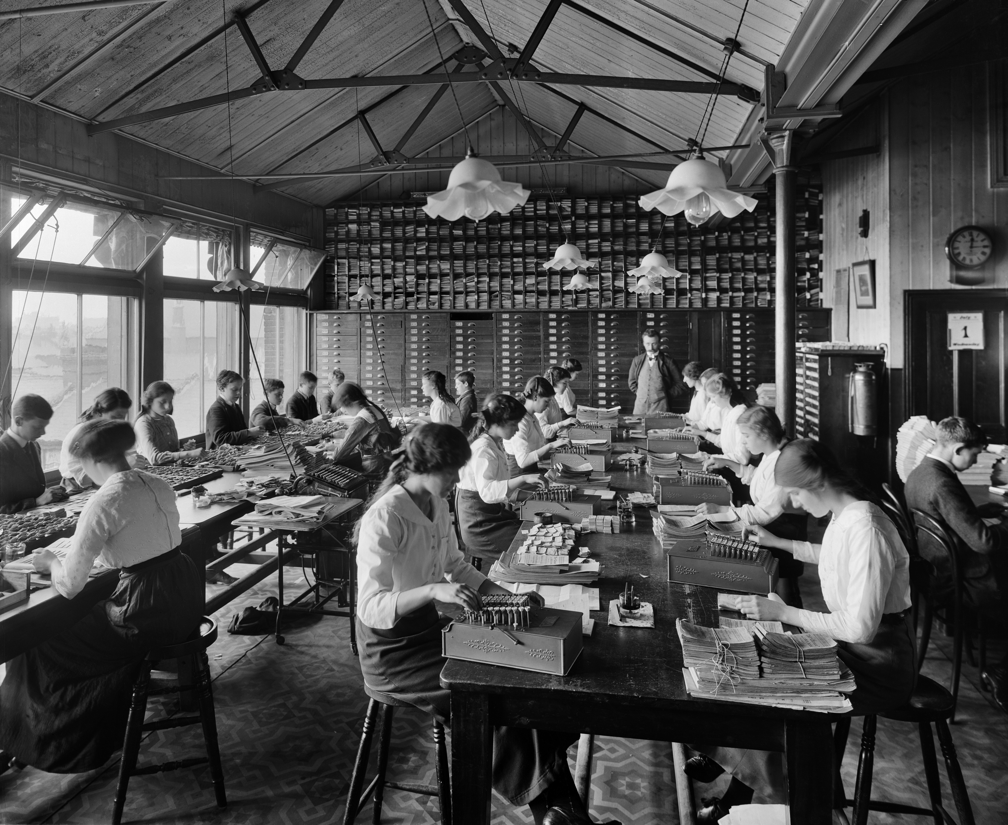
Photo 11
11
The Comptometer room at the Stratford (London) Co-operative Society in 1914, showing girls and boys working on model 'E' comptometers. The comptometer was invented in 1887 and was the first successful manual calculating machine.
Notes:
Image: Source: Historic England Archive Ref: BL22762 Date: 1st July 1914 - https://historicengland.org.uk/services-skills/education/educational-images/stratford-co-operative-society-maryland-street-stratford-greater-london-10410

Slide 18
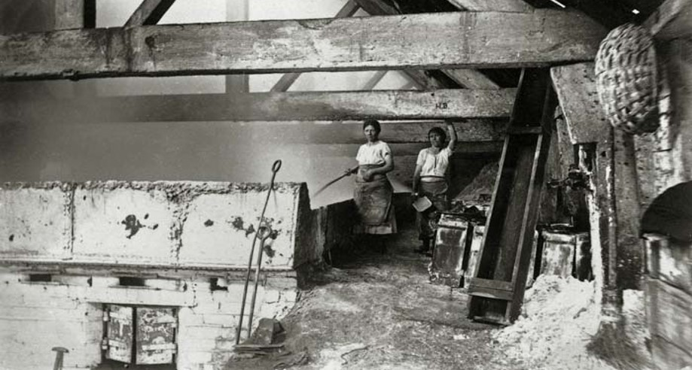
Photo 13
12
Two female workers standing beside a tank of boiling brine in a salt works in Droitwich, Worcestershire. Taken between 1880 – 1900
Notes:
Image: Source: Historic England Archive Ref: OP08513 Date: 1880-1900 - https://historicengland.org.uk/services-skills/education/educational-images/salt-works-droitwich-spa-10121

Slide 19

Activity 2
Use the facts given on the following slides to select 6 of the photographs to help answer the enquiry question:
Once you’ve made your own selection work in pairs or small
groups to discuss and debate each person’s choice of
images before coming to an overall answer.
You may like to present your findings in as a PowerPoint.
To what extent were women's lives already changing before World War One?
Think, pair, share

Slide 20
Additional Information
New jobs opened up for middle- and working-class women - often because of new technology. Examples include; jobs as machinists making clothes, office jobs such as comptometer operators, photographic processors, typists and working on telephone switchboards.
The development of department stores, aimed at women, led to middle class women going out to shop instead of ordering from catalogues. Girls and women got jobs as shop assistants and some began to live away from home in hostels, often provided by the stores. Hostels built specifically for low-waged single working women emerged from 1900. In 1910 there were about 60 lodging houses for lower-middle- and middle-class working women in London.
Teashops in London were 'an enormous move to freedom', providing cheap meals with female staff enabling 'respectable' women to use them. The first teashop opened in 1884 and there were over 50 shops by 1890. These were followed by the Lyons Tea Shop from 1894 and Lyons Corner Houses from 1909.

Slide 21
Additional information 1
Laws were passed to try and regulate women’s working conditions - the 1899 Seats for Shop Assistants Act prompted inventions for temporary seating for women shop assistants who worked an 80 hour week and were forced to stand all day – the act failed because there was no enforcement. In 1894 the drapery union called this work 'The Slavery of the Counter'
The 1895 Co-operative Women's Guild enquiry found female apprentice milliners (hat makers) and dressmakers under 18 in its 104 Co-operative Stores received no wages at all.
The 1909 Women's Industrial Council reported that women homeworkers such as London 'fancy blouse-makers' made only 5s (25p) a week after expenses. By comparison, Fabian Women's Group research showed men's weekly wages in Lambeth averaging from 18s (90p) to 30s (£1.50).
As early as 1855, a magazine called 'The Sempstress' carried an article on how rich young ladies could help working women by refusing to shop at any 'emporium' where 'one gets such delightful bargains' and asking why the goods were so cheap.
Florence Nightingale set up the Nightingale Nurses Training School at St Thomas' Hospital, London SE1 in 1860.

Slide 22
Additional information 2
The 1911 census report records that in "all other occupations" (which includes domestic and other allied services, professional occupations, commercial clerks, and all manufacturing industries) the total females increased from 3,817,453 to 4,258,405, or by 11.6 per cent (compared with 1901 – the previous census). It states ‘Probably a large part of the recorded increase for the unmarried represents a real extension of female employment’.
Women’s clothing changed from restricting crinolines to clothes that allowed them to take up sports and new pastimes such tennis or cycling
The Ladies' Lavatory Company opened its first public toilet for women near Oxford Circus, in 1884.
Women began to travel on public transport – some trains had carriages just for women.
From 1880 all children had to go to school between the ages of 5 and 10. By 1900 97% of children could read and write.
By 1900 women were allowed to attend some universities and teacher training colleges.

Slide 23

Additional useful information
https://historicengland.org.uk/research/inclusive-heritage/womens-history/
https://historicengland.org.uk/research/inclusive-heritage/womens-history/visible-in-stone/fashion-for-shopping/

Slide 24
Extension Activities
The following slides have a number of differentiated extension activities aimed at giving students the opportunity to look at documentary sources to add to the evidence from the photographs.
Notes:
Image: Source: Historic England Archive Ref: BL22762 Date: 1st July 1914 - https://historicengland.org.uk/services-skills/education/educational-images/stratford-co-operative-society-maryland-street-stratford-greater-london-10410

Slide 25

Extension Work 1 - Find out more from the census
Ask students to look at the table on the next slide. This shows changes in the proportions of women employed in a variety of occupations (the numbers are women as a proportion of all employed people over the age of 12, men and women, in that trade). The information was gathered in the censuses of 1861 - 1911.
The figures are taken from a larger table which is part of the 1911 census General report. The whole document, along with the reports from other census years can be found on the Vision of Britain website
Ask students what evidence can be drawn from the figures.
Does any of this evidence confirm or challenge the evidence
they drew from the photographs?
Think

Slide 26
Proportions of Females in certain Occupations, 1861-1911
The proportions of females in certain occupations, and their variations at successive censuses from 1861, may be seen from the following table, ...... These tables relate to the whole country, but it may be pointed out that the numbers of the two sexes in certain occupations vary considerably in different localities.
Occupations | Proportions of Females per 1,000 Persons occupied.
 | 1861 | 1871 | 1881 | 1891 | 1901 | 1911
Agriculture | 70 | 59 | 47 | 40 | 33 | 29
Schoolmasters, Teachers, Professors, Lecturers | 725 | 741 | 727 | 740 | 745 | 727
Photographers | 66 | 147 | 197 | 234 | 257 | 297
Laundry and Washing Service | 990 | 987 | 981 | 964 | 957 | 931
Commercial or Business Clerks | 5 | 16 | 33 | 72 | 153 | 245
Telegraph, Telephone—Service (including Government) | 82 | 76 | 236 | 291 | 406 | 522

Slide 27
Proportion of Females in certain Occupations, 1861-1911
Occupations | Proportions of Females per 1,000 Persons occupied.
 | 1861 | 1871 | 1881 | 1891 | 1901 | 1911
Earthenware, China, Porcelain—Manufacture | 311 | 354 | 384 | 385 | 392 | 421
Paper Manufacture | 417 | 395 | 444 | 401 | 366 | 312
Cotton Manufacture | 567 | 598 | 620 | 609 | 628 | 614
Wool and Worsted Manufacture | 461 | 513 | 561 | 557 | 582 | 571
Hosiery Manufacture | 468 | 468 | 533 | 629 | 713 | 735
Drapers, Linen Drapers, Mercers | 208 | 257 | 349 | 433 | 504 | 560
Straw—Plait, Hat, Bonnet Manufacture | 921 | 926 | 903 | 814 | 737 | 666

Slide 28

Extension Work 2 – Women’s role in World War One
Ask students to search the Educational Images
(https://historicengland.org.uk/services-skills/education/educational-images/) for more images.
Type ‘women work’ into the search box, then ‘Filter results’ and select ‘World War One(1914 – 1918)’ from the list of Periods
Then ask them to select a further 7 images to show how the war did or did not change the lives of women
Or use the Teaching Activity: How did WWI change the role of women in Britain?

Slide 29

More resources
MORE RESOURSCES AT
HistoricEngland.org.uk/Education

